Slide 1
Measuring Stellar and Planetary Parameters of the 51 Eridani System
Ashley Elliott, Louisiana State University
CHARA Science Meeting March 2023
Special thanks to the NSF Grant: “Characterizing Exoplanet Host Stars”:
PI: Tabetha Boyajian

Slide 2
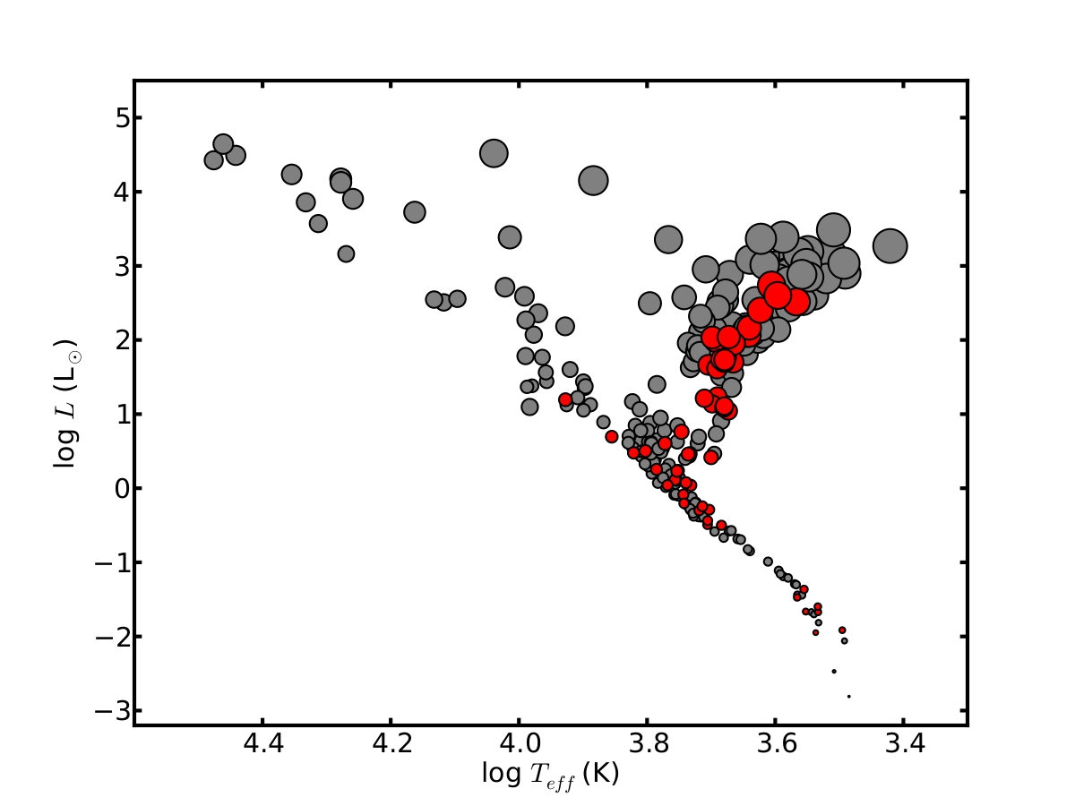
Motivation
“Know thy star, know thy planet”
“Direct” measurements
Angular diameter
Parallax
Bolometric flux
Empirical stellar properties
Effective Temperature
Luminosity
Age and Mass Estimates
Exoplanet characterization
Size
Density
Insight on how planet was formed
von Braun & Boyajian (2017)
Notes:
3978 exoplanets have been discovered via transit method
1027 exoplanets have been discovered via radial velocity
62 have been discovered via direct imaging
NOTES:
“Know thy star, know thy planet”
Knowing the star properties really well help us know the planet.
Roughly ~300 stars with the size of the circle proportional to logR_Star
~60 of these are exoplanet host stars
Direct measurements lead to empirical stellar properties which lead to age and mass estimates for the star. Which then lead to exoplanet characterization.
Young stars have young planets.

Slide 3
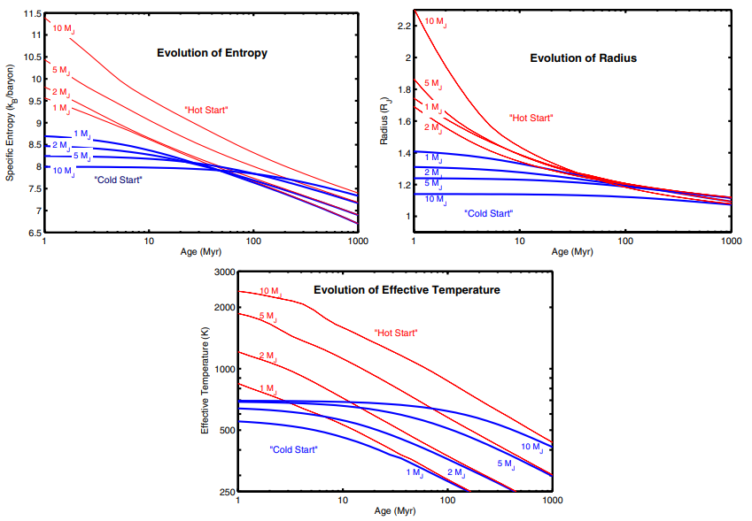
Are young planets hot or cold?
“Hot” Start Model
Disk instability
Part of the disk collapses rapidly into a planet
Faster time
Results in higher effective temperature, larger radii, and high entropy
“Cold” Start Model
Core accretion
Rocky core forms and material accretes onto the core
Results in lower entropy and smaller radii
Spiegel & Burrows (2011)

Slide 4
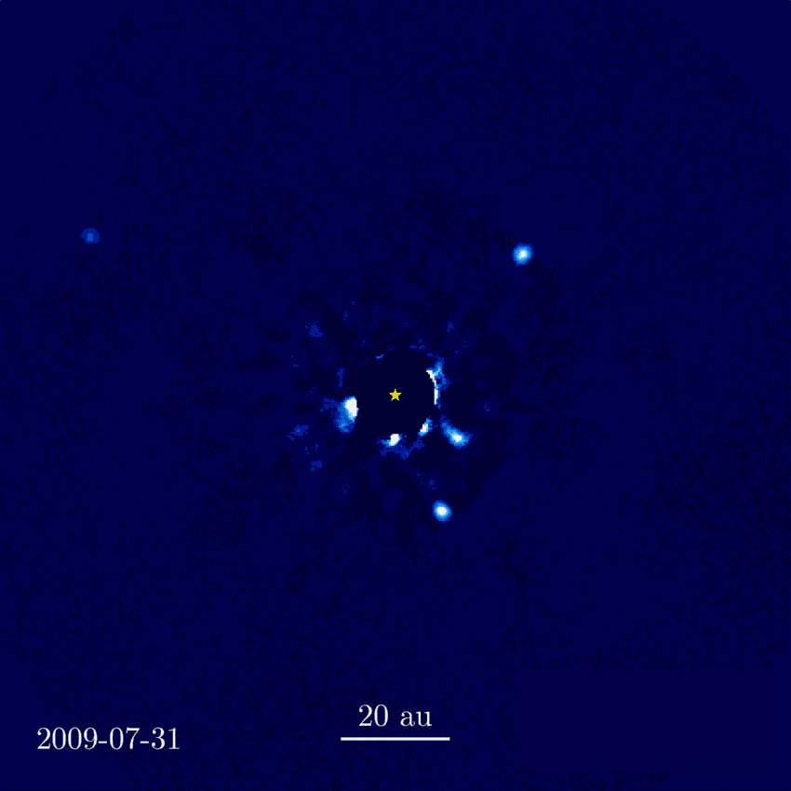
Two Similar Systems: HR 8799
Ellyn Baines published two different age and mass estimate scenarios in 2012 (used PAVO data):
Contracting onto the ZAMS
Age: 33 Myr
Mass: 1.516 M☉
Moving away from the ZAMS
Age: 90 Myr
Mass: 1.513 M☉
Strongly suggests that the 4 objects were planets not brown dwarfs
Jason Wang et al.
Notes:
HR 8799:
Hosts 4 directly imaged exoplanets
Ellyn Baines published updated ages and masses to this system using CHARA interferometric observations
Used PAVO
observed in 2010 and 2011
used YaPSI isochrones to determine age and mass
angular diameter determined to be 0.342 p/m 0.008 mas, temp of 7193 p/m 83 K, luminosity of 5.05 p/m 0.29 L_Solar.
Two different ages and masses were determined.
1.516 solar masses and an age of 33 Myr if the star is contracting onto the ZAMS or 1.513 solar masses and an age of 90 Myr is the star is expanding from the ZAMS.
It indicates the imaged planets are planets and not brown dwarfs.

Slide 5
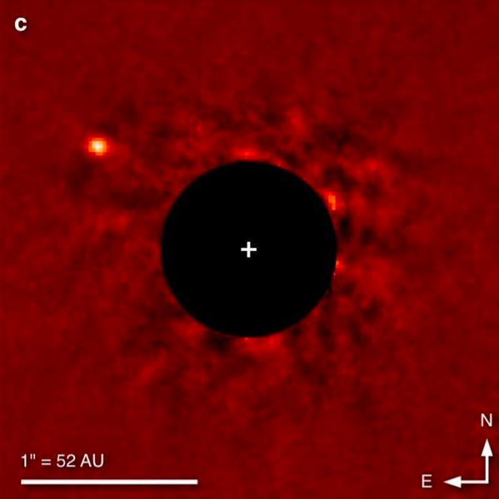
Two Similar Systems: ϰ Andromeda
Jeremy Jones published mass and age estimates in 2016
PAVO data
Used MESA evolutionary models for oblate stars to obtain:
Age: 47 Myr
Mass: 2.768 M☉
J. Carson et al 2012
Notes:
Kappa Andromeda:
Jeremy Jones in 2016 published updated age and mass for the star along with a mass for the exoplanet companion.
Used PAVO, observed in 2012 and 2013, used MESA evolutionary models to determine age and mass due to Kappa And A being a rapid rotator. Results are: 47 +40 -27 Myr and 2.768 +0.109 -0.1 M☉.

Slide 6
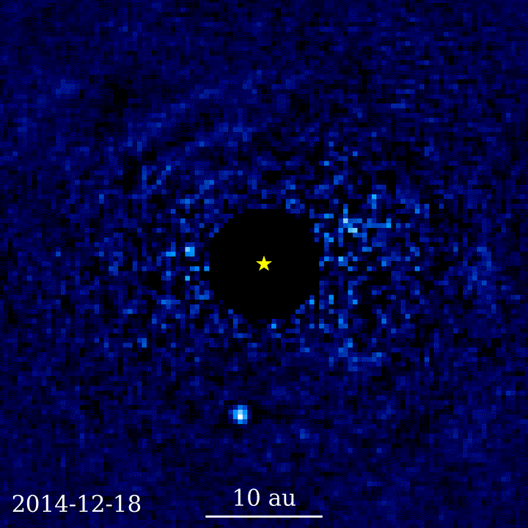
The 51 Eridani System
Composed of:
51 Eridani
Binary system GJ 3305 AB
51 Eridani b
51 Eridani and GJ 3305 AB are separated by 66”
Planet was discovered in 2015 by Macintosh et al. via the Gemini Planet Imager (First one!!)
A member of the 𝛃 Pictoris Moving Group
Young, nearby group of stars
Ages: ~10-30 Myr
Jason Wang (Caltech)/Gemini Planet Imager Exoplanet Survey
Notes:
With the BPMG point, mention the dynamical age trace-back method which is from the studies of the moving group

Slide 7
Past Work on 51 Eridani/ 51 Eridani b:
Current Stellar Parameters:
Mass: 1.75±0.05 M๏
Angular Diameter: 0.518±0.009 mas
Age: ~18-20 Myr
Age estimates were obtained through lithium depletion, FGKM dynamical age trace-backs, and isochronal methods.
Mass and angular diameter from M.Simon and G. Schafer
Notes:
FGKM dynamical age trace-back - Beta Pictoris Moving Group
Planetary parameters:
Mass upper limit determined by Dupuy et al 2022 through absolute and relative astrometry of the Hipparcus and GAIA catalog
Radius and temperature were determined by Samland et al 2017 using SPHERE located at VLT using their cloudy models.

Slide 8
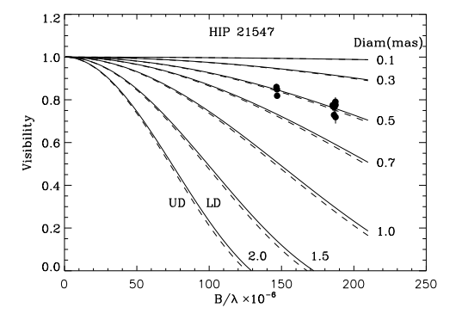
Results from M.Simon and G. Schafer:
Best fit visibility curve is for 0.5 mas
Solid line represents limb darkened
Dashed line represents uniform disk
Notes:
This is data in the H and K bands from CHARA CLASSIC.

Slide 9
Past Work on 51 Eridani/ 51 Eridani b:
Current Stellar Parameters:
Mass: 1.75±0.05 M๏
Angular Diameter: 0.518±0.009 mas
Age: ~18-20 Myr
Age estimates were obtained through lithium depletion, FGKM dynamical age trace-backs, and isochronal methods.
Mass and angular diameter from M.Simon and G. Schafer
Current Planetary Parameters:
Mass: ≤ 10.6 M_{Jup}
Radius: 1.11±0.15 R_{Jup}
Effective temperature: 760±20 K
Notes:
FGKM dynamical age trace-back - Beta Pictoris Moving Group
Planetary parameters:
Mass upper limit determined by Dupuy et al 2022 through absolute and relative astrometry of the Hipparcus and GAIA catalog
Radius and temperature were determined by Samland et al 2017 using SPHERE located at VLT using their cloudy models.

Slide 10
Observations with……
Notes:
Make table smaller and highlight the bad calibrator. On the other side show something using the bad calibrator versus not using it. Tell the story about finding the bad calibrator during data reduction/calibration
Diameter difference:
Top plot: Ang diam: 0.3616 mas
Bottom plot: Ang diam: 0.4728 mas

Slide 11
Observations with PAVO!!
Date (UT) | Baseline | Brackets | Calibrators
2015-10-11 | E1/W1 | 7 (5) | HD 28375 HD 27563 HD 29335
2015-10-12 | S2/E2 | 9 (7) | HD 28375 HD 27563 HD 29335
2015-11-06 | E2/W1 | 3 (1) | HD 27563 HD 29335
2016-11-09 | W2/E2 | 3 (1) | HD 27563 HD 29335
Notes:
Make table smaller and highlight the bad calibrator. On the other side show something using the bad calibrator versus not using it. Tell the story about finding the bad calibrator during data reduction/calibration
Diameter difference:
Top plot: Ang diam: 0.3616 mas
Bottom plot: Ang diam: 0.4728 mas

Slide 12
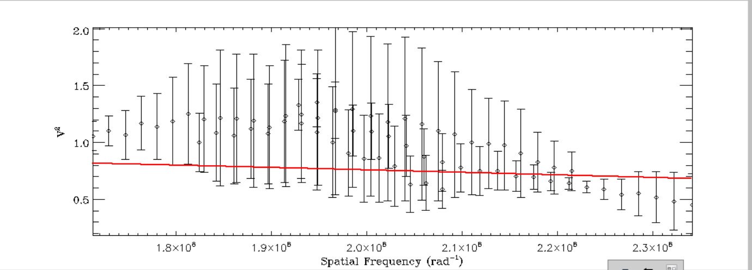
Observations with PAVO
With the bad calibrator- Ang diam: 0.3616 mas
Date (UT) | Baseline | Brackets | Calibrators
2015-10-11 | E1/W1 | 7 (5) | HD 28375 HD 27563 HD 29335
2015-10-12 | S2/E2 | 9 (7) | HD 28375 HD 27563 HD 29335
2015-11-06 | E2/W1 | 3 (1) | HD 27563 HD 29335
2016-11-09 | W2/E2 | 3 (1) | HD 27563 HD 29335
Notes:
Make table smaller and highlight the bad calibrator. On the other side show something using the bad calibrator versus not using it. Tell the story about finding the bad calibrator during data reduction/calibration
Diameter difference:
Top plot: Ang diam: 0.3616 mas
Bottom plot: Ang diam: 0.4728 mas

Slide 13
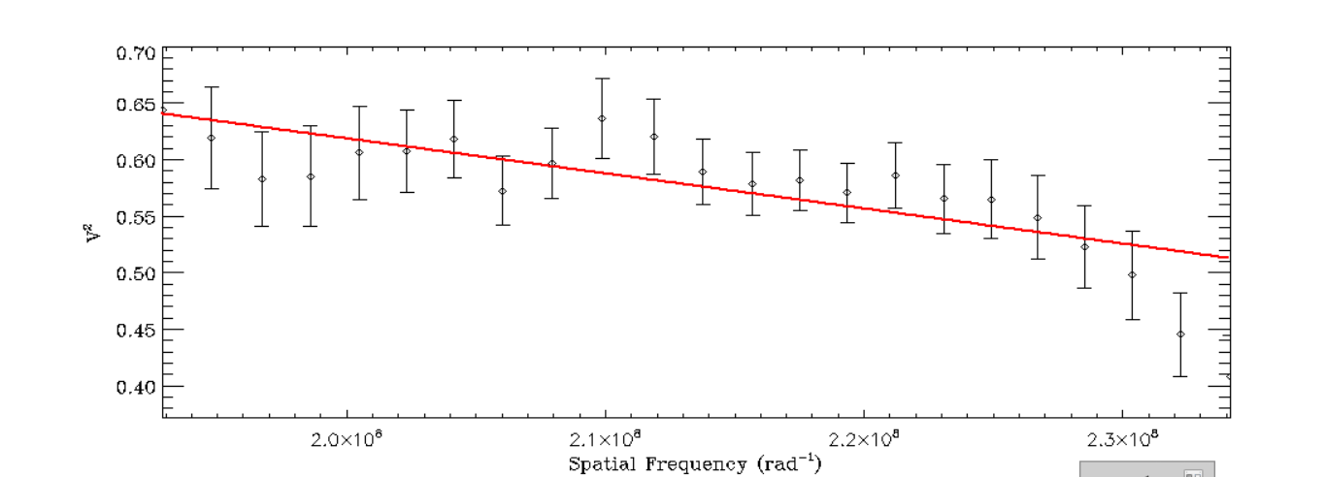
Observations with PAVO
Without the bad calibrator- Ang diam: 0.4728 mas
Date (UT) | Baseline | Brackets | Calibrators
2015-10-11 | E1/W1 | 7 (5) | HD 28375 HD 27563 HD 29335
2015-10-12 | S2/E2 | 9 (7) | HD 28375 HD 27563 HD 29335
2015-11-06 | E2/W1 | 3 (1) | HD 27563 HD 29335
2016-11-09 | W2/E2 | 3 (1) | HD 27563 HD 29335
Notes:
Make table smaller and highlight the bad calibrator. On the other side show something using the bad calibrator versus not using it. Tell the story about finding the bad calibrator during data reduction/calibration
Diameter difference:
Top plot: Ang diam: 0.3616 mas
Bottom plot: Ang diam: 0.4728 mas

Slide 14
Observations with PAVO
With the bad calibrator:
Date (UT) | Baseline | Brackets | Calibrators
2015-10-11 | E1/W1 | 7 (5) | HD 28375 HD 27563 HD 29335
2015-10-12 | S2/E2 | 9 (7) | HD 28375 HD 27563 HD 29335
2015-11-06 | E2/W1 | 3 (1) | HD 27563 HD 29335
2016-11-09 | W2/E2 | 3 (1) | HD 27563 HD 29335
Without the bad calibrator:
Notes:
Make table smaller and highlight the bad calibrator. On the other side show something using the bad calibrator versus not using it. Tell the story about finding the bad calibrator during data reduction/calibration
Diameter difference:
Top plot: Ang diam: 0.3616 mas
Bottom plot: Ang diam: 0.4728 mas

Slide 15
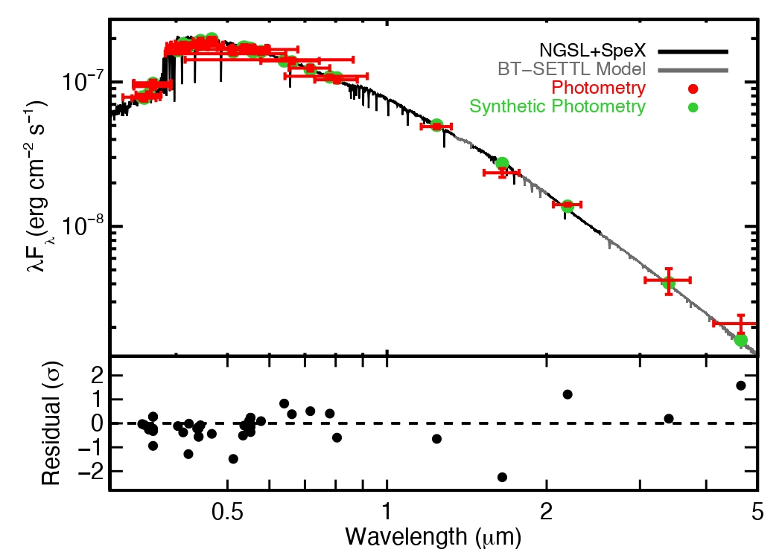
Data Reduction/Calibration
Used the bolometric flux and angular diameter to determine a temperature and limb darkened coefficient
Iterated this process until minimal or no change was seen
Andrew Mann (2015)
Notes:
Move first bullet point to previous slide
Bolometric flux plot courtesy of andrew man using
ADD:
With the bolometric flux and the angular diameter, we iterated this process to determine the temperature and limb darkened coefficients until no change.
Can add linear radius

Slide 16
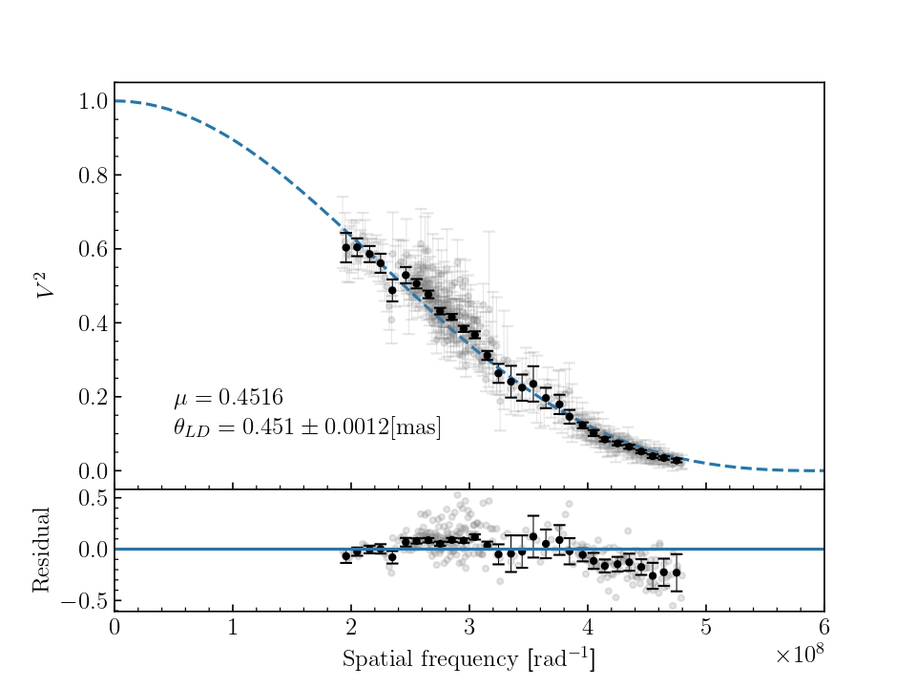
Elliott et al. (in prep)
Notes:
Each pavo measurement is taken over a spectrum of 15 bandpasses and are correlated because we are taking the measurement with the exact same instrument, at the same time, and in the same condition.
Binning helps minimize the correlations with the measurements
Multiple different calibrators, multiple different baselines, over multiple nights
PAVO has some wiggles

Slide 17
Data Reduction/Calibration
Used the bolometric flux and angular diameter to determine a temperature and limb darkened coefficient
Iterated this process until minimal or no change was seen
Final results:
𝛉_{LD} = 0.451 ± 0.001 mas
μ = 0.4516
T_{eff} = 7414 ± 32 K
L★ = 5.7 ± 0.1 L☉
Andrew Mann (2015)
Notes:
Move first bullet point to previous slide
Bolometric flux plot courtesy of andrew man using
ADD:
With the bolometric flux and the angular diameter, we iterated this process to determine the temperature and limb darkened coefficients until no change.
Can add linear radius

Slide 18
Age and Mass Estimates
Multiple models were used to model 51 Eridani
MESA Isochrones and Stellar Tracks (MIST)
The PAdova and TRieste Stellar Evolution Code (PARSEC)
Yale- Potsdam Stellar Isochrones (YaPSI)
The Garching Stellar Evolution Code (GARSTEC)
Using the observables calculated, the isochrones were interpolated to get an age and mass estimate

Slide 19
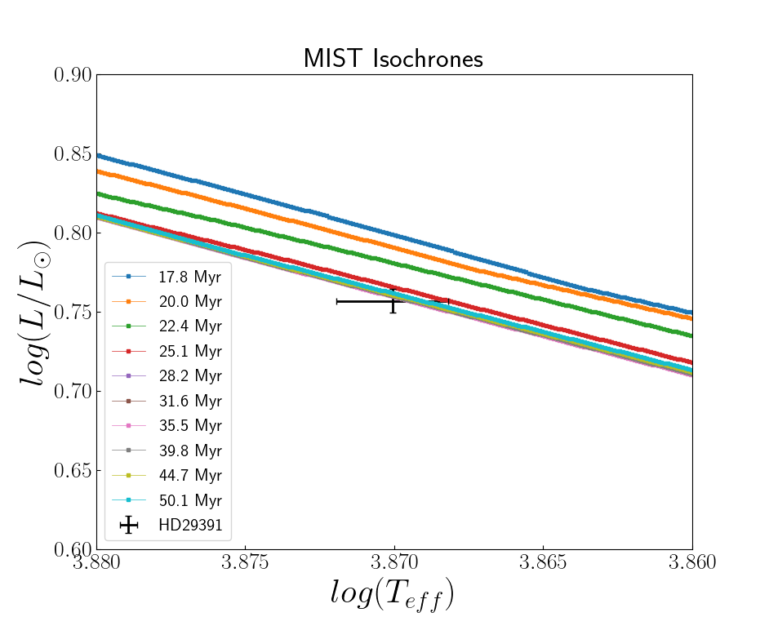
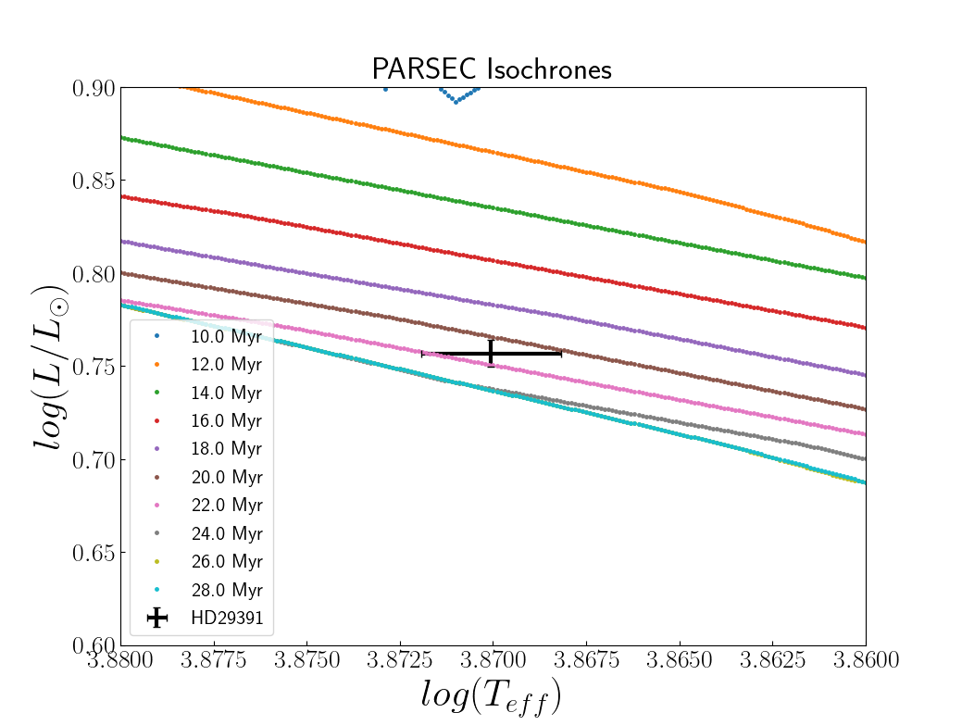
MIST Model:
PARSEC Model:
Age Estimate: 35.5 Myr
Mass Estimate: 1.57 M☉
Age Estimate: 22 Myr
Mass Estimate: 1.54 M☉
Notes:
Make data point much thicker and visible
Make axis numbers larger

Slide 20
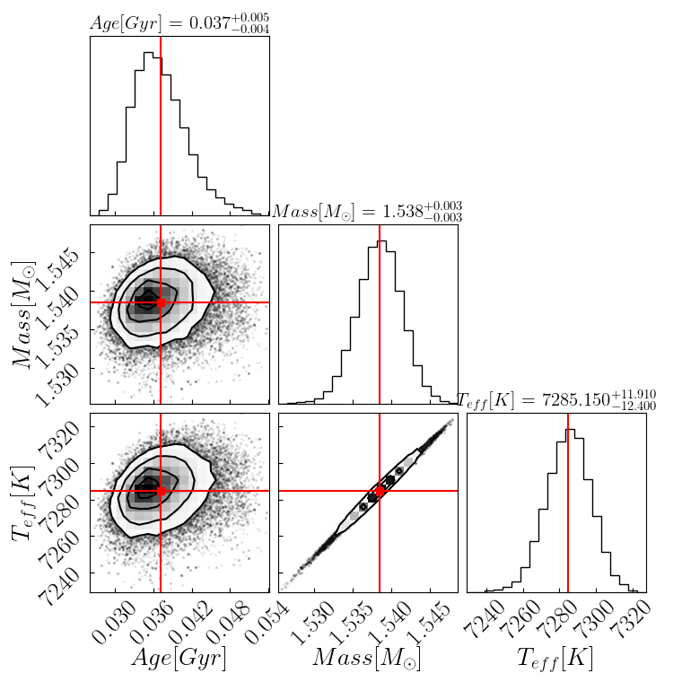
YaPSI Isochrones
Using bagemass, the yapsi28 model was used to run MCMC to get the age and mass
The mean run has given the following with an acceptance rate of ~62%
Age Estimate: 37 Myr
Mass Estimate: 1.538 M☉
Notes:
Show corner plot
Can draw the lines on the corner plot
Remove bullet point about the issues. Add an extra slide just in case
Add a summary isochrone slide

Slide 21
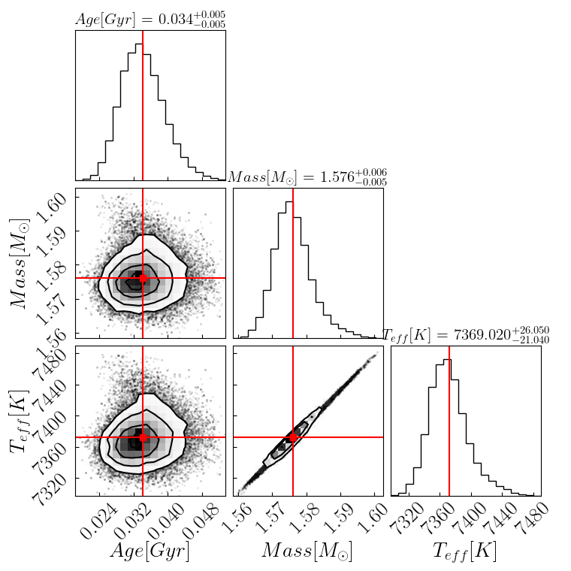
GARSTEC Isochrones
Using bagemass, the GARSTEC model with a mixing length of 1.78 and a Helium enhancement value of 0 to run the MCMC
The mean run gave:
Age Estimate: 34 Myr
Mass Estimate: 1.576 M☉

Slide 22
Isochrone Result Summary
Model: | MIST | PARSEC | YaPSI | GARSTEC
Age Estimate [Myr] | ~35.5 | ~22 | 37土 0.5 | 34土 0.5
Mass Estimate [M☉ ] | ~1.57 | ~1.54 | 1.538 土 0.003 | 1.576 土 0.003

Slide 23
Summary
Using observations taken by PAVO, raw visibilities were reduced and calibrated
Calibrated visibilities were fitted to obtain an angular diameter of 0.451 ± 0.001 mas
The effective temperature was determined to be 7414 ± 32 K
The luminosity was determined to be 5.7 ± 0.1 L☉
Using isochronal methods, age and mass estimates were determined.
Future work:
Finalizing the age and mass estimates
Starting work on refining the planetary parameters of 51 Eridani b
Postdoc position at LSU for the LUSTER mission!

Slide 24
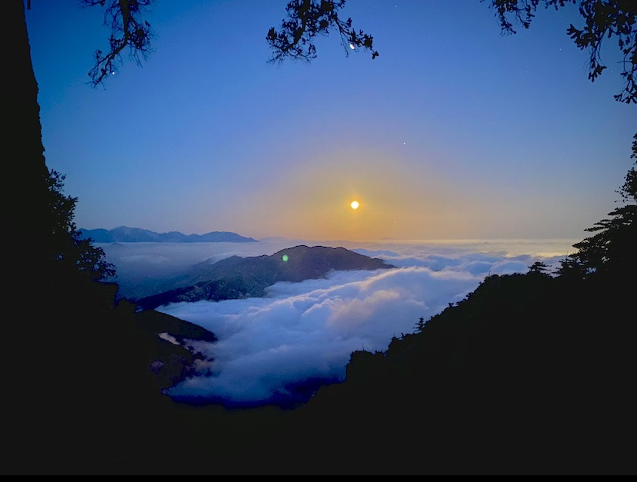
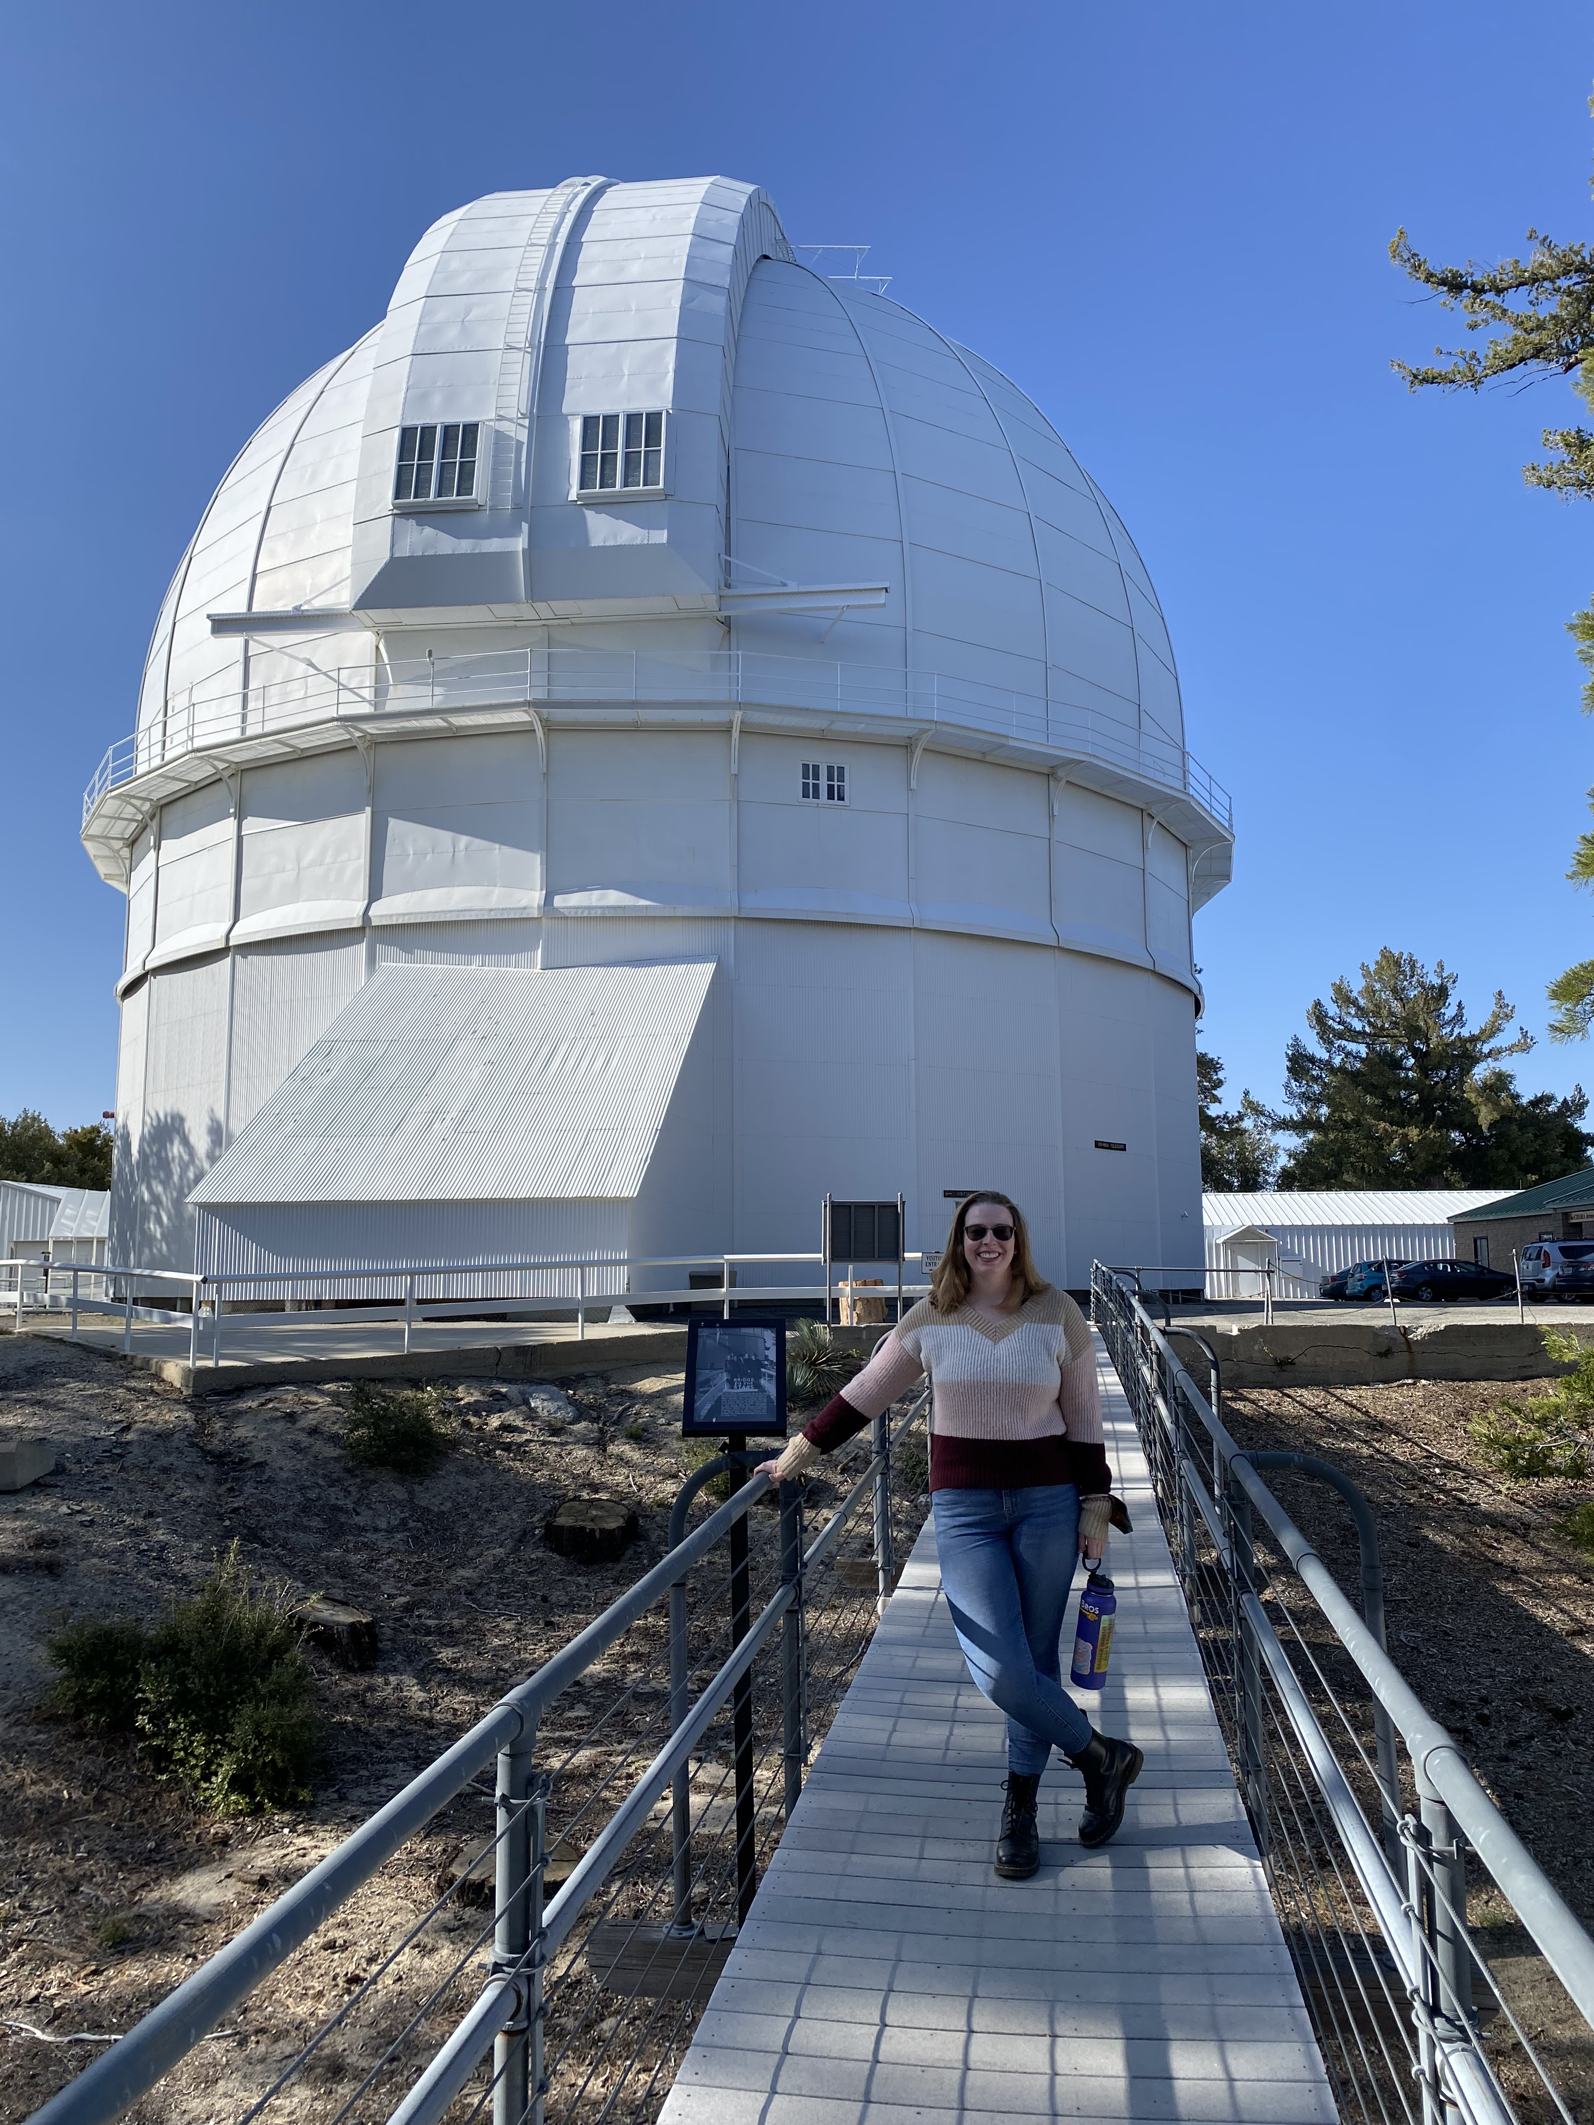
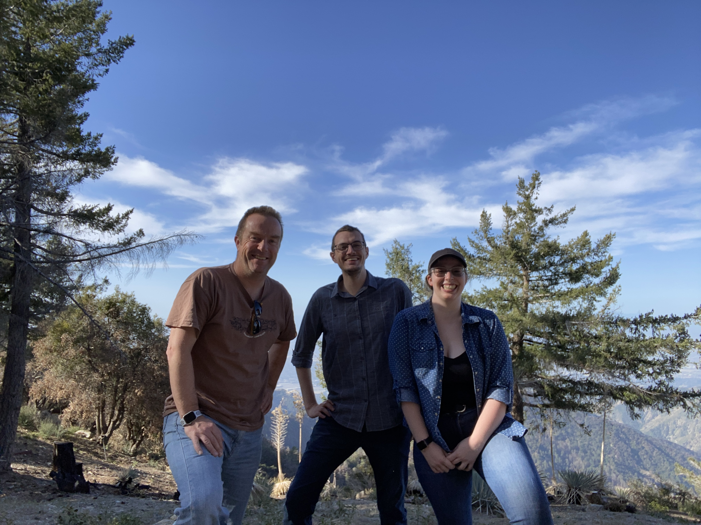
Questions?

Slide 25
References:
Baines E.~K., White R.~J., Huber D., Jones J., Boyajian T., McAlister H.~A., ten Brummelaar T.~A., et al., 2012, ApJ, 761, 57. doi:10.1088/0004-637X/761/1/57
Bressan A., Marigo P., Girardi L., Salasnich B., Dal Cero C., Rubele S., Nanni A., 2012, MNRAS, 427, 127. doi:10.1111/j.1365-2966.2012.21948.x
Choi J., Dotter A., Conroy C., Cantiello M., Paxton B., Johnson B. D., 2016, ApJ 823 102
Dotter A., 2016, ApJS 222 8
Dupuy T. J., Brandt G. M., Brandt T. D., 2022, MNRAS, 509,4411
Ireland M. J., et al., 2008, in Schöller M., Danchi W. C., Delplancke F., eds, Society of Photo-Optical Instrumentation Engineers (SPIE) Conference Series Vol. 7013, Optical and Infrared Interferometry. p. 701324, http://dx.doi.org/10.1117/12.788386
Jones J., White R.~J., Quinn S., Ireland M., Boyajian T., Schaefer G., Baines E.~K., 2016, ApJL, 822, L3. doi:10.3847/2041-8205/822/1/L3
Mann A.~W., Feiden G.~A., Gaidos E., Boyajian T., von Braun K., 2015, ApJ, 804, 64. doi:10.1088/0004-637X/804/1/64
Maxted P.~F.~L., Serenelli A.~M., Southworth J., 2017, ascl.soft. Ascl:1708.010
M. Simon and G. H. Schaefer 2011 ApJ 743 158
Samland M., et al., 2017, A&A,603,A57
Spada F., Demarque P., Kim Y.-C., Boyajian T.~S., Brewer J.~M., 2017, ApJ, 838, 161. doi:10.3847/1538-4357/aa661d
Spiegel D.~S., Burrows A., 2012, ApJ, 745, 174. doi:10.1088/0004-637X/745/2/174
ten Brummelaar T. A., et al., 2005 ApJ 628 453
Weiss A., Schlattl H., 2008, Ap\&SS, 316, 99. doi:10.1007/s10509-007-9606-5

Slide 26
Outline
Motivation behind project
Directly imaged exoplanet, exoplanet science is growing every day, star/system is relatively young
Background on the system
What makes up the 51 Eridani system
Past work on 51 Eridani
Data Reduction/Calibration Results
Any issues found
Final results of calibration: angular diameter and the limb darkened coefficient
Plot with fit
Stellar Parameter Calculations
Report final temperature, luminosity, and linear radius
Age and Mass Estimations
Why isochronal fitting
Isochrone models used and the results for each one
Future Steps
Move towards planet calculations,

