Slide 1
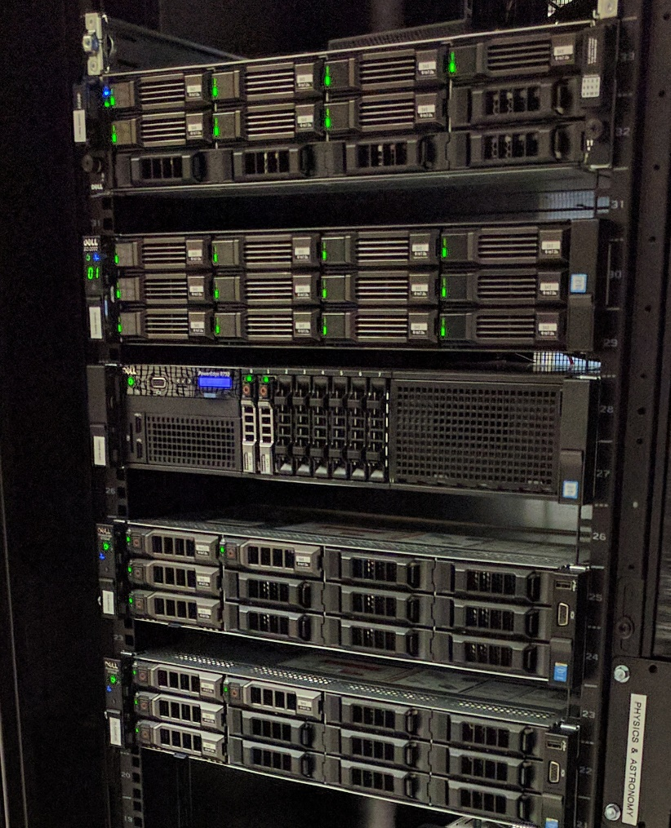
CHARA
Remote Operations
and Data Access
Jeremy Jones, CHARA Data Scientist

Slide 2
The CHARA Server
Located at GSU Data Center
4 Virtual Machines:
  Remote Observing
  Data Archive
  Remote Data Reduction
  Database Portal

Slide 3
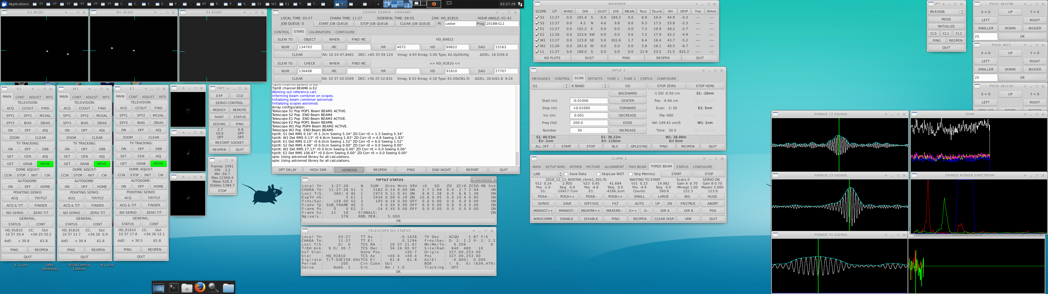
Remote Observing
Screenshot courtesy of Katie Lester

Slide 4
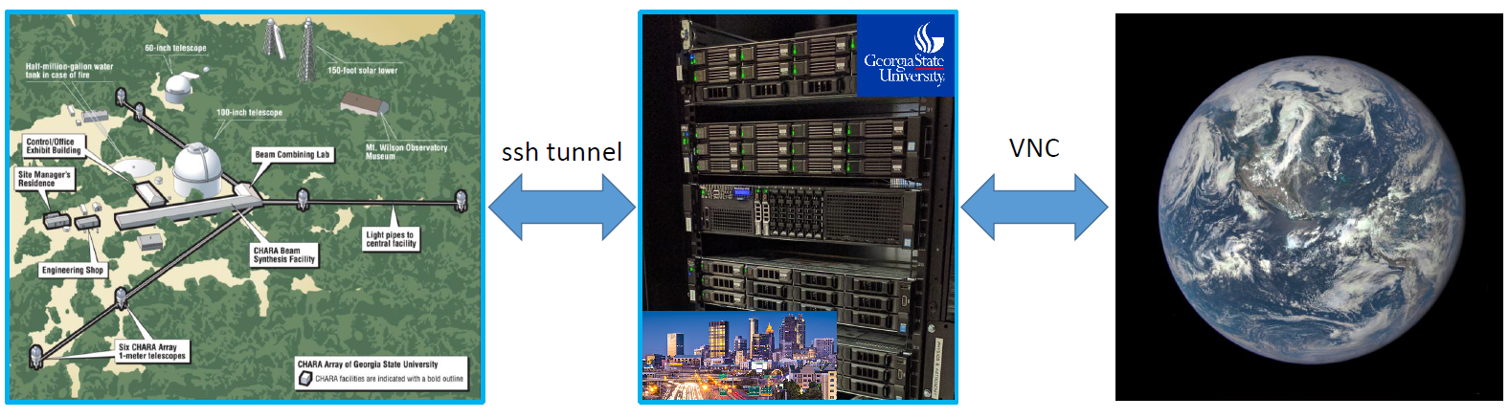
Remote Observing
Connect to Atlanta machine using VNC
Atlanta machine connects to mountain using SSH tunnel
CHARA software is the same as that on the mountain

Slide 5
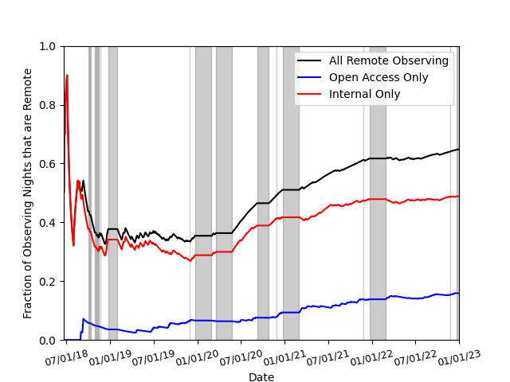
Remote Observing Stats
817 Remote Nights
616 Internal
201 Open Access
65% Remote Nights
49% Internal+Remote
16% Open Access+Remote

Slide 6
Remote Observing Stats
817 Remote Nights
616 Internal
201 Open Access
COVID
Initial AO Installation
Winter
Winter
Bobcat Fire
Winter
WINTER
Winter
65% Remote Nights
49% Internal+Remote
16% Open Access+Remote

Slide 7
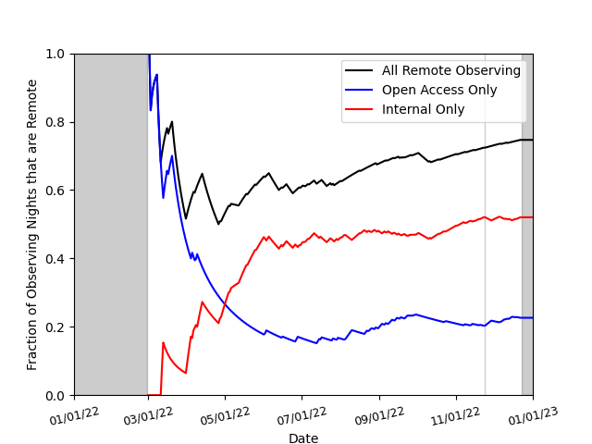
Remote Observing Stats (2022 Only)
221 Remote Nights
154 Internal
67 Open Access
75% Remote Nights
52% Internal+Remote
23% Open Access+Remote

Slide 8
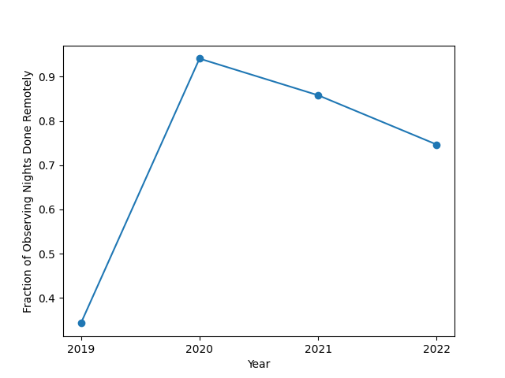
Remote Observing Stats (2019 – 2022)
94%
86%
75%
34%

Slide 9
Remote Observing Stats (2019 – 2022)
94%
86%
75%
???
34%

Slide 10
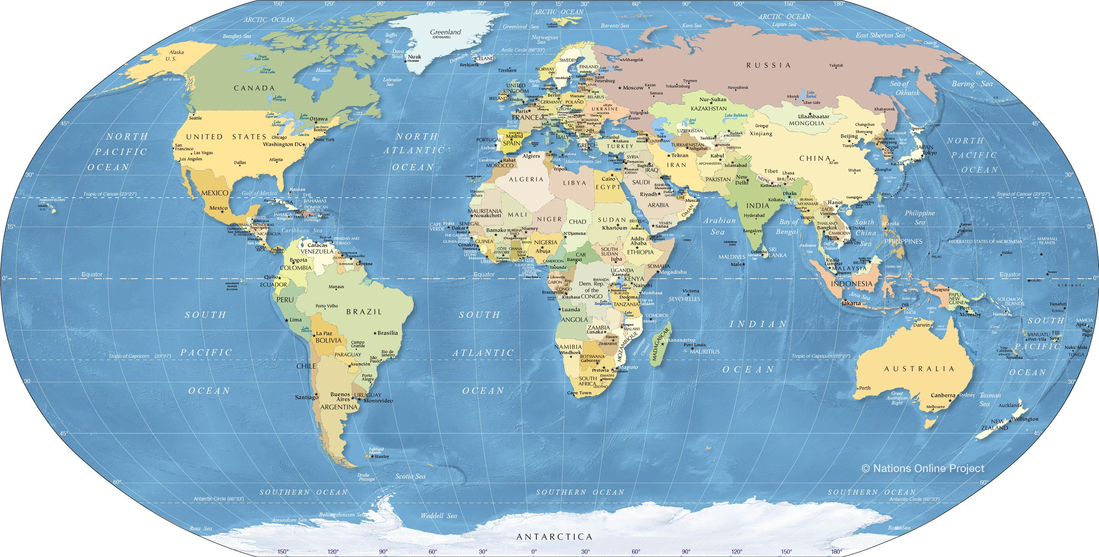
CHARA Atlanta Data Archive

Slide 11
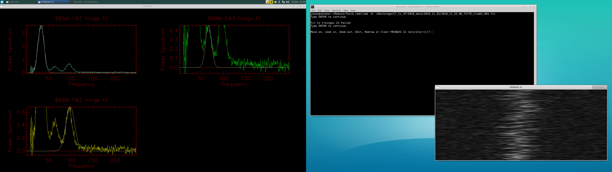
CHARA Data Policy
  All CHARA data are public EXCEPT:
    New data (18-month proprietary period)
    Student thesis data
    Long-term survey data
Data accessible on the Remote Data Reduction Machine
11

Slide 12
Remote Data Reduction
12

Slide 13
Remote Data Reduction
  Data Reduction Machine linked to archive
  Reduce data remotely
  Download final reduction
  Benefits:
    Reduction software always up to date
    No need to download raw data
    Cross-platform
13

Slide 14
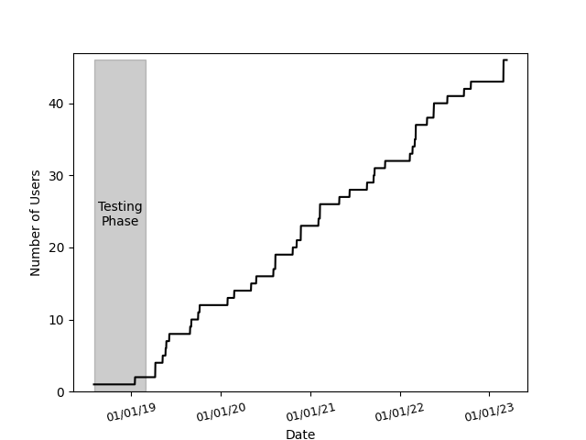
Remote Data Reduction
46 Users
~1 User/Month
14

Slide 15
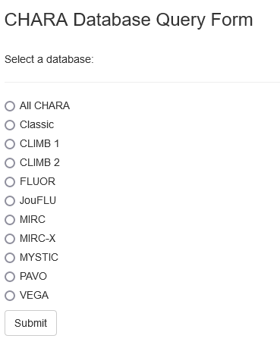
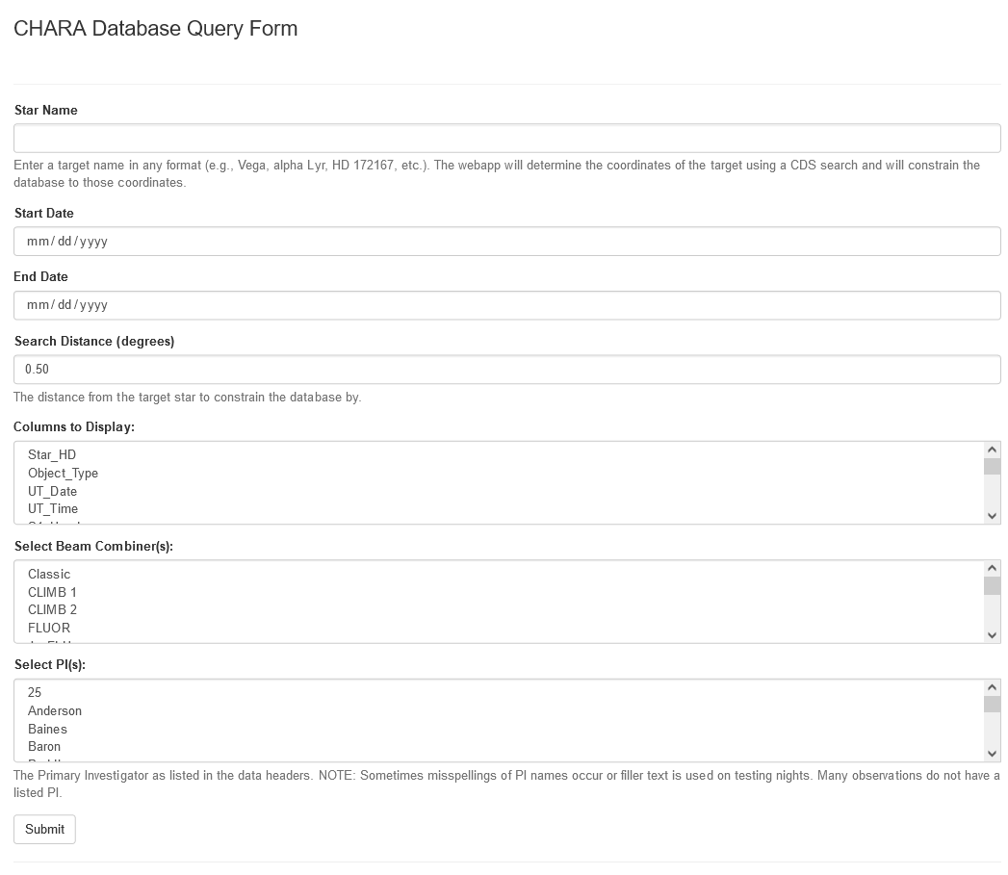
CHARA Online Database Portal
database.chara-array.org
15

Slide 16
CHARA Online Database Portal
Stored on archive machine
Raw Data
Read headers
SQLite Database File
Upload info to…
Accessible on the…
Read database file
Data Reduction
Machine
JMMC
OIDB
ObsPortal
Flask Website
Online & Accessible
Searchable
16

Slide 17
CHARA Online Database Portal
Demo! (everybody loves a demo!)
17

Slide 18
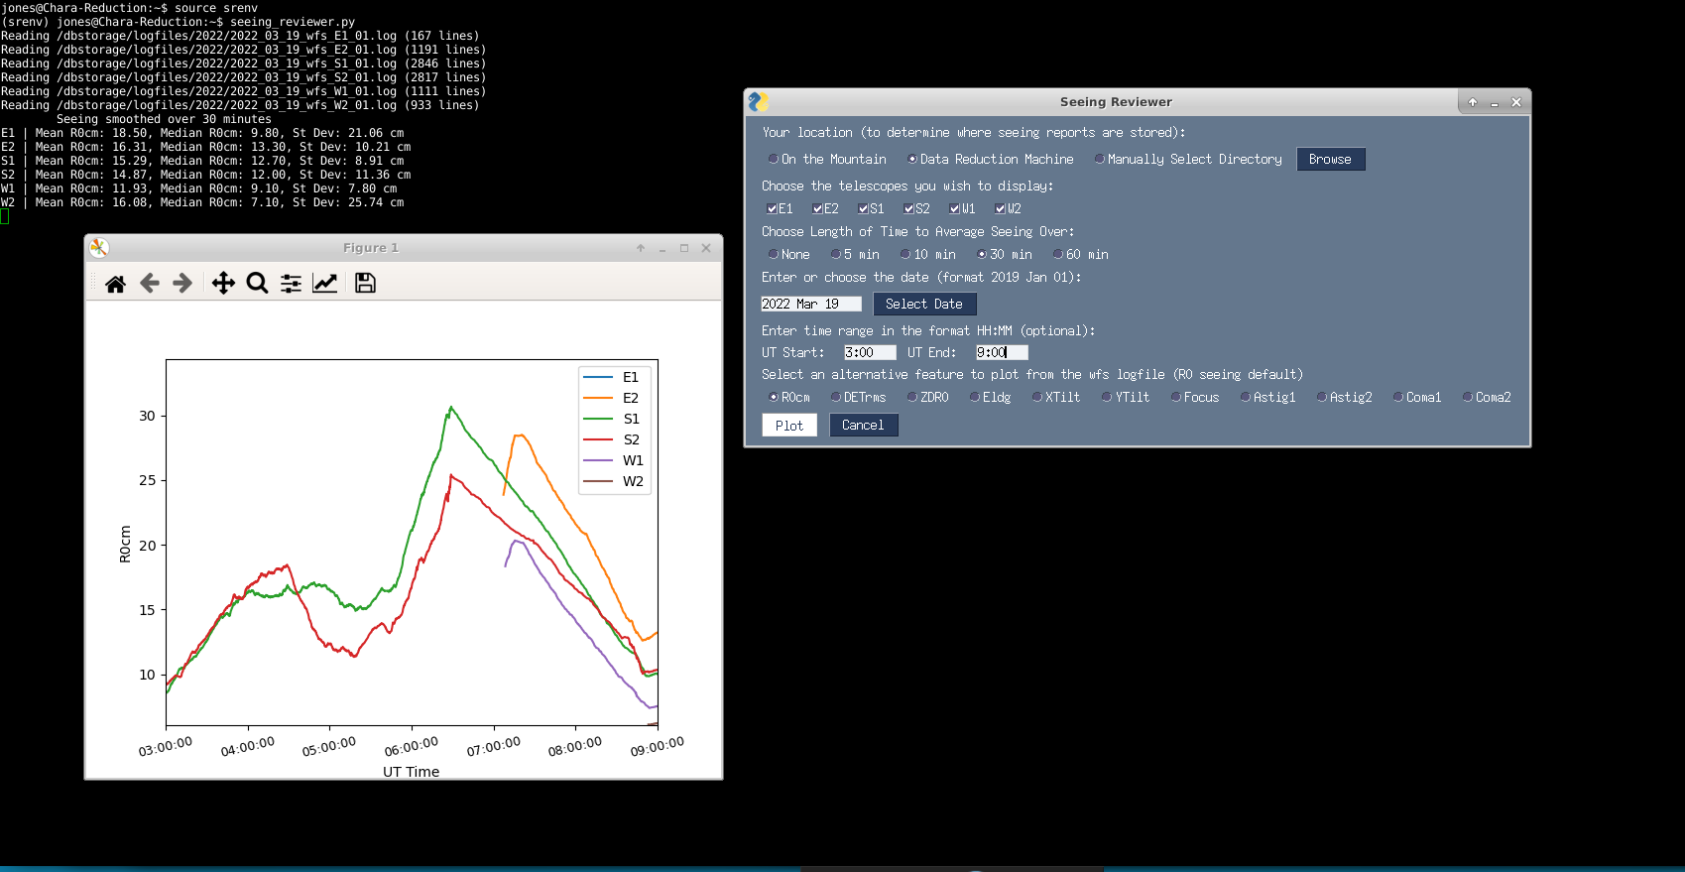
CHARA Seeing Reviewer
18

Slide 19
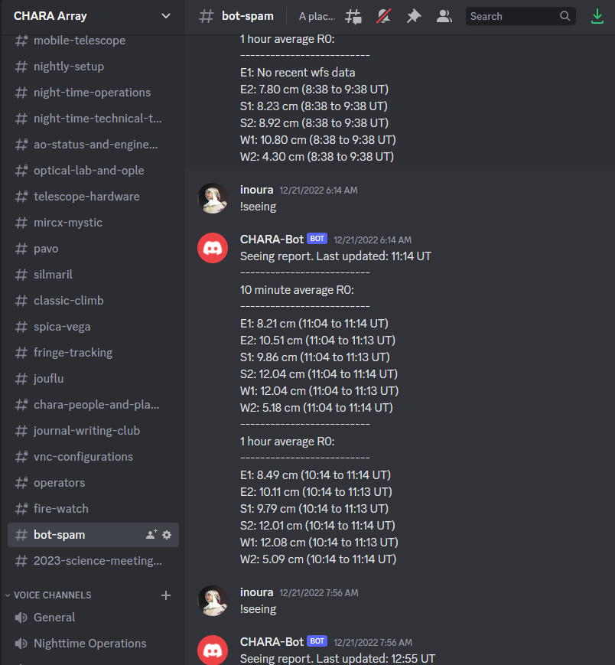
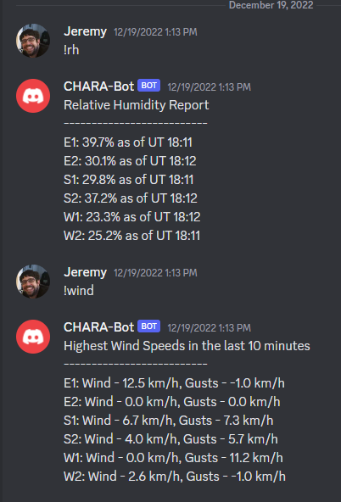
CHARA Discord Bot
  Reads wavefront sensor and weather logs
  bot-spam channel
  Can print reports:
    !seeing (R0 seeing in cm)
    !rh (Relative Humidity)
    !wind (Sustained & Gust)
  In the future:
    Warn about weather risks
19

Slide 20
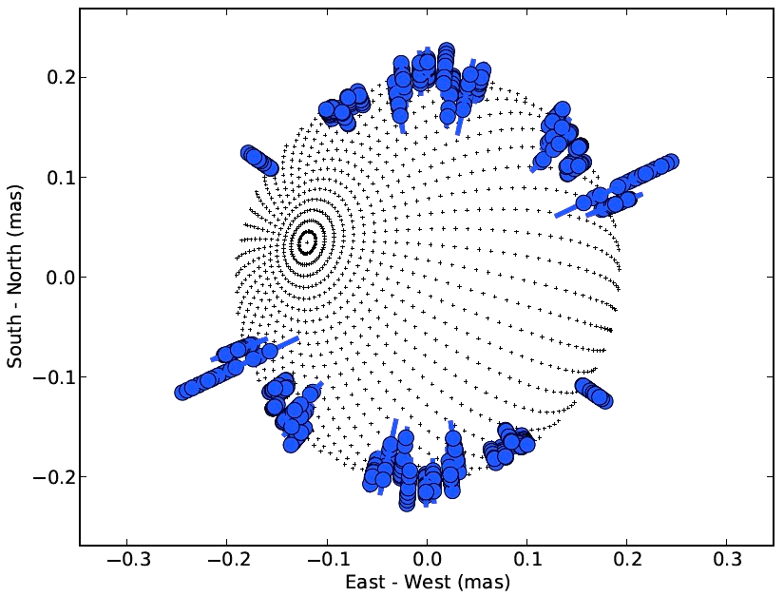
A Bit of Science
Modelling Rapid Rotators
  Model a rapidly rotating
  early-type star
  Data:
    Interferometric Visibilities
    Photometric Fluxes
    Projected Rotational Velocity v sin(i)
  Free Model Parameters:
    Radius, Temperature, Inclination, Rotation Speed, Position Angle
κ Andromedae
Jones et al. 2016
20

Slide 21
A Bit of Science
The Age of the Hyades
Free Parameters
Evolution Model Results
HD 27934 (Hyades member)
Jones et al. (in prep)
21

Slide 22
A Bit of Science
The Age of the Hyades
Jones et al. (in prep)
  Complete data for four Hyades members
  The higher mass ones show good agreement in age
  The lower mass ones … not so much
  To investigate:
    Are the data bad?
    Are we using the models wrong?
    Are the models wrong?
22

Slide 23
On the Horizon
Atlanta CHARA Archive:
  Prepare for SPICA
  Integrate with JMMC
Discord Bot:
  Add alerts
  Expand report request options
NOIRLab program support
Hyades
23

