Slide 1
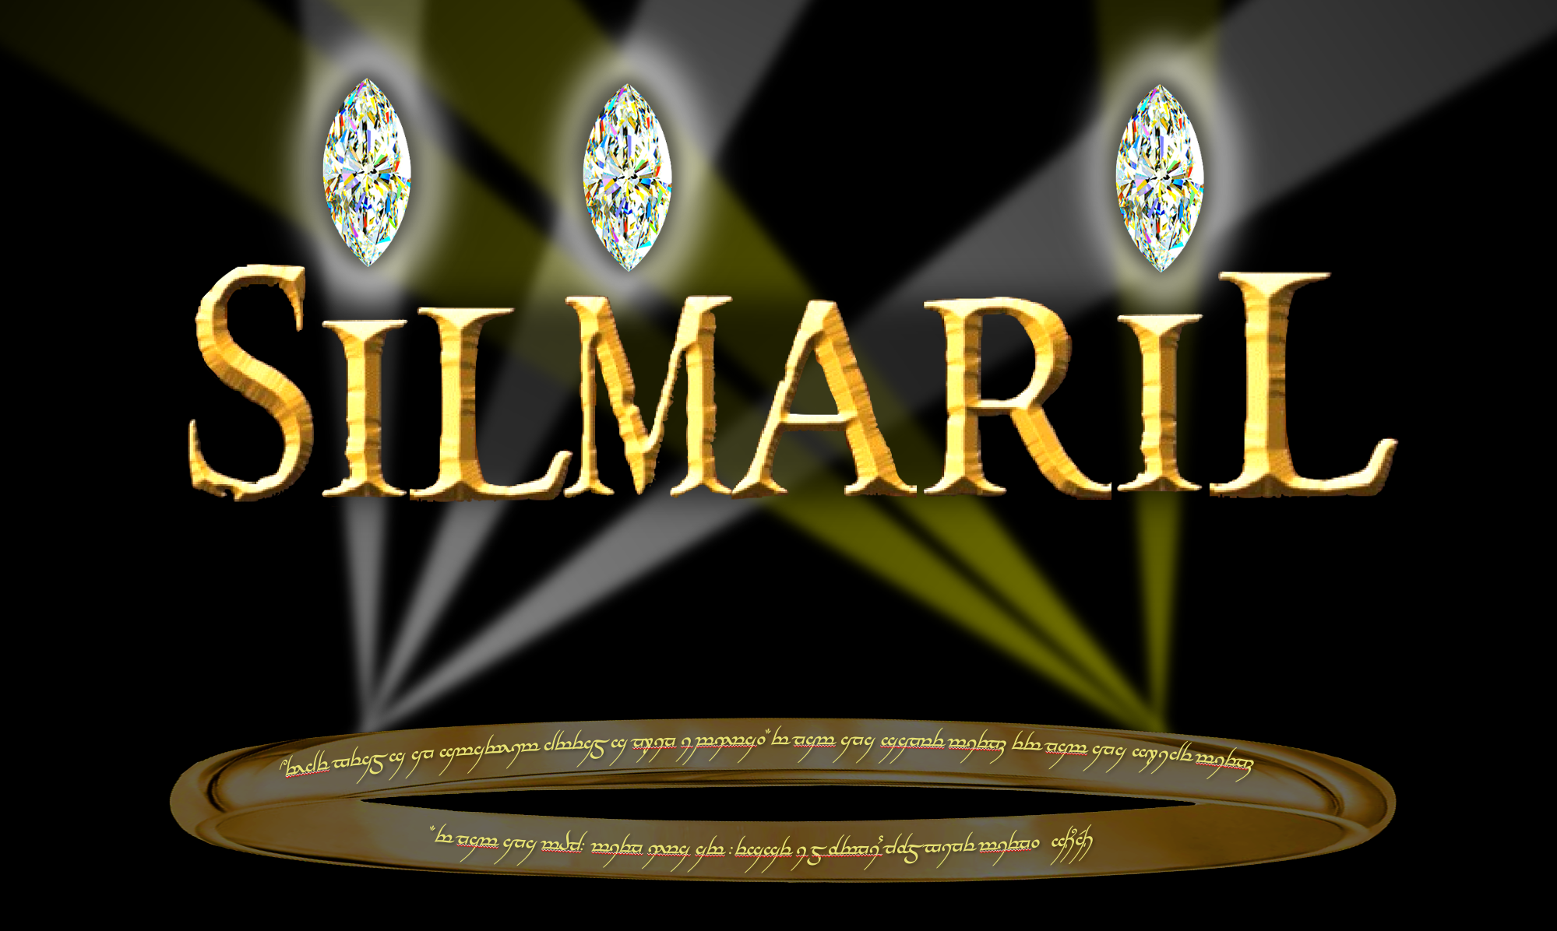
Design of Silmaril
by Cyprien Lanthermann, Theo ten Brummelaar, Peter Tuthill, Marc-Antoine Martinod, E. Robert Ligon, Douglas Gies, Gail Schaefer, and Matthew Anderson
Notes:
Hi, I’m Cyprien Lanthermann. I’m working at the CHARA Array, and today I will present you the design of Silmaril, a new instrument that we are implementing currently.

Slide 2
NIR CHARA beam combiners
Most sensitive is CLASSIC/CLIMB
  but MIRC-X/MYSTIC are closing the gap
CLASSIC/CLIMB lost in attractiveness
Upgrade CLASSIC/CLIMB for sensitivity
Instruments | CLASSIC (CLIMB) | MIRC-X (MYSTIC)
# Telescopes | 2 (3) | 6
Spectral band | H/K | J/H (K)
Spectral resolution | Broad band | 50
Limiting magnitude | H/K = 8.5 (7.0) | H (K) = 7.5
Notes:
The main default of interferometry, compared to other observing techniques is its sensitivity. Huge efforts on this matters has been done in the previous years. At CHARA, until recently, the most sensitive instrument was without a doubt CLASSIC/CLIMB, CLIMB being the 3-telescope version of CLASSIC, allowing closure phase measurement, in exchange of losing some sensitivity. But for a few years now, we have MIRC-X, in combination with MYSTIC more recently, which reach sensitivity getting close to CLASSIC. In the table here are the official best performance, but this value is conservative, with a best performance at 8.1 for now for MIRC-X, and 9.2 for CLASSIC. Because of that, CLASSIC/CLIMB lost some of its attractiveness, with MIRC-X being now the most requested and used instrument at CHARA. Therefore, we decided to upgrade CLASSIC/CLIMB with the main goal being the sensitivity.

Slide 3
C-RED One camera
Using a SHAPHIRA e-APD detector (J-H-K-band)
  Fast frame rate (3500 Hz in full frame)
  Low readout noise (<1 e⁻/pix/frame)
  Decent dark current (80 e⁻/pix/s)
Used by MIRC-X and MYSTIC
Notes:
For this upgrade, the starting point is a better camera. And for interferometry in the near infrared, the best detector is currently the relatively recent SAPHIRA detectors, using an electron Avalanche PhotoDiode technology (or e-APD). It presents the advantages of a fast frame rate with low readout noise, less than an electron, and it has a decent dark current.
It has been developed by the Leonardo company in association with ESO, for the AO and Fringe Tracking system of GRAVITY, and has been used by several other instruments since then, including MIRC-X and MYSTIC at the CHARA Array that I mentioned earlier, and that use the ready to use C-RED One camera. So, we decided to use this solution as well, as we have good experience with them, and that it will make it easier to implement as we already have the tools for it. The performance of the camera by itself will already allow a gain in sensitivity.

Slide 4
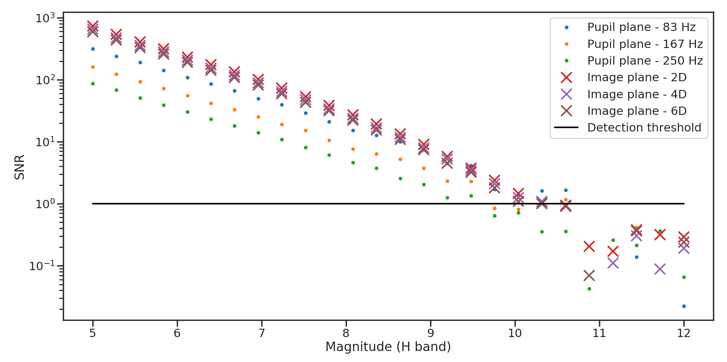
Design choice
3-Telescope beam combiner
  Limit sensitivity loss caused by combining a greater number of telescopes
  Keep the ability to obtain a closure phase
Pupil plane or Image plane?
  Simulation to compare
  Image plane better for
  sensitivity
Notes:
To push even further for sensitivity, we also studied the design of the beam combiner specifically. First, we chose to limit it to 3 beams, as we chose to stay conservative with a minimum number of telescopes, but we wanted to be able to measure closure phases. Then, even if the original idea was to keep the general design of CLASSIC and CLIMB, we studied the difference between a 3-telescope pupil plane combiner, like CLIMB, and a image plane combiner. On the figure here we plot the simulated fringe SNR as a function of the star magnitude in the H band, the dotes are for the pupil plane combiner, the crosses are for the image plane. And we see that the image plane gives a better SNR, giving a better limiting magnitude. So, we changed our plan and went for an image plane beam combiner.

Slide 5
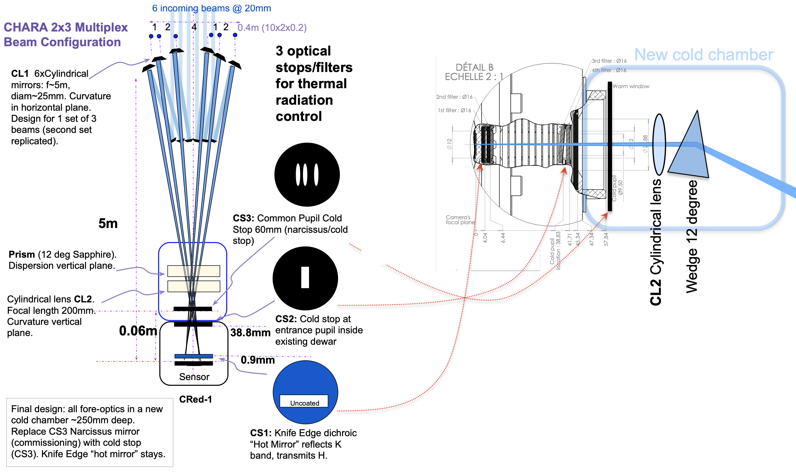
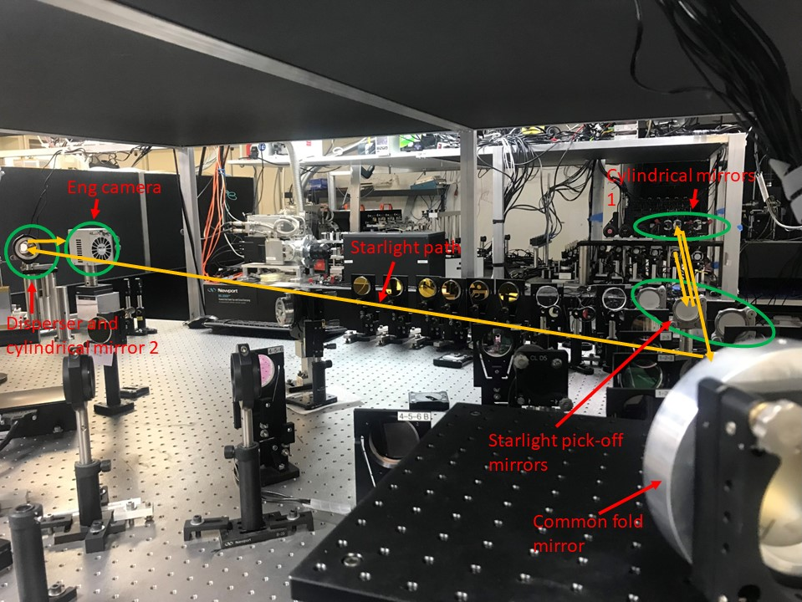
Silmaril’s design
As few optics as possible
  Fringe axis: long focal length (5.2m)
  cylindrical mirror (CL1)
  Spectral axis: shorter focal length (0.35m)
  cylindrical mirror (CL2)
  Low spectral resolution (R = ~35)
  dispersive element
  Edge Filter:
    One half H-band
    One half K-band
  (external Dewar as a second phase)
Notes:
The design we decided on consists of using as few optical element as possible, taking inspiration from the FRIEND instrument at MROI, to limit the loss of flux each element can bring. On the picture here you can see the path of light coming from the telescopes. First, we have pickoff mirrors that send the beams on a higher level, to be able to implement the combiner on the already crowded table. It reaches the first set of cylindrical mirrors, that are non redundantly spaced, and characterized by a long focal length of 5.2m, in the fringe’s direction and it sends the beams to a second cylindrical mirror, with a shorter focal length of 0.35m in the spectral direction. We needed an extra fold mirror so we could fit the combiner on the optical table.
Just before the second cylindrical mirror, the beams pass through a dispersive element, with a low spectral resolution around R of 35, which will allow the group delay tracking of the fringes, and the CL2 send the beams on the camera, which here is one of the engineering camera we used, in place of the CRED one that we will get this year.
Now, as shown in this early scheme of the combiner, we plan a second implementation phase, where the second cylindrical mirror and the dispersive element should be placed in a cold external dewar to reduce the background and gain even more in sensitivity. An alternative to the cold external dewar would be to use a Narcissus mirror.
To allow the observation in both H and K-band simultaneously, we decided to use an edge filter at the position of the closest filter to the detector, in the camera. This edged filter will have one half coated to filter out the K-band photon, and the other half uncoated to allow the K-band to go through.

Slide 6
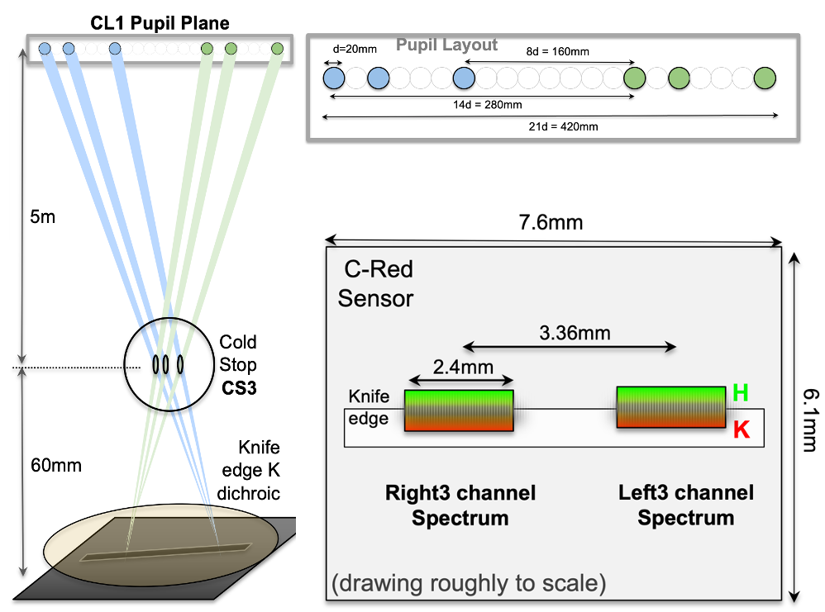
Final 2x3 beam combiner
Notes:
Luckily, this design have just enough space to be able to implement a second set of 3 beams, that we will implement in a second time, like the external dewar, to obtain this final layout with a 2 times 3-beam combiner.

Slide 7
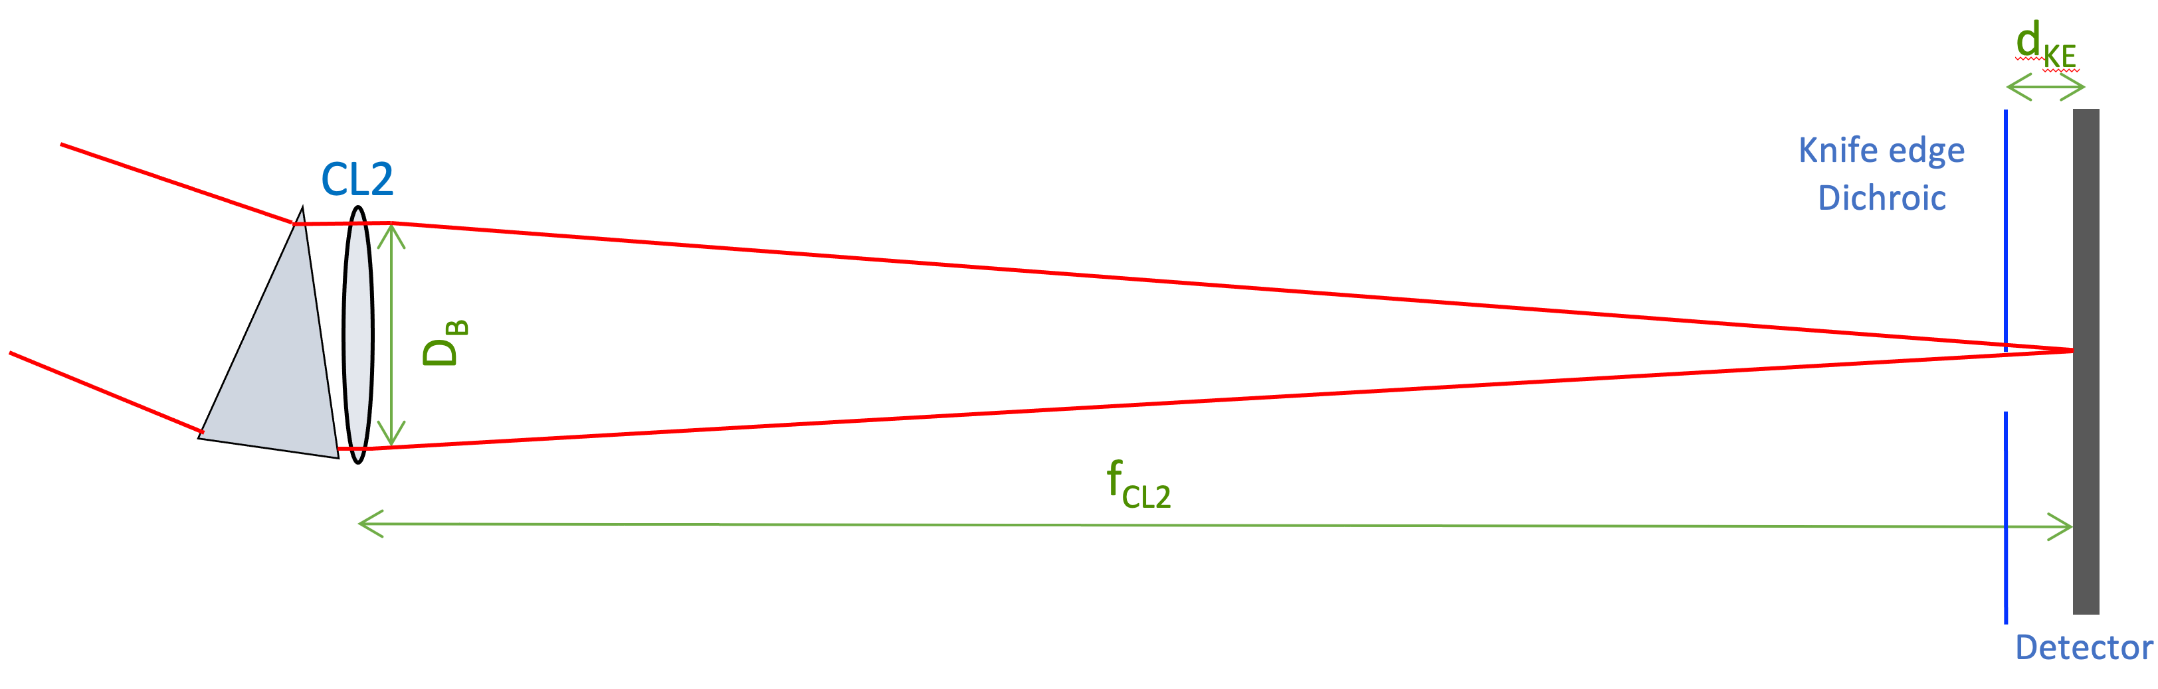
Edge filter primary design
Leakage of K-band photon in the
H-band
  Special filter design to get closer to
  the detector
  Transition is within the 6 pixels gap between H- and K-band for d_{KE}<1mm
  Only 10% leakage in the first pixels of H-band for initial d_{KE} (2.4mm)
  Not worth the risk, going for flat filter
Hardest element to procure with thin enough transition coat (100μm)
Coat filtering
out K-band
No coat
Notes:
As described previously, the edge filter will have one half coated to filter out the K-band photons, so we can reduce the noise in the H-band part of the detector, and a second half without coat, to let through the K-band photons, both thermal and from the astrophysical target, but this part of the design is the one that presents the most difficulties. Indeed, as the edge filter is situated in front of the detector, some of the K-band photon can leak into the H-band in the region of the transition between the coated and uncoated part of the filter, as you can see on the scheme, part of the light will go through the coated part, and some will not. In our design, the gap between the H and the K-band represent 6 pixels on the detector, so we want to limit the area affected by the transition of the edge filter on the detector. To do that, the transition need to be relatively sharp (about 100 micron) and as straight as possible. This edge filter presents a real difficulty to acquire, as its manufacture present several challenges, like the accuracy of the transition between the coated and uncoated parts, or the sharpness of this transition. In the end, we found one company that said they should be able to build it with our requirement.

Slide 8
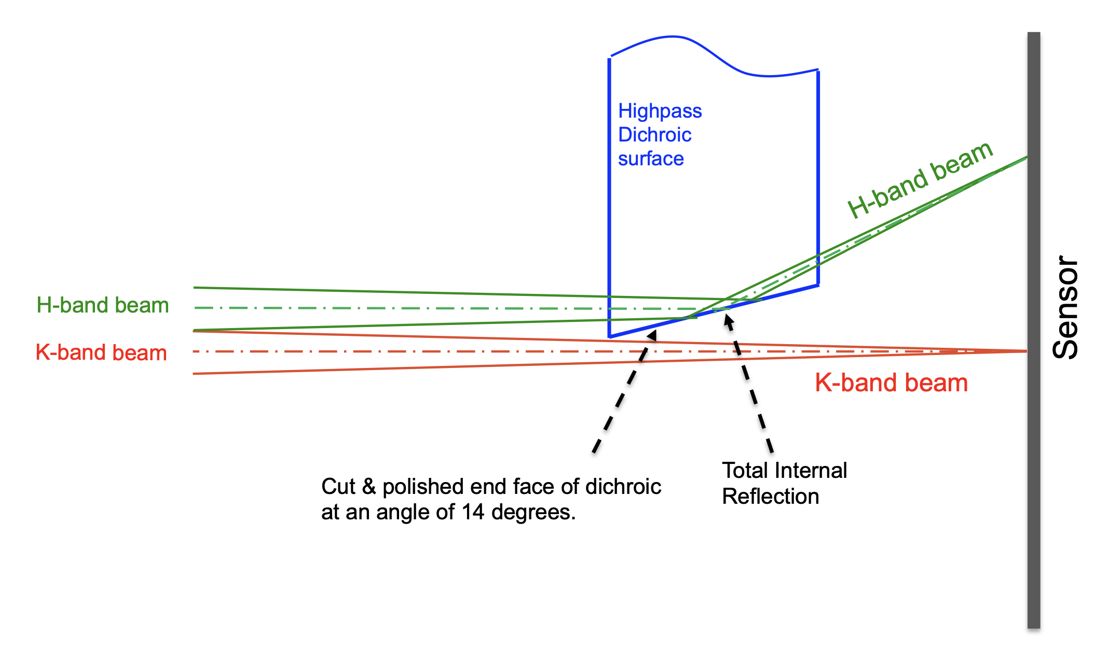
Edge filter alternative design
Half-filter with polished surface at a predefined angle
  H-band going through the filter, being reflected further
  K-band not going through the filter
Change position of H-band on the detector, introduces an optical path difference between H- and
K-band => inducing a defocus between the two bands
Notes:
But in case the first design has a poor performance, we thought of an alternative design that should work, but presents some disadvantages. The design presented on the top right figure is using a full K filter, cut in half, with the cut edge being polished to a predetermined angle, sending the H-band further on the detector, avoiding the potential transition area that a not perfect edge would create. The K-band would pass outside of the filter. The main issue is that this design will introduce some optical path difference between the the H- and K-band, and this optical path difference will induce a defocus between the 2 bands. But our prediction is a defocus of about 2 pixels on the detector, which is not great but we should be able to deal with it. Of course, we hope for the first design to work well to avoid that.

Slide 9
Simulated performance
2-step simulation
Atmospheric turbulence
  Seeing with r₀ (r)
  Spectral resolution (R)
  Number of pixels sample in the fringe direction (n)
Detector
  Magnitude of the target (c)
  Incoherently added frames (s)
  Coherently added frame (p)
  Camera’s parameter (RON, ENF, BKG)
Notes:
Now that we have the design, we can simulate the performance of the instrument. For that we use a 2-step simulation, the first part simulating the phase induced by the atmospheric turbulence, the second simulating the detector performance, with different parameters indicated here. In this presentation I will go directly talk about the seeing parameter, the magnitude of the star being implicit as we are looking for the most sensitive performance. But you can check the others parameters’ effect in my SPIE paper from last year.

Slide 10
Seeing r₀(r)
r₀ = 5, 10, 20 cm
Does not affect K-band much (more stable turbulence)
H-band SNR increase with r0,
Both bands have similar M_{lim} = 12 in average and best conditions
(M_{lim} = 12 for final design with Dewar, for just the C-RED ONE, M_{lim} = 10)
Notes:
So, for the seeing, we have r₀ that we use to call r0, and is called r in the simulation, with the values here that represent bad, average and good conditions, respectively. The study shows that the K-band is not much affected by this parameters, as in this band the atmosphere is more stable, but in the H-band, the SNR increase noticeably with the value of r, which is expected. On the plot, we have the limiting magnitude as a function of r, and we can see that for both average and good seeing, we reach a limiting magnitude of 12. Note that these values are for the expected background of the final design with an external dewar and special cold block. For the background gain just with the C-RED ONE camera, we should be able to reach magnitude of 9 or 10 already.

Slide 11
Expected best performance
For best conditions and best BKG
  M_{lim} = 12 for p = 1 and s = 12
In most conditions and BKG
  M_{lim} = 10 for p = 1 and s = 3
Gain in sensitivity of 2 to 4 magnitudes
Notes:
To summuraize, the best conditions and background should bring a gain in sensitivity of 4, and in the current state of the design, we should have a gain 2 magnitude already.

Slide 12
Software architecture and Reduction pipeline
Based on MIRC-X software and data reduction pipeline
Detector acquisition: MIRC-X software as-it-is
Fringe acquisition and group delay tracking: MIRC-X software (6T) adapted for Silmaril (3T)
Data reduction pipeline: similar data acquisition sequence allowing to use a version of the MIRC-X pipeline that will be adapted for 3T
Notes:
On the software side, the advantage of using a C-RED One camera is that we already have the software developed to use the camera, and as we will use an image plane combiner, we can adapt the MIRC-X software for both the data acquisition and reduction, with the biggest change being going from 6 telescopes to 3.

Slide 13
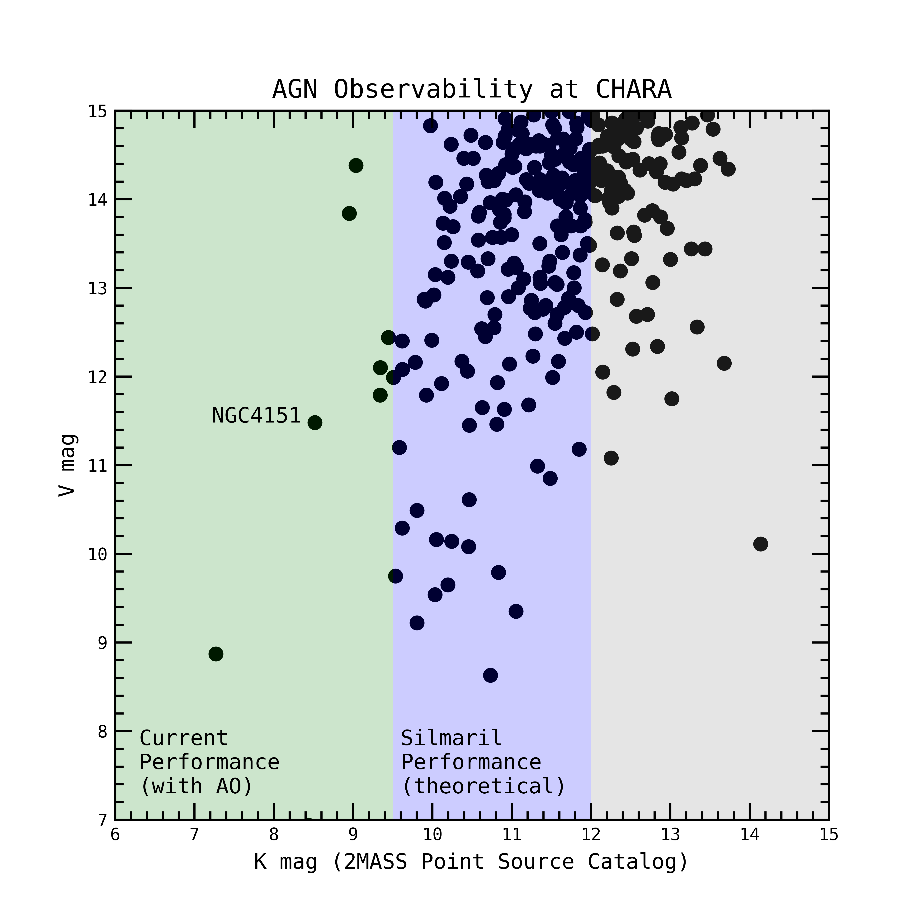
Science cases
AGNs
Angular diameter of stars
Disks around Young stars
Massive star’s winds
Interacting binaries
Young Binaries
Transient events
Notes:
Here are the science cases that drive the will to improve the sensitivity of the CHARA array, opening some new science, like the study of AGNs, represented by the left plot, with in green the current CHARA performance, and in blue the sensitivity that SILMARIL will reach, or extending the already the science case already studied at CHARA, like the young binaries, represented by the figure on the right, with the histogram of the magnitude of the young known stars in the nearby forming regions, with the gray area representing the gain in sensitivity brought by SILMARIL.

Slide 14
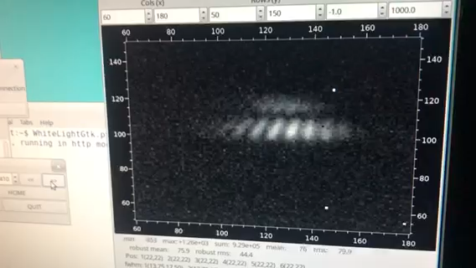
Agenda
Winter 2023: Testing alignment procedure + Lab fringes with an engineering camera
March 2023: test on-sky with an engineering camera (cancelled due to snow)
Spring 2023: implementation of the C-RED One camera + Lab fringes
July 2023: first on-sky commissioning
Further development:
  2x3-beam combiner
  External Dewar/Narcissus mirror
Notes:
The agenda of the implementation at CHARA is the following.
We planned to test the alignment procedure and get lab fringes this winter. We got to the point of obtaining fringes with 2 of the beams the evening the snow storm started, as you can see here the fringes passing by while we are scanning the internal delay lines. I would like to thanks particularly Gerard for lending us the CRED 2 we are now using while waiting for the CRED one delivery. We would have had a really hard time finding fringes with the first engineering camera we planned to use, as it is lacky a lot of dynamic. The on-sky test were cancelled due to the snowstorm that you now all heard about.
We should receive the C-RED One camera in June, and should implement it right away, and with a planned on-sky commissioning early July.
Once the capability of the instrument will be proved on sky, we will start the further development of the instrument, with the implementation of the second set of 3 beams and the development of the external dewar or the narcissus mirror.

Slide 15
Conclusions
Only difficult part of the design is the edge filter
Magnitude limit: 11 to 12 in its final design (with external Dewar) in both H- and K-band
Open new science cases and extend existing ones
Notes:
So, I let you with the conclusion slide that summaries this presentation and will answer your questions.

