Slide 1
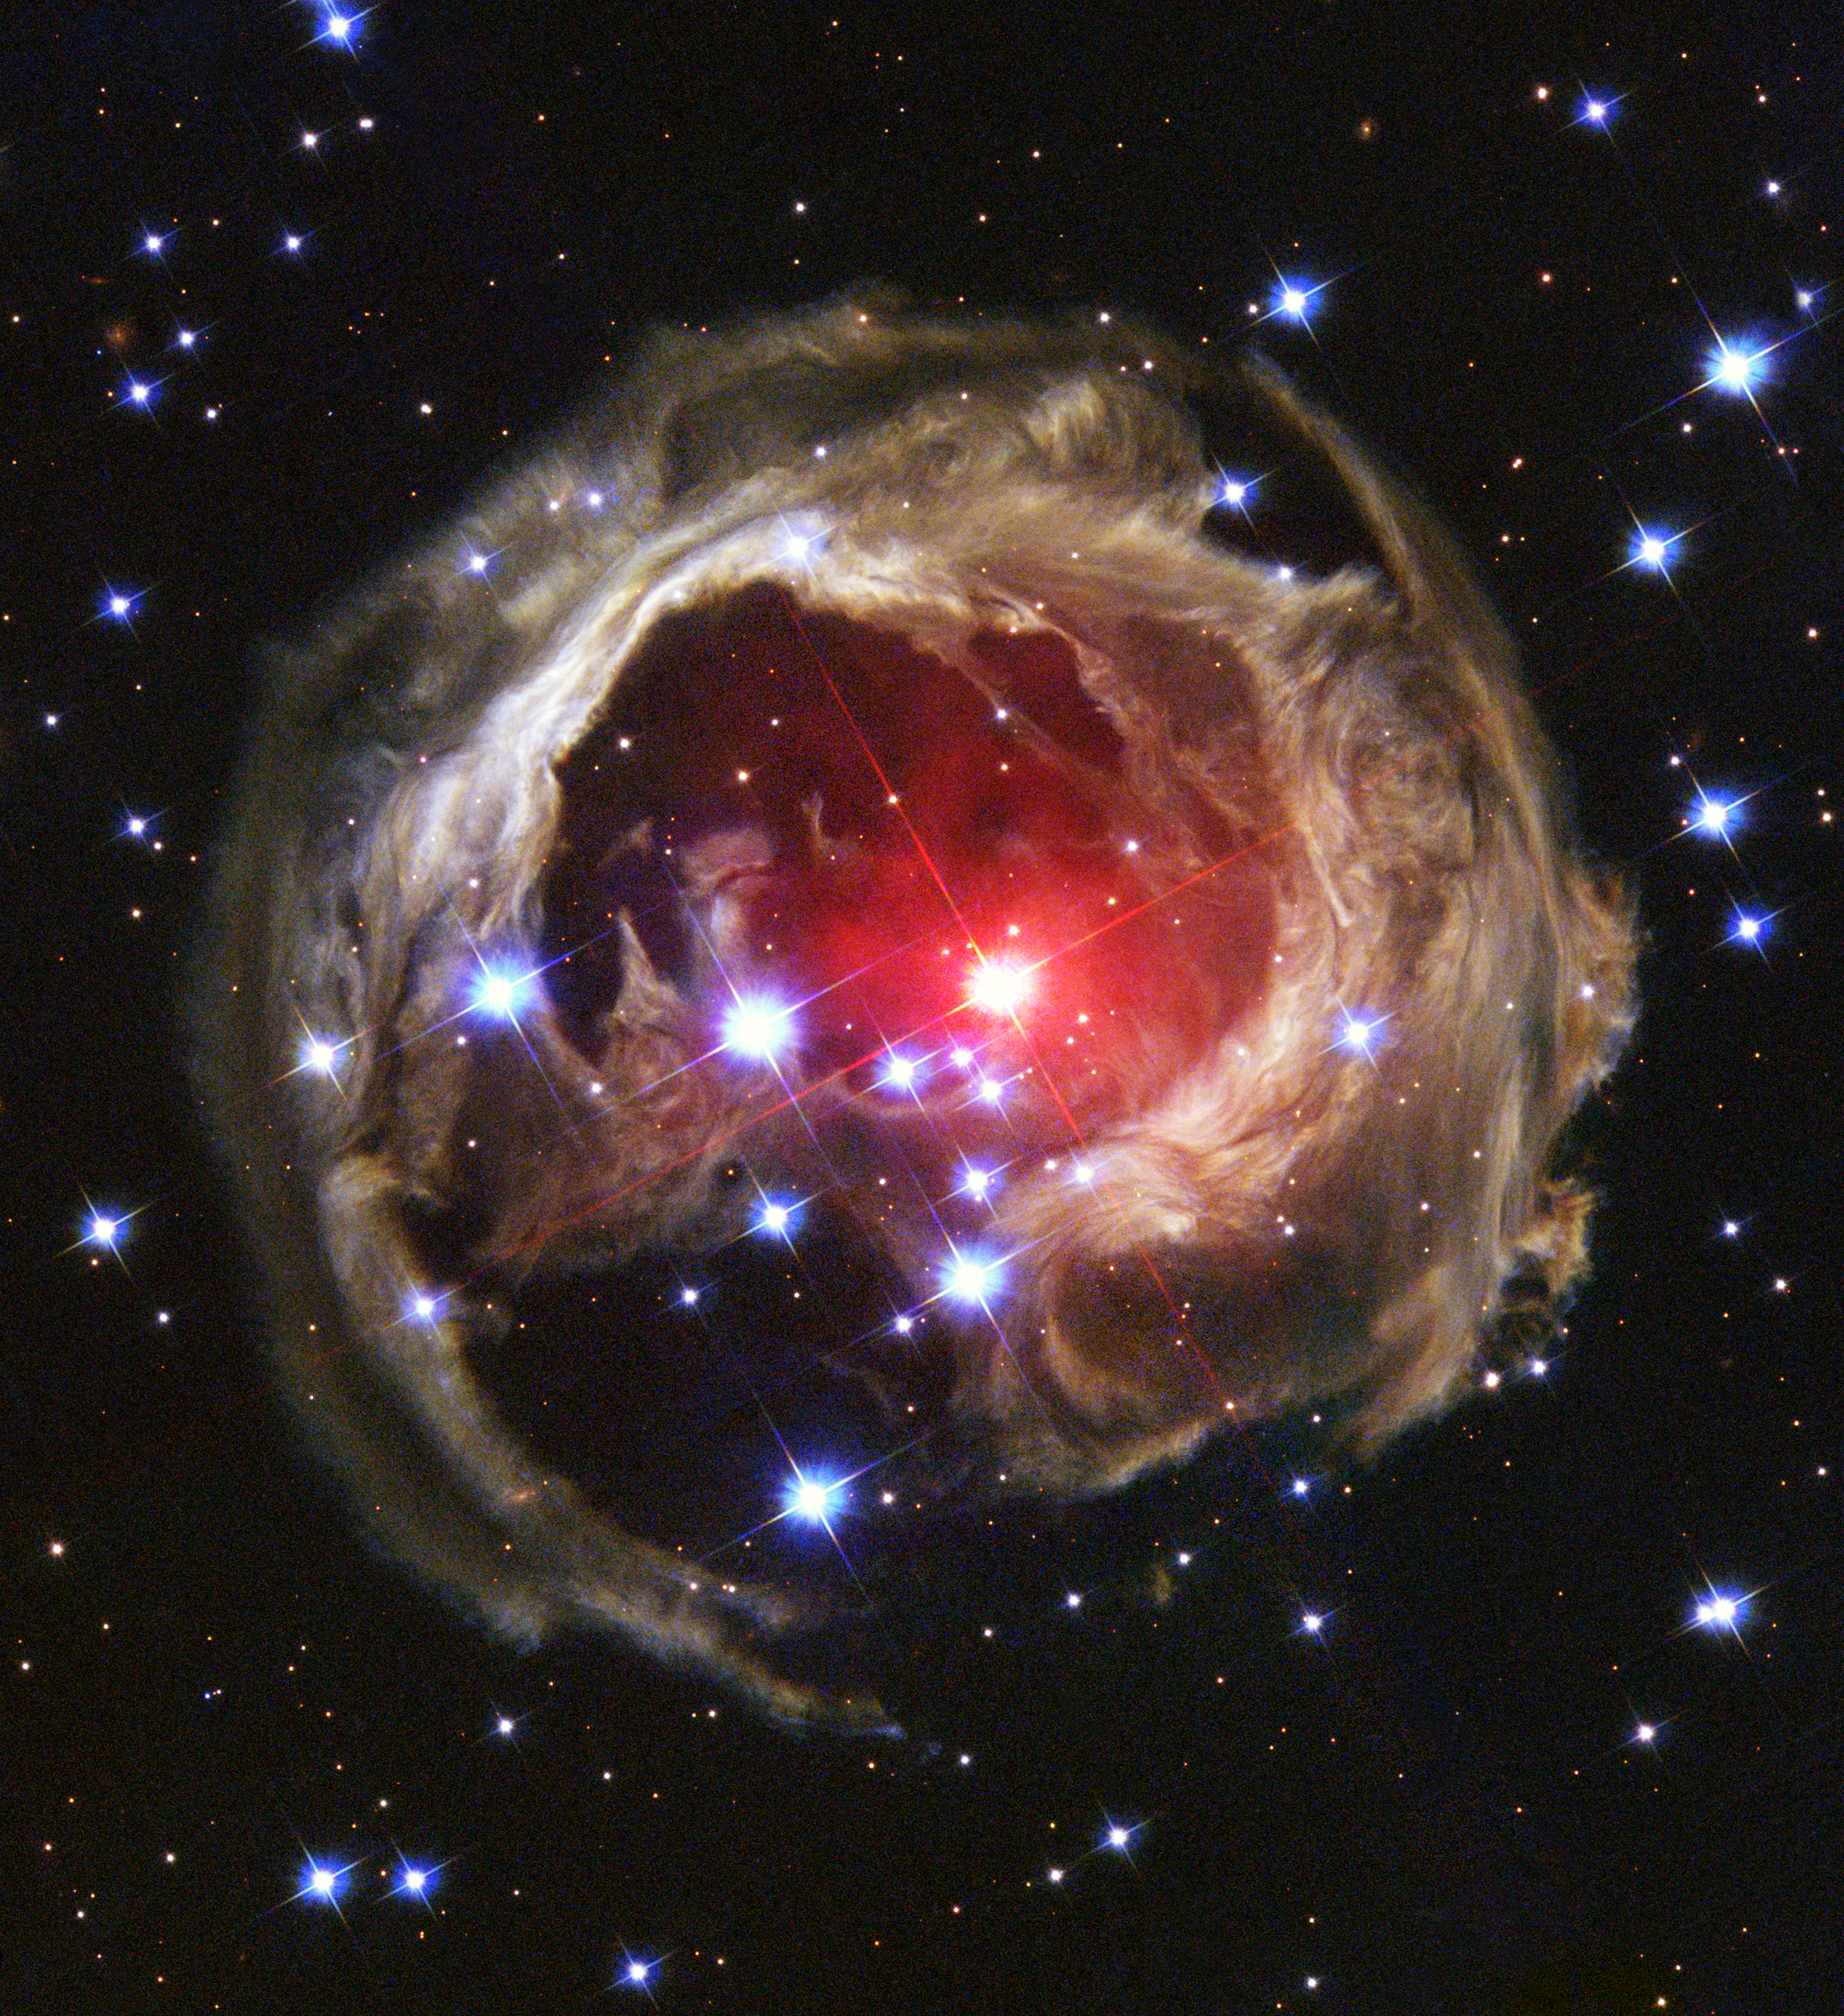
Imaging the stellar merger remnant V838 Monocerotis with VLTI and CHARA
Muhammad Zain Mobeen, CAMK Toruń

Slide 2
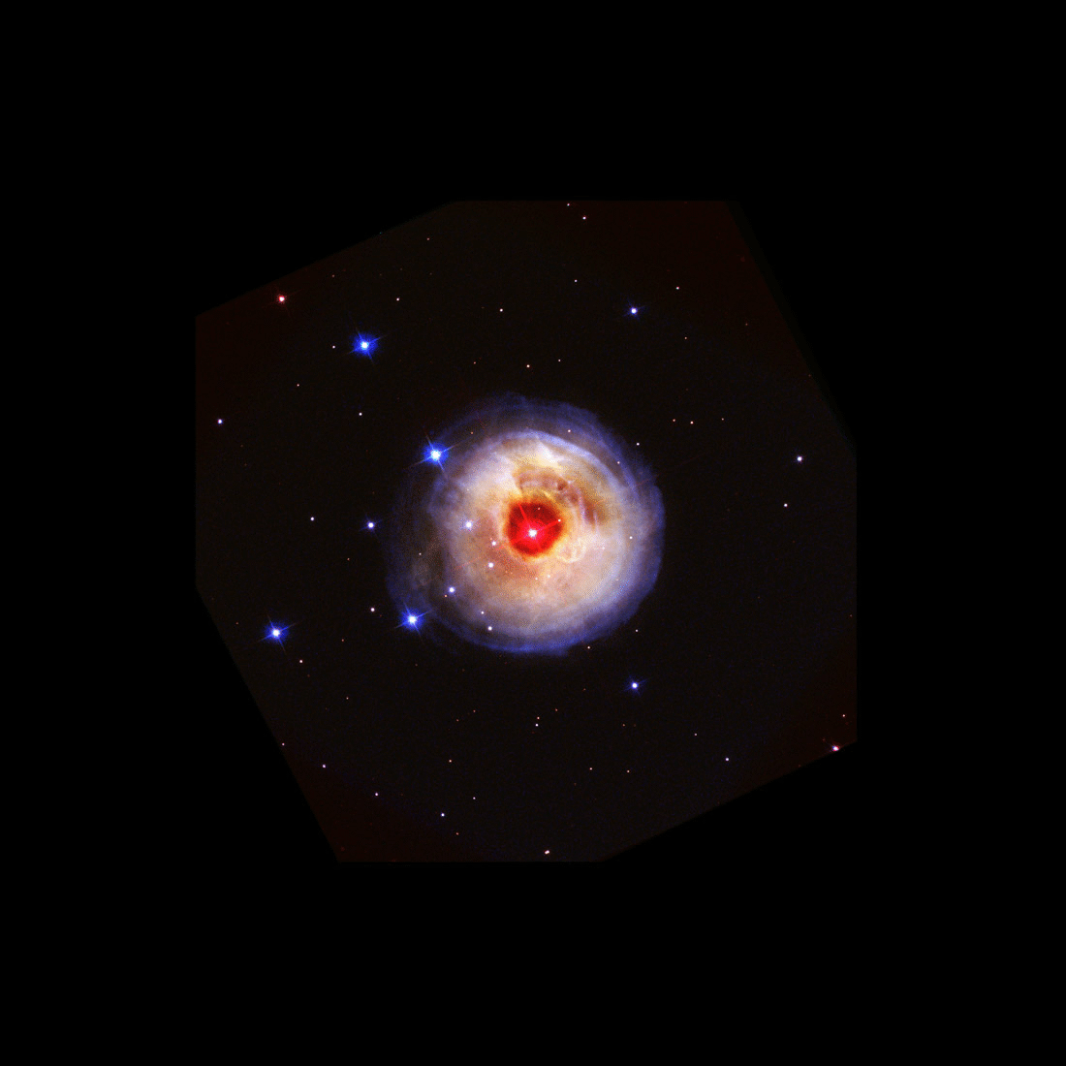
HST light echo
Outburst in 2002, ~${10}^{6}$$L_{⊙}$
Spectral type evolved to L type
Molecular lines observed
Dust formation
Notes:
T~ 2600 K , best pic of Hubble
Look up pre outburst luminosity, explain IR excess, examples of molecules

Slide 3
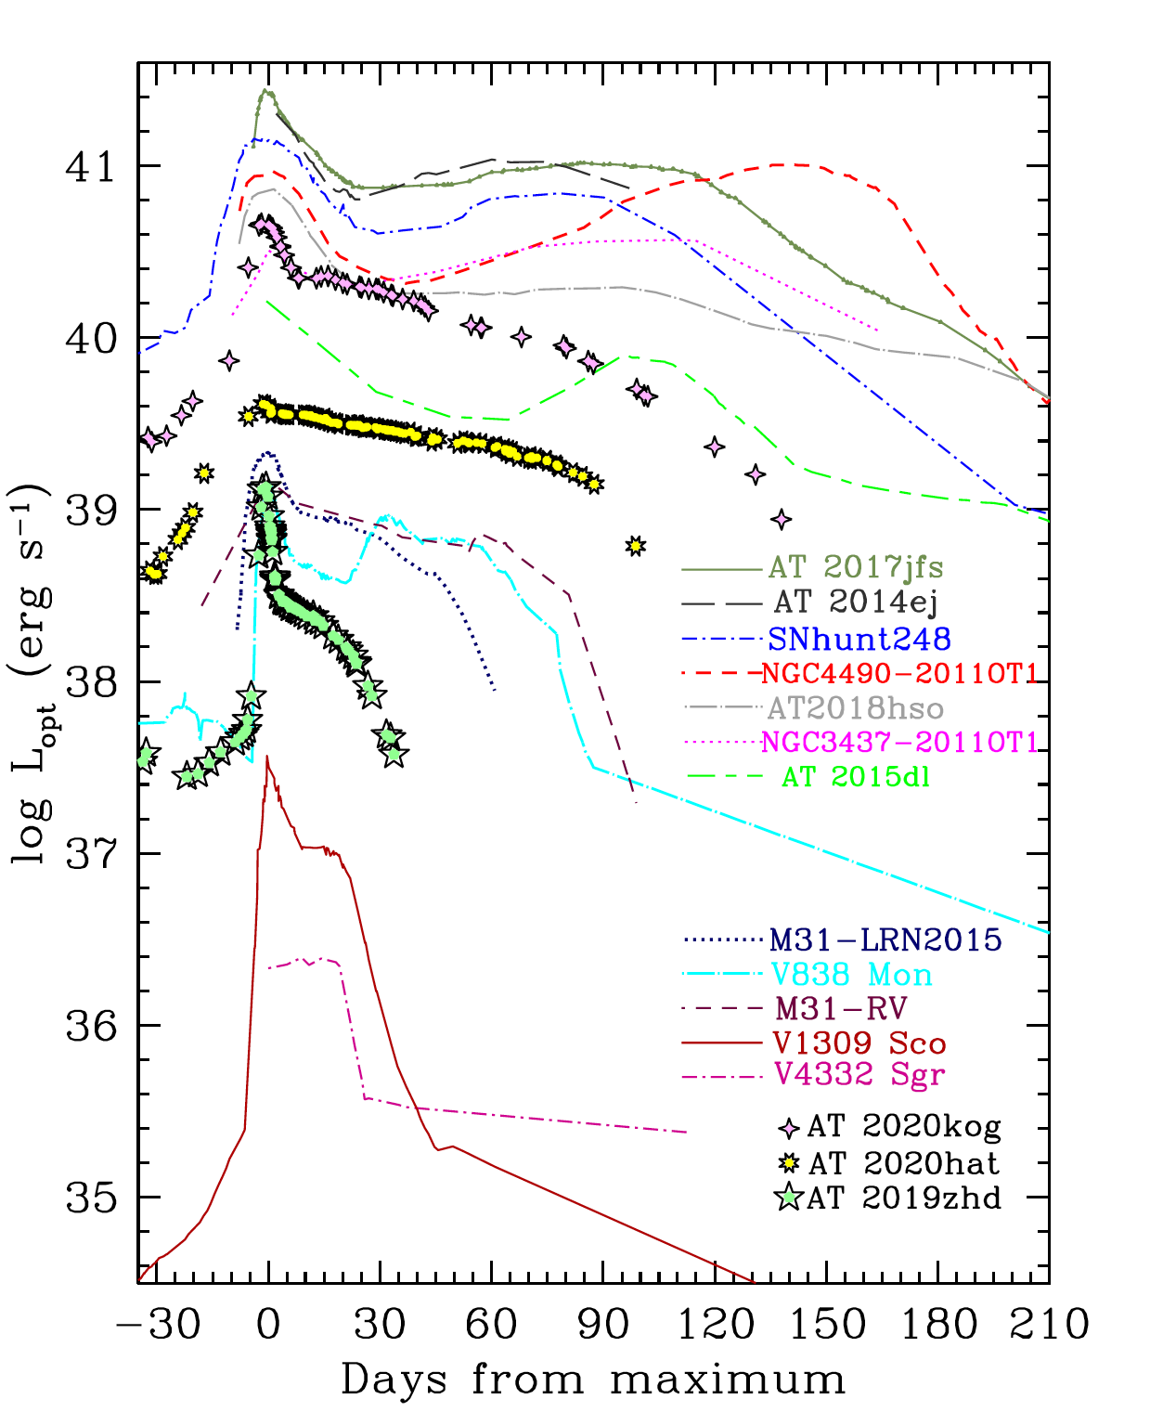
Common Envelope
Stellar merger of 0.3 $M_{⊙}$ + 8 $M_{⊙}$
(Tylenda & Soker 2006)
Merger in hierarchical system
Notes:
Tidal forces and drag cause orbital contraction مشترکہ لہاف
Common envelope, mention that

Slide 4
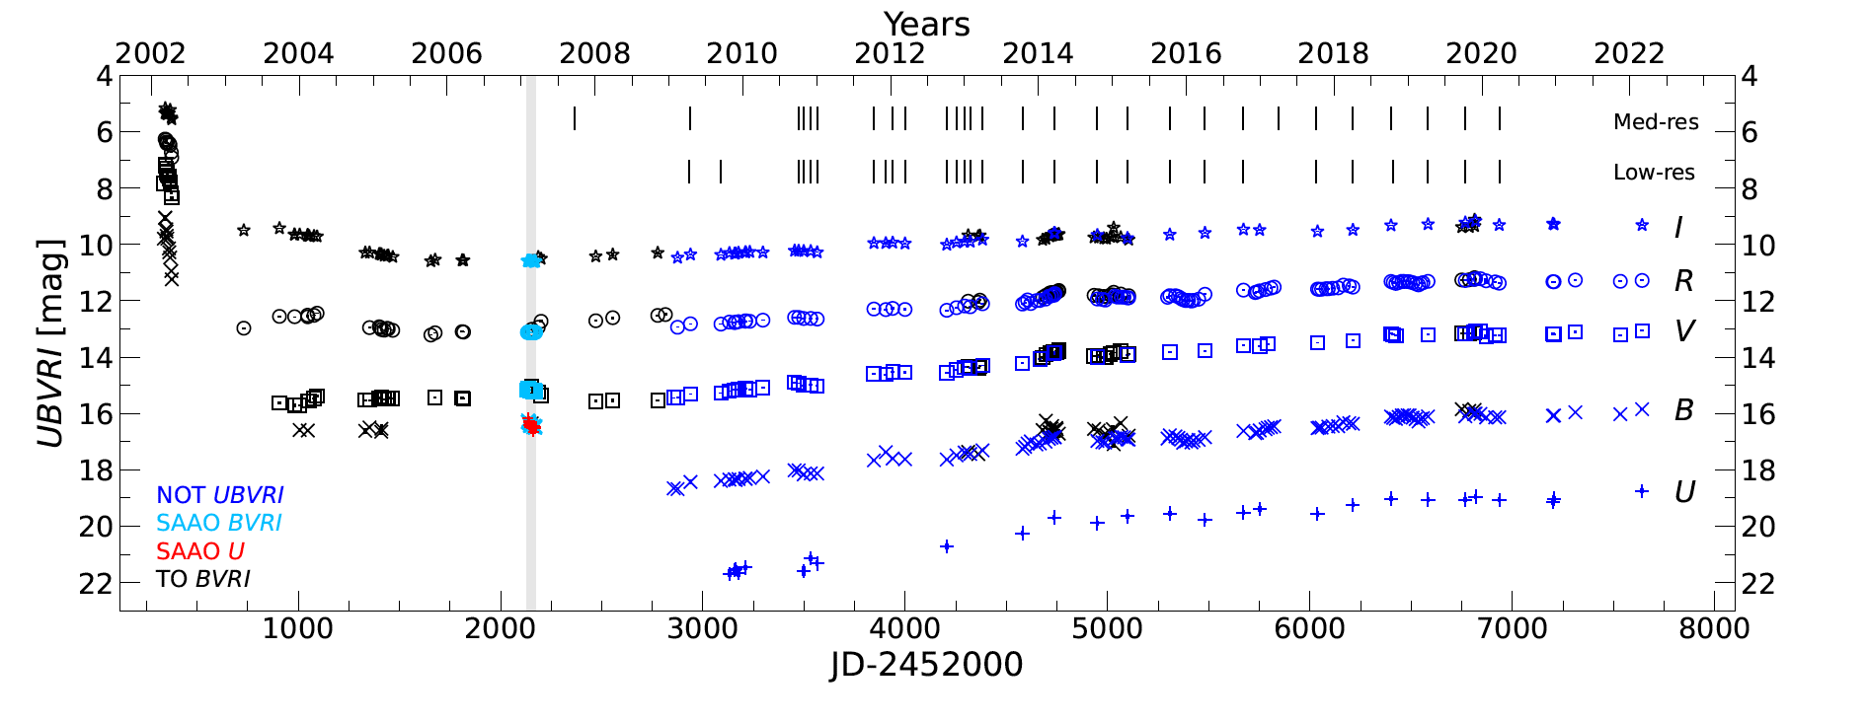
d~230 au
Companion eclipsed, as of now not visible
(Kamiński et al 2021)
B3 V
However!
Remnant
T. Liimets et al 2022
Ideal for Interferometry!
Notes:
Merger occurred in a hierarchal triple system ، after some time companion was found

Slide 5
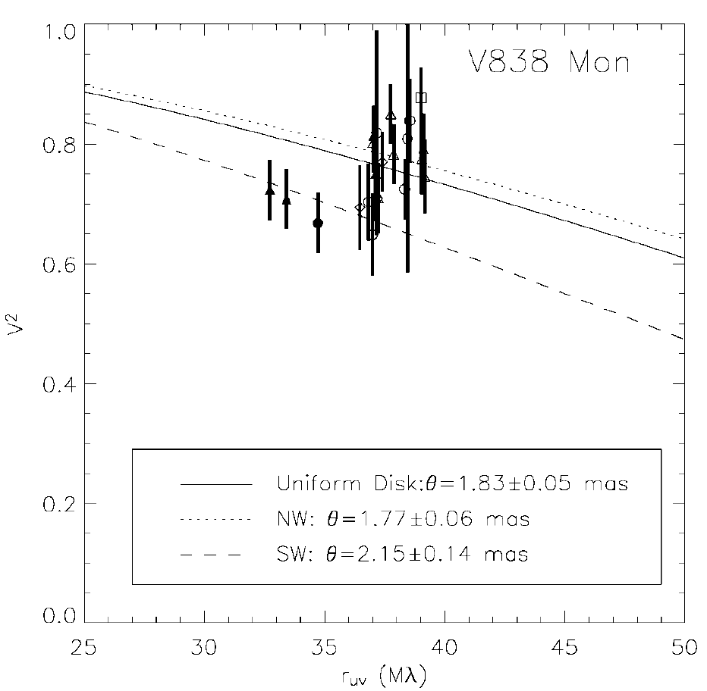
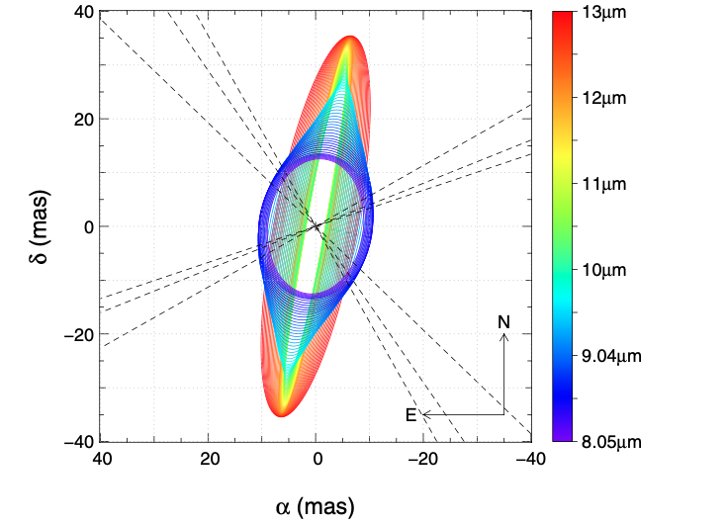
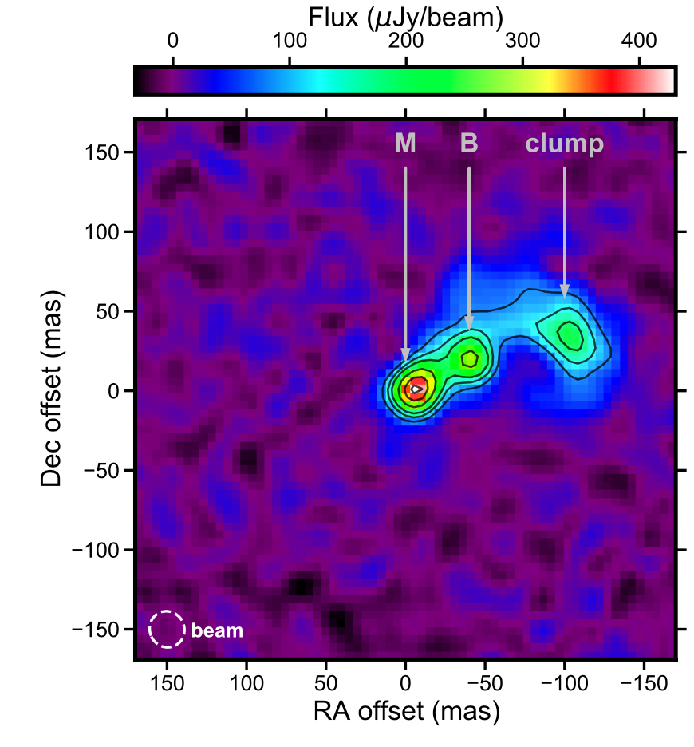
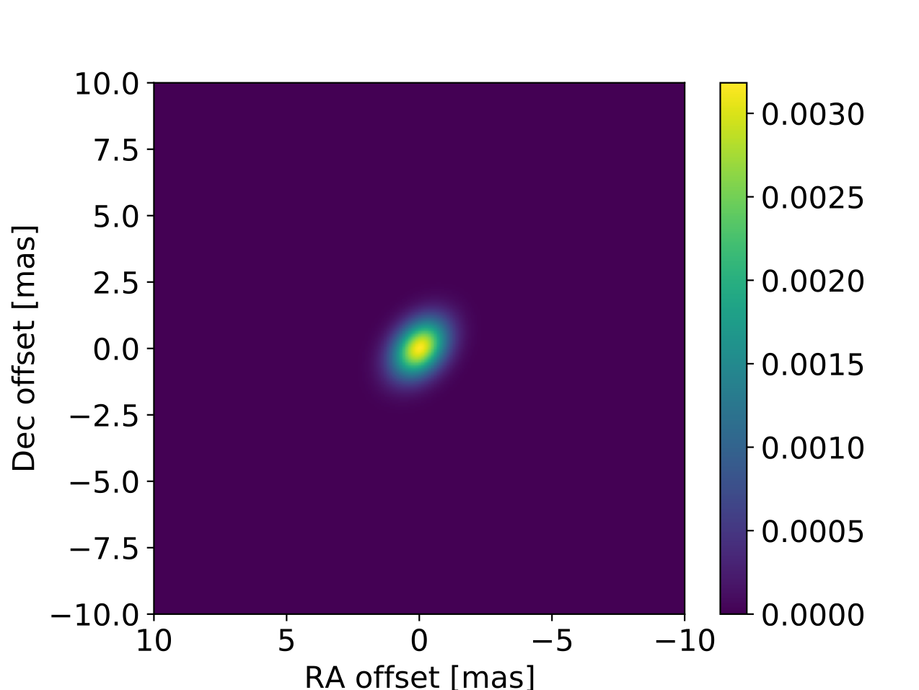
PTI
MIDI & AMBER
Lane et al 2005
Contraction!
Chesneau et al 2014
ALMA
MATISSE
PA=-40, f.ratio~1.5
Kamiński et al 2021
Mobeen et al 2021
8 au

Slide 6
VLTI Observations 2021-2022
MATISSE: LM bands
GRAVITY: K band
Largest baseline ~ 140 m
ATs

Slide 7
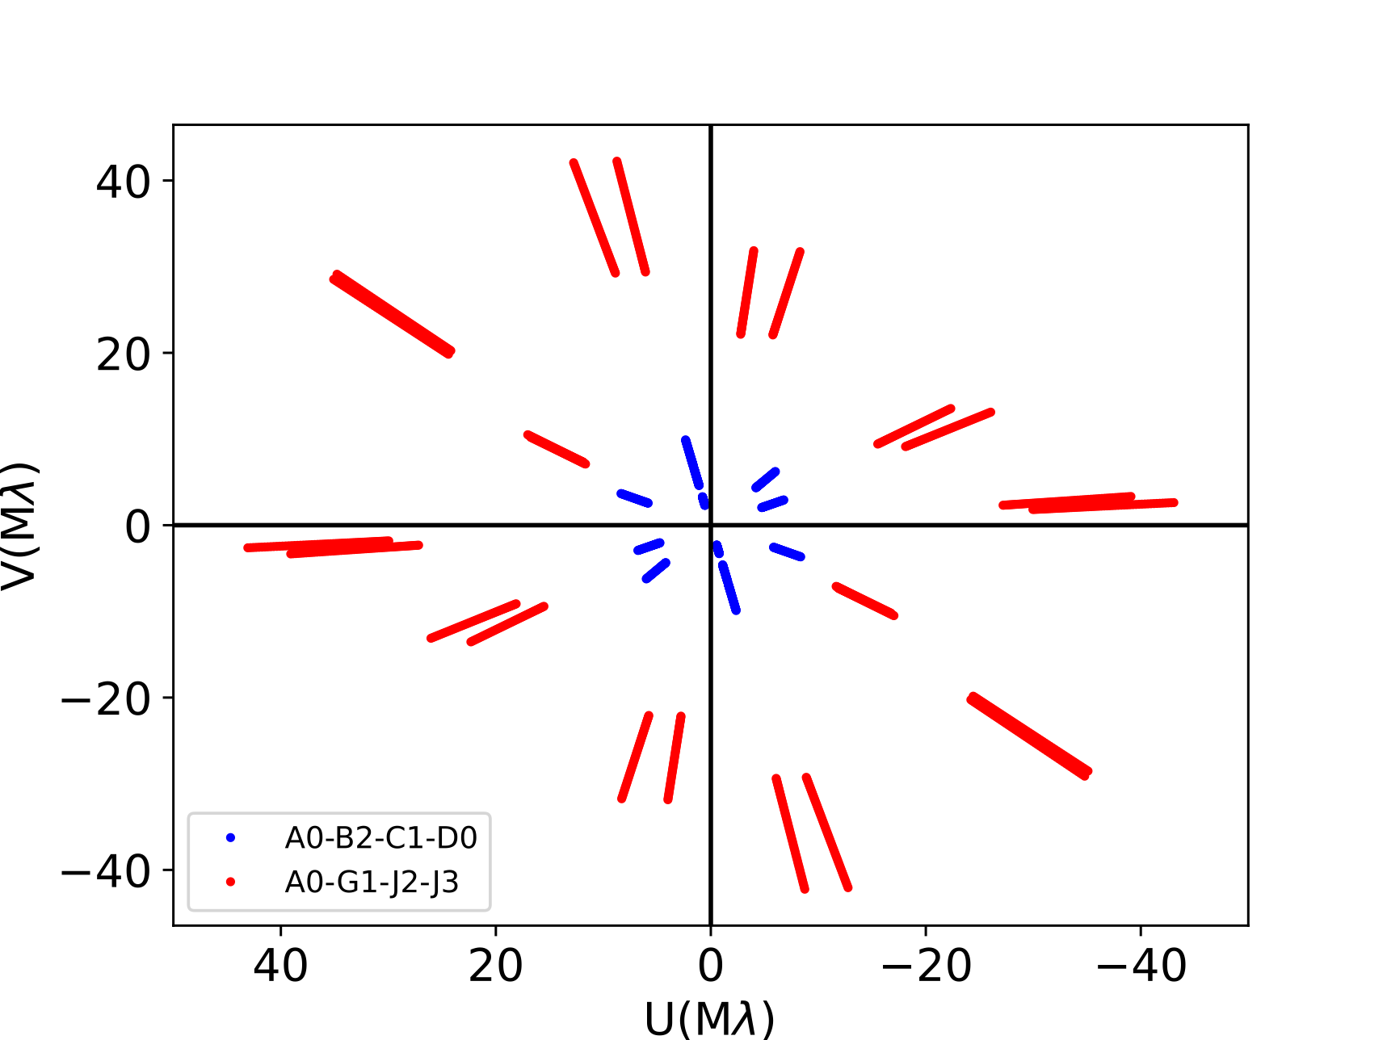
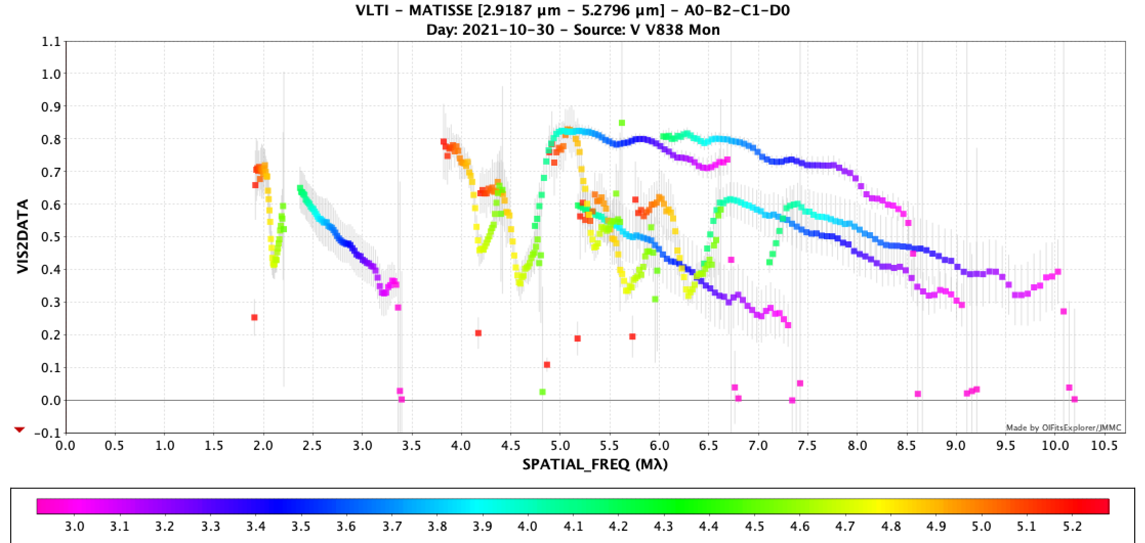
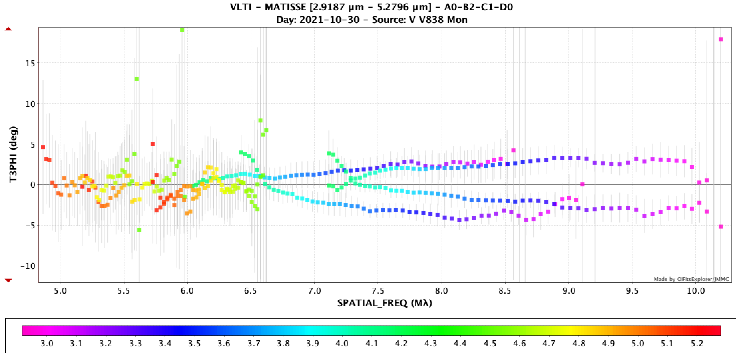
L band structure stable

Slide 8
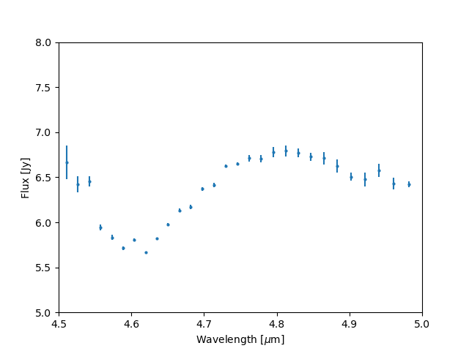
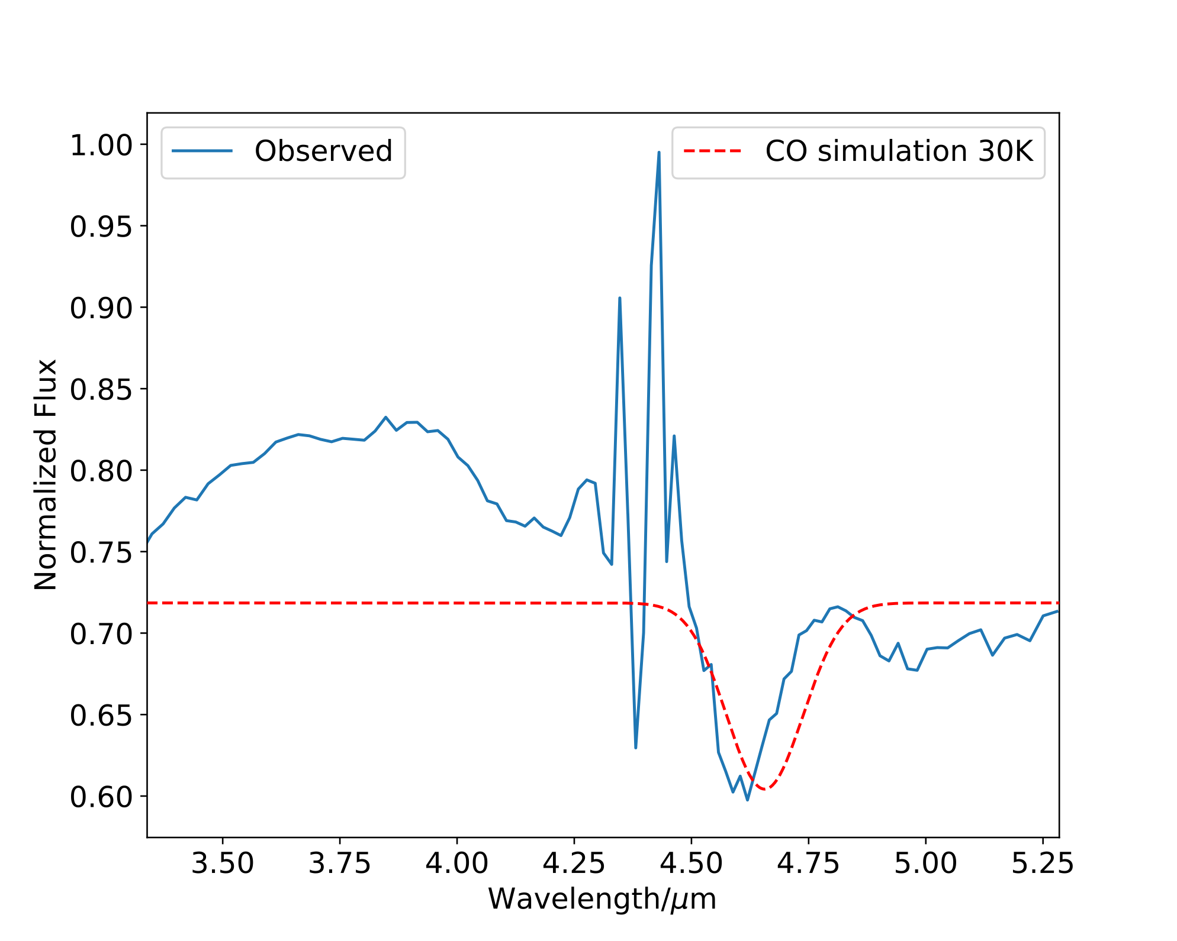
CO
First time seen in M band!

Slide 9
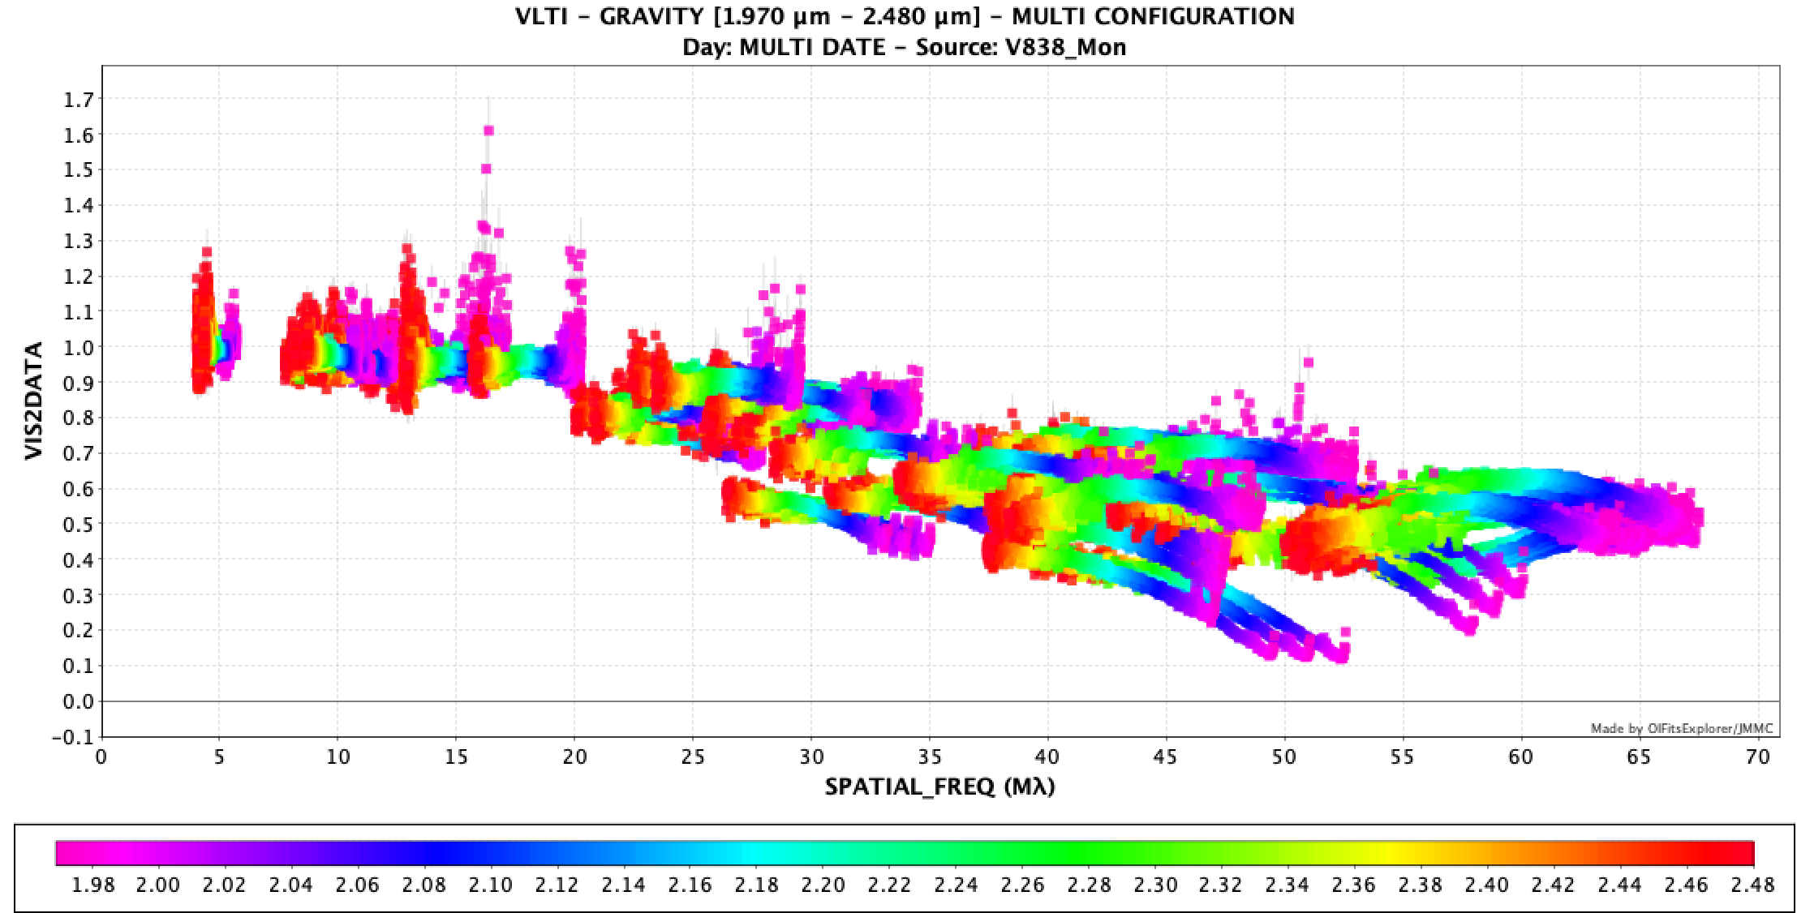
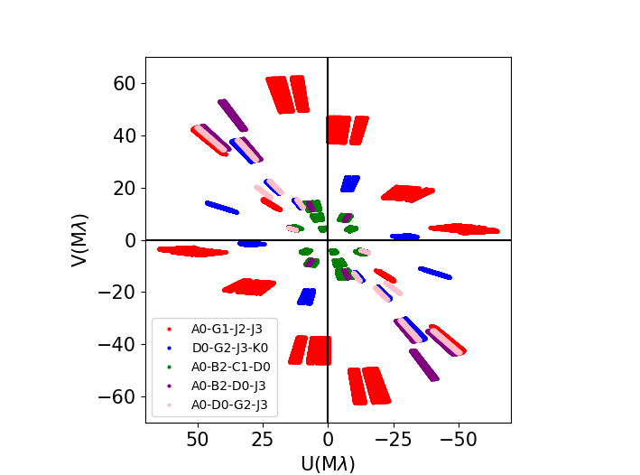
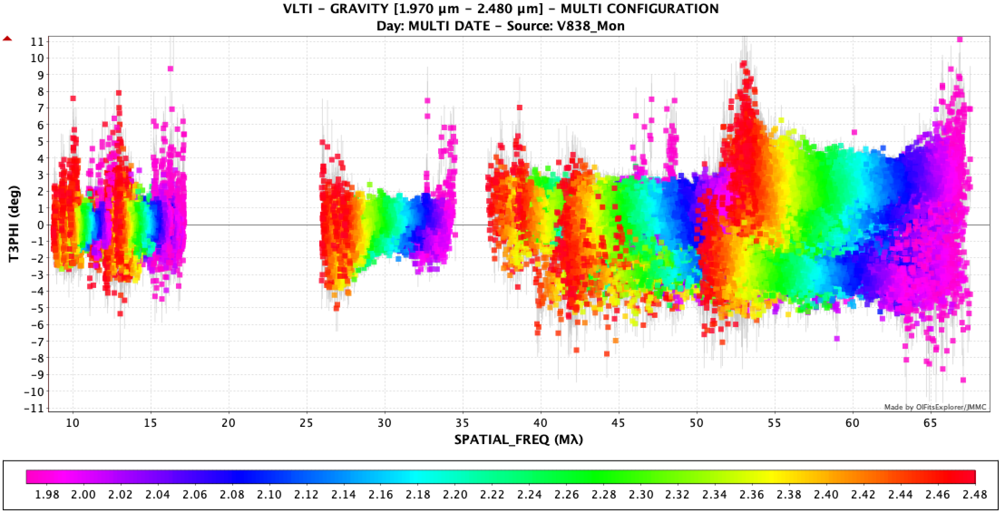

Slide 10
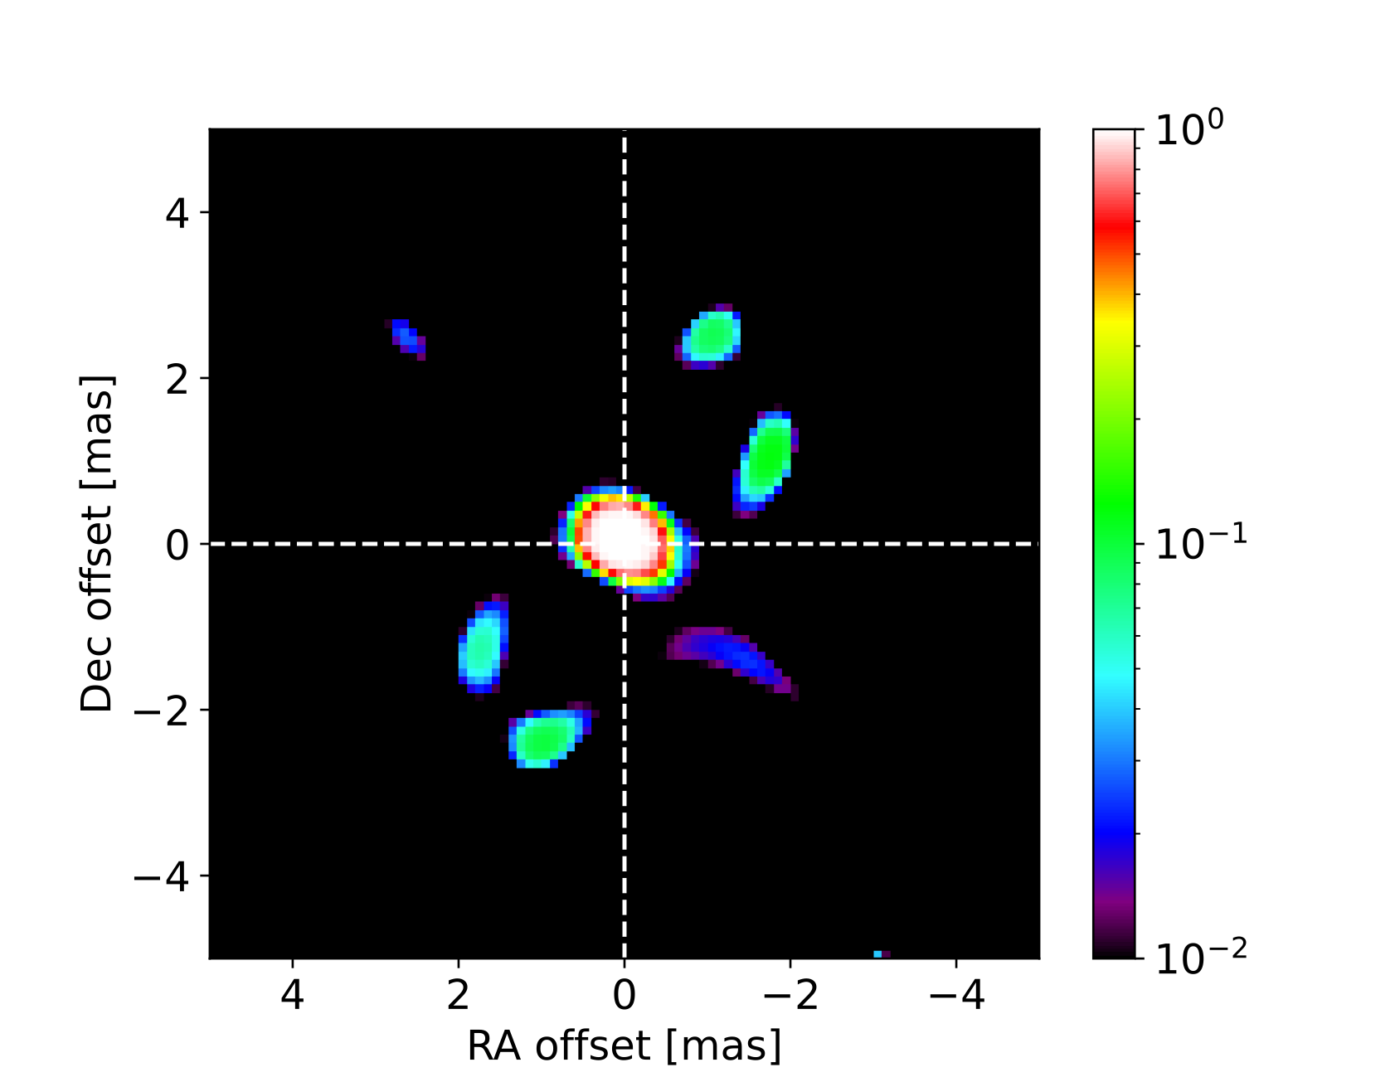
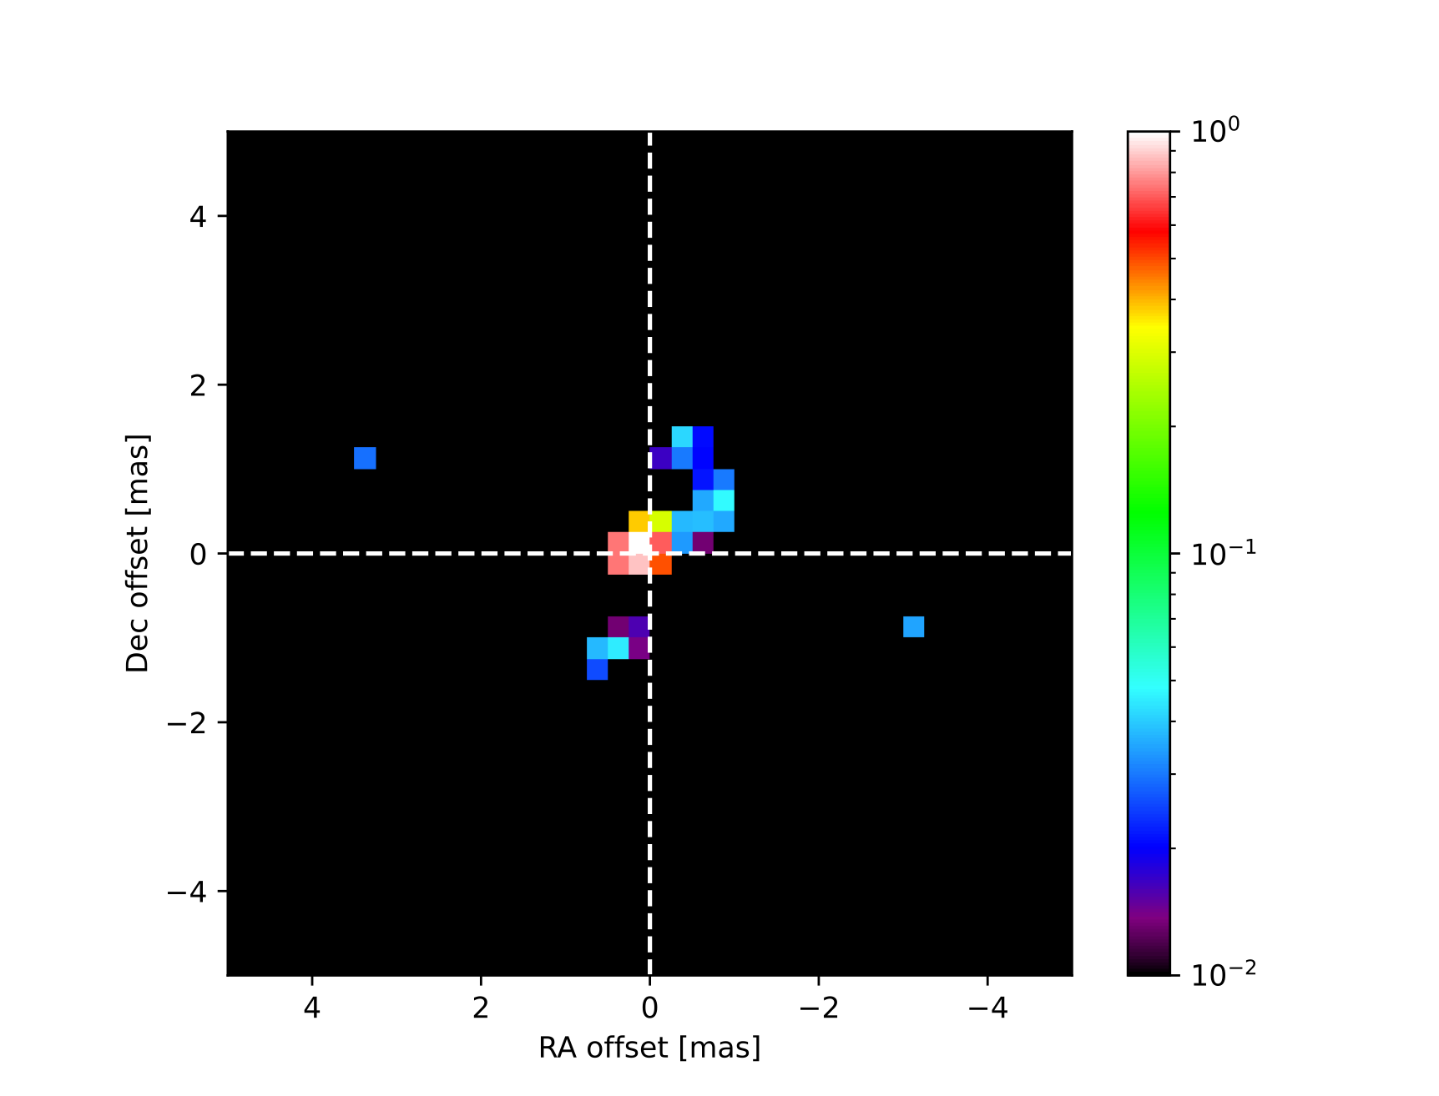
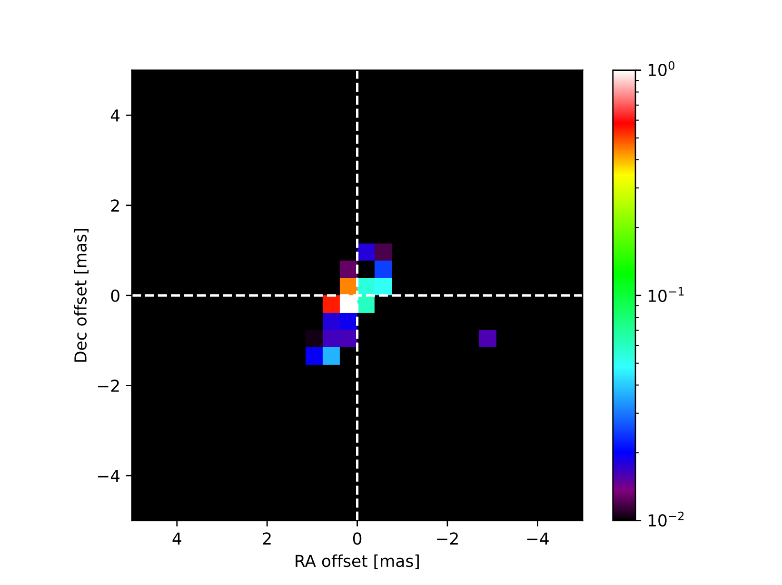
0.1 mas
0.8 mas
IMAGING
0.5 mas
Bi-polar structure!
Contraction has reversed!

Slide 11
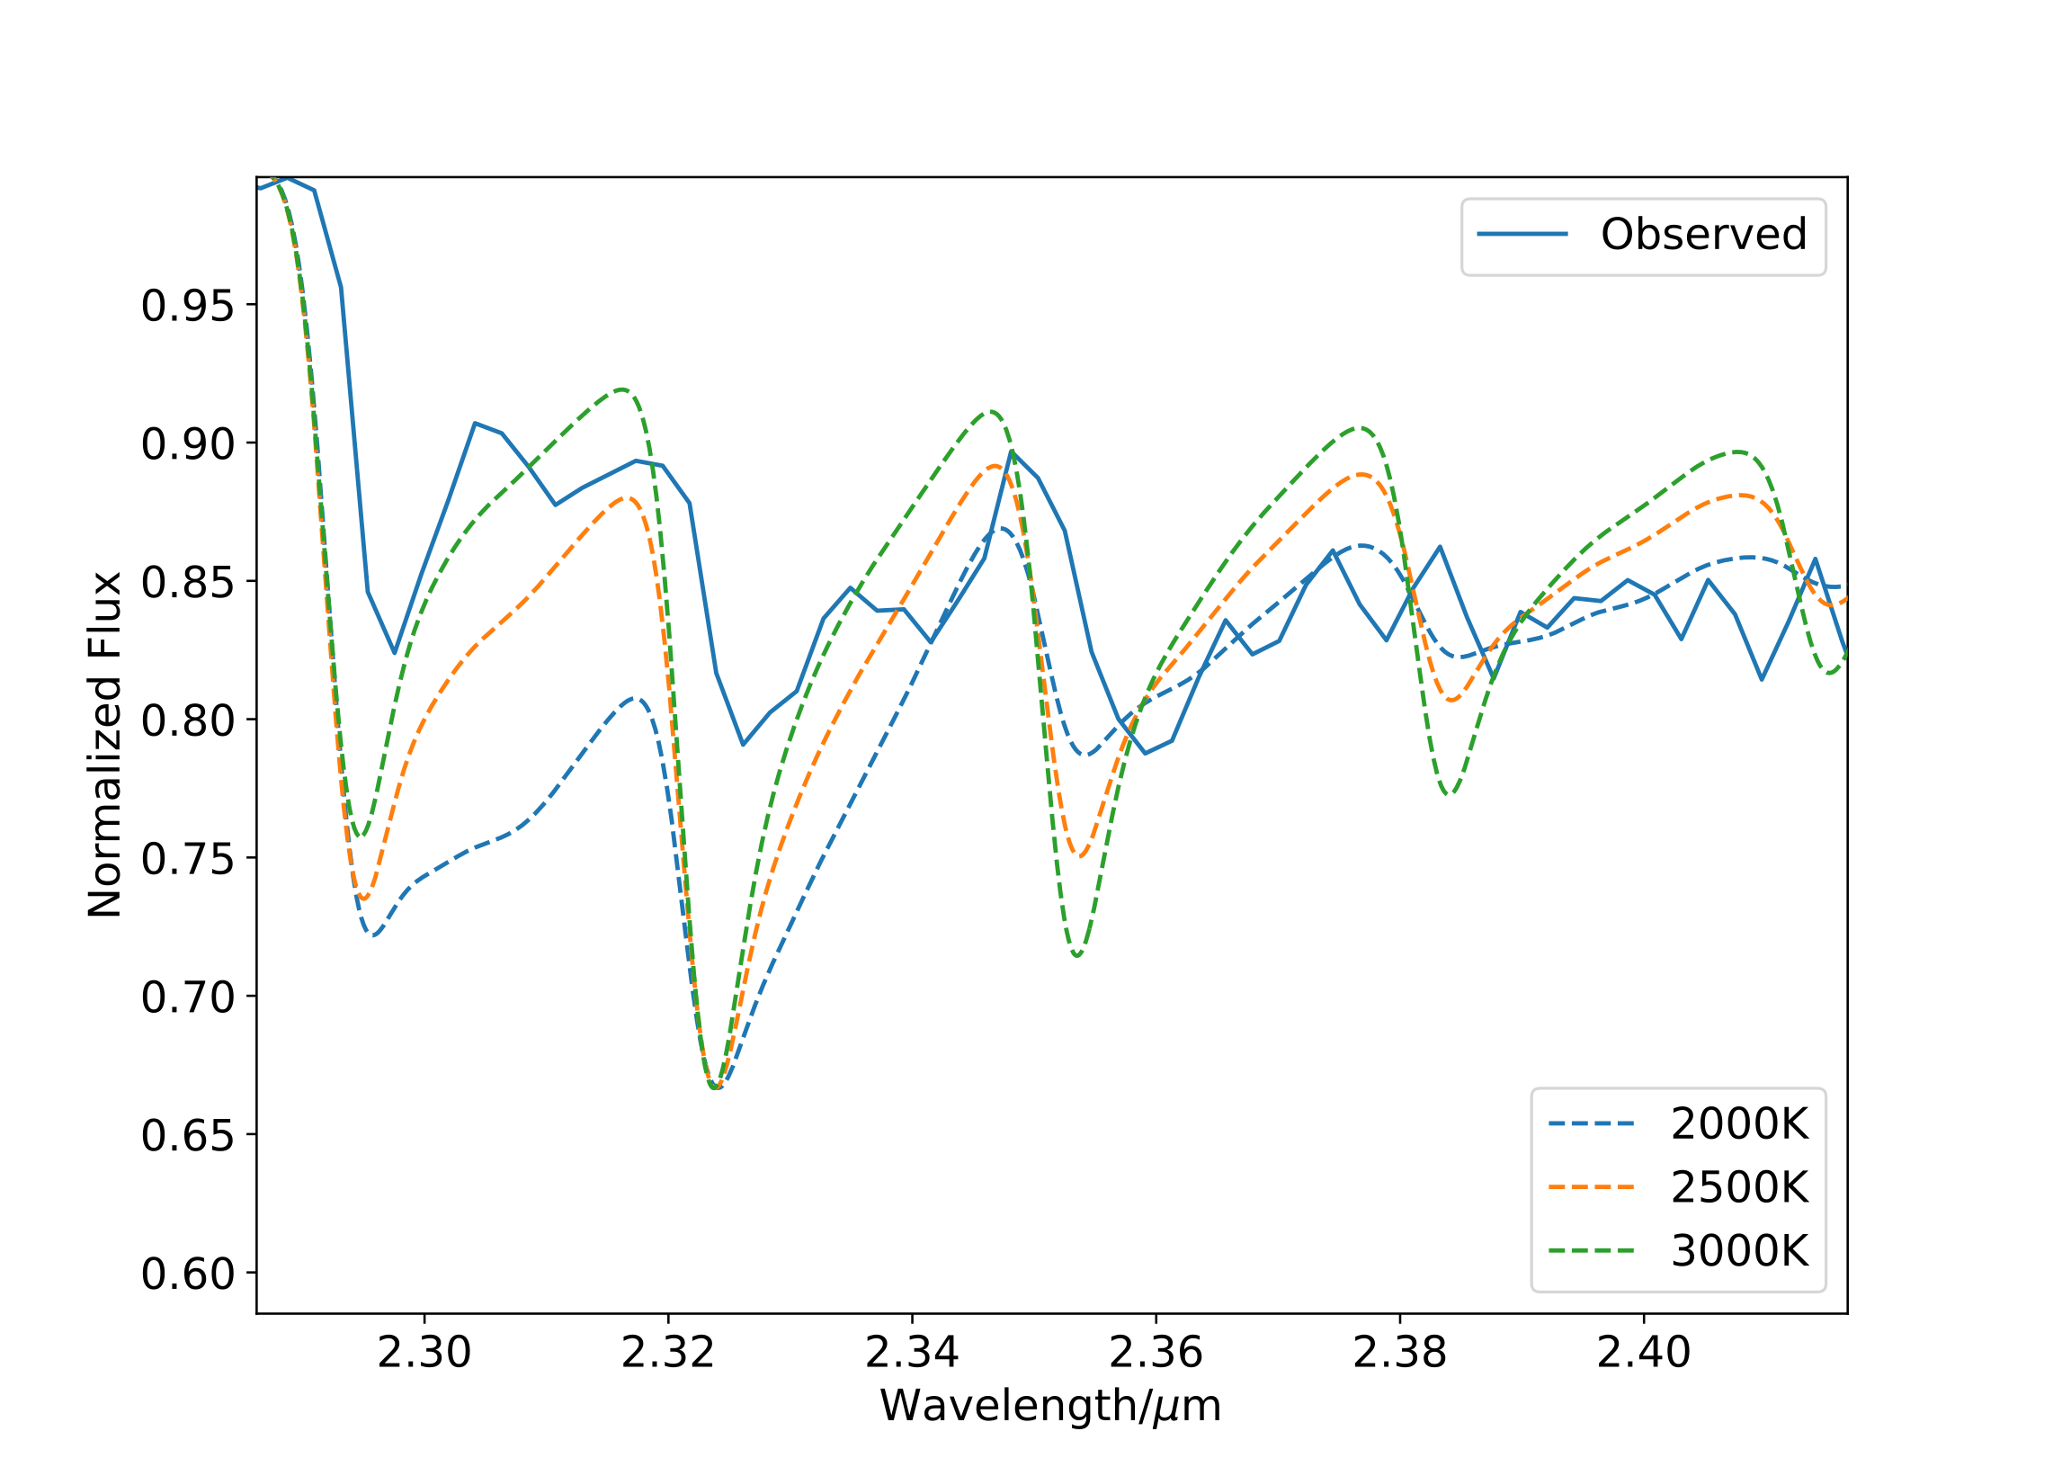
GRAVITY Spectra
CO Overtones
Temperatures suggest photospheric origin

Slide 12
MIRC-X/MYSTIC
HK band
Largest baseline~ 300km
Best resolution~ 0.5 mas
5 nights of observations
4-5 Telescopes

Slide 13
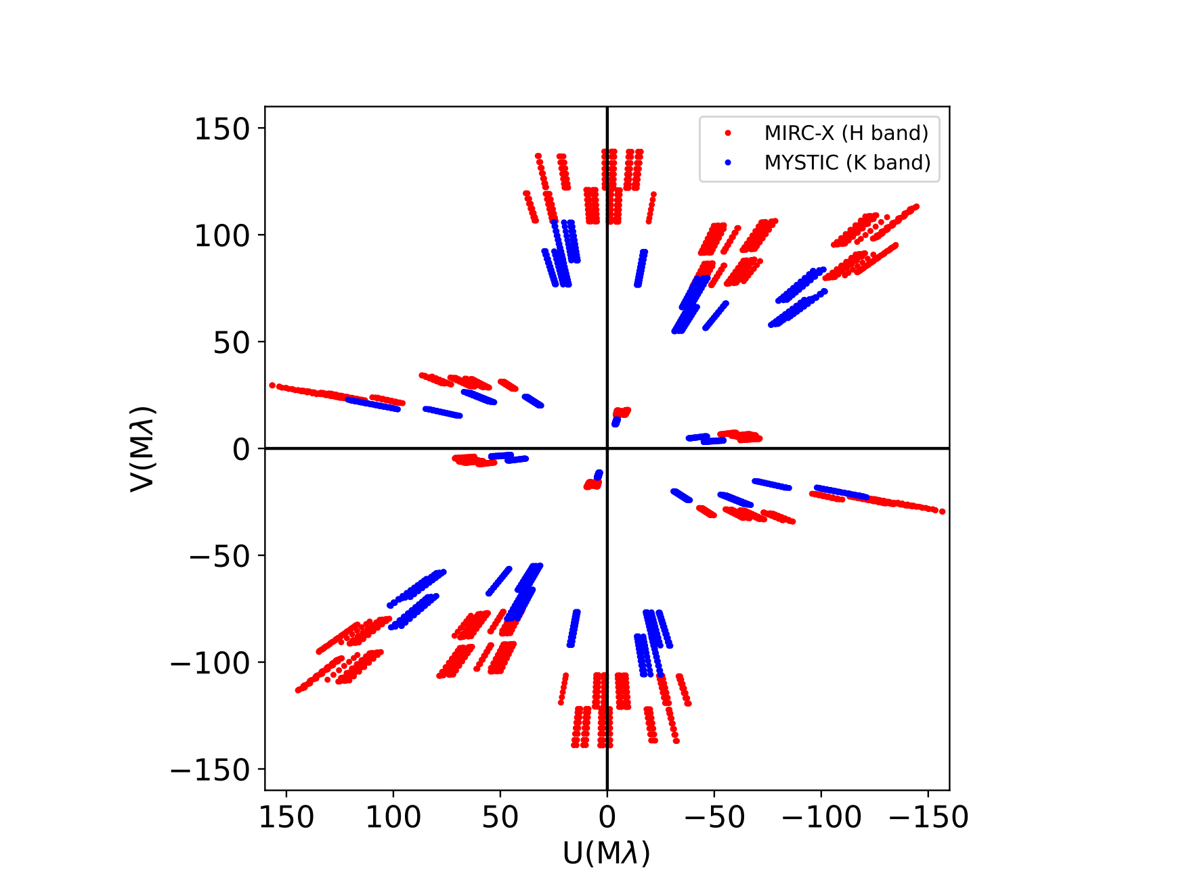
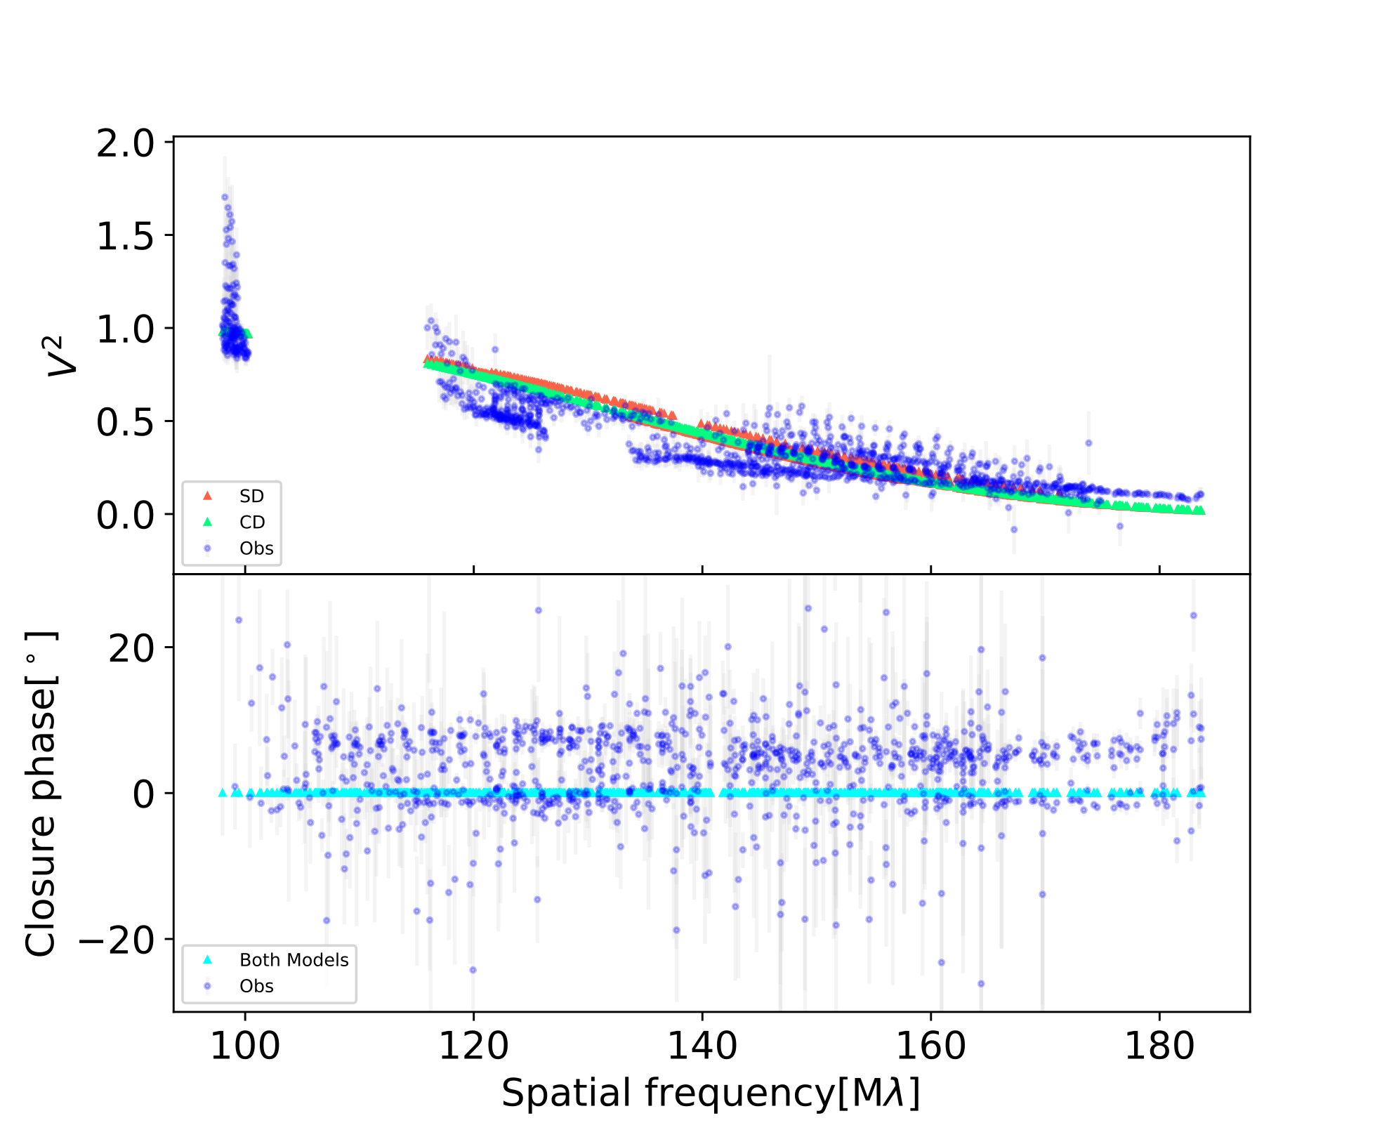
CPs show an intrinsic asymmetry
Not reproduced by simple models

Slide 14
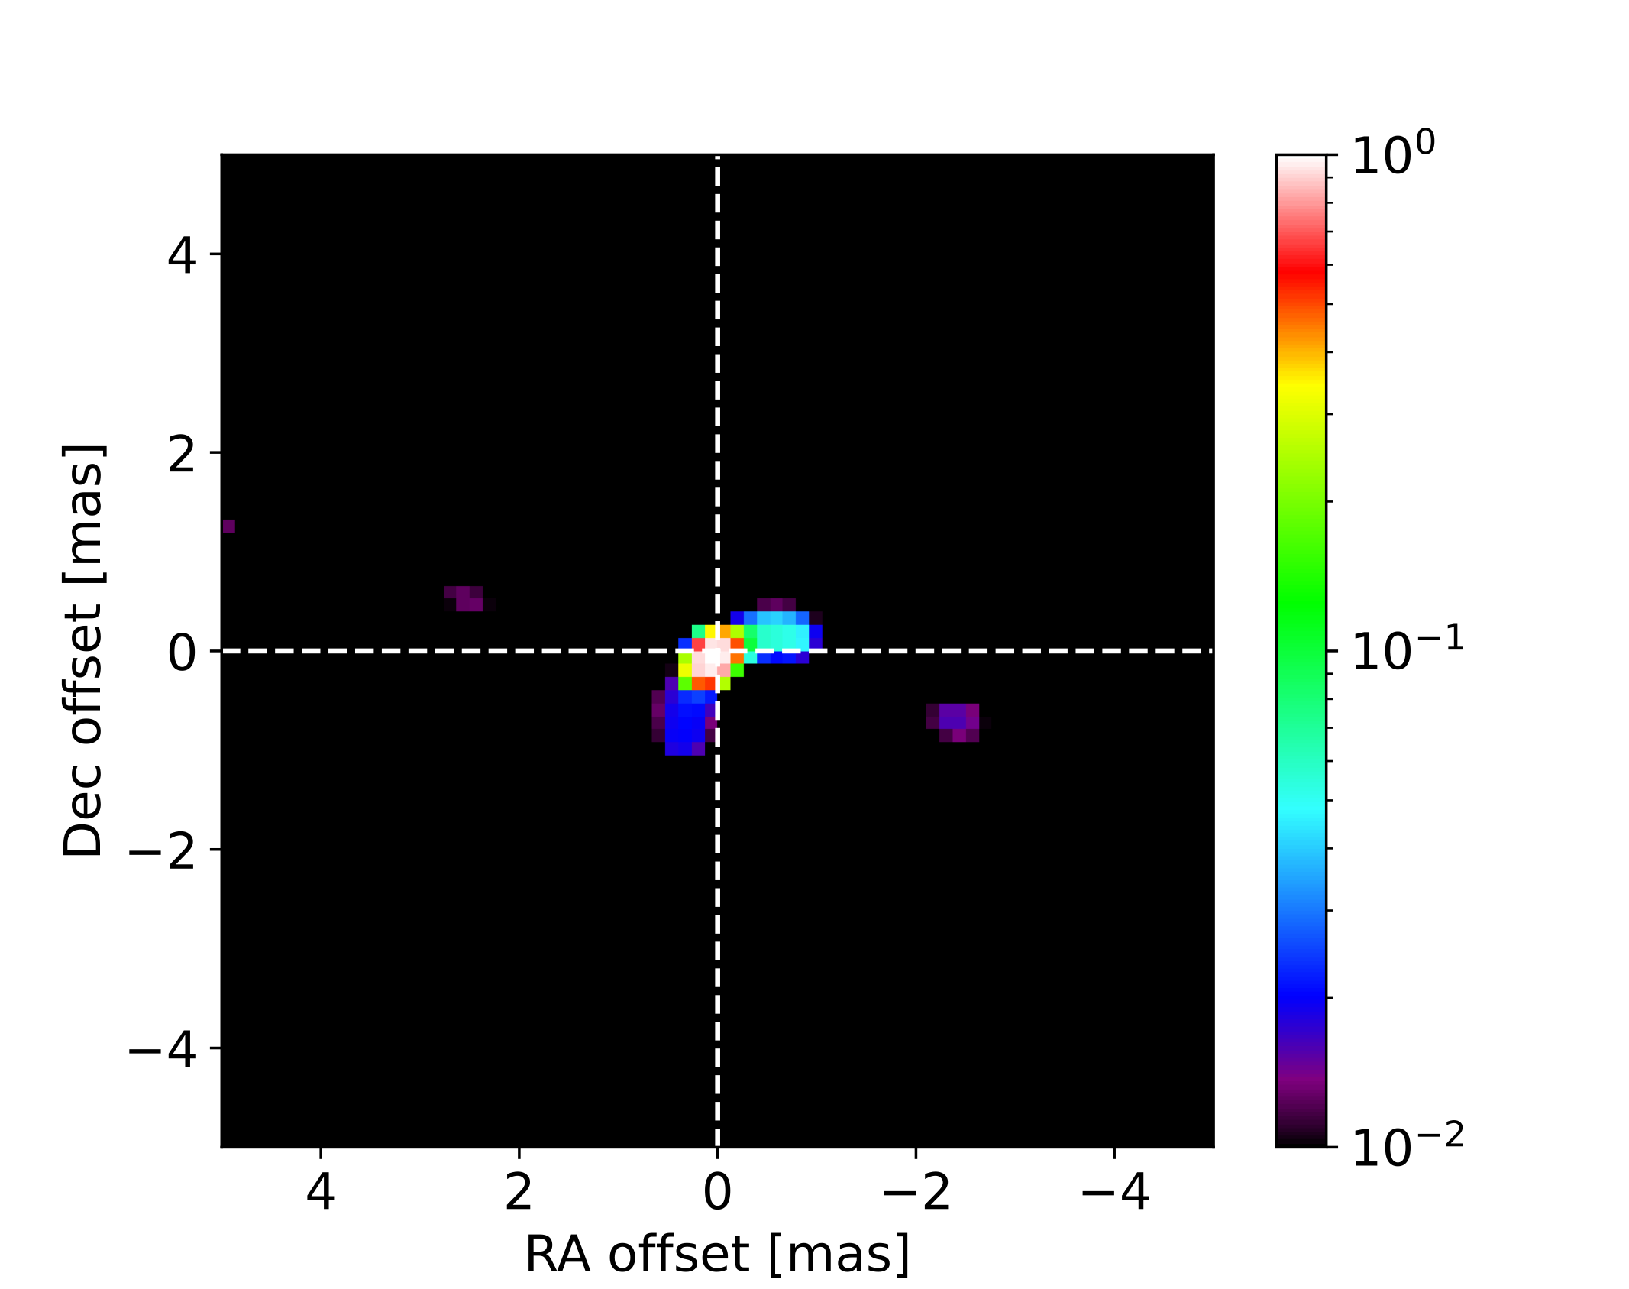
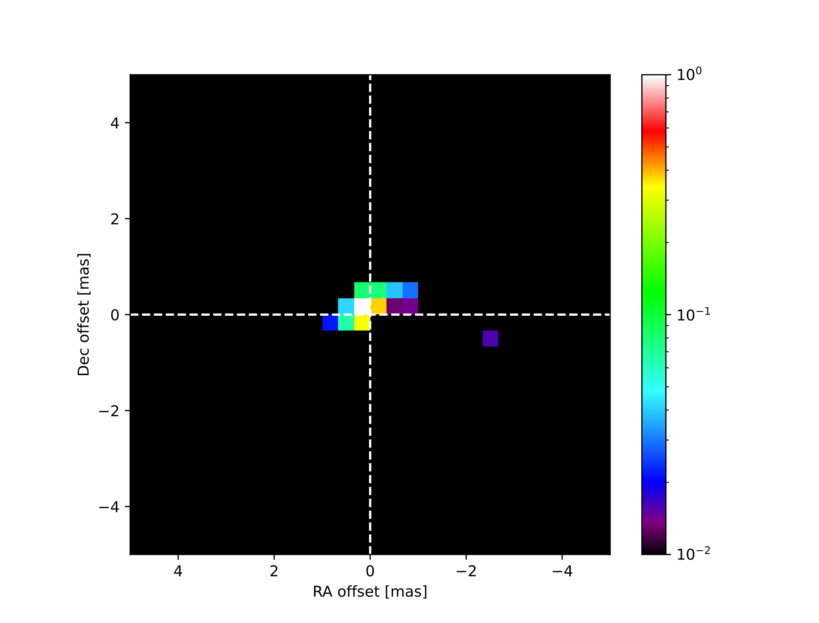
0.2 mas
0.5 mas
Asymmetric bi-polar features in the H band!

Slide 15
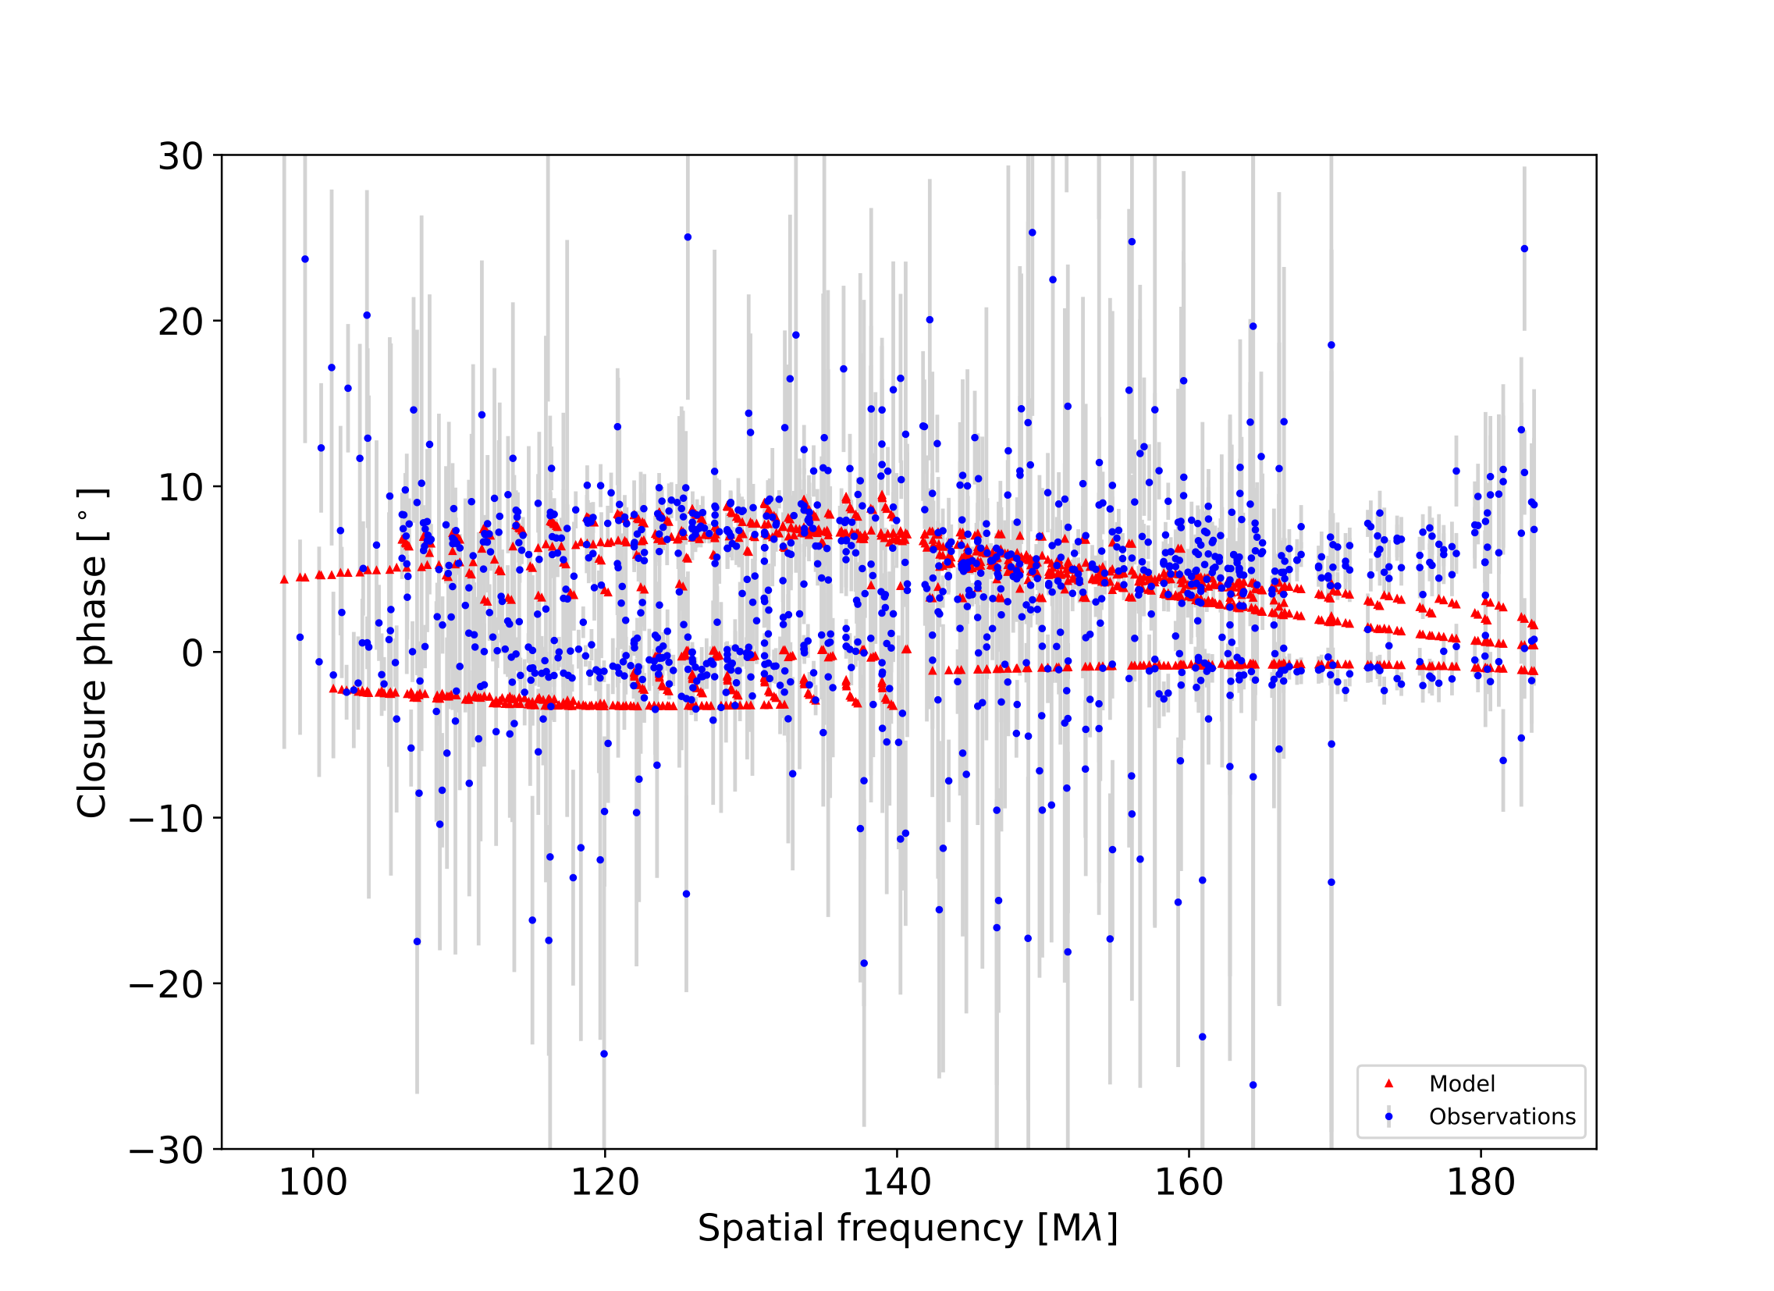
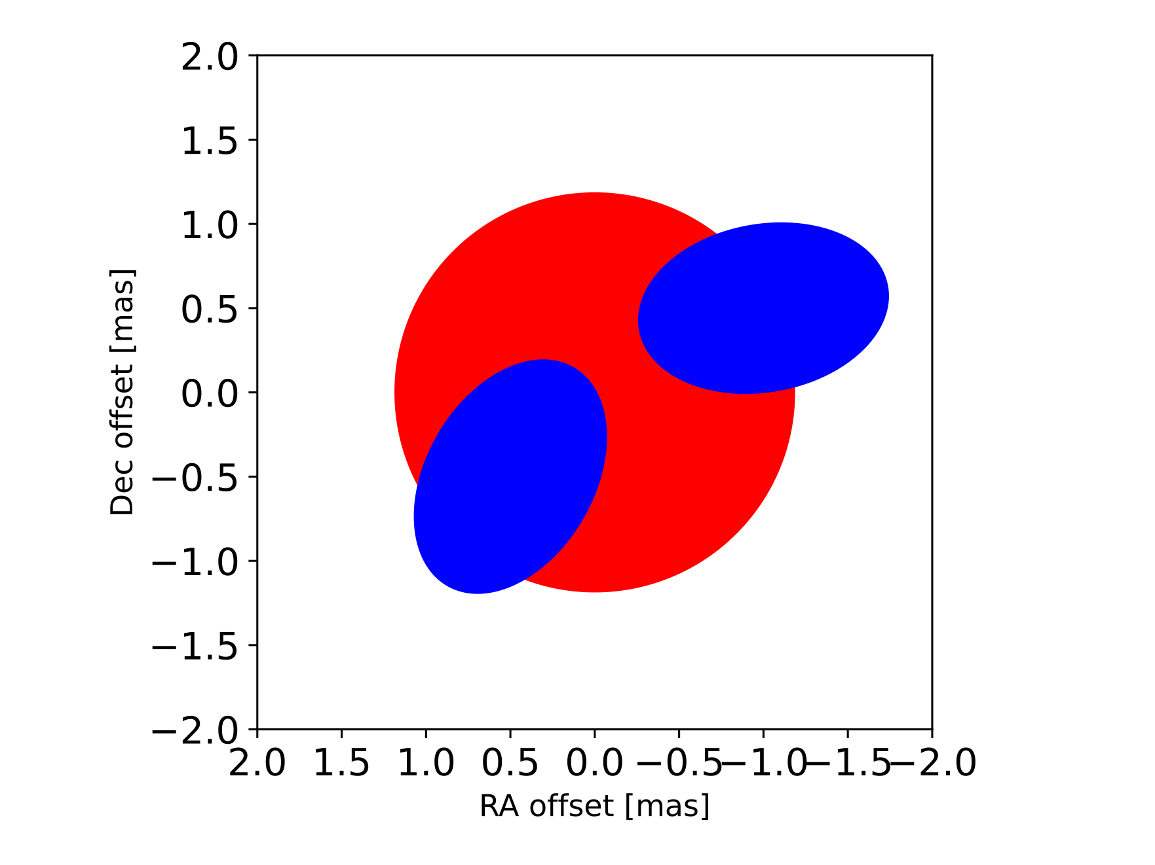
A toy model

Slide 16
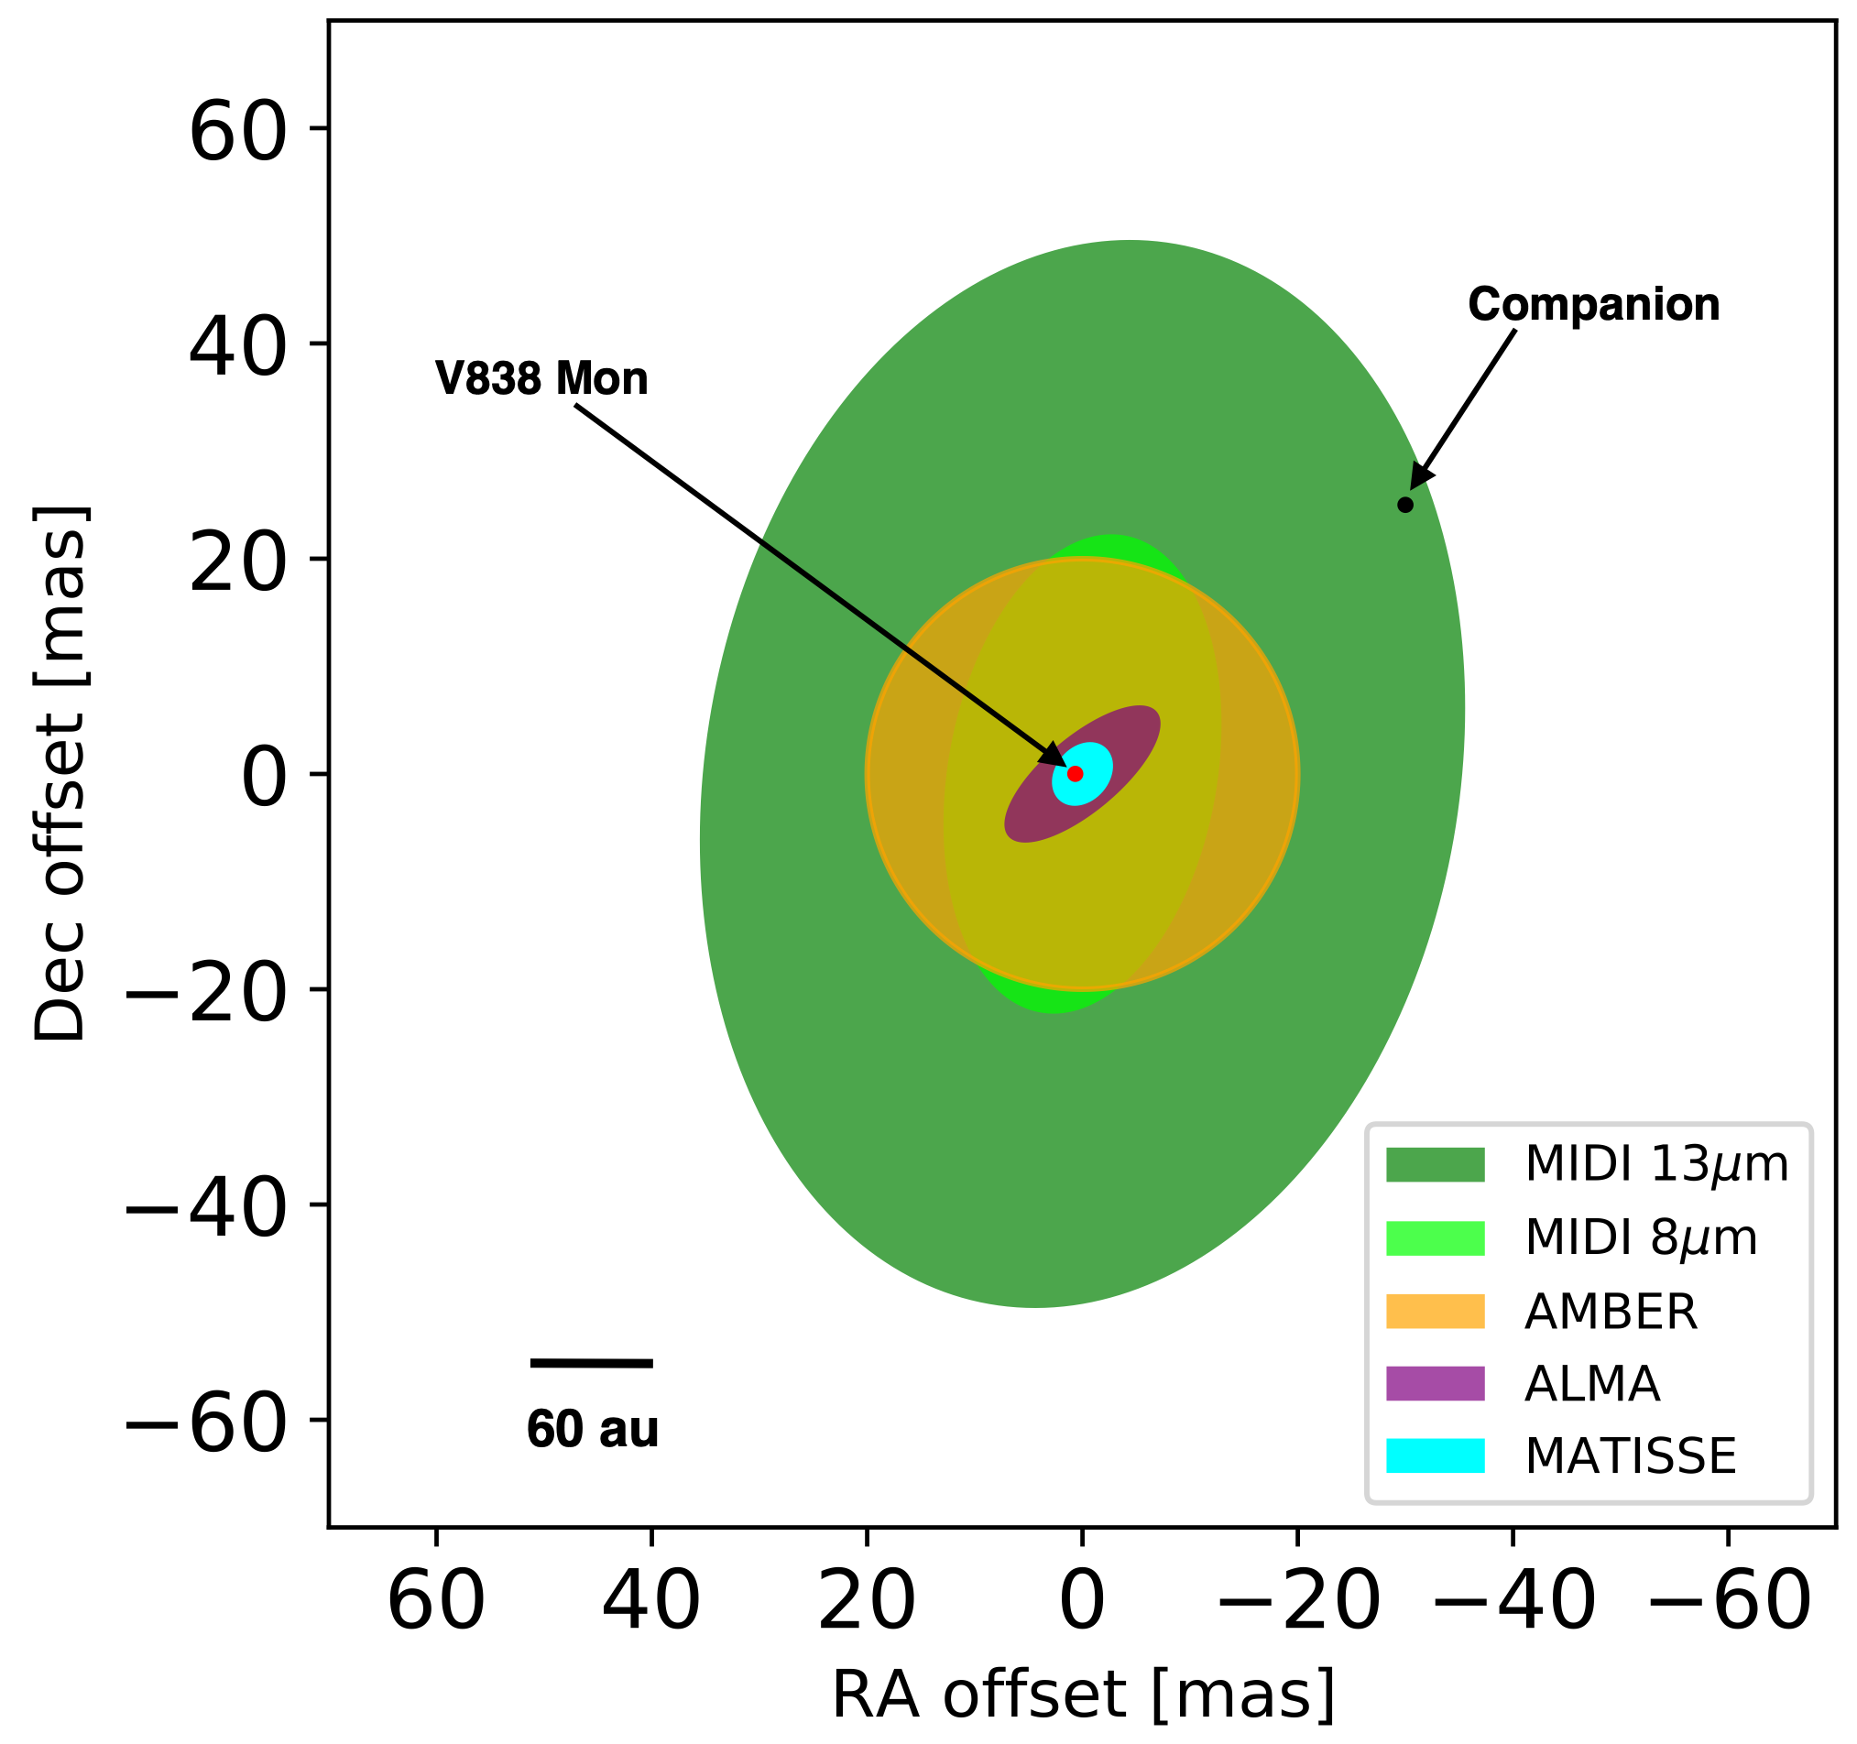
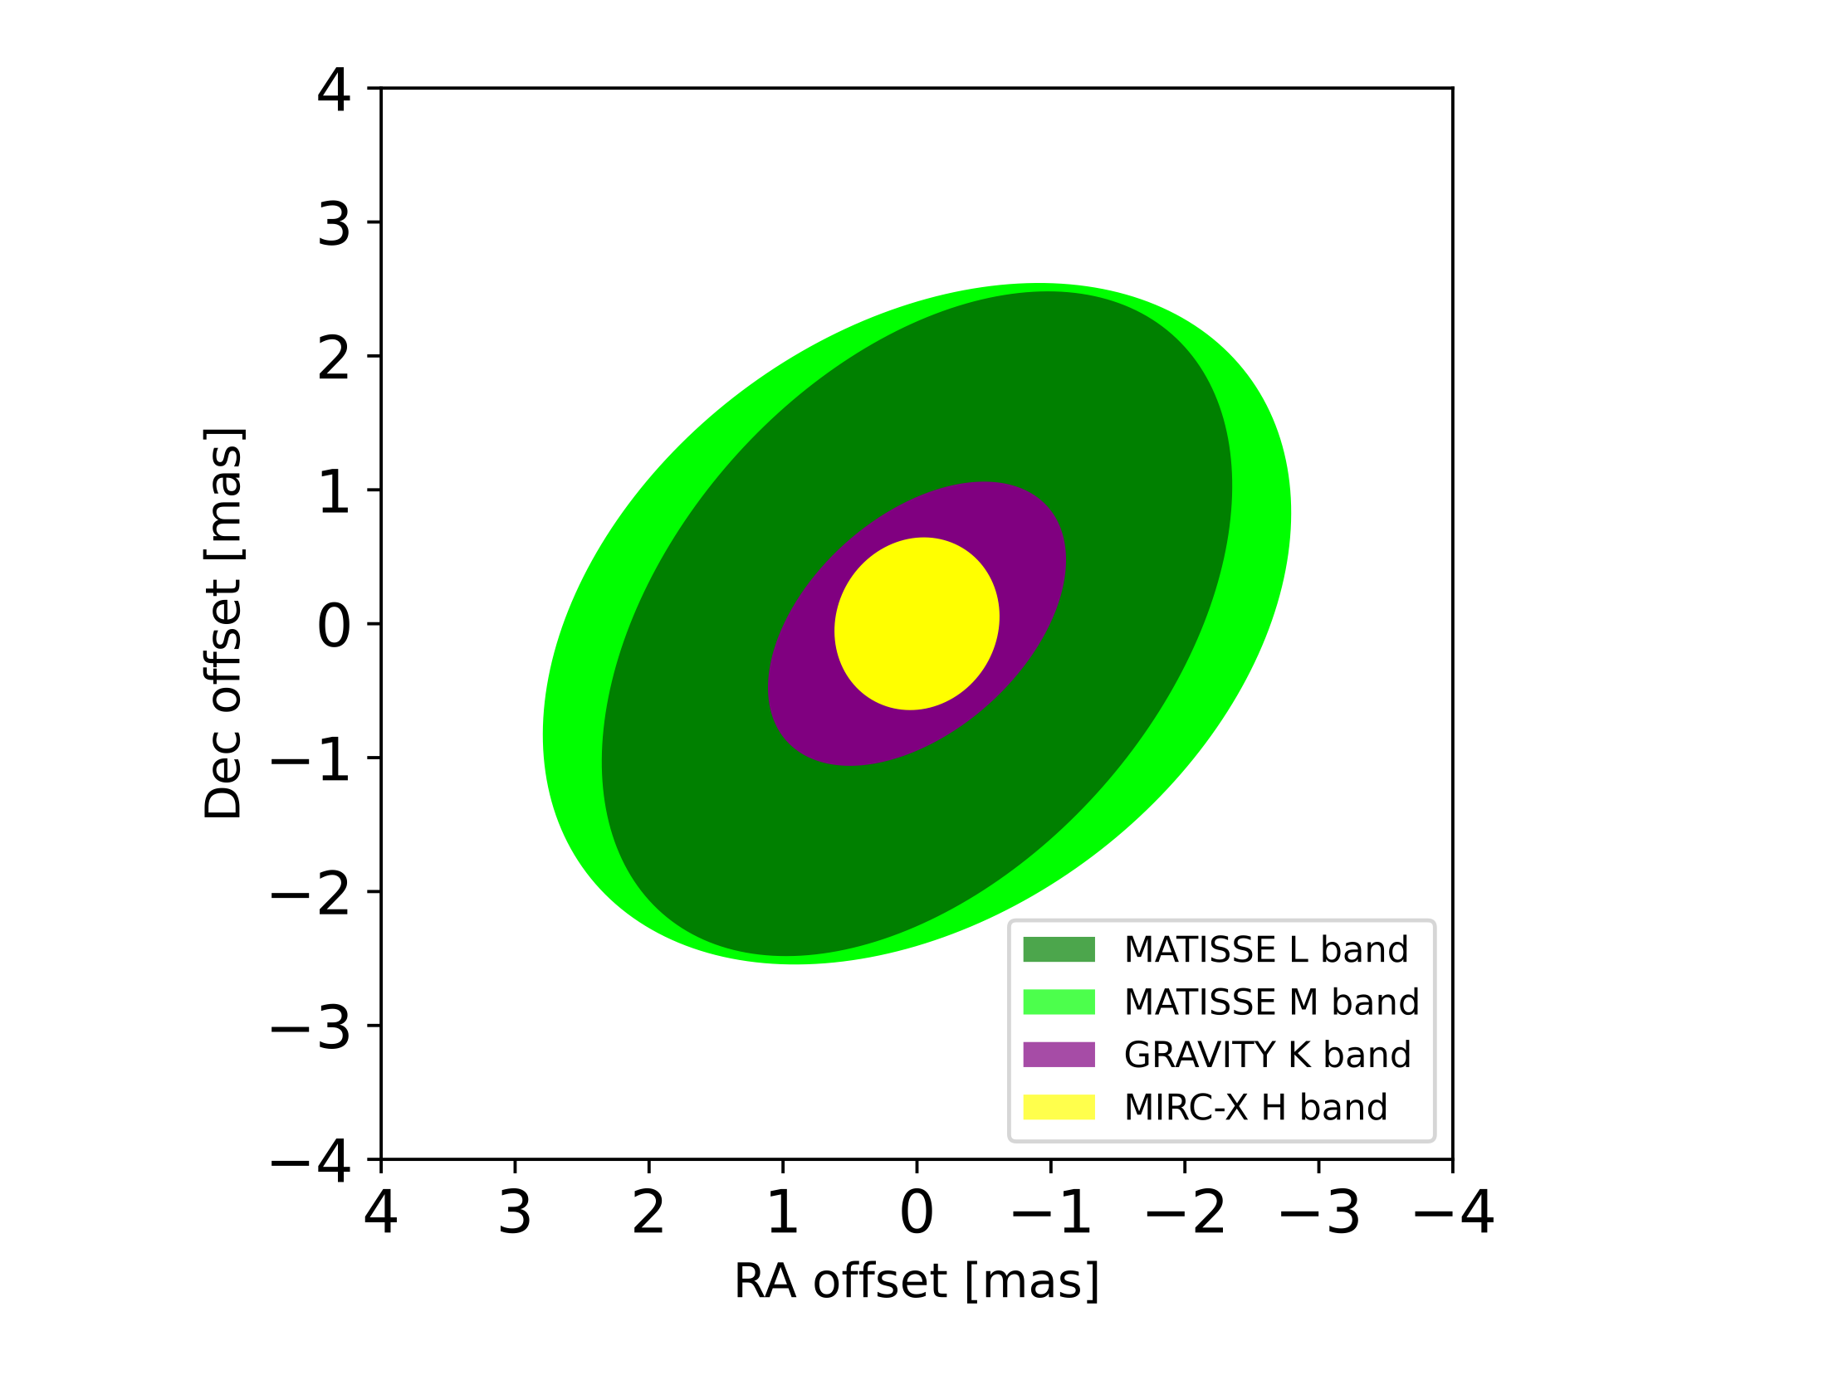

Slide 17
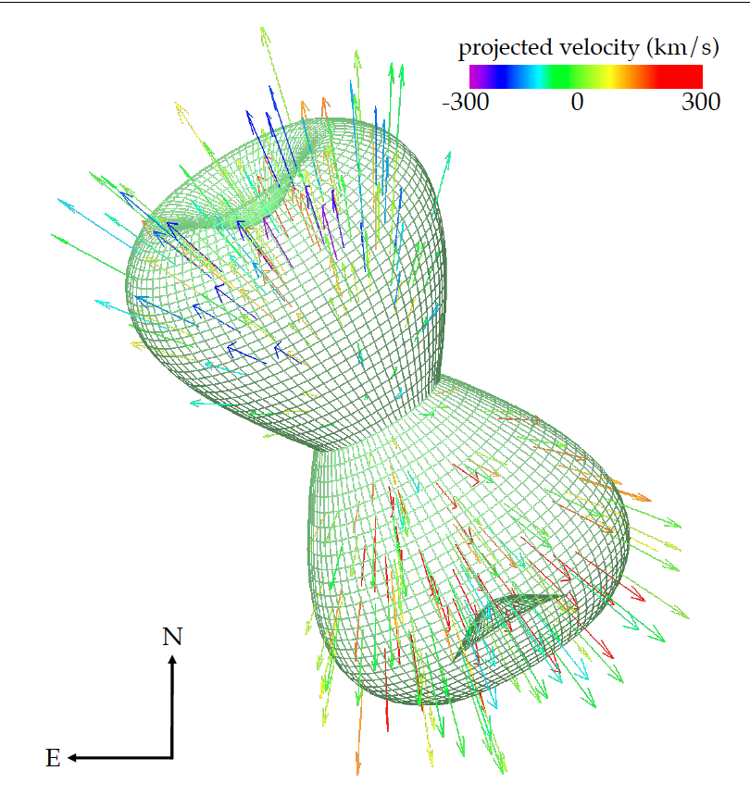
Summary and Future Work
First ever high resolution HK images of V838 Mon
VLTI suggests that contraction has ceased
CHARA reveals asymmetry closer to the star
Radiative models will be updated
Upcoming VLTI observations of V4332 Sgr
Paper in the works (Mobeen et al 2023)
Kamiński et al 2018
V 4332 Sgr
Thank you for your attention!

