Slide 1
Imaging Spotted
Stellar Surfaces
Rachael Roettenbacher
51 Peg b Fellow
University of Michigan
Imaging Spotted Stars

Slide 2
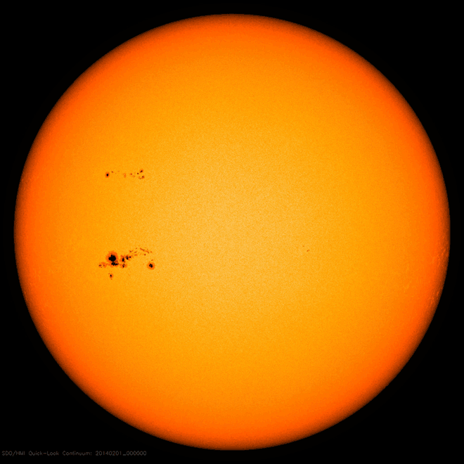
Sunspots
SDO/HMI/NASA
Imaging Spotted Stars

Slide 3
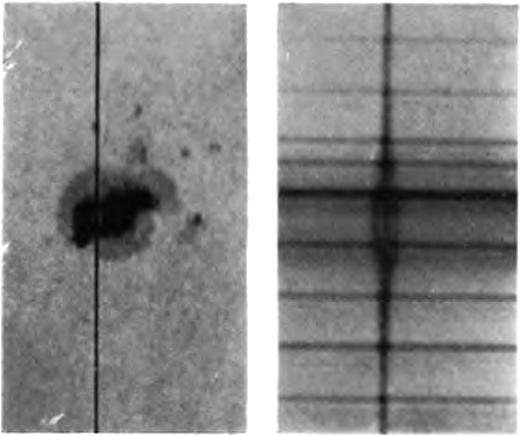
Sunspots
Zeeman splitting
Hale & Nicholson 1938
Imaging Spotted Stars

Slide 4
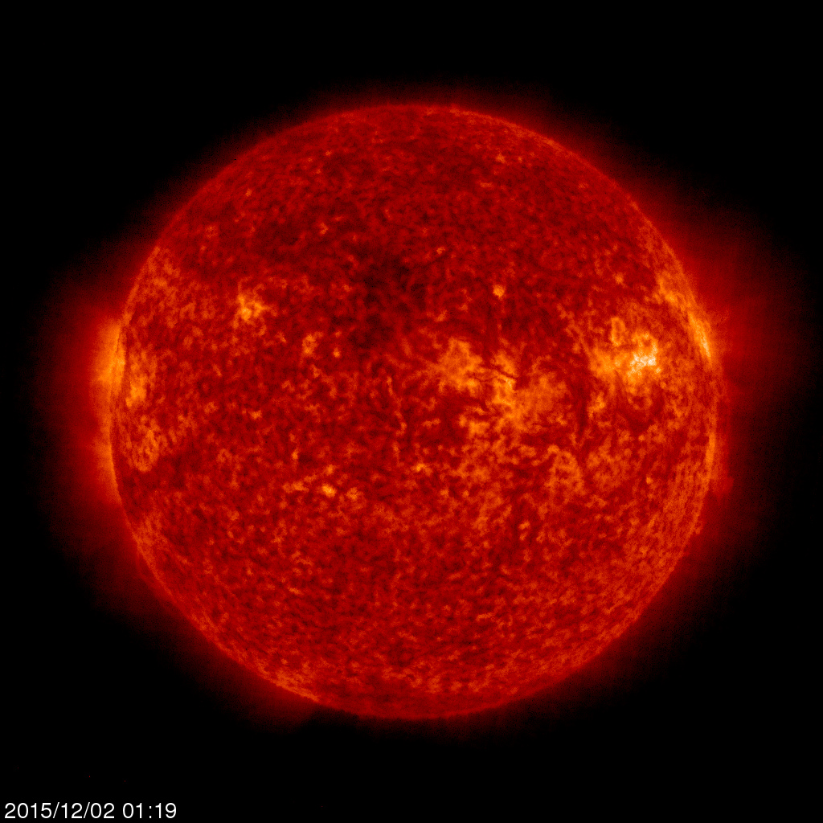
Sunspots
convective zone
tachocline
radiative zone
core
SOHO/RMR
Imaging Spotted Stars

Slide 5
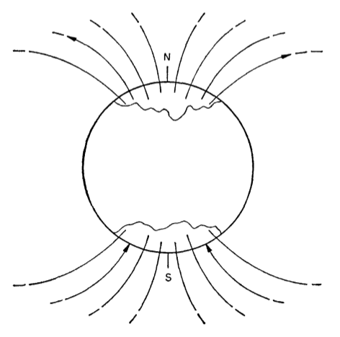
Sunspots
Babcock 1961
Imaging Spotted Stars

Slide 6
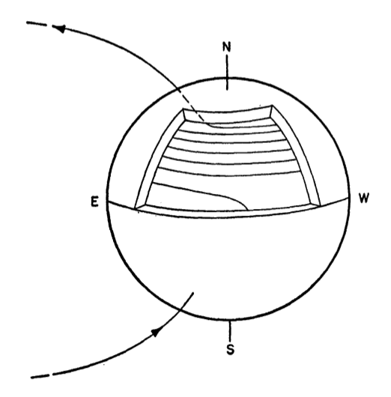
Sunspots
Babcock 1961
Imaging Spotted Stars

Slide 7
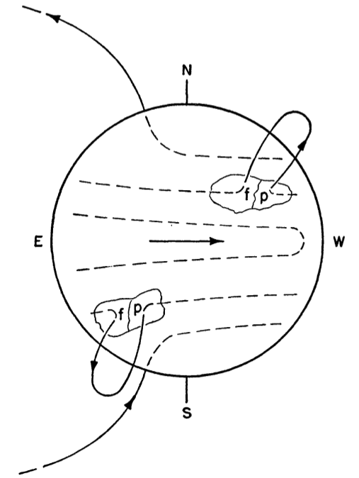
Sunspots
Babcock 1961
Imaging Spotted Stars

Slide 8
Starspots
Babcock 1961
Imaging Spotted Stars

Slide 9
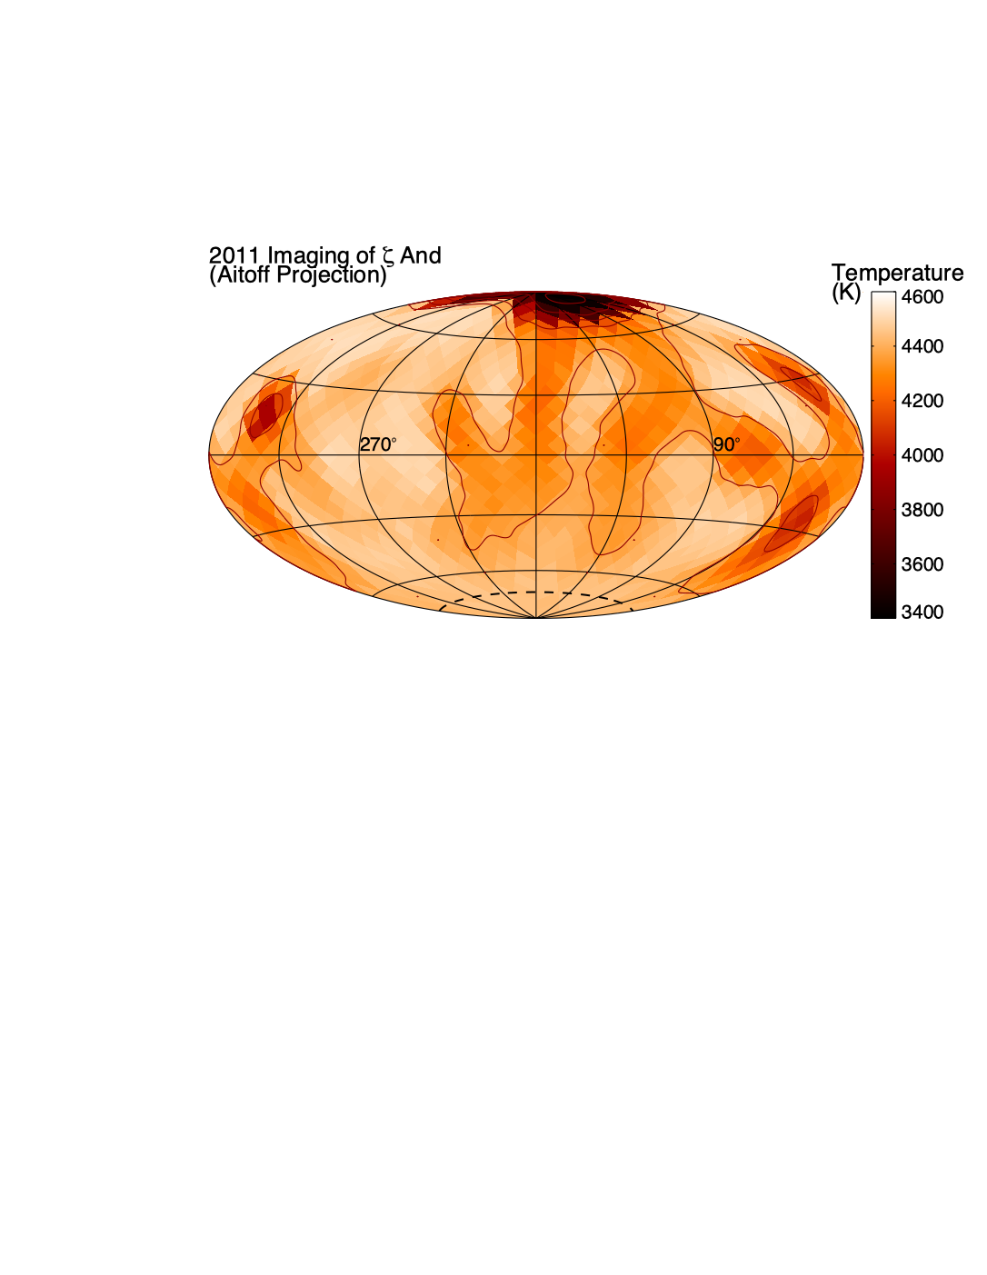
ζ And
2011
Roettenbacher et al. 2016
Imaging Spotted Stars

Slide 10
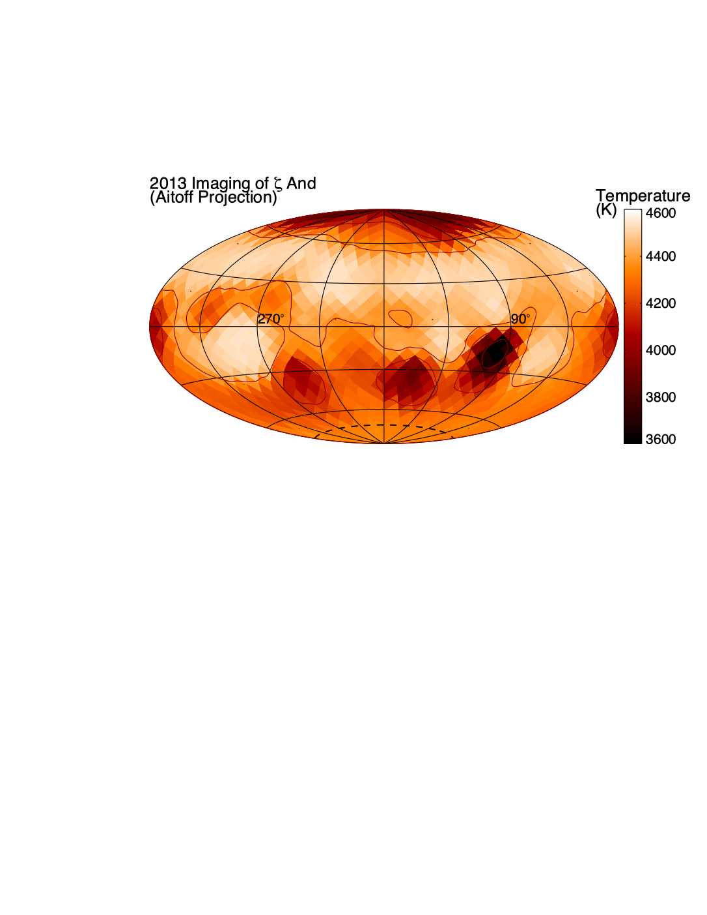
ζ And
2011
2013
Roettenbacher et al. 2016
Imaging Spotted Stars

Slide 11
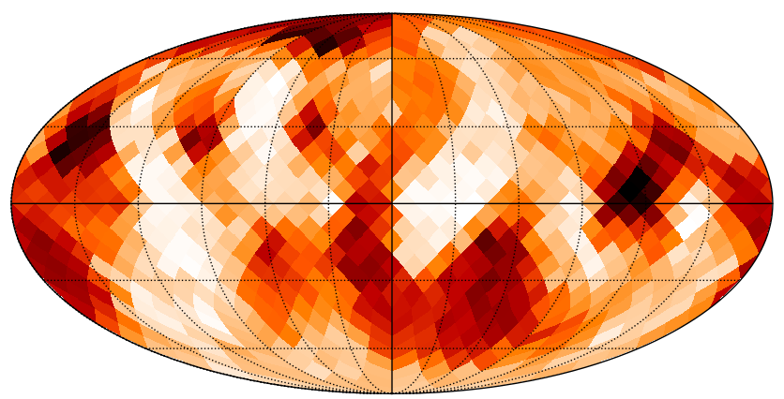
late July-early August
ζ And
2019
Roettenbacher et al. in prep.
Imaging Spotted Stars

Slide 12
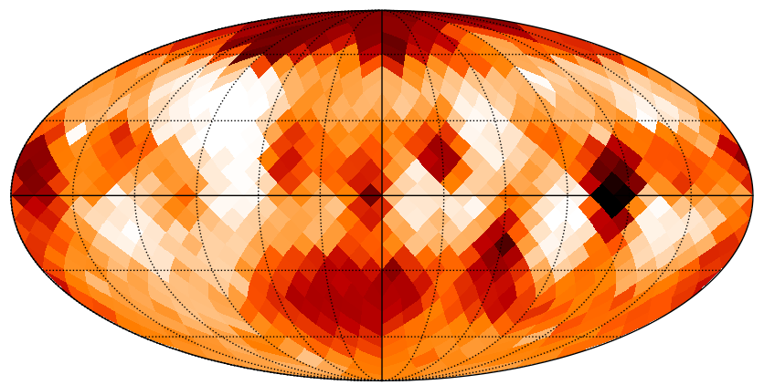
late July-early August
end of August-mid September
ζ And
2019
Roettenbacher et al. in prep.
Imaging Spotted Stars

Slide 13
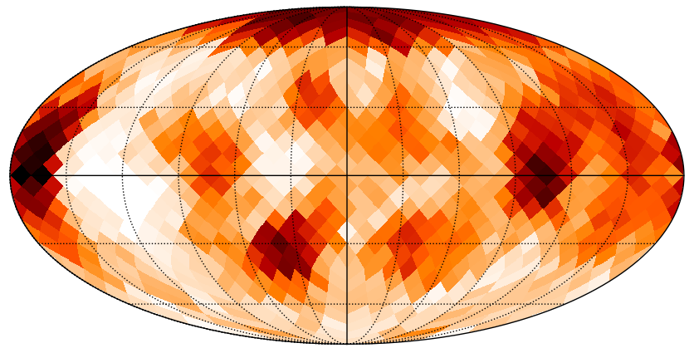
late July-early August
end of August-mid September
ζ And
2019
early October
Roettenbacher et al. in prep.
Imaging Spotted Stars

Slide 14
late July-early August
ζ And
2019
end of August-mid September
early October
Roettenbacher et al. in prep.
Imaging Spotted Stars

Slide 15
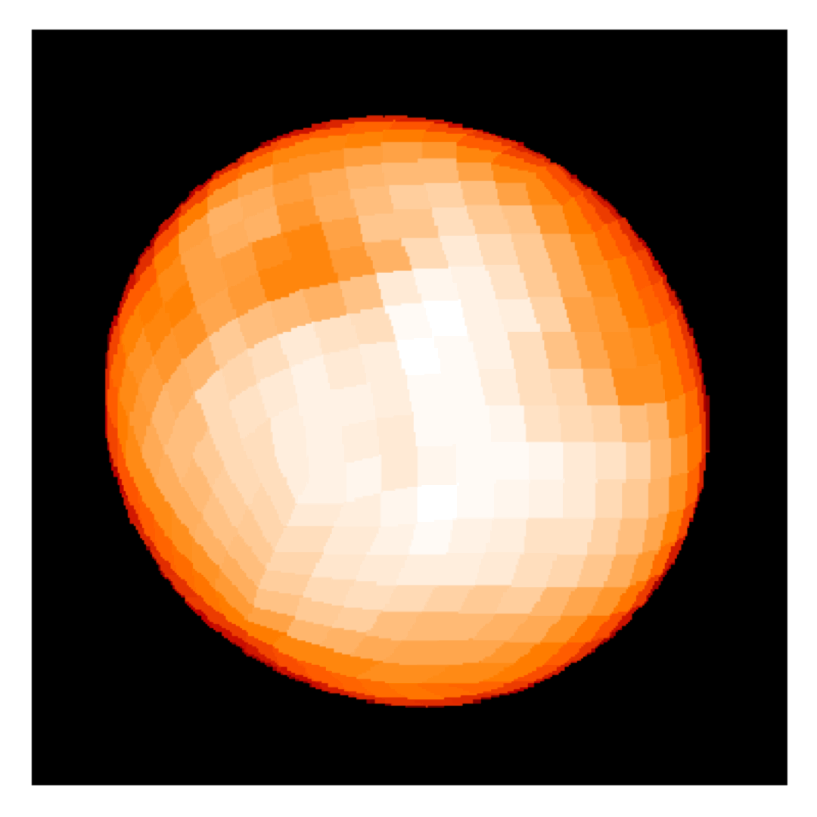
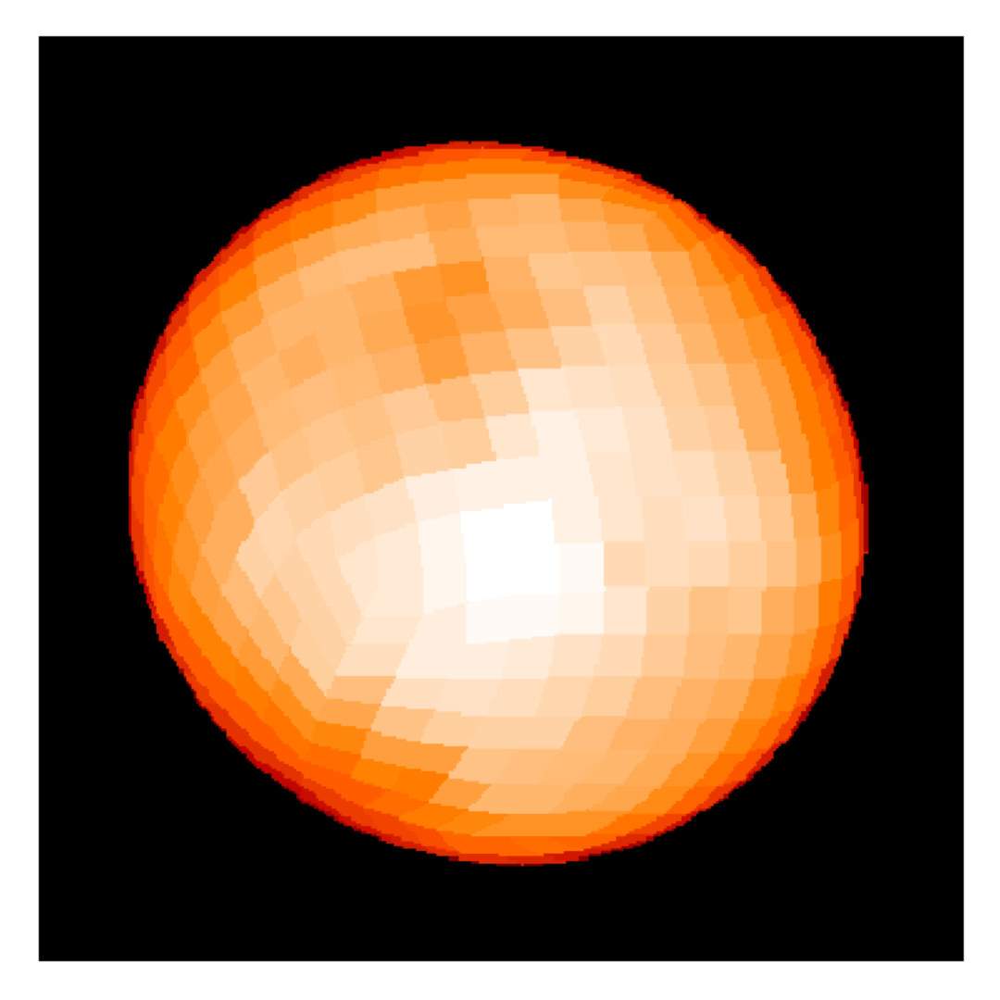
ζ And
2019
late July-early August
end of August-mid September
early October
Roettenbacher et al. in prep.
Imaging Spotted Stars

Slide 16
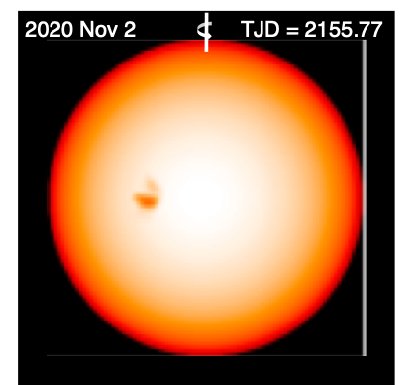
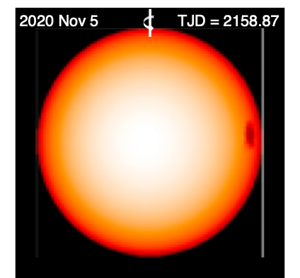
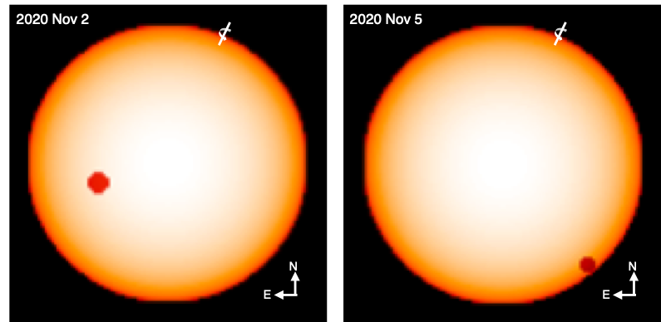
ε Eri
2020
Light-curve
inversion
Interferometric
spot model
Roettenbacher et al. 2022
Imaging Spotted Stars

Slide 17
ε Eri
2020
Light-curve
inversion
Interferometric
spot model
Roettenbacher et al. 2022
Imaging Spotted Stars

Slide 18
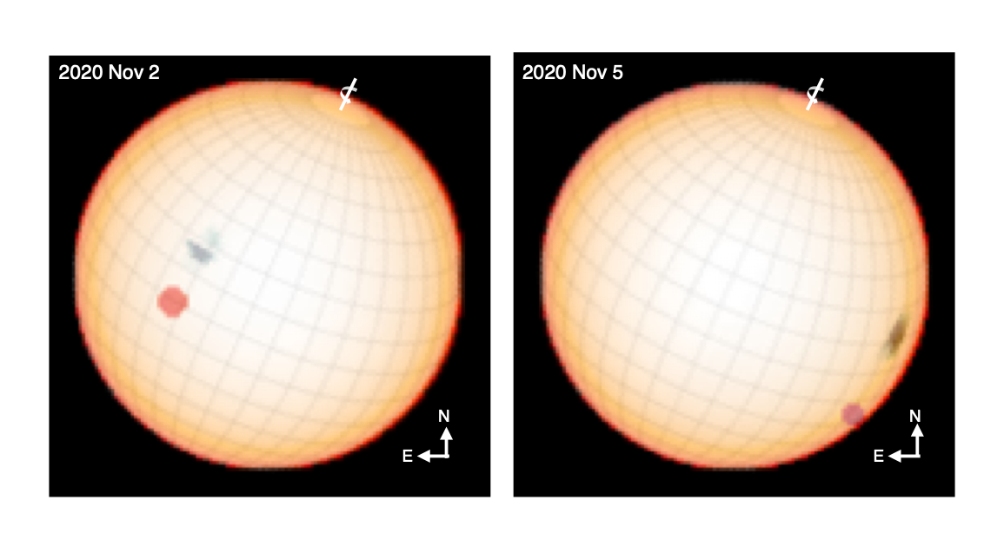
ε Eri
2020
Light-curve inversion overlay with grid in grayscale
Interferometric spot model in color
Roettenbacher et al. 2022
Imaging Spotted Stars

Slide 19
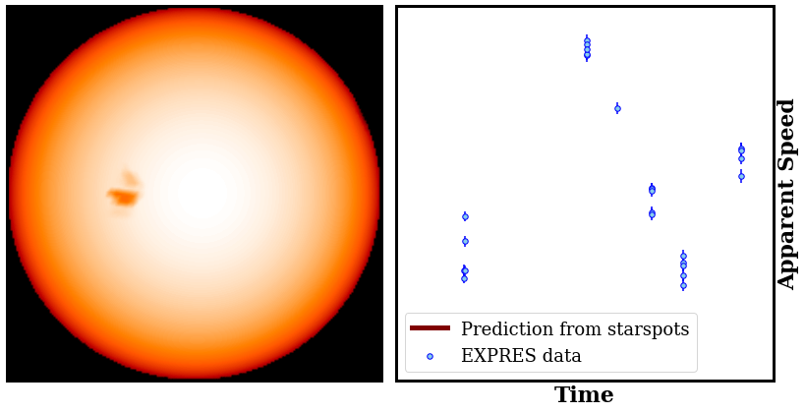
ε Eri
2020
Roettenbacher et al. 2022
Imaging Spotted Stars

Slide 20
ε Eri
2021
Roettenbacher et al. in prep.
Imaging Spotted Stars

Slide 21
ε Eri
VLTI/PIONIER data to be added soon!
2021
Roettenbacher et al. in prep.
Imaging Spotted Stars

Slide 22
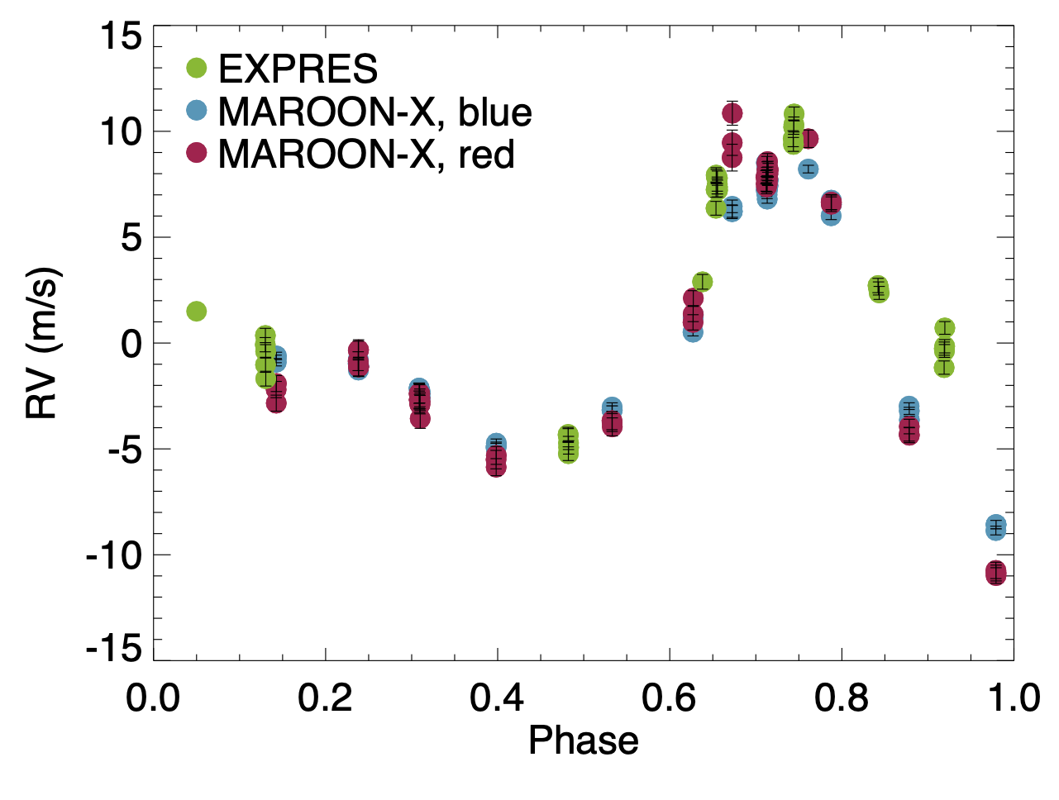
ε Eri
VLTI/PIONIER data to be added soon!
2021
Roettenbacher et al. in prep.
Imaging Spotted Stars

Slide 23
To Come…
Quantitatively compare ζ And epochs
Compare to contemporaneous Doppler images
Add VLTI/PIONIER data to ε Eri
Model RVs of ε Eri and compare to observations
Repeat for
τ Ceti
61 Cyg A
61 Cyg B
Roettenbacher et al. in prep.
Imaging Spotted Stars

