Slide 1
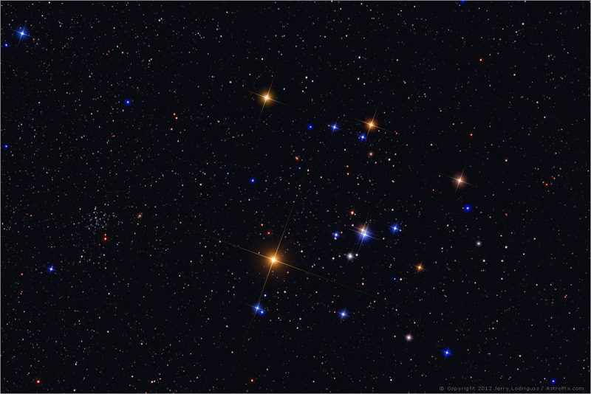
Open Cluster Ages from Red Giant Star Sizes
Russel White (GSU)
The Hyades Star Cluster – Face of the Bull in Taurus. Image credit: Jerry Lodriguss

Slide 2
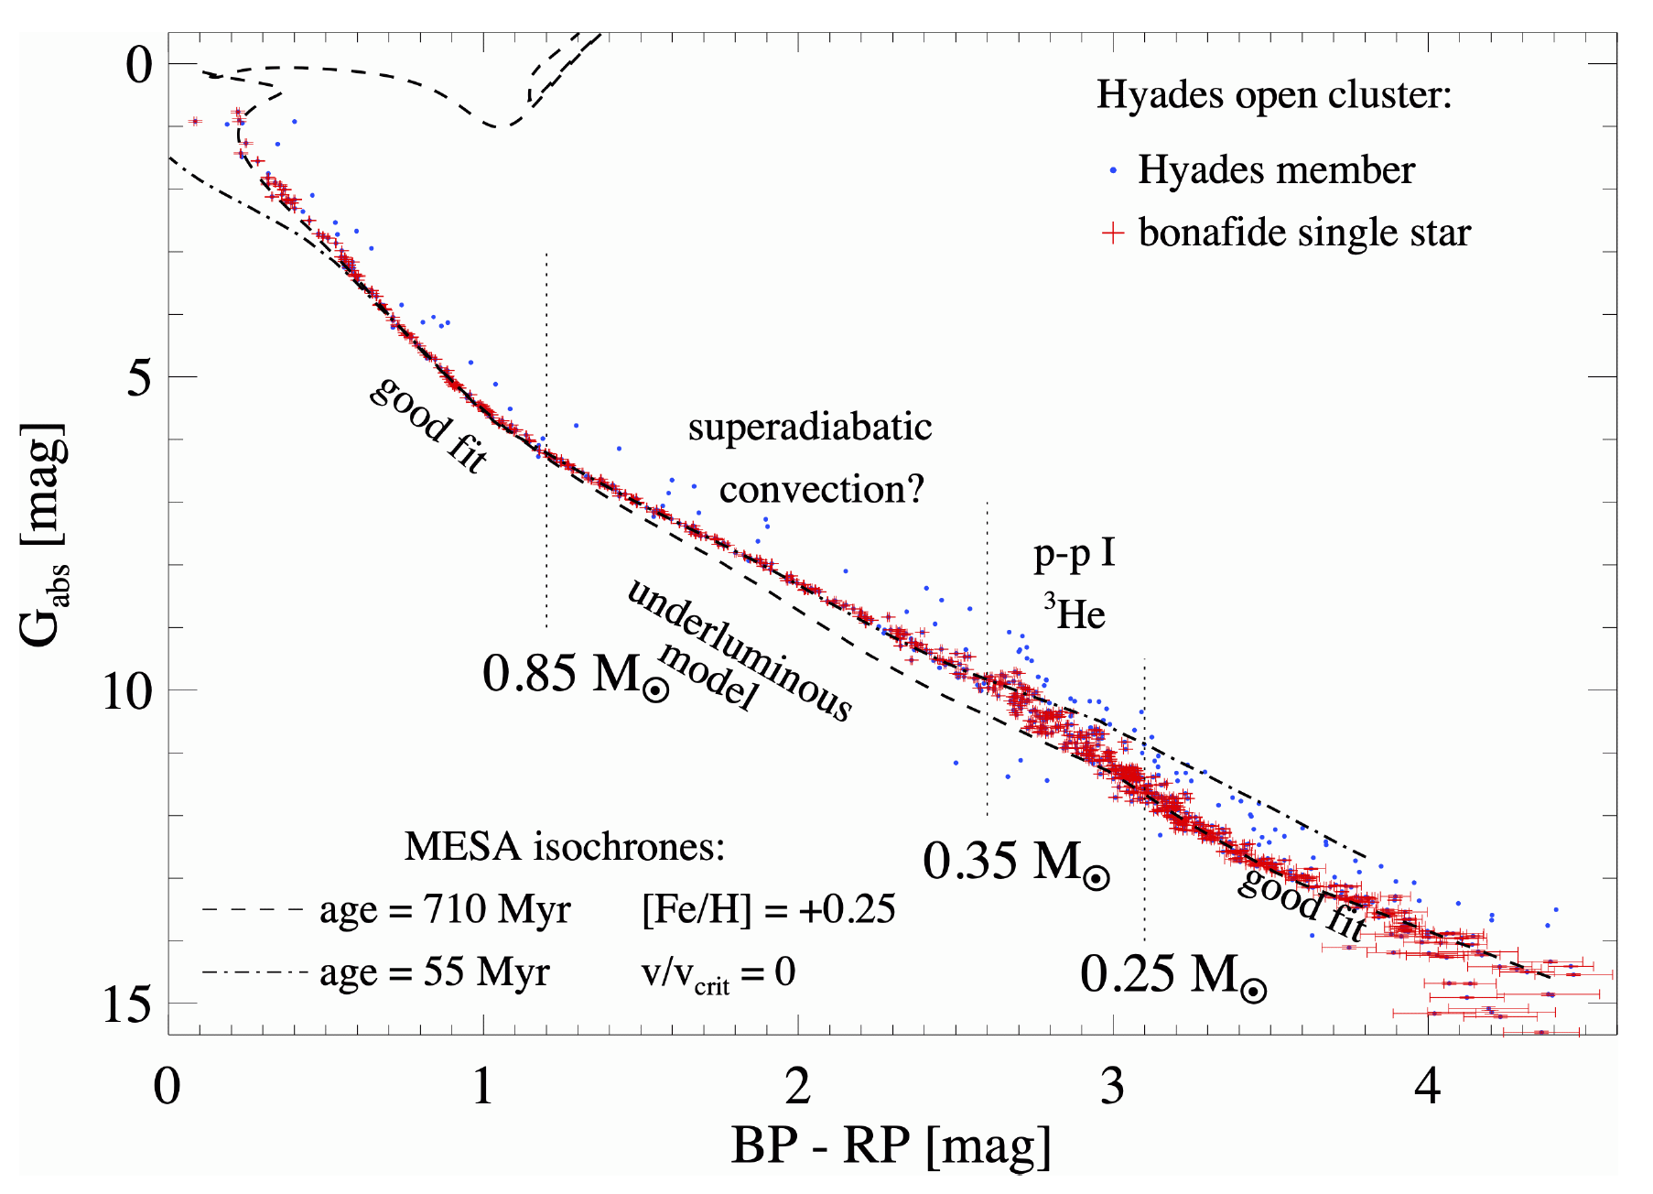
The 625 Myr Hyades Cluster (data from Brandner et al. 2022)
Clusters provide
benchmarks for stellar evolution

Slide 3
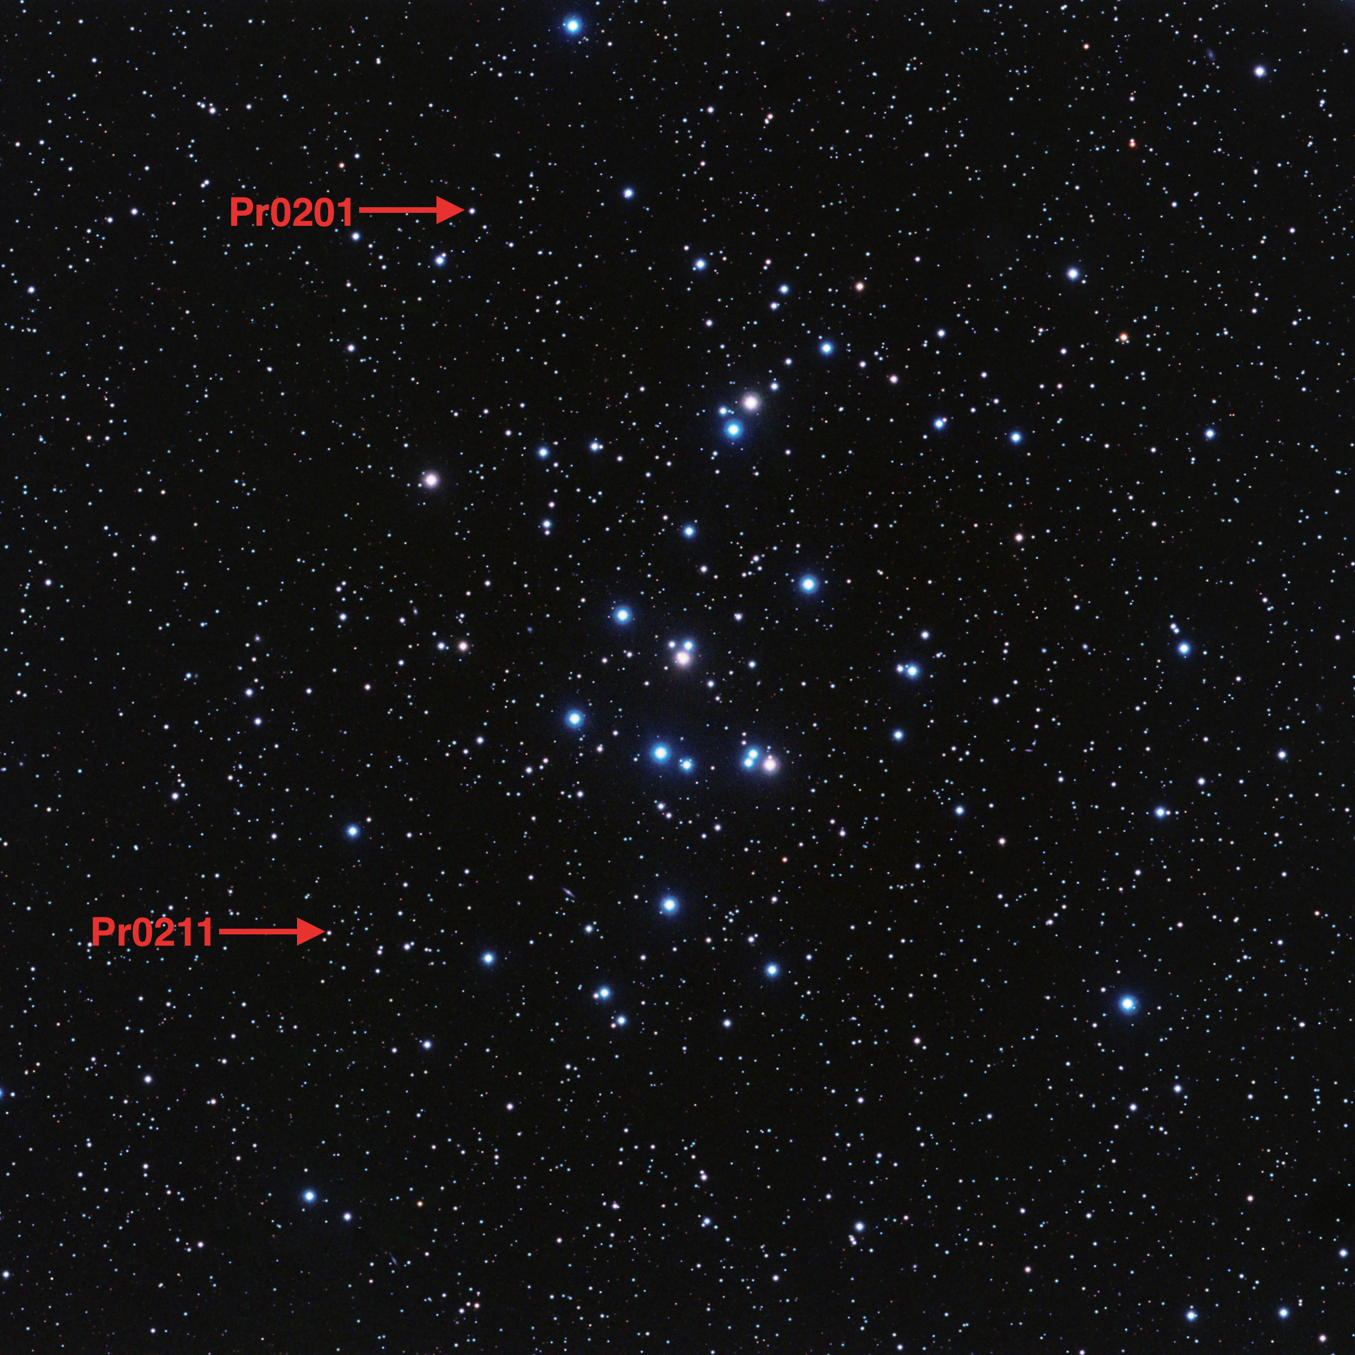
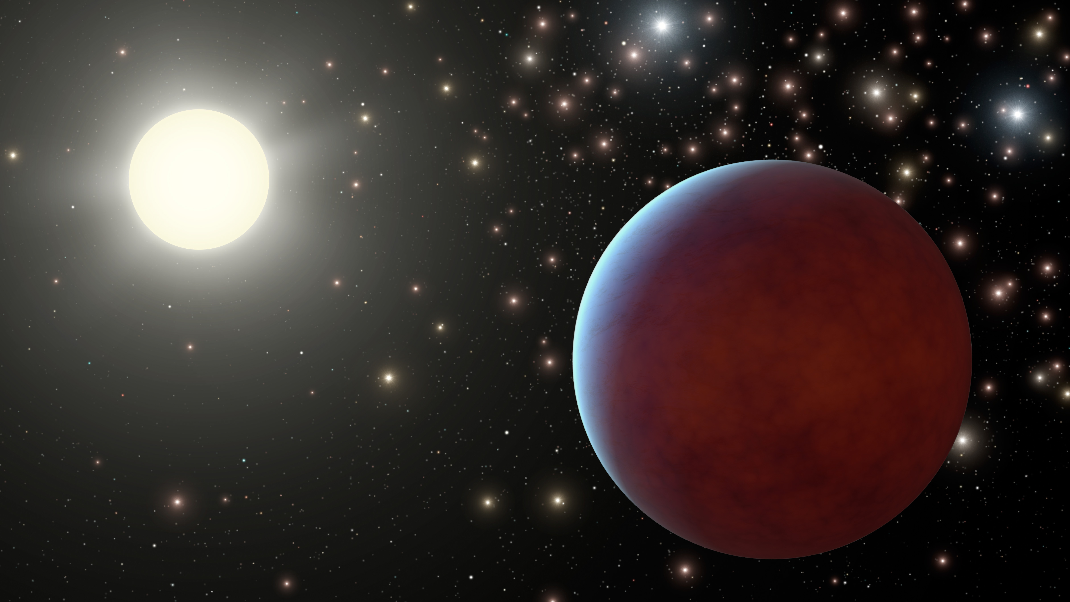
And now
benchmarks for planet evolution
Artist credit: R. Hurt
see Quinn et al. 2012, Quinn 2014
(Praesepe)
(Hyades)

Slide 4
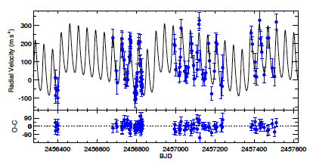
And now
benchmarks for planet evolution
Artist credit: R. Hurt
see Quinn et al. 2012, Quinn 2014
(Praesepe)
(Hyades)
A new double-planet system in Coma Berenices!
Quinn et al. (in prep)

Slide 5
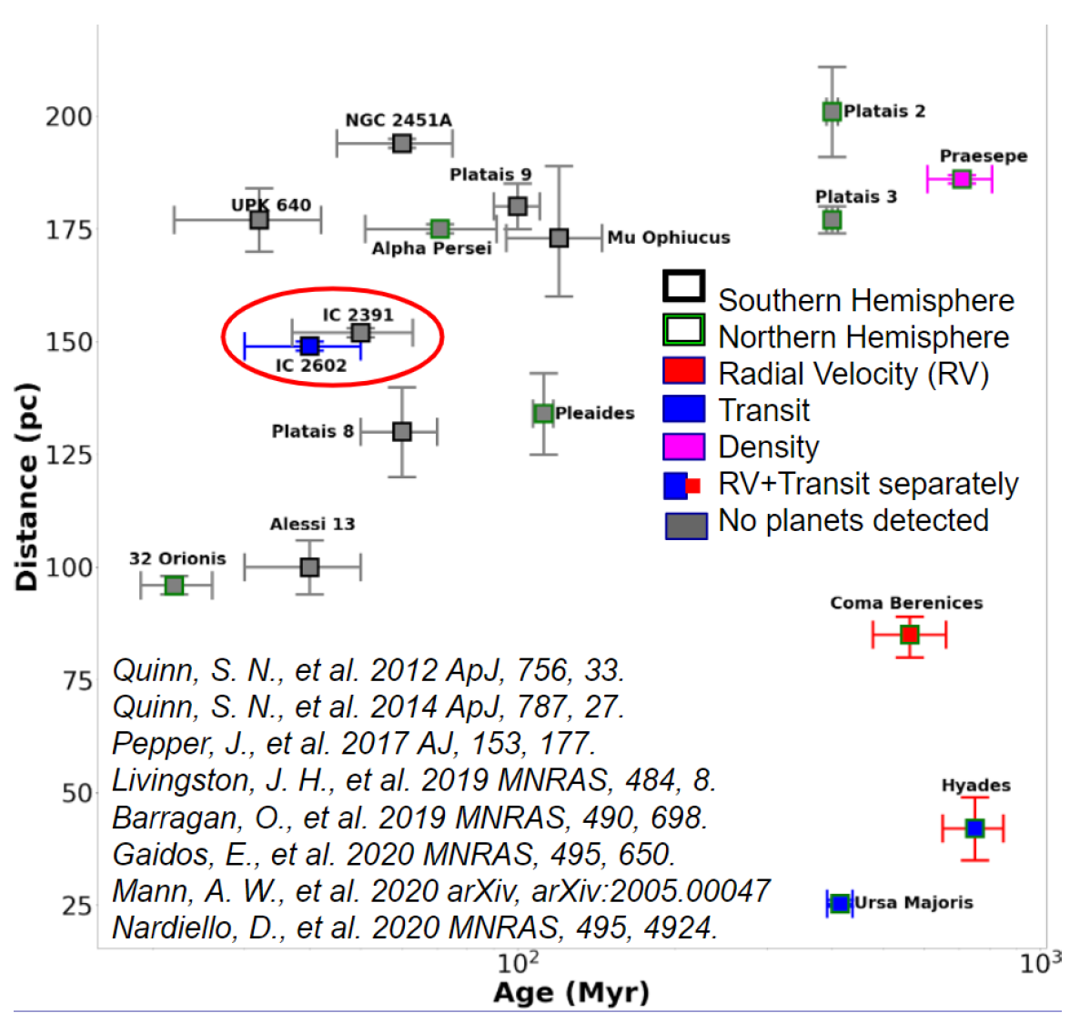
The Nearest Open Clusters (and their planets)
From the dissertation of Dr. Azmain Nisak (2022)

Slide 6
Is the Hyades really 625 Myr old?

Slide 7
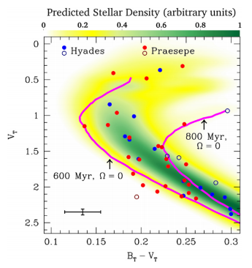
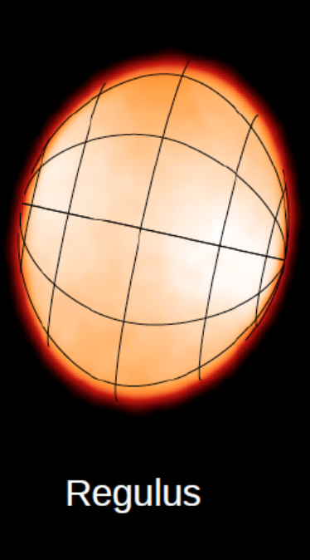
Main Sequence Turnoff Age … is complicated by rapid rotation
A CHARA image of the rapidly rotating star Regulus (Che et al. 2011)
Brandt & Huang (2015) suggest ~800 Myr

Slide 8
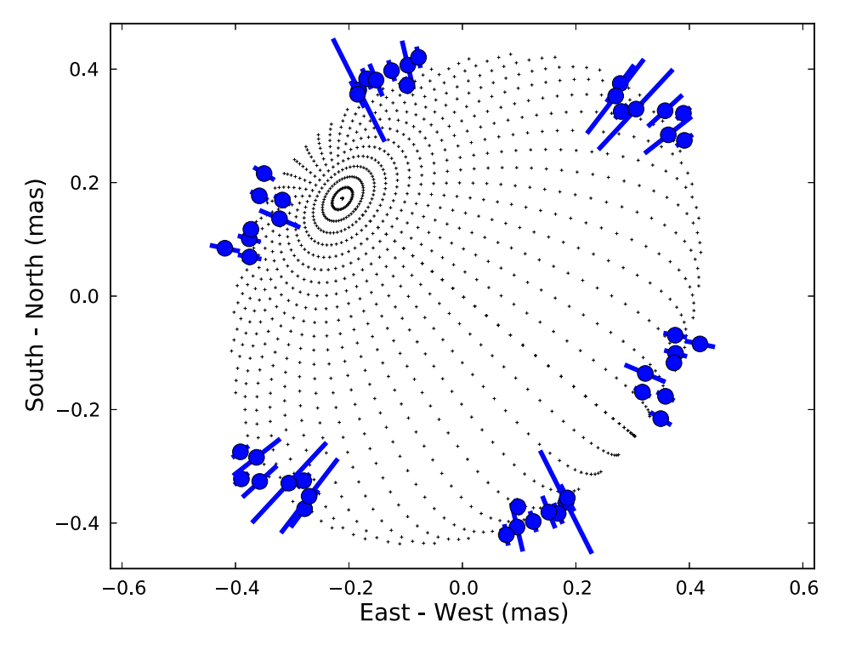
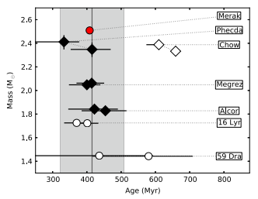
CHARA size measurements of spectral type A stars in Ursa Majoris …
Jeremy Jones et al. (2015)
… account for gravity darkening and improve the age (414 ± 23 Myr)

Slide 9
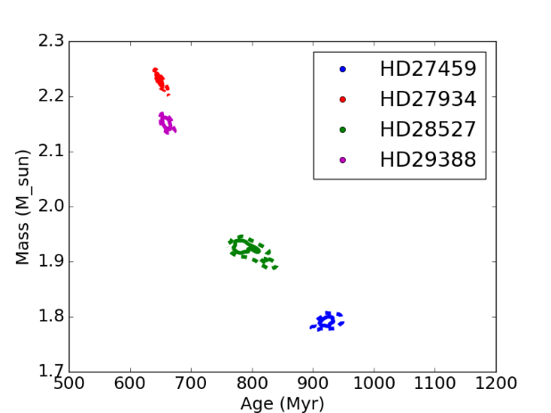
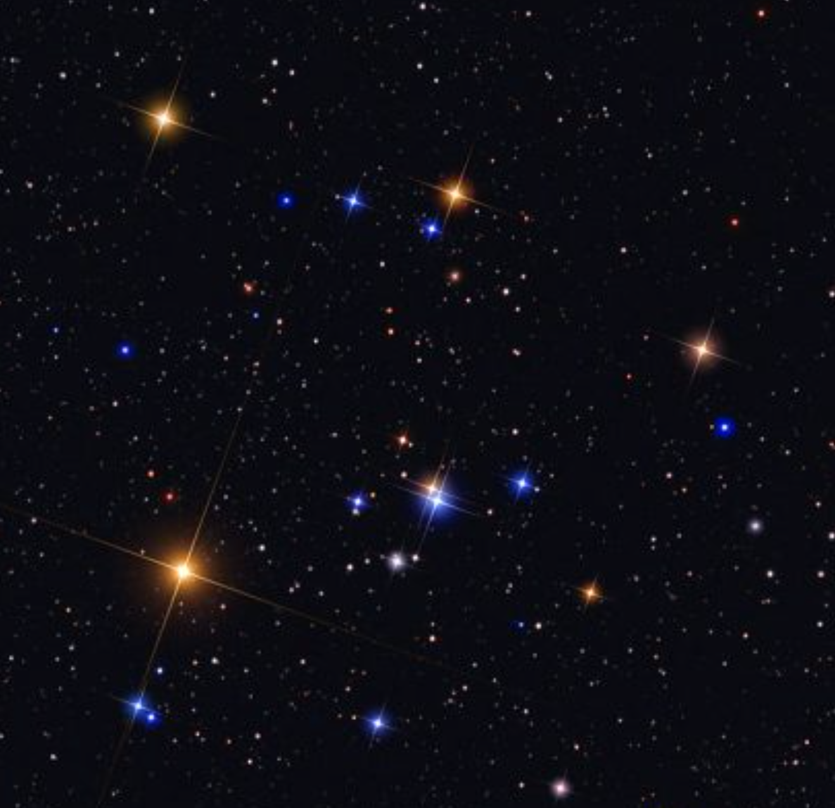
Can this be done with the Hyades? (from Jeremy Jones’ talk)
Jones NSF/AAG Hyades proposal:
G. Schaefer –
MS binaries
J. Jones – rapidly rotating MS turn-off stars
R. White – red giants

Slide 10
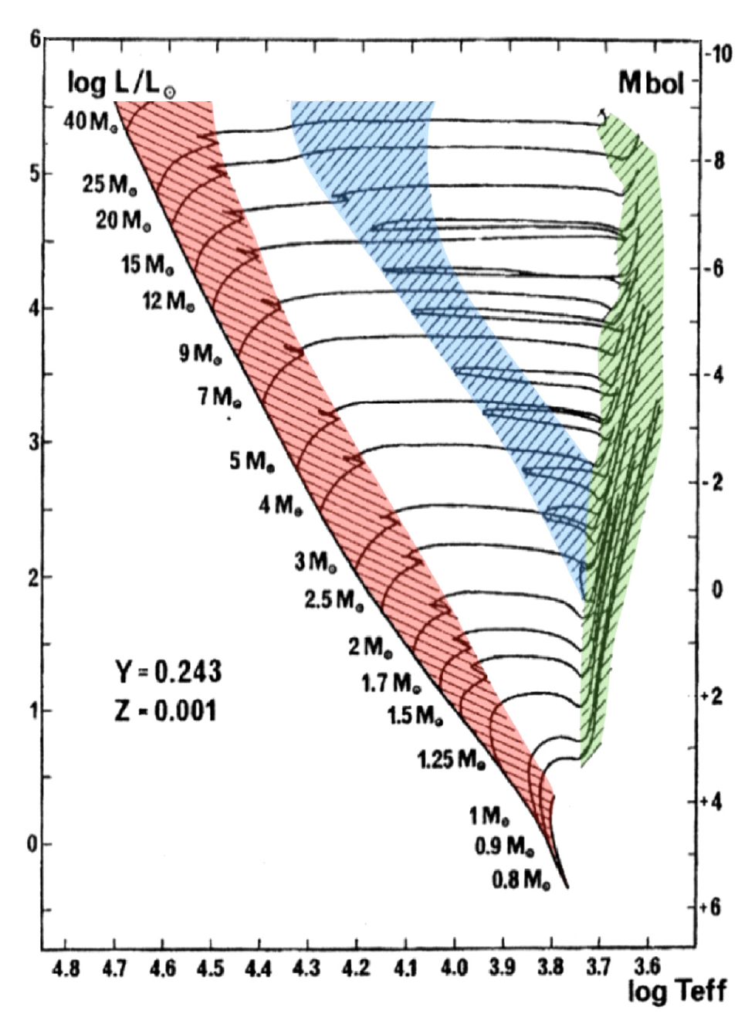
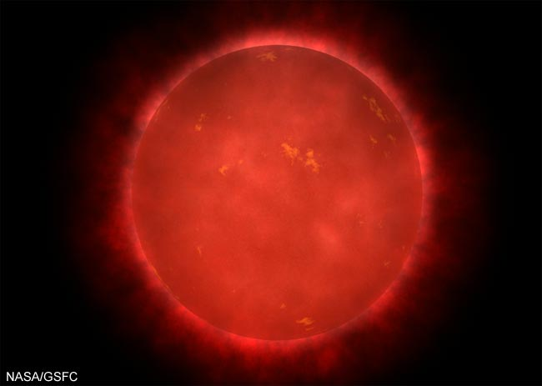
While sizes provide more accurate stellar properties …
… extracting ages requires careful comparisons.
from Lamers & Levesque

Slide 11
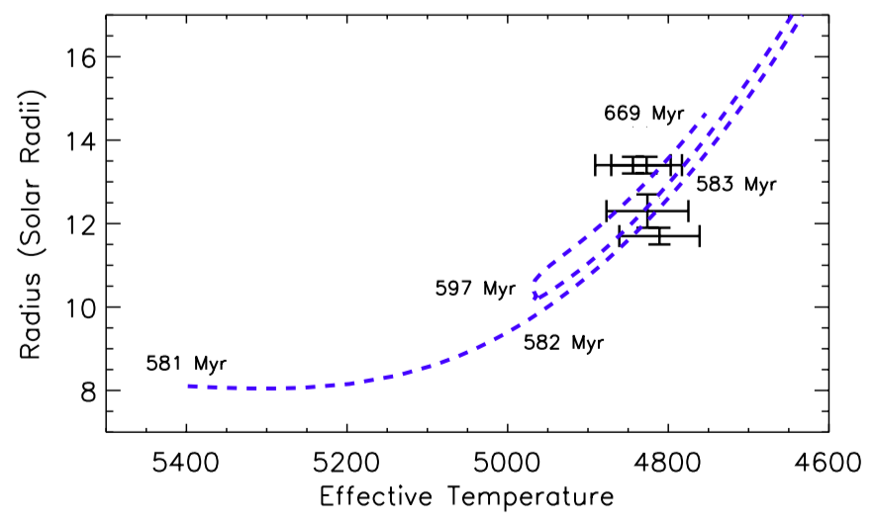
Open Cluster Ages from Giant Star Sizes
Ages require a ‘likelihood analysis’ that accounts for the temporal evolution
Jorgensen & Lindegren (2005); Ligi et al. (2016)
Hyades giants
Boyajian et al. (2009)
CHARA

Slide 12
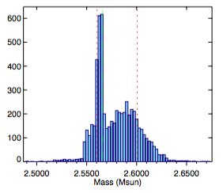
Mostly likely mass for 1 star
Hyades giants
Boyajian et al. (2009)
CHARA

Slide 13
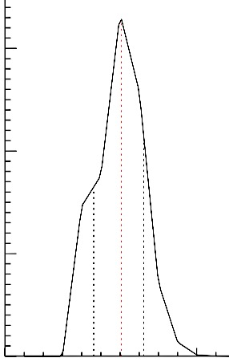
Mostly likely age assuming all 4 are coeval
PDF
610 ⁺¹¹⁰ ₋₁₄₀ Myr
500
1000
Hyades giants
Boyajian et al. (2009)
CHARA

Slide 14
How to Improve Red Giant Ages?
Asteroseismology
- Arentoft et al. (2019) – 𝛆 Tau
New Sizes / Images
- MIRC-X, MYSTIC, SPICA
Resolve SB1s (e.g., 𝛄 Tau, 𝜃¹ Tau)
- ARMADA techniques
Hyades giants
Boyajian et al. (2009)
CHARA

Slide 15
Other Samples
Ruprecht 147
(e.g. Curtis et al. 2013)
Age = 2.7 By
D = 300 pc
Fe/H = +0.10
REU student W. Brennom
CHARA

Slide 16
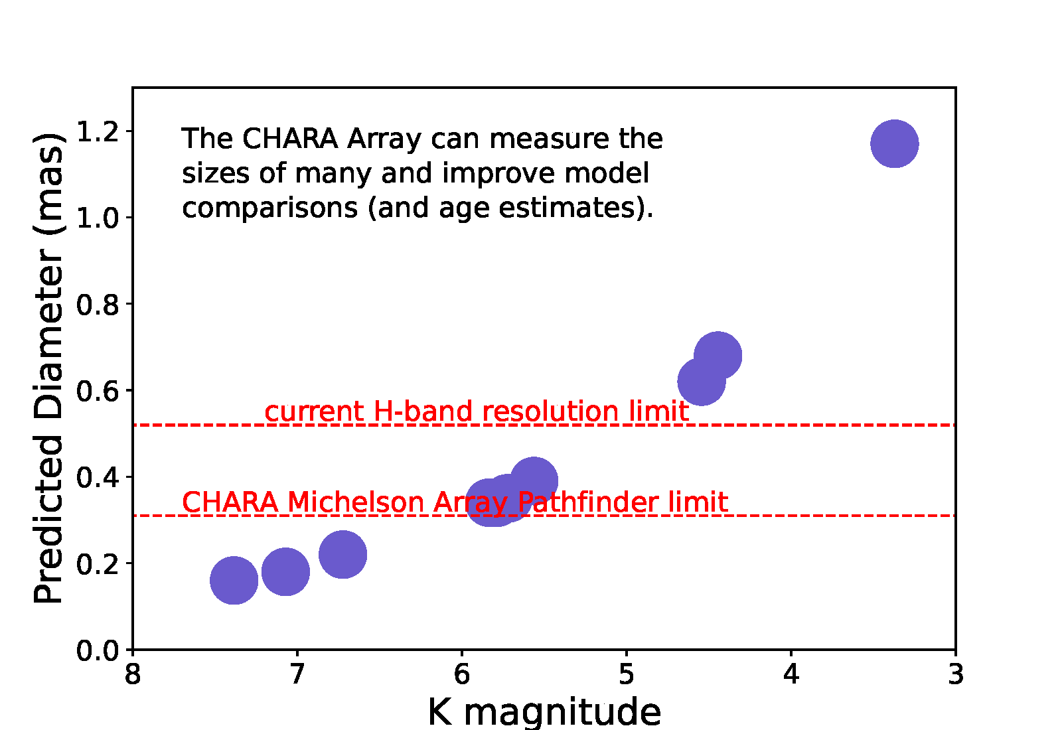
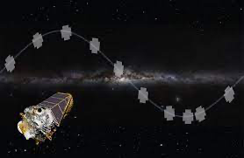
11 Red Giants in Ruprecht 147
K2 campaign 7 observed these
(J. Curtis, priv. comm.)

Slide 17
Summary
Open clusters are useful benchmarks for stellar and planetary evolution
Precise CHARA sizes can constrain ages …
- new measurements
- mass information
... and constrain evolution theory across the HR diagram

