Slide 1
Be Star Disk Asymmetries
Peter Wysocki
Georgia State University

Slide 2
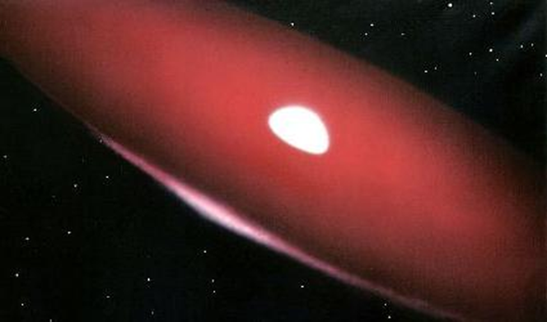
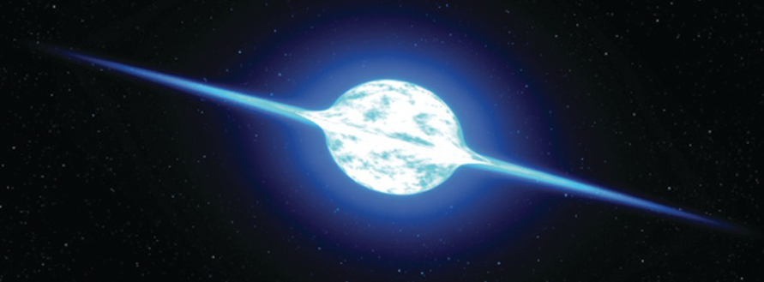
Be Stars
Rapidly rotating massive stars that show emission from a decretion disk
Credit: Bill Pounds
Credit: NASA/ESA/G. Bacon (STScI)

Slide 3
V/R Variations

Slide 4
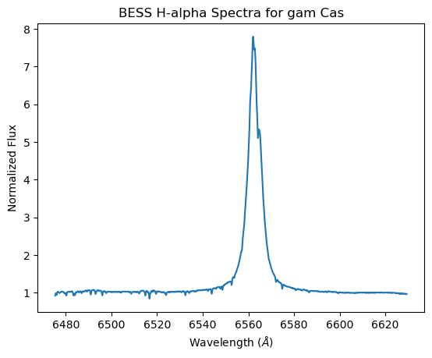
V/R Variations

Slide 5
Previous Work
Density Perturbation
Variations likely caused by 1-armed spiral density perturbations (Okazaki 2016)
Carciofi et al. (2009) showed a global oscillation model for the disk of zeta Tau matches the V/R Variations and asymmetries implied by interferometric VLTI/AMBER data

Slide 6
My Work
Get VEGA data on 4 sample Be stars that have shown V/R Variations
Gam Cas, beta CMi, phi Per, zet Tau
Create a disk model with spiral asymmetries
Compare H-alpha disk model V/R variations with BESS V/R variations
Compare model Differential Visibility Amplitudes and Phases with VEGA’s
Combine results with MIRC-X data on the stars

Slide 7
My Work
Get VEGA data on 4 sample Be stars that have shown V/R Variations
Gam Cas, beta CMi, phi Per, zet Tau
Create a disk model with spiral asymmetries
Compare H-alpha disk model V/R variations with BESS V/R variations
Compare model Differential Visibility Amplitudes and Phases with VEGA’s
Combine results with MIRC-X data on the stars
Gain a better understanding of the structures inside the disks at different scales!

Slide 8
My Model
A radiative transfer code that can create models (containing images, fluxes, velocities) with spiral density asymmetries for multiple wavelength bins.
Inputs are: star, line, inc, n0, m, jrot, beta, scattering, mode, offset, ef, sigma, spa

Slide 9
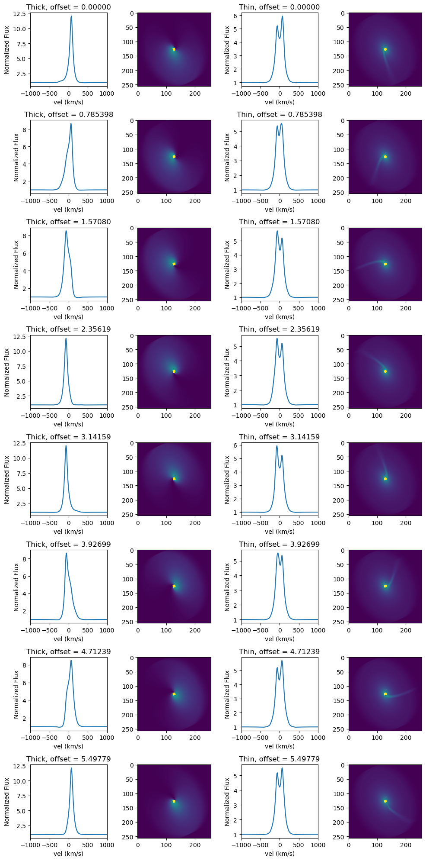
1
2
3
4

Slide 11
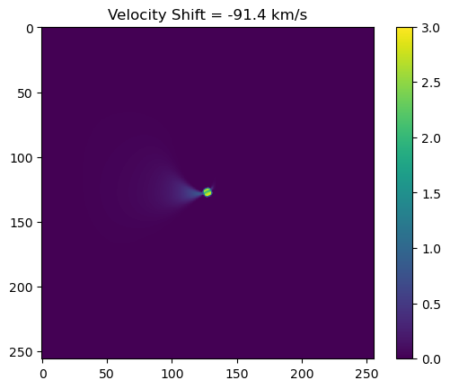
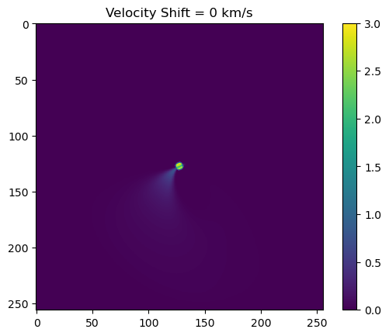
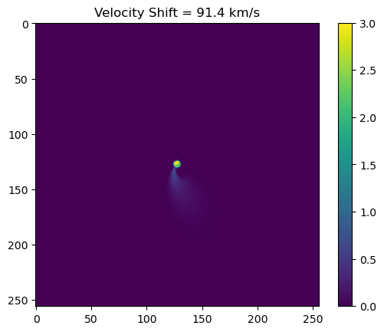
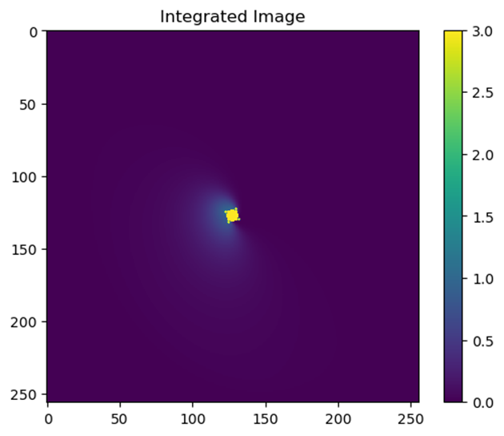

Slide 12
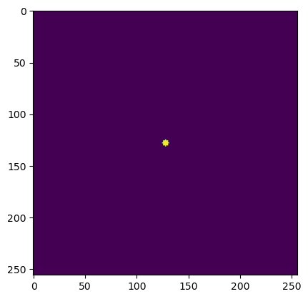
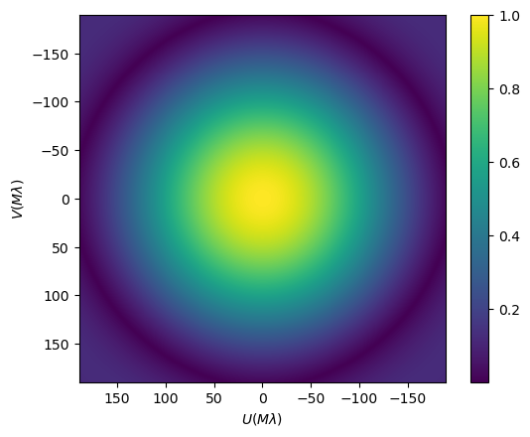

Slide 13
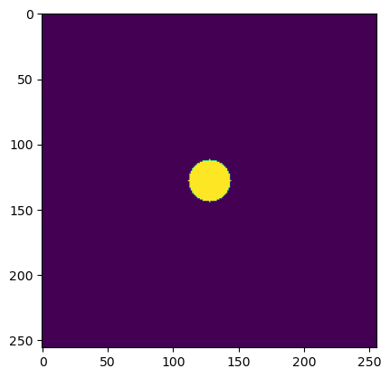
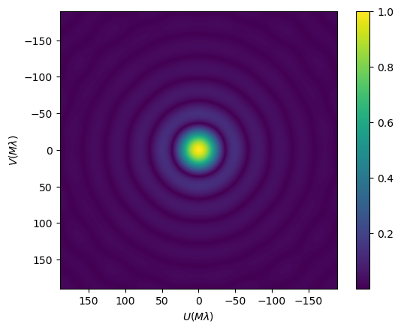

Slide 14
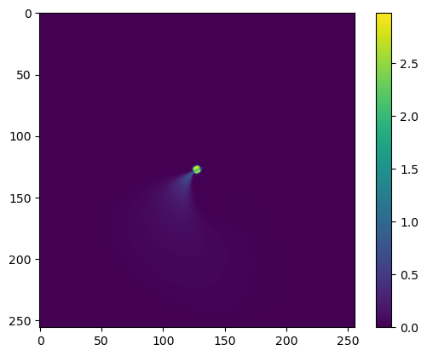
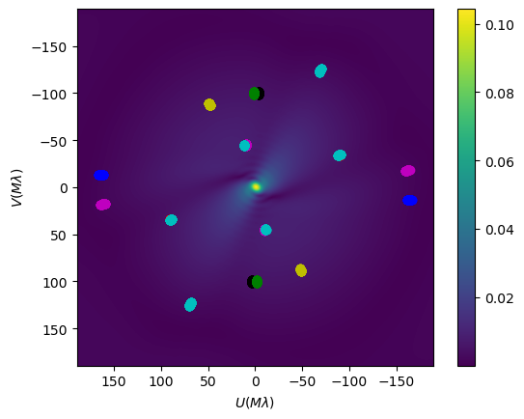
Visibility of Model

Slide 15
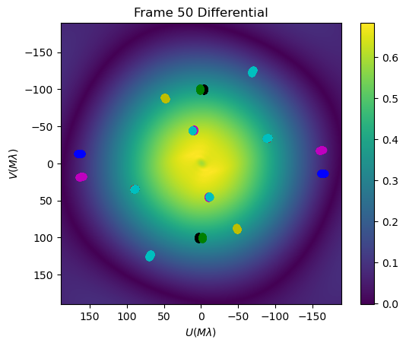
Differential Visibility of Model

Slide 16
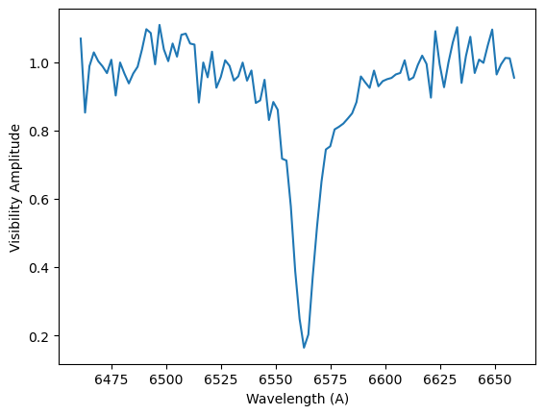
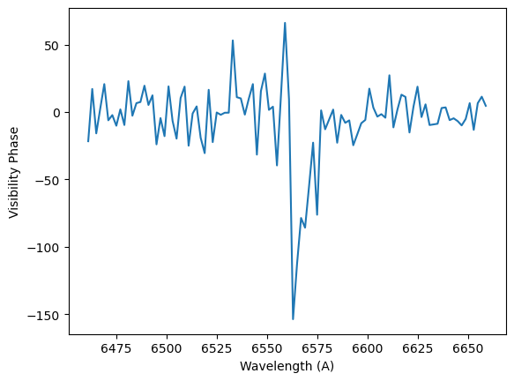
VEGA Differential Visibility and Phase

Slide 17
Objectives
Current
Future
Validate that my visibilities for my images are correct
Begin comparing VEGA data to my models
Begin determining which parameters fit H-alpha profile, differential visibility amplitudes, and differential visibility phases
Expand to all of my stars
Expand to MIRC-X data

