Slide 1
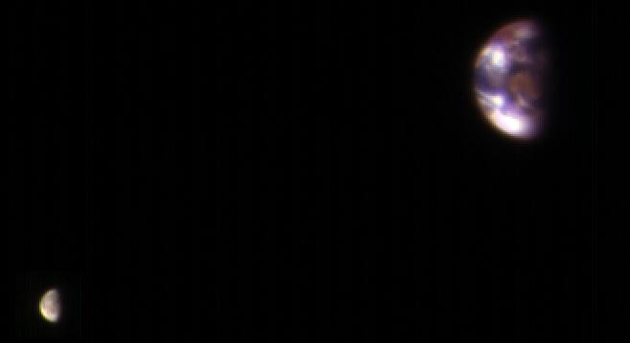
Where is this?
HiRISE camera
on MRO
2016
…
composite
Moon much darker
Notes:
EARTH AND MOON FROM MARS: This composite image of Earth and its moon, as seen from Mars, combines the best Earth image with the best moon image from four sets of images acquired on Nov. 20, 2016, by the High Resolution Imaging Science Experiment (HiRISE) camera on NASA's Mars Reconnaissance Orbiter.
Each was separately processed prior to combining them so that the moon is bright enough to see. The moon is much darker than Earth and would barely be visible at the same brightness scale as Earth. The combined view retains the correct sizes and positions of the two bodies relative to each other.
HiRISE takes images in three wavelength bands: infrared, red, and blue-green. These are displayed here as red, green, and blue, respectively. This is similar to Landsat images in which vegetation appears red. The reddish feature in the middle of the Earth image is Australia. Southeast Asia appears as the reddish area (due to vegetation) near the top; Antarctica is the bright blob at bottom-left. Other bright areas are clouds.
These images were acquired for calibration of HiRISE data, since the spectral reflectance of the Moon's near side is very well known. When the component images were taken, Mars was about 127 million miles (205 million kilometers) from Earth. A previous HiRISE image of Earth and the moon is online at PIA10244.

Slide 2
The Future
papers
due
5pm
reviews
due
5pm
grades
due
23
24
talks
T u r k e y T i m e

Slide 3

Life Beyond Earth

Slide 4
The Votes Are In
YES NO
Life in Solar System? ? ?
Life in Universe? ? ?
Intelligent Life in Solar System? ? ?
Intelligent Life in Universe? ? ?

Slide 5
The Votes Are In 2024
YES NO
Life in Solar System? 3 4
Life in Universe? 6 1
Intelligent Life in Solar System? 0 7
Intelligent Life in Universe? 5 2

Slide 6
The Votes Are In 2003-2024
YES NO
Life in Solar System? 69 (70%) 30
Life in Universe? 99 (98%) 2
Intelligent Life in Solar System? 4 (4%) 98
Intelligent Life in Universe? 90 (89%) 11
Notes:
Did not do votes in 2022 … I was in Chile.

Slide 7
Case for Life As We Know It
+ no shortage of locations with varying environments
+ plenty of energy from stars, impacts, weather
+ raw materials, CHON, are ubiquitous
+ evidence of chemical evolution found in meteorites
+ DNA made of a few basic molecules (bases/sugars/phosphates)
+ significant evidence of evolutionary adaptability
+ time
o no evidence that there is no life
– series of unlikely accidents required?
– the Universe can be an unforgiving place
– no experiment has produced a living organism (but, virus made)
– no evidence that there is life!
but, it is early in the game

Slide 8
Solar System Locations for Life
1 star Sun
4 terrestrial planets Mercury, Venus, Earth, Mars
2 gas giant planets Jupiter, Saturn
2 ice giant planets Uranus, Neptune
7 large moons Moon, Io, Europa, Ganymede,
Callisto, Titan, Triton
small moons, asteroids, Phobos, Ceres, Amalthea,
comets, TNOs, dust Rhea, Enceladus, Titania, Proteus,
Pluto, Charon
WHICH ARE THE BEST OPTIONS?
Notes:
Titania = Uranus’ largest moon, #8 in SS, diam 980 mi
Proteus = Neptune’s second largest moon, diam 260 mi

Slide 9
Solar System Locations for Life
1 star Sun
4 terrestrial planets Mercury, Venus, Earth, Mars
2 gas giant planets Jupiter, Saturn
2 ice giant planets Uranus, Neptune
7 large moons Moon, Io, Europa, Ganymede,
Callisto, Titan, Triton
small moons, asteroids, Phobos, Ceres, Amalthea,
comets, TNOs, dust Rhea, Enceladus, Titania, Proteus,
Pluto, Charon

Slide 10
Exoplanet Scorecard (20 NOV 2024)
Indirect Methods
1. pulsar timing 8 planets
2. radial velocities 1094 planets
3. transits 4309 planets
4. microlensing 230 planets
5. astrometry 3 planets
6. other 61 planets
Direct Methods
6. imaging 82 planets
TOTAL 5787 planets
NASA Exoplanet Archive
Last 2 Years
...
+ 8%
+ 11%
+ 27%
…
…
+ 28%
+ 11%
Notes:
counts updated 12 APR 2017 using exoplanet.eu
X. microlensing 81 systems 84 planets

Slide 11
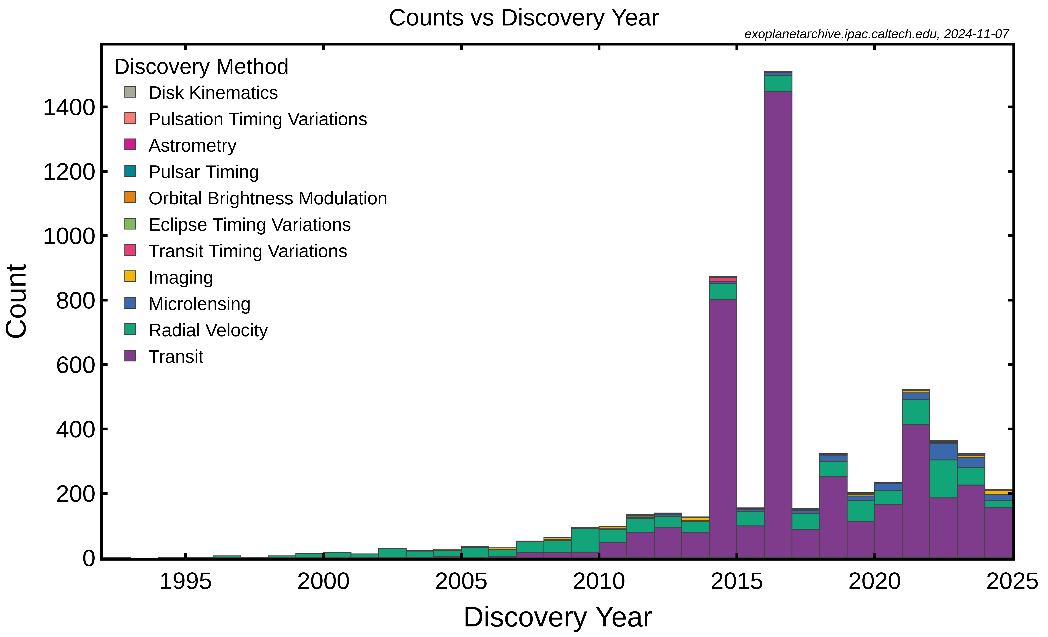
Exoplanets
Gaia will soon blow this up …

Slide 12
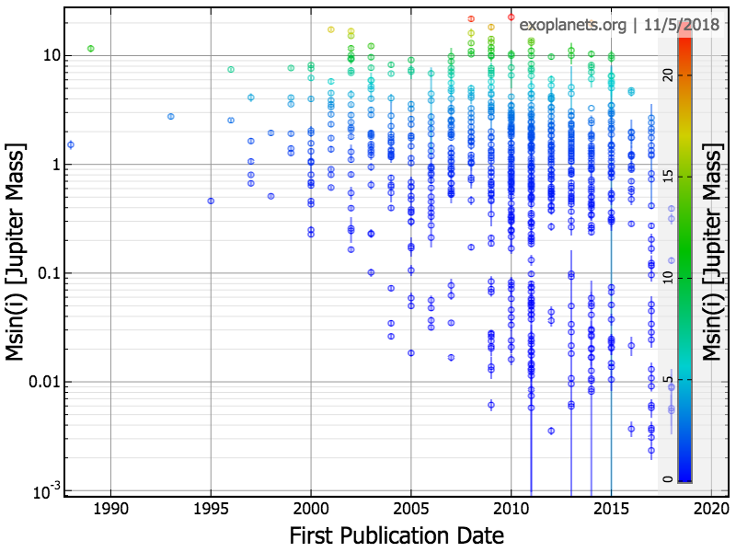
Exoplanets
Jup
Nep
Ear
Notes:
12

Slide 13
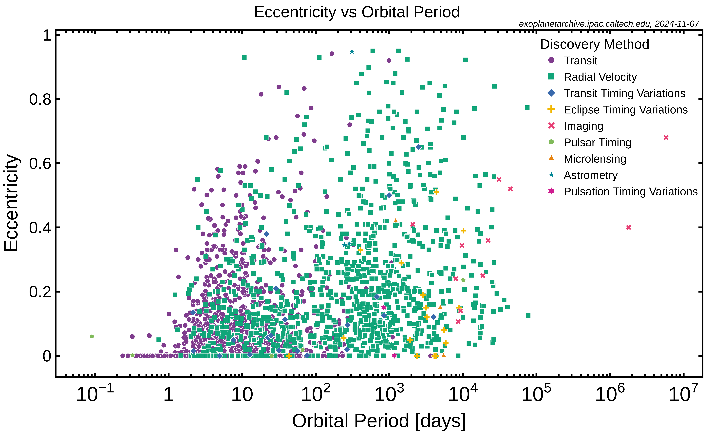
Exoplanets
The Universe will make anything you want …

Slide 14
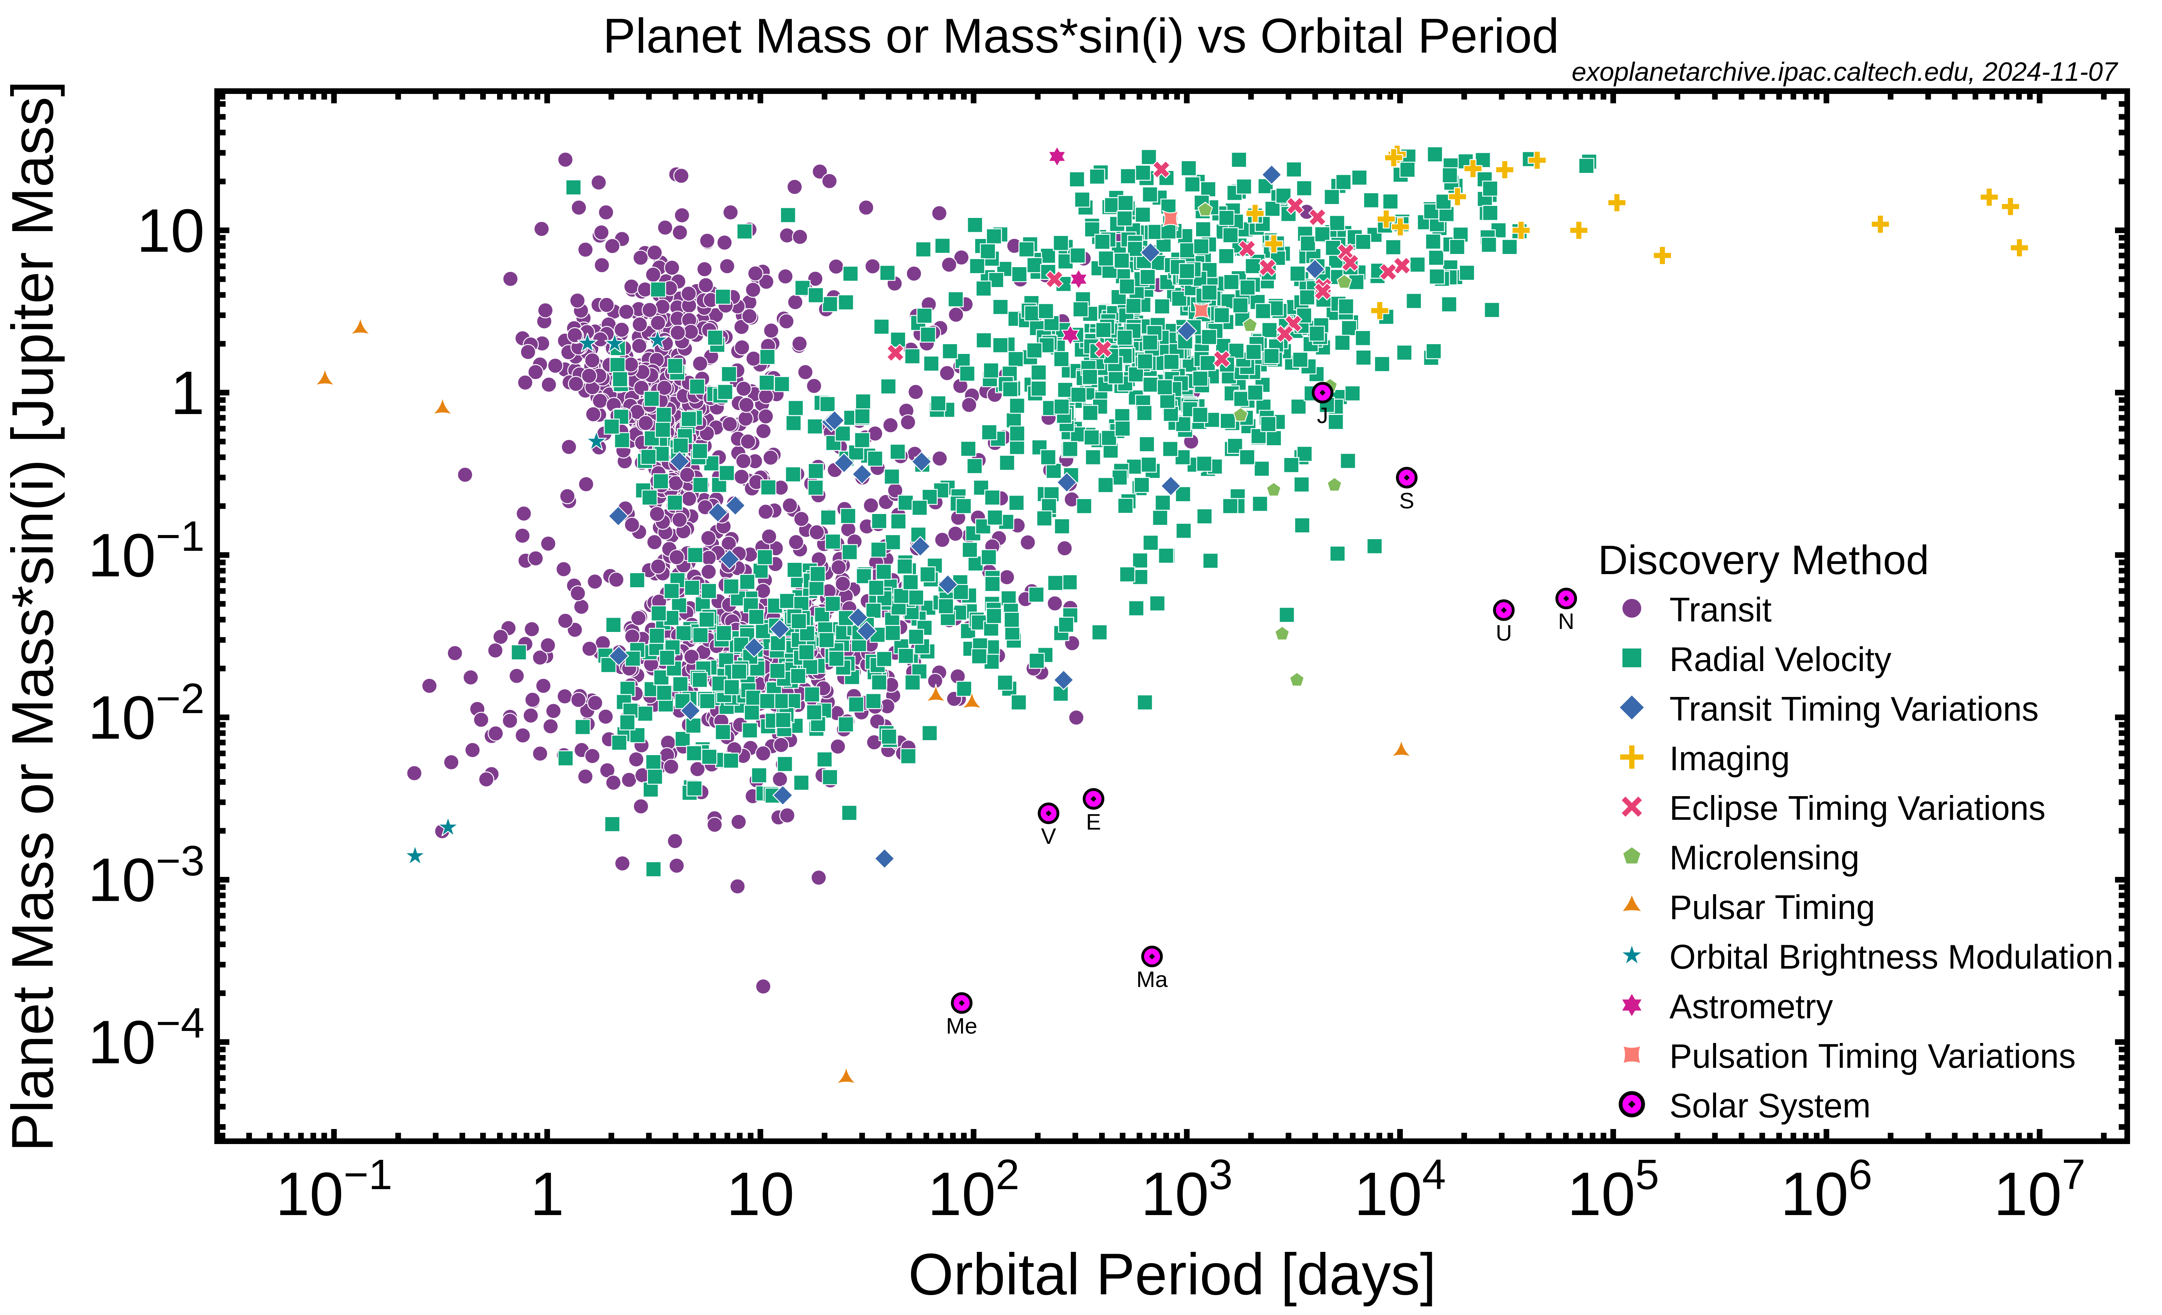
Exoplanets
Notes:
14

Slide 15
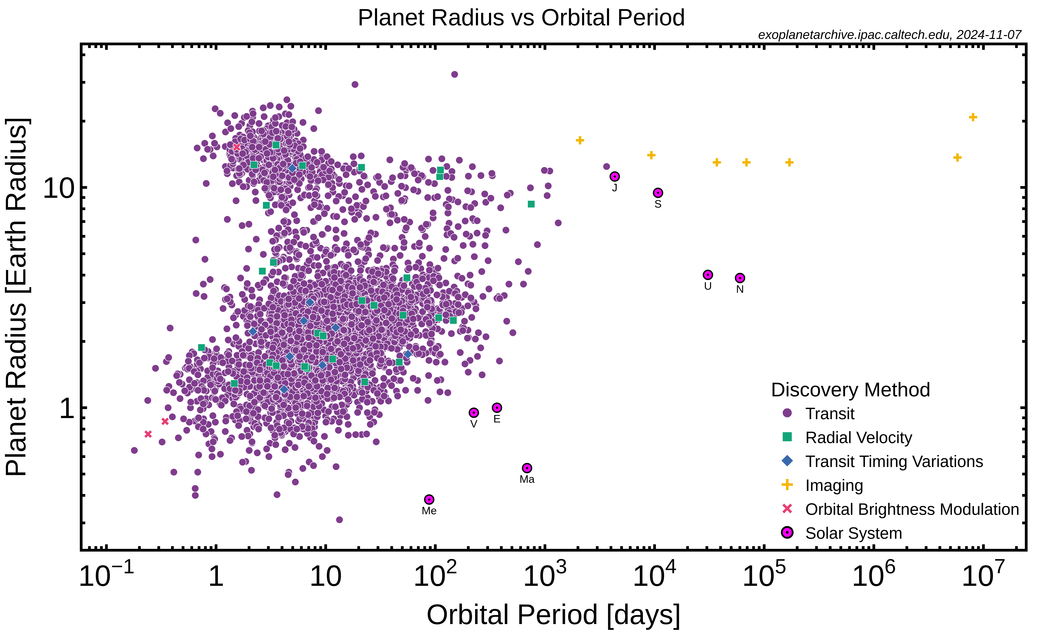
Exoplanets
Notes:
15

Slide 16
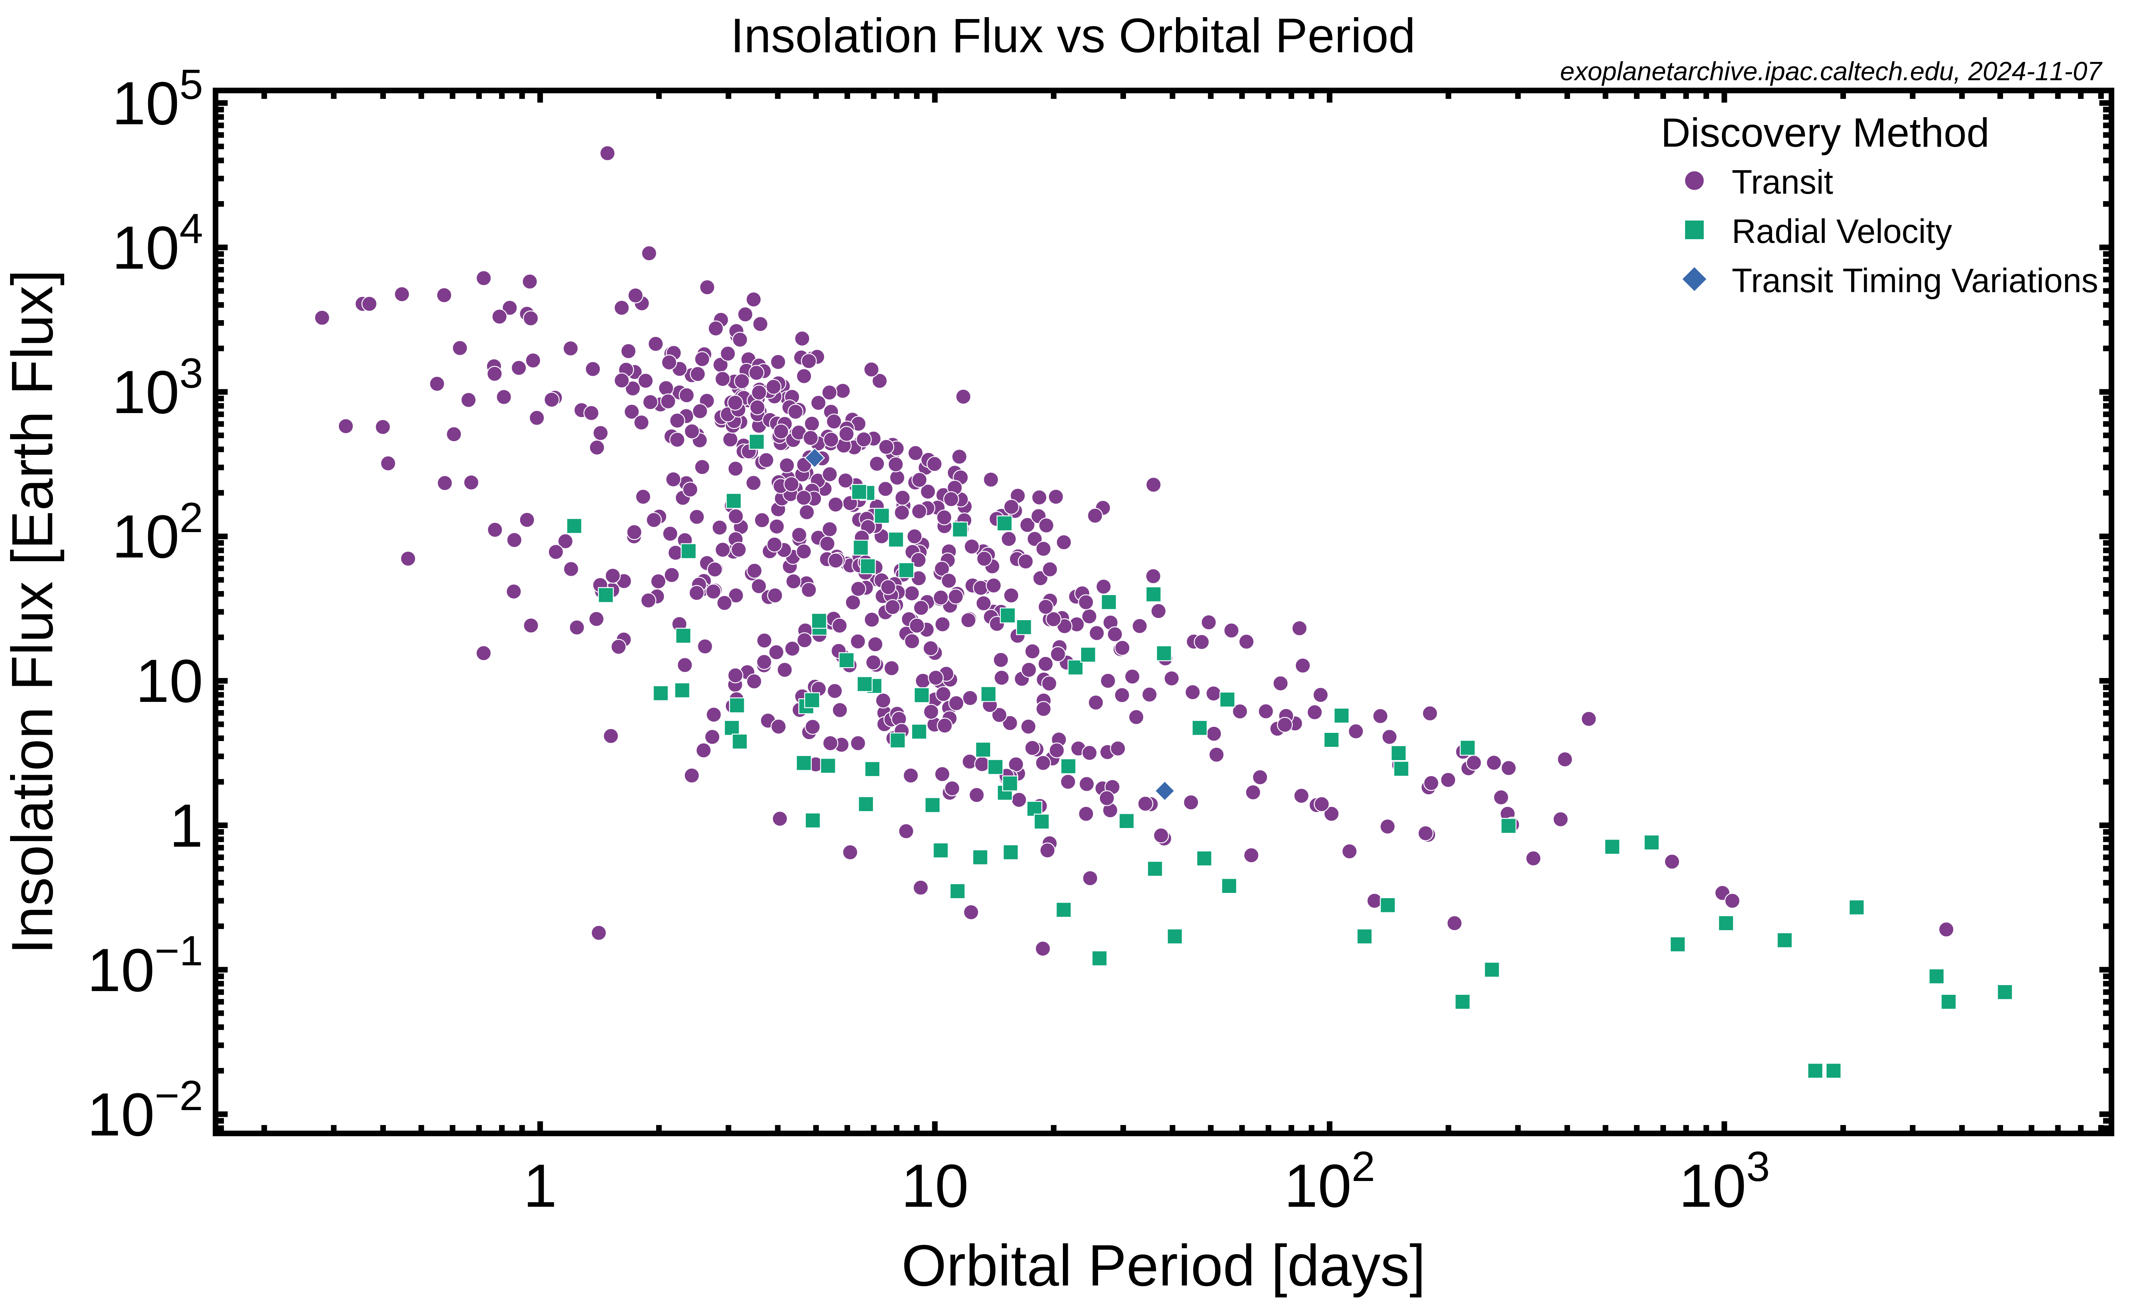
Exoplanets
Earth
Notes:
16

Slide 17
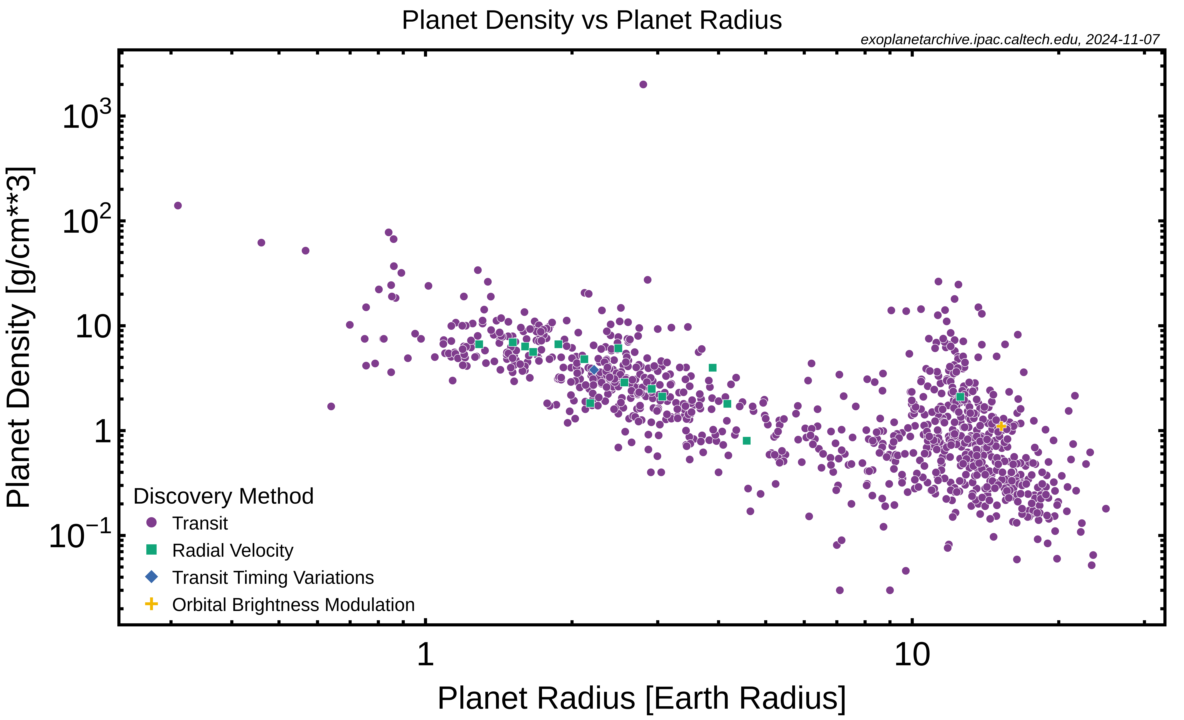
Exoplanets
?
Jupiter
Earth
?
The Universe will make (just about) anything you want …

Slide 18
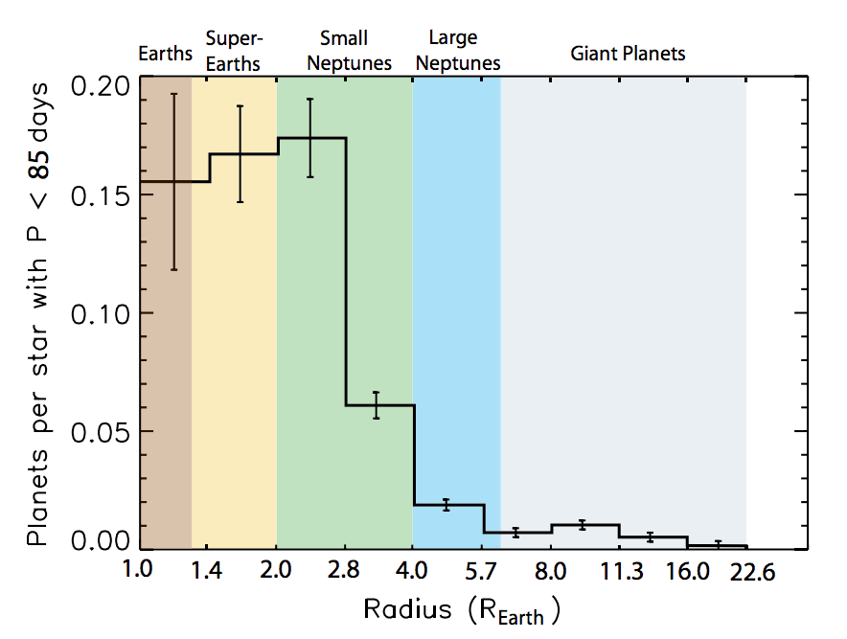
Kepler Results (all stellar types)
what about
longer
orbital P?
Neptune
Fressin+ 2013
occurrence not strong dependence on host star type
Notes:
Occurrence appears that it might level off for sizes below ~2.8 R_Earth. Is this inherently true for all small planets, or might it be a consequence of the types of orbits Kepler is most sensitive to (<85 day orbits). What about size distributions at longer periods?

Slide 19
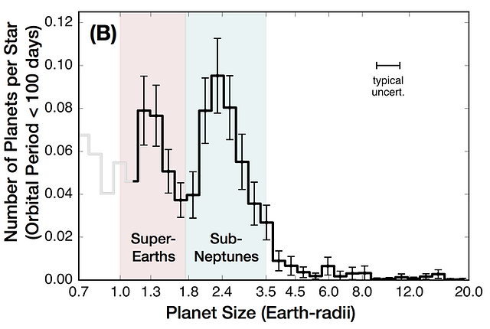
Exoplanet Types
what about
longer
orbital P?
Fulton+ 2017
Notes:
Occurrence appears that it might level off for sizes below ~2.8 R_Earth. Is this inherently true for all small planets, or might it be a consequence of the types of orbits Kepler is most sensitive to (<85 day orbits). What about size distributions at longer periods?

Slide 20
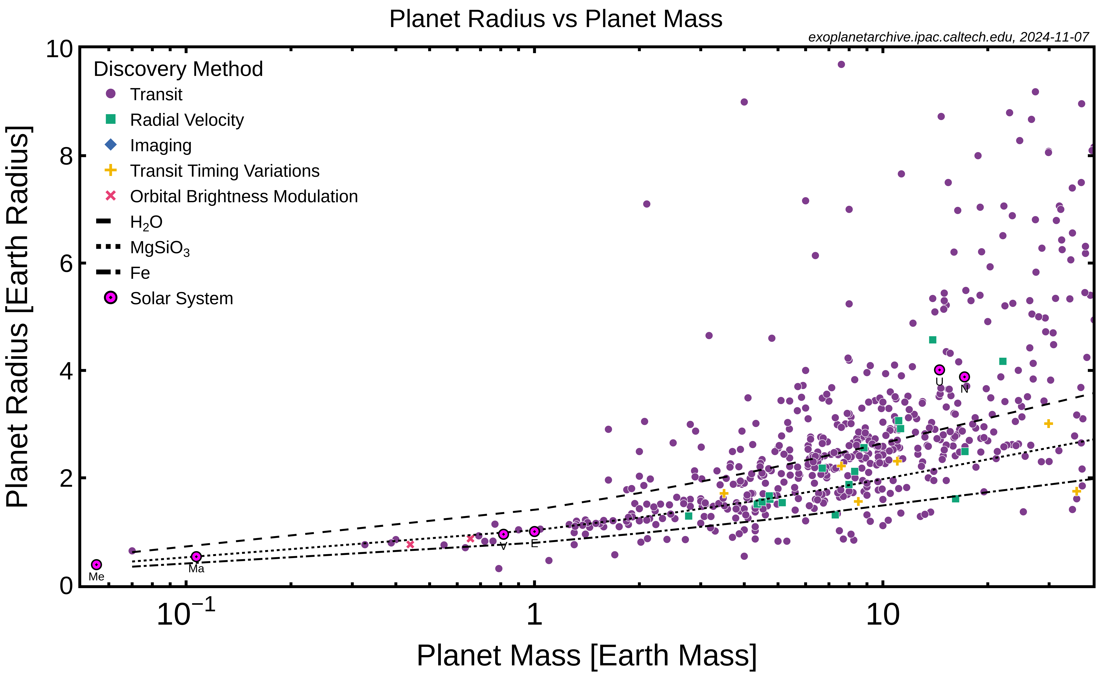
Radius/Mass Diagram

Slide 21
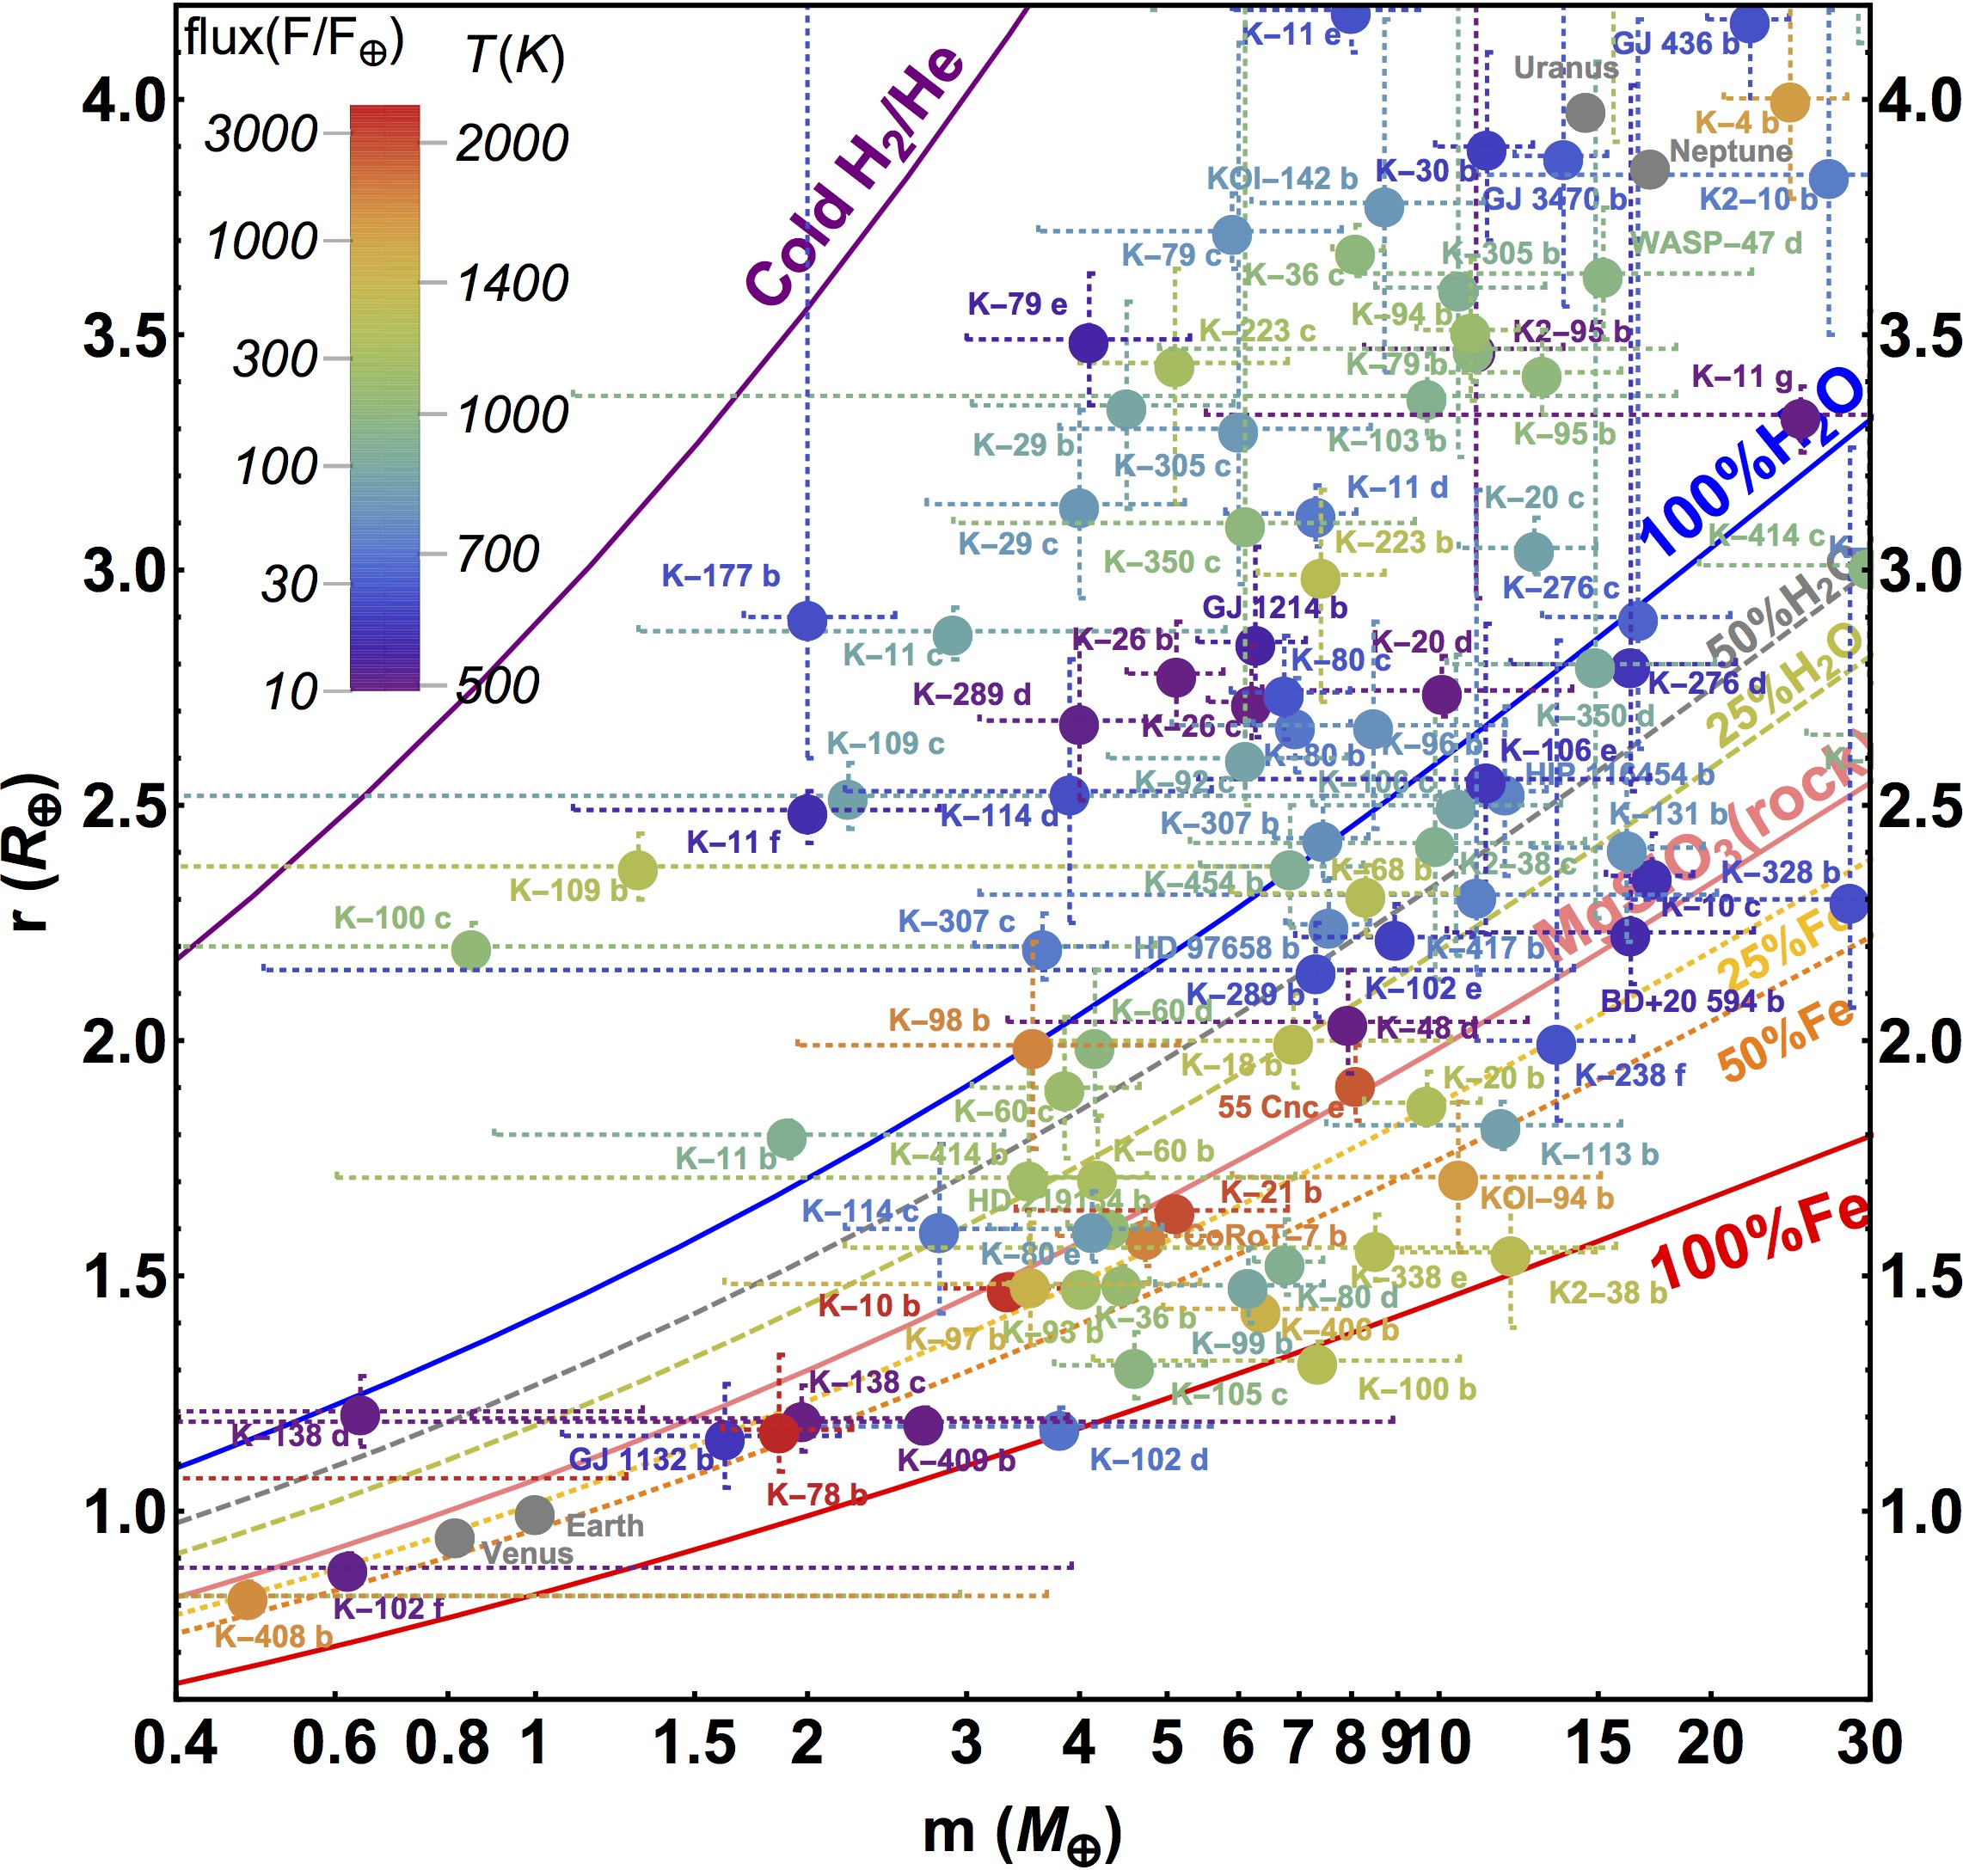
Radius/Mass Diagram … Dirty
planets
orbiting
various
stellar
types
Kaltenegger
2017

Slide 22
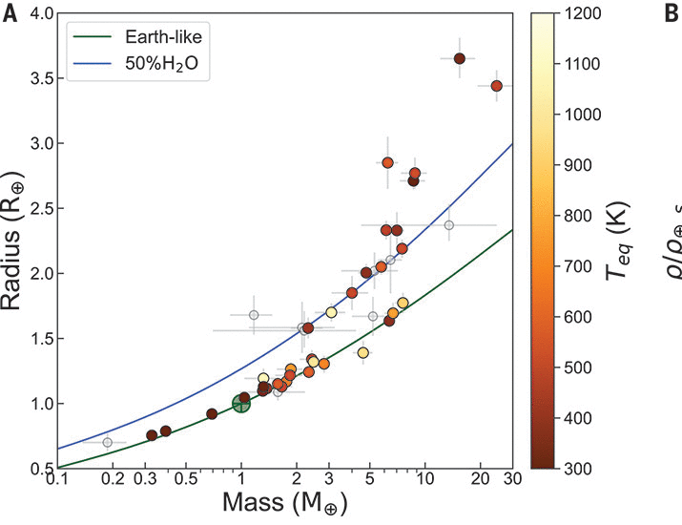
Radius/Mass Diagram … Clean(er)
planets
orbiting
M dwarfs
Luque & Palle
2022

Slide 23
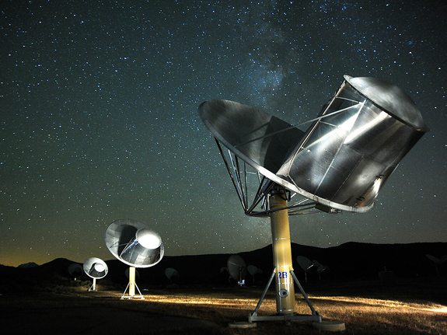
Life Beyond Earth
photo: Emory Kristof
Notes:
Allen Array pic by Seth Shostak

Slide 24
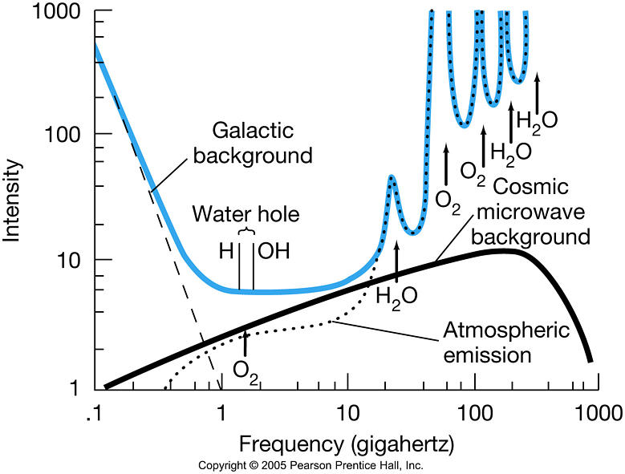
SETI Water Hole

Slide 25
SETI Surveys
 | Ozma | Project Phoenix | Allen Array
Telescope(s) | Greenbank 26m | Arecibo 305m Parkes 64m Greenbank 43m | 350 x 6.1m (= 101m dish)
Frequencies | 1.4198 to 1.4202 GHz | 1.0 to 3.0 GHz | 0.5 to 11.2 GHz
Resolution | 100 kHz | 1 Hz | 0.7 Hz
# channels | 4 | 2 x 10⁶ | 2200
Weeks/year | 4 (once) | 3 (repeating) | 52
Funding | ??? | NASA, then private | SETI Institute
# target stars | 2 | 10³ | 10⁶
# completed | 2 | ~ 50% | first light 2004
# ET signals | 0 | 0 | ???

Slide 26
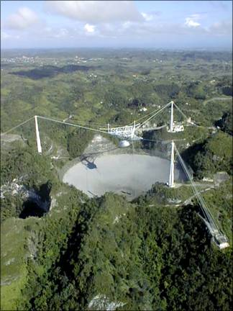
Project Phoenix
began as NASA’s High Resolution Microwave Survey (HRMS)
Targeted Search (Ames) and Sky Survey (JPL)
first observations, October 12, 1992
cancelled by Congress in 1993
renamed Project Phoenix
private funding sources sought
private funding sources found
Arecibo 305m (largest in N)
Jodrell Bank (England)
Greenbank 43m
Parkes 64m (largest in S)

Slide 27
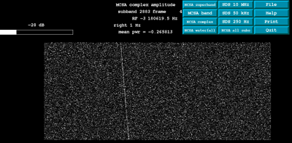
Project Phoenix Detects ET!
time
frequency
test case: Pioneer 10 beyond 70 AU
signal allowed to drift in frequency from Earth motion
separates terrestrial from extraterrestrial signals

Slide 28
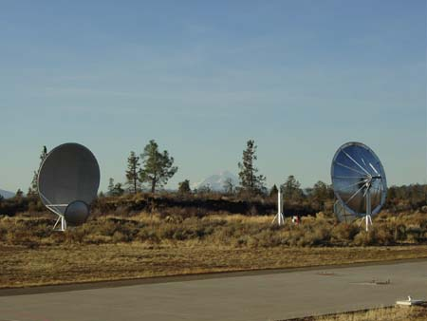
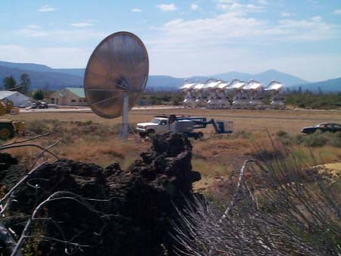
Allen Array
dedicated SETI effort … Paul Allen (co-founder of Microsoft) $30M
SETI Institute and UC Berkeley
Hat Creek Observatory, Mt. Lassen, California
350 antennas 6.1m diameter = 100m radio telescope
42 in operation

Slide 29
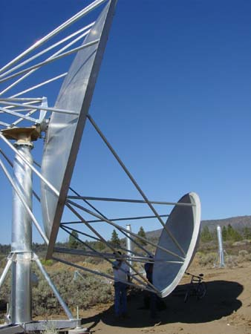
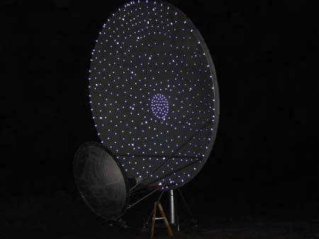
Allen Array
Gregorian design
350 X 6.1m dishes
Notes:
to reduce interference, Gregorian telescopes: A secondary mirror bounces incoming radio signals collected by the large (6.1 meter diameter) primary reflector back to the feed antenna (hidden from view by a fabric shroud) where they are amplified and sent on their way to the control buildings.

Slide 30
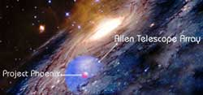
Allen Array
Project Phoenix got 3 weeks/year at Arecibo
Allen Array increases efficiency by > 100X
full time SETI operation
daytime observations ok (Arecibo has Sun problem)
different stars (Arecibo limited to near-ecliptic sources)
multiple dishes … ~20 stars searched simultaneously
expansion easy
… target list grows from 1,000 stars to 1,000,000 stars
Project Phoenix 50 pc
Allen Array 300 pc
Notes:
single pointing of subarrays has ~20 individual stars

Slide 31
The Drake Equation
N = R* f_{p} n_{e} f_{l} f_{i} f_{c} L
N # civilizations with detectable electromagnetic emissions
R* rate of star formation (stars/year) suitable for intelligent life
f_{p} fraction of stars with planetary systems
n_{e} # of worlds/system with environment suitable for life
f_{l} fraction of planets on which life appears
f_{i} fraction of life-bearing planets on which intelligent life emerges
f_{c} fraction of civilizations revealing existence
L length of time civilizations release detectable signals (years)

Slide 32
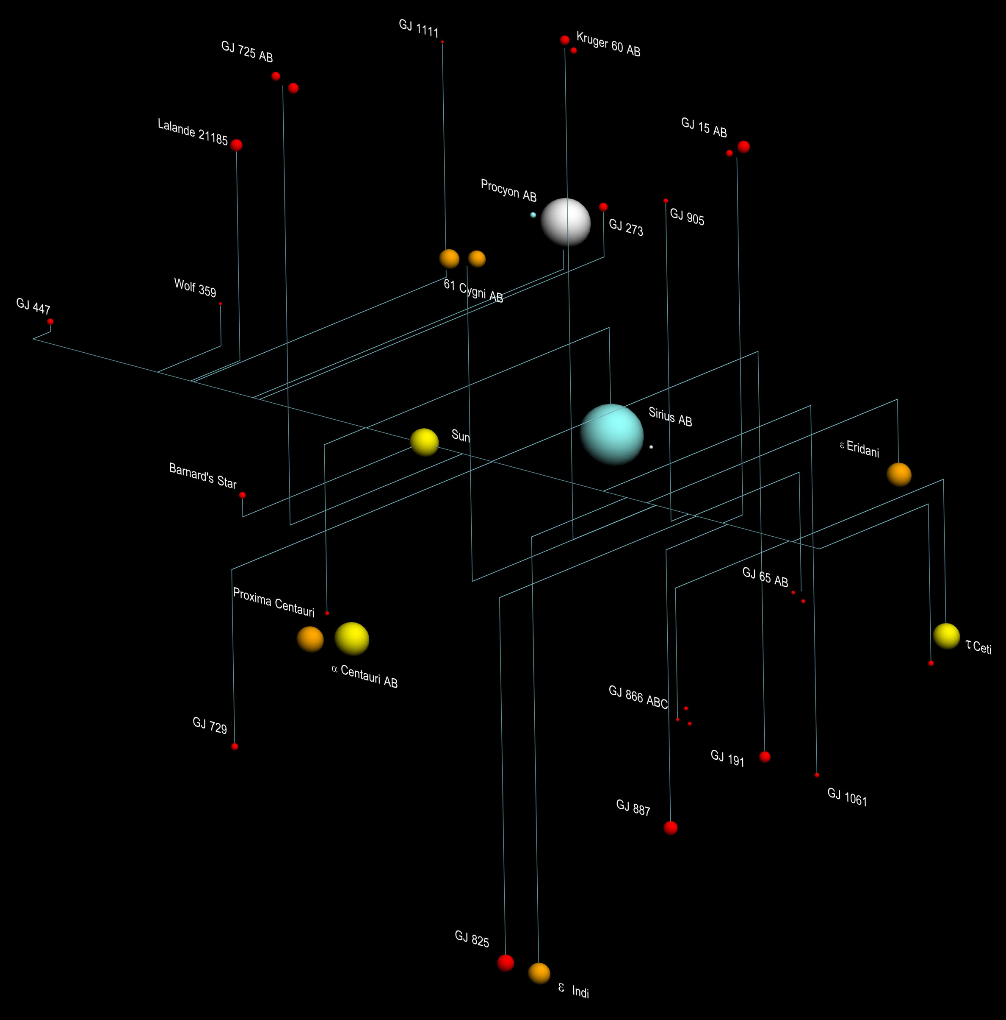
10 Parsec Census 2024
wd 21 6 %
O,B 0 0 %
A 4 1 %
F 7 2 %
G 19 5 %
K 42 11 %
M 280 75 %
pl 107+8
Henry & Jao 2024
Notes:
M dwarfs includes WT 460B

Slide 33
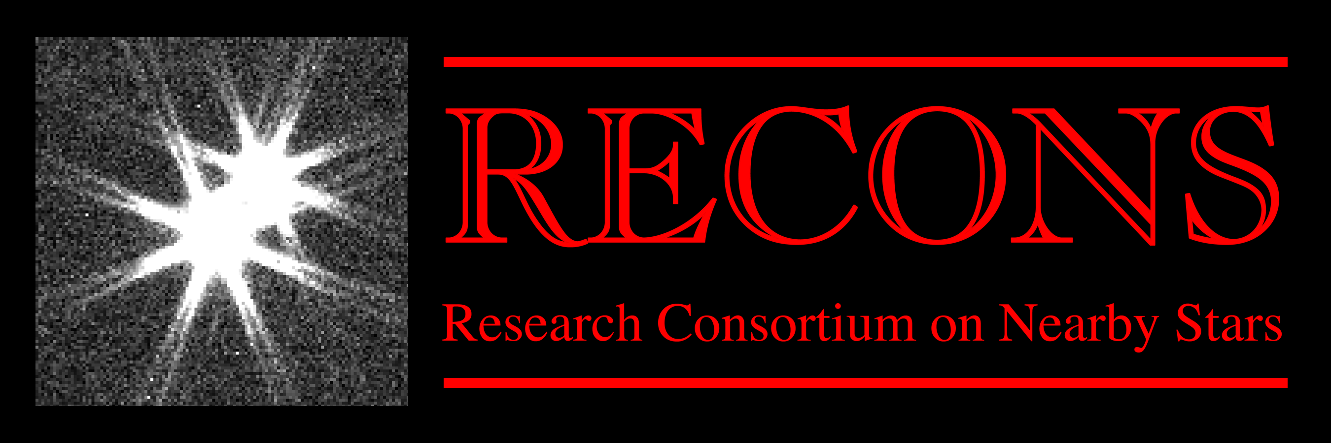
Three Laws of M Dwarfs
M dwarfs account for three of every four stars.
M dwarfs counts increase all the way to the end of the main sequence.
M dwarfs are partially radiative at high masses and fully convective at low masses.
Henry & Jao 2024

Slide 34
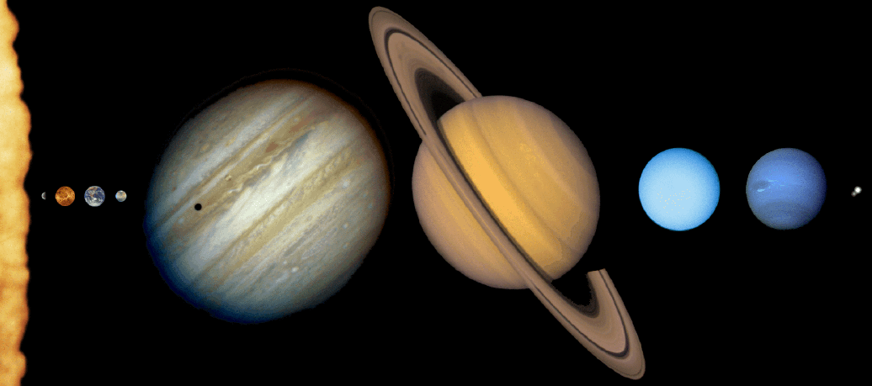
Solar Family
How are they different?

Slide 35
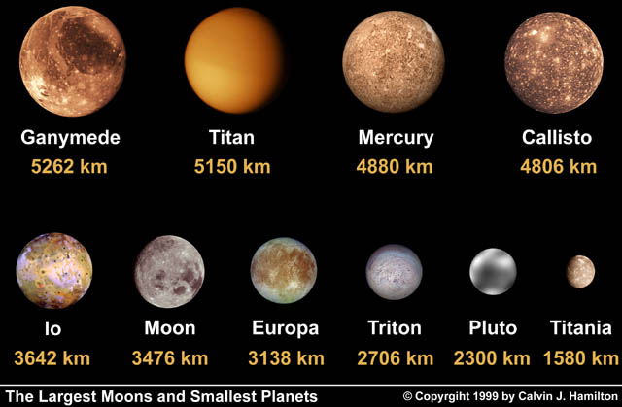
The Seven Dwarfs

Slide 36
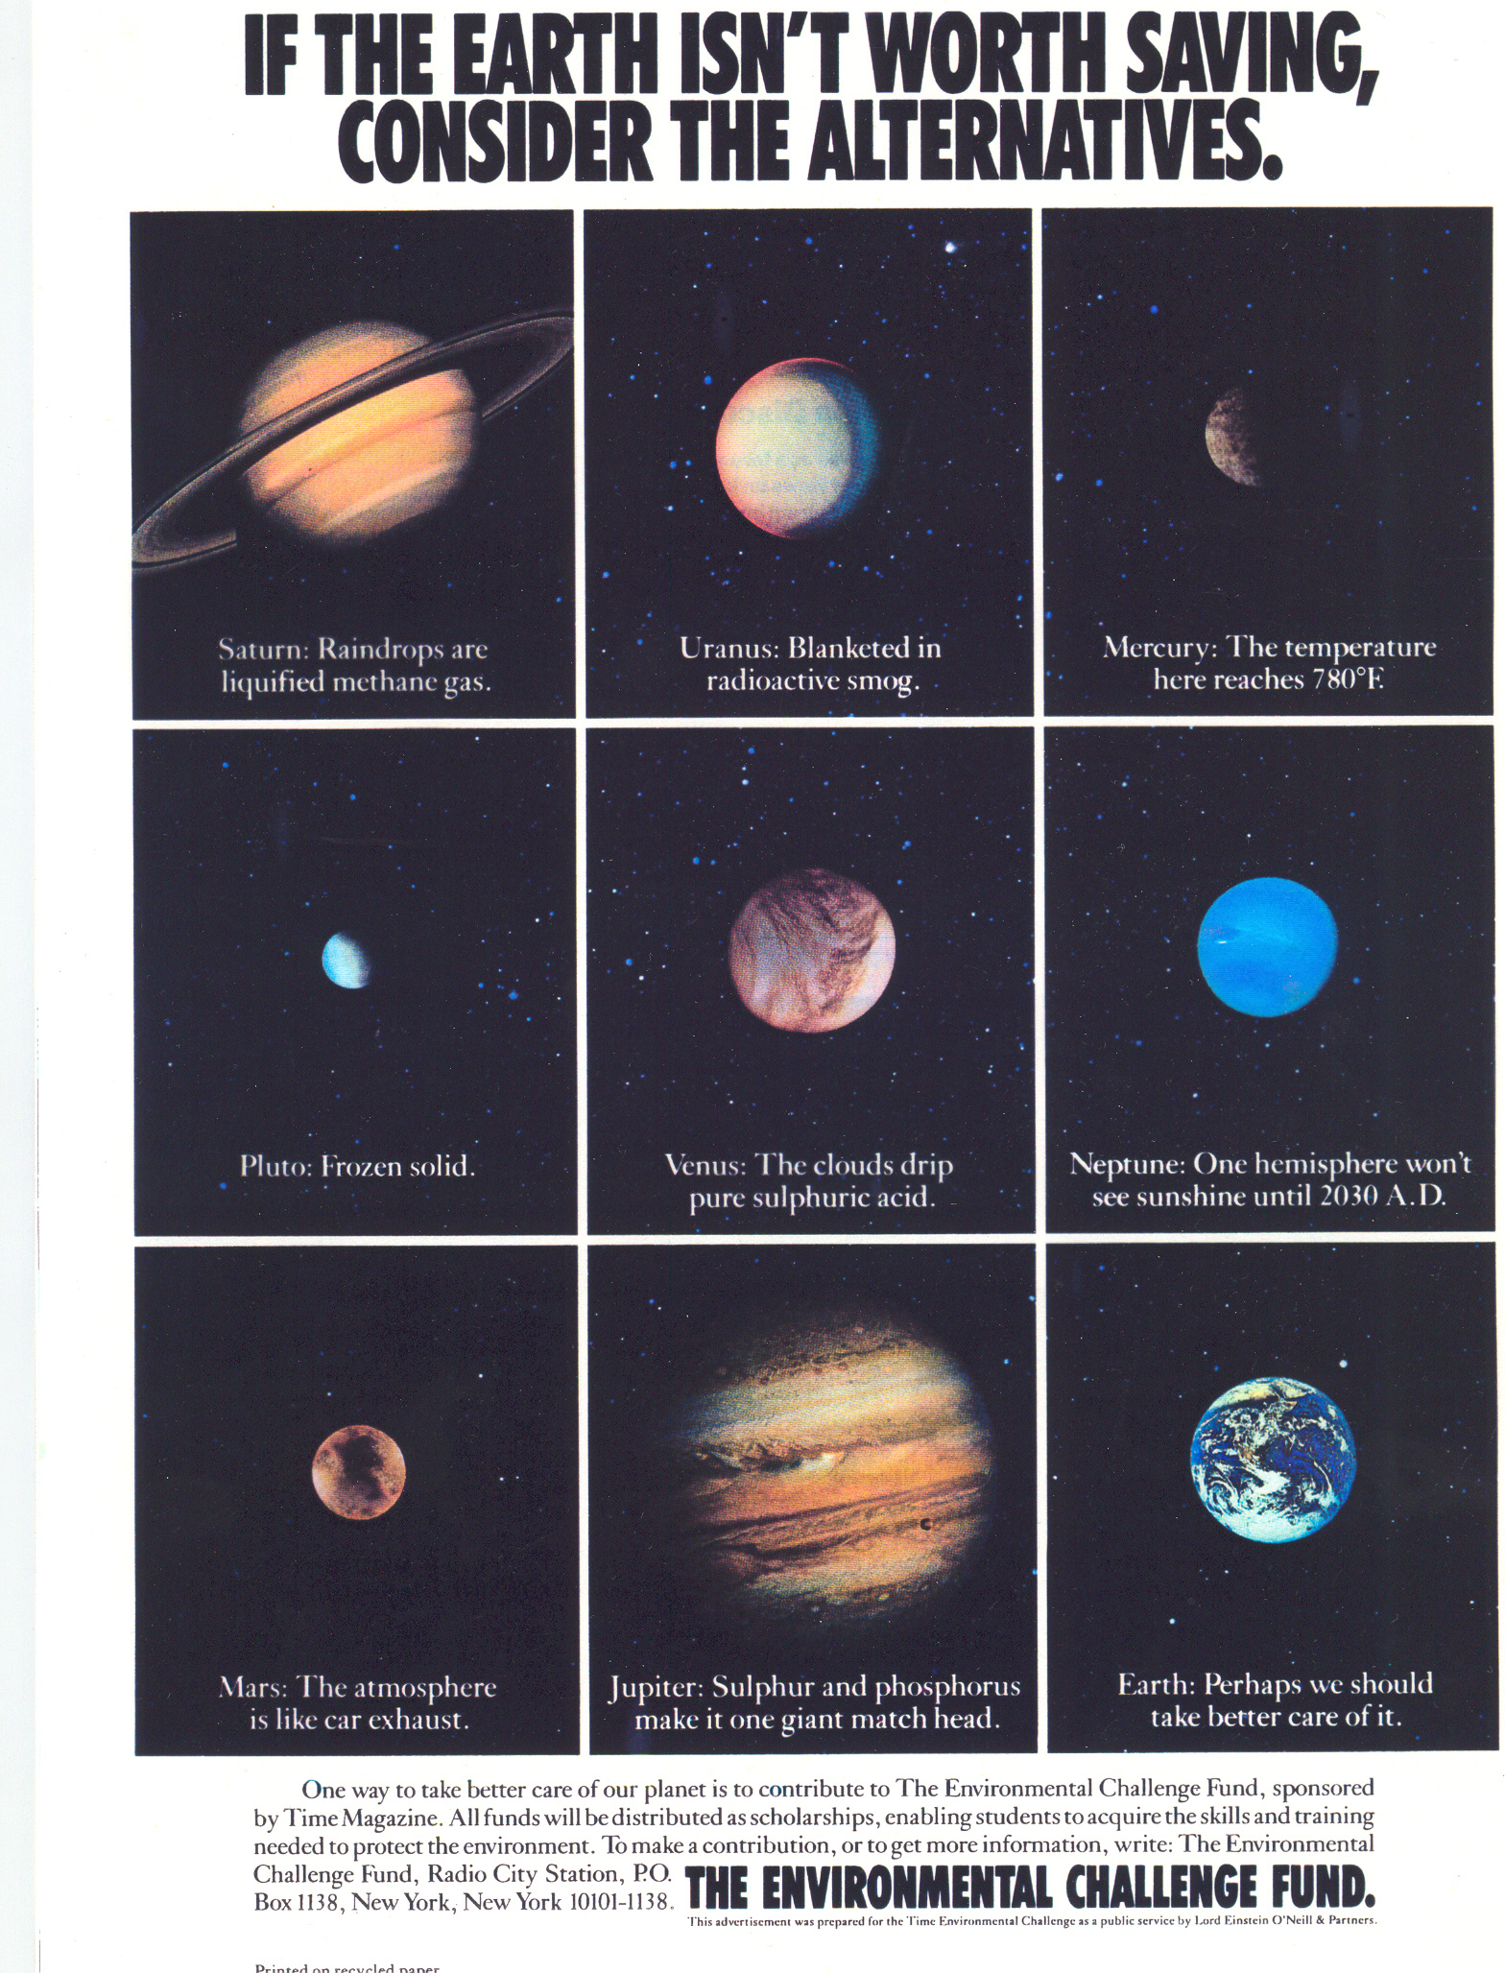
Nice Earth

Slide 37


The Brothers Henry

Slide 38
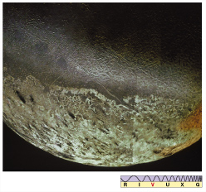
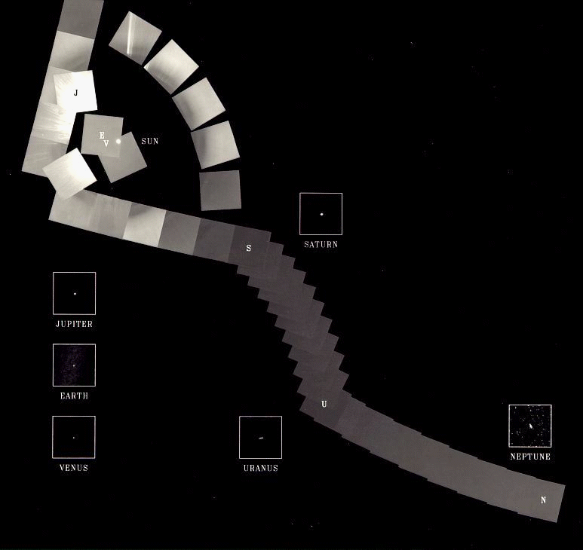
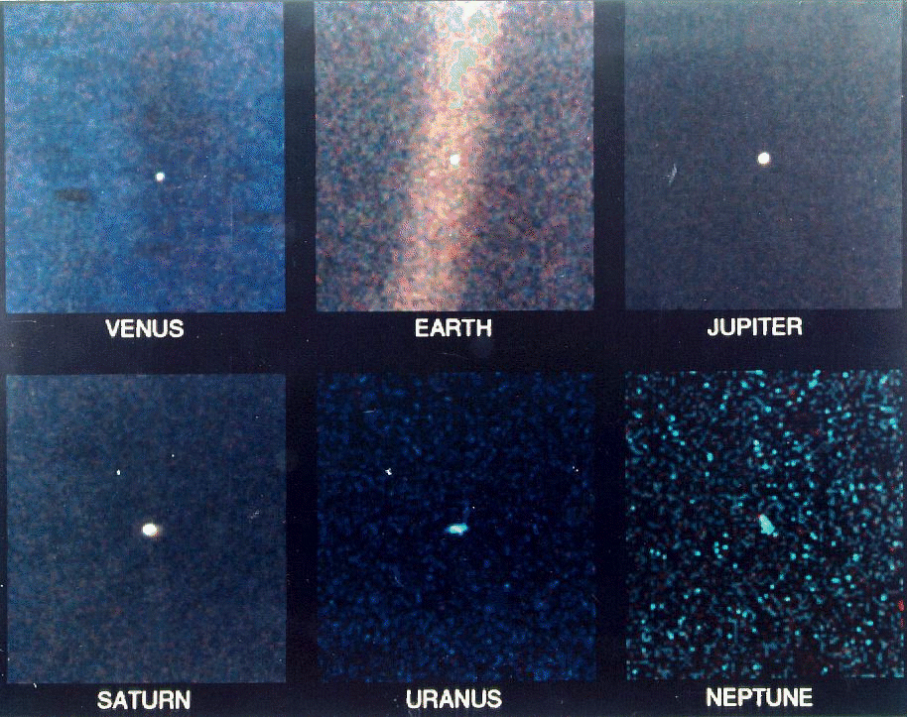
Voyager’s Farewell

Slide 39
Solar System Explorers: 21 NOV
Describe any crazy extremophile found on Earth.
1. Lesser flamingos … 75% all in one 140F lake with ph = 9-10.5
2. Sulphur mollys … fish in H2O to 109F, in caves in Mexico, different subspecies per cave
3. Acithio bacillus … in ph < 1 acid mine drainage, used in biometallurgy to extract metals from ores
4. Pyrococcus furiosas … hydrothermal vents > 80C, with tungsten in enzymes
5. Snoticle … New Mexico, high concentrations of H2S in dark caves
6. Chroococcidiopsis … photosynthetic bacterium survives desication for 13 Myr
7. Vibrio cholerae … superalkaline by manufacturing it to kill competitors
8. Halobacterium … lives in hypersaline lakes
9. Yeti crab … hydrothermal vents to 2200 meters
10. …
11. …
12. …
13. …
14. …
15. …
16. …
17. …
18. …
19. …
20. …

Slide 40
Solar System Explorers: 21 NOV
Name the 2 favorite things that you learned in ASTR 8850 this year.
1. Greeks vs. Trojans exist
2. Rock became plastic in a deep Earth hole … 12 km
3. Jupiter’s magnetotail is largest structure in SS
4. Takes 7 parameters to determine an orbit
5. Charge particle sputtering makes tenuous atmospheres
6. Titan has mountains of H2O ice
7. Hiker’s rule = 5F drop per 1000 feet
8. Tadpole and horseshoe orbits are real things
9. Mars is losing its atmosphere
10. Venus has broken terrain rather than plate tectonics
11. Uranus and Neptune MAY have swapped positions
12. Europa has cycloids
13. Yarkovsky effect changes orbits and YORP changes rotation
14. Haumea is rapidly rotating in 4 hours
15. Saturn’s north polar clouds have hexagonal shape
16. Moon orbits Sun not Earth !!!!!
17. …
18. …
19. …
20. …

Slide 41
Solar System Explorers: 22 NOV
A mysterious game of fun …
1. …
2. …
3. …
4. …
5. …
6. …
7. …
8. …
9. …
10. …
11. …
12. …
13. …
14. …
15. …
16. …
17. …
18. …
19. …
20. …

Slide 42
…………………………
Notes:
42

Slide 43
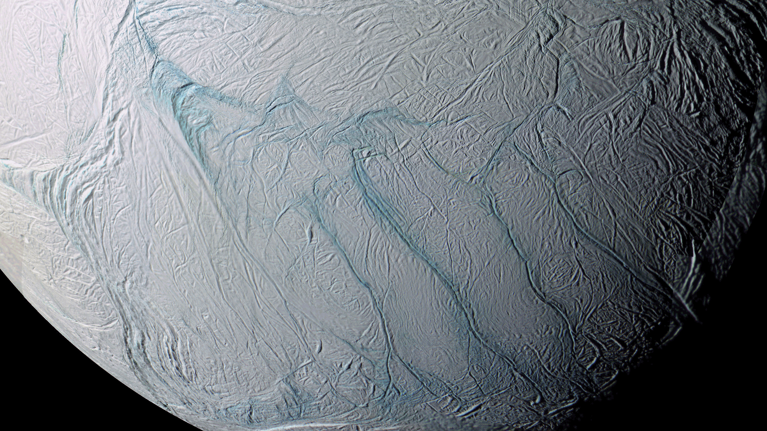
Where is this?
Notes:
ENCELADUS by CASSINI

Slide 44
How Far for 1 Million Stars?
G 375 parsecs 1222 light years
F-K 244 parsecs 795 light years
A-M 142 parsecs 462 light years
500 Light Year Catalog ... would give 10⁶ stars
The Dream
100 Parsec Catalog … ~350,000 stars

Slide 45
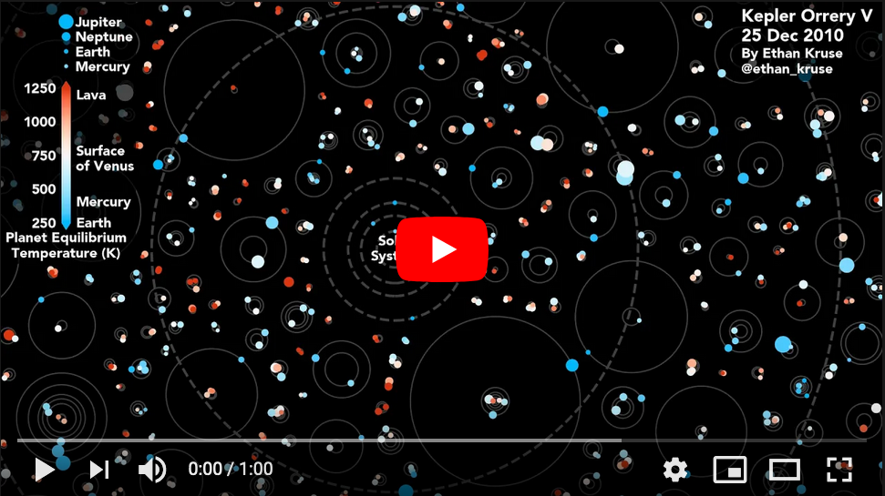
Kepler Orrery V
https://www.youtube.com/watch?v=Td_YeAdygJE

Slide 46
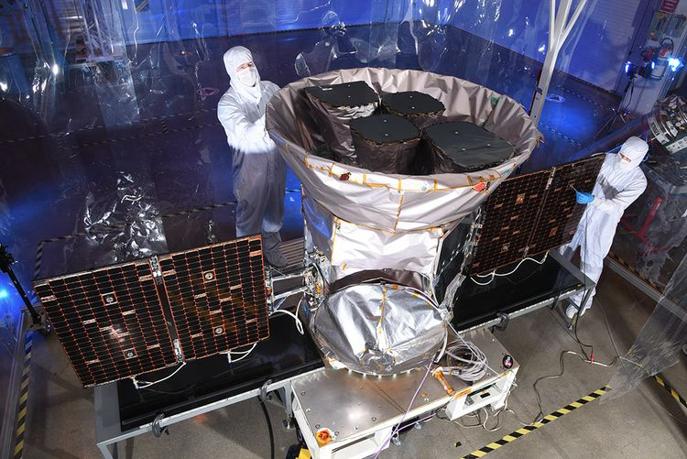
Transiting Exoplanet Survey Satellite TESS

Slide 47
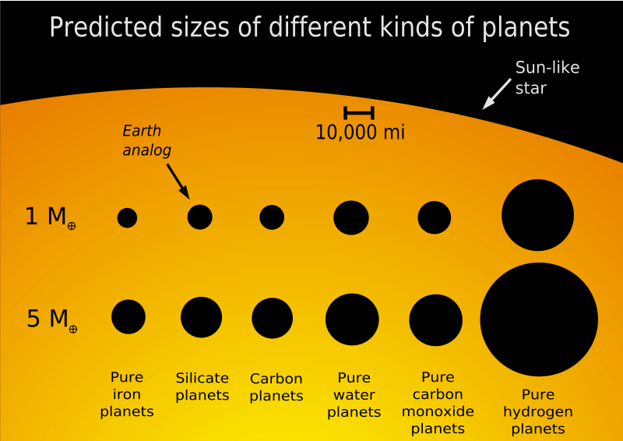

Slide 48
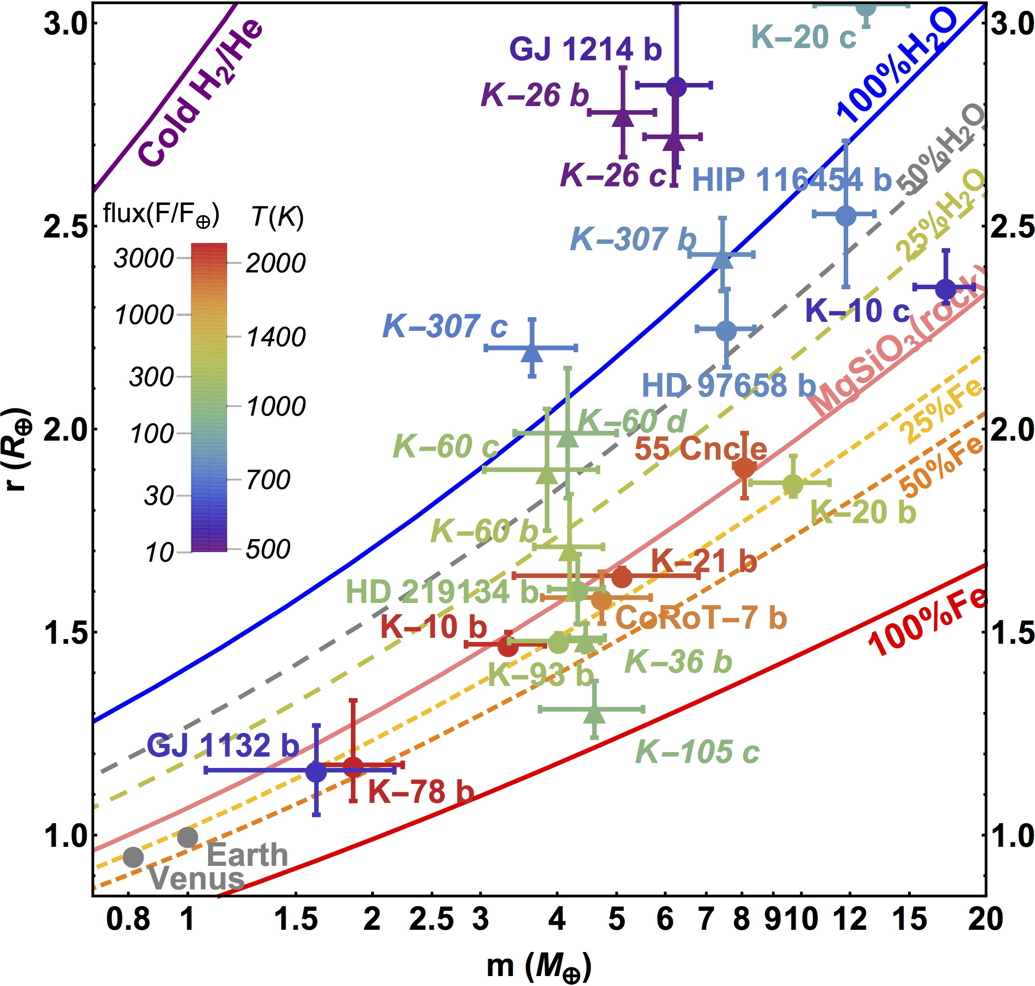
Mass-Radius Plot
of Planets up to
20 Earth Masses
(errors 30% or less)
Zeng
2016

Slide 49
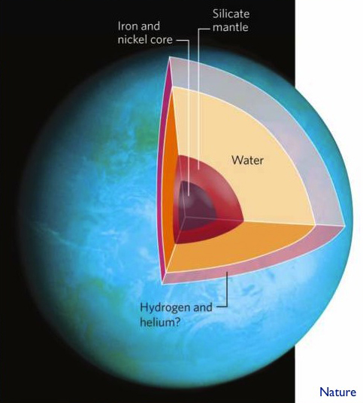
GJ 1214’s Planet
density ~1 g/cm³

Slide 50
M Stars for SETI
the bad news
a. HZ width narrow and close
estimated to be 0.75 AU wide for Sun, only 0.20 for M0V
tidal locking
b. flares, spots
c. planet presence
some models show no terrestrial planets in close
few giants to protect from/encourage comet bombardment
the good news
a. presence of atmosphere can solve tidal locking
for M0V and P = 1.0 Earth, HZ from 0.25 to 0.45 AU
for M0V and P = 0.1 Earth, HZ from 0.14 to 0.30 AU

Slide 51
Planets around M Dwarfs
atmospheric simulations by Joshi et al. 1997
planet placed in orbit to match solar flux levels
compare Earth’s: P ~ 1.0, tau ~ 0.9, room temp 295K
run | pressure | τ | planet | result
1 | 1.0 | 1.00 | Earth, CO₂ | T: 260-330K, CO₂ gas, H₂O ~ solid
2 | 0.1 | 0.25 | Earth, CO₂ | T: 190-360K, CO₂ gas, near collapse
3 | 1.5 | 1.50 | Earth, CO₂ | T: 290-330K, H₂O liquid, nice!
4 | 1.0 | 0.25 | Earth, N₂ | T: 220-330K, N₂ gas, collapse at 77K
5 | 1.0 | 0.50 | Earth, CO₂ | T: 240-320K
6 | 1.0 | 2.00 | Earth, CO₂ | T: 300-360K, hot!
R1 | 1.0 | 1.00 | 2R_{E} , g_{E} | T: 250-340K, further distance
R2 | 1.0 | 1.00 | 2R_{E} , 3g_{E} | T: 230-360K, slow winds
R3 | 1.0 | 1.00 | Mars, CO₂ | T: 270-310K, CO₂ gas

Slide 52
M Stars for SETI
the bad news
a. HZ width narrow and close
estimated to be 0.75 AU wide for Sun, only 0.20 for M0V
tidal locking
b. flares, spots
c. planet presence
some models show no terrestrial planets in close
few giants to protect from/encourage comet bombardment
the good news
a. presence of atmosphere can solve tidal locking
for M0V and P = 1.0 Earth, HZ from 0.25 to 0.45 AU
for M0V and P = 0.1 Earth, HZ from 0.14 to 0.30 AU
b. flares make O3, total UV flux in HZ during flare < Earth-Sun
spots last days/months, not years
c. many of the constraints are purely theoretical
+ time
+ location, location, location

Slide 53
Bottom Line for M Stars
also to be considered…
starspots
flares
orbital eccentricity
atmospheric evolution
less UV flux than for Sun
varying albedo
surface topography affecting wind patterns
what about … global ocean? darkside icecaps? moons?
BOTTOM LINE:
HZ around M dwarfs not determined simply by the M dwarf !
atmospheric composition (τ) matters
atmospheric pressure (P) matters
planet gravity (g) matters
planet size (R) matters

Slide 54
G Stars vs. M Stars
Where are you more likely to find an Earth?
HZ limits dist/* # * total dist
G stars 0.85-1.60 AU 0.75 AU 19 14.3 AU
M stars 0.25-0.45 AU 0.20 AU 280 56.0 AU
finally, don’t forget search advantages of M dwarfs
detection: interferometry and radial velocities measure reflexes
imaging: dynamic range to bridge identical, but M dwarfs closer

Slide 55
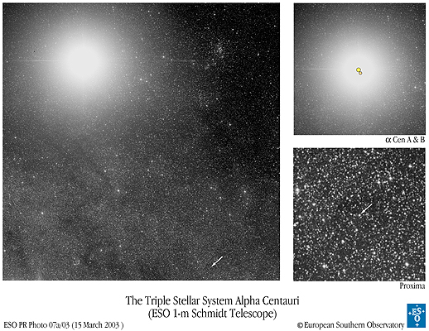
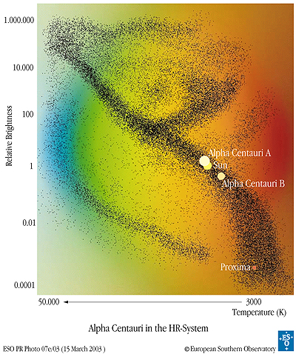
The Nearest Star System
Proxima V = 11.09 M5.5V 0.11 Mo 0.15 Ro 0.00014 Lo
π = 0.77199 0.00225 arcsec
α Cen A V = 0.01 G 2 V 1.10 Mo 1.23 Ro 1.52 Lo
α Cen B V = 1.34 K 0 V 0.91 Mo 0.87 Ro 0.50 Lo
π = 0.74723 0.00117 arcsec
AB orbit P = 80 y a = 24 AU

Slide 56
Target List: Project Phoenix
3-part sample (Henry, Torres, Soderblom, Latham et al. 1995)
Sample I = Nearest 100 Star Systems
  selected by trigonometric parallax
  ~ 150 stars within 7 pc (70% are M dwarfs)
  unbiased sample, maximizes signal strength threshold
  bonus science: luminosity and mass functions, planet targets
Sample II = Best & Brightest
selected by trigonometric parallax and characteristics
very solar type stars:
(B-V) = 0.55 to 0.75
older than 3 Gyr via chromospheric emission
no stellar companions within 10 AU
~ 140 stars within 20 pc, G0V to G8V types (reduced to 70)
push sensitivity limit to extremes
bonus science: context of our Sun in Galaxy

Slide 57
Target List: Project Phoenix
Sample III = G Dwarfs
selected by Stromgren photometry + spectral types
somewhat solar type stars … ~ 5000 stars within 50 pc, F8V to K2V
a. (B-V) = 0.50 to 1.00
b. older than 3 Gyr via chromospheric emission
~ 1 star in 3 is removed because of youth
c. no stellar companions within 10 AU
~ 1 star in 4 is removed because of a close companion
… result is ~ 1000 rigorously selected sweet stars
bonus science: stellar birthrate, multiplicity
( these are the targets searched by the radial velocity groups )

Slide 58
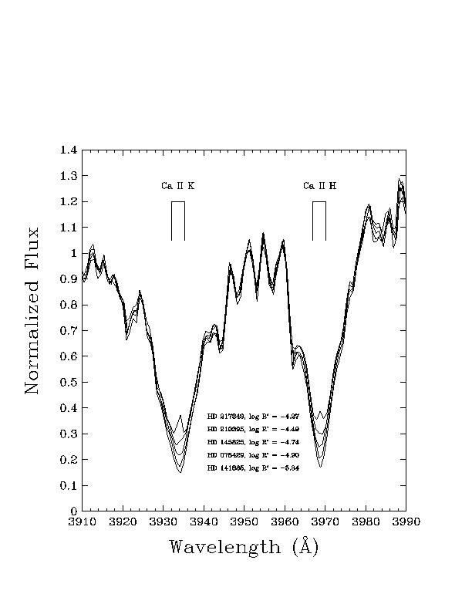
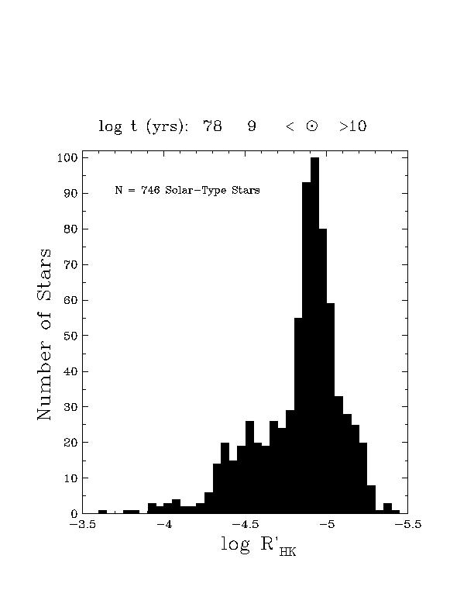
Ca II HK Measurements

Slide 59
Target List: ATA Search
generalized sample (Turnbull and Tarter 2003)
a. direct observations
parallaxes from Hipparcos results
spectral type/Stromgren photometry
multiplicity
Ca II HK emission
variability/X-ray luminosity
b. derived characteristics
kinematics
rotation
metallicity
c. theoretical constraints
habitable zones
evolutionary tracks
three-body stability

Slide 60
Solar System Inventory 2012
stars
planets
moons
ring systems
minor planets
Centaurs
Trans-Neptunian Objects
comets
… and …
1
8
167 (JPL 2012 JAN 16)
4 (+1?)
576,776 (JPL 2012 JAN 16)
204 (JPL 2012 JAN 16)
1,495 (JPL 2012 JAN 16)
255ª (MPC 2012 JAN 16)
dust
ª periodic and numbered
Notes:
JUP = 62 … SAT = 61 … URA = 24 … NEP = 13 … PLU = 4

Slide 61
Solar System Inventory 2009
stars
planets
moons
ring systems
minor planets
Kuiper Belt Objects
comets
… and …
1
8
165 (as of 2009 JAN 11)
4+1
436,000ª (as of 2008 DEC 12)
1,300 (as of 2009 JAN 11)
152,000^{b} (as of 2008 DEC 15)
dust
ª with orbits
^{b} periodic and numbered

Slide 62
Solar System Inventory 2006
stars
planets
moons
ring systems
minor planets
Kuiper Belt Objects
comets
… and …
1
8
152 (as of 2006 JAN 17)
4
305,000ª (as of 2005 DEC 15)
923 (as of 2006 JAN 17)
95,000^{b} (as of 2005 DEC 15)
dust
ª with orbits
^{b} periodic and numbered

