Slide 1
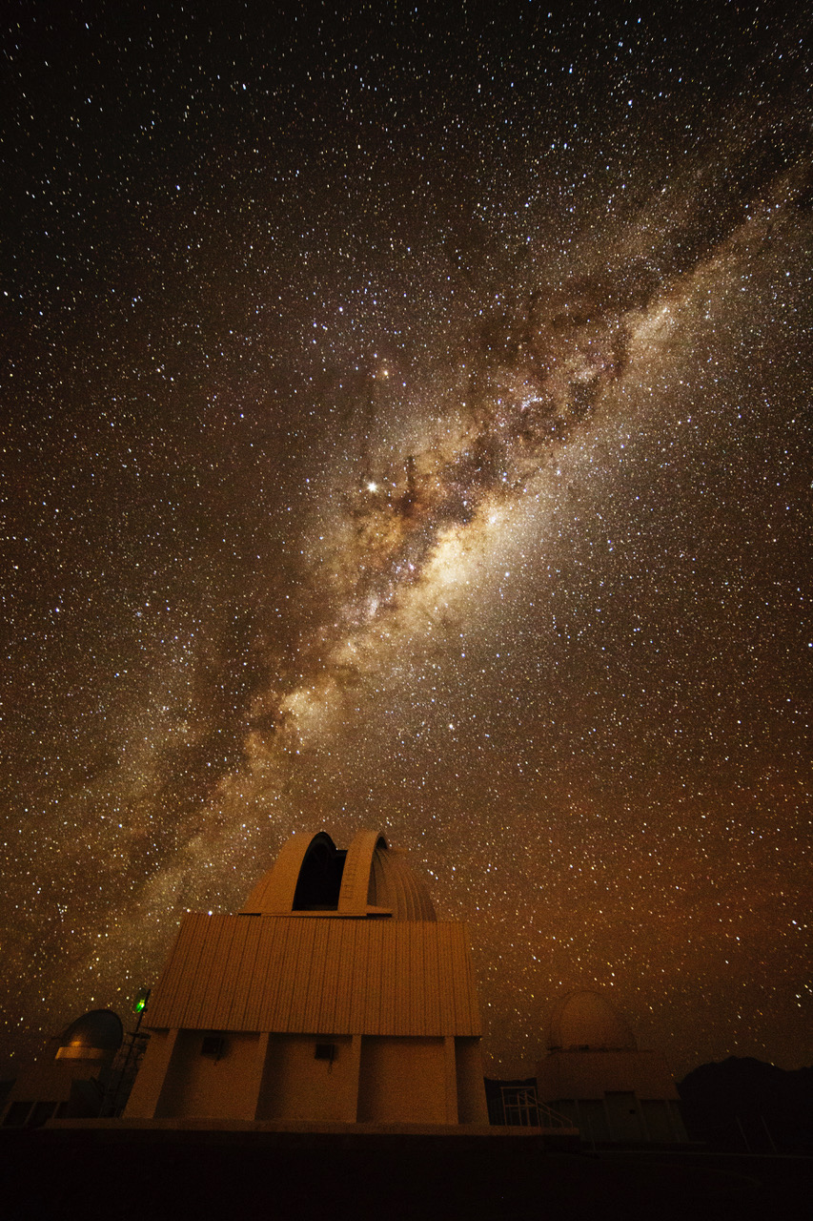
ASTR 8200 Galactic Structure
photo: Travis Rector
Notes:
Might want to add a few more slides

Slide 3
Part 1
Background
3 weeks
Part 2
MW Proper
6 weeks
Part 3
MW Fringe
2 weeks
Part 4
Intense Work
2 weeks

Slide 4
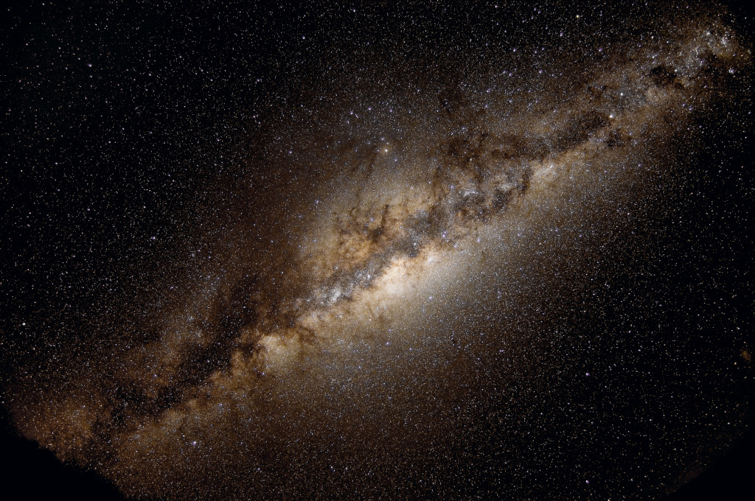
ASTR 8200: Galactic Structure
www.astro.gsu.edu/~thenry/GALACTIC

Slide 5
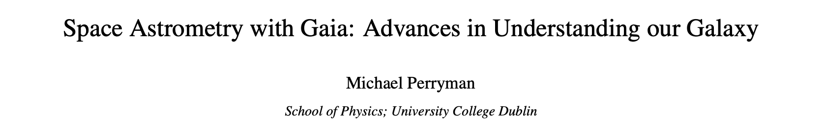
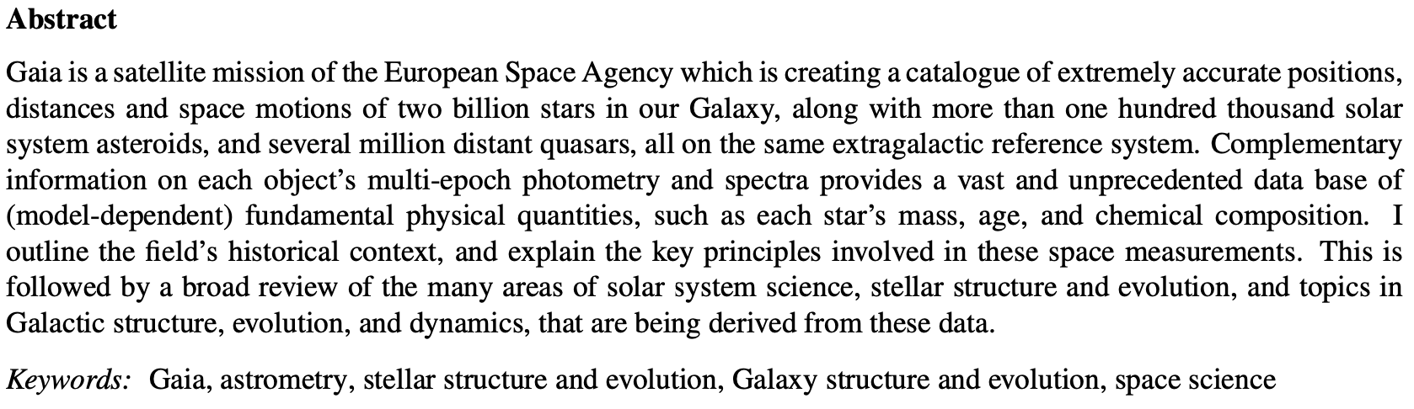
“The Book”
197 pages of text … 80 pages of references
Observations yield a picture in which disk matter is well accounted for
(by stars, and interstellar gas and dust), and in which any dark matter in the Galaxy
must be distributed in the form of the spherical halo,
with little if any concentrated in the form of the disk (Section 8.11).
Perryman (2026) … page 191

Slide 6

Proposal Pieces
GOAL: Fund yourself as a $75K/year postdoc for 3 years
1. Project Description 8.0 pages text + 2.0 pages Tab/Fig
2. References 0.5 page
3. Biographical Sketch 2.0 pages (SciENcv)
4. Budget 1.0 page (spreadsheet)
5. Budget Justification 1.0 page
6. Facilities 0.5 page
7. Student Mentoring Plan 0.5 page
8. Data Management Plan 0.5 page
Total Challenge ~ 16 pages

Slide 7
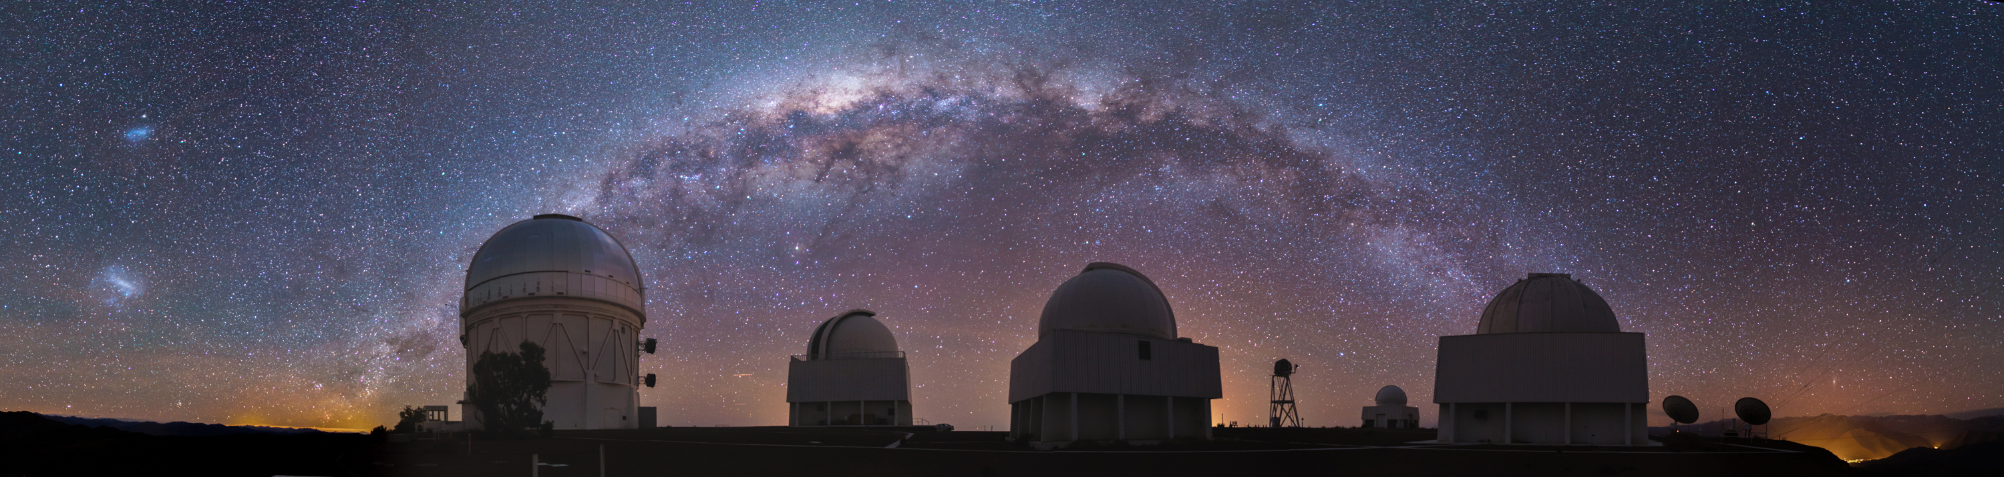
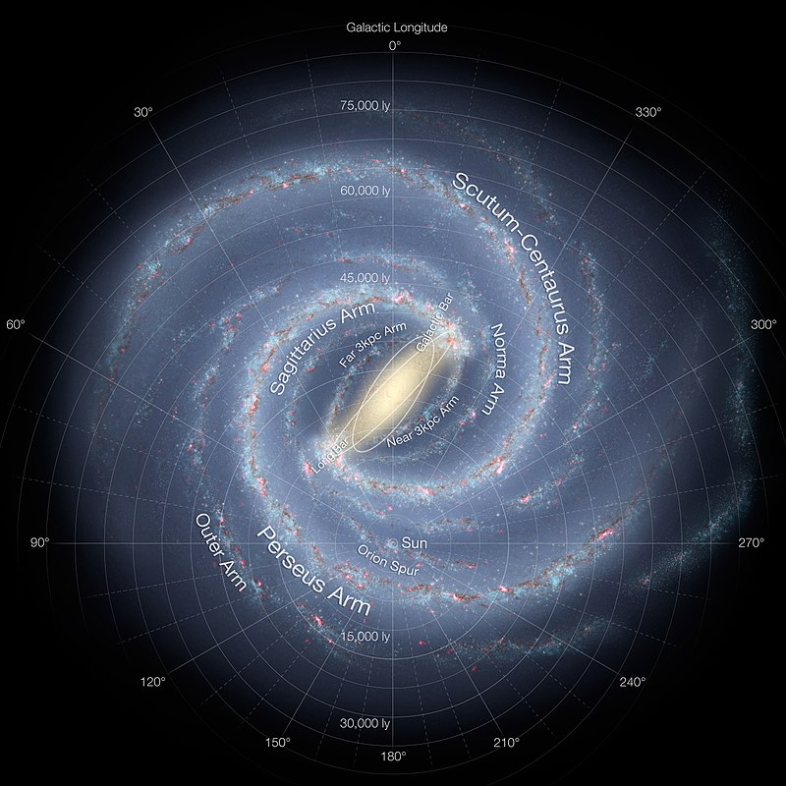
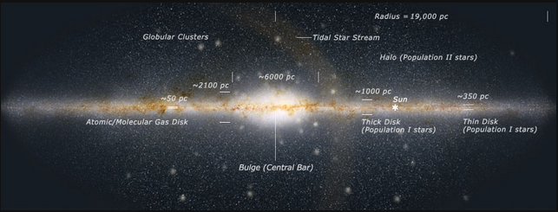
Milky Way History I
What do you know about the Milky Way?

Slide 8
Where We Are By Eye
1. Sun + Moon … EARTH AS A SPINNING PLANET
2. planets … SOLAR SYSTEM
3. white haze of sky … MILKY WAY GALAXY
Greek “γαλα” = “gala” = milk … galaxy
Latin “via lactea” = Milky Way
thickest in Sagittarius, through Cygnus, Orion
star clusters … nurseries
dark bands … obscuration
WE ARE INSIDE MILKY WAY

Slide 9
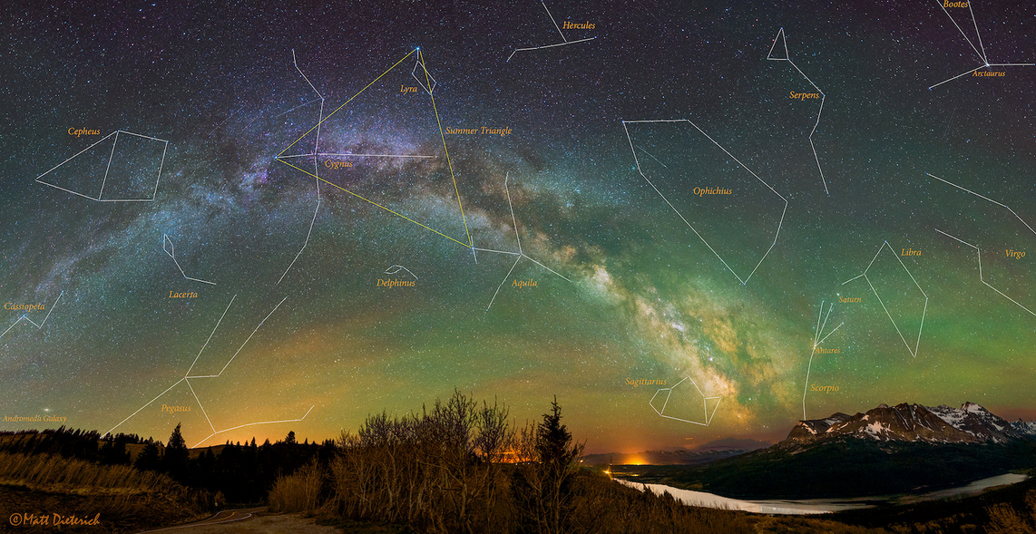
Milky Way Constellations
What are some types of objects in the Milky Way?
How did we learn what it is and where we are?
Notes:
Why is giant Arcturus not in plane? only 11.2 pc away

Slide 10
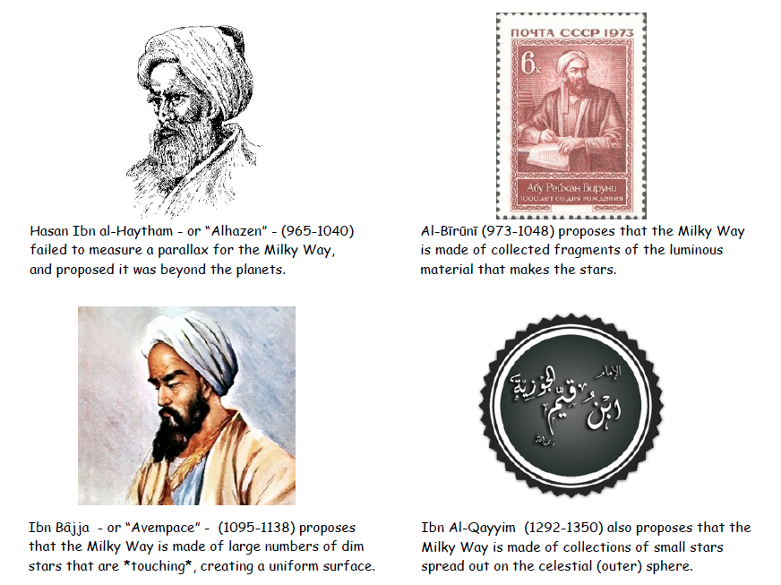
900-1300: Islamic Golden Age MW
Notes:
Ibn = son of

Slide 11
900-1300: Islamic Golden Age MW
Notes:
Ibn = son of

Slide 12
900-1300: Islamic Golden Age MW
Notes:
Ibn = son of

Slide 13
900-1300: Islamic Golden Age MW
Notes:
Ibn = son of
Alhazen … Book of Optics
Al-Biruni … 95 books on math/astro

Slide 14
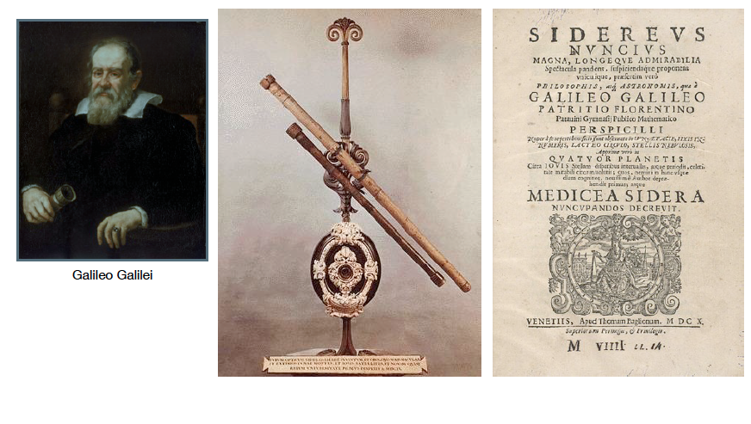
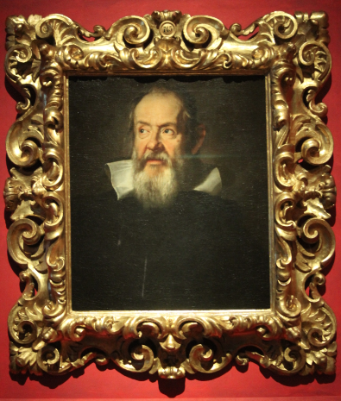
1610: Galileo’s MW Resolved Stars
Sidereus Nuncius (1610) = “Starry Messenger”
Notes:
Italian --- Galileo Galilei
my picture of Galileo from Florence (Ufizzi or Galileo Museum?)
Siderius Nuncius contains the results of Galileo's early observations of the imperfect and mountainous Moon, of hundreds of stars not visible to the naked eye in the Milky Way and in certain constellations, and of the Medicean Stars (Galilean moons) that appeared to be circling Jupiter.

Slide 15
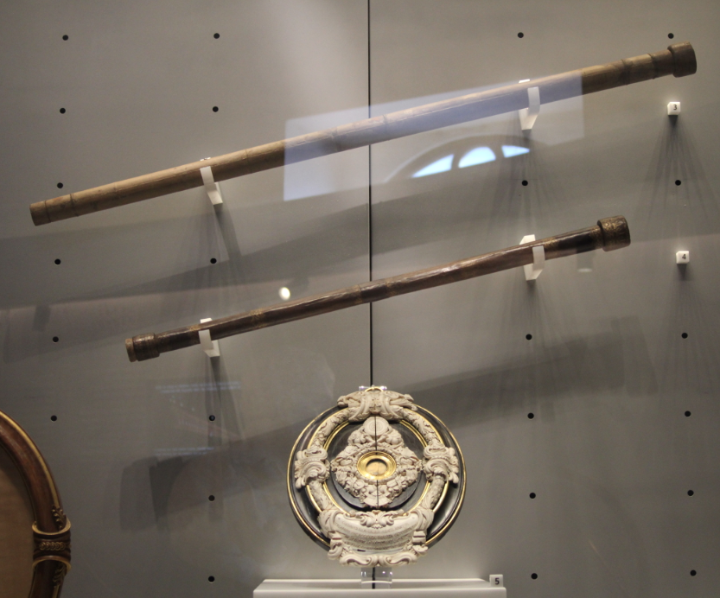
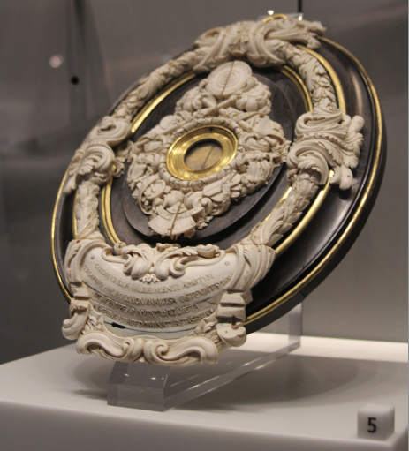
Galileo’s MW Resolved Stars
Galileo’s telescopes and lens (Galileo Museum in Florence, Italy)

Slide 16
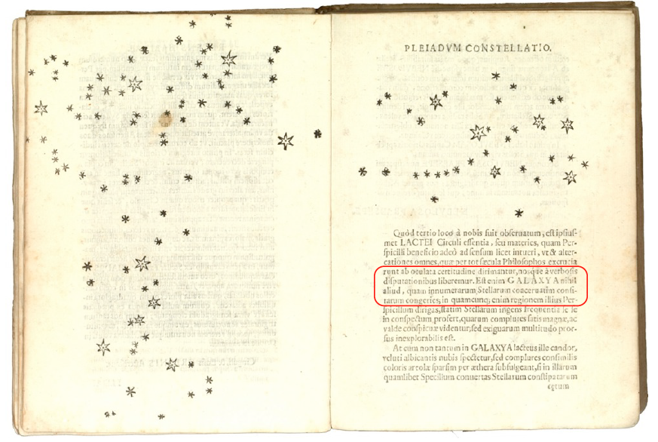
Galileo’s MW Resolved Stars
“the galaxy is nothing other than …
a mass of innumerable stars”

Slide 17
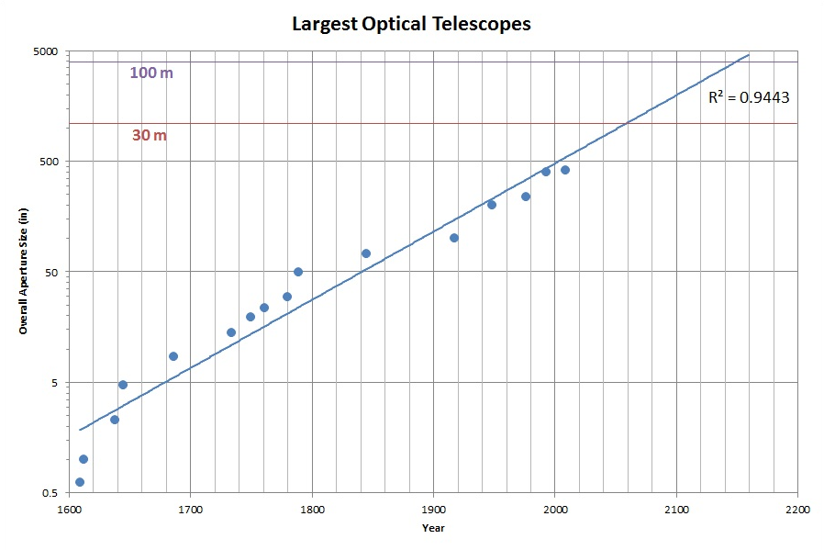
O/IR Telescope Size Progression
Galileo
https://leepavelich.wordpress.com/2011/09/18/progression-of-telescope-sizes
Notes:
1 = Galileo 1609 … 0.6”
2 = Galileo 1612 … 1.0”
3 = Galileo 1620 … 1.5”
4 = Hevelius 1638 … 2.3”
4 = Hevelius 1645 … 4.7”

Slide 18
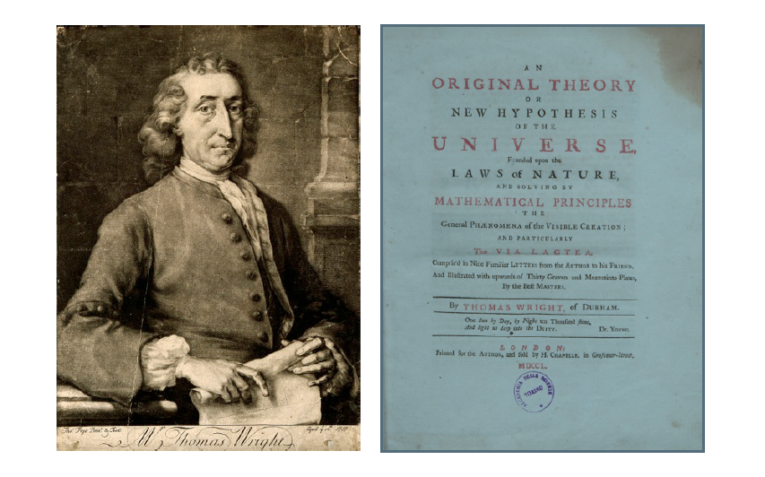
1750: Wright MW Flat and Rotating
An Original Theory or New Hypothesis of the Universe (1750)
observations by Galileo + theory by Newton (Universal Gravity)
“an optical effect due to our immersion
in what locally approximates to a flat layer of stars”
… AND … faint nebulae are galaxies
Notes:
Thomas Wright (22 September 1711 – 25 February 1786) was an English astronomer, mathematician, instrument maker, architect and garden designer. He was the first to describe the shape of the Milky Way and to speculate that faint nebulae were distant galaxies.

Slide 19
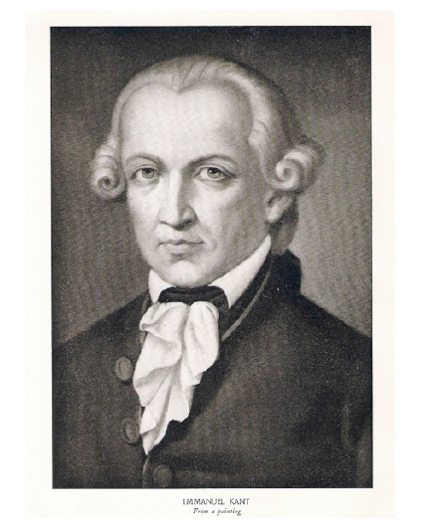
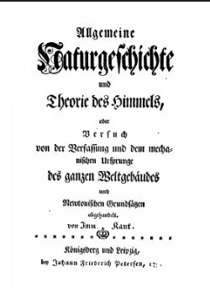
1755: Kant “Island Universes”
Universal Natural History and Theory of the Heavens (1755)
(published anonymously)
Milky Way is a large disk of stars … AND … other galaxies = island universes
Notes:
German philosopher --- Immanuel Kant, also Solar System formed from large cloud of gas

Slide 20
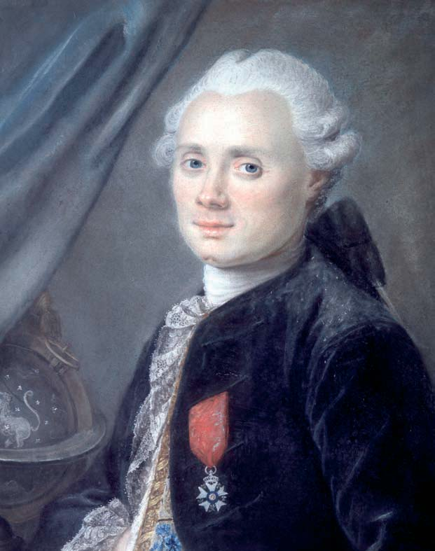
1771+: Messier Catalog
was looking for comets with 4in tel
with assistant Pierre Méchain
northern hemisphere to DEC −36
1771: preliminary version
1774: 45 objects
1780: 80 objects
1781: 103 objects (… really 102)
1967: 110 objects (using their notes)
What is the Messier number for Andromeda?
Charles Messier
Catalogue des Nébuleuses et des Amas d'Étoiles (1771)
(Catalogue of Nebulae and Star Clusters)
Notes:
French
102 vs. 103 (by Messier in 1781) due to confusion about entry 102, which was duplication of 101 or new NGC 5866

Slide 21
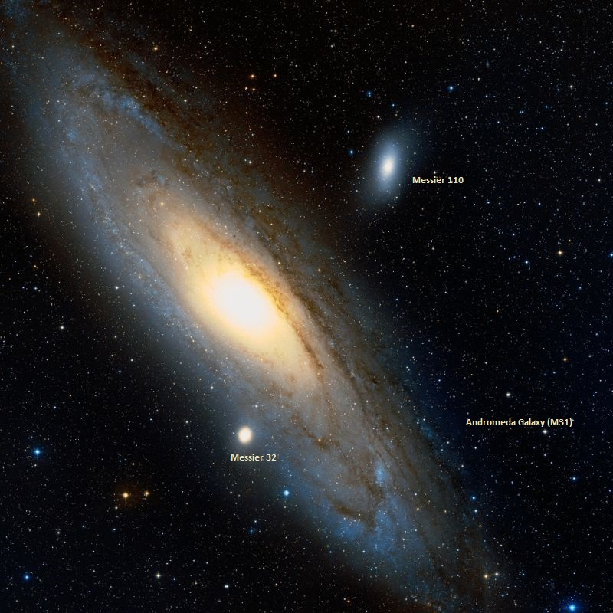
1771+: Messier Catalog
Charles Messier
Catalogue des Nébuleuses et des Amas d'Étoiles (1771)
(Catalogue of Nebulae and Star Clusters)
“Island Universe” hypothesis via Kant makes these really interesting
Notes:
French
102 vs. 103 (by Messier in 1781) due to confusion about entry 102, which was duplication of 101 or new NGC 5866

Slide 22
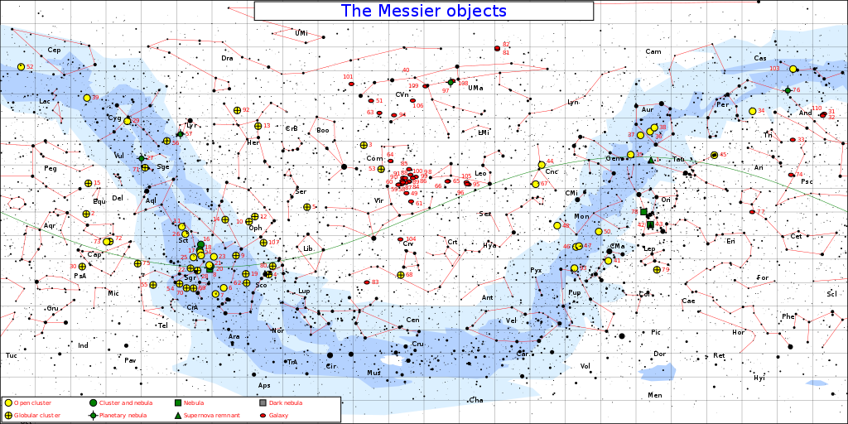
Messier Catalog
Where are various types of objects found?
open clusters … in plane
globular clusters … in+out of plane
galaxies … out of plane
Notes:
1 supernova remnant = M1
4 planetary nebulae = M27, M57, M76, M97

Slide 23
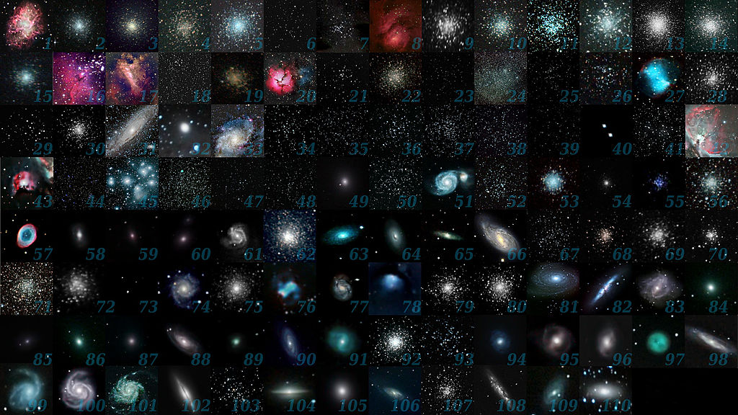
Messier Catalog
What Messier objects can you name?
Notes:
M1 is only supernova remnant

Slide 24
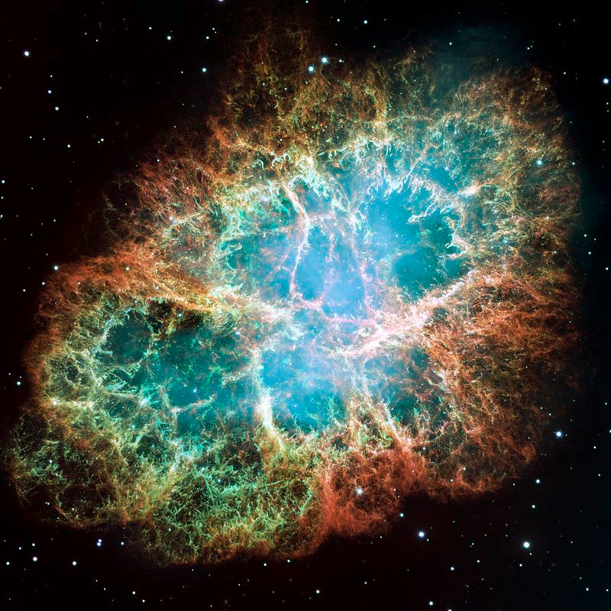
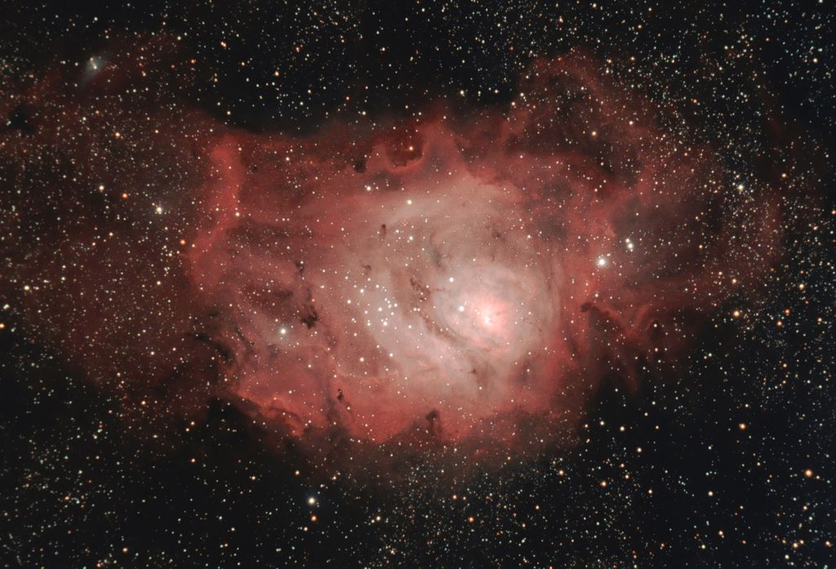
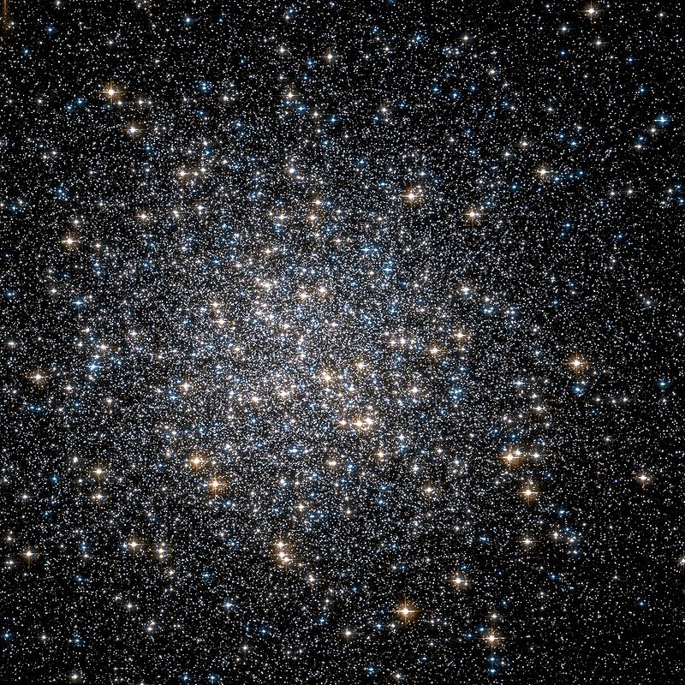
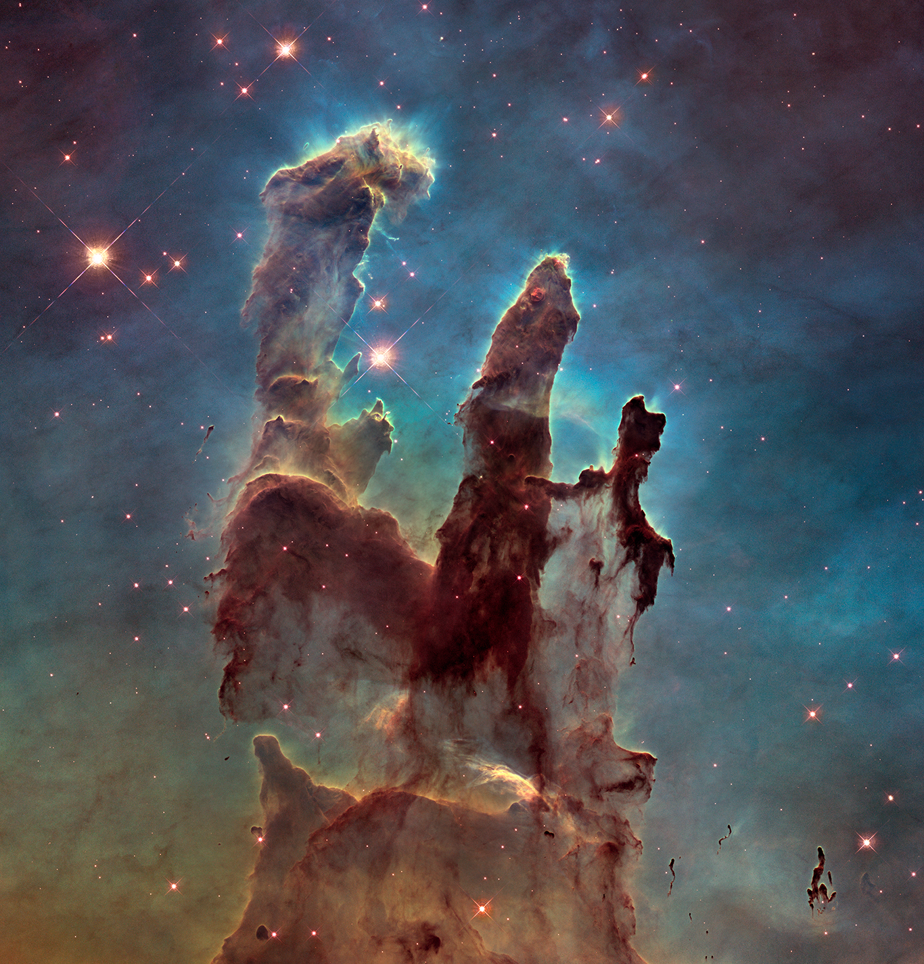
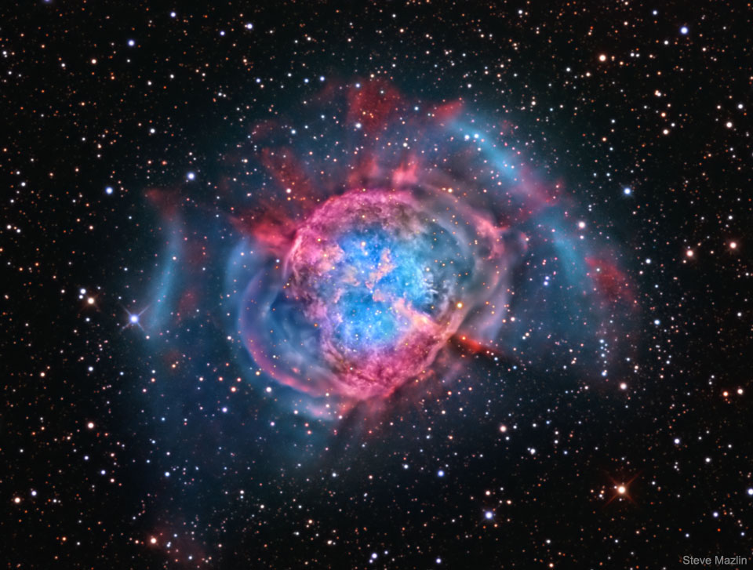
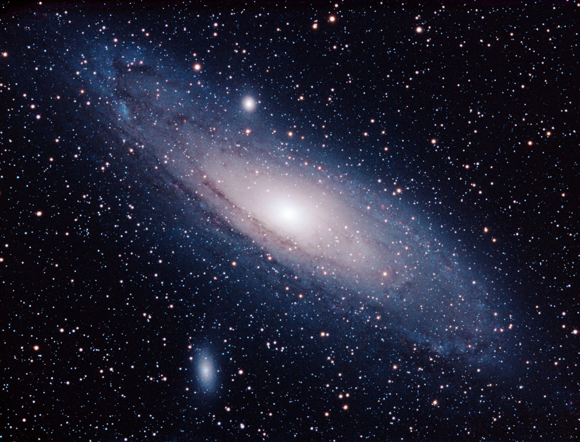
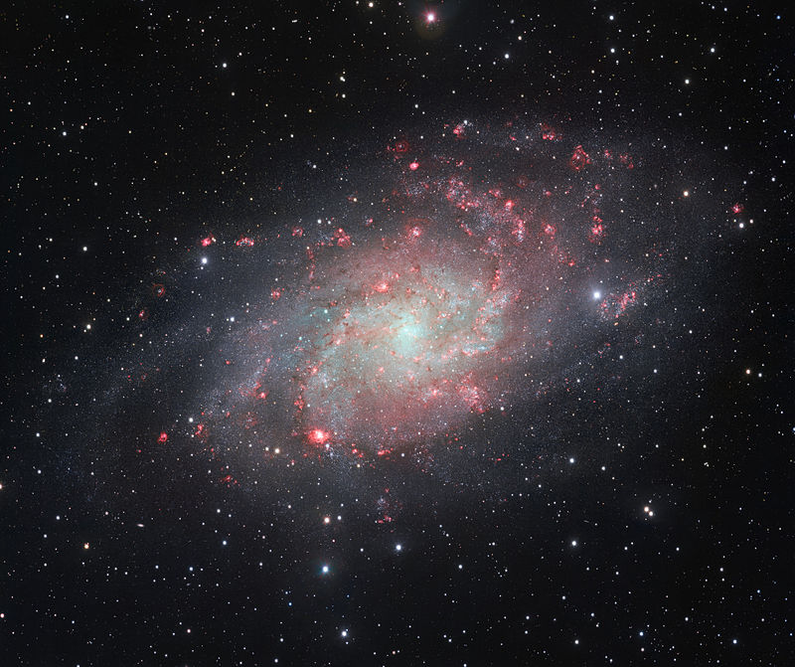
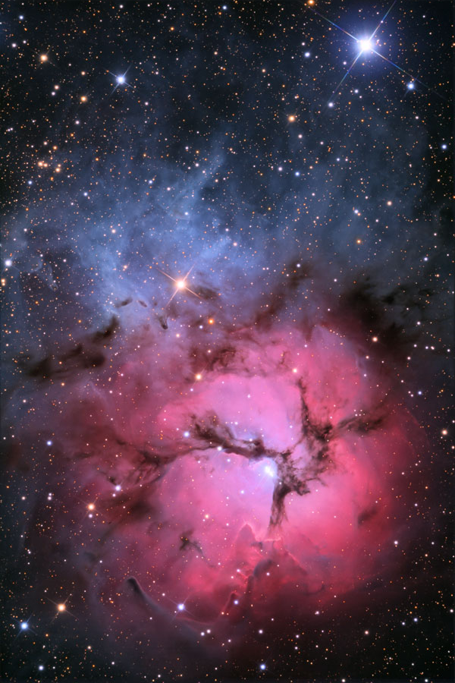
Messier Catalog Greatest Hits
M1
Crab Nebula
M8
Lagoon Nebula
M13
Hercules Globular
M16
Eagle Nebula
M20
Trifid Nebula
M27
Dumbbell Nebula
M31
Andromeda Galaxy
M33
Triangulum Galaxy

Slide 25
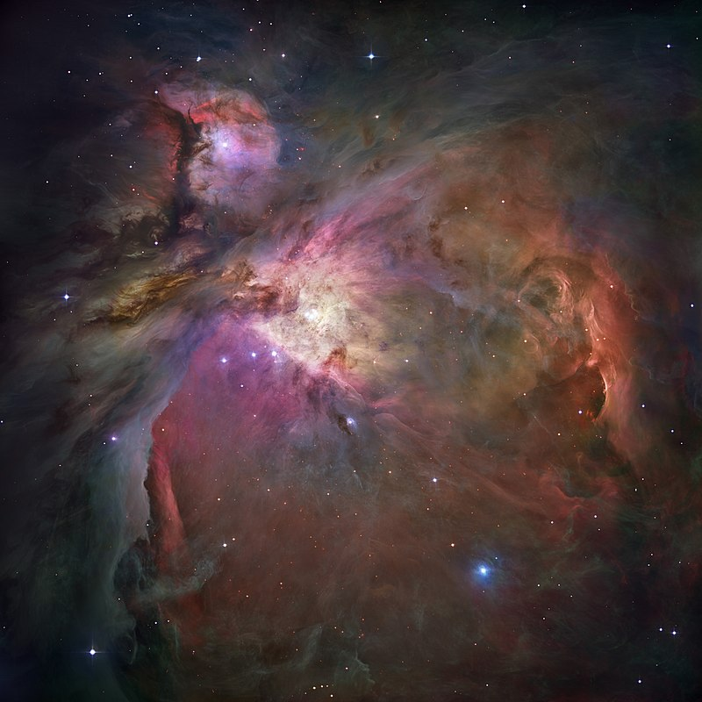
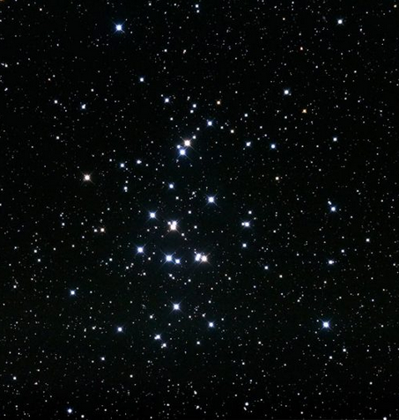
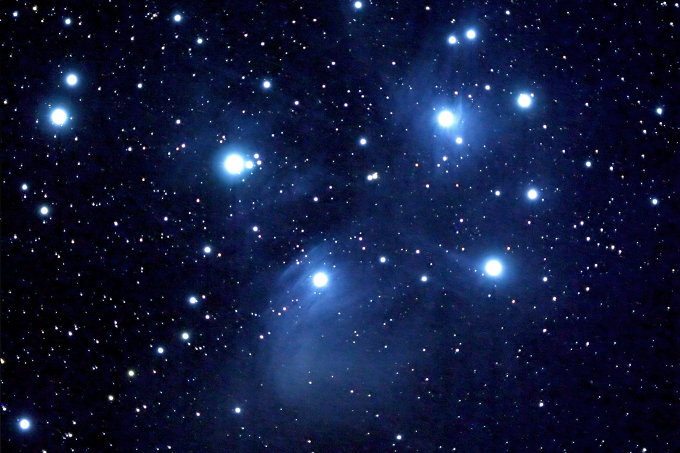
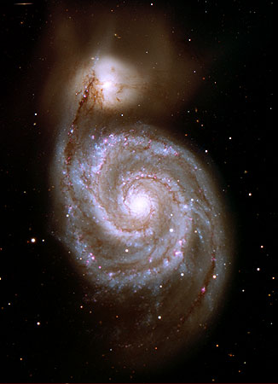
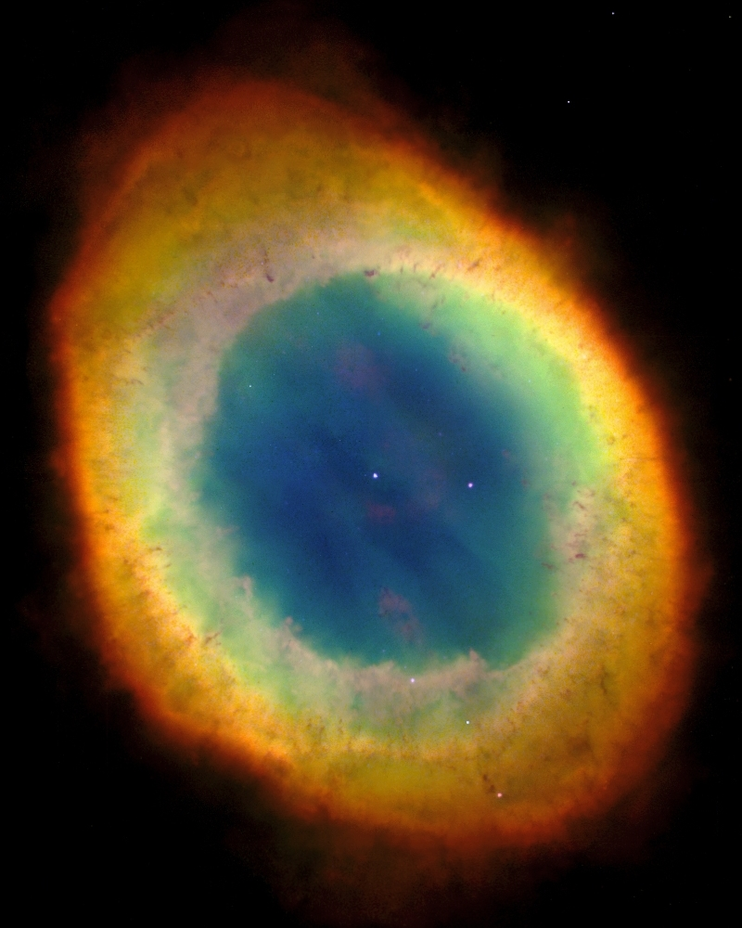
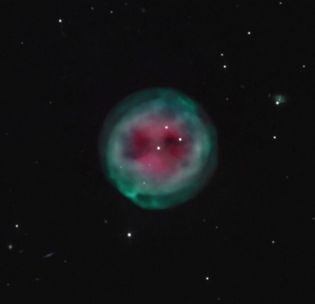
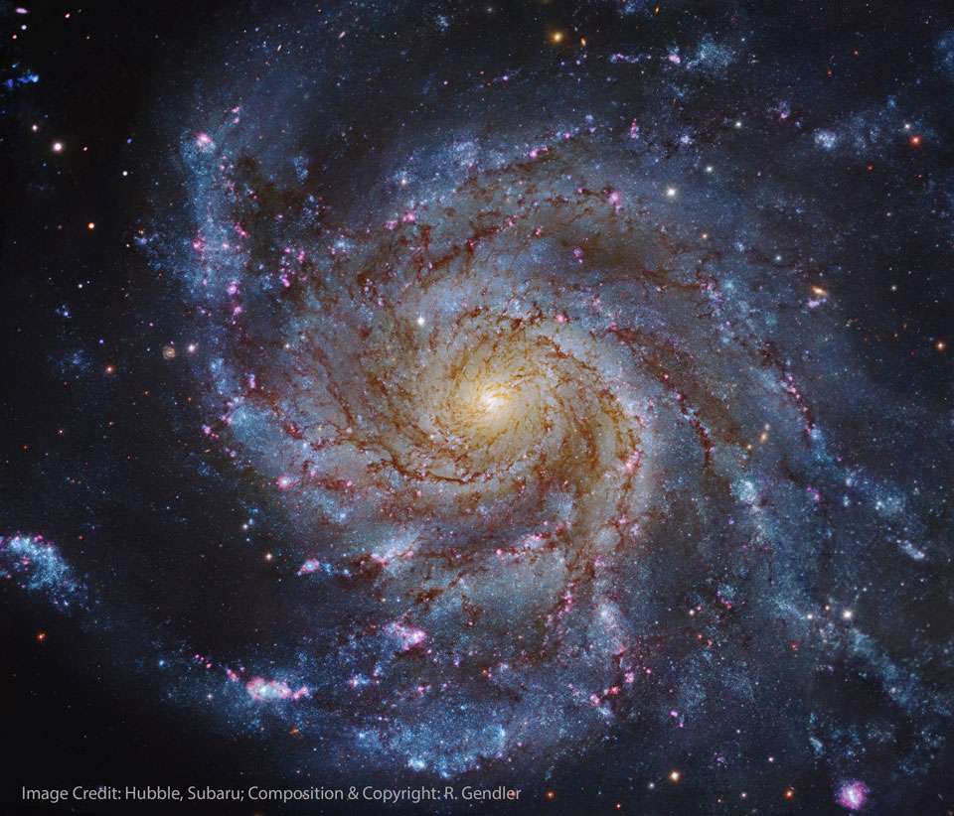
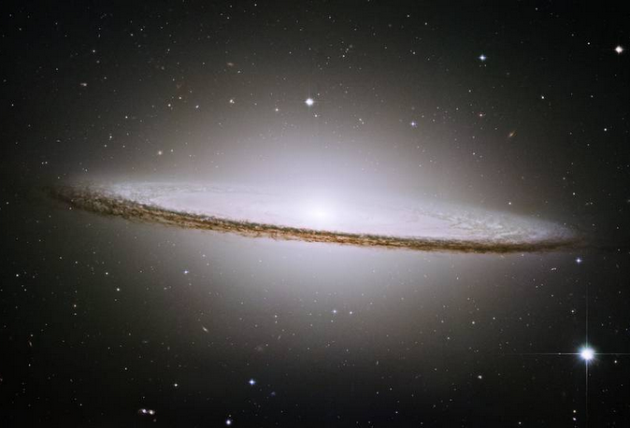
Messier Catalog Greatest Hits
M42
Orion Nebula
M44
Beehive Cluster
M45
Pleiades Cluster
M51
Whirlpool Galaxy
M57
Ring Nebula
M97
Owl Nebula
M101
Pinwheel Galaxy
M104
Sombrero Galaxy

