Slide 1
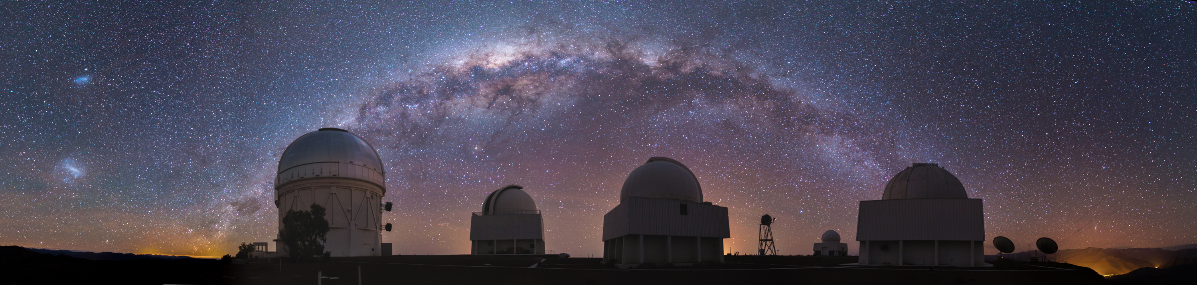
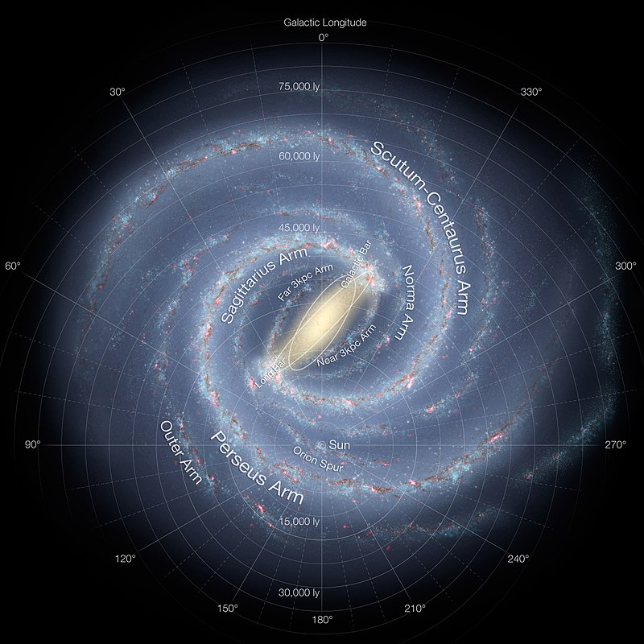
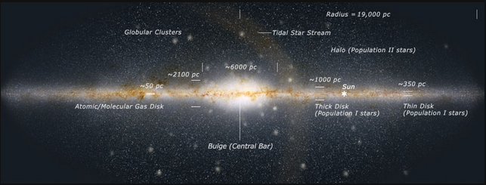
Milky Way History II
Notes:
Might want to add a few more slides

Slide 2
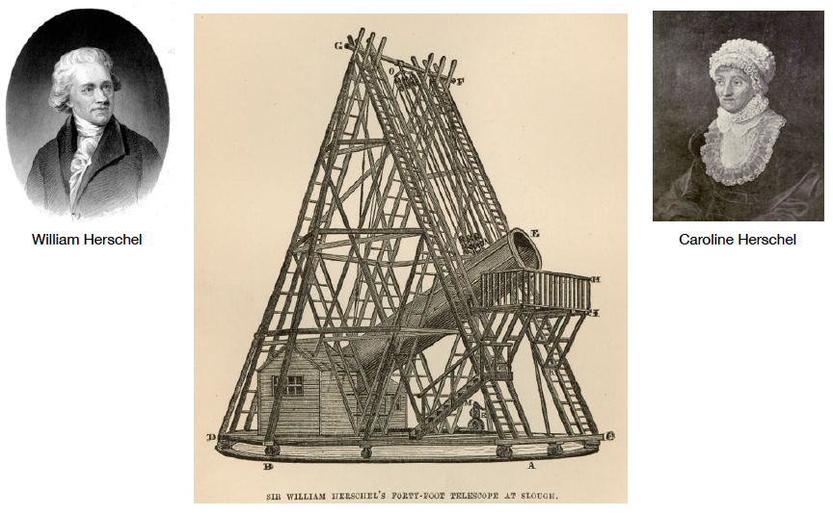
1785: Herschels’ MW
“Forty Foot
Telescope”
48in refractor
in England
(focal length 40ft)
On the Construction of the Heavens (1785)
first detailed study of the Milky Way as a galactic system
Notes:
German brother and younger sister

Slide 3
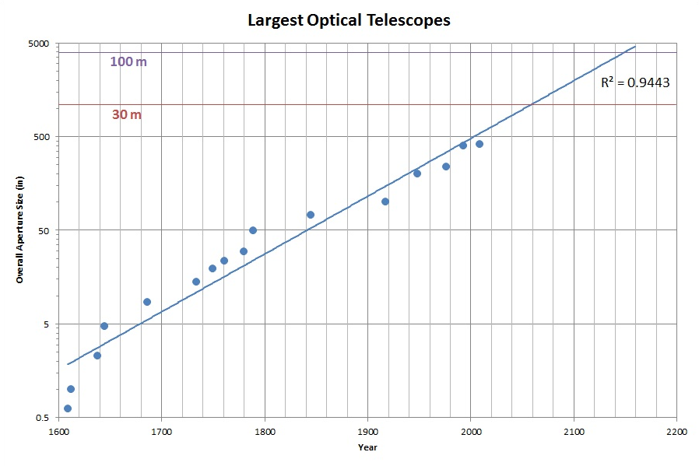
O/IR Telescope Size Progression
Herschels
Galileo
https://leepavelich.wordpress.com/2011/09/18/progression-of-telescope-sizes

Slide 4
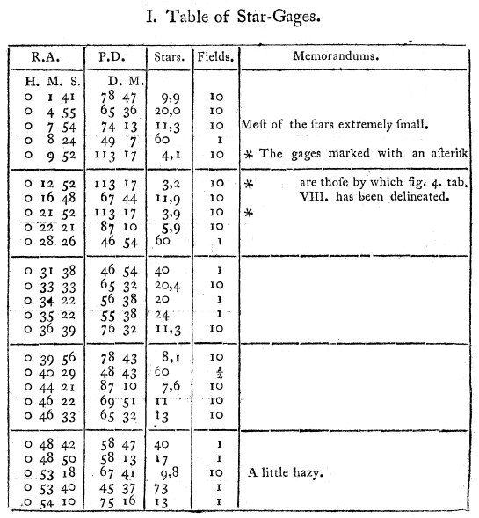
1785: Herschels’ Milky Way
USED
star count model with “Star-Gages”
number densities of stars in > 600 fields
low density? … several fields averaged

Slide 5
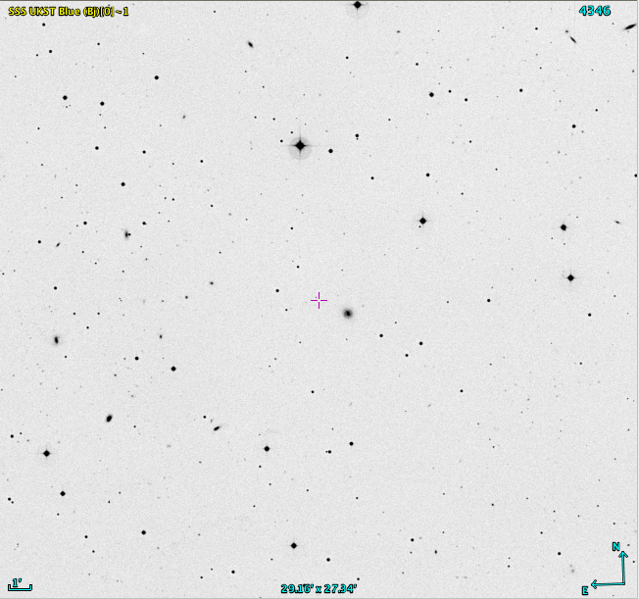
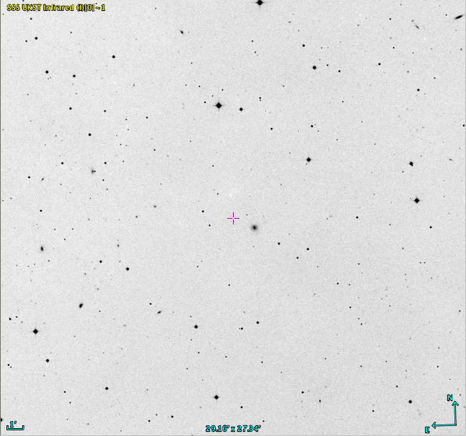
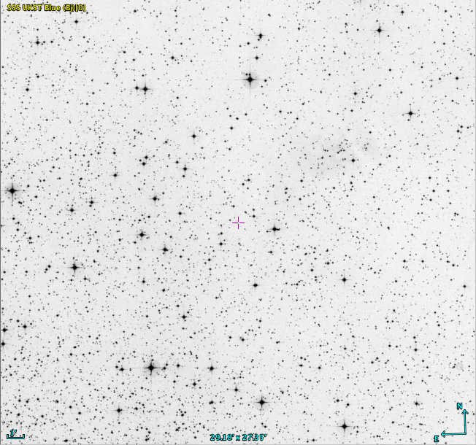
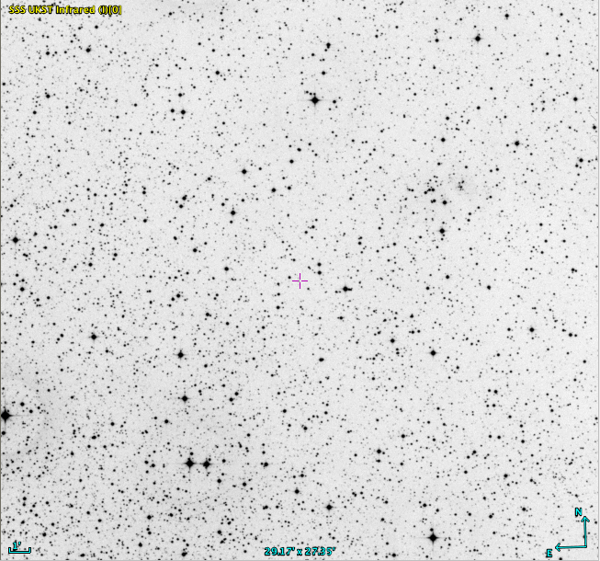
SuperCOSMOS Images (30 arcmin)
Galactic
North
Pole
Galactic
Center
B I
B I
Notes:
Galactic North Pole = 12 51 24 +27 07 00
Galactic Center = 17 45 36 −28 56 00
images from SuperCOSMOS ~30 arcmin on a side

Slide 6
1785: Herschels’ Milky Way
USED
star count model with “Star-Gages”
number densities of stars in > 600 fields
low density? … several fields averaged
DID NOT HAVE/USE
parallaxes … no luminosities
star colors … no temperatures
… no HR diagram

Slide 7
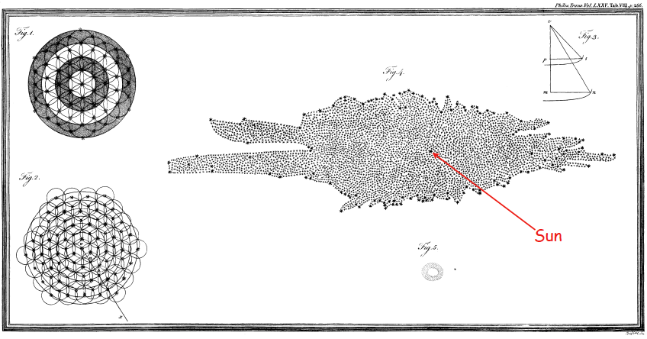
1785: Herschels’ Milky Way
ASSUMED (a) all stars identical
(b) stellar density uniform
(c) no obscuration
then … surface densities become volumes become distances …
RESULTS disk of stars thickness 1/10 diameter
Sun near center MW much too small
Notes:
GREEN = correct
RED = oops

Slide 8
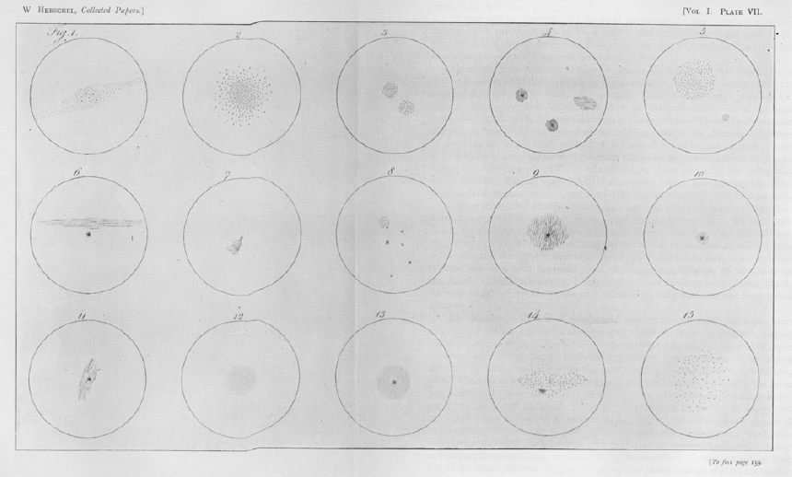
1785: Herschels’ Milky Way
ALSO “nebulae” drawn by Caroline Herschel
William Herschel writes: “These suns, every one of which is probably as much consequence to a system of planets, satellites, and comets, as our own sun, are now to be considered, in their turn, as the minute parts of a proportionally greater whole.”
[… the curse of “planetary nebulae” that have nothing to do with planets …]
… debate: are “nebulae” inside or outside the Milky Way? …
Notes:
Herschel called some of the Messier objects “planetary nebulae” because they look like planetary systems … oops.

Slide 9
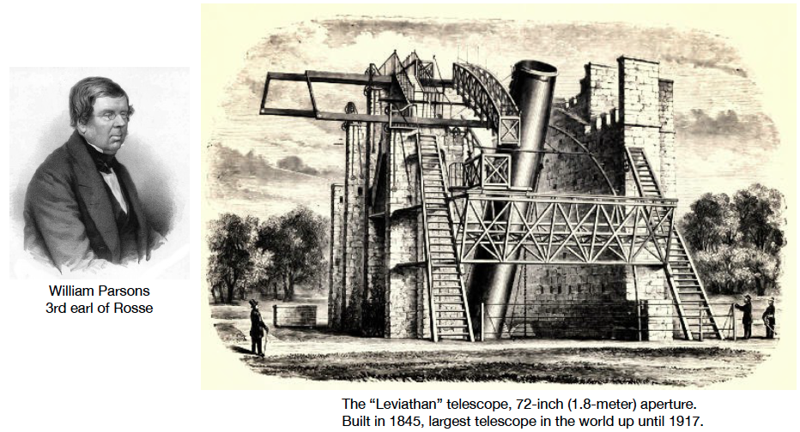
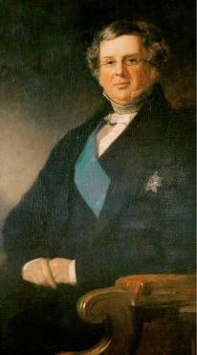
1845: Parsons’ Spirals
William Parsons
3rd Earl of Rosse
72in reflector in Ireland
PURPOSE revisit nebulae in Messier list … nebulae or unresolved clusters?
Notes:
British
72in vs. 48in … 2.25X collecting area and 1.5X resolution
Hooker (Mount Wilson) 100in was next step up

Slide 10
O/IR Telescope Size Progression
Parsons
Herschels
Galileo
https://leepavelich.wordpress.com/2011/09/18/progression-of-telescope-sizes

Slide 11
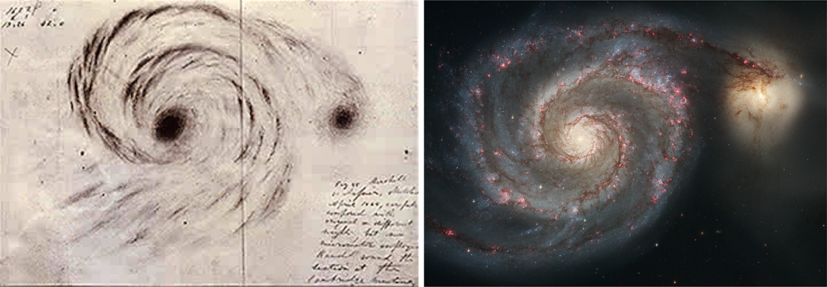
1845: Parsons’ Spirals
RESULTS resolved stars in M51
several nebulae had spiral structure … “spiral nebulae”
but still don’t know if far galaxies or near planetary systems

Slide 12
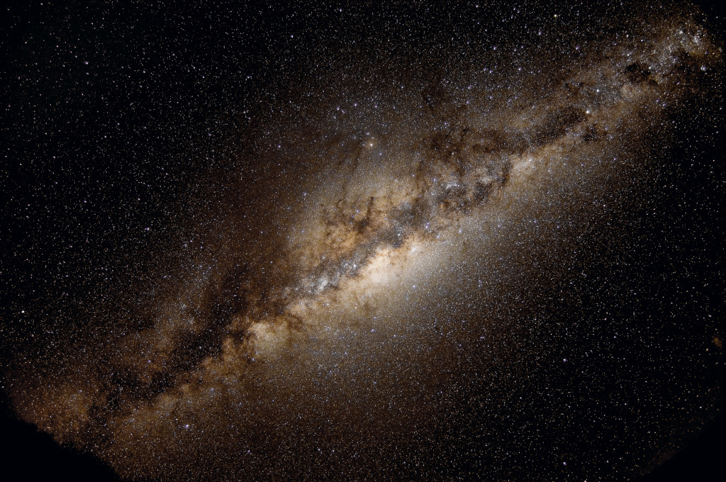
A Century+ Ago: Key Questions
What is the structure of the Milky Way?
2. How big is the Milky Way?
3. Are the nebulae other “Milky Ways”?

Slide 13
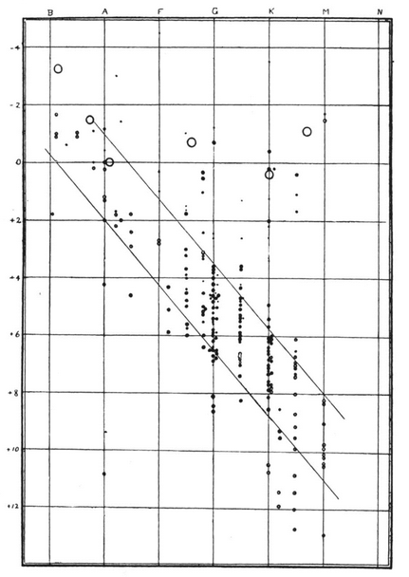
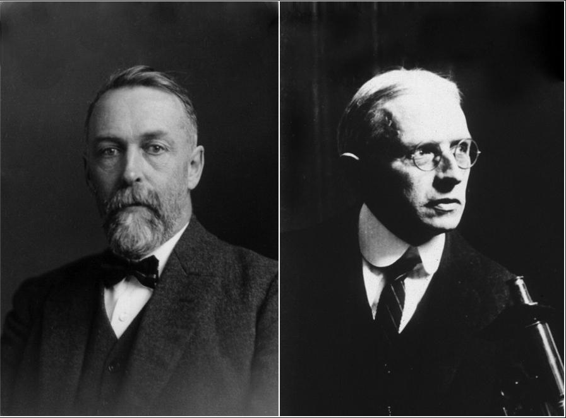
1910s: H-R Diagram
THANK
YOU
PARALLAXES
Ejnar Hertzsprung and Henry Norris Russell
Relations Between the Spectra
and Other Characteristics of the Stars II
Russell 1914, Nature, 93, 252
Hertzsprung published many papers
with tabular data, but no (?) plots
Notes:
Dutch
American

Slide 14
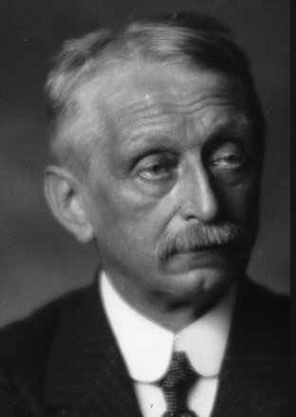
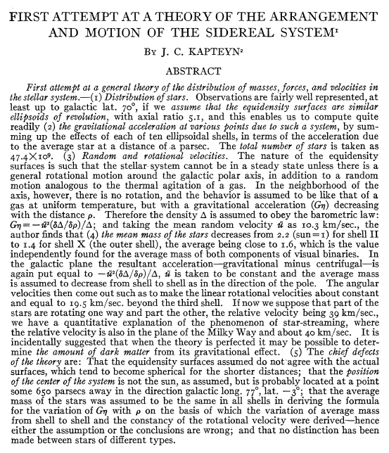
1922: Kapteyn’s MW
Jacobus Kapteyn
new attempt using star counts
uses some parallaxes
+ proper motion proxies
with HR diagram available
Kapteyn 1922, ApJ, 55, 302
Notes:
Dutch
parallaxes now show that all stars are NOT the same luminosity
few parallaxes available, so used proper motions as proxies
ApJ started in 1895
AJ started 1849, Civil War hiatus 1861-1885, restarted 1885

Slide 15
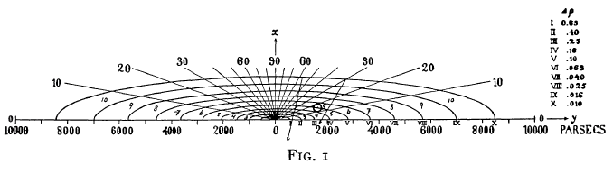
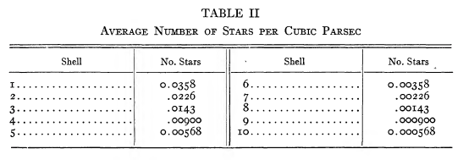
1922: Kapteyn’s MW
MW disk radius ~8500 parsecs (Sun not at center)
What is current density for 373 stars within 10 parsecs?
10 parsec value: 0.089 */pc³
Notes:
Figure from 1922 paper (?)

Slide 16
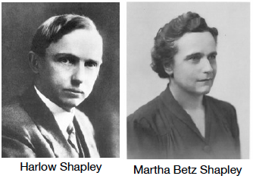
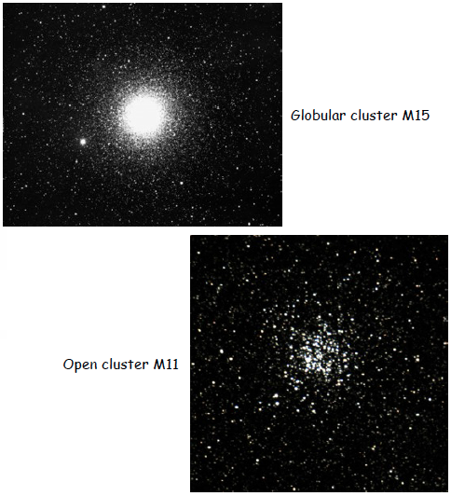
1920: The Great Debate
study star clusters
use apparent sizes + brightest star mags
derive distances
Wikipedia: “as she was the more talented in mathematics of the two Shapleys”
differences between open and globular
open clusters smaller, survive inside MW
globular clusters larger, not in MW
would be torn apart by gravity
Notes:
husband and wife … better at math, she helped him with thesis work … then had 5 kids

Slide 17
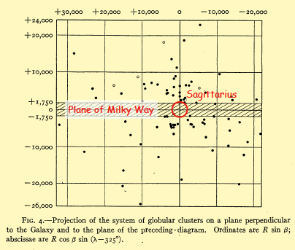
1920: The Great Debate
distribution of globulars not symmetric
WE ARE NOT AT THE CENTER
distances much larger than found by Kapteyn
If the spiral nebulae are the size of the MW, yet tiny on the sky,
they must be VERY far away … and that can’t be true.

Slide 18
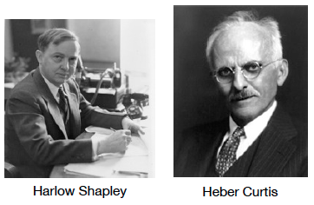
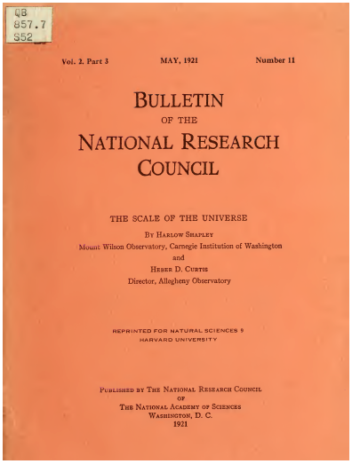
1920: The Great Debate
large MW small MW
Sun offset Sun centered
single galaxy many galaxies

Slide 19
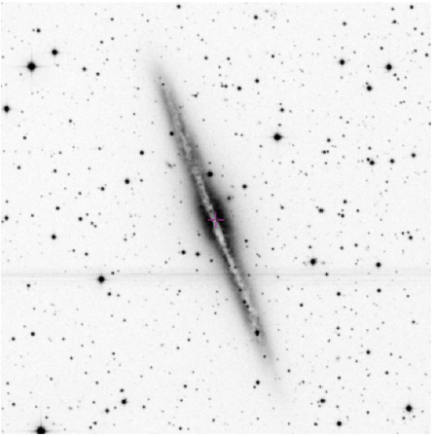
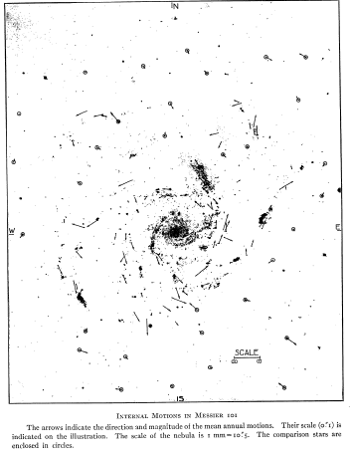
1920: The Great Debate
Curtis spiral nebulae have spectra similar to Sun, so are collections of stars
Shapley nebulae surface brightnesses higher than MW, dense like globulars
most found outside plane of MW just like globulars, so connected to MW
Curtis some nebulae have obscuring dark bands, MW might hide nebulae in plane
Shapley van Maanen found motion in M101 … if outside MW, faster than light
Curtis nebulae have wide range of sizes, even if M101 inside MW, others far outside
faint “novae” in Andromeda … if similar to MW’s, then Andromeda far

Slide 20
1920: The Great Debate
large MW small MW
Sun offset Sun centered
single galaxy many galaxies

Slide 21
A Century+ Ago: Key Questions
What is the structure of the Milky Way?
2. How big is the Milky Way?
Are the nebulae other “Milky Ways”?
… we need a distance scale …

Slide 22
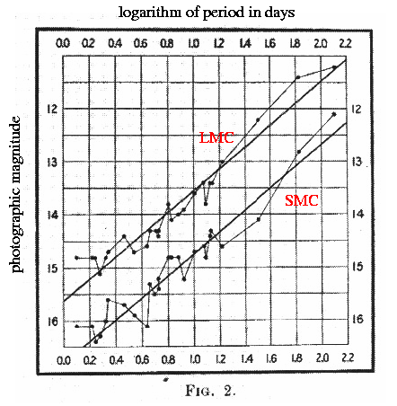
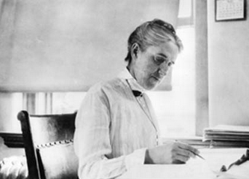
1912: Leavitt’s Law of Cepheids
Henrietta Leavitt
classified 1777 variables in LMC and SMC
47 as Cepheids
brighter ones had longer periods
the first standard candle
Notes:
delta Cephei (265 pc) is prototype, only closer Cepheid is Polaris (133 pc)

Slide 23
O/IR Telescope Size Progression
Parsons
Hooker = Mount Wilson 100in
Hubble
Herschels
Galileo
https://leepavelich.wordpress.com/2011/09/18/progression-of-telescope-sizes
Notes:
100in on Mount Wilson is new largest telescope

Slide 24
Sensitivity and Resolution
Compare the sensitivity and resolution of
Galileo’s 1in telescope
to
Hubble’s 100in telescope

Slide 25
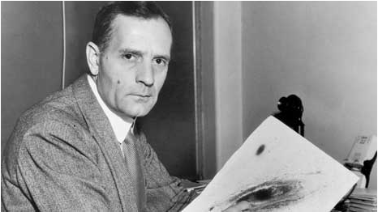
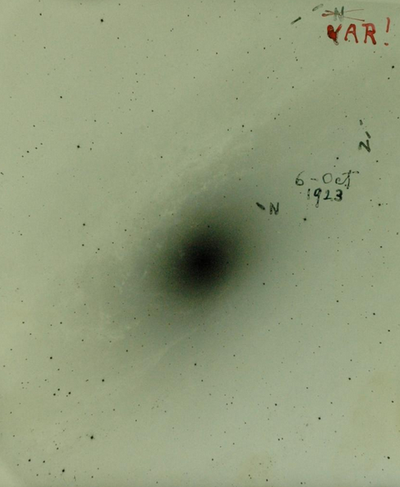
1925: Hubble’s Galaxies
Edwin Hubble
Cepheids in
Andromeda (M31) and Triangulum (M33)
both ~285 kpc
(really 780 kpc and 840 kpc)
other galaxies not in MW
Notes:
N means nova … then one N got crossed out because it was found to be VAR Cepheid

Slide 26
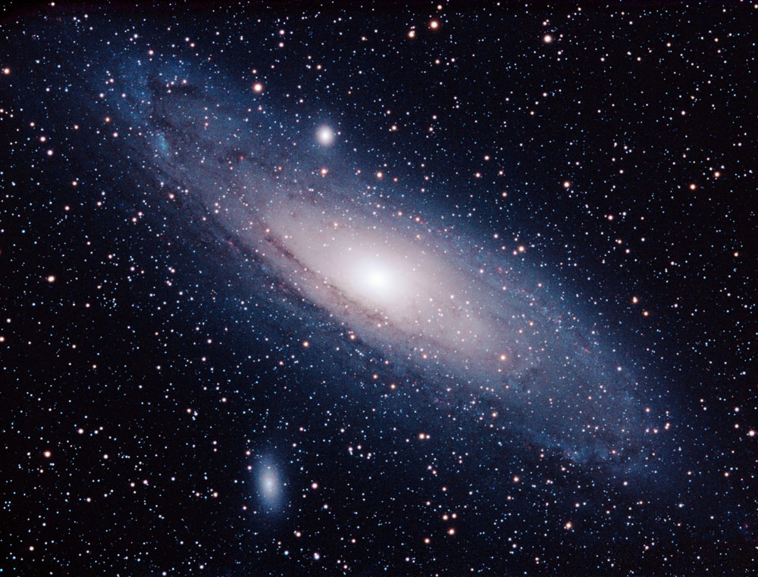
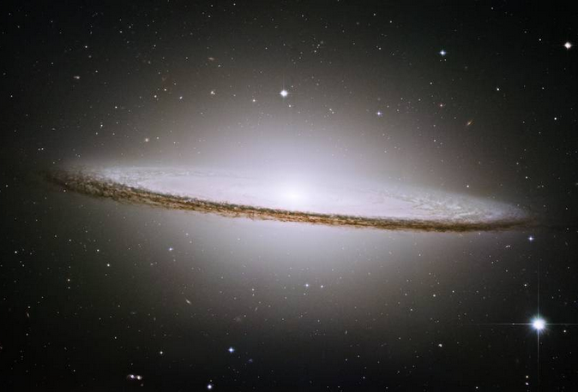
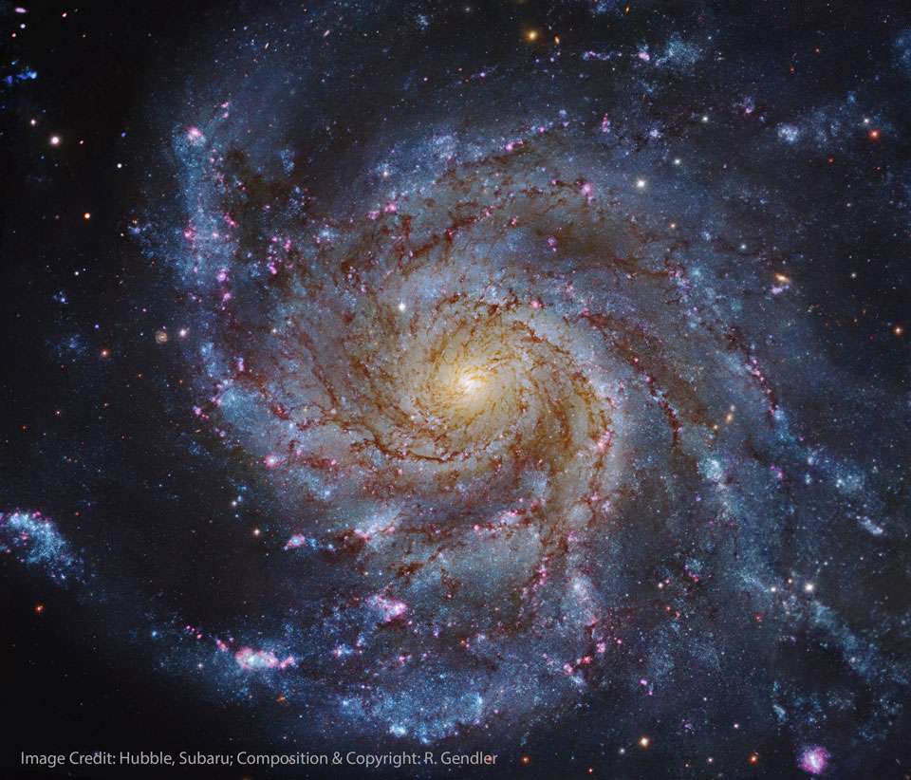
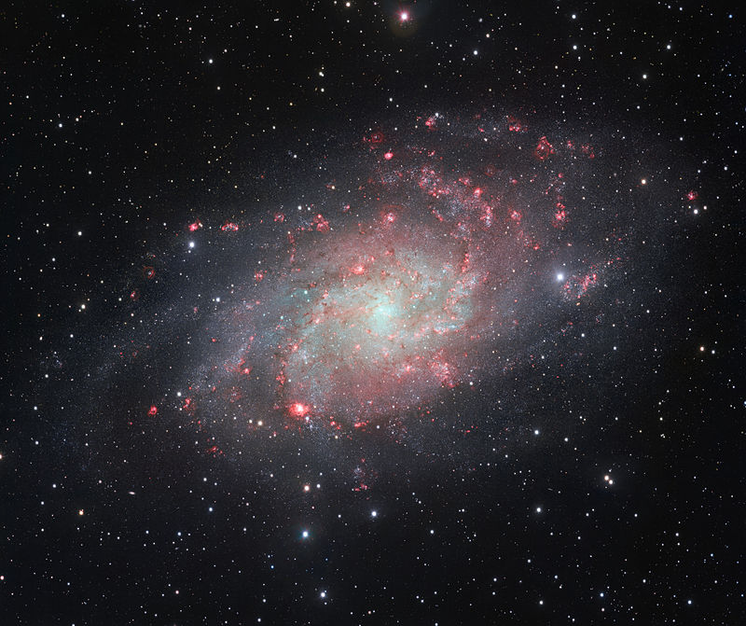
Milky Way Today

Slide 28
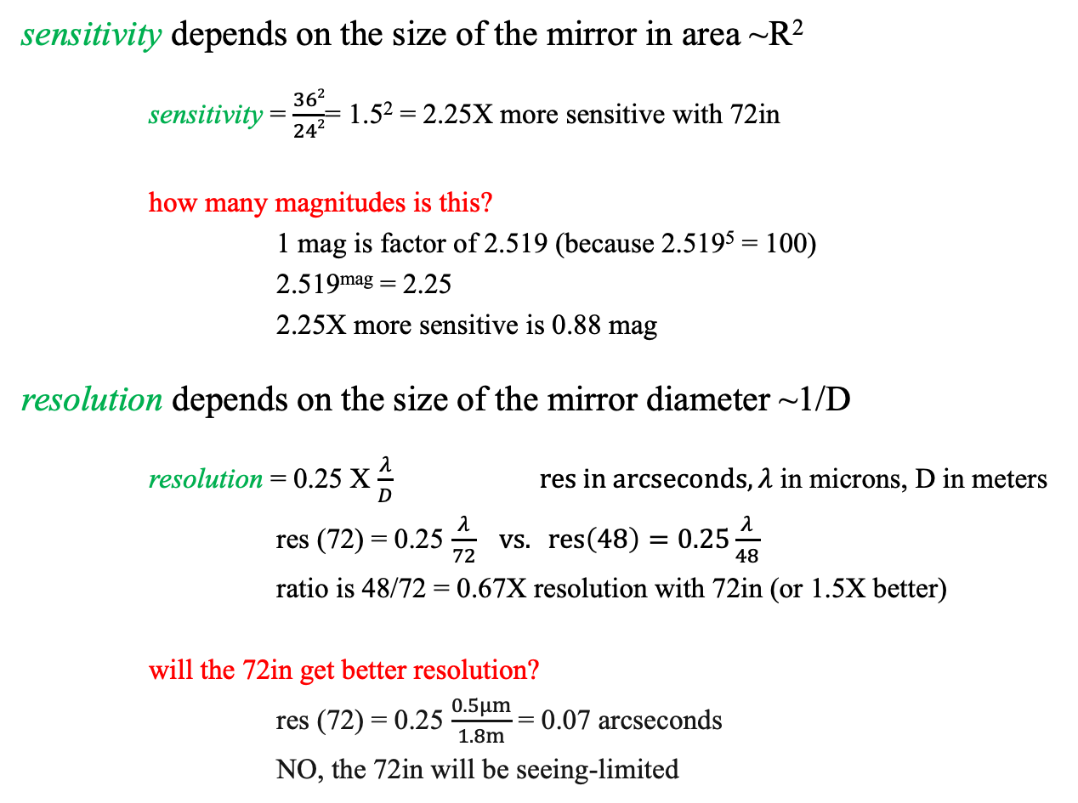
Sensitivity and Resolution
What are the sensitivity and resolution of the 72in compared to 48in?

