Slide 1
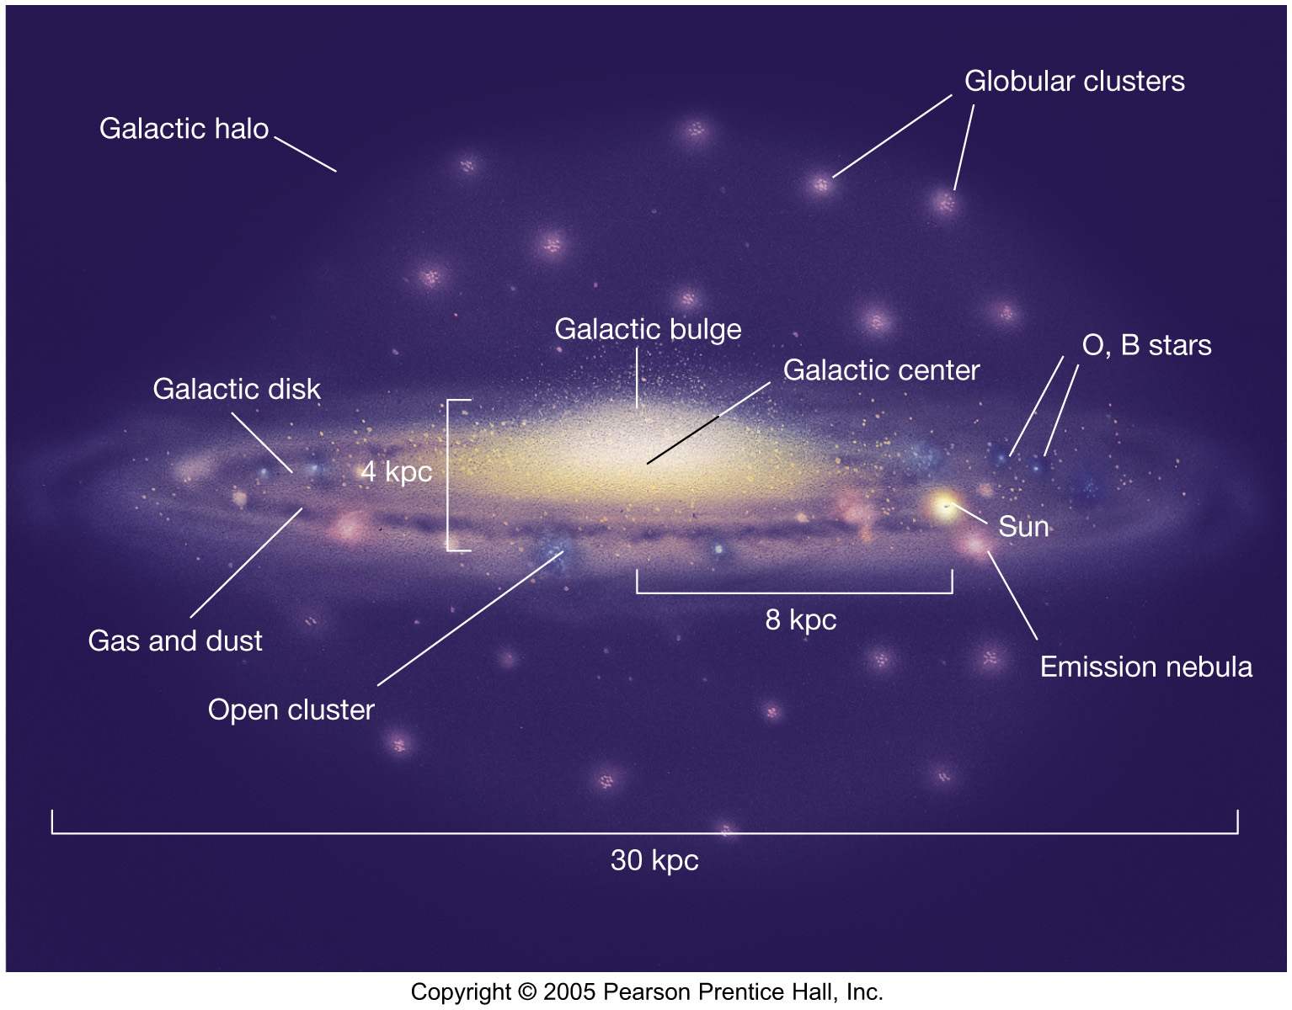
Milky Way Overview

Slide 2
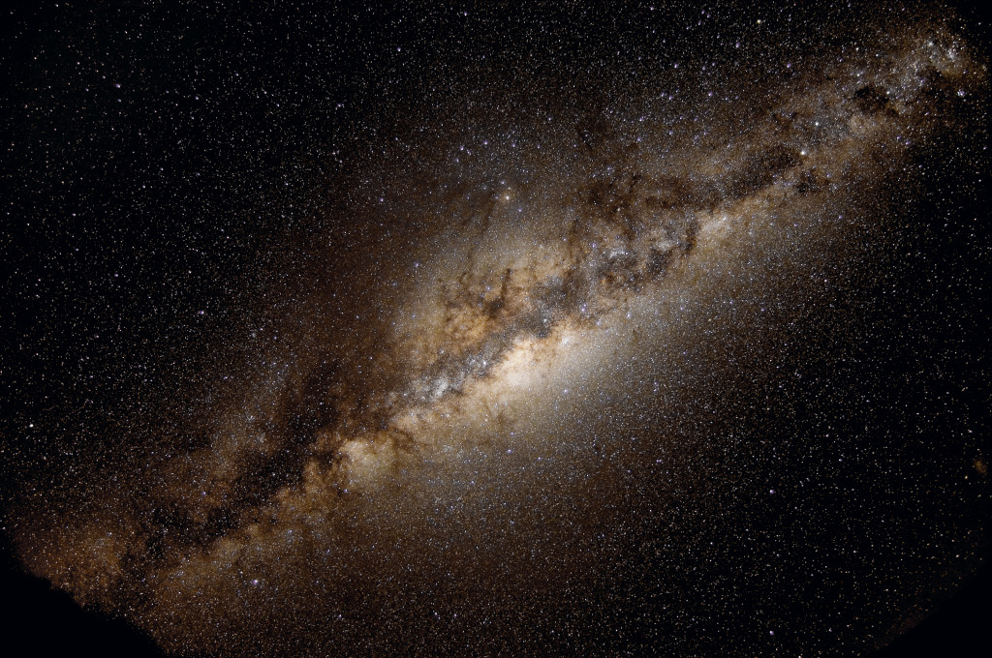
How will YOU explore the Milky Way?

Slide 3



Assignment #1
Due: Tuesday 03 FEB
Level 0 1 … 2 … 3 … 4
1 piece of paper to me
2 ideas
3 references each
4 sentences each

Slide 4
Assignments
Tuesday 03 FEB Level 0 … Ideas
Tuesday 17 FEB Level 1 … Outline … 2 weeks later
Tuesday 03 MAR Level 2 … 1st Draft … 2 weeks later
Tuesday 24 MAR Level 3 … 2nd Draft … 3 weeks later
Tue/Thu 14/16 APR Presentations … 3 weeks later
Thursday 23 APR Level 4 … submit … 1 week later

Slide 5
Milky Way Overview

Slide 6
Milky Way Galaxy
Members stars 10¹¹ to 10¹²
entire HR Diagram
not stars black holes, neutron stars, white dwarfs
brown dwarfs
rocks disks … planets, asteroids, TNOs, comets
gas/dust disks, nebulae, ISM, GMCs
life

Slide 7
Milky Way Territories
DISK
30 x 0.3 kpc
100:1
arms
young
blue/white
2% metals
open clusters
gas/dust/*formation
merry-go round
last
BAR/BULGE
4 x 6 kpc
football
bar
mixed
yellow
massive BH
gas/dust ring
tilted ellipses
HALO
~ 100 kpc
~ spherical
edge?
old
red
0.02% metals
globular clusters
no gas/dust/planets
giant electron-like
first
size
details
stars
contents
motion
origin
Notes:
Sun is 98% H and He
2019 --- lowest metallicity stars were SMSS 0313-6708 with Fe/H = -7.3 (Fe not detected) and SMSS 1605-1443 = -6.2 (Fe detected)
2025 --- SDSS J0715-7334 red giant in halo of LMC Fe/H = -4.3 but TOTAL metallicity also log Z/Zsun = -4.3 … that’s a new record

Slide 8
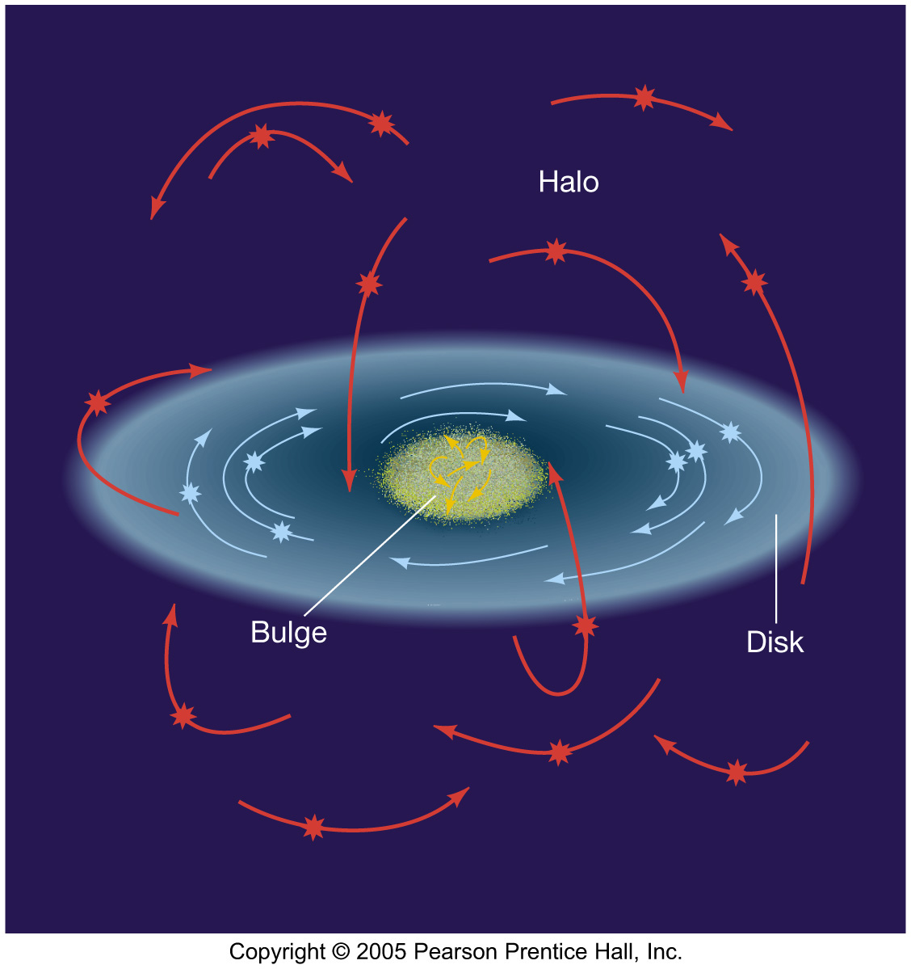
Star Motions

Slide 9
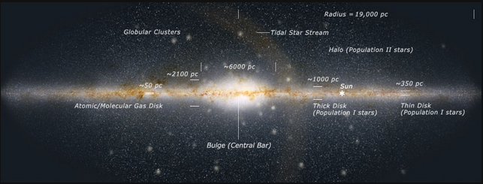
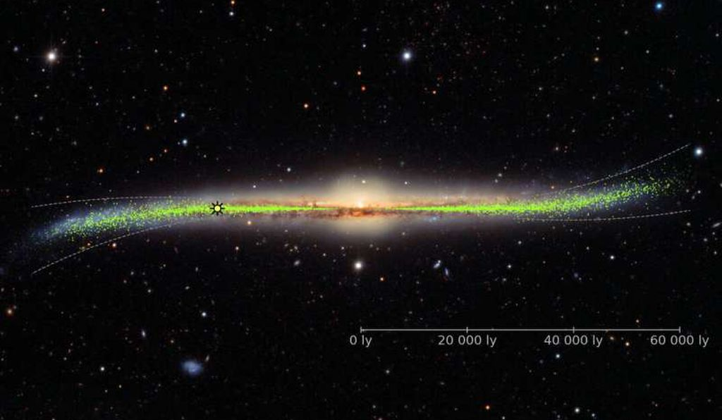
Milky Way Warp

Slide 10
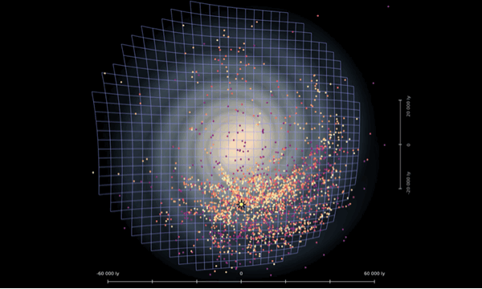
Milky Way Warp
200,000+ images of 2341 Cepheids
(Skowron+ 2019, Science, 365, 478 / OGLE / Astronomical Observatory, University of Warsaw)

Slide 11
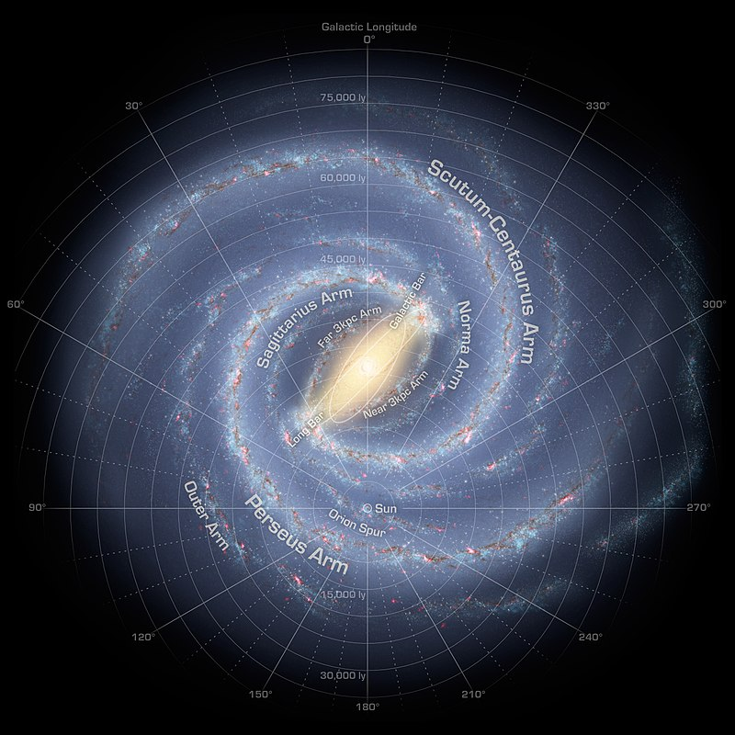
Milky Way Map
2 ARMS (2008):
Spitzer solar-type *s
N = 110 million
1. Perseus
2. Scutum-Centaurus
… or …
4 ARMS (2013):
Spitzer massive *s
N = 1600
1. Sagittarius
Orion Spur
2. Perseus
3. Outer/Norma
4. Scutum-Centaurus
Notes:
before Spitzer in 2008, thought there were 4 arms

Slide 12
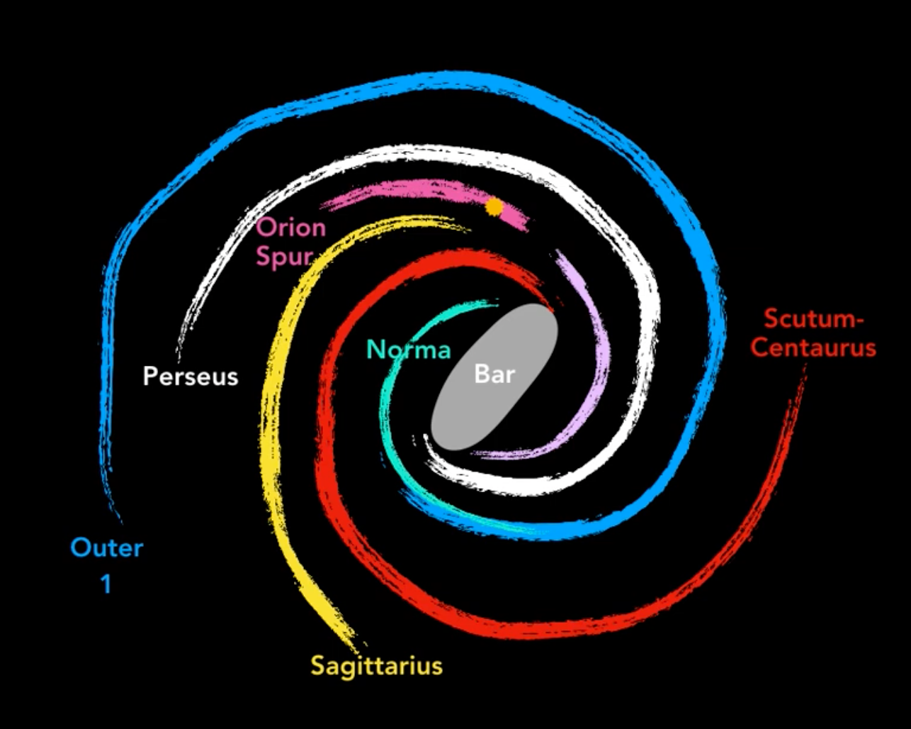
Milky Way Map
Alyssa Goodman’s take
https://www.youtube.com/watch?v=oSYWTsNCoyI

Slide 13
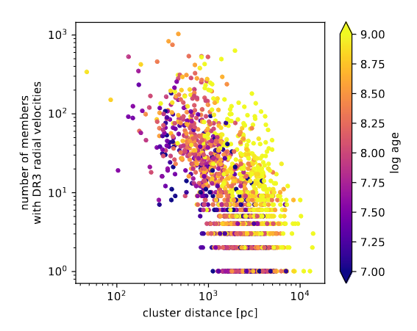
Relatively Local Situation (GDR3)
possible via GDR3
RVs … 6D XYZ+velocities
parameters OB/RGB/etc.
OB stars … 580,000
open clusters … 988
… structure to 5 kpc
Cepheids … 2800
… structure to 10 kpc
?
Pleiades
Hyades
Gaia Collab/Drimmel+ (2023)
Notes:
Fig. 1. Number of cluster members with available line-of-sight velocities in Gaia DR3 as a function of cluster distance and age.
Classical Cepheids are young Pop I and 4-20 Msun

Slide 14
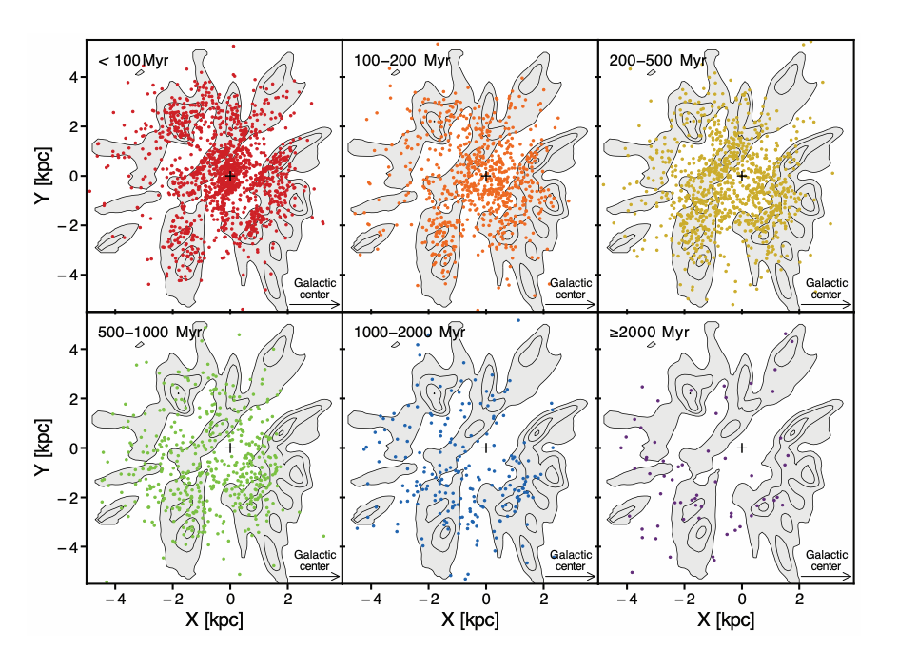
Relatively Local Situation (GDR3)
Perryman (2026)

Slide 15
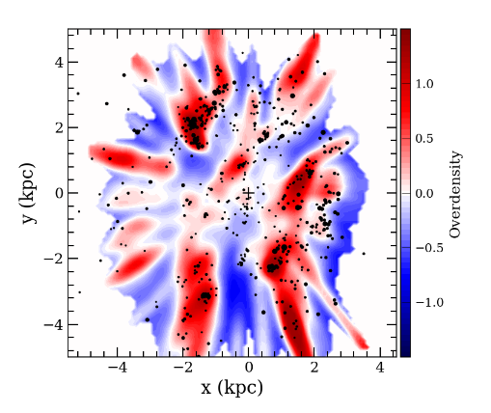
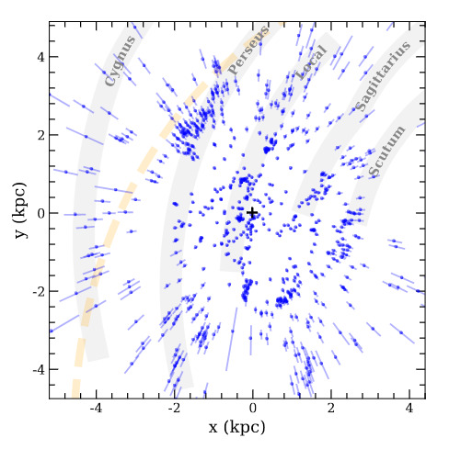
Relatively Local Situation (GDR3)
OB stars … red/blue
open clusters … dots
… structure to 5 kpc
Do you see any arms?
grey bars: Reid+ (2019)
dotted: Levine+ (2006)
Gaia Collab/Drimmel+ (2023)
Notes:
Fig. 13. Overdensity map of the OB stars overplotted with the positions of the open clusters younger than 63 Myr and with n0 > 5, plotted with filled circles whose size is proportional to √n0. The cross indicates the position of the Sun.
Fig. 14. Heliocentric coordinates of the clusters younger than 63 Myr. Thick grey lines are the spiral arm model of Reid et al. (2019), and the dashed line is the trace of the Perseus arm modelled by Levine et al. (2006). The bars represent the 1σ uncertainty on the distance. They take statistical and systematic parallax errors into account.

Slide 16
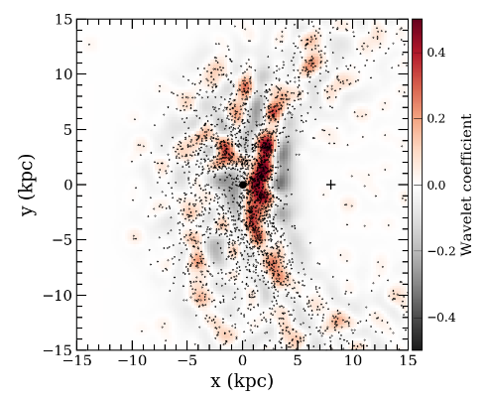
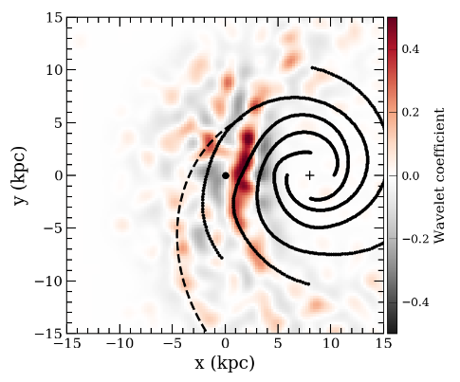
Relatively Local Situation (GDR3)
Cepheids < 200 Myr
dots: individual stars
… structure to 10 kpc
Do you see any arms?
lines: Taylor/Cordes (1993)
dotted: Levine+ (2006)
Gaia Collab/Drimmel+ (2023)
Notes:
Fig. 15. Wavelet transformation of the Cepheids with age <200 Myr. Black dots in the left panel show the positions of the single sources, and the right panel shows on a larger scale an overlay of the model from Taylor & Cordes (1993, solid lines) and the model from Levine et al. (2006, dashed line).

