Slide 1
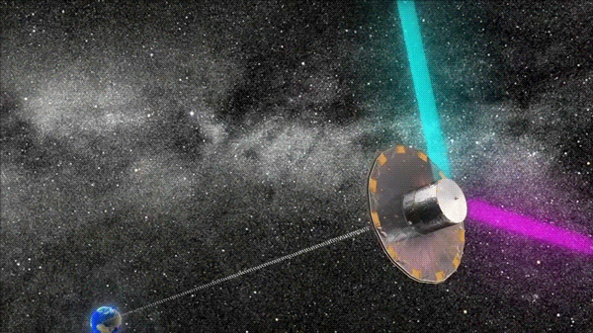
Gaia

Slide 2
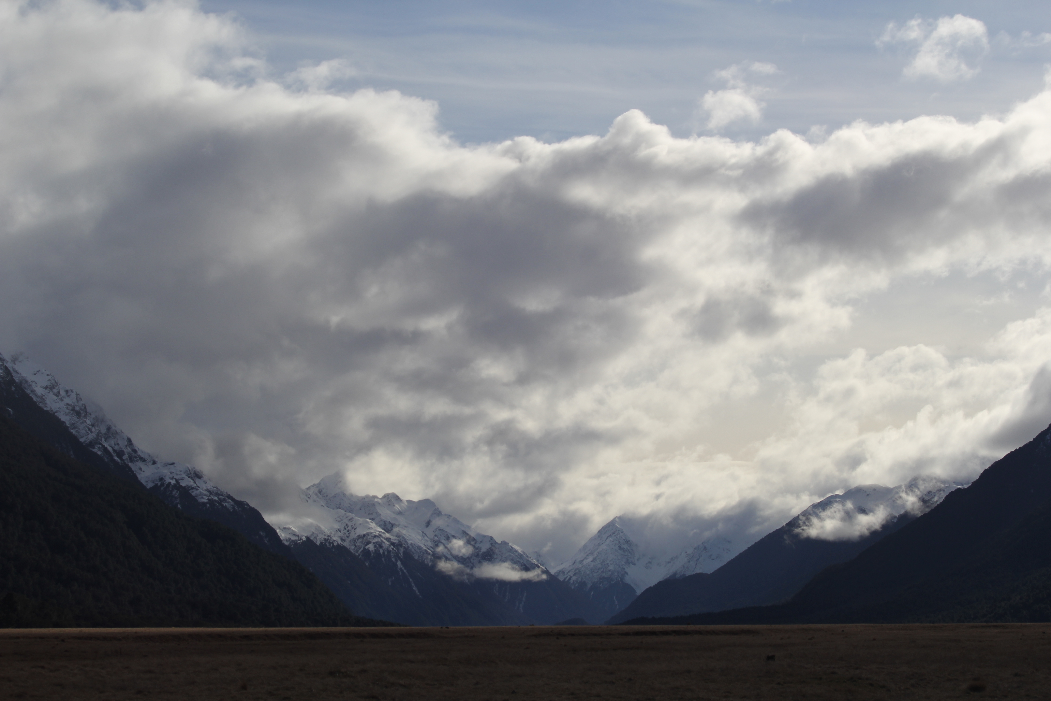


Assignment #1
Due: Tuesday 03 FEB
Level 0 1 … 2 … 3 … 4
1 piece of paper to me
2 ideas
3 references each
4 sentences each

Slide 3
Assignments
Tuesday 03 FEB Level 0 … Ideas
Tuesday 17 FEB Level 1 … Outline … 2 weeks later
Tuesday 03 MAR Level 2 … 1st Draft … 2 weeks later
Tuesday 24 MAR Level 3 … 2nd Draft … 3 weeks later
Tue/Thu 14/16 APR Presentations … 3 weeks later
Thursday 23 APR Level 4 … submit … 1 week later

Slide 4
Gaia

Slide 5

Gaia (Greek Version)
Chaos (Khaos)
…
Gaia (Terra Mater = Earth)
…
Uranus (Caelus)
…
Cronos (Saturn, a Titan)
…
Zeus (Jupiter)
Gaia sculpture by Tellus 13-9 BCE
Notes:
Gaia is the Earth in Greek mythology. She is the offspring of Chaos or comes into being after it.
Mother of Uranus (Sky or Heaven).
Gaia and Uranus bear the Titans (including Cronos) … thrown into Tartarus inside Earth … Gaia gets them to dethrone Uranus … Cronos/Saturn rules Earth, eats sons, but Zeus/Jupiter escapes and takes over
So … Gaia is mother of Uranus … grandmother of Cronos … great grandmother of Zeus

Slide 6
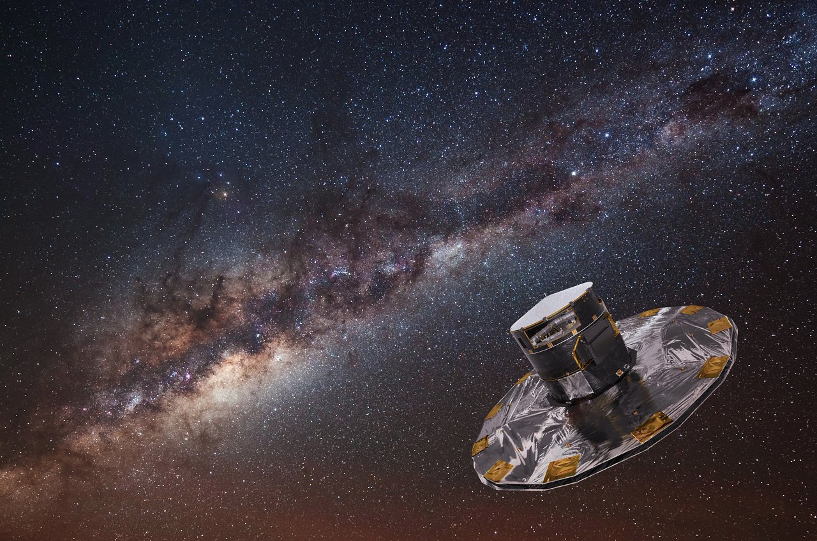
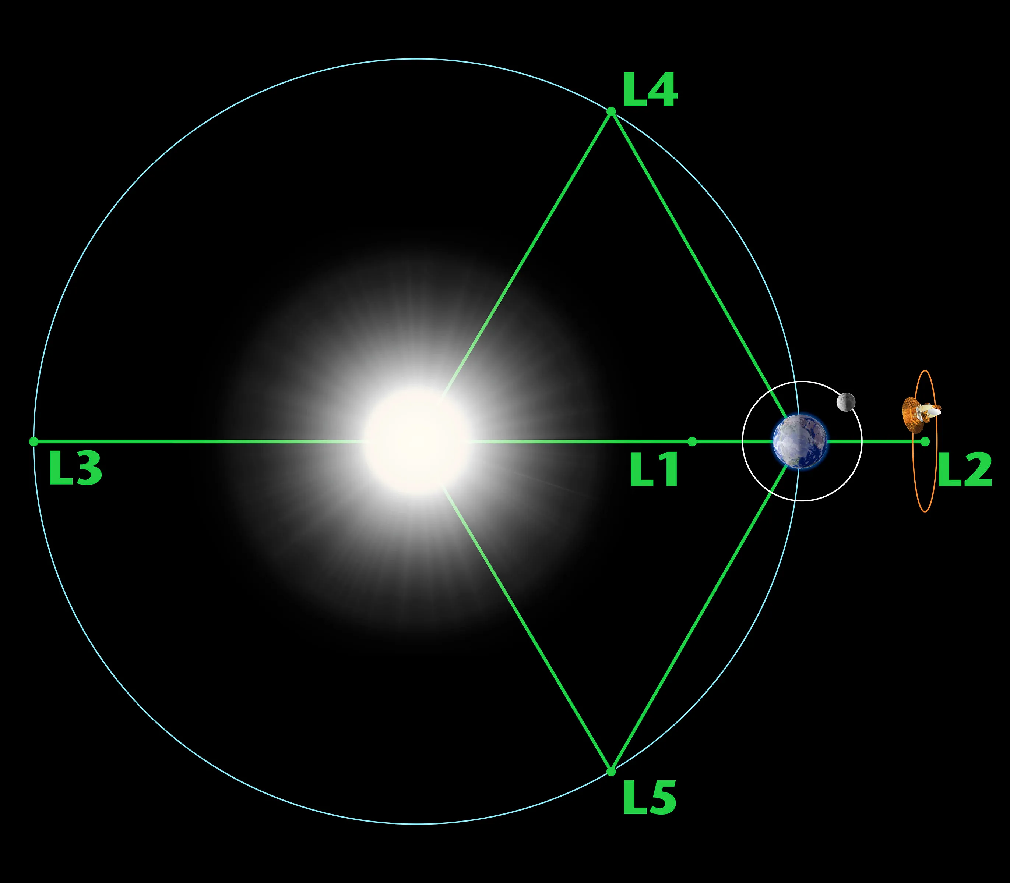
Gaia
Prime Contract MAY 2006
2 telescopes
3 science instruments: astrometer, photometer, RV spectrometer
Launched DEC 2013 from French Guiana (5 N)
Orbit JAN 2014 Lissajous around L2
Notes:
Kennedy Space Center is 29 N

Slide 7

Gaia Launch to Orbit
https://www.youtube.com/watch?v=9XcJ1wFRCk8

Slide 8
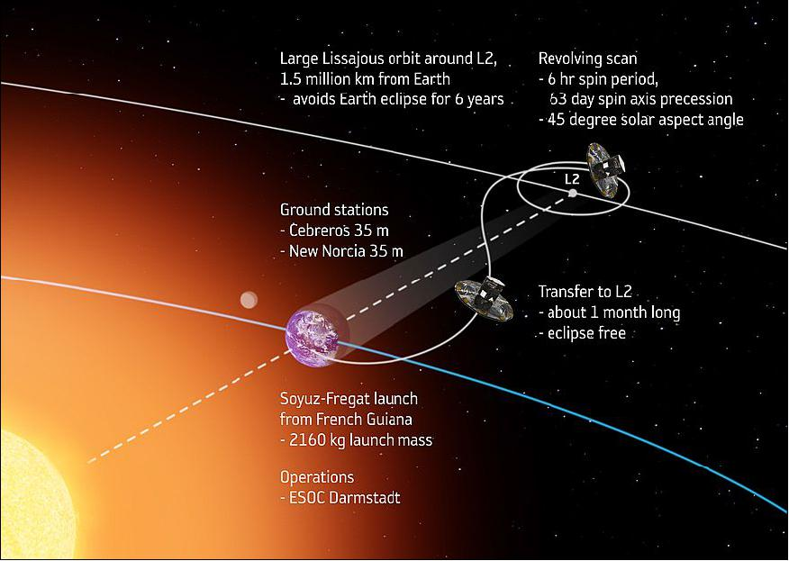
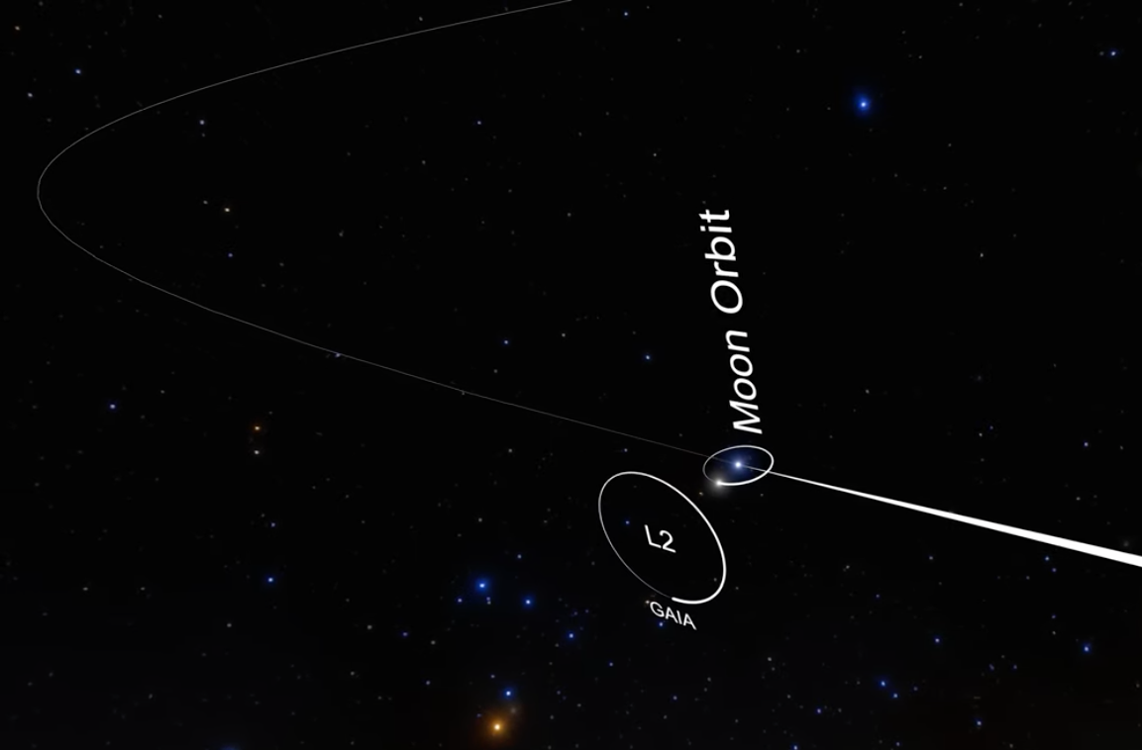
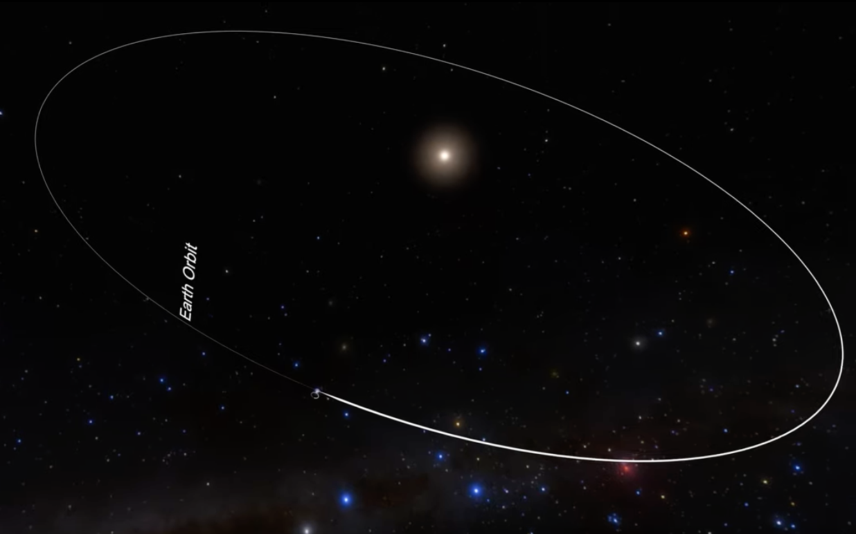
Gaia
Notes:
Cebreros is near Madrid, Spain
New Norcia is near Perth, Australia

Slide 9
Gaia
Prime Contract MAY 2006
2 telescopes
3 science instruments: astrometer, photometer, RV spectrometer
Launched DEC 2013 from French Guiana (5 N)
Orbit JAN 2014 Lissajous around L2
Data Start JUL 2014
DR1 SEP 2016
DR2 APR 2018
EDR3 DEC 2020
DR3 JUN 2022 … 34 months
Data End JAN 2025 (fuel out)
DR4 DEC 2026 … 66 months
DR5 2030 ish … 126 months
Notes:
Kennedy Space Center is 29 N

Slide 10

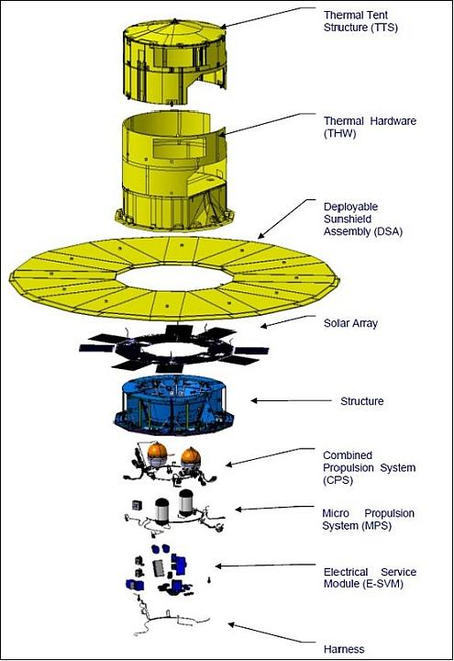
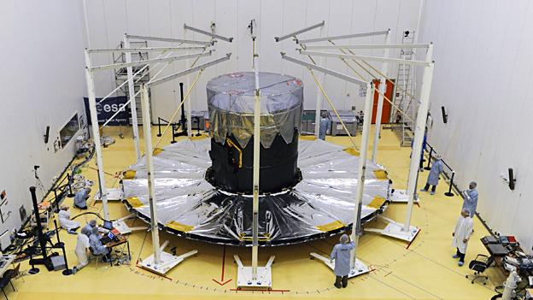
Gaia
satellite position tracked to 20 mas
ESO 2.6m in Chile
Liverpool 2m in Canaries
LCO 2m in Australia+US
2 primary mirrors 1.45m x 0.45m
repeated observations via spin
4 rotations/day
106.5 deg offset between fields
axis precesses every 63 days
Which has more collecting area,
a Gaia primary
or the 0.9m telescope?
Notes:
1.49m x 0.54m … 0.80 m2
0.9m … 0.64 m2

Slide 11
Gaia Scanning
https://www.gaia.ac.uk/multimedia/gaia-nominal-scanning-law-movie
https://www.youtube.com/watch?v=lntlPhXSRQY

Slide 12
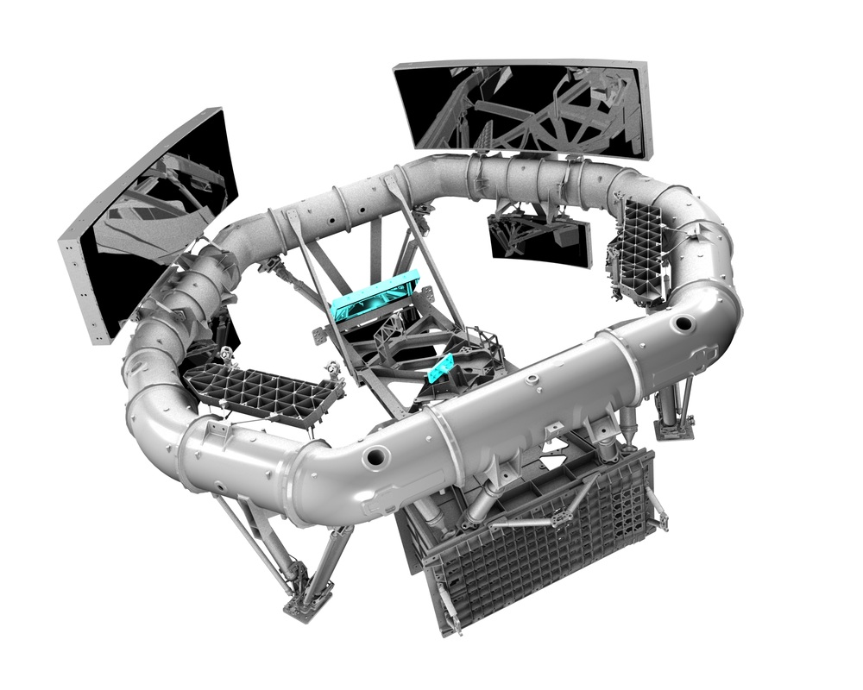
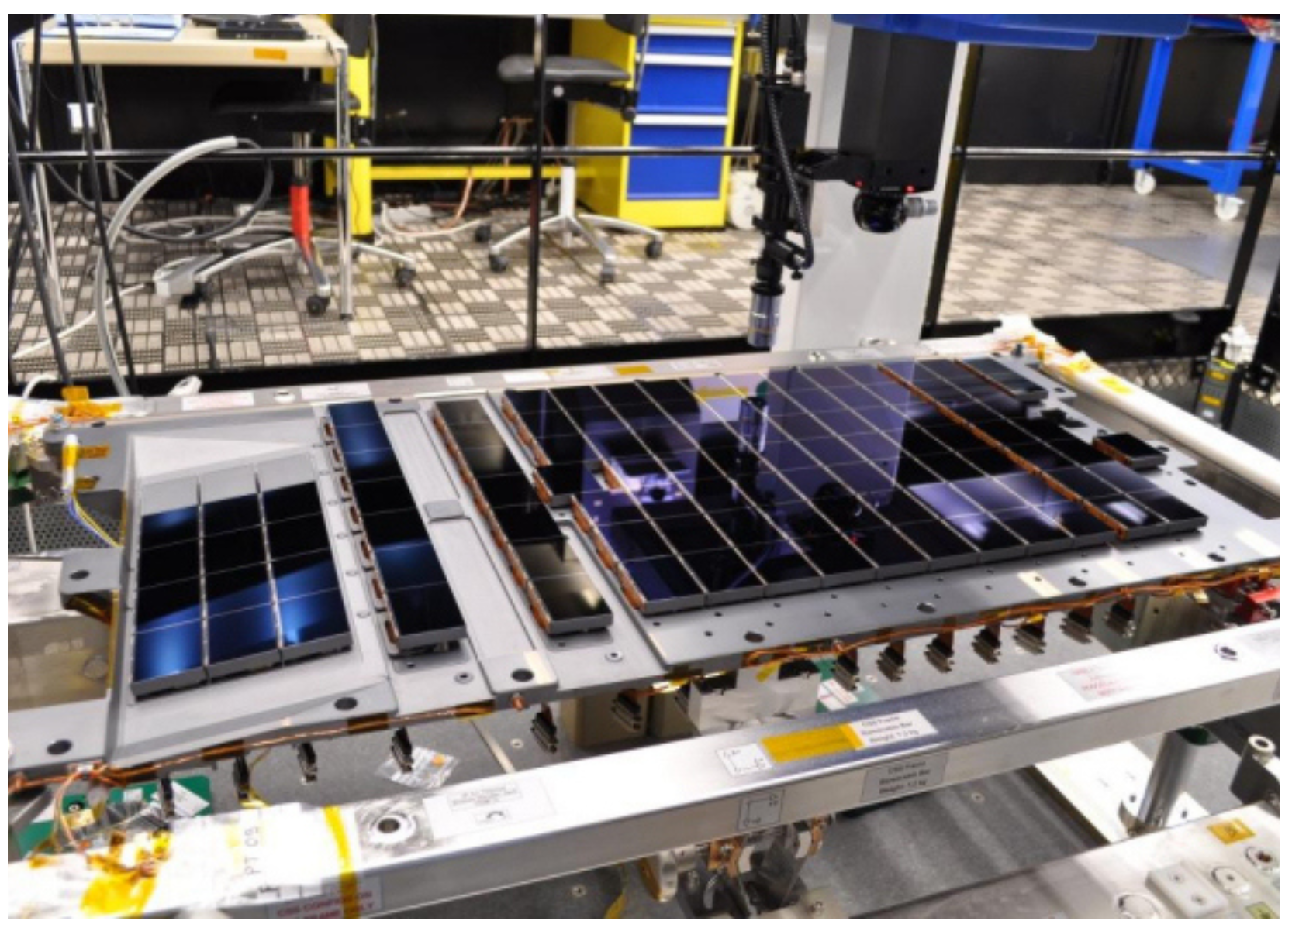
Gaia Mirrors + CCDs
2 mirrors = 2 telescopes
both send images to the same 106 CCDs
~1 minute to star to cross 1.5 deg focal plane
CCDs 4.5 X 5.9 cm 4500 x 1966 pixels
rectangular pixels 10 x 30 microns
on the sky 59 x 177 mas
image width ~ 0.1 arcsec … resolution limit
Time Delayed Integrations … charge shifted
… precise astrometry at both narrow
and wide separations

Slide 13
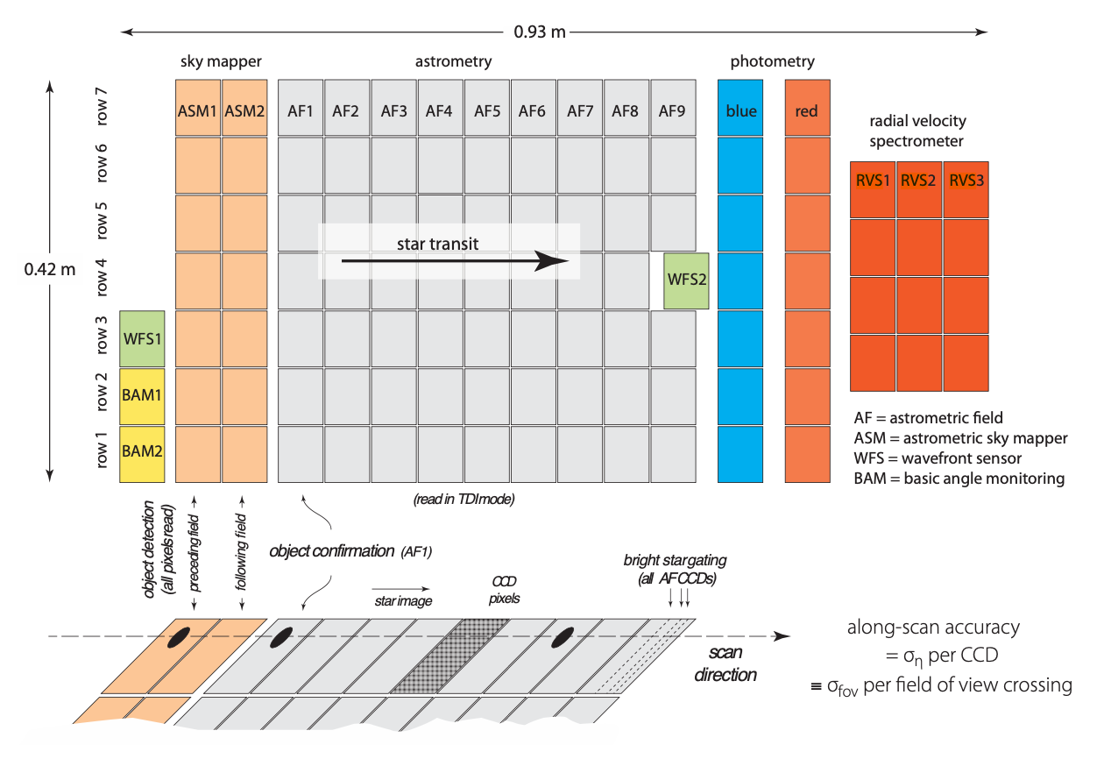
Gaia’s 3 Instruments
ASTROMETRY
(the best stuff)
PHOTOMETRY
(the pretty good stuff)
SPECTROSCOPY
(the ok stuff)
G
350-1050 nm
Radial Velocity
Spectrometer (RVS)
grating
+
lenses
+
filter
focusing
prisms give low-res
spectra … BP+RP
Notes:
each star observed an average of 70 times in first 5 years

Slide 14
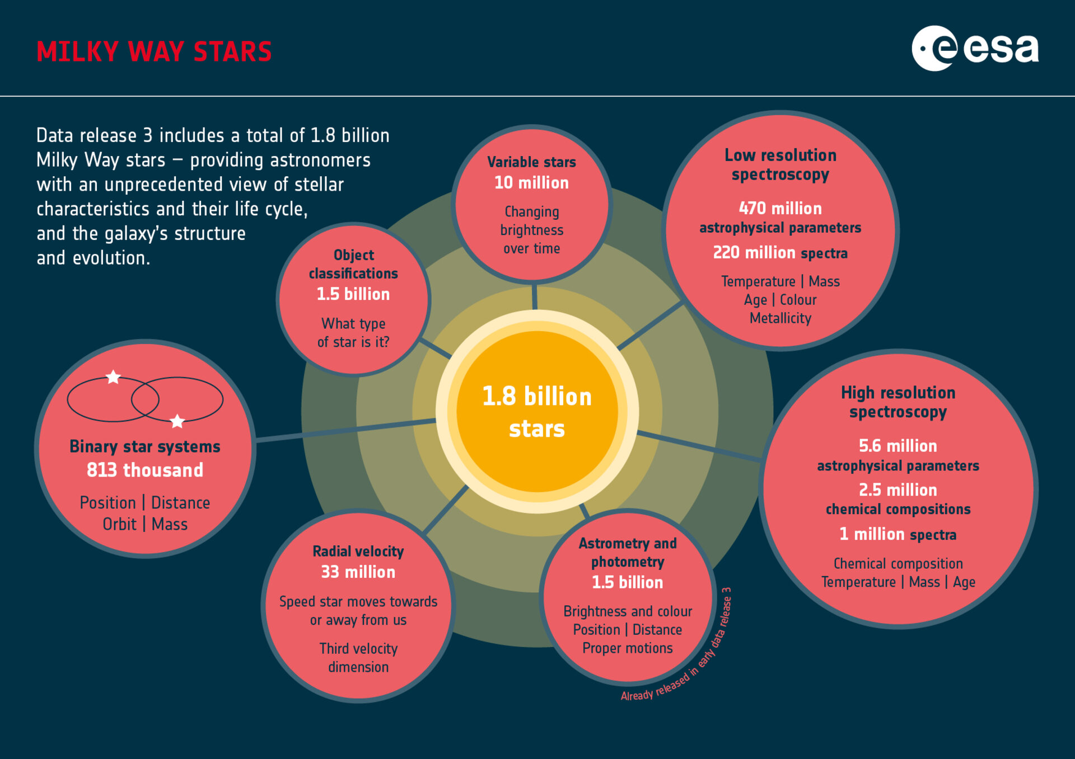
Gaia DR3 … 34 months of data
??
?
~70 observations
over first 5 years
complete to G = 20.7
V = 20-22
> 100 million
eventually?

Slide 15
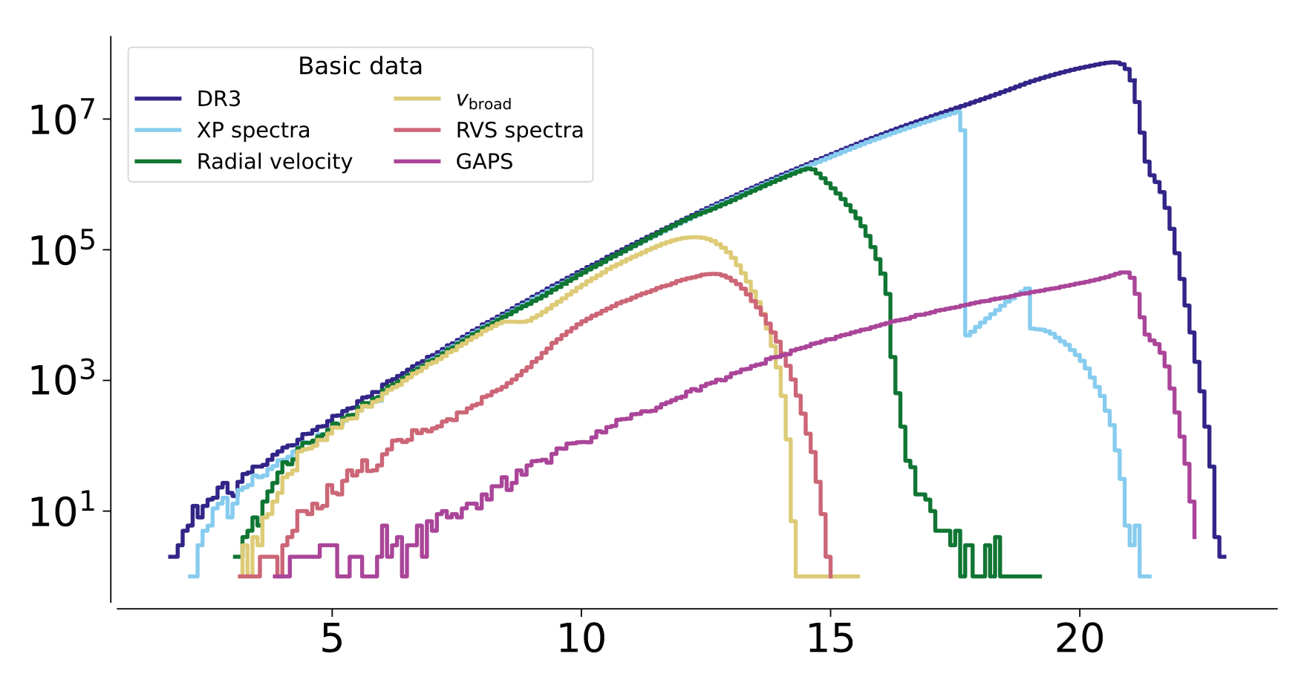

Gaia Faint Limits: DR3
Gaia Collaboration
/ Vallenari+ (2023)
DR3 astrometry in G mag … most have BP and RP mags
XP BP + RP spectra yielding astrophysical parameters
Radial velocity RV values from combined visits
V_{broad} line broadening velocity from RVS
RVS spectra epoch RVs and chemical composition (R ~ 11700 / 845⎼872 nm)
GAPS Gaia Andromeda Photometric Survey

Slide 16
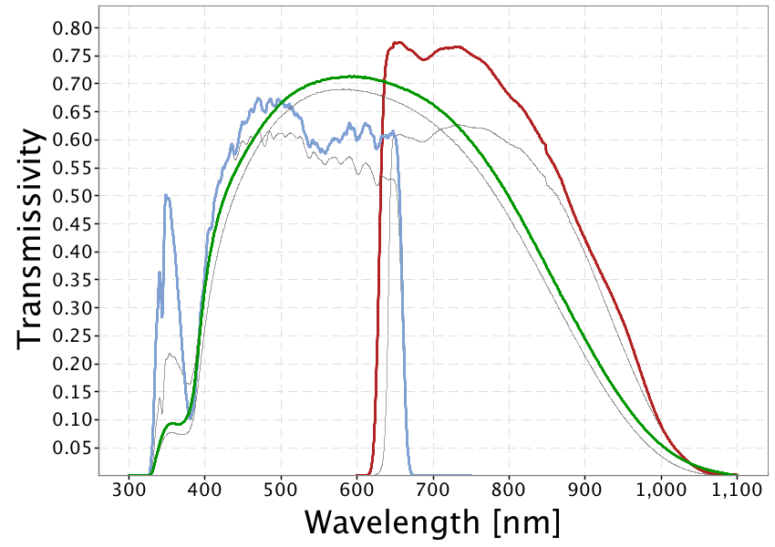
Gaia Photometric Bands (DR2)
G
RP
BP
gray lines are pre-launch and DR1
Notes:
The coloured lines in the figure show the revised passbands for G, G_{BP} and G_{RP} (green: G; blue: G_{BP}; red: G_{RP}), defining the Gaia DR2 photometric system. The thin, grey lines show the nominal, pre-launch passbands published in Jordi et al. 2010, used for Gaia DR1.

Slide 17
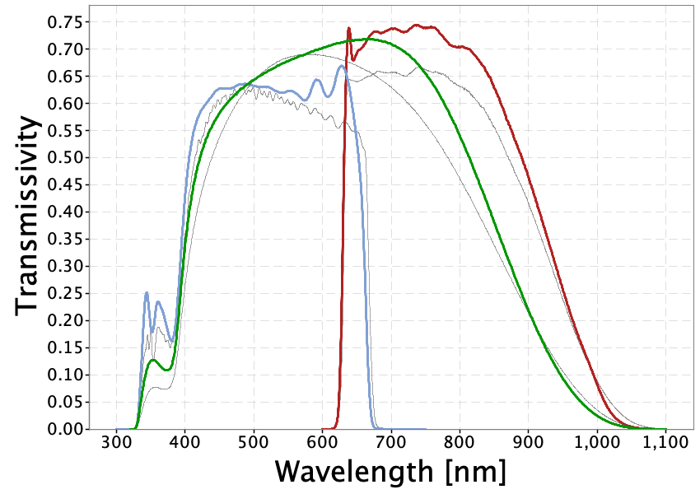
Gaia Photometric Bands (DR3)
G
RP
BP
gray lines are pre-launch and DR1

Slide 18
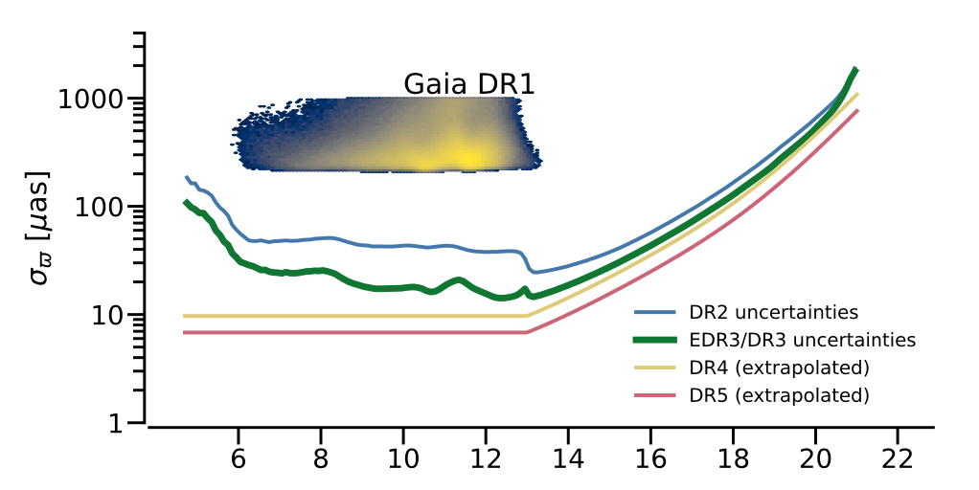
Gaia Parallaxes
1.0 mas
typical limits of ground-based parallaxes
1.0 ± 0.1 mas means 10% error at 1000 pc
beware of
systematics
assume Gaia DR3 errors for your proposals
What is M_{G} for G = 14 at 1000 pc?
Gaia Collaboration
/ Vallenari+ (2023)

Slide 19
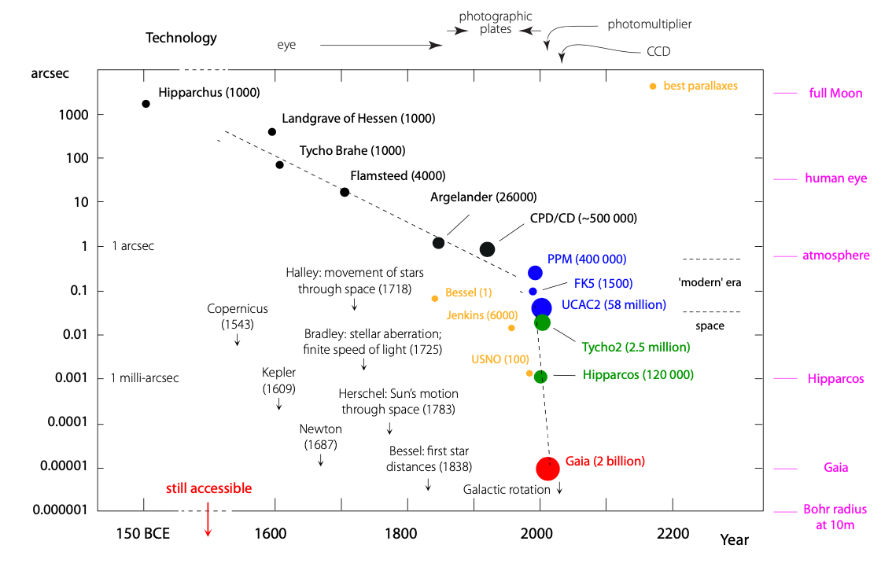
Gaia Leap
RECONS (800)
Notes:
Jenkins is 1952 YPC

Slide 20
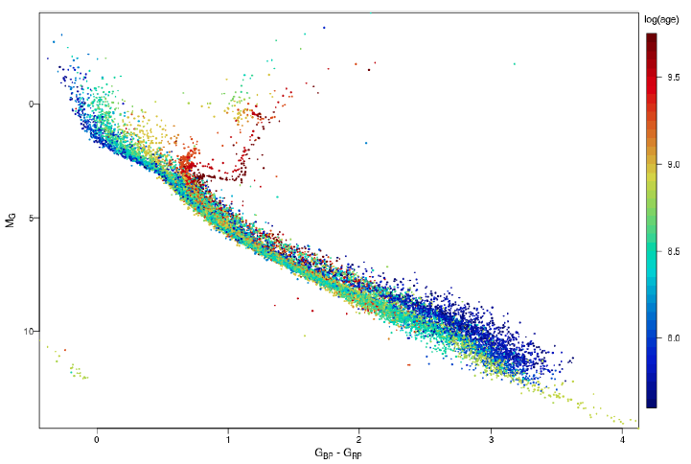
32 Clusters by Gaia
Gaia Collaboration
/ Babusiaux+ 2023

Slide 21
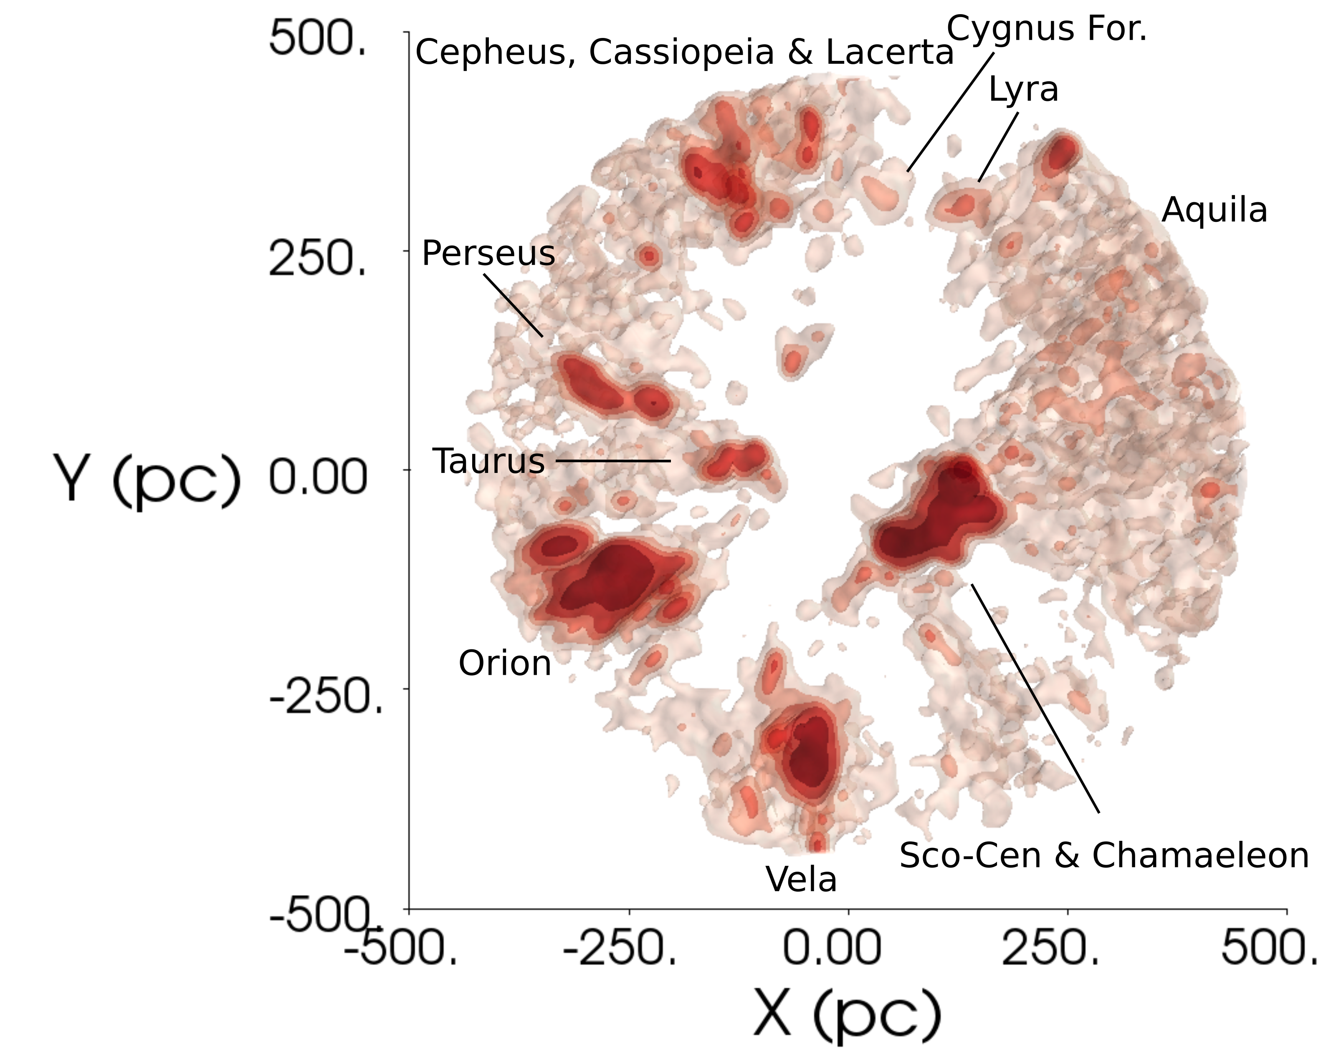
Stellar Populations by Gaia

Slide 22
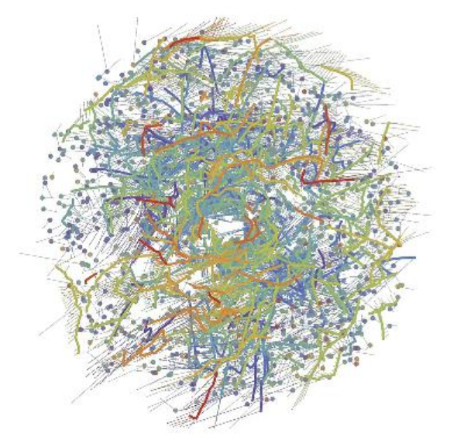
Stellar Populations by Gaia
dots stellar clusters
lines comoving groups
dashed 5 Myr trajectories
(gap is artefact)
purple oldest … 1 Gyr
red youngest … < 100 Myr
1 kpc
Kounkel & Covey (2019)
Notes:
This diagram shows a face-on view of stellar ‘families’ – clusters (dots) and co-moving groups (thick lines) of stars – within about 3000 light-years from the Sun, which is located at the center of the image. The diagram is based on data from the second data release of ESA’s Gaia mission. Each family is identified with a different color and comprises a population of stars that formed at the same time. Purple hues represent the oldest stellar populations, which formed around 1 billion years ago; blue and green hues represent intermediate ages, with stars that formed hundreds of millions of years ago; orange and red hues show the youngest stellar populations, which formed less than a hundred million years ago. Thin lines show the predicted velocities of each group of stars over the next 5 million years, based on Gaia’s measurements. The lack of structures at the center is an artefact of the method used to trace individual populations, not due to a physical bubble. Image credit: M. Kounkel & K. Covey (2019)

Slide 23
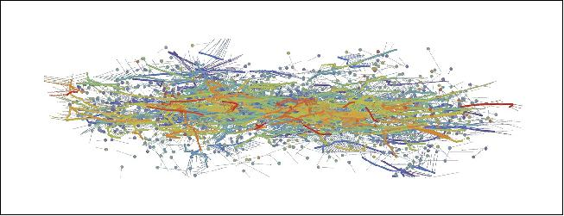
Stellar Populations by Gaia
~2000 new clusters and groups
half in long stringy structures … think spaghetti
clusters disperse in billions of years, not millions
young star strings perpendicular to plane … old ones horizontal … spiral arms
1 kpc
Kounkel & Covey (2019)

Slide 24
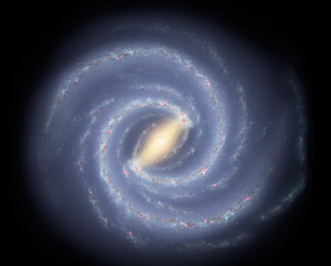
MW Galactic Bar by Gaia
150 million stars … most red giants
distances estimated
colors from Gaia
extinction from
Pan-STARRS
2MASS
AllWISE
https://www.youtube.com/watch?time_continue=13&v=B5USIE8rCJg&feature=emb_logo
Anders+ (2019)
Notes:
Revealing the galactic bar. This color chart shows the distribution of 150 million stars in the Milky Way probed using data from the second release of ESA’s Gaia mission in combination with infrared and optical surveys, with orange/yellow hues indicating a greater density of stars. Most of these stars are red giants. The distribution is superimposed on an artistic top view of our galaxy. - While the majority of charted stars are located closer to the Sun (the larger orange/yellow blob in the lower part of the image), a large and elongated feature populated by many stars is also visible in the central region of the galaxy: this is the first geometric indication of the galactic bar. - The distances to the stars shown in this chart, along with their surface temperature and extinction – a measure of how much dust there is between us and the stars – were estimated using the StarHorse computer code [image credit: Data: ESA/Gaia/DPAC, A. Khalatyan (AIP) & StarHorse team; Galaxy map: NASA/JPL-Caltech/R. Hurt (SSC/Caltech)]

Slide 25
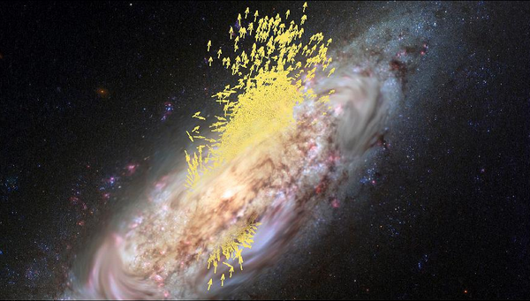
Milky Way + Enceladus (the galaxy)
previously …
MW built up by mergers
3D space motions of 7 million stars
30,000 stars opposite rotation
elongated orbits
new
Gaia-Enceladus
10 Gyr ago merger
specific population
today’s inner halo
thick disk origin
Helmi+ (2018)
Notes:
Enceladus was buried under Mount Etna, in Sicily, and responsible for local earthquakes. Similarly, the stars of Gaia-Enceladus were deeply buried in the Gaia data, and they have shaken the Milky Way, leading to the formation of its thick disc.
13 globulars/100s variables
+APOGEE spectra

Slide 26
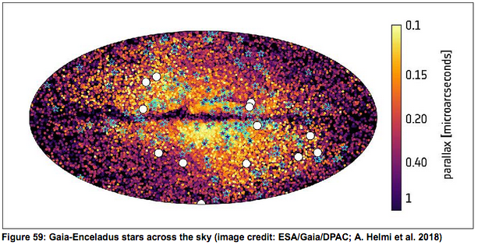
Milky Way + Enceladus (the galaxy)
variables starred / globular clusters as dots
Magellanic Cloud sized?
tiny parallaxes …
How far away is an object with parallax 1 microarcsecond?

Slide 27
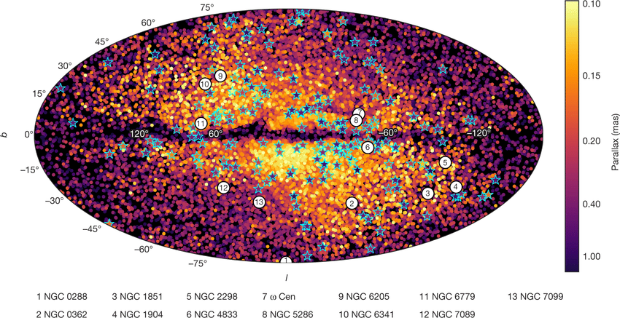
Milky Way + Enceladus (the galaxy)
wrong by a factor of 1000 !
How far away is an object with parallax 1 milliarcsecond?

Slide 28
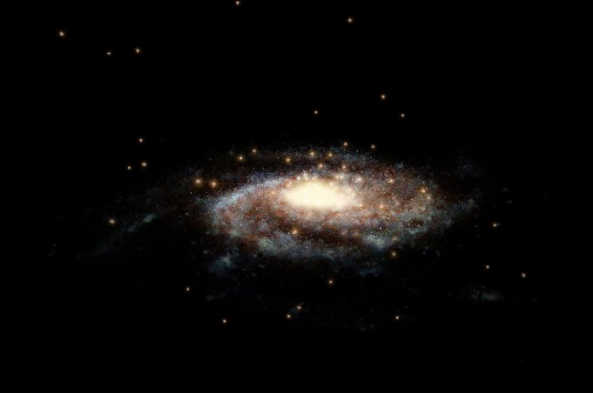
Milky Way Mass by Gaia
previously …
500 billion M to 3 trillion M
globular radial velocities
new
46 globular clusters
proper motions
Gaia DR2: 34 within 21 kpc
HST: 12 more within 40 kpc
1.54 trillion M within 40 kpc of center
+ 0.75 … ⎼ 0.44 errors
Watkins+ (2019)
Notes:
Watkins, L.+ 2019 = 2019ApJ...873..118W

Slide 29
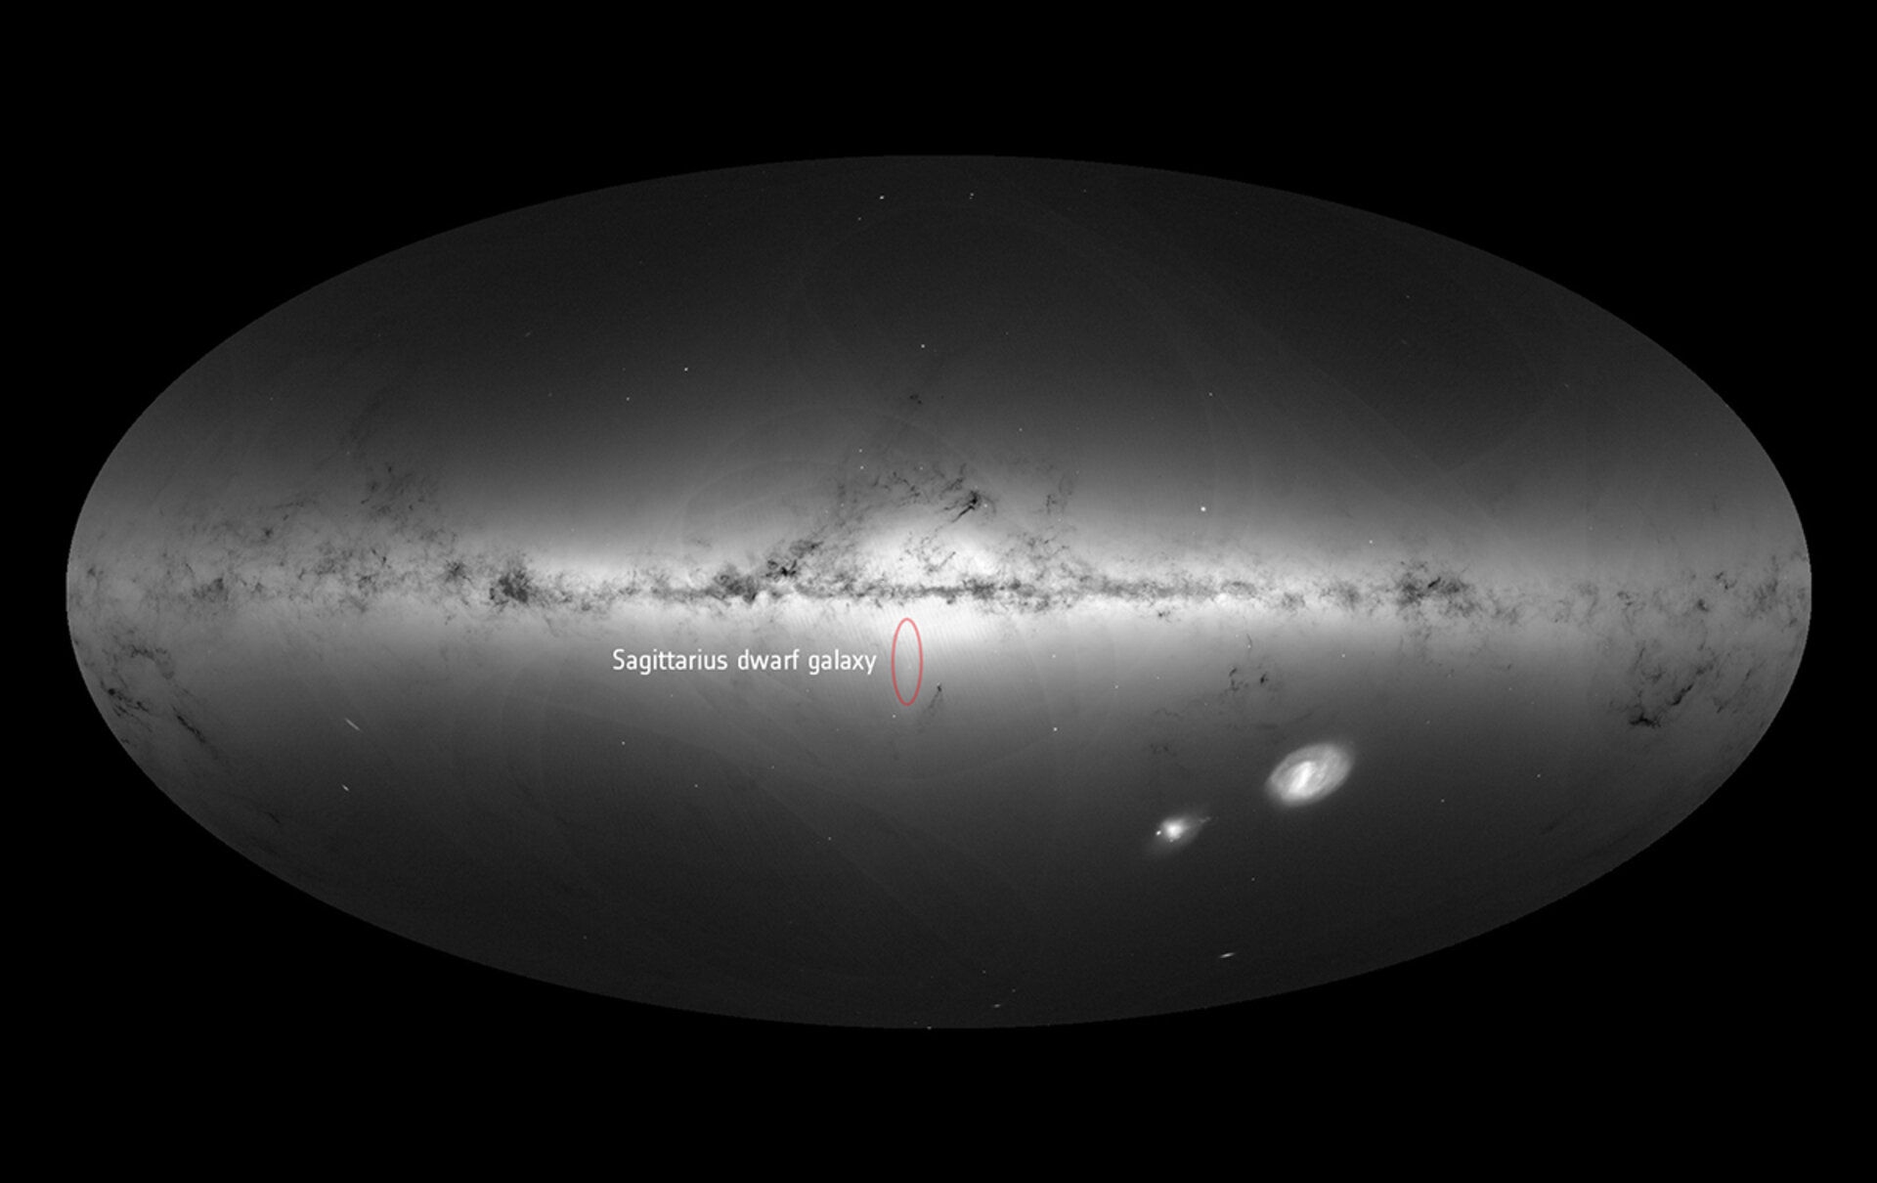
Not Just Inside MW
M31
M33
Notes:
M33 is Triangulum

Slide 30
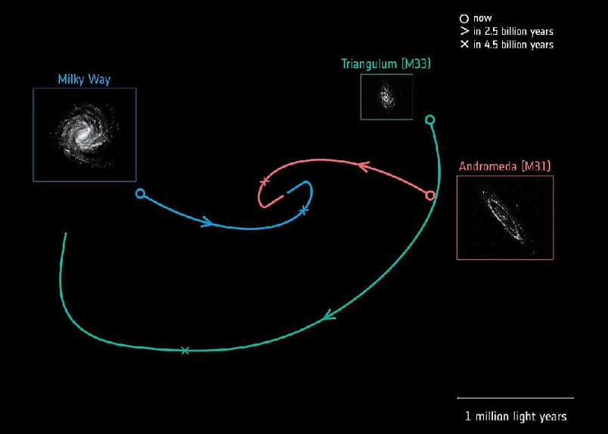
Gaia Predicts the Future
previously …
MW+And head-on in 3.9 Gyr
Tri+And first infall … or not?
1000s of stars in And+Tri
proper motions
new
MW+And
4.5 Gyr first pass
near miss at 120 kpc
Tri on first infall
also, And+Tri rotations
https://www.youtube.com/watch?v=nzhL4bgqkJY
van der Marel+ (2019)
Notes:
van der Marel predicted head-on collision at 3.9 Gyr … WRONG
The future orbital trajectories of three spiral galaxies: our Milky Way (blue), Andromeda, also known as M31 (red), and Triangulum, also known as M33 (green). The circle indicates the current position of each galaxy, and their future trajectories have been calculated using data from the second release of ESA's Gaia mission. The Milky Way is shown as an artist's impression, while the images of Andromeda and Triangulum are based on Gaia data. Arrows along the trajectories indicate the estimated direction of each galaxy's motion and their positions, 2.5 billion years into the future, while crosses mark their estimated position in about 4.5 billion years. Approximately 4.5 billion years from now, the Milky Way and Andromeda will make their first close passage around one another at a distance of approximately 400,000 light-years. The galaxies will then continue to move closer to one another and eventually merge to form an elliptical galaxy (image credit: Orbits: E. Patel, G. Besla (University of Arizona), R. van der Marel (STScI)

Slide 31
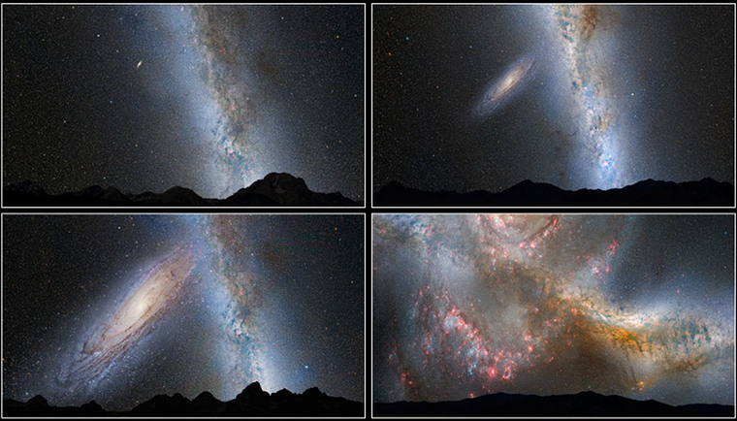
Milky Way + Andromeda Future
today 2 Gyr
4.4 Gyr 4.5 Gyr
Notes:
This series of photo illustrations shows the predicted merger between our Milky Way galaxy and the neighbouring Andromeda galaxy, as it will unfold over the next several billion years. The sequence is inspired by dynamical computer modelling of the inevitable future collision between the two galaxies.
First Row, Left Panel: Present Day — This is a nighttime view of the current sky, with the bright belt of our Milky Way. The Andromeda galaxy lies 2.5 million light-years away and looks like a faint spindle, several times the diameter of the full Moon.
First Row, Right Panel: 2 Billion Years — The disk of the approaching Andromeda galaxy is noticeably larger.
Second Row, Left Panel: 3.75 Billion Years — Andromeda fills the field of view. The Milky Way begins to show distortion due to tidal pull from Andromeda.
Second Row, Right Panel, and Third Row, Left Panel: 3.85-3.9 Billion Years — During the first close approach, the sky is ablaze with new star formation, which is evident in a plethora of emission nebulae and open young star clusters.
Third Row, Right Panel: 4 Billion Years — After its first close pass, Andromeda is tidally stretched out. The Milky Way, too, becomes warped.
Fourth Row, Left Panel: 5.1 Billion Years — During the second close passage, the cores of the Milky Way and Andromeda appear as a pair of bright lobes. Star-forming nebulae are much less prominent because the interstellar gas and dust has been significantly decreased by previous bursts of star formation.
Fourth Row, Right Panel: 7 Billion Years — The merged galaxies form a huge elliptical galaxy, its bright core dominating the nighttime sky. Scoured of dust and gas, the newly merged elliptical galaxy no longer makes stars and no nebulae appear in the sky. The ageing starry population is no longer concentrated along a plane, but instead fills an ellipsoidal volume.
NOTE: These illustrations depict the view from about 25,000 light-years away from the centre of the Milky Way. The future view from our solar system will most likely be markedly different, depending on how the Sun's orbit within the galaxy changes during the collision.

Slide 32
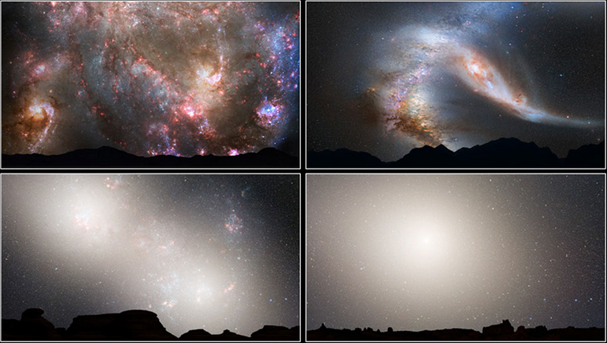
Milky Way + Andromeda Future
4.5 Gyr 4.6 Gyr
5.7 Gyr 8 Gyr
Notes:
This series of photo illustrations shows the predicted merger between our Milky Way galaxy and the neighbouring Andromeda galaxy, as it will unfold over the next several billion years. The sequence is inspired by dynamical computer modelling of the inevitable future collision between the two galaxies.
First Row, Left Panel: Present Day — This is a nighttime view of the current sky, with the bright belt of our Milky Way. The Andromeda galaxy lies 2.5 million light-years away and looks like a faint spindle, several times the diameter of the full Moon.
First Row, Right Panel: 2 Billion Years — The disk of the approaching Andromeda galaxy is noticeably larger.
Second Row, Left Panel: 3.75 Billion Years — Andromeda fills the field of view. The Milky Way begins to show distortion due to tidal pull from Andromeda.
Second Row, Right Panel, and Third Row, Left Panel: 3.85-3.9 Billion Years — During the first close approach, the sky is ablaze with new star formation, which is evident in a plethora of emission nebulae and open young star clusters.
Third Row, Right Panel: 4 Billion Years — After its first close pass, Andromeda is tidally stretched out. The Milky Way, too, becomes warped.
Fourth Row, Left Panel: 5.1 Billion Years — During the second close passage, the cores of the Milky Way and Andromeda appear as a pair of bright lobes. Star-forming nebulae are much less prominent because the interstellar gas and dust has been significantly decreased by previous bursts of star formation.
Fourth Row, Right Panel: 7 Billion Years — The merged galaxies form a huge elliptical galaxy, its bright core dominating the nighttime sky. Scoured of dust and gas, the newly merged elliptical galaxy no longer makes stars and no nebulae appear in the sky. The ageing starry population is no longer concentrated along a plane, but instead fills an ellipsoidal volume.
NOTE: These illustrations depict the view from about 25,000 light-years away from the centre of the Milky Way. The future view from our solar system will most likely be markedly different, depending on how the Sun's orbit within the galaxy changes during the collision.

Slide 33
Topics
naked eye stars
O/B dwarf population(s)
blue/red supergiants
red giants
red clump/horizontal branch stars
cool subdwarfs
hot subdwarfs
white dwarfs
brown dwarfs
binaries
Cepheid variables (phot time series)
RR Lyrae variables (phot time series)
RV Tauri variables (yellow supergiants)
long period variables (Mira)
cataclysmic variables
recurrent/dwarf novae
SN remnants
planetary nebulae
moving groups
young clusters (Orion, other Messier)
old clusters (M67)
globular clusters
map a Galactic arm
MW thin/thick disk via kinematics
MW tidal streams
LMC/SMC/And/Tri populations
LMC/SMC/And/Tri proper motions
Andromeda visitors
LBVs … only ~20
asteroids/comets … Solar System
exoplanets … not Galactic
Notes:
general project: binary stars revealed --- how many stars/mass hidden pre-Gaia?
cultural project: HR Diagram over time --- what happened to WDs?

