Slide 1
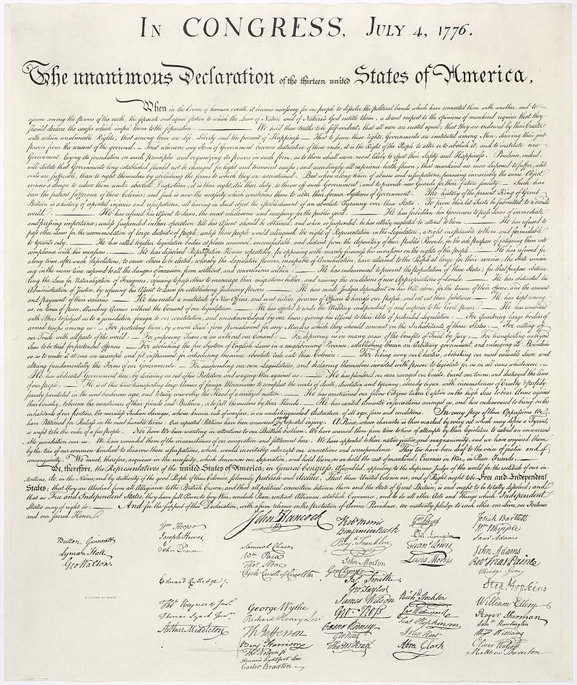
Writing Proposals
X
$

Slide 2
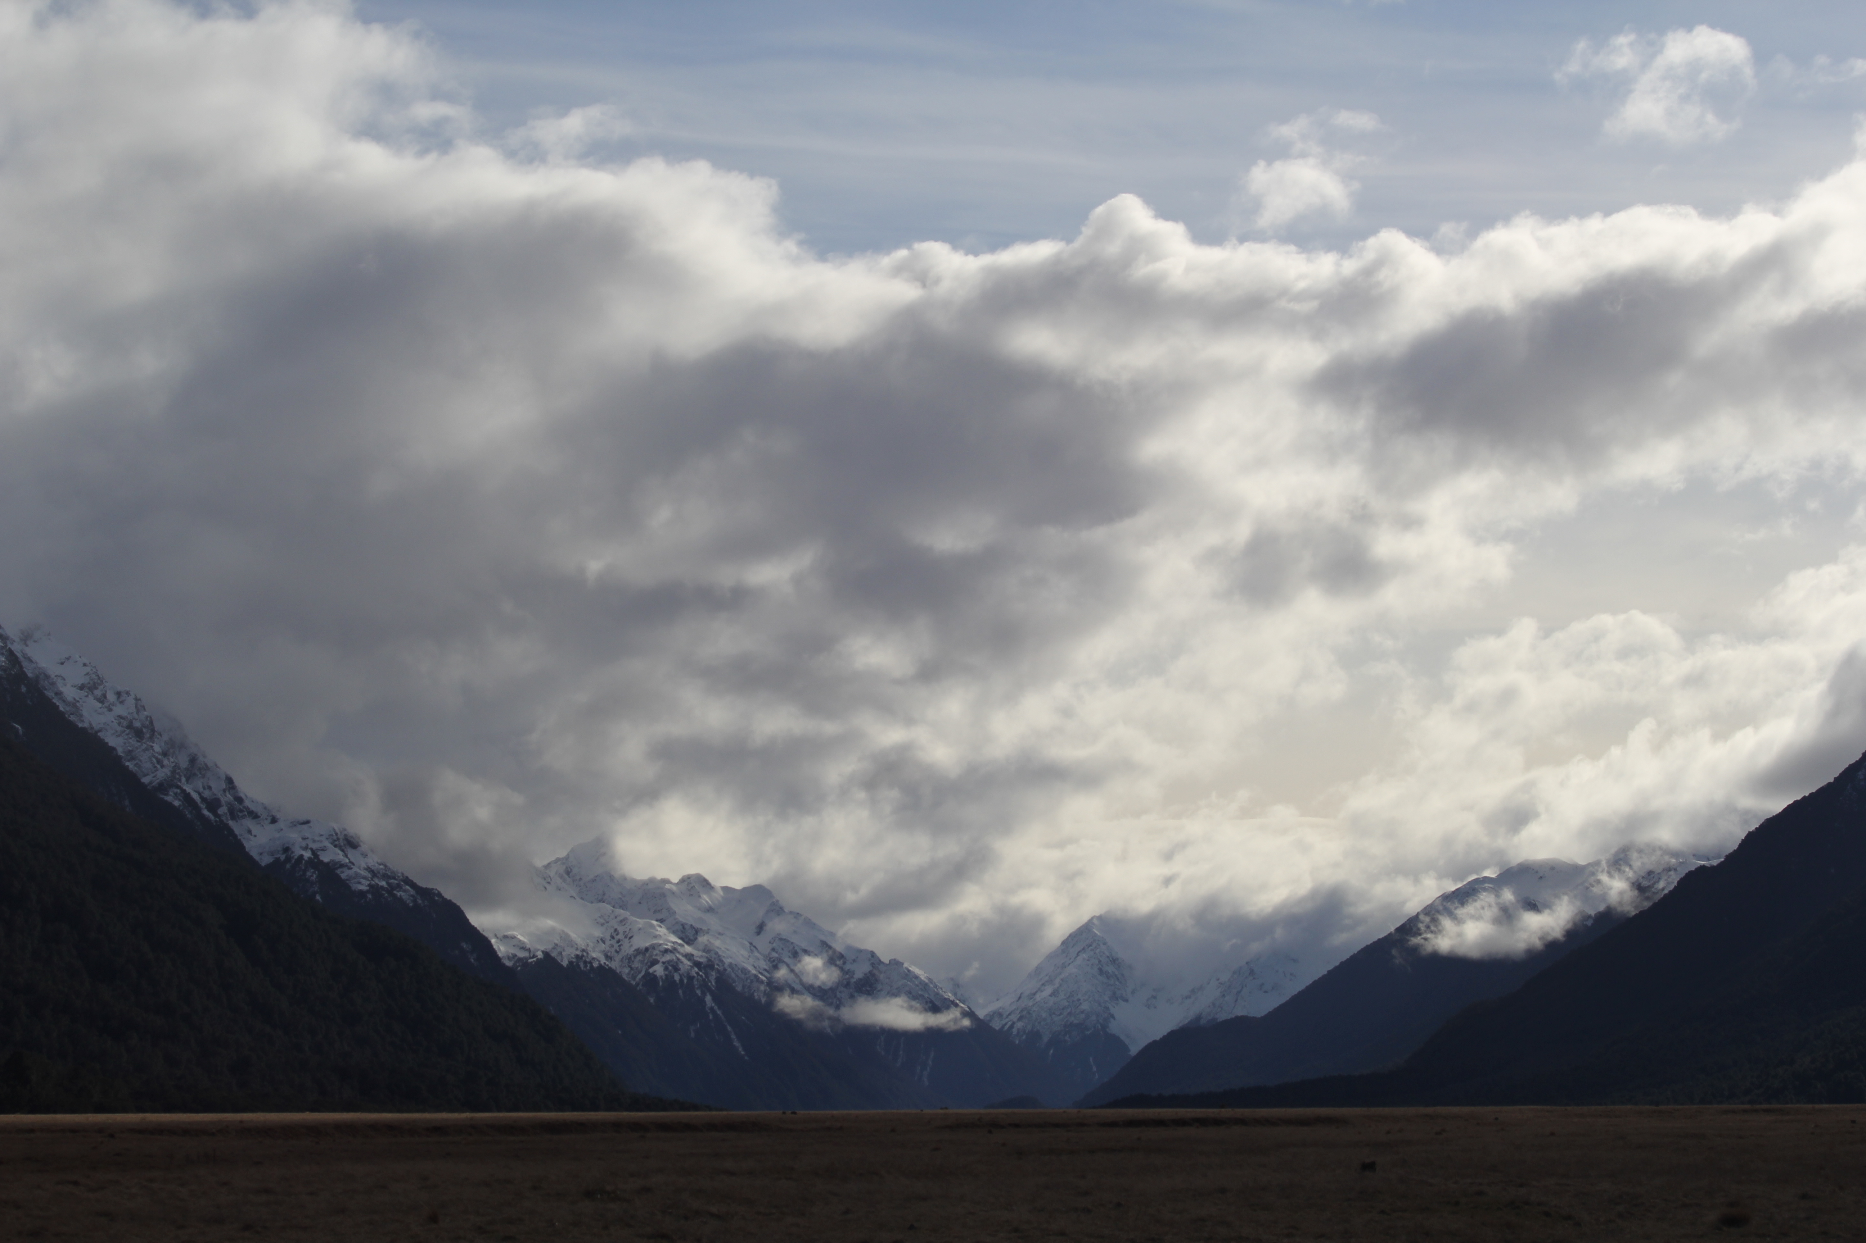

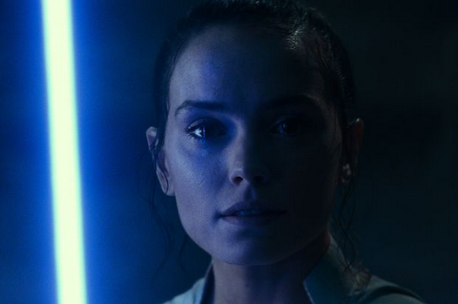
Assignment #1
Due: Tuesday 03 FEB
Level 0 1 … 2 … 3 … 4
1 piece of paper to me
2 ideas
3 references each
4 sentences each

Slide 3
Assignments
Tuesday 03 FEB Level 0 … Ideas
Tuesday 10 FEB Bio Sketch
Tuesday 17 FEB Level 1 … Outline … 2 weeks later
Tuesday 03 MAR Level 2 … 1st Draft … 2 weeks later
Tuesday 24 MAR Level 3 … 2nd Draft … 3 weeks later
Tue/Thu 14/16 APR Presentations … 3 weeks later
Thursday 23 APR Level 4 … submit … 1 week later

Slide 4

Bio Sketch on SciENcv
Due: Tuesday 10 FEB
Let’s get started now …
google “SciENcv”

Slide 5
Writing Proposals
X
$

Slide 6
Topics
naked eye stars
O/B dwarf population(s)
blue/red supergiants
red giants
red clump/horizontal branch stars
cool subdwarfs
hot subdwarfs
white dwarfs
brown dwarfs
binaries
Cepheid variables (phot time series)
RR Lyrae variables (phot time series)
RV Tauri variables (yellow supergiants)
long period variables (Mira)
cataclysmic variables
recurrent/dwarf novae
SN remnants
planetary nebulae
moving groups
young clusters (Orion, other Messier)
old clusters (M67)
globular clusters
map a Galactic arm
MW thin/thick disk via kinematics
MW tidal streams
LMC/SMC/And/Tri populations
LMC/SMC/And/Tri proper motions
Andromeda visitors
LBVs … only ~20
asteroids/comets … Solar System
exoplanets … not Galactic
Notes:
general project: binary stars revealed --- how many stars/mass hidden pre-Gaia?
cultural project: HR Diagram over time --- what happened to WDs?

Slide 7

Proposal Pieces
GOAL: Fund yourself as a $75K/year postdoc for 3 years
1. Project Description 8.0 pages text + 2.0 pages Tab/Fig
2. References 0.5 page
3. Biographical Sketch 2.0 pages (SciENcv)
4. Budget 1.0 page (spreadsheet)
5. Budget Justification 1.0 page
6. Facilities 0.5 page
7. Student Mentoring Plan 0.5 page
8. Data Management Plan 0.5 page
X. Project Summary
X. Current & Pending
X. Collaborators & Affiliations
Total Challenge ~ 16 pages

Slide 8
Writing Proposals
CONTEXT

Slide 9
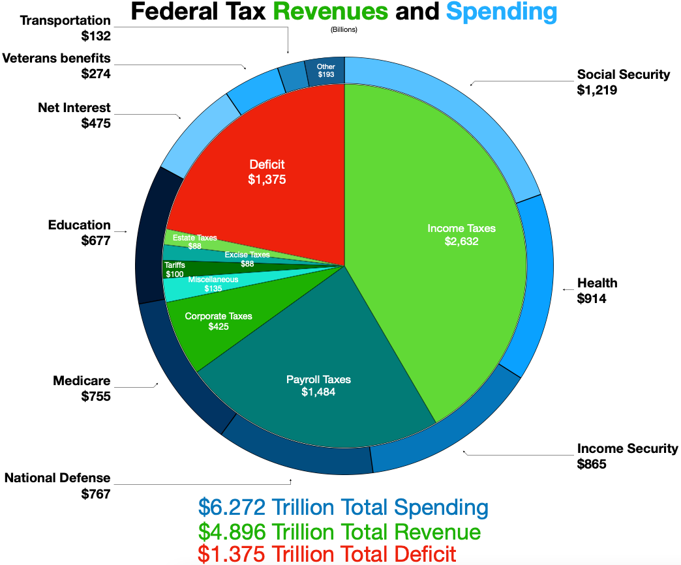
US Federal Budget (FY2022)
FY2025:
World GDP
$ 117 trillion
US GDP
$ 31 trillion
US budget
$ 7 trillion
Notes:
FY2025 … China was 19T … Germany 5T … Japan/India/UK

Slide 10
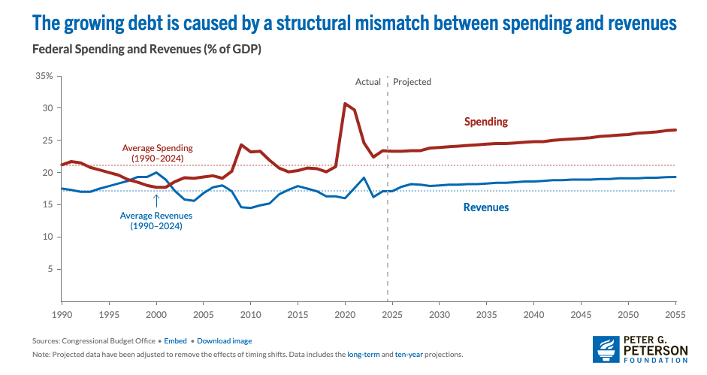
US Federal Deficit and Debt
Notes:
FY2025 … China was 19T … Germany 5T … Japan/India/UK

Slide 11
US Federal Budget (FY2022)
in 2022:
Medicare+ 27%
Social Sec. 19%
Defense+ 17%
Welfare 14%
Education 11%
Interest 8%
Transportation 2%
Other 3%
Notes:
China was 18T .. Japan/Germany 4T … India/UK/France 3T

Slide 12
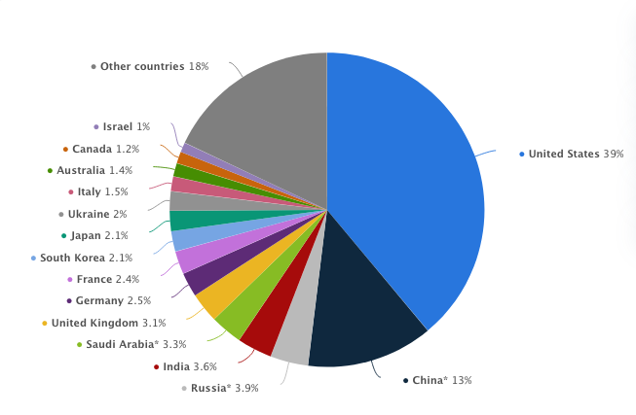
Military Spending (2022)
Notes:
US spends about 1/3 of all defense spending in the world

Slide 13
US Federal Budget (FY2022)
in 2022:
Other 3.08%
NIH $45B 0.72%
NASA $24B 0.38%
NSF $ 9B 0.14%
Notes:
China was 18T .. Japan/Germany 4T … India/UK/France 3T

Slide 14
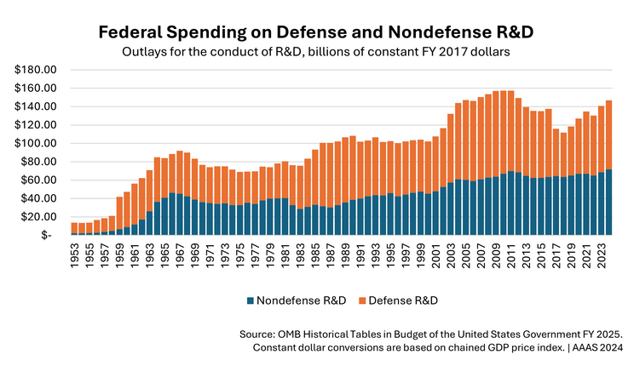
US Science Budget
Notes:
stays flat for 2021-2024

Slide 15
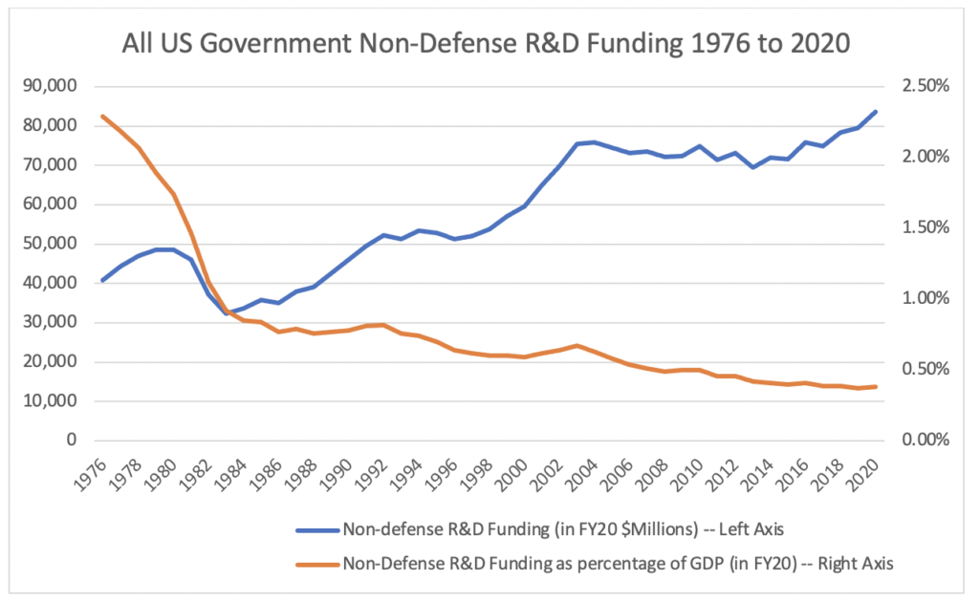
US Science Budget
Notes:
stays flat for 2021-2024

Slide 16
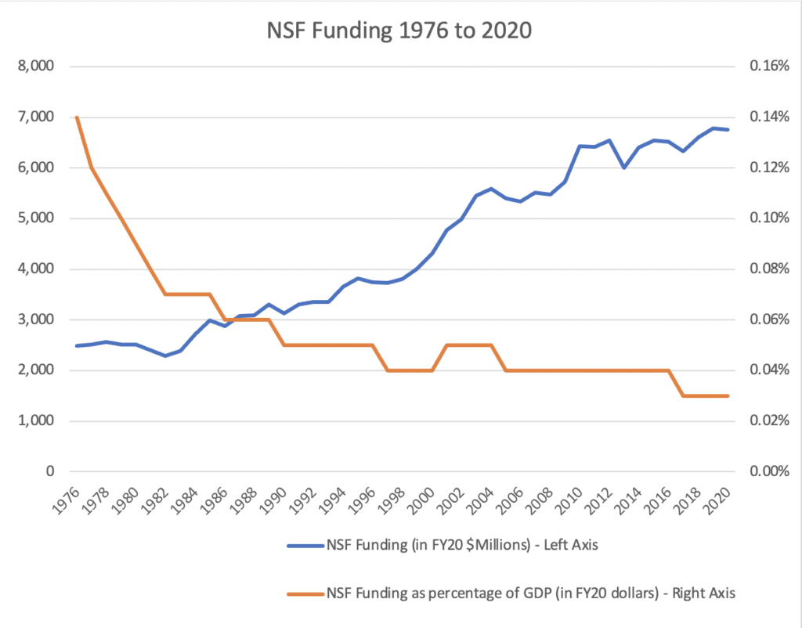
NSF Budget
Notes:
NIH FY2019 budget $39.1B via HHS

Slide 17
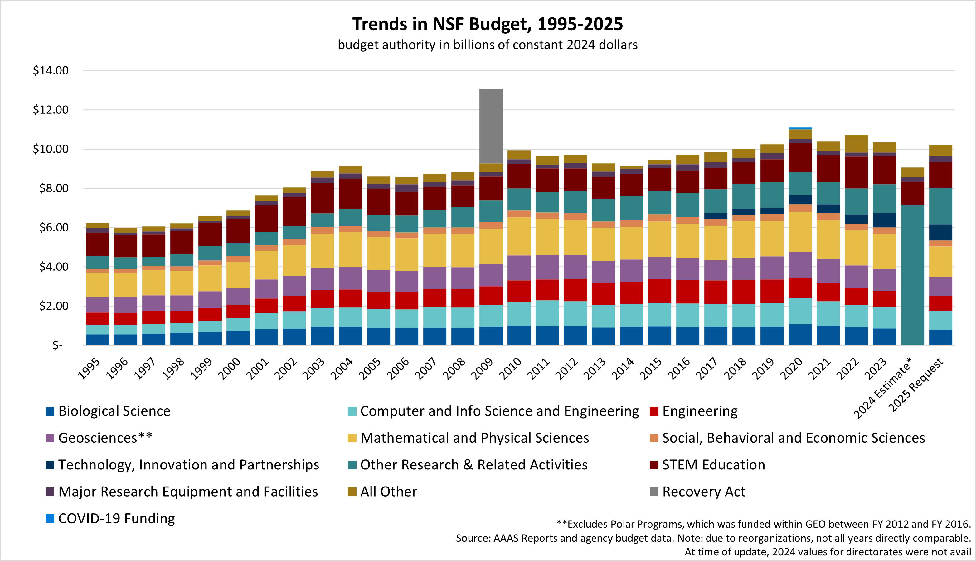
NSF Budget
FY2024 $9.06B
FY2025 $9.06B
FY2026 $8.75B ⎼ 3.4%
Notes:
NIH FY2019 budget $39.1B via HHS

Slide 18


National Science Foundation
US: National Science Foundation (NSF)
UK: Science and Technology Facilities Council (STFC)
Chile: National Commission for Scientific and Technological Research (CONICYT)
Vision: A nation that creates and exploits new concepts in science and engineering and provides global leadership in research and education.
Mission: To promote the progress of science; to advance the national health, prosperity, and welfare; to secure the national defense; and for other purposes.
driven by science and scientists
driven by missions it is told to do
Notes:
NSF is driven by science and scientists … NASA is driven by missions it is told to do

Slide 19
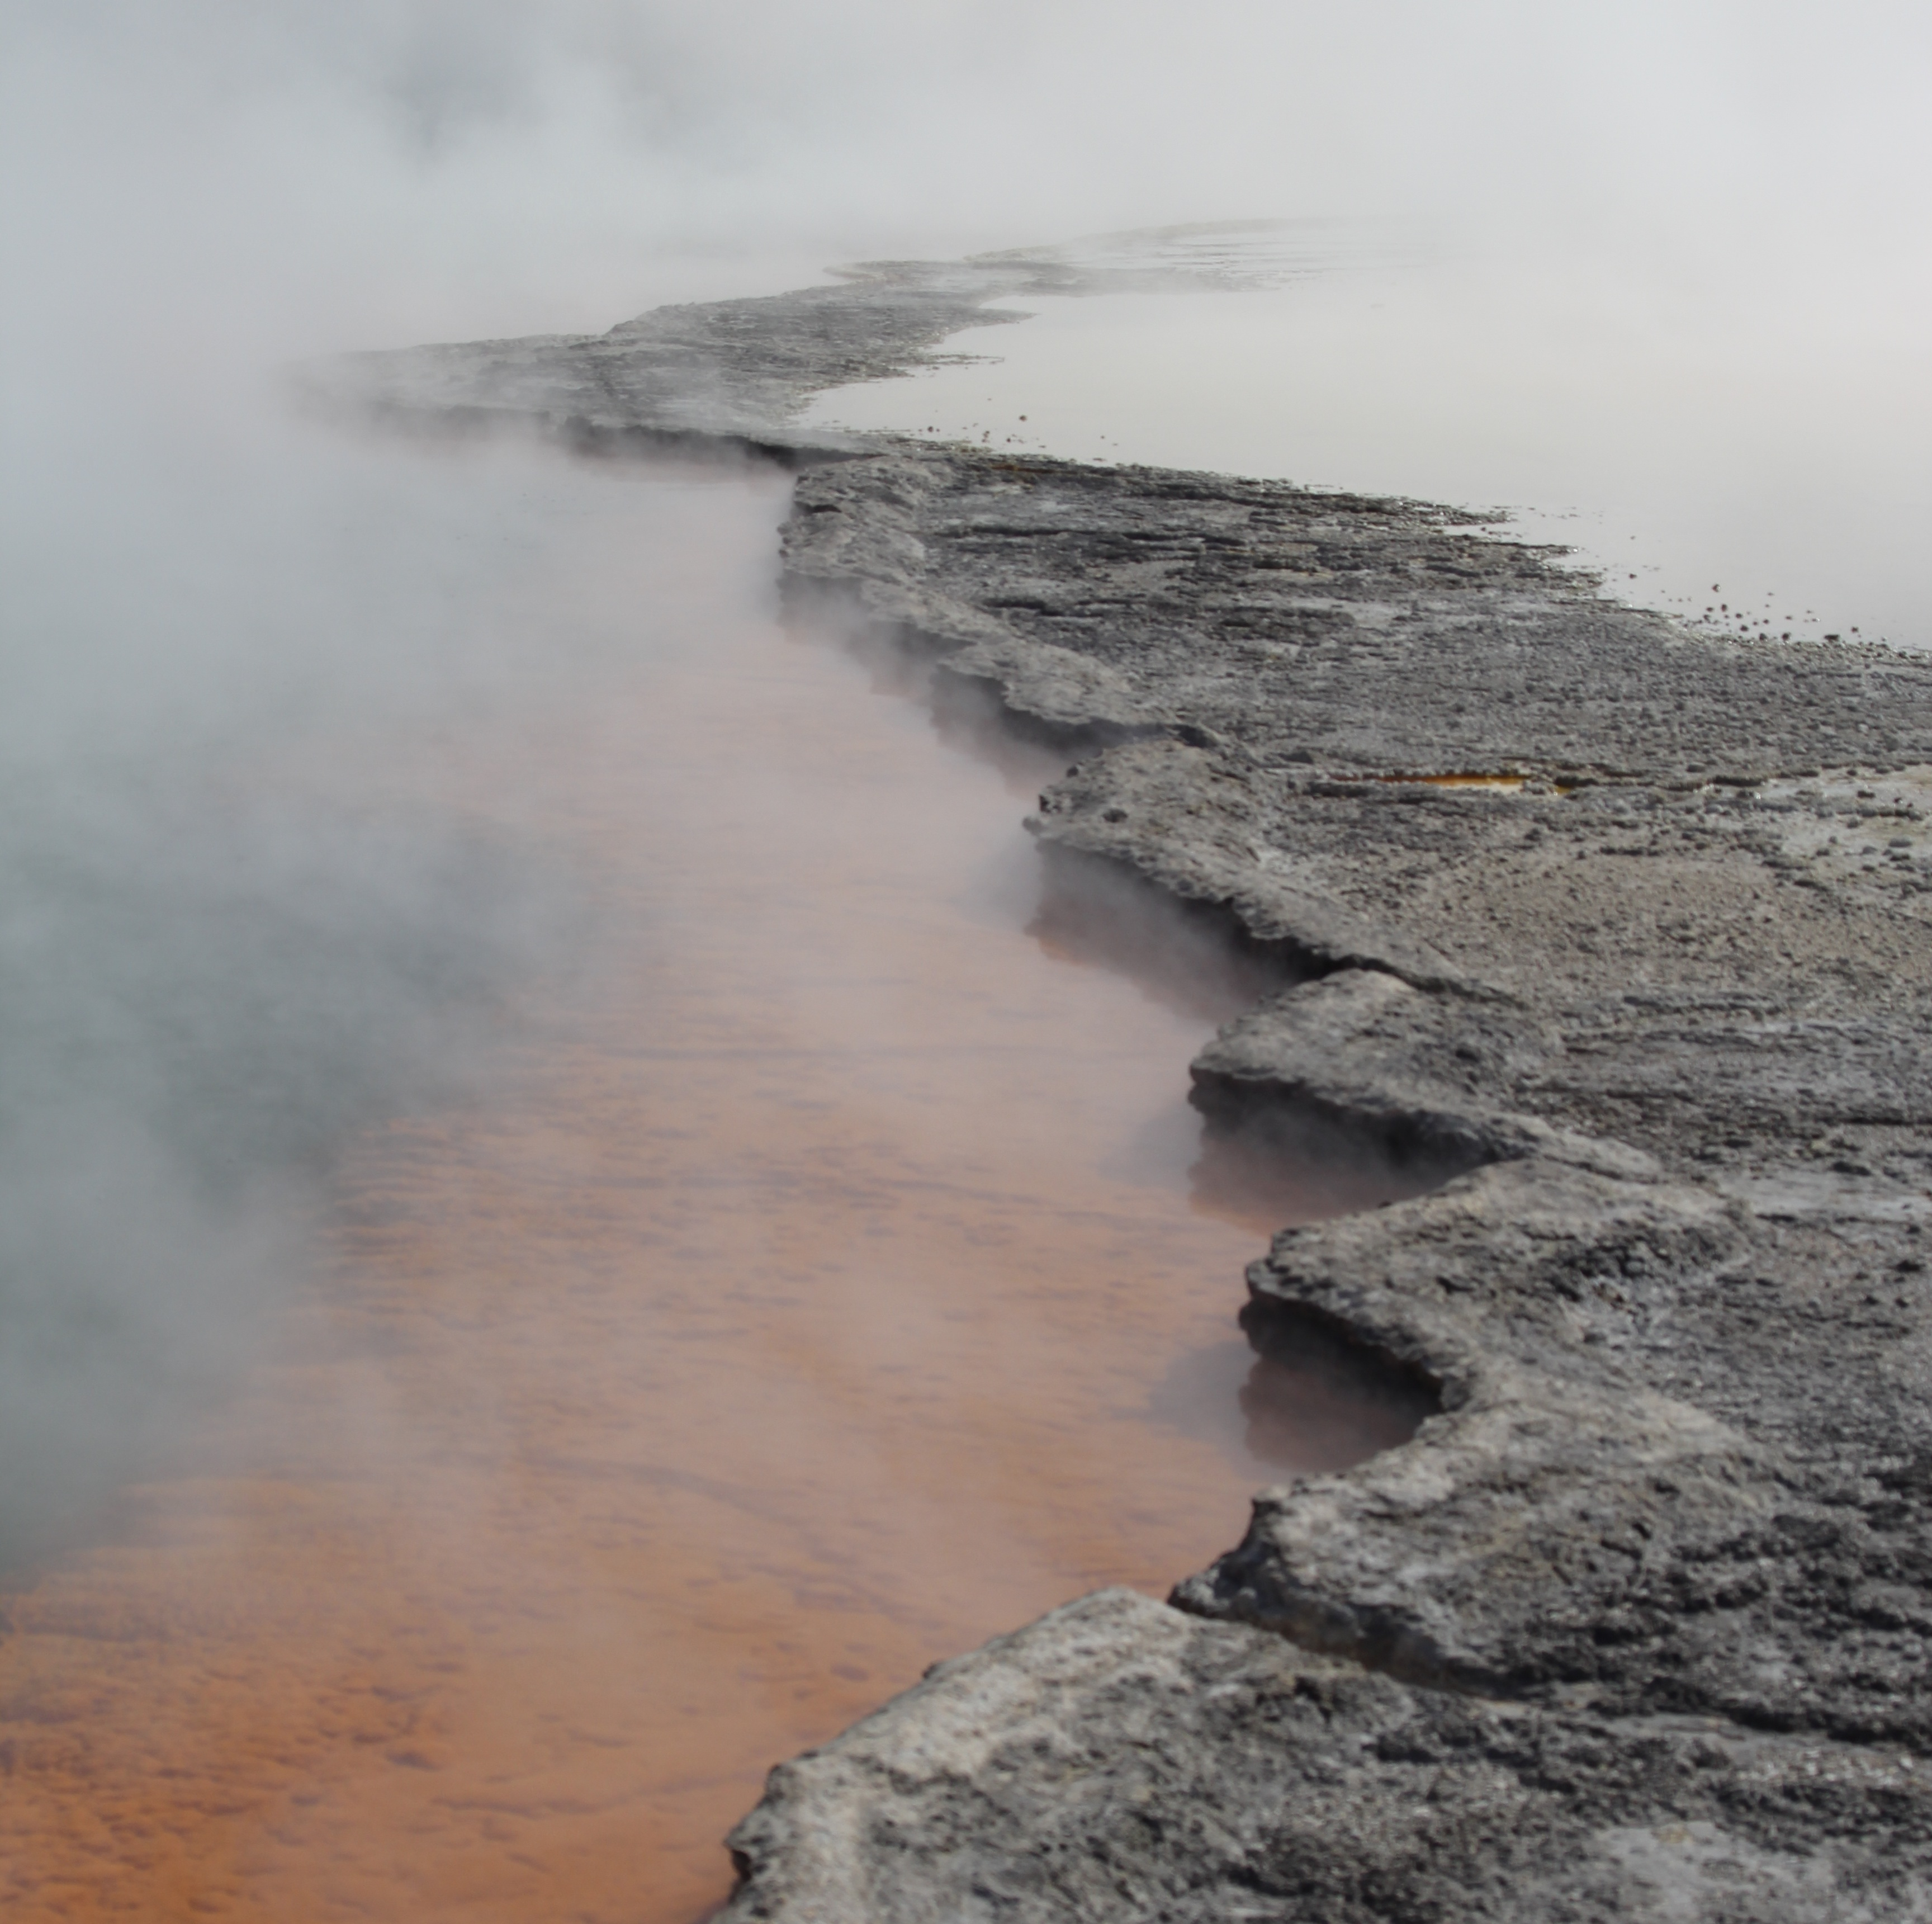
Proposal Rules
1. Must use Gaia DR3 data … talk about DR4.
2. Must use a ground-based facility.

Slide 20
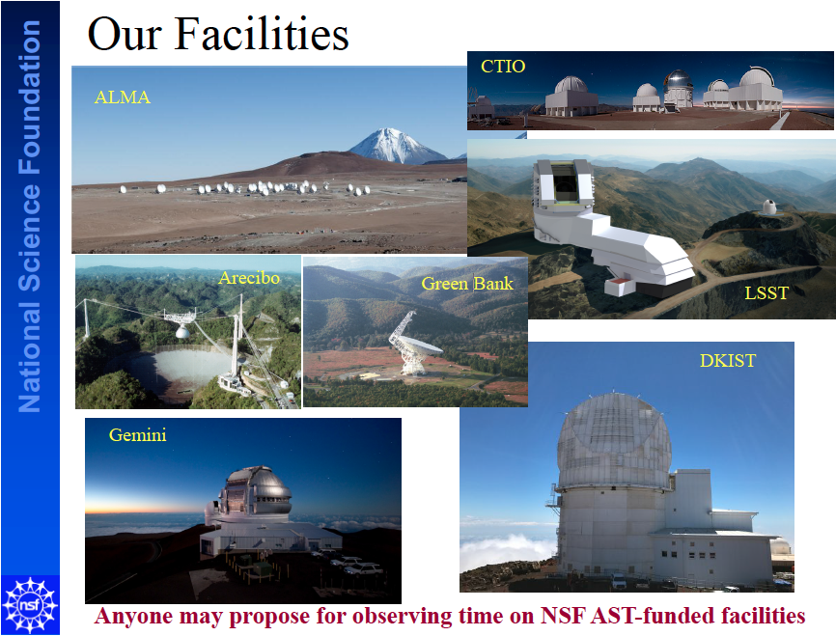
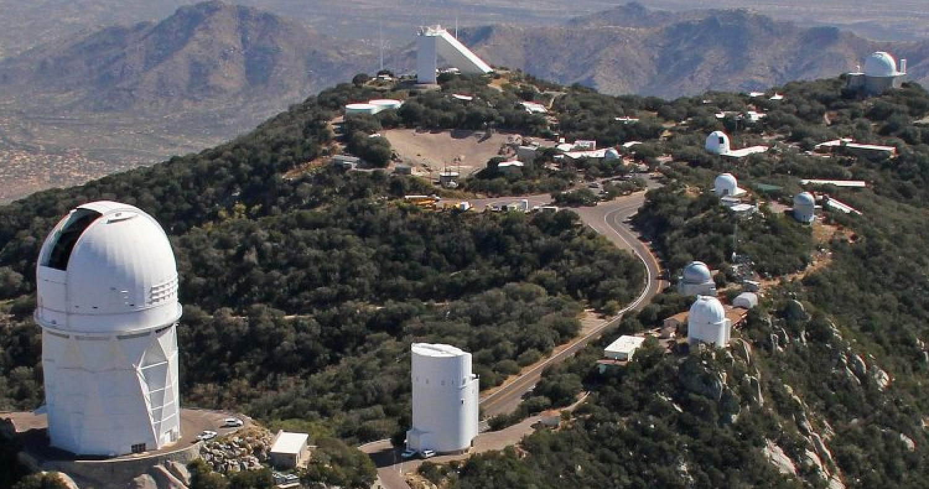
+ SOAR
KPNO

Slide 21
Proposal Rules
1. Must use Gaia DR3 data … talk about DR4.
2. Must use a ground-based facility.
3. Can be related to current research,
but not identical.
4. One 3-year project.
5. Must submit all 8 bits.

Slide 22
Why My Proposal?
1. Why this project?
2. Why you and not someone else?
Intellectual Merit … uniqueness of research
available facilities (SMARTS, CHARA, APO)
Broader Impact
educational opportunities
3. What are your strengths?
4. Express yourself clearly --- YOU must convince reviewer.
5. Have a colleague read your proposal and leave your ego behind …

Slide 23
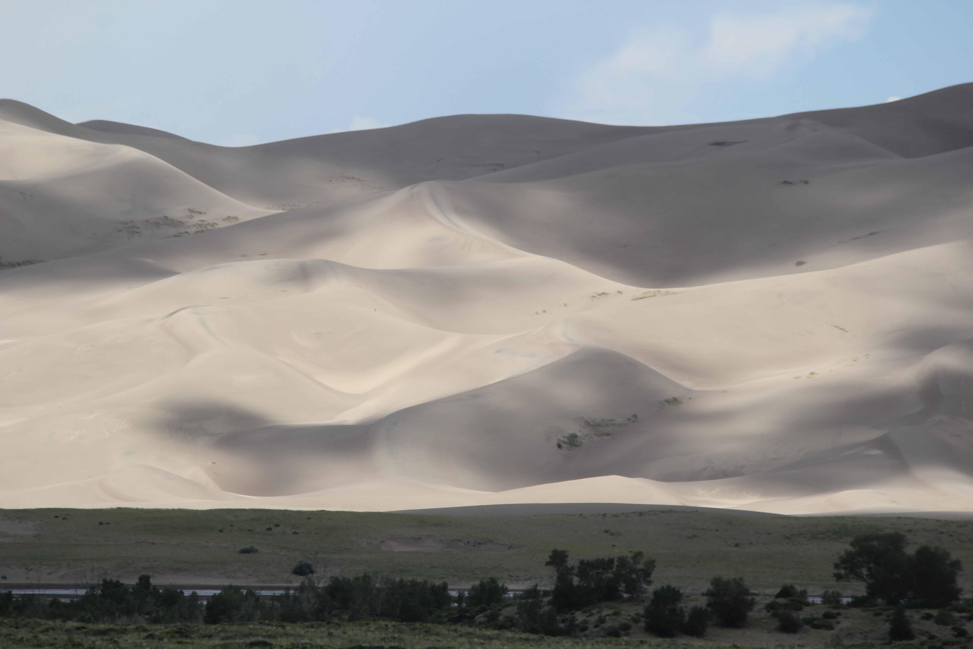
Key Proposal Bits
Intellectual Merit the potential to advance knowledge
Broader Impacts the potential to benefit society and contribute to the achievement of specific, desired societal outcomes
Education: improved STEM education at any level
Outreach: increase public scientific literacy Broadening Participation: diverse STEM workforce
Partnerships: academia/industry/others

Slide 24
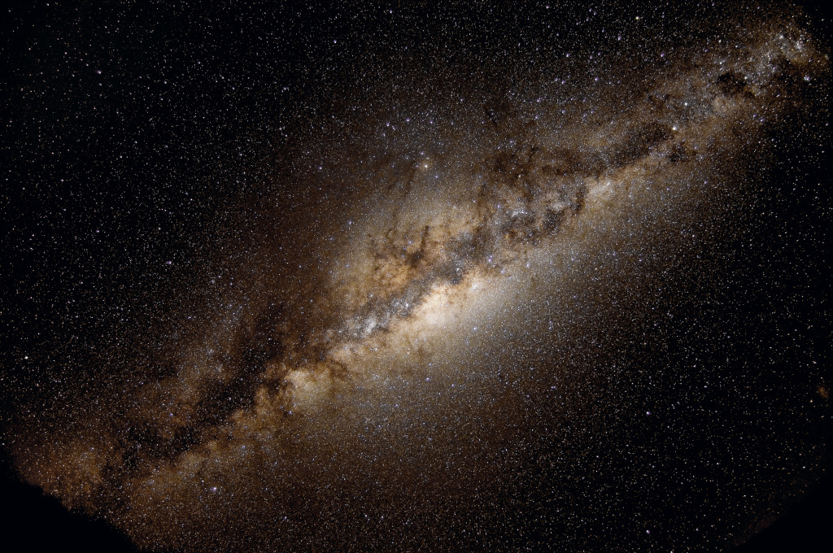
How Will YOU Explore the Milky Way?
Notes:
Figure from 1922 paper (?)

Slide 25
Notes:
Figure from 1922 paper (?)

Slide 26
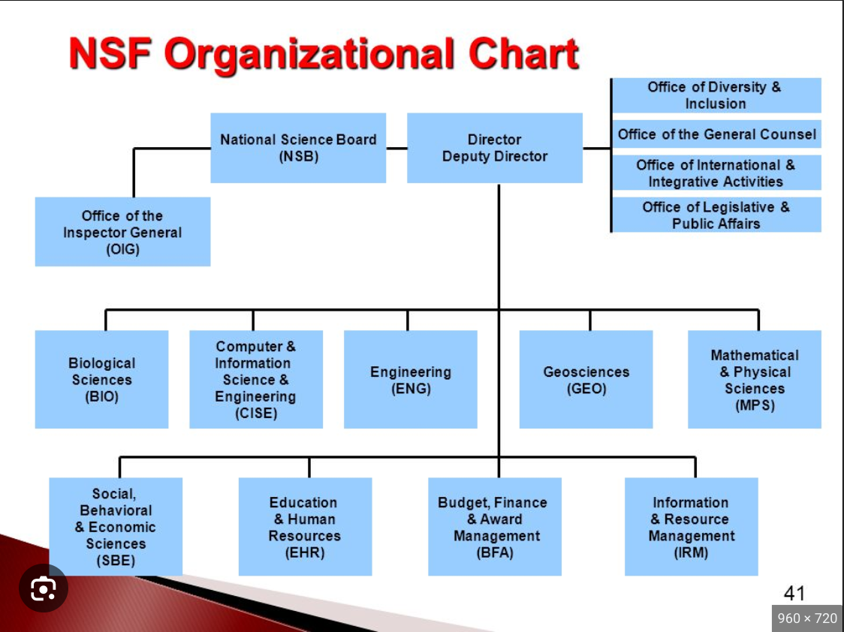
National Science Foundation
“MPS”
AST
CHE
DMR (Materials)
DMS (Math)
OSI (Strategic)
PHY

Slide 27
NSF 8.84B = 8840M (FY2022)
MPS 1613M
AST 290M
AAG 50M
50M out of 6.272T = 0.0008 % = 1 part in 125000
AAG: observational, theoretical or laboratory, addressing astronomical research in planetary, solar, stellar, exoplanets, galactic, extragalactic, or cosmology topics
Proposals that are solely or predominantly for the acquisition, analysis, or interpretation of space-based data from NASA-supported missions will be returned without review.

Slide 28
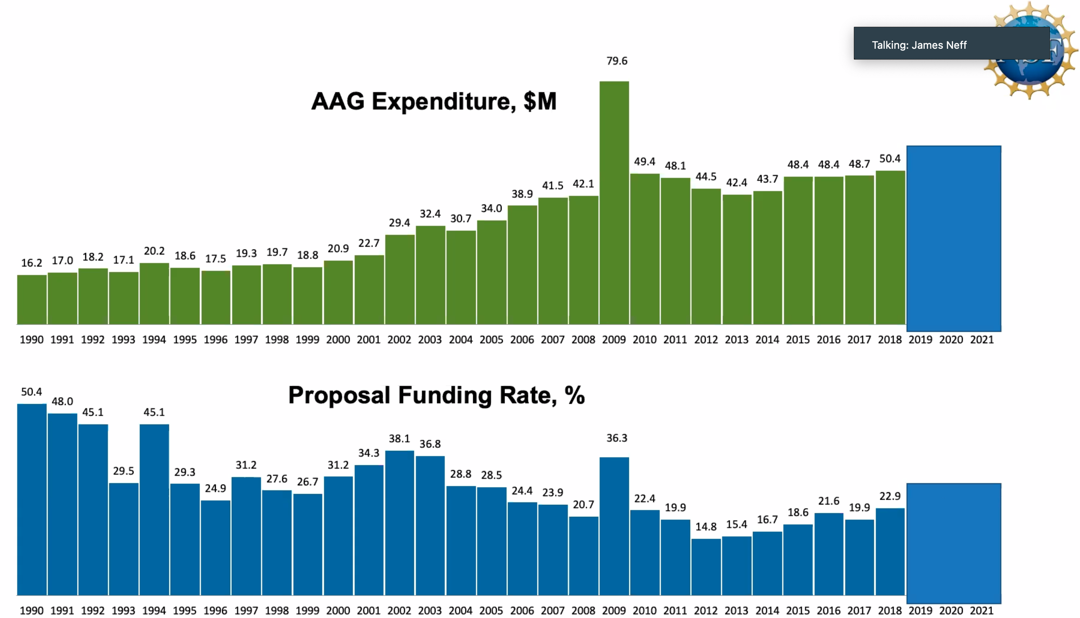
AAG Proposals 1990-2021
2023: 19.7%
R
R
R
R
R
8
6
R
R
R
R
?
2024

Slide 29
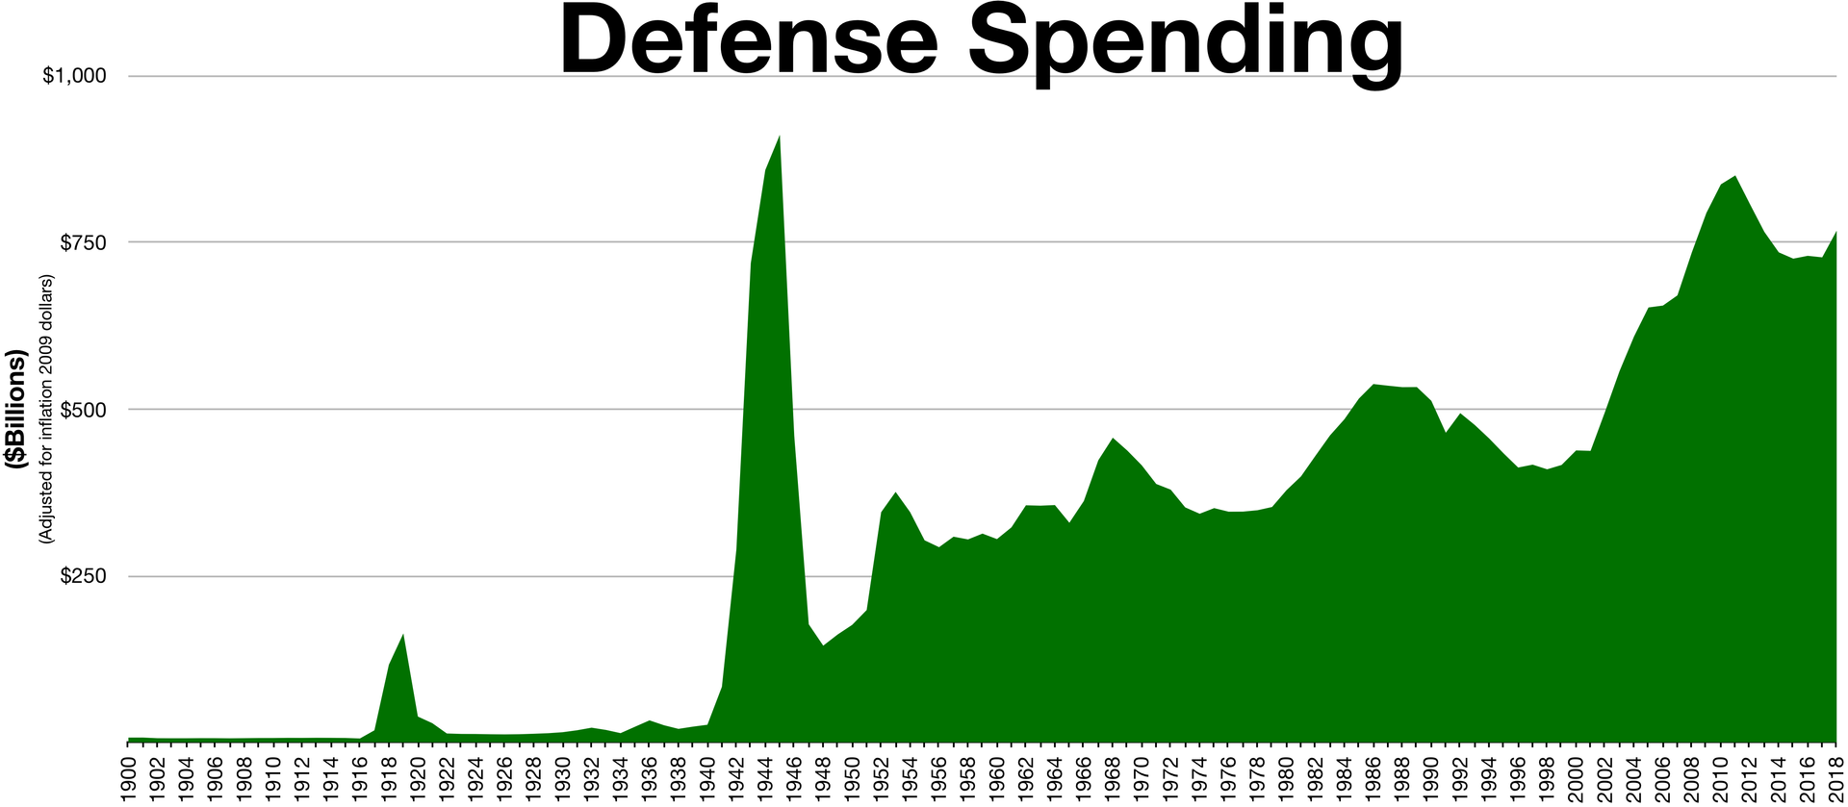
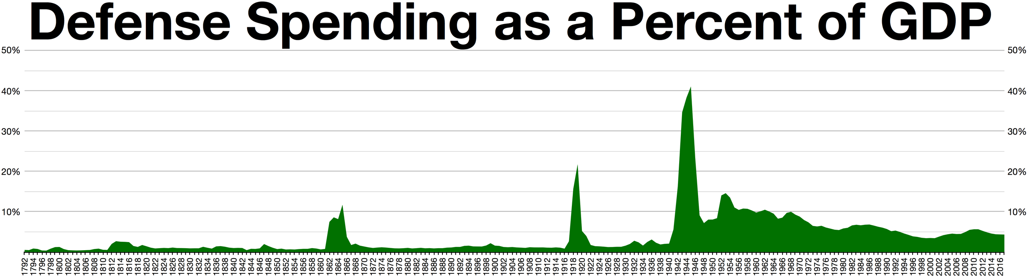

Slide 30
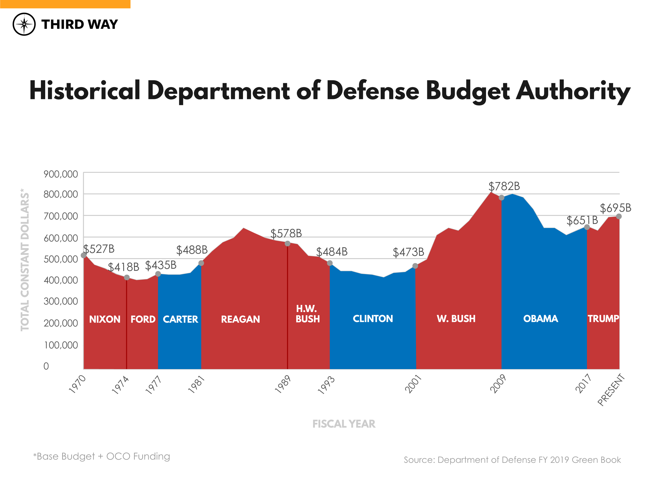

Slide 31
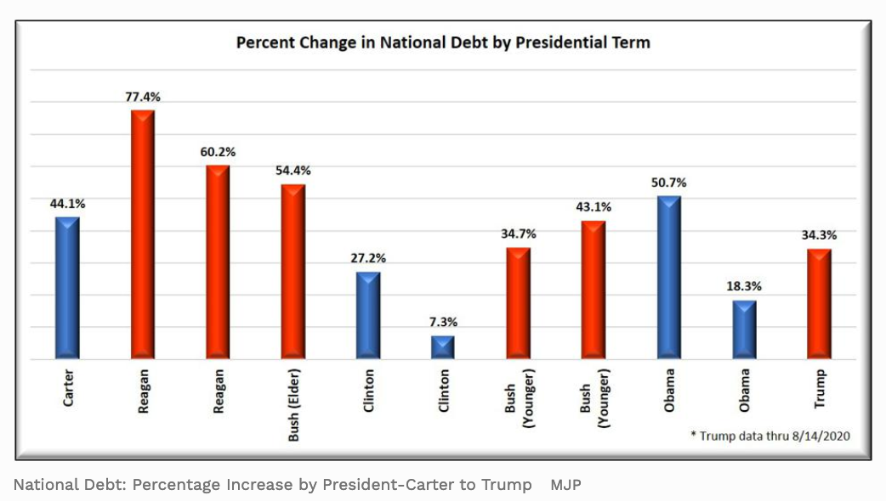
Presidential Debt Increases

Slide 32
