Slide 1

Proposal Brainstorming
https://www.merriam-webster.com/words-at-play/definition-of-brainstorming

Slide 2



Assignment #1
Due: Tuesday 03 FEB
Level 0 1 … 2 … 3 … 4
1 piece of paper to me
2 ideas
3 references each
4 sentences each

Slide 3
Assignments
Tuesday 03 FEB Level 0 … Ideas
Tuesday 10 FEB Bio Sketch
Tuesday 17 FEB Level 1 … Outline … 2 weeks later
Thursday 19 FEB Milky Way Neighborhood
Tuesday 03 MAR Level 2 … 1st Draft … 2 weeks later
Tuesday 24 MAR Level 3 … 2nd Draft … 3 weeks later
Tue/Thu 14/16 APR Presentations … 3 weeks later
Thursday 23 APR Level 4 … submit … 1 week later

Slide 4
Milky Way Neighborhood (2026)
 | RA | DEC | Size (kpc) | Dist (kpc) | Bits / # Globulars / References
Milky Way | --- | --- |  | 0
Andromeda M31 | 00:43 | +41:16 |  |  | Roger + Ben
Triangulum M33 | 01:33 | +30:39 |  |  | Megan + Ella
Bode’s M81 | 09:55 | +69:03 |  |  | Akshat + Madeline
Pinwheel M101 | 14:03 | +54:20 |  |  | AJ + Karina
Whirlpool M51 | 13:30 | +47:13 |  |  | Mahir + Madison

Slide 5
Topics
naked eye stars
O/B dwarf population(s)
blue/red supergiants
red giants
red clump/horizontal branch stars
hot subdwarfs
cool subdwarfs
white dwarfs
brown dwarfs
binaries
Cepheid variables (phot time series)
RR Lyrae variables (phot time series)
RV Tauri variables (yellow supergiants)
long period variables (Mira)
cataclysmic variables
recurrent/dwarf novae
SN remnants
planetary nebulae
moving groups
young clusters (Orion, other Messier)
old clusters (M67)
globular clusters
map a Galactic arm
MW thin/thick disk via kinematics
MW tidal streams
LMC/SMC/And/Tri populations
LMC/SMC/And/Tri proper motions
Andromeda visitors
LBVs … only ~20
asteroids/comets … Solar System
exoplanets … not Galactic

Slide 6
Observing Techniques
ASTROMETRY
positions
proper motions
parallaxes
orbits
PHOTOMETRY
gamma-ray
x-ray
ultraviolet
optical
infrared
radio
SPECTROSCOPY
wavelength range
low/medium/high resolution
CADENCE

Slide 7
Galactic Research Tools
Gaia DR3 list of objects … sample
colors … HR diagrams
distances, transverse velocities
membership confirmation for clusters (UVW), small galaxies
mean RVs … sequences in GDR4
variable light curves
unresolved binaries … NSS = Non-Single Star Catalogue

Slide 8
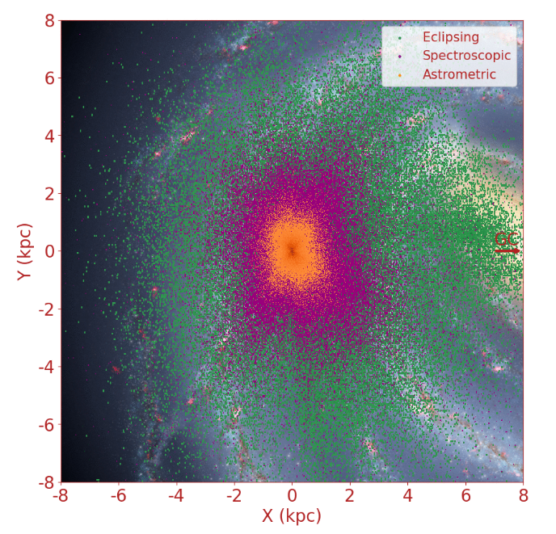
Galactic Research Tools
Notes:
As the angular motion on the sky of the binaries decreases with distance, astrometric binaries are detected at small distances only. At the other extreme, eclipsing binaries can be detected at very large distances by even a small drop of brightness of faint stars. In between, the spectroscopic binaries could in principle be seen independently of distance, but since spectra are obtained for bright stars only, the stars are generally at a limited distance only.

Slide 9
Galactic Research Tools
Gaia DR3 list of objects … sample
colors … HR diagrams
distances, transverse velocities
membership confirmation for clusters (UVW), small galaxies
mean RVs … sequences in GDR4
variable light curves
unresolved binaries … NSS = Non-Single Star Catalogue
TESS all-sky, 200000 stars, V~16, 30/2/+ min cadences, 27 days
ZTF north of DEC ⎯31, 2” FWHM, gri~20, since 2018, 4B lightcurves
ASAS south of DEC +28, 15 million stars, V~14, since 1997
0.9m/ARCSAT confirmation at any cadence
CHIRON confirmation spectral types V~16, 20 m/s RVs V~12, metallicities
TRES same for northern hemisphere
APO … CHARA
Notes:
TESS 200,000 stars searched for exoplanets … many more in full frame images

Slide 10
NSF Proposal Ideas
Akshat C. hot subdwarfs … PN
Madeline D. quasars … ???
Karina K.-S. IMF of clusters … ???
Madison M. bulge Cepheids … LMC
AJ M. SN … binaries
Roger M. And spitballs … dust winds
Mahir P. GC red giants … ???
Megan P. YSO variables … strings/snakes/pearls
Ella R. magnetism in open clusters … rotation
Ben T. solar neighborhood metallicities … ???

Slide 11
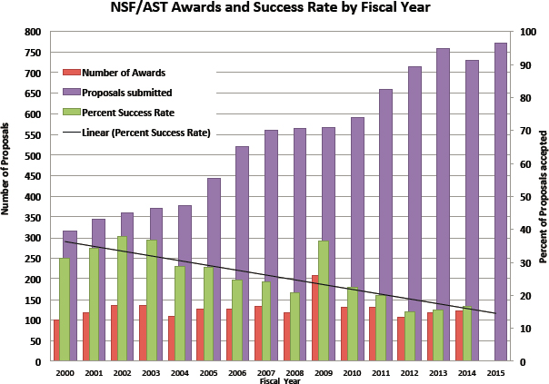
AAG Proposals 2000-2015
960
2023

Slide 12
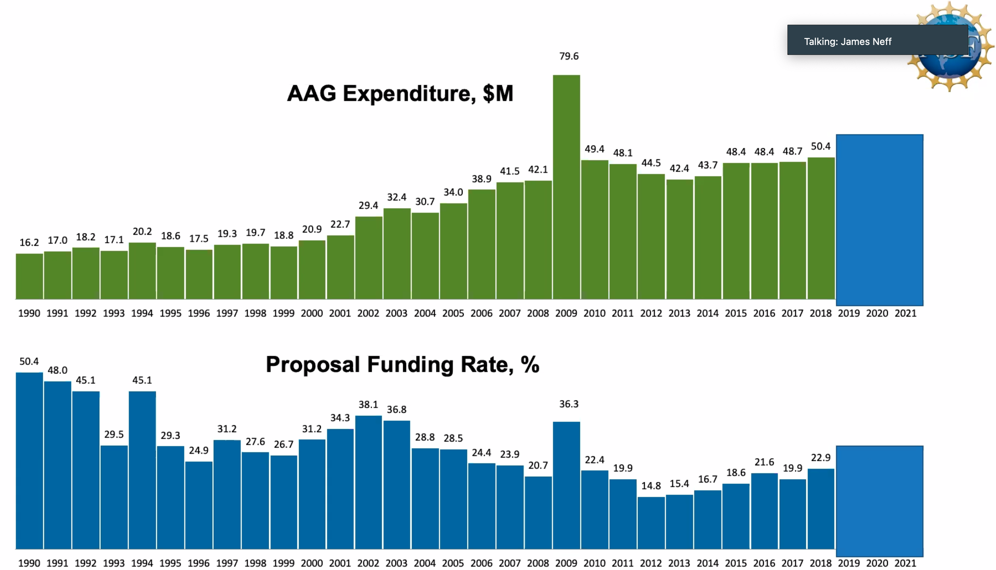
AAG Proposals 1990-2021

Slide 13
Trust Me … NSF History
RECONS 2005 $523K Awarded
RECONS 2008 $683K Declined
RECONS 2009 $582K Awarded
RECONS 2012 $557K Declined
RECONS 2013 $572K Declined
RECONS 2014 $492K Awarded **
RECONS 2017 $496K Awarded
RECONS 2020 $487K Declined
RECONS 2021 $494K Awarded
RECONS 2025 $489K Declined **
RECONS 2026 $501K ????????
REDDOT 2011 $232K Awarded
Collaborative:
RKSTAR 2014 $232K Declined **
RKSTAR 2015 $243K Awarded
RKSTAR 2018 $311K Declined
RKSTAR 2019 $363K Awarded
RKSTAR 2024 $386K Declined
RKSTAR 2025 $399K Awarded **
BOTTOM LINE … 9 of 17 … 53%
Notes:
also REDDOT = RECONS+ 2011 $232K Awarded

Slide 14
Comments: 2012 RECONS
Many on the panel appreciated the PI’s long-term success in identifying the low mass content of our stellar neighborhood, and the very strong publication record of this group over the years. However, the panel felt that the motivation presented in this present proposal is a bit of a miss, with only a brief mention of the (previous) improvement in our knowledge of the slope of the IMF. There was concern that perhaps further improvement at this point would only be incremental.
Although there were along list of “goals” the overall scientific motivation could have been more strongly developed; in the end, that was the main reason the proposal was not ranked higher.

Slide 15
Comments: 2013 RECONS
The panel agreed that this proposal is competitive and highly relevant to contemporary directions in astrophysics. Concerns were expressed though about the competitiveness of the proposed effort in the era of Panstars, Gaia and others. It was noted, however, that the PI is fully aware of these efforts, and places the RECONS survey in context.
The intellectual merit was considered to be very high, along with the broader impacts. Having a census of the closest stars is important. The panel felt that the relevance of this effort will be eclipsed in about 3 years with the public release of Gaia and Panstars data. No major weakness was spotted.

Slide 16
Comments: 2020 RECONS
The data quality is excellent, and the majority of low mass targets that are observed with this survey are not accessible to other astrometric surveys (i.e. Gaia).
The proposal lacked a strong grounding in theory, which could have been used to justify the total time baseline of observations necessary to achieve the overall scientific goals. For example, the proposal would have been improved had it included information about the theoretical predictions regarding the duration of magnetic field cycles on low mass stars and/or the scientific implications of characterizing the long versus short term activity cycles.
The proposal failed to recognize that twin stars should not necessarily produce similar observable magnetic field quantities because magnetic dynamos are stochastic.
The layout of the proposal that distributed the broader impact efforts throughout the text was refreshing and nice to read.
The broader impact efforts have the potential to increase the diversity in our field in particular, and science in general, due to the diverse population of GSU, but the proposal failed to explain the PI's explicit role in this process.

Slide 17
Comments: 2025 RECONS
This is a well-structured program that builds on many years of previous work. By leveraging earlier efforts, the work will advance knowledge of long-term M star magnetic spot cycles, crucial for identifying stars with behavior similar to our Sun's and for understanding the driving dynamo.
The inclusion of TESS and Gaia data conjoined with decades of observations from the CTIO 0.9m telescope demonstrates the importance of a long-term term dedicated study with added value from newer resources.
… it was unclear how the new orbital data would be used to distinguish between models for binary formation and evolution and the impact on the formation of planets suitable for life.
The investigation of long-term stellar magnetic cycles was presented only in terms of photometric data; the proposal would have been strengthened with some discussion of any available inclusion of spectroscopy of H-alpha and CaII H and K lines.
The proposal lacked a clear time line for the completion and an organizational outline for the steps to be carried out.

Slide 18
Comments: 2014 RKSTAR
The panel expressed concern about whether the proposers will be able to confirm the necessary Gemini observing time with their camera in the longer term, especially in connection with Gemini South.
The research is straightforward, but the team's observational capabilities indicate that it will be of great value. The panel's only concern is whether the necessary amount of large-telescope time will be forthcoming.

Slide 19
Comments: 2018 RKSTAR
After discussing initial disparate scores, the committee had significant concerns about the sample size and techniques employed for this study. The value of 2000 K dwarfs along an equatorial band was not clear to the committee, as compared to a similarly volume-limited, volume-complete sample of nearby FGK stars. The number of stars was not a compelling component of the proposal, since it was not clear what would be learned with 2,000 stars rather than 1,000 or 500.
There was little detail discussed beyond binary fraction, such as mass ratios and the presence of hierarchal systems.
There was little quantitative discussion of observing space properties, such as contrast ratios and expected mass-separation sensitivity.
The technique used for wide binaries (blinking) is no longer sufficient, given the sensitivity of Gaia proper motions. Within four years, Gaia will deliver the binary properties of many of these stars, limiting the overall impact of the sample.
It was also not clear how the exoplanet community would adopt this sample, as most planet searches are focused on bright stars, or low-mass M dwarfs to find small, rocky planets.

Slide 20

Bio Sketch on SciENcv
Due: Tuesday 10 FEB
Let’s get started now …
google “SciENcv”

Slide 21
Gaia
Bio Sketch
https://www.ncbi.nlm.nih.gov/sciencv/

Slide 22
Gaia
NSF Bio Sketch

Slide 23
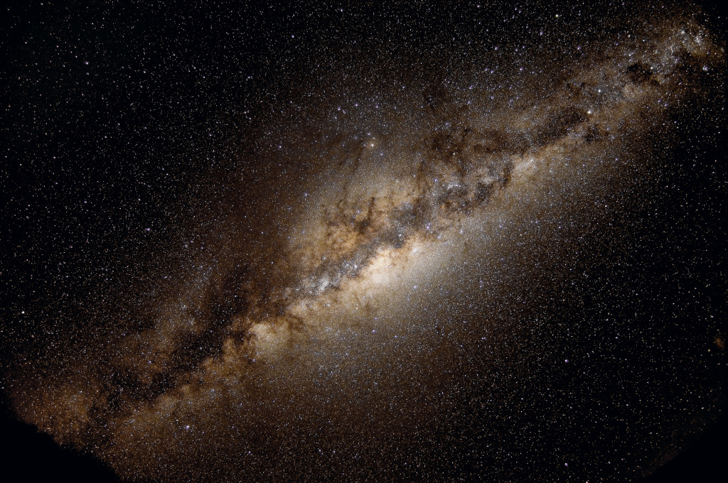
How will YOU explore the Milky Way?

