Slide 1
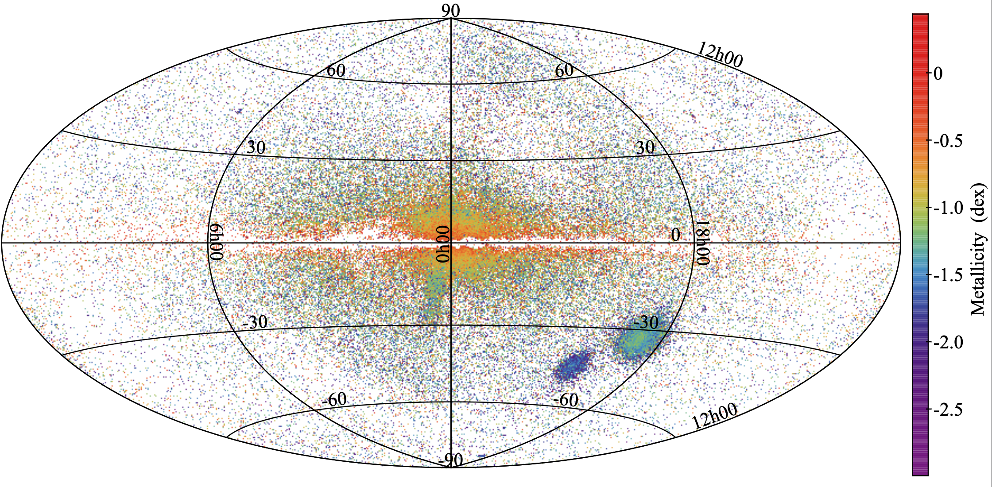
Milky Way Variables

Slide 2
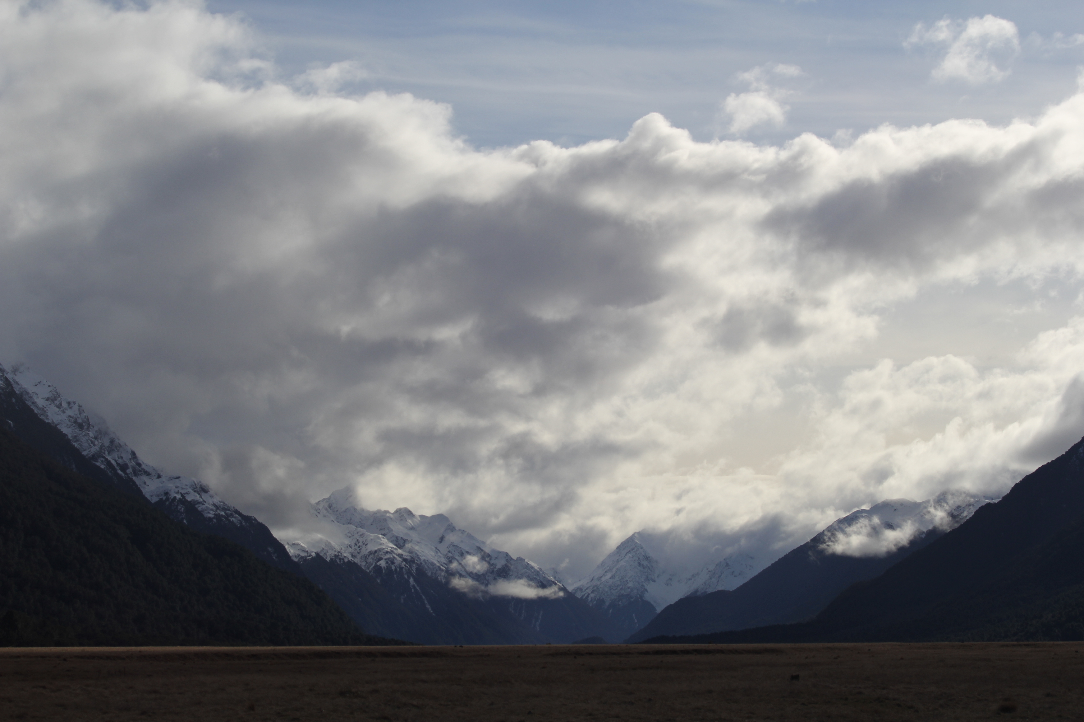


Assignments
Tuesday 03 FEB Level 0 … Ideas
Tuesday 10 FEB Bio Sketch
Tuesday 17 FEB Level 1 … Outline … 2 weeks later
Thursday 19 FEB Milky Way Neighborhood
Tuesday 03 MAR Level 2 … 1st Draft … 2 weeks later
Tuesday 24 MAR Level 3 … 2nd Draft … 3 weeks later
Tue/Thu 14/16 APR Presentations … 3 weeks later
Thursday 23 APR Level 4 … submit … 1 week later

Slide 3
Milky Way Neighborhood (2026)
 | RA | DEC | Size (kpc) | Dist (kpc) | Bits / # Globulars / References
Milky Way | --- | --- |  | 0
Andromeda M31 | 00:43 | +41:16 |  |  | Roger + Ben
Triangulum M33 | 01:33 | +30:39 |  |  | Megan + Ella
Bode’s M81 | 09:55 | +69:03 |  |  | Akshat + Madeline
Pinwheel M101 | 14:03 | +54:20 |  |  | AJ + Karina
Whirlpool M51 | 13:30 | +47:13 |  |  | Mahir + Madison

Slide 4
Milky Way Variables

Slide 5
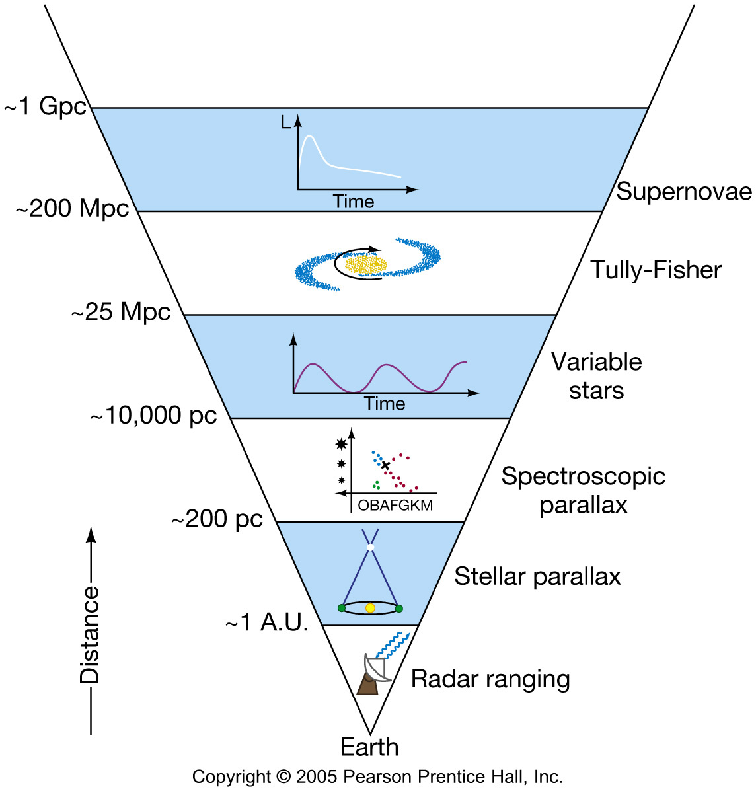
Distance Ladder
d_{parsec} = 1 / π_{arcsec}
1 arcsec 1 pc
0.1 arcsec
100 mas
10 mas
1 mas
GDR3 errors ~ 0.02 to 0.1 mas
10 pc
100 pc
1000 pc

Slide 6
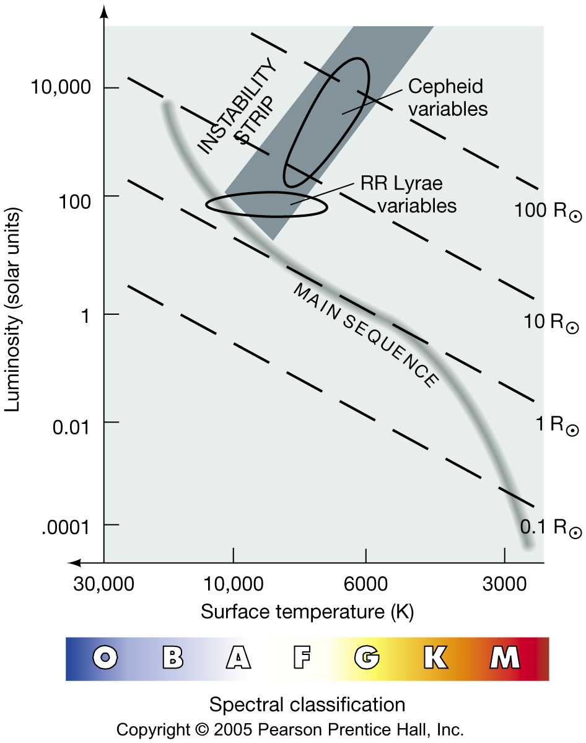
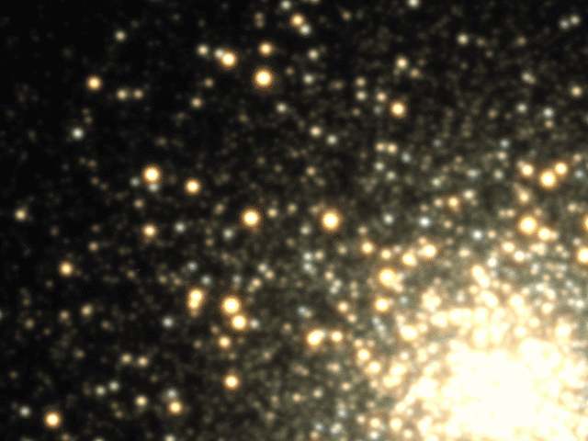
Variable Stars
Variable Stars small fraction of all stars
eclipsing … two stars
novae/supernovae … sporadic
pulsating … regular
“Instability Strip”
M3 during a single night
most variables = RR Lyraes
Harman & Stanek (see APOD 2007.0415)
Notes:
movie: https://apod.nasa.gov/apod/ap070415.html
pulsate because of changing opacity
… RR Lyraes and Cepheids both because of kappa mechanism in outer layers = changes in the opacity of ionized helium trap heat, causing the star's envelope to expand, cool, contract, and reheat in a cycle lasting less than a day

Slide 7

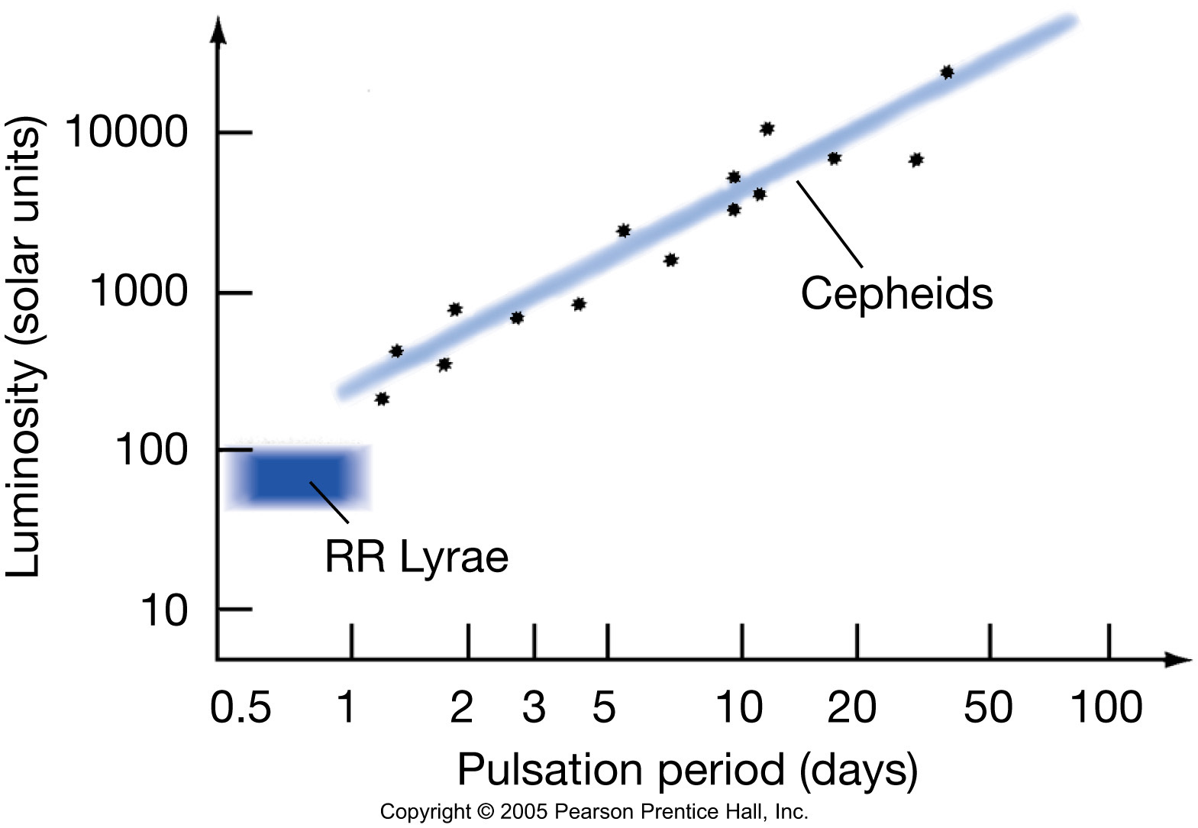
Standard Candles
measure P …
predict L …
observe mag …
derive distance
know L …
observe mag …
derive distance
(there is a P-L relation in K band)

Slide 8
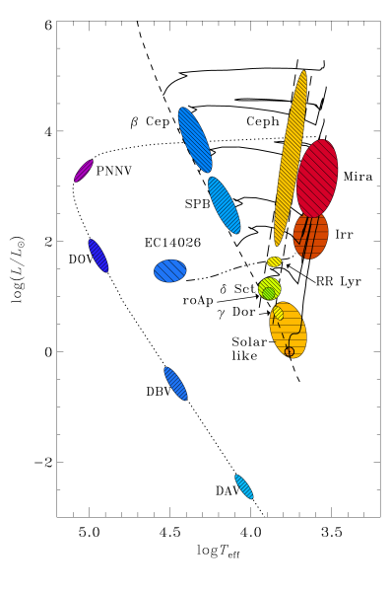
Pulsating Variables
pulsations driven by blocked radiation
NOT in hydrostatic equilbrium
gravity vs. radiation pressure
“kappa mechanism”
evolved stars Miras
~solar metals classical Cepheids
evolved stars RR Lyraes
low metals
main sequence δ Scuti stars
white dwarfs DAV = ZZ Ceti stars
pre-WD
He
H
credit: AAVSO
http://www.aavso.org/vsots_rrlyr
Notes:
delta Scuti stars are “dwarf Cepheids”, A/F giants or main seq stars, P ~ hours
second most abundant variable stars after WDs, e.g., Altair
Pulsations in ~all variables due to kappa mechanism, where opacity changes at some depth in atmosphere … OPACITY INCREASES WITH TEMP INSTEAD OF DECREASES
In a normal star, an increase in compression of the atmosphere causes an increase in temperature and density; this produces a decrease in the opacity of the atmosphere, allowing energy to escape more rapidly. The result is an equilibrium condition where temperature and pressure are maintained in a balance. However, in cases where the opacity increases with temperature, the atmosphere becomes unstable against pulsations.^{[2]} If a layer of a stellar atmosphere moves inward, it becomes denser and more opaque, causing heat flow to be checked. In return, this heat increase causes a build-up of pressure that pushes the layer back out again. The result is a cyclic process as the layer repeatedly moves inward and then is forced back out again.

Slide 9
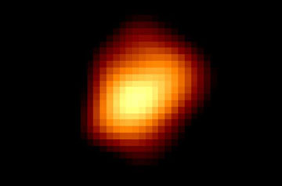
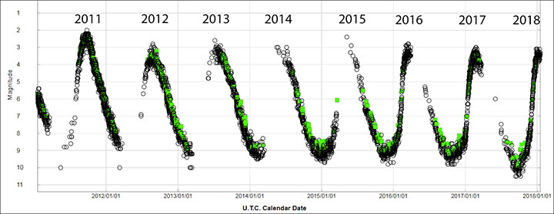

Miras
NOT in hydrostatic equilbrium
evolved stars P ~ 100-1000 days
AGB stars, C/O core
to be … WDs
*NOT* standard candles
HST image … aspherical … 700 R$⊙$
Mira … P = 331 days
credit: AAVSO
Notes:
A visible-light image of Mira taken by the Hubble Space Telescope reveals the star's odd shape. Its resemblance to a football may be due to changes in the star's shape during its expansion-contraction cycles or to unresolved starspots on its surface. Mira is 700 times larger than the Sun.
NASA / ESA

Slide 10
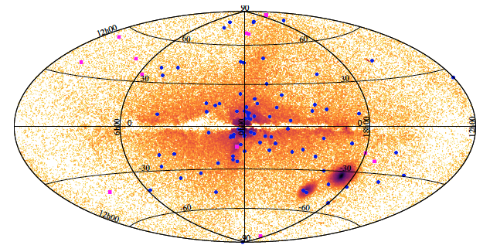
RR Lyraes in GDR2
140,000 orange = RR Lyraes
blue = 87 globular clusters
pink = 12 dwarf spheroidal galaxies
Clementini+ 2019

Slide 11
RR Lyraes in GDR3
297,000 RR Lyraes
134,000 with metallicities

Slide 12
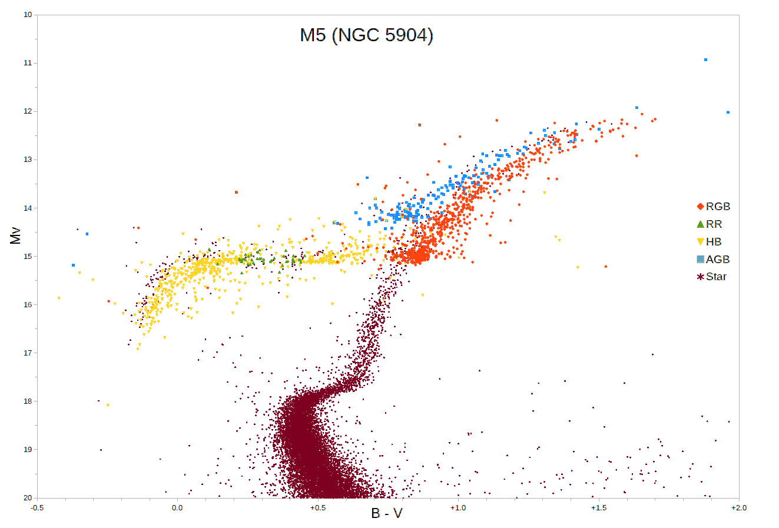
RR Lyraes
MW disk, globulars
P < 1 day
140,000 in Gaia DR2
35% new
(Clementini+ 2019)
297,000 in Gaia DR3
were:
G or K dwarfs
metal poor Pop II
shed mass in RG phase
now:
A or F subgiants
horizontal branch stars
~ 0.5 M
10^{1.5} L
3 types:
RRab steep rise (91%)
RRc sinusoidal
RRd double-mode pulsators
V
B-V
issues:
relatively faint
crowded fields/blending problems
diff metallicities … metal poor, longer P
Notes:
M5 is a globular cluster
note WRONG vertical axis … should be V (?)

Slide 13
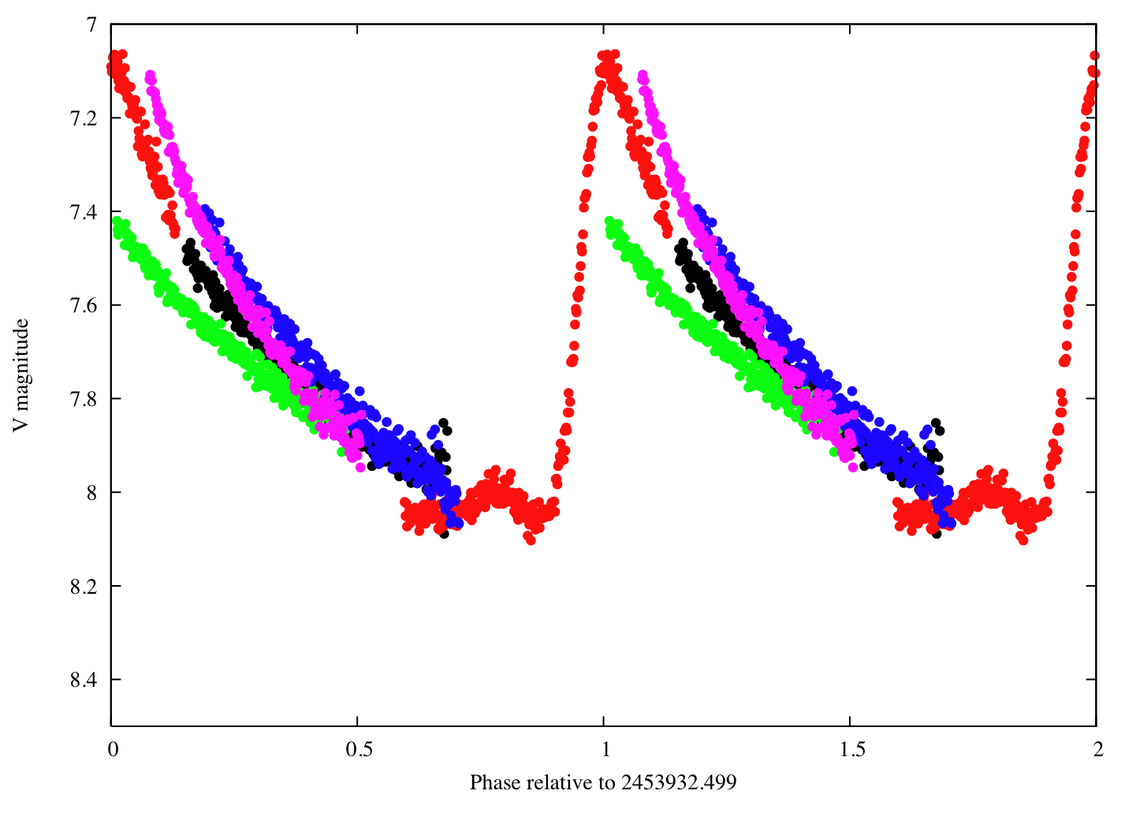
RR Lyrae, the Prototype
different colors are different cycles
credit: AAVSO
Notes:
different cycles not all the same

Slide 14
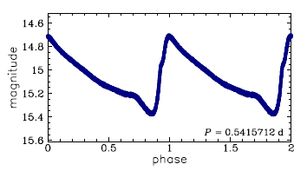
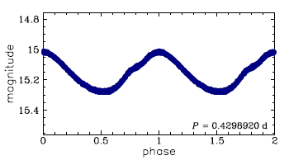
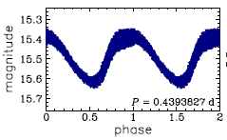
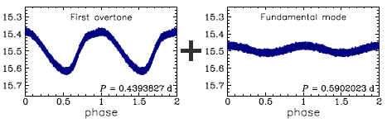
RR Lyrae Subtypes
RRab
fundamental mode pulsators
0.3 − 1.0 days
RRc
first overtone pulsators
0.2 − 0.5 days
RRd
fundamental + first overtone modes
credit:
OGLE Project
Notes:
different cycles not all the same
Fundamental Mode (RRab) Mechanism: The entire star pulsates as one, with a single node at the center.
First-Overtone Mode (RRc) Mechanism: The star pulsates with a node located in the stellar envelope (between the surface and core), causing inner and outer layers to move in opposite directions.

Slide 15
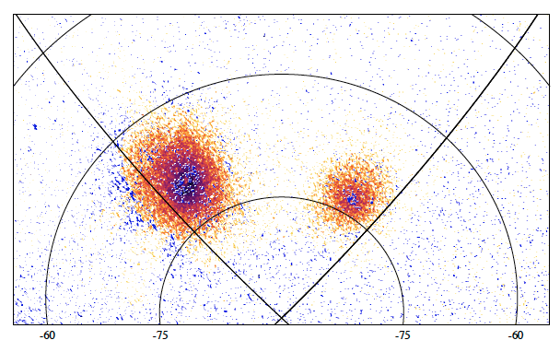
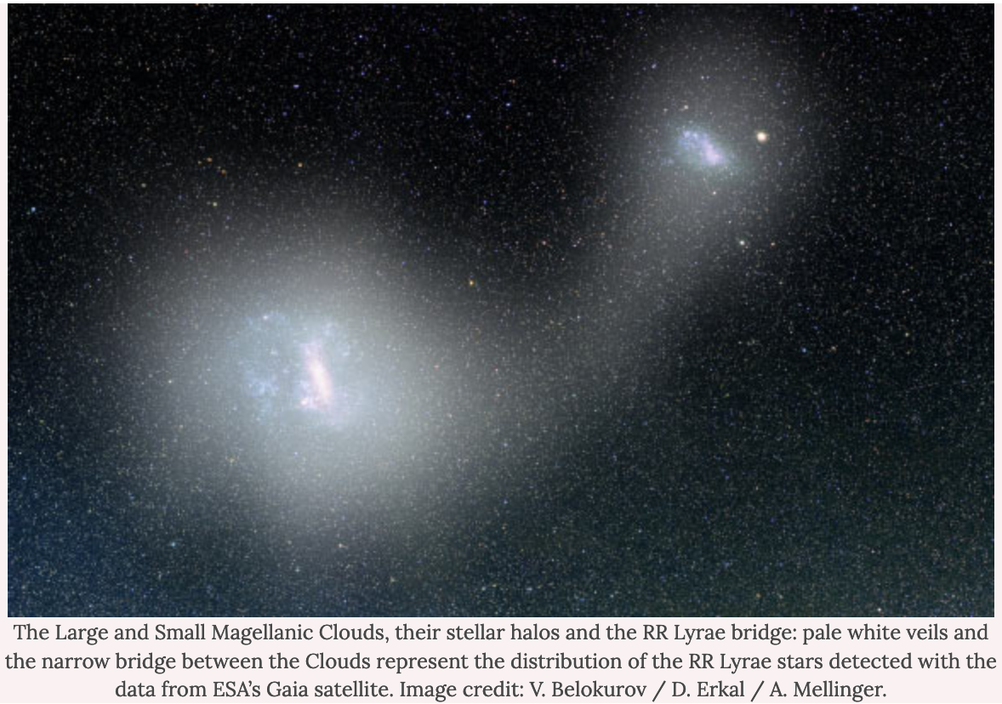
RR Lyraes in LMC + SMC
orange = RR Lyraes
orange = OGLE and others
blue = Gaia (new)
Clementini+ 2019
Notes:
Spatial distribution of RR Lyrae stars located in the region of the two Magellanic Clouds released in Gaia DR2. Orange dots show known RR Lyrae stars from the OGLE surveys, and blue dots represent RR Lyrae stars identified by Gaia and confirmed by the SOS Cep&Cep pipeline.

Slide 16
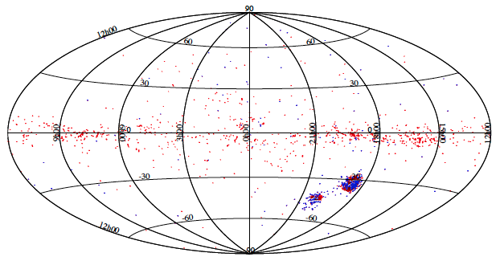
9500 Cepheids in GDR3
red = OGLE and others
blue = Gaia (new)
Clementini+ 2019
Notes:
Spatial distribution of the bona fide Cepheids released in Gaia DR2 (about 8900 sources in total). Red filled circles are known Cepheids in the literature (OGLE and other surveys), and blue filled circles are new Cepheids detected by Gaia in the LMC, SMC (118 in total), and All-Sky (about 240 in total). The latter sample has been cleaned from other types of variable objects that do not follow the PL and PW relations.

Slide 17
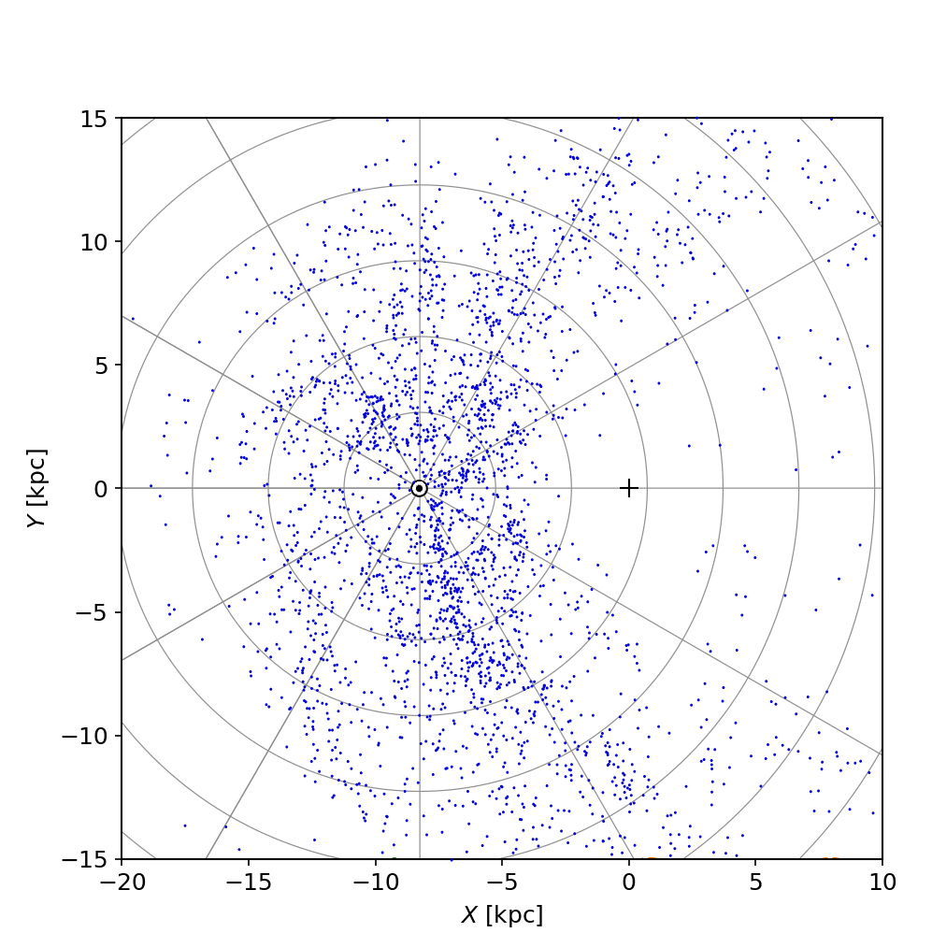
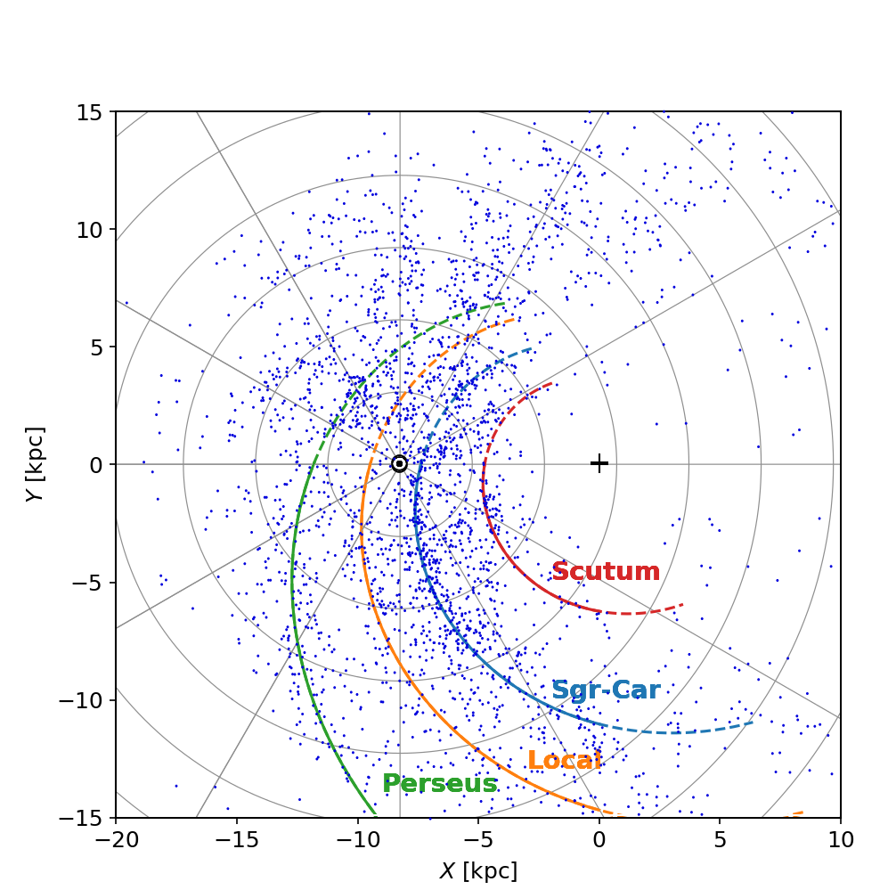
15000 Cepheids in GDR2
How many arms in Milky Way?
https://gaia-unlimited.org/map-of-milky-way-cepheid-variables/

Slide 18
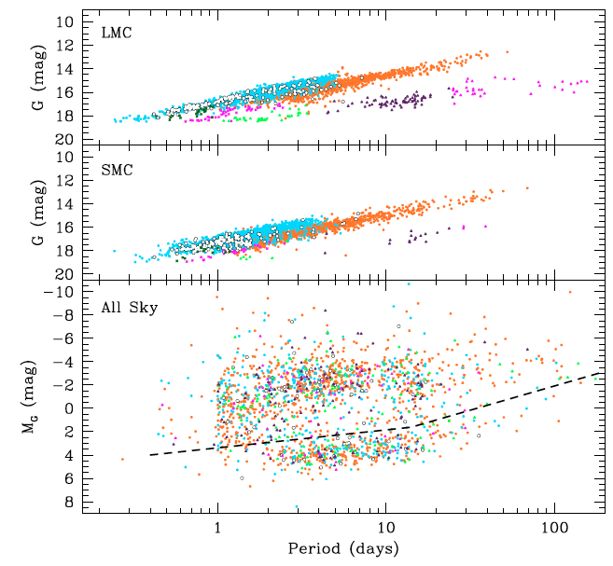
Cepheids
MW, LMC, SMC, And, Tri, +
P ~1-100 days
9500 in GDR2
3% new
(Clementini+ 2019)
15000 in GDR3
Type 1 (Classical) Cepheids:
brightest
Type II Cepheids:
faintest
Pop II stars (metal poor)
Anomalous Cepheids:
coalesced old binaries?
key:
Leavitt’s Law = P-L Relation
(varies by Cepheid type)
cyan+orange Type I fund+first order
Type II
below dotted line: BAD
no extinction correction
not Cepheids
very high reddening
incorrect parallaxes
Clementini+ 2019
Notes:
Upper and middle panels: G-band PL distribution in apparent magnitude not corrected for reddening of DCEPs, ACEPs, and T2CEPs in the LMC and SMC, respectively. Lower panel: PL distribution in absolute G magnitude (MG) not corrected for extinction of All-Sky Cepheids of the different types.
Orange filled circles: DCEPs F; cyan filled circles: DECPs 1O; blank filled circles: multi-mode DCEPs; magenta four-stars: ACEPs F; dark green four-stars: ACEPS 1O; green open triangles: BL Her; violet open triangles:WVir; magenta open triangles: RV Tau. The much larger scatter of the All-Sky Cepheid PL distribution is clearly visible: the Y-axis in the lower panel of the figure spans a magnitude range of 20.0 mag, to compare with the 11.5 mag range of the two upper panels. Several All-Sky sources lie below the dashed line in the lower panel of the figure. They are a mix of misclassifications (spurious sources), sources with very high reddening, and Cepheids with an incorrect parallax value that is due to the still simplified astrometric processing applied for DR2, among which in particular the lack of a proper treatment of binary or multiple sources.

Slide 19
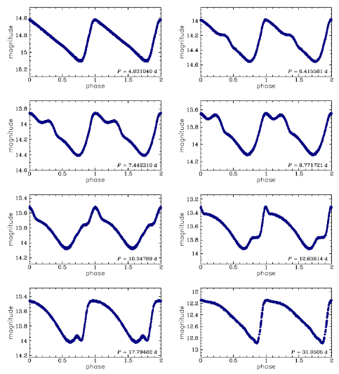
Type I (Classical) Cepheids
Type I = Pop I stars
FGK types
bright giants/supergiants
~ 4-20 M
10⁵ L
How far away is a Cepheid
if it is 10⁵ L and has V = 12.5?
10⁵ L is ~12.5 mag brighter than Sun
Sun has M_{V} ~ 5
so … Cepheid has M_{V} ~ –7.5
M – m = 5 – 5 log d
–7.5 – 12.5 = 5 – 5 log d
5 = log d
d = 10⁵ pc = 100 kpc
credit:
OGLE Project

Slide 20
Cepheids
MW, LMC, SMC, And, Tri, +
P ~1-100 days
9500 in GDR2
3% new
(Clementini+ 2019)
15000 in GDR3
Type 1 (Classical) Cepheids:
brightest
Type II Cepheids:
faintest
Pop II stars (metal poor)
Anomalous Cepheids:
coalesced old binaries?
key:
Leavitt’s Law = P-L Relation
(varies by Cepheid type)
cyan+orange Type I fund+first order
Type II
Clementini+ 2019
Notes:
Upper and middle panels: G-band PL distribution in apparent magnitude not corrected for reddening of DCEPs, ACEPs, and T2CEPs in the LMC and SMC, respectively. Lower panel: PL distribution in absolute G magnitude (MG) not corrected for extinction of All-Sky Cepheids of the different types.
Orange filled circles: DCEPs F; cyan filled circles: DECPs 1O; blank filled circles: multi-mode DCEPs; magenta four-stars: ACEPs F; dark green four-stars: ACEPS 1O; green open triangles: BL Her; violet open triangles:WVir; magenta open triangles: RV Tau. The much larger scatter of the All-Sky Cepheid PL distribution is clearly visible: the Y-axis in the lower panel of the figure spans a magnitude range of 20.0 mag, to compare with the 11.5 mag range of the two upper panels. Several All-Sky sources lie below the dashed line in the lower panel of the figure. They are a mix of misclassifications (spurious sources), sources with very high reddening, and Cepheids with an incorrect parallax value that is due to the still simplified astrometric processing applied for DR2, among which in particular the lack of a proper treatment of binary or multiple sources.

Slide 21
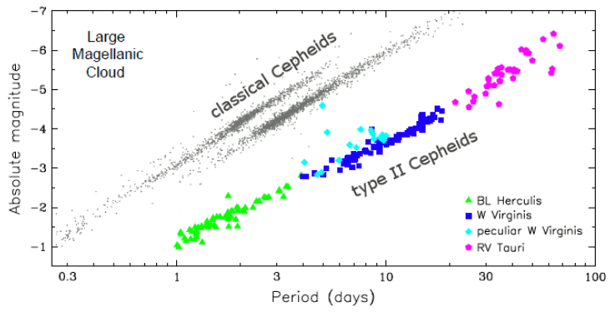
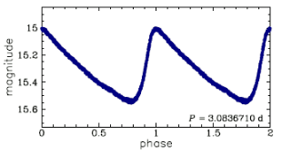
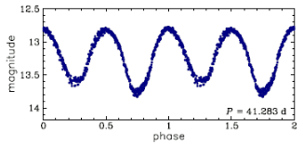
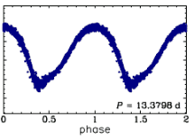
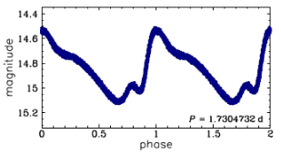
Type II Cepheids
RR
Lyraes
Type II = Pop II stars (metal poor)
P = 1-50+ days … different P-L relation than Classical Cepheids
~ 0.5 M
includes … BL Her …….… W Vir ………. RV Tau subclasses
HB➔AGB He flash/AGB AGB➔WD
credit:
OGLE Project
Notes:
separation between RR Lyrae and Type II Cepheid around P ~ 1 day, 1-9 mags fainter

Slide 22
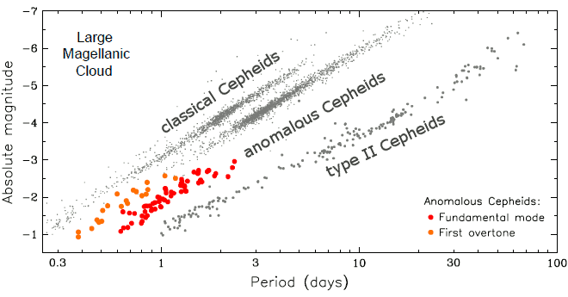
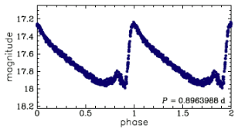
Anomalous Cepheids
P = 0.4-3 days
1-2 M
metal deficient
intermediate age/low metallicity … OR … coalesced old binaries
credit:
OGLE Project

Slide 23
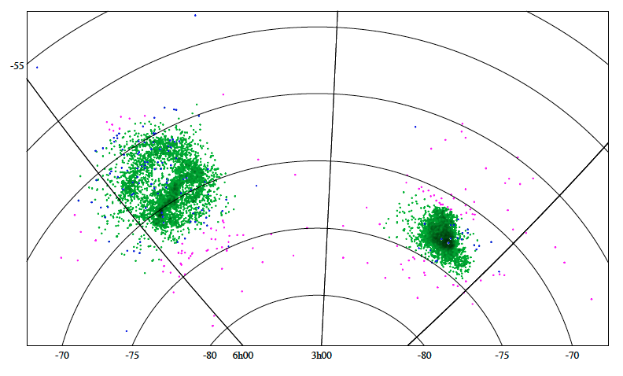
Cepheids in LMC+ SMC
USEFUL
BUT
RARE
green = OGLE Cepheids
pink = OGLE and others
blue = Gaia (new)
credit:
OGLE Project
Notes:
Spatial distribution of Gaia DR2 Cepheids located in the region of the two Magellanic Clouds. Green filled circles show known Cepheids observed in the LMC and SMC regions defined in Sect. 2 by the OGLE survey, magenta filled circles represent All-Sky known (from OGLE or other surveys) Cepheids, and blue filled circles show new Cepheids identified by Gaia in the LMC and SMC (118 in total).

