Slide 1
Stellar Populations I
100
dwarfs
6 wd
1 A
2 F
5 G
11 K
75 M
Henry & Jao (2024)
Notes:
FINAL VERSION USED

Slide 2



Assignments
Tuesday 03 FEB Level 0 … Ideas
Tuesday 10 FEB Bio Sketch
Tuesday 17 FEB Level 1 … Outline … 2 weeks later
Thursday 19 FEB Milky Way Neighborhood
Tuesday 03 MAR Level 2 … 1st Draft … 2 weeks later
Tuesday 24 MAR Level 3 … 2nd Draft … 3 weeks later
Tue/Thu 14/16 APR Presentations … 3 weeks later
Thursday 23 APR Level 4 … submit … 1 week later

Slide 3
Milky Way Neighborhood (2026)
 | RA | DEC | Size (kpc) | Dist (kpc) | Bits / # Globulars / References
Milky Way | --- | --- |  | 0
Andromeda M31 | 00:43 | +41:16 |  |  | Roger + Ben
Triangulum M33 | 01:33 | +30:39 |  |  | Megan + Ella
Bode’s M81 | 09:55 | +69:03 |  |  | Akshat + Madeline
Pinwheel M101 | 14:03 | +54:20 |  |  | AJ + Karina
Whirlpool M51 | 13:30 | +47:13 |  |  | Mahir + Madison
Thursday 19 FEB
25 min research
25 min present
25 min bedazzle

Slide 4
Stellar Populations I
100
dwarfs
6 wd
1 A
2 F
5 G
11 K
75 M
Henry & Jao (2024)
Notes:
FINAL VERSION USED

Slide 6
Dwarfs
B
A
O
F
G
M
K
Notes:
used Willie Torres’ table from 2009 paper to generate sizes

Slide 7
Dwarfs
B
A
O
F
G
M
K

Slide 8
Dwarfs
A F G K M
1% 2% 5% 11% 75%
+ 6%
white dwarfs

Slide 9
Stellar Populations I
1 million stars
super
giant
I
bright
giant
II
(reg)
giant
III
sub
giant
IV
(reg)
dwarf
V
sub
dwarf
VI
O
B
A
F
G
K
M
< 1
300
10,000
18,000
50,000
110,000
750,000
300
1,000
5,000
10?
10?
8,000
20,000
W (Wolf Rayet) < 1
S+C (AGB) stars < 1
white dwarfs 55,000
neutron stars unknown
black holes unknown
Notes:
O stars --- maybe 20,000 in entire MW
B stars --- 4 within 100 light years = 30.7 pc

Slide 10
Stellar Types within 25 Parsecs
supergiants I
bright giants II
giants III
subgiants IV
dwarfs V
pre-main seq …
subdwarfs VI
white dwarfs VII
SUBTOTAL
unclassified
TOTAL
Database Expected Fraction
0 0 0%
1 1 ~ 0%
24 ~ 30 ~ 1%
83 ~ 100 ~ 3%
2693 ~3500 ~ 90%
12 ~ 30 ~ 1%
16 ~ 30 ~ 1%
190 ~ 200 ~ 5%
3019 …… ……
874 …… + dwarfs
3893 3893 100%
RECONS pre-GDR2
Notes:
using RECX25 search by Wei-Chun on 2020.0211
179 WDs in Subasavage+ 2017

Slide 11
Stellar Types within 25 Parsecs
supergiants I
bright giants II
giants III
subgiants IV
dwarfs V
pre-main seq …
subdwarfs VI
white dwarfs VII
SUBTOTAL
unclassified
TOTAL
3019 …… ……
874 …… + dwarfs
3893 3893 100%
classify all the
non-main sequence
stars within 25 parsecs
RECONS pre-GDR2
Notes:
using RECX25 search by Wei-Chun on 2020.0211
179 WDs in Subasavage+ 2017

Slide 12
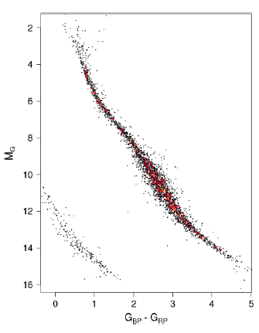
Gaia’s Solar Neighborhood
young stars
Riedel thesis
old stars (cool subdwarfs)
Jao thesis
non-stars (white dwarfs)
Subasavage thesis
end of main sequence
Dieterich thesis
M dwarfs
Clements thesis
Couperus thesis
Kar thesis
Kimani-Stewart thesis
M dwarf multiples
Winters thesis
Vrijmoet thesis
LeBlanc thesis
K dwarfs
Paredes thesis
James thesis
Carrazco thesis
Johns thesis
25 pc
NOT QUITE COMPLETE
unresolved multiples
K0
M0
M3
M6
Babusiaux+ (2018)

Slide 13
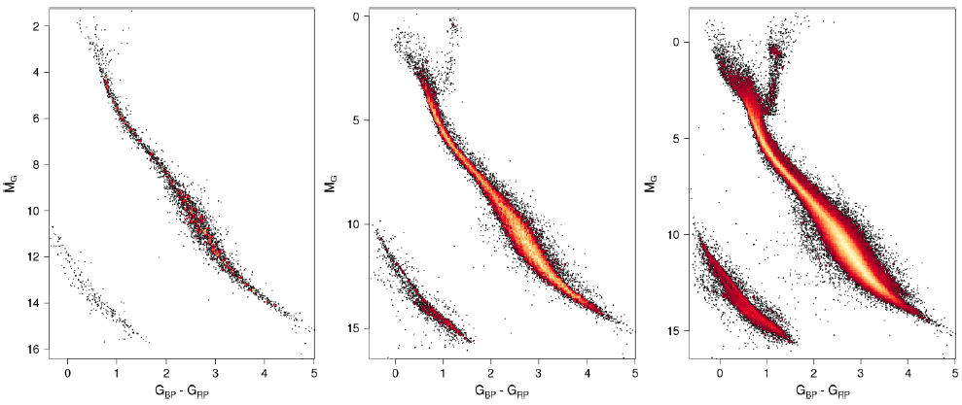
Gaia’s Solar Neighborhood
25 pc 50 pc 100 pc
What “extra” populations are evident past 25 parsecs? (high end first)
red giants, red clump stars
Babusiaux+ (2018)
Notes:
because (a) faint stars missed beyond 25 pc, and (b) close multiples get merged and are not affected so much by astrometric perturbations

Slide 14
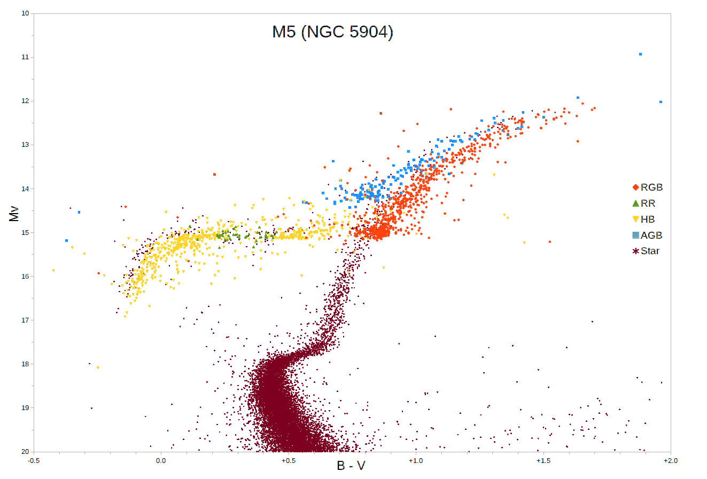
Red Clump Stars
V
B-V
Notes:
M5 is a globular cluster
note WRONG vertical axis … should be V (?)
red clump stars are core He burning at reddest edge of HB --- Red clump stellar properties vary depending on their metallicities, but typically have early K spectral types and T~5000 K. There is a considerable spread in the properties of red clump stars even within a single population of similar stars such as an open cluster, due to variations in temperatures and luminosities of horizontal branch stars when they form and as they evolve. Although red clump stars are generally hotter than red-giant-branch stars, the two regions overlap and the status of individual stars can only be assigned with a detailed chemical abundance study.

Slide 15
Gaia’s Solar Neighborhood
25 pc 50 pc 100 pc
What “extra” populations are evident past 25 parsecs?
red giants, red clump stars, binary M dwarfs, binary WDs, cool subdwarfs
How many more stars expected within 100 pc compared to 25 pc?
Why aren’t there 64X as many stars?
Babusiaux+ (2018)
Notes:
because (a) faint stars missed beyond 25 pc, and (b) close multiples get merged and are not affected so much by astrometric perturbations

Slide 16
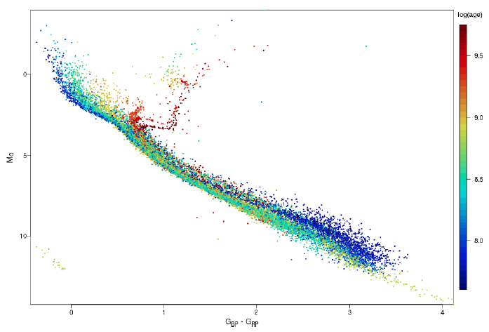
32 Open Clusters in Gaia
1
old clusters have RG branches
young clusters have
M dwarfs settling
onto main sequences
3
2
young clusters have
no white dwarfs yet
4
K0
M0
M3
Hyades
M5
GC/Babusiaux+ (2018)
Notes:
Although red clump stars are generally hotter than red-giant-branch stars, the two regions overlap and the status of individual stars can only be assigned with a detailed chemical abundance study.

Slide 17
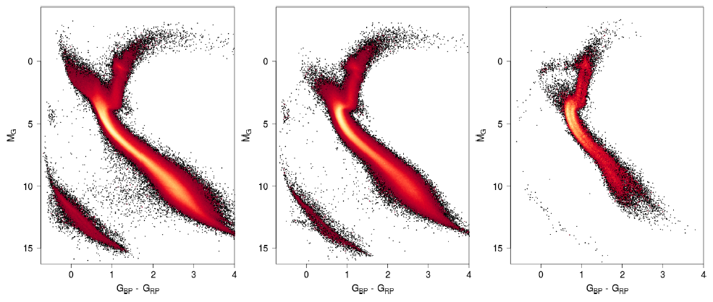
Gaia’s Solar Neighborhood
thin
disk
thick
disk
halo
How can you tell which population (thin disk, thick disk, halo) is being plotted?
thin disk: young, hot stars
thick disk: more defined turnoff
halo: lack of upper main sequence, extended HB, fewer fainter stars
NOTE! 2 main sequences in halo …
Babusiaux+ (2018)

Slide 18
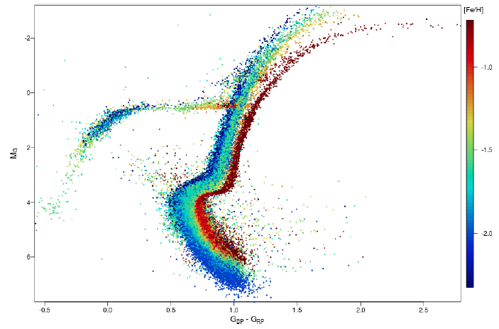
14 Globular Clusters in Gaia
metal-poor clusters have
blue horizontal branches
metal-rich clusters
have redder RG branches
1
2
1
3
blue
stragglers
formed later
not cluster members
collision/merger
mass transfer
formed later
not cluster members
collision/merger
mass transfer
Babusiaux+ (2018)

Slide 19
Limits?
B
A
O
F
G
M
K
Notes:
used Willie Torres’ table from 2009 paper to generate sizes

Slide 20
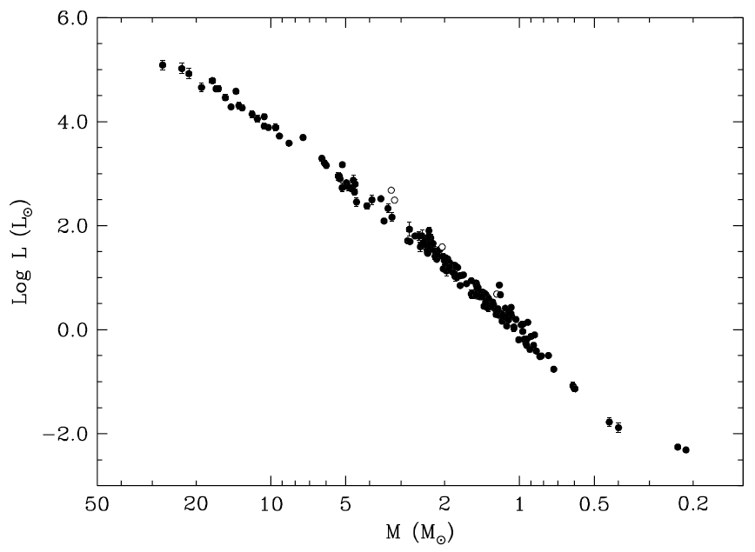
Mass-Luminosity Relation
27.27 ± 0.55 M
masses and radii
±3%
0.214 ± 0.008 M
Torres+ (2010)

