Slide 1
Stellar Populations II
100
dwarfs
6 wd
1 A
2 F
5 G
11 K
75 M
Henry & Jao (2024)
Notes:
FINAL VERSION USED

Slide 2
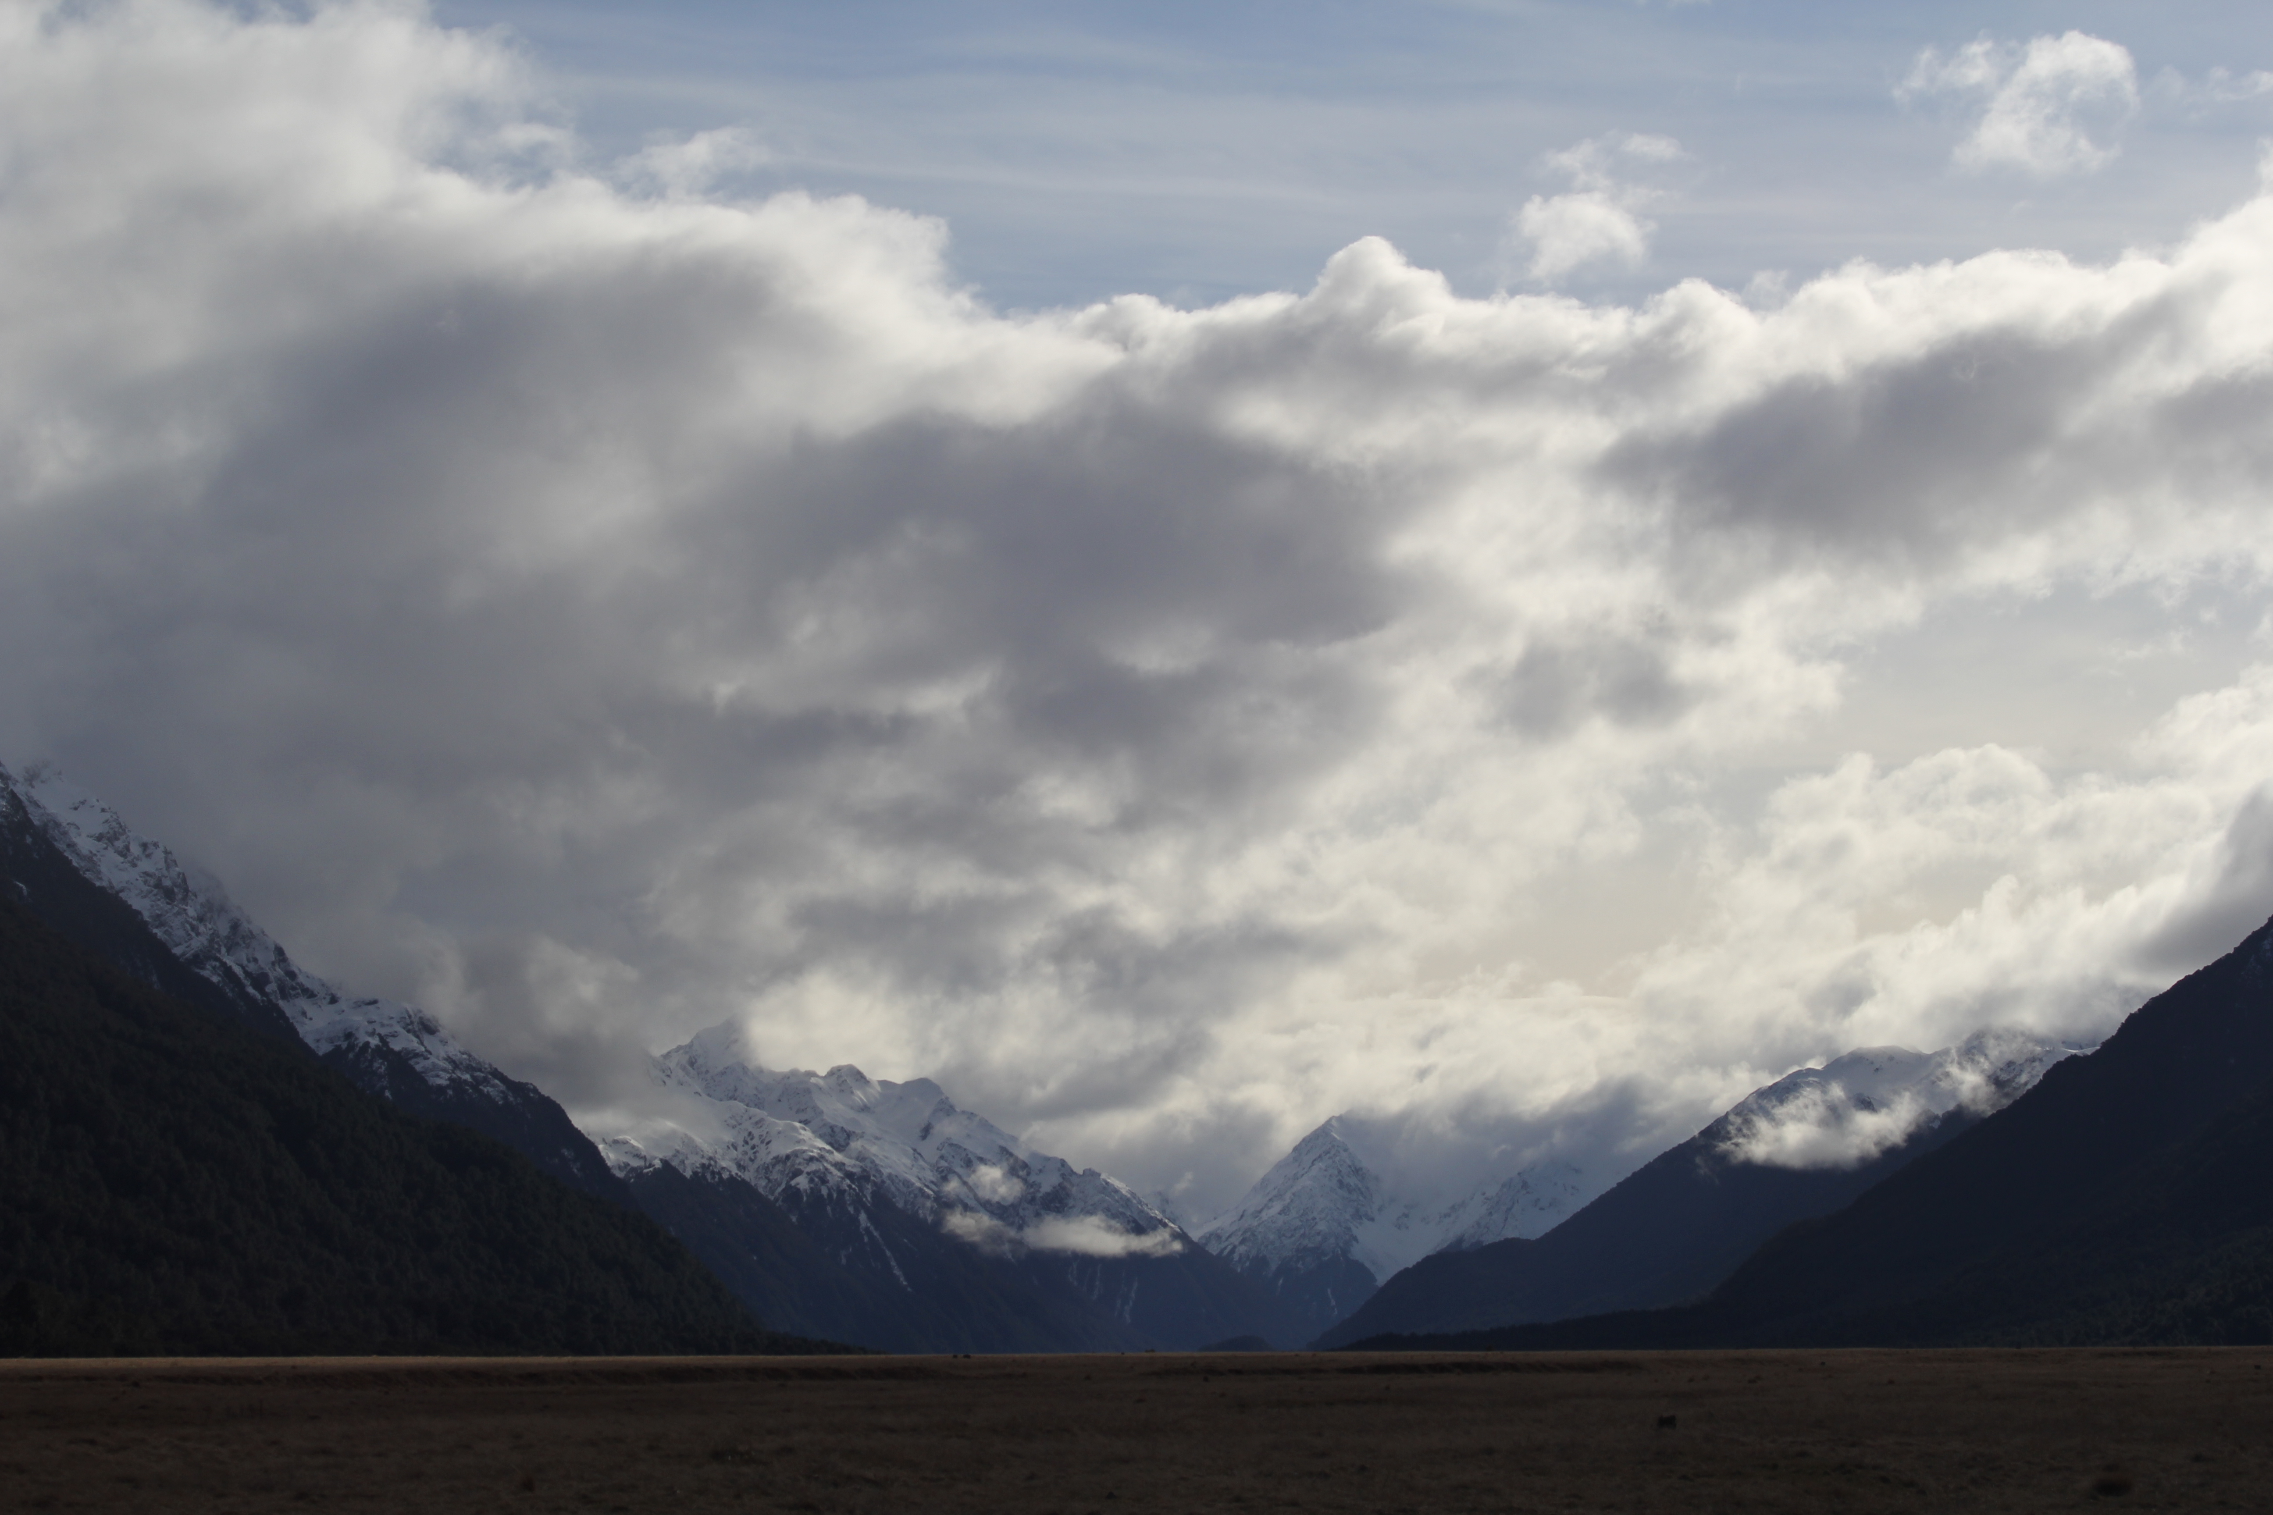

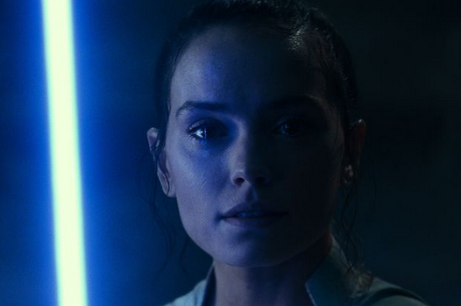
Assignments
Tuesday 03 FEB Level 0 … Ideas
Tuesday 10 FEB Bio Sketch
Tuesday 17 FEB Level 1 … Outline … 2 weeks later
Thursday 19 FEB Milky Way Neighborhood
Tuesday 03 MAR Level 2 … 1st Draft … 2 weeks later
Tuesday 24 MAR Level 3 … 2nd Draft … 3 weeks later
Tue/Thu 14/16 APR Presentations … 3 weeks later
Thursday 23 APR Level 4 … submit … 1 week later

Slide 3
Assignments
http://www.astro.gsu.edu/~thenry/GALACTIC/
Tuesday 17 FEB Proposal Level 1 --- OUTLINE
Page 1: Title/Name/Intellectual Merit/Broader Impacts
IM (Abstract) and BI have a few sentences each
Page 2: Introduction has a few sentences (3+ refs)
Sections, Tables, Figures listed

Slide 4
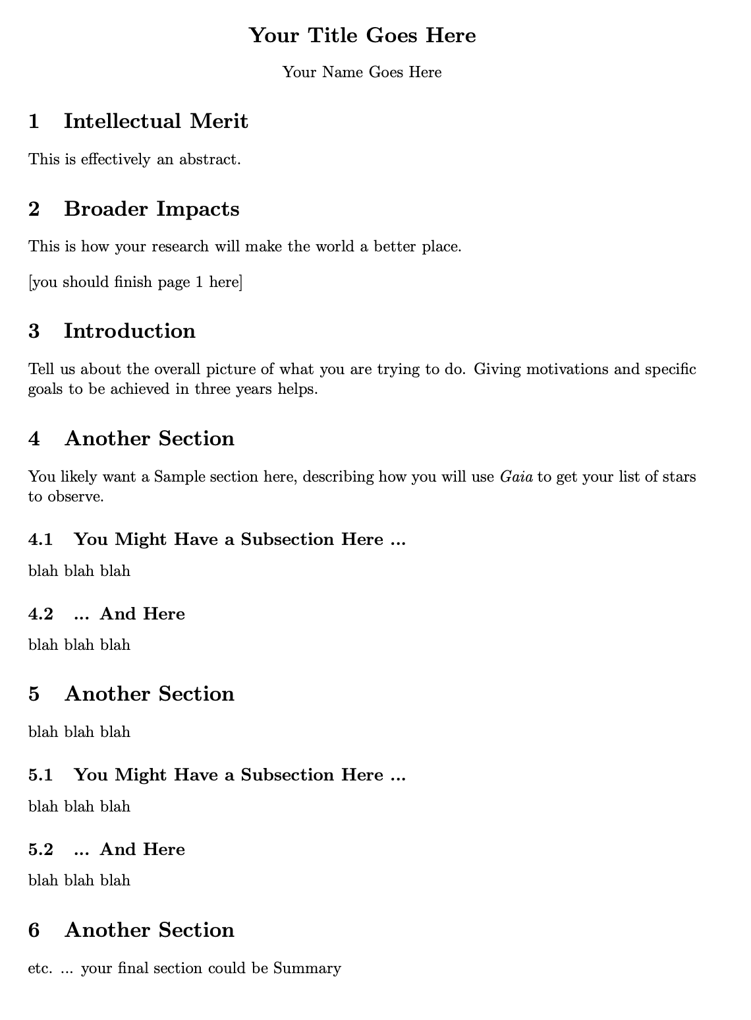
Assignments

Slide 5

Proposal Pieces
GOAL: Fund yourself as a $75K/year postdoc for 3 years
1. Project Description 8.0 pages text + 2.0 pages Tab/Fig
2. References 0.5 page
3. Biographical Sketch 2.0 pages (SciENcv)
4. Budget 1.0 page (spreadsheet)
5. Budget Justification 1.0 page
6. Facilities 0.5 page
7. Student Mentoring Plan 0.5 page
8. Data Management Plan 0.5 page
X. Project Summary
X. Current & Pending
X. Collaborators & Affiliations
Total Challenge ~ 16 pages

Slide 6
Stellar Populations II
100
dwarfs
6 wd
1 A
2 F
5 G
11 K
75 M
Henry & Jao (2024)
Notes:
FINAL VERSION USED

Slide 7
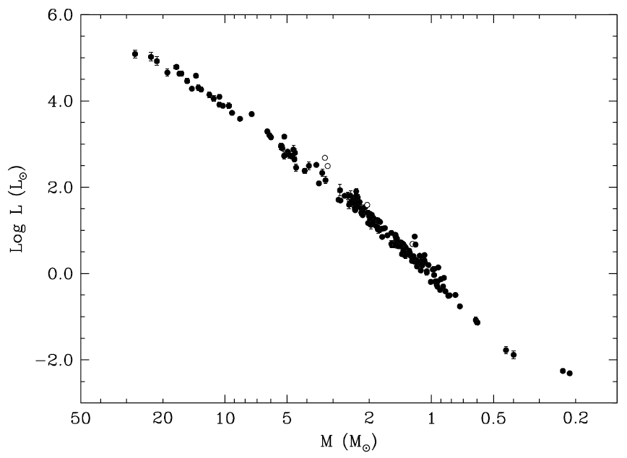
Mass-Luminosity Relation
27.27 ± 0.55 M
masses and radii
±3%
rarely eclipse
… we need
something else
0.214 ± 0.008 M
Torres+ (2010)

Slide 8
Stellar Limits Large and Small
Largest MS Star
10⁷ L
53000 K
O2-3V
WN5h
Wolf-Rayet
N+H emission
315 M
???
Luminosity
Temperature
(Spectral Type)
Mass
Radius
What is the radius of the largest main sequence star?

Slide 9
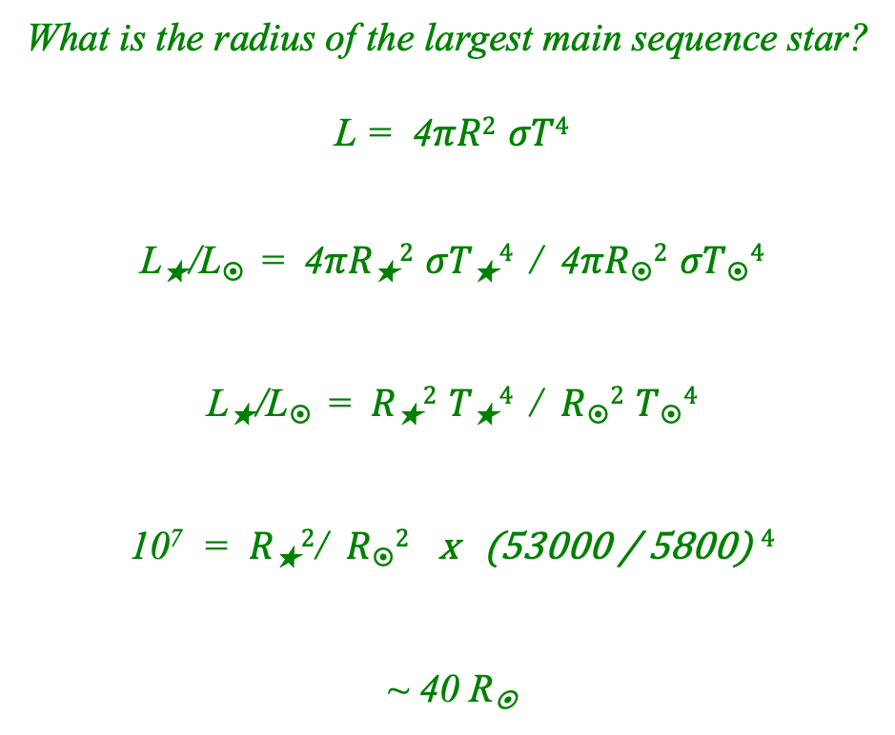
Stellar Limits Large and Small
Largest MS Star
10⁷ L
53000 K
O2-3V
WN5h
Wolf-Rayet
N+H emission
315 M
???

Slide 10
Stellar Limits Large and Small
Largest MS Star
10⁷ L
53000 K
O2-3V
WN5h
Wolf-Rayet
N+H emission
315 M
40 R
Luminosity
Temperature
(Spectral Type)
Mass
Radius

Slide 11
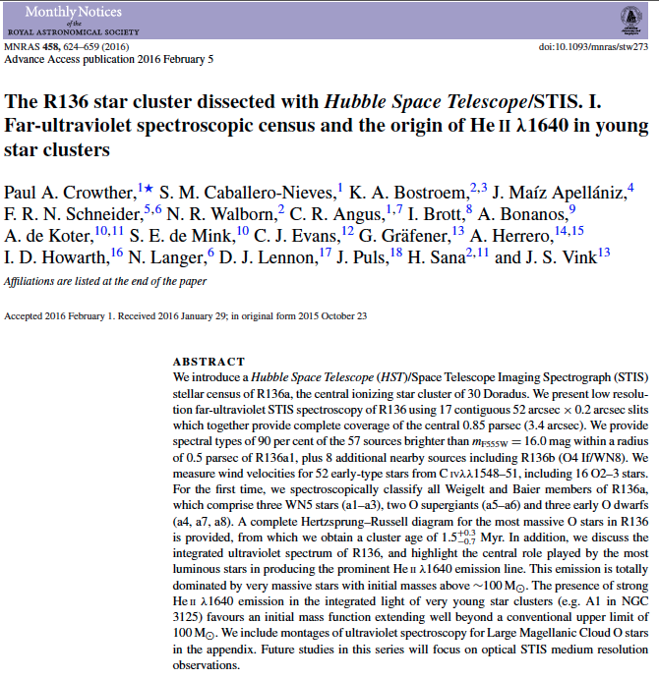
Largest Stars
LMC
…
30 Doradus = Tarantula Nebula
…
NGC 2070 cluster
...
R136 stellar group
(Radcliffe Obs. Magellanic Clouds catalog)
~ 10000 stars
~ 1.5 Myr old
not highly reddened … UV
Crowther+ (2016)

Slide 12
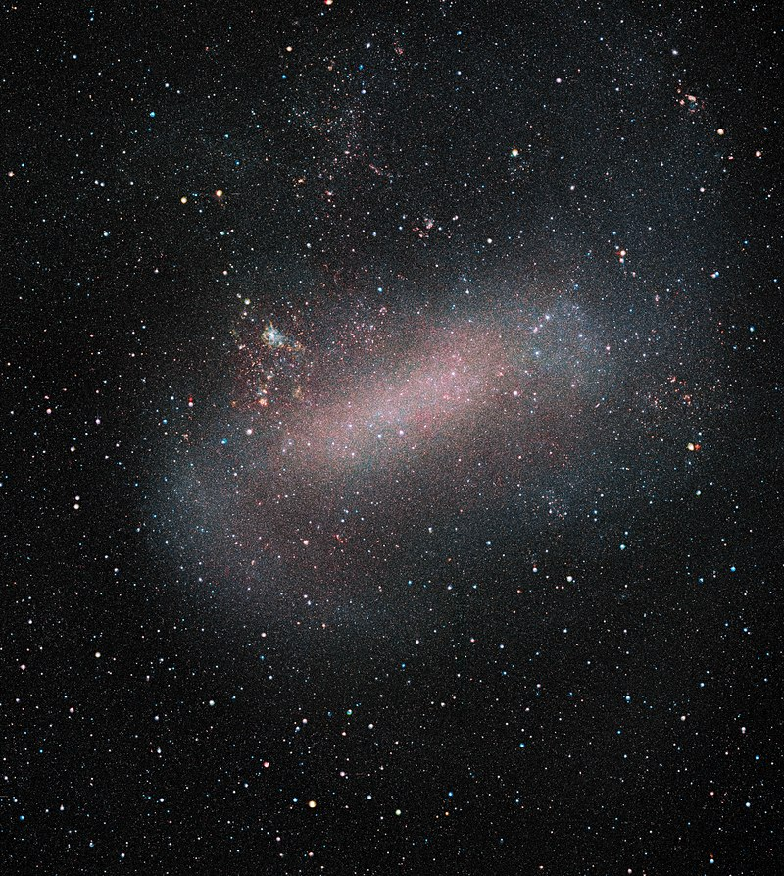
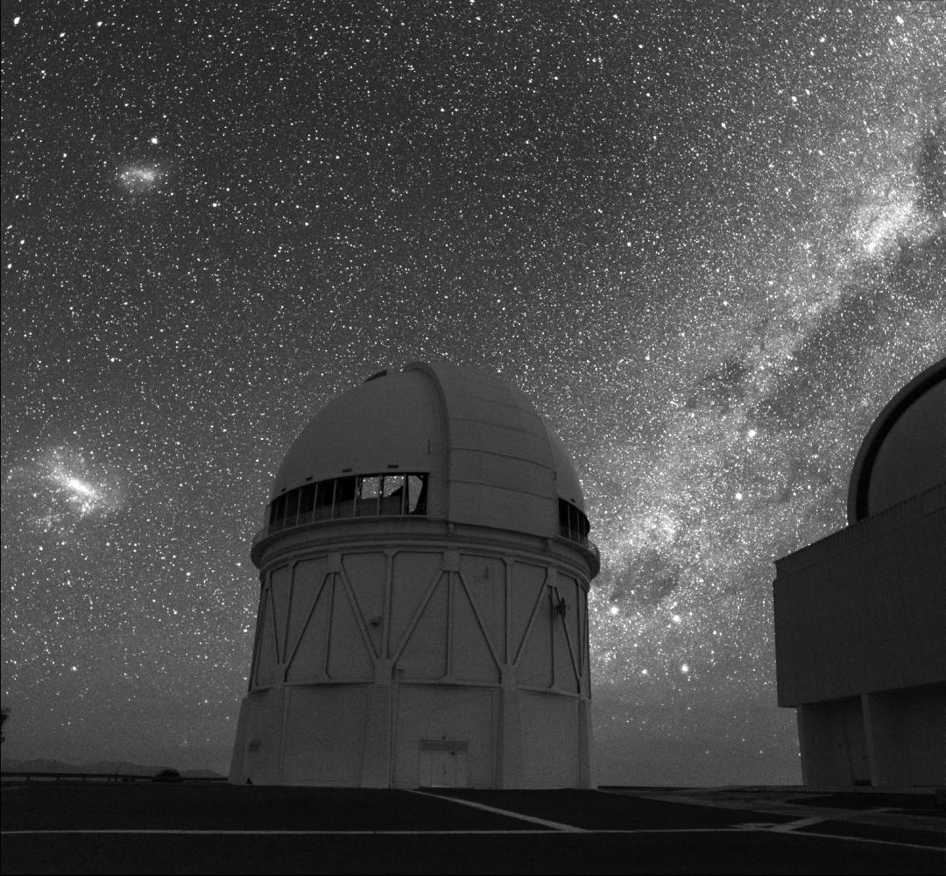
The Largest Star
photo: Roger Smith

Slide 13
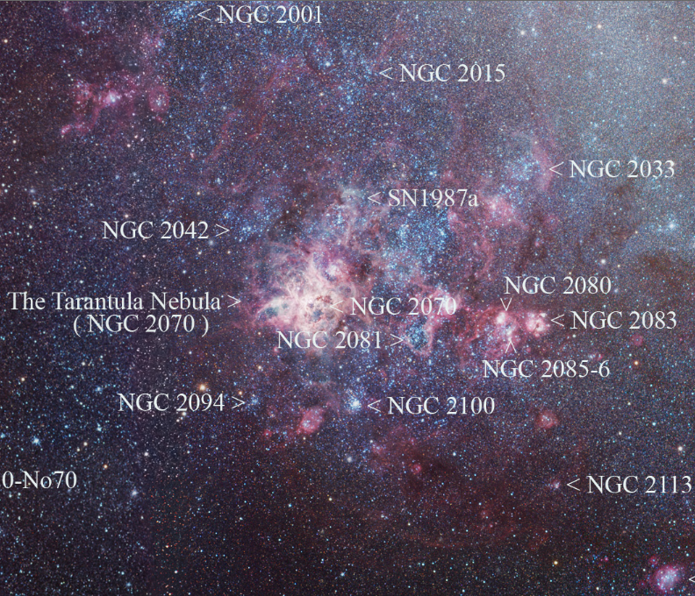
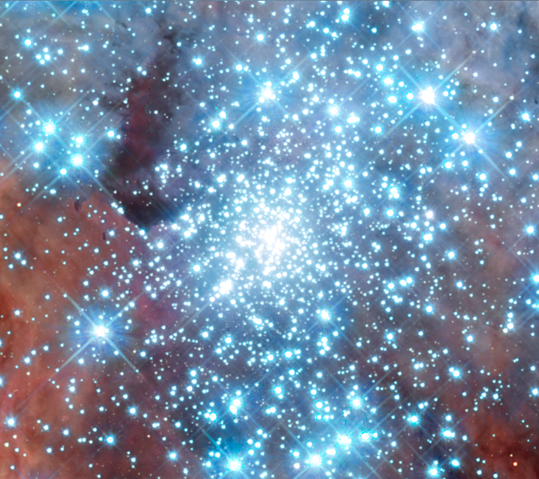
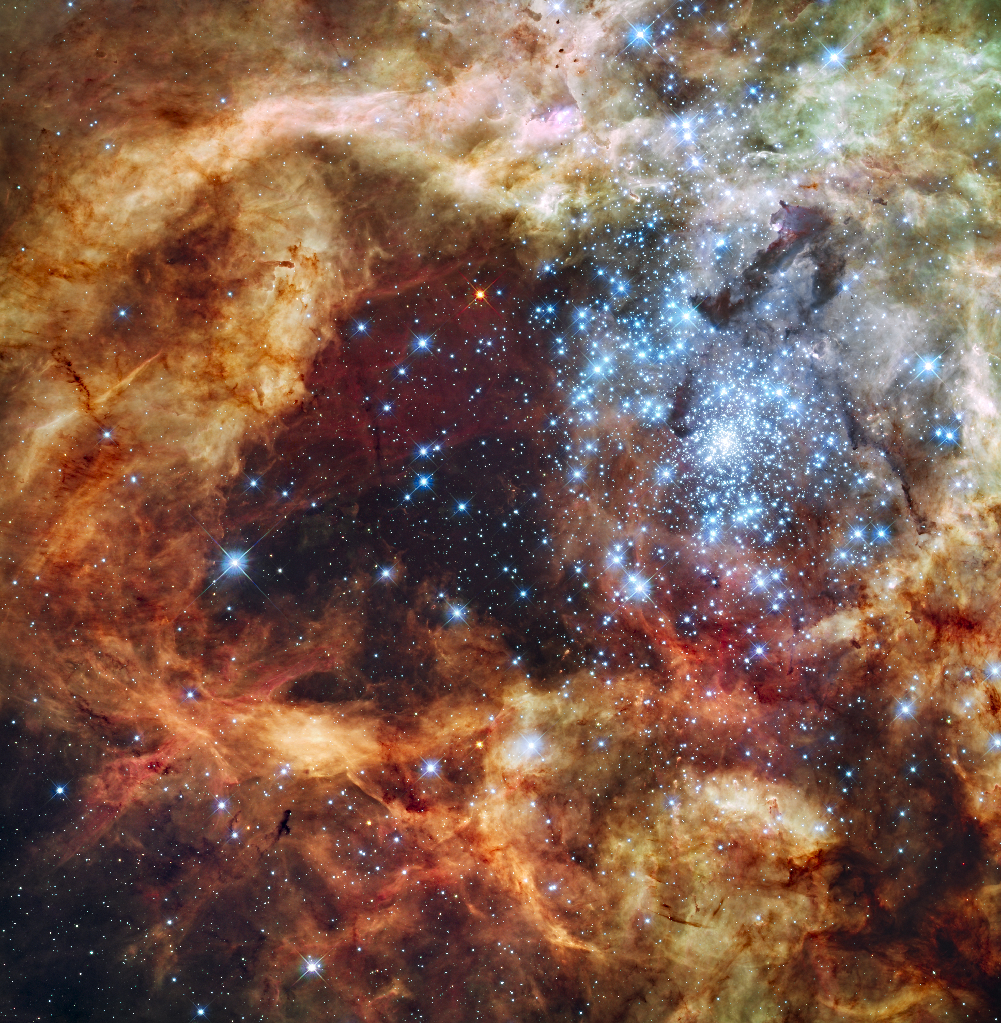
The Largest Star

Slide 14
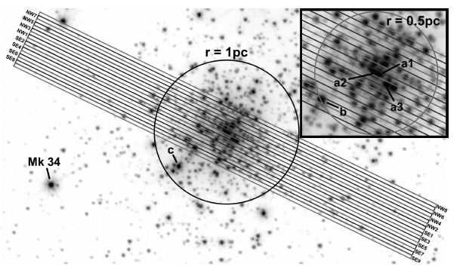
Largest Stars: Observations
HST-STIS spectroscopy of central parsec (0.2” slits)

Slide 15
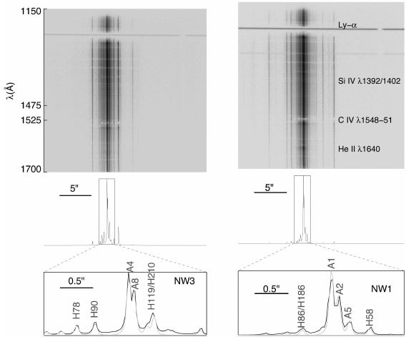
Largest Stars: Observations

Slide 16
Largest Stars: BONNSAI
BONN Stellar Astrophysics Interface (Schneider+ 2014 A&A, 570, 66)
Bayesian statistical method comparing observations to models
can use
magnitudes … luminosities
colors/SEDs/spectra … temperatures
compositions
radii/surface gravities
rotational velocities
Initial Mass Function (IMF)
test components in eclipsing binaries: masses 4-28 M
input = masses, radii, rotational velocities
output = initial masses, initial rotations, ages
probability distributions of initial masses and ages
works to a few % … but systematics evident
NO TRULY MASSIVE CALIBRATION STARS

Slide 17
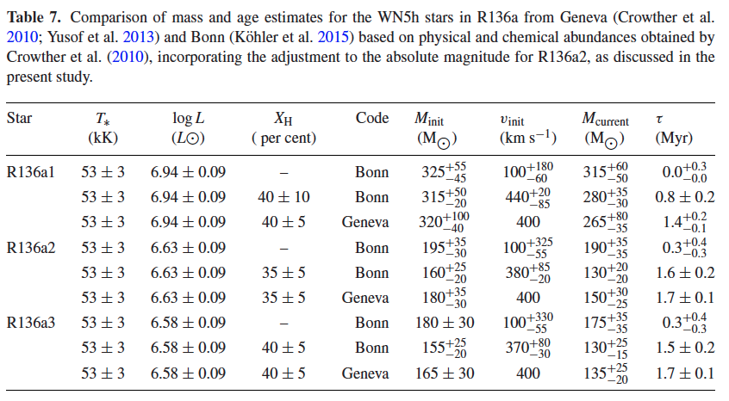
Largest Stars: Stats
6 stars with masses > 100 M 3 WN stars (below)
1 Of/WN … 1 O2If … 1 O2-3V
more recent estimates … 170 – 230 M

Slide 18
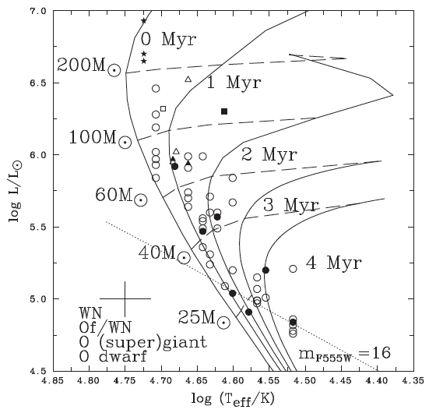
Largest Stars: HR Diagram
★
○
Notes:
starred points are Wolf-Rayet (WR) stars … WN = spectra dominated by nitrogen … WC = spectra dominated by carbon/oxygen
filled points are optical spectral types … open points are UV spectral types … both yield temperatures

Slide 19
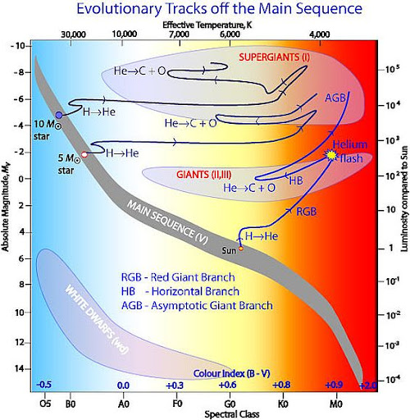
Stellar Evolutionary Tracks
53000K
10⁷ L 
MS
core H➔He
RGB
shell H➔He
HB/RC
core He➔C
AGB
shell H➔He
shell He➔C

Slide 20
Mass-Luminosity Relation
Schnurr+ (2008)
NGC 3603 A1
eclipsing
116±31 and 89±16
Why are there few points here for massive stars?
masses and radii
±3%
Why are there few points here for low mass stars?
Torres+ (2010)

Slide 21
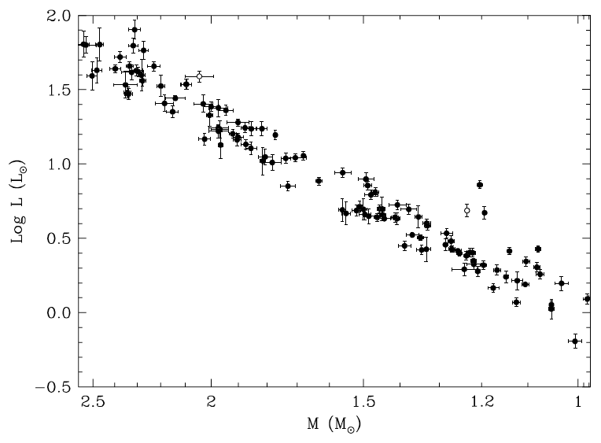
Accurate Luminosities
Why don’t all the stars
fall along a line?
Torres+ (2010)

Slide 22
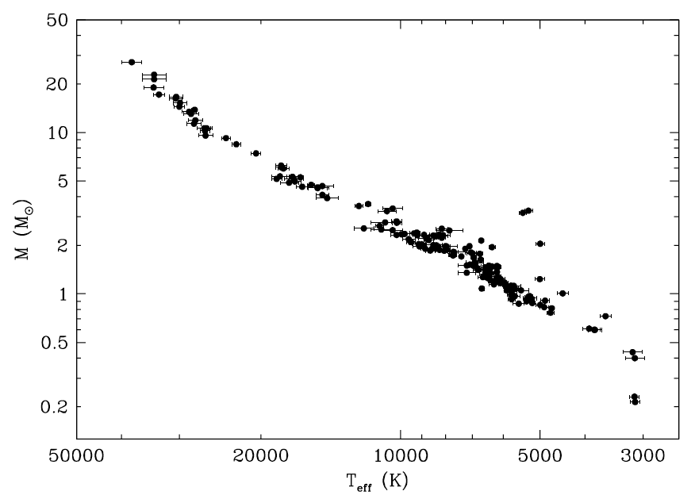
Accurate Temperatures
Torres+ (2010)

Slide 23
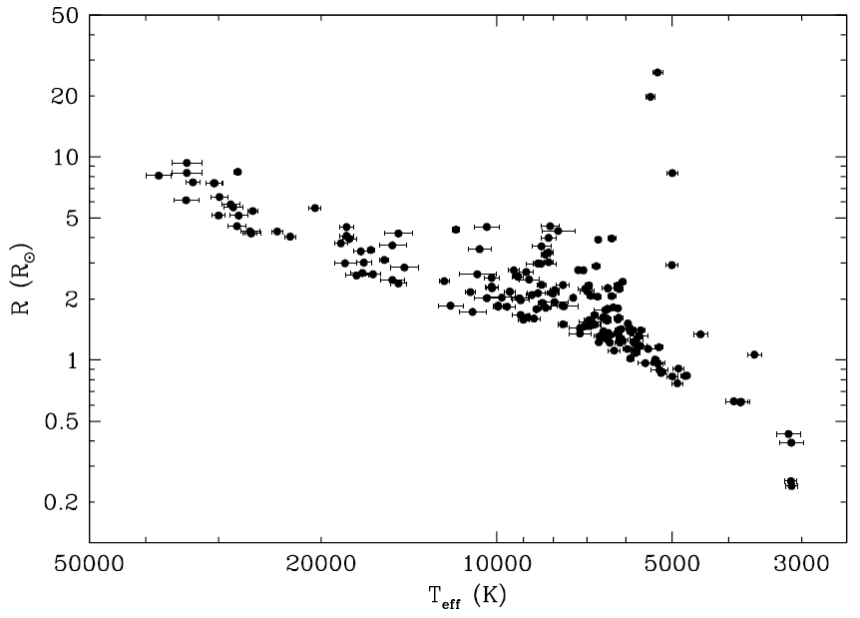
Accurate Radii
Torres+ (2010)

Slide 24
Mass-Luminosity Relation
27.27 ± 0.55 M
masses and radii
±3%
0.214 ± 0.008 M
Torres+ (2010)

Slide 25
High Resolution Techniques
“High Resolution” here means anything < 1”
Technique Mag Limit Res Limit Telescope/Instrument
Gaia G ~ 21 0.5” in space
RoboAO / Lucky Imaging J ~ 11 0.1” various ~4m
Infrared AO (4m) K ~ 9 0.07” CFHT/KIR
Infrared AO (8m) K ~ 10 0.07” VLT/NaCo or Gemini-N/NIRI
Infrared AO (10m) K ~ 10 0.05” Keck/NIRC2
Fine Guidance Sensors V ~ 15 0.05” HST-FGS
Optical Speckle (4m) R ~ 15 0.02” WIYN, APO, LDT, SOAR
Optical Speckle (8m) R ~ 16 0.01” Gemini-N/S
LB Interferometry K ~ 8? <0.001” CHARA

Slide 26
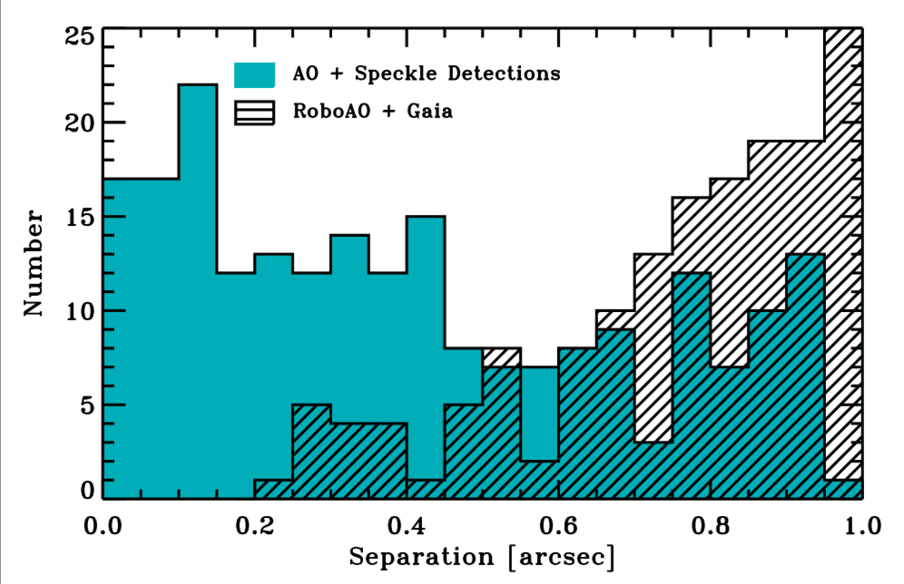
High Resolution Sensitivities
Ciardi (2018)

Slide 27
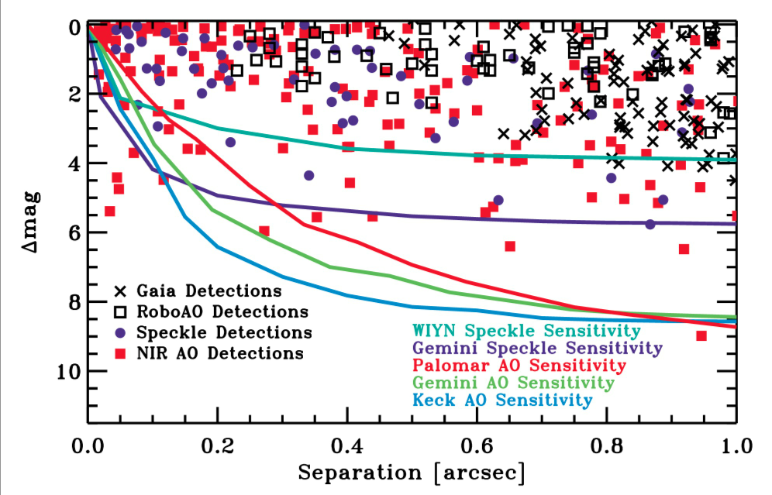
High Resolution Sensitivities
Ciardi (2018)

Slide 28
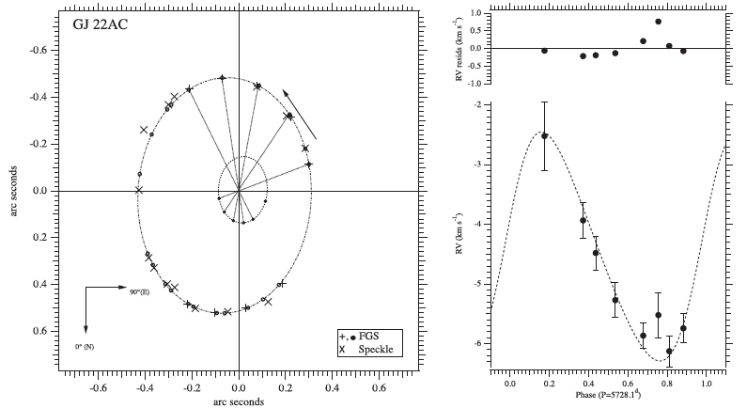
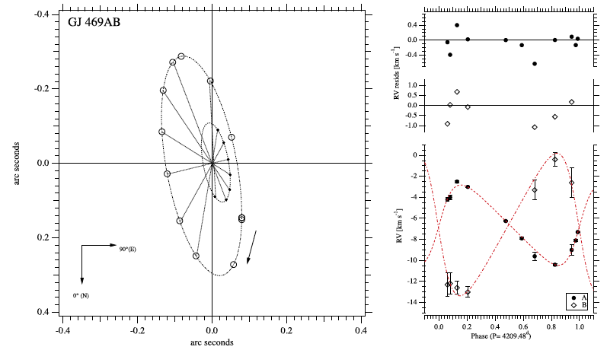
Mass-Luminosity Relation
Benedict+ (2016)

Slide 29
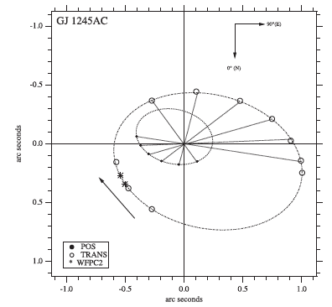
Mass-Luminosity Relation
A: 0.111 ± 0.001 M
B: 0.076 ± 0.001 M
not eclipsing
Benedict+ (2016)

Slide 30
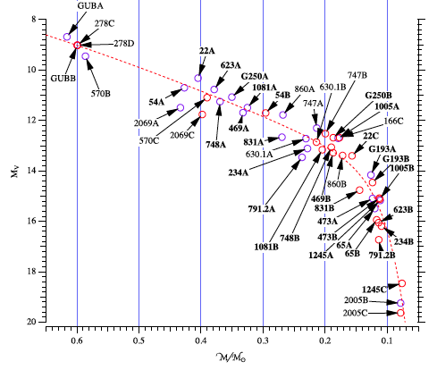
Mass-Luminosity Relation
Benedict+ (2016)

Slide 31
Mass-Luminosity Relation
Torres+ (2010) and Benedict+ (2016)

Slide 32
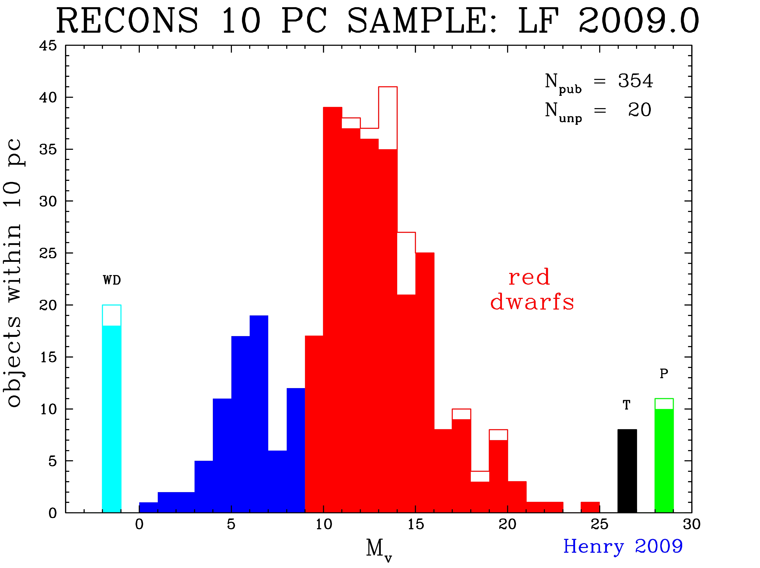
Luminosity Function (LF)

Slide 33
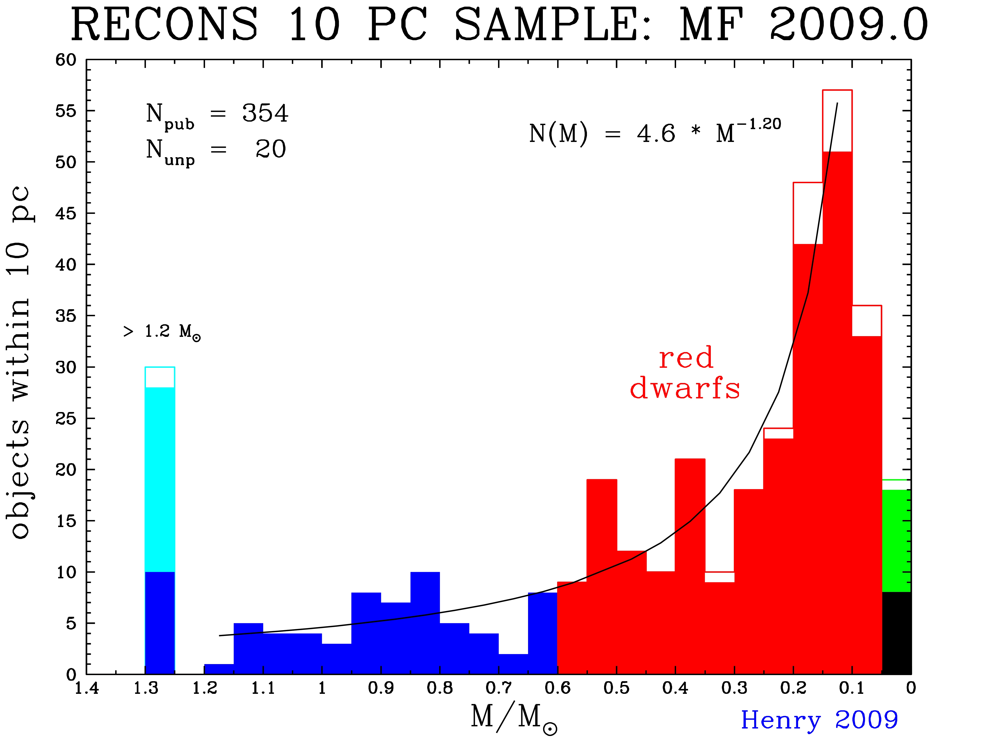
Mass Function (MF)

Slide 34
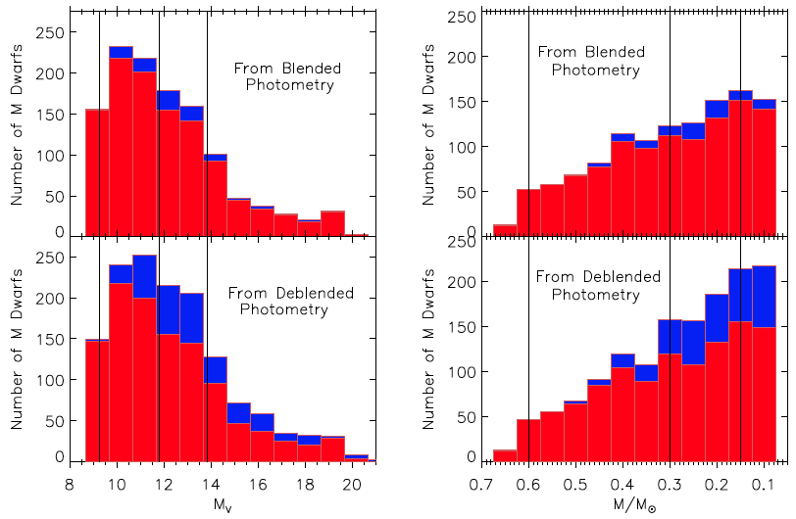
Red Dwarfs: Companions Matter
LF MF
primaries … secondaries
Winters+ (2019)
Notes:
lines are factors of 2 in mass

Slide 35
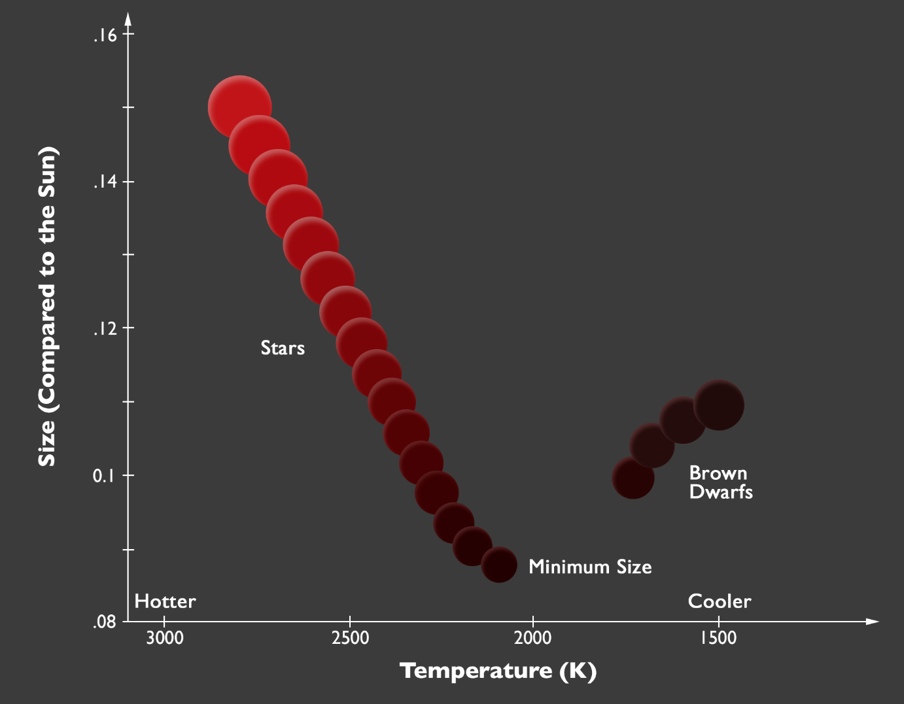
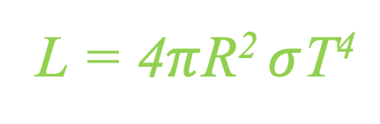
Smallest Stars
thermo equil e⁻ degeneracy
hydrogen
burning
limit
… or Luminosity
Dieterich/NOAO
Notes:
Stefan-Boltzmann Law

Slide 36
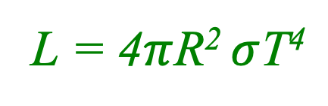
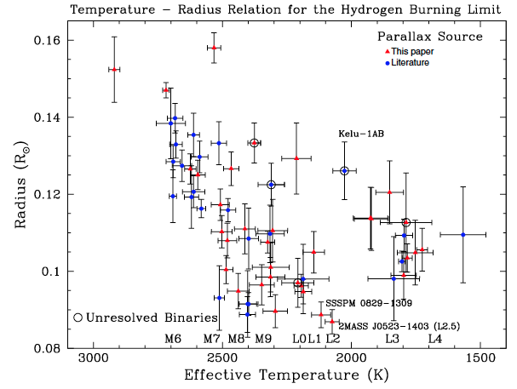
Smallest Stars
thermo equil e⁻ degeneracy
T ~ 2000 K
Dieterich+ (2014)

Slide 37
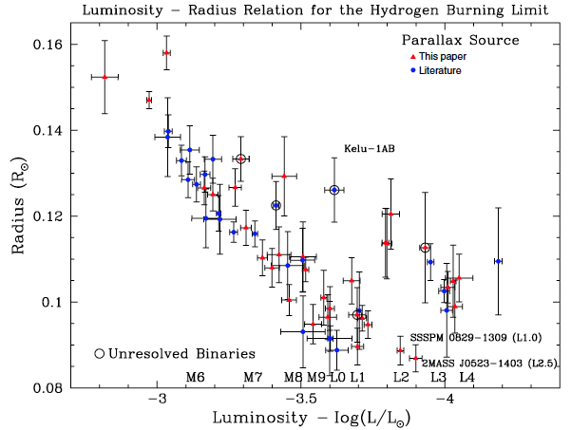
Smallest Stars
thermo equil e⁻ degeneracy
L ~ 10⁻⁴ L
Dieterich+ (2014)

Slide 38
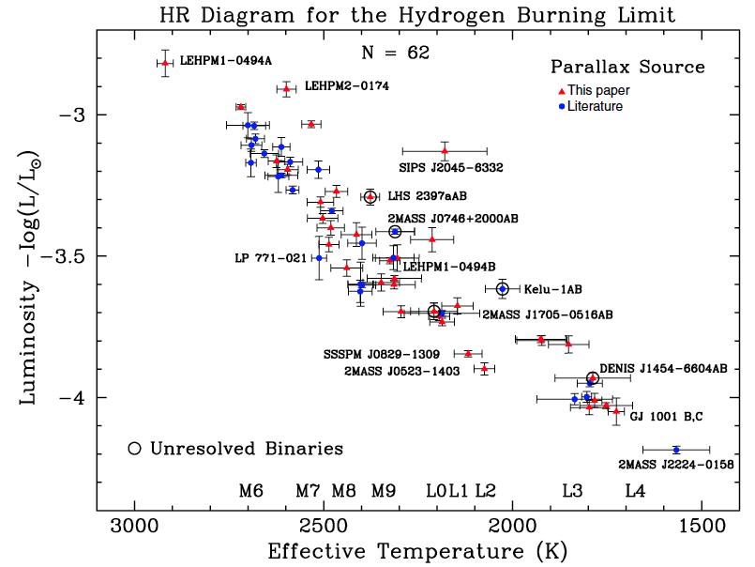
Smallest Stars
Dieterich+ (2014)

Slide 39
Smallest Stars
Henry & Jao (2024)

Slide 40
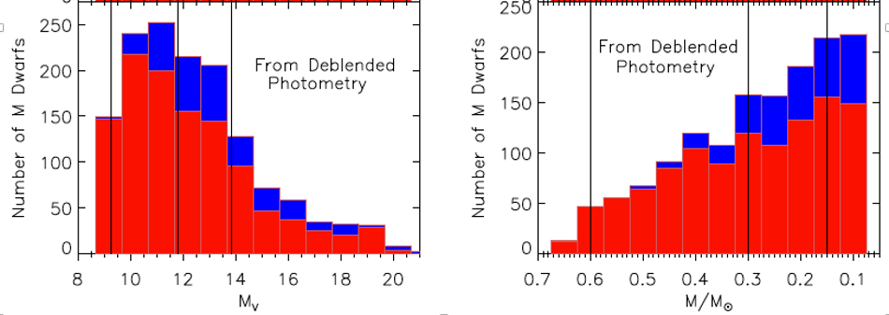
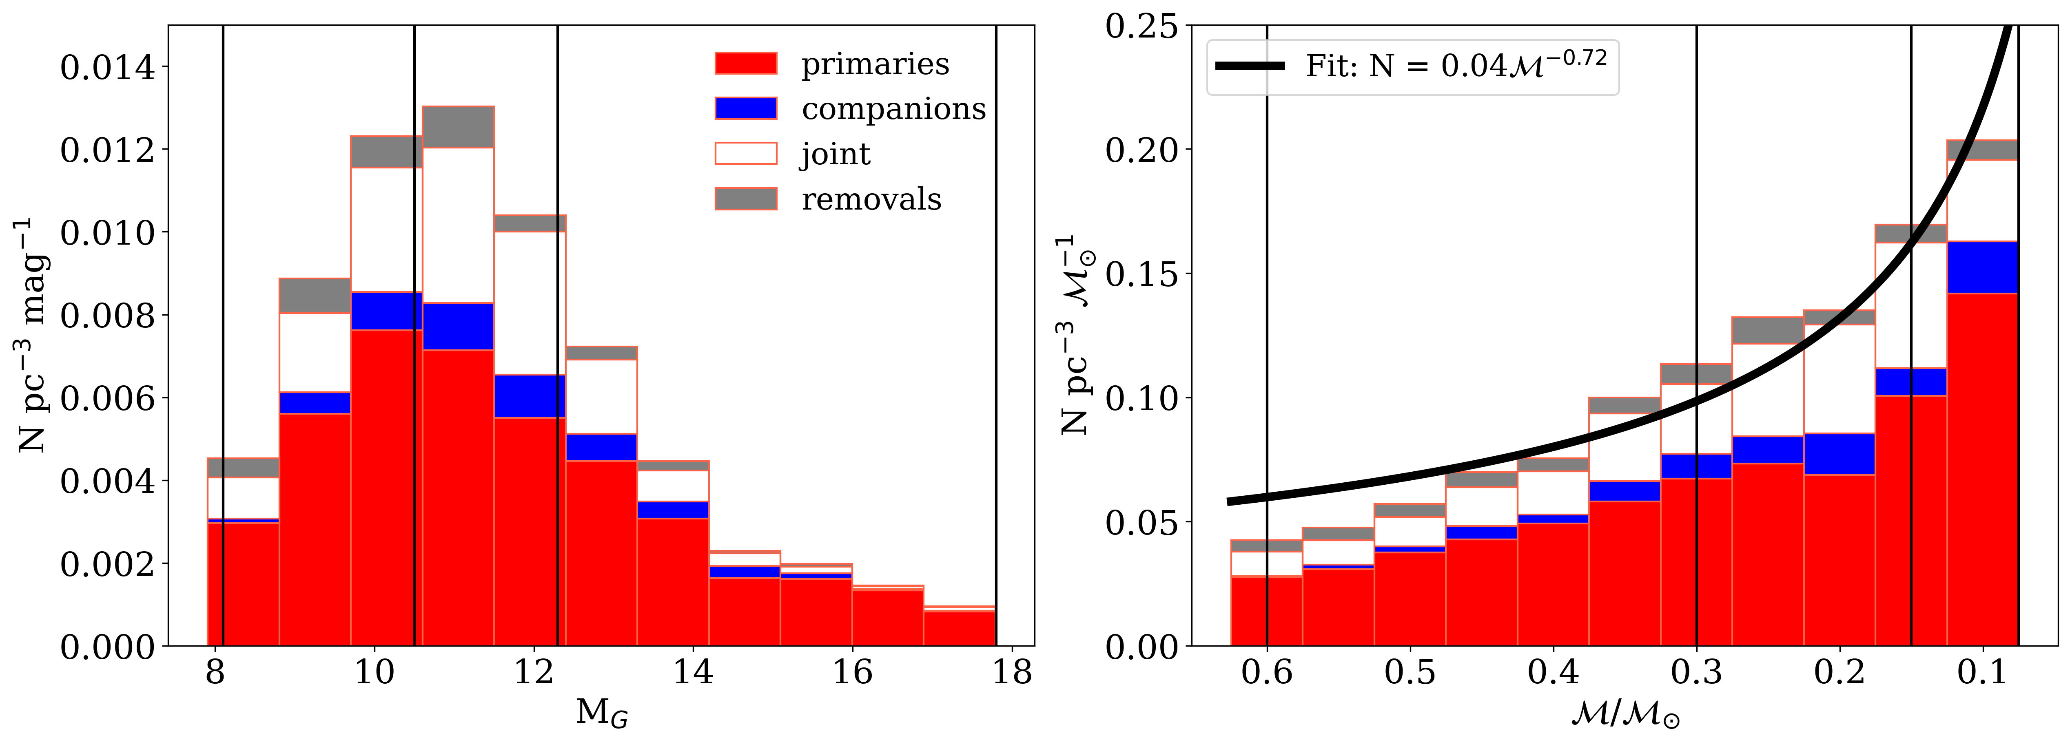
Smallest Stars
Winters+ (2019)
LeBlanc+ (2026)

Slide 41
Stellar Limits Large and Small
Largest MS Star
10⁷ L
53000 K
O2-3V
WN5h
Wolf-Rayet
N+H emission
315 M
40 R
Smallest MS Star
10⁻⁴ L
2000 K
M9.5V
L2.5V
0.075 M
0.085 R
Luminosity
Temperature
(Spectral Type)
Mass
Radius

Slide 42
Dwarfs
WN
L
O
M
X
X
27 ± 0.6 M
or
116 ± 31 M
or
315 ± 60 M
0.075 M
What about other characteristics?

Slide 43

Stellar Populations
5 Characteristics
mass
age
composition
magnetism
rotation/convection
…
temperature
luminosity class
evolutionary state
…
(multiplicity)

Slide 45
Galactic Explorers 2
1. Positions on the HR diagram are set primarily by mass, composition, and age, all discussed via HR diagrams in the paper. Name ONE other characteristic of stars that may shift their positions.
2. Several categories of objects NOT on the main sequence are discussed. Other than white dwarfs, name TWO.
3. At worst, what is the uncertainty on parallax adopted by the authors for acceptable stars for the HR diagrams?
0.1%, 1%, 5%, 10%
4. To what distance within the local bubble is extinction stated to be “almost negligible” (Lallement+ 2003)?
10 pc, 60 pc, 100 pc, 300 pc
5. What are the red stars ~1 magnitude below the main sequence called?
6. About how many brown dwarfs are there in Gaia DR2 with parallaxes better than 10% (and shown in plots)?
50, 500, 5000, 50000
7. What is the explanation given for the two white dwarf sequences?
8. What is the explanation given for the two main sequences in the halo star sample?
9. (see Figure)
10. (see Figure)
BONUS …

Slide 46
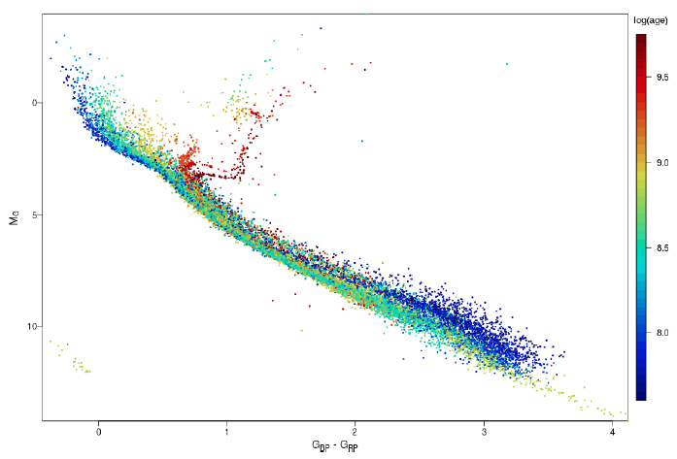
#9.
Why don’t these parts of the
main sequences overlap?

Slide 47
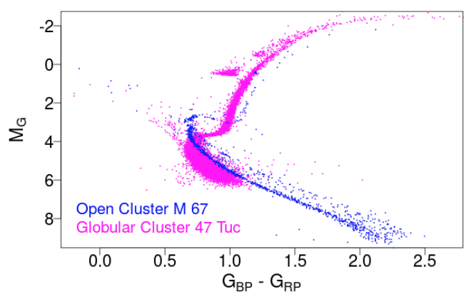
#10.
What is this group of stars?

Slide 48
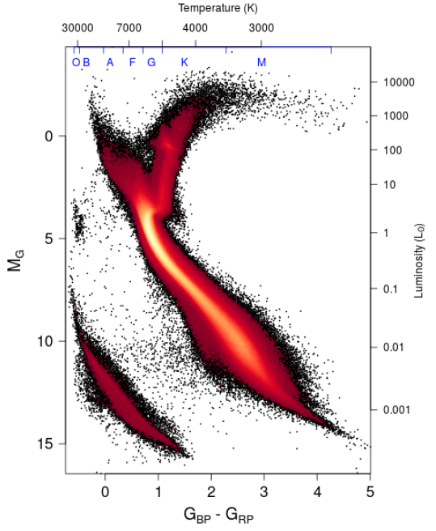
BONUS #1 and #2
B1: What are these stars called?
B2: What ARE they?
Notes:
Red clump stellar properties vary depending on their metallicities, but typically have early K spectral types and T~5000 K. There is a considerable spread in the properties of red clump stars even within a single population of similar stars such as an open cluster, due to variations in temperatures and luminosities of horizontal branch stars when they form and as they evolve. Although red clump stars are generally hotter than red-giant-branch stars, the two regions overlap and the status of individual stars can only be assigned with a detailed chemical abundance study.

Slide 49

Galactic Explorers 2

Slide 50
Galactic Explorers 2
1. Positions on the HR diagram are set primarily by mass, composition, and age, all discussed via HR diagrams in the paper. Name ONE other characteristic of stars that may shift their positions.
magnetic field, rotation, winds/mass loss, convection/overshooting, unresolved multiplicity
2. Several categories of objects NOT on the main sequence are discussed. Other than white dwarfs, name TWO.
hot subdwarfs, post-AGB stars, planetary nebulae stars, cool subdwarfs, brown dwarfs
3. At worst, what is the uncertainty on parallax adopted by the authors for acceptable stars for the HR diagrams?
0.1%, 1%, 5%, 10%
4. To what distance within the local bubble is extinction stated to be “almost negligible” (Lallement+ 2003)?
10 pc, 60 pc, 100 pc, 300 pc
5. What are the red stars ~1 magnitude below the main sequence called?
cool subdwarfs
6. About how many brown dwarfs are there in Gaia DR2 with parallaxes better than 10% (and shown in plots)?
50, 500, 5000, 50000
7. What is the explanation given for the two white dwarf sequences?
hydrogen vs. helium white dwarfs
8. What is the explanation given for the two main sequences in the halo star sample?
different metallicities of -0.5 and -1.3
9. (see Figure)
10. (see Figure)
BONUS …

Slide 51
#9.
Why don’t these parts of the
main sequences overlap?
red dwarfs not yet on main
sequence in younger clusters

Slide 52
#10.
What is this group of stars?
sequence of multiples

Slide 53
BONUS #1 and #2
B1: What are these stars called?
“red clump” stars
B2: What ARE they?
red giants on horizontal branch
Notes:
Red clump stellar properties vary depending on their metallicities, but typically have early K spectral types and T~5000 K. There is a considerable spread in the properties of red clump stars even within a single population of similar stars such as an open cluster, due to variations in temperatures and luminosities of horizontal branch stars when they form and as they evolve. Although red clump stars are generally hotter than red-giant-branch stars, the two regions overlap and the status of individual stars can only be assigned with a detailed chemical abundance study.

