Slide 1
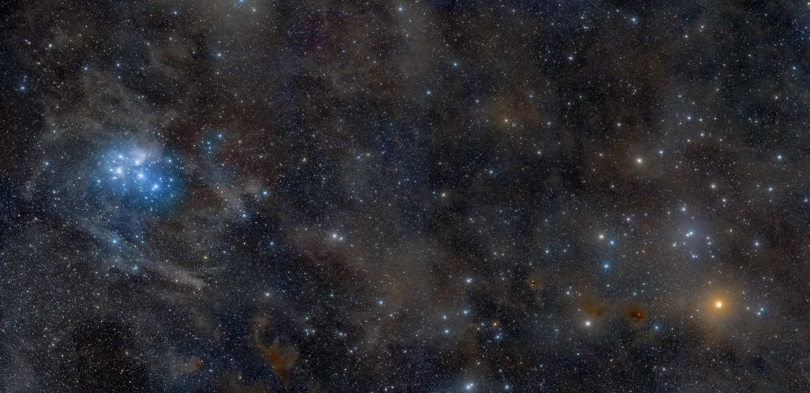
Milky Way Disk: Clusters I
image: Rogelio Bernal Andreo
Notes:
Aldebaran at 20 pc, Hyades at 47 pc

Slide 2
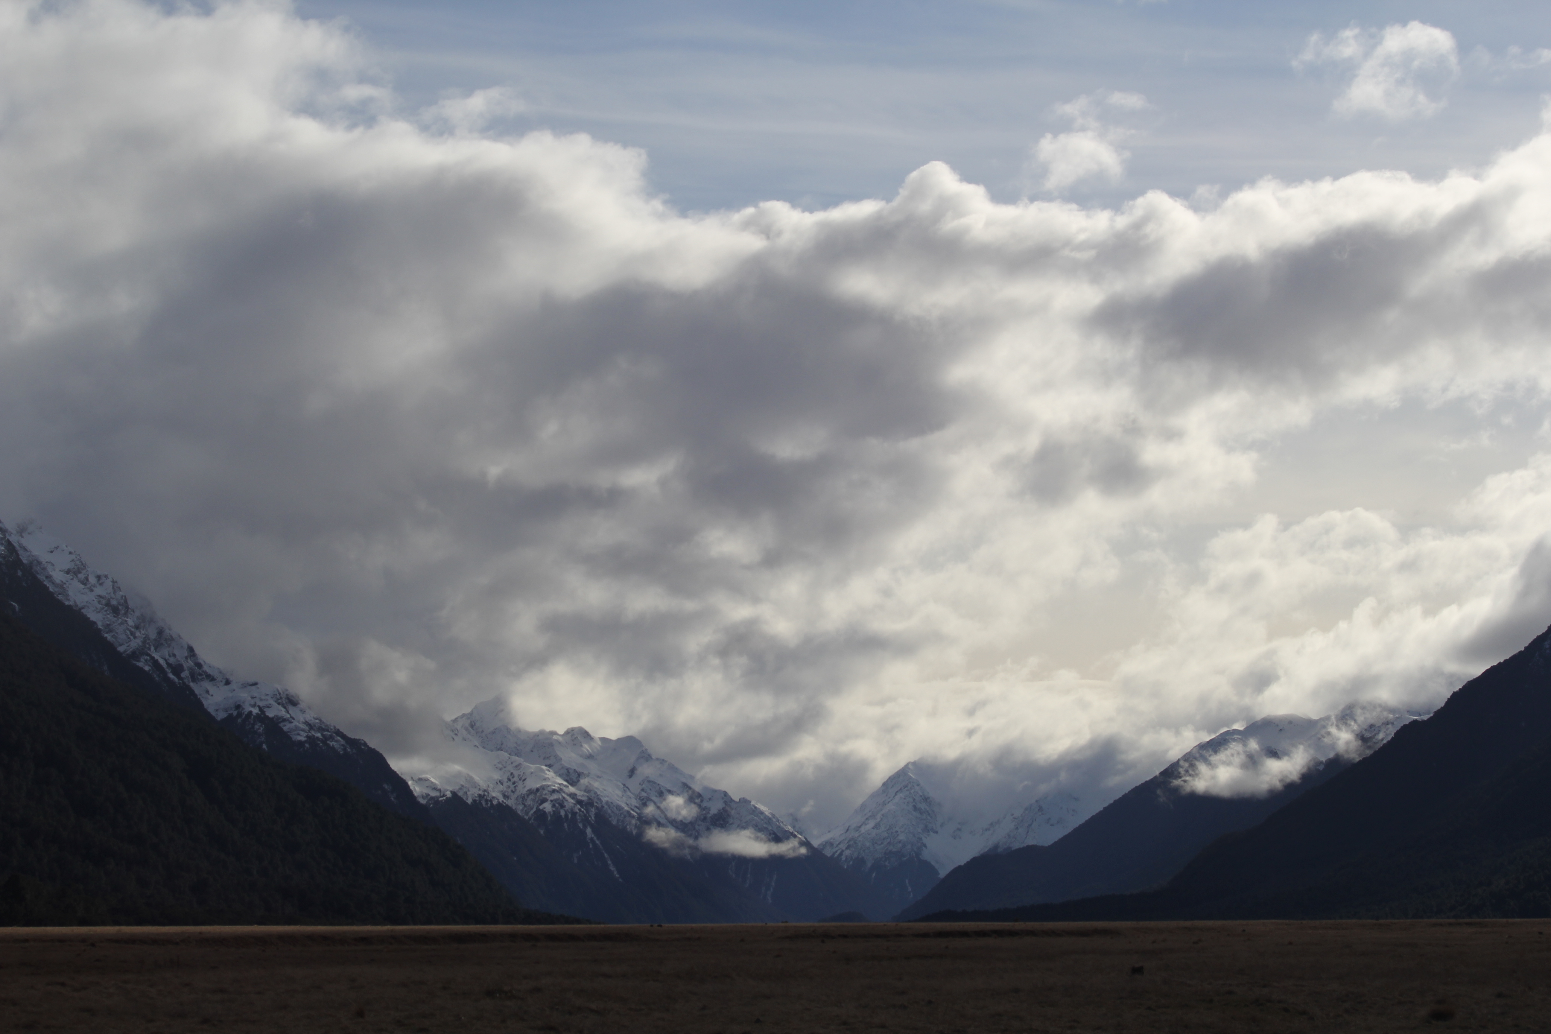


Assignments
http://www.astro.gsu.edu/~thenry/GALACTIC/
Tuesday 17 FEB Proposal Level 1 --- OUTLINE --- 2 pages
Page 1: Title/Name/Intellectual Merit/Broader Impacts
IM (Abstract) and BI have a few sentences each
Page 2: Introduction has a few sentences (3+ refs)
Sections, Tables, Figures listed

Slide 3
Dwarfs
WN
L
O
M
X
X
27 ± 0.6 M
or
116 ± 31 M
or
315 ± 60 M
0.075 M
What about other characteristics?

Slide 4
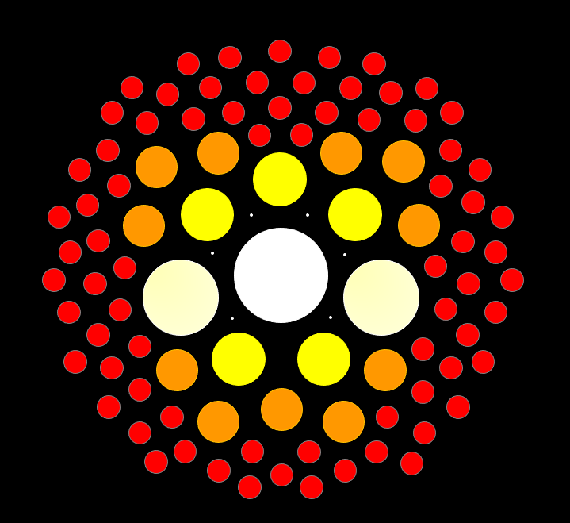
Stellar Populations
5 Characteristics
mass
age
composition
magnetism
rotation/convection
…
temperature
luminosity class
evolutionary state
…
(multiplicity)

Slide 5
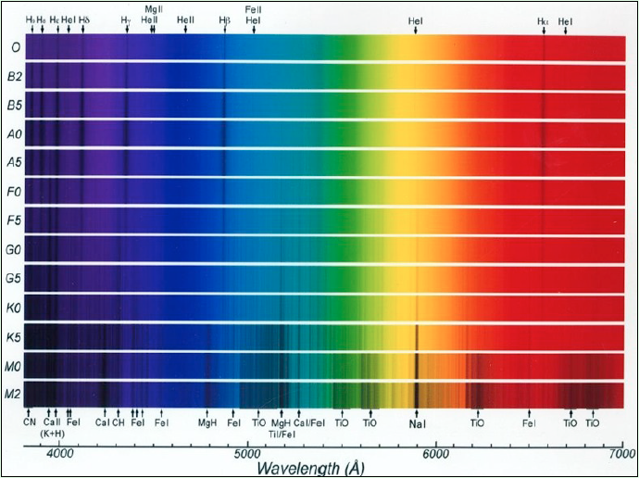
Temperature Sets Spectral Type
letter sequence defined by atomic H strength

Slide 6
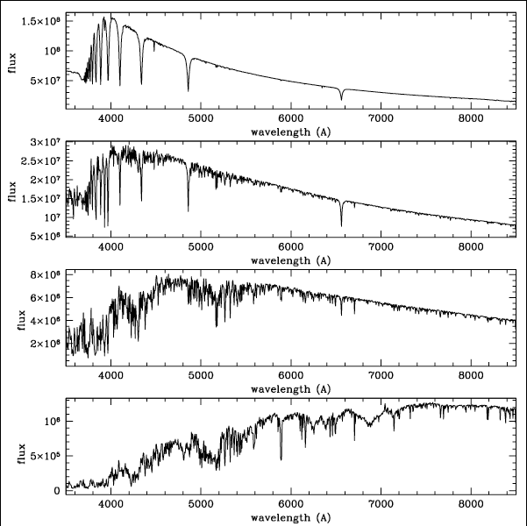

Features+Peak yield Temperature
A
7500 K
What are the stars’
temperatures?
F
6900 K
G
6000 K
M
3800 K
Notes:
Ha, Hb … TiO

Slide 7
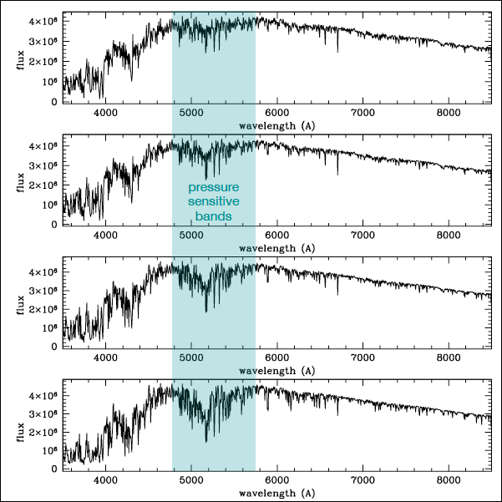
Line Widths yield Luminosity Class
G I
G III
Mg I b
triplet
5167A
5172A
5183A
pressure
sensitive
G IV
G V
Notes:
Mg I triplet at 847.6, 855.7, 871.0 nm
Gaia RVS uses 845-872 nm window with Ca and Fe lines --- off the edge

Slide 8
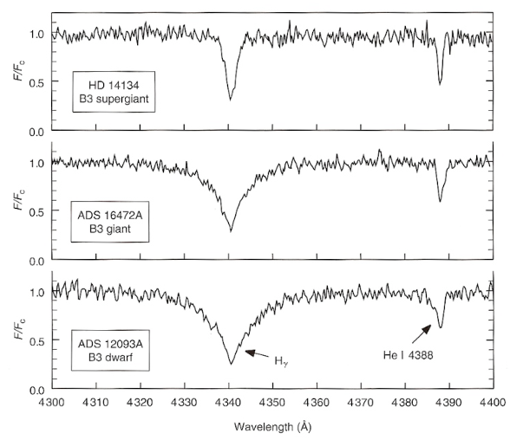
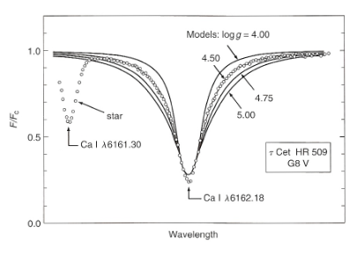

Line Widths yield Luminosity Class
B stars
H$γ+He I$
G stars
Ca I
Pettini: Structure and Evolution of Stars
Notes:
Mg I triplet at 847.6, 855.7, 871.0 nm
Gaia RVS uses 845-872 nm window with Ca and Fe lines --- off the edge

Slide 9
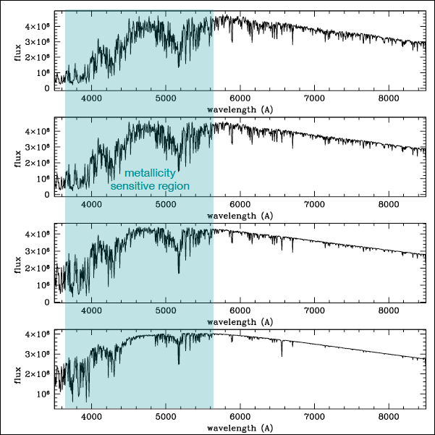
Line Features yield Metallicity
G high Z
Fe I, Ca II,
+
Mg I b
triplet
for metallicities
G low Z

Slide 10
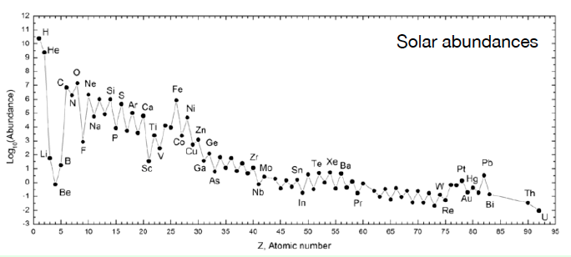
Metallicity
[Fe/H] ≡ log₁₀{n(Fe) / n(H)}_{star} − log₁₀{n(Fe) / n(H)}_{Sun}
we measure other elements BY # ATOMS relative to iron and compare them to the Sun:
[O/Fe] ≡ log₁₀{n(O) / n(Fe)}_{star} − log₁₀{n(O) / n(Fe)}_{Sun}
we define abundance fractions BY MASS using
X = hydrogen … Y = helium … Z = everything else
Sun (X,Y, Z) = 0.70, 0.28, 0.02

Slide 11
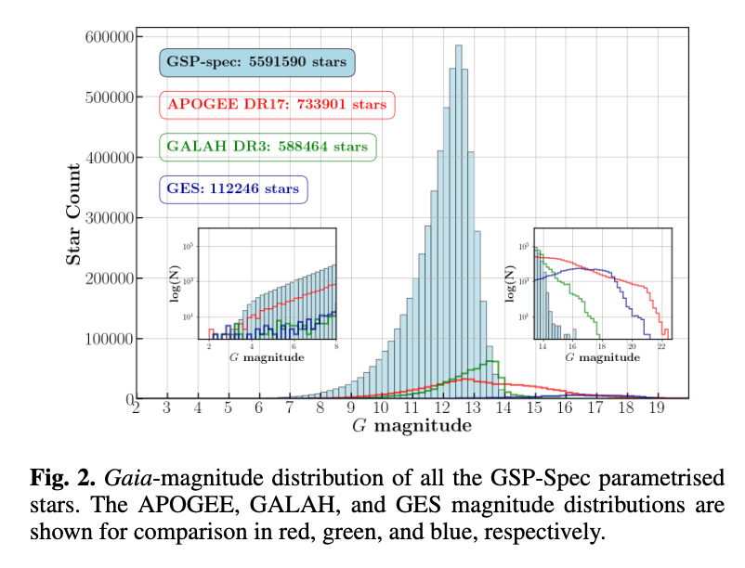
Metallicity via GDR3
Gaia
RVS
spectra
(GSP-spec
is a widget)
Recio-Blanco+ 2022

Slide 12
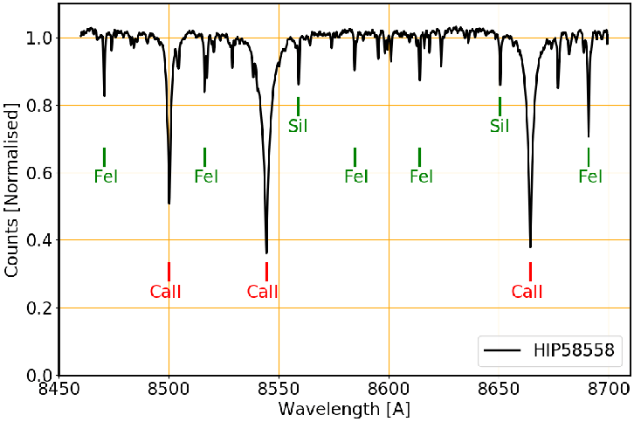
Metallicity via GDR3
Gaia RVS uses 845-872 nm window with Ca and Fe lines
Katz+ 2019

Slide 13
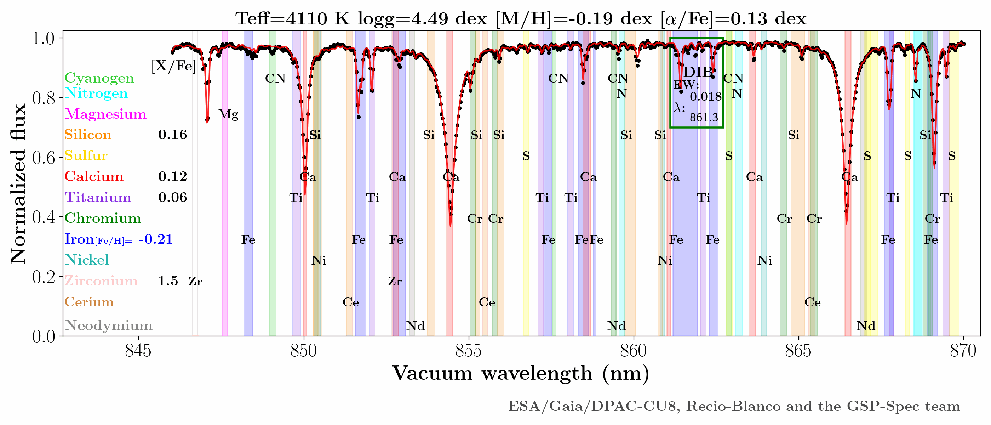
Metallicity via GDR3
https://www.cosmos.esa.int/web/gaia/iow_20210709

Slide 14
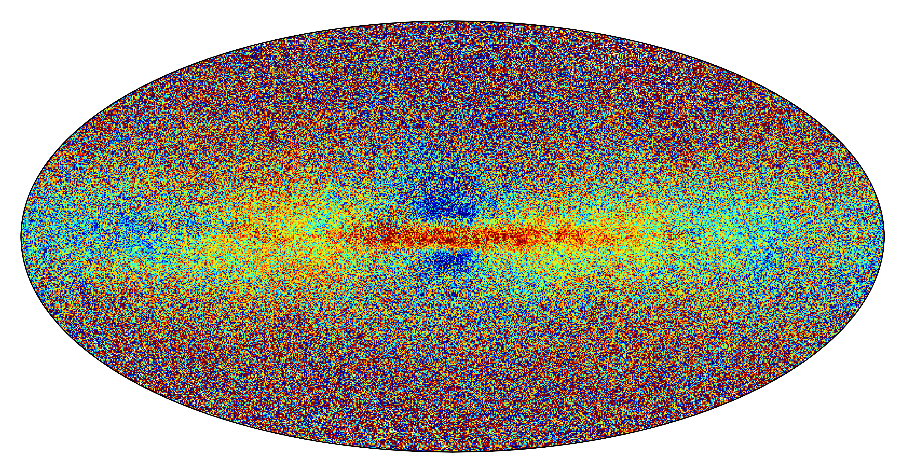
Metallicity via GDR3
Recio-Blanco+ 2022
5.6 million stars with RVS spectra
red = high metals … blue = low metals

Slide 15
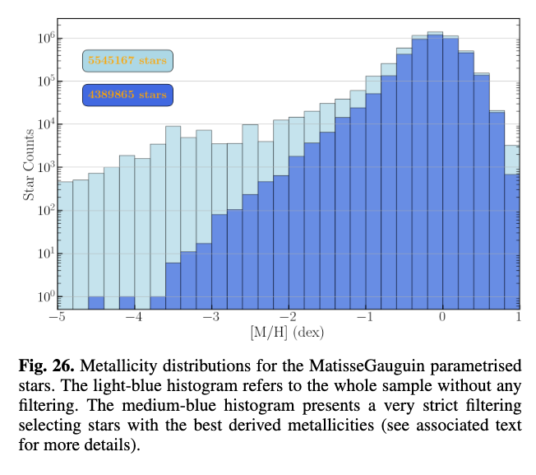
Metallicity via GDR3
Recio-Blanco+ 2022

Slide 16
Milky Way Disk: Clusters
X
brightest *
B stars
brightest *
A/G/K giants
Hyades
47 pc (#1)
700 Myr
N ~ 700 within 30 pc of center
[Fe/H] = 0.05 to 0.14
image: Rogelio Bernal Andreo
Pleiades (M45)
135 pc (#2)
120 Myr
N ~ 850
[Fe/H] = 0.03 to 0.04
Notes:
Aldebaran K5III at 20 pc (1 of 24 giants within 25 pc), Hyades at 47 pc

Slide 17
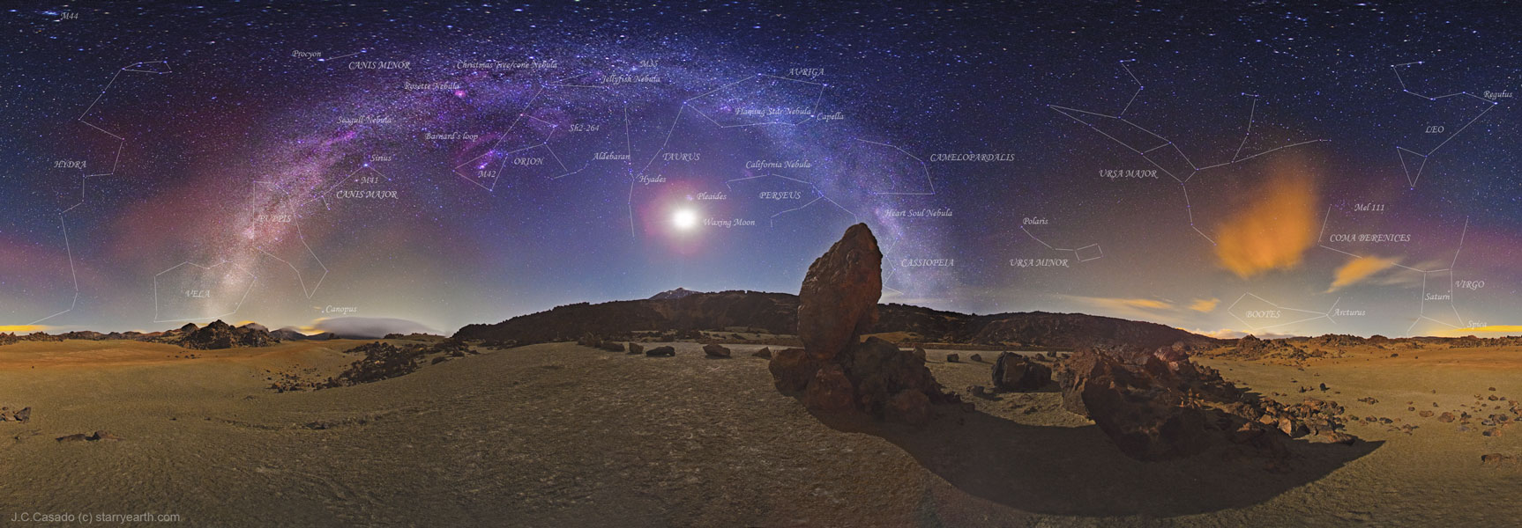
Coordinates
(200, −9)
Betelgeuse
(163, +4)
Capella
(227, −9)
Sirius
(123, +26)
Polaris
Hyades (180, −22)
Pleiades (167, −24)
image: Juan Carlos Casado
Galactic longitude, latitude = (l, b)
Galactic Center = (0,0)

Slide 18
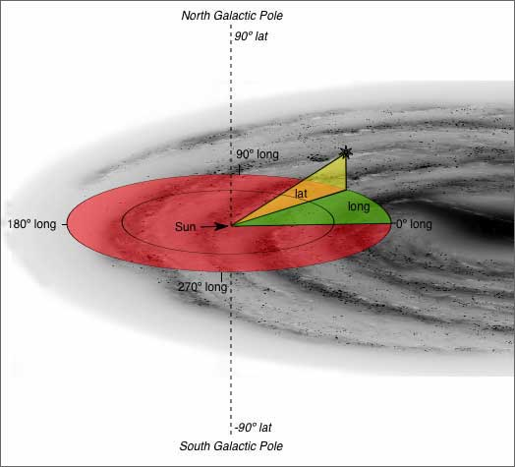
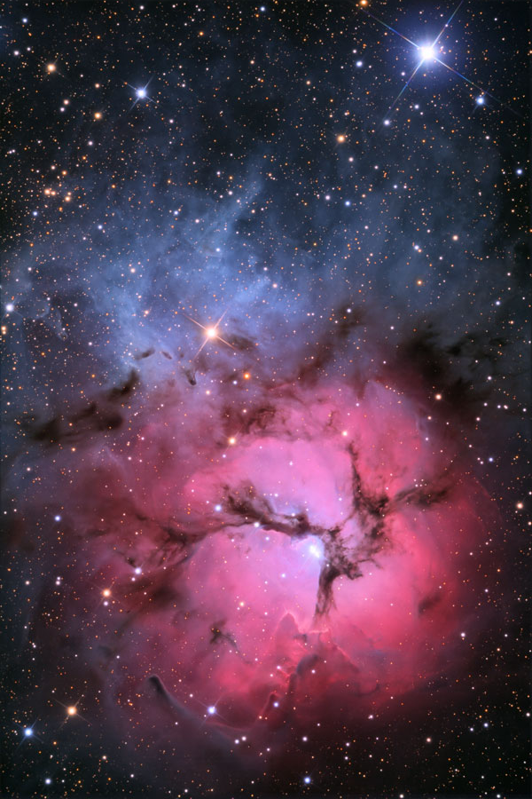
Galactic Coordinates
. .
Hyades
(180, −22)
M20
Trifid Nebula
(7,0)
Notes:
Hyades dot on top of Sun, but Trifid about right at 1.3 kpc in Scutum arm

Slide 19
Hyades Movies
Hyades cluster: https://www.youtube.com/watch?v=FS1mpR7jSEw&feature=emb_logo
Hyades tails: https://www.youtube.com/watch?v=Wqqj2T6ox70&feature=emb_logo
Hyades mass segregation: https://www.dropbox.com/s/19m4q08eenkzq8z/animation_Hyades_30pc.mp4
Notes:
Aldebaran K5 III at 20.0 pc, not in Hyades … 14th nearest giant … Pollux K0 III is nearest at 10.4 pc … Arcturus K1.5 III is 2nd at 11.3 pc
Hyades in a box: note mass segregation
green = white dwarfs
red = brown dwarfs

Slide 20
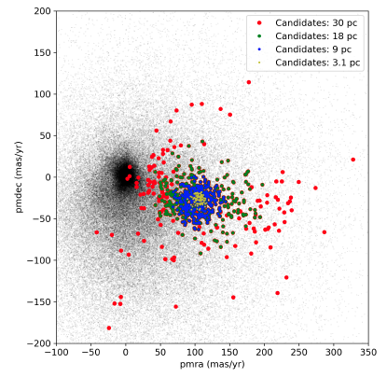
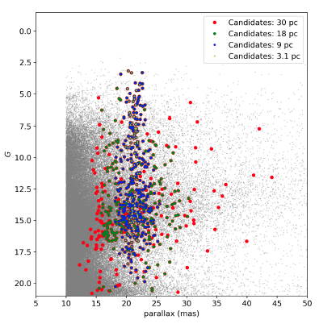
Hyades Membership
selection by
proper motion
selection by
parallax
Lodieu+ (2019)

Slide 21
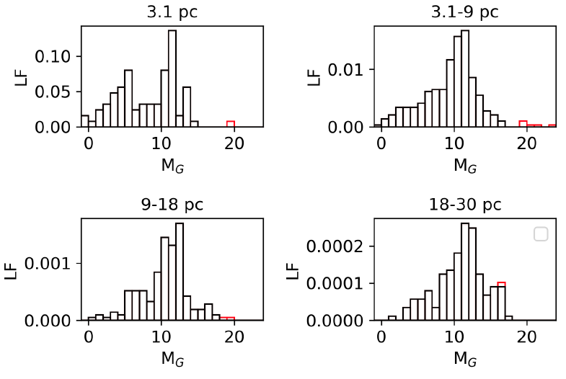
Hyades LF
Lodieu+ (2019)
Notes:
red blips are brown dwarfs

Slide 22
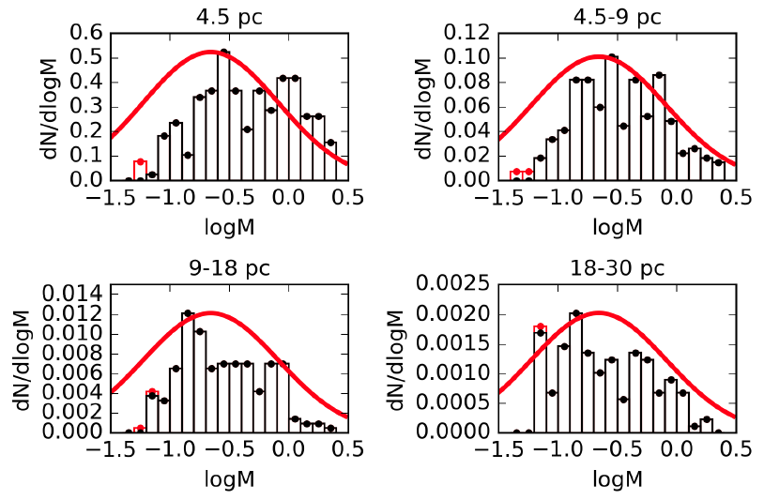
Hyades MF
85 dots 61 M 381 218 M
568 292 M 710 343 M
not corrected for multiples
0.72 0.57
0.51 0.48
mass/dot
. .
Lodieu+ (2019)
Notes:
4.5 pc should be 3.1 pc … Fig from preprint, so erroneous?
red blips are brown dwarfs
blue numbers are masses/dot … not corrected for multiples

Slide 23
Hyades Membership
from Wikipedia:
The Hyades' cohort of lower-mass stars – spectral types K and M – remains poorly understood, despite proximity and long observation. At least 48 K dwarfs are confirmed members, along with about a dozen M dwarfs of spectral types M0-M2. Additional M dwarfs have been proposed, but few are later than M3, and only about 12 brown dwarfs are currently reported. This deficiency at the bottom of the mass range contrasts strongly with the distribution of stars within 10 parsecs of the Solar System, where at least 239 M dwarfs are known, comprising about 76% of all neighborhood stars.
Membership for ANY star cluster
is highly suspect at lower masses.

Slide 24
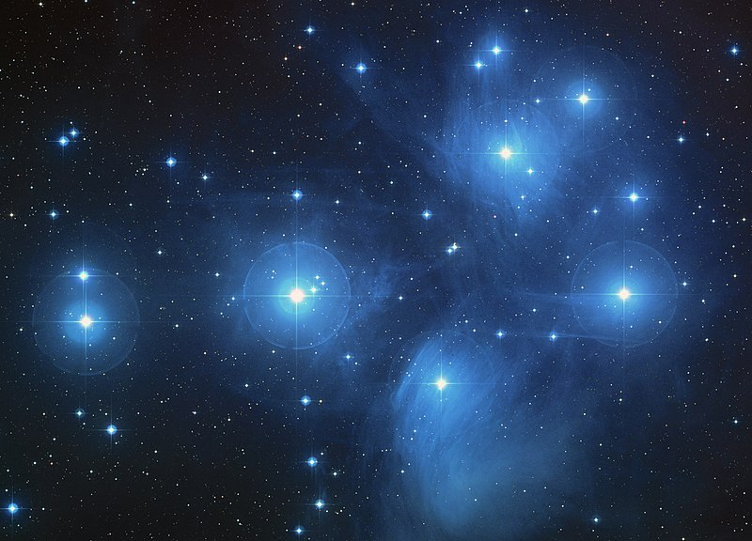
~ 1 pc
Notes:
B stars
stars passing through ISM, not leftover material

Slide 25
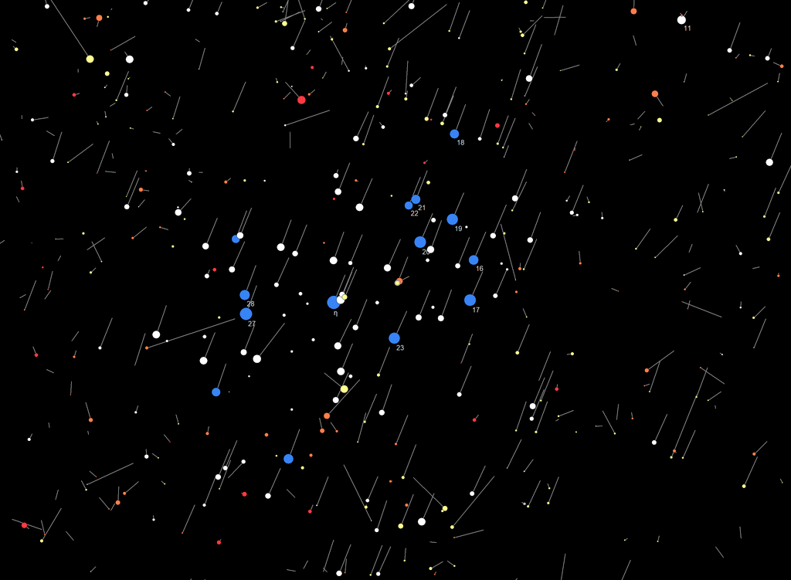
Pleiades
10000 yr of
backwards
proper motion

Slide 26
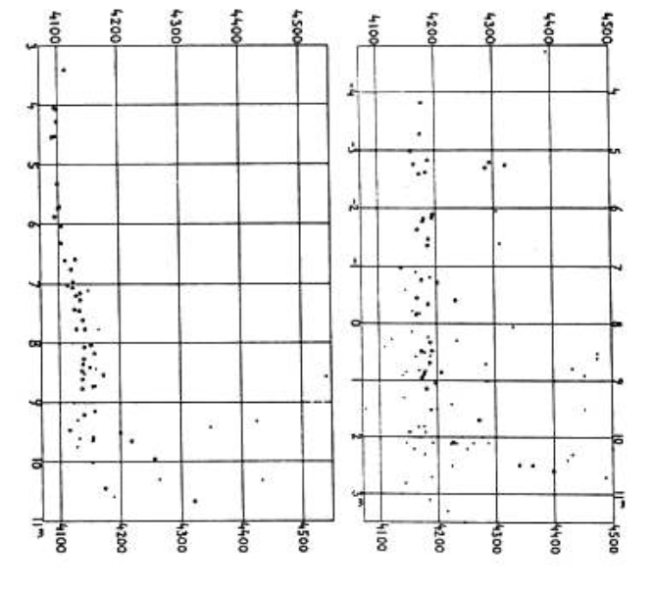
Pleiades + Hyades by Hertzsprung
horizontal axis = peak wavelengths ~ spectral types
Hertzsprung (1911)
Notes:
The first published Hertzsprung–Russell (H–R) diagrams of the Pleiades and Hyades clusters (left and middle; Hertzsprung 1911). Plotted on the vertical axis are the magnitudes (e.g., more luminous stars are at the top) and on the horizontal axis are the peak wavelengths or spectral types of the stars (e.g., hotter, bluer stars towards the left).

Slide 27
Pleiades
10000 yr of
backwards
proper motion
~1000 members
> 6 pc
tidal radius = 13 pc
distance from center cluster at which the external gravitation of the galaxy has more influence members in the cluster than the cluster
~ 1 pc

Slide 28
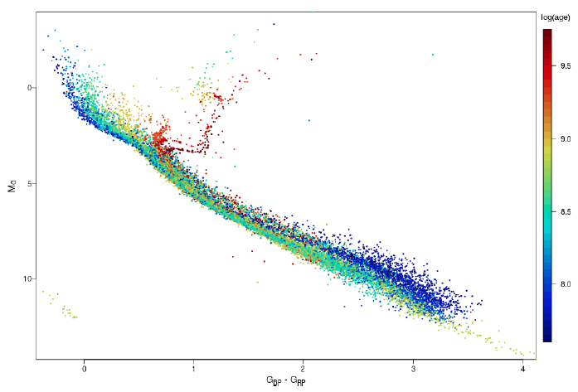
Pleiades + Hyades
32 open clusters in Gaia
Hyades
~ 8.90
Pleiades
~ 8.04
M0
M3
M5
GC/Babusiaux+ (2018)

