Slide 1
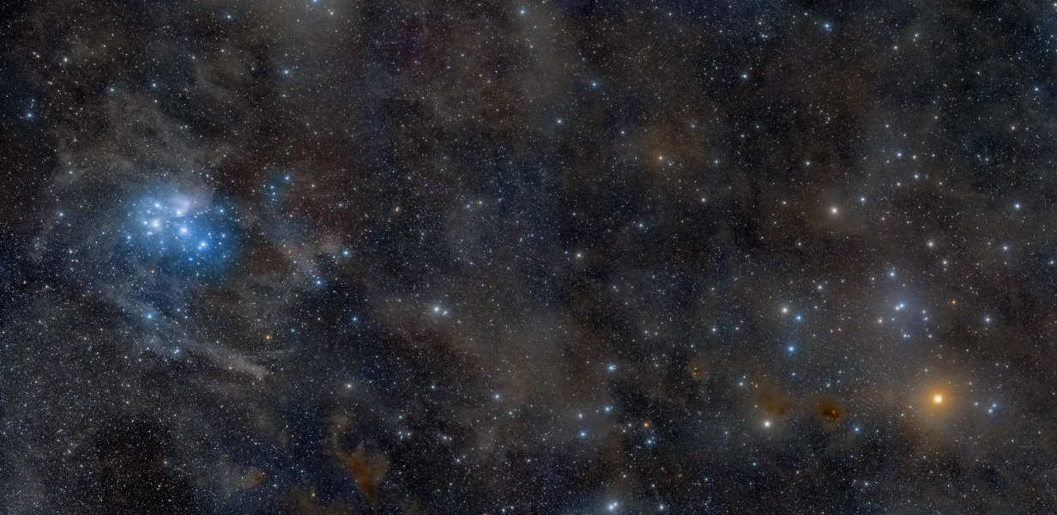
Milky Way Disk: Clusters II
image: Rogelio Bernal Andreo
Notes:
Aldebaran at 20 pc, Hyades at 47 pc

Slide 2
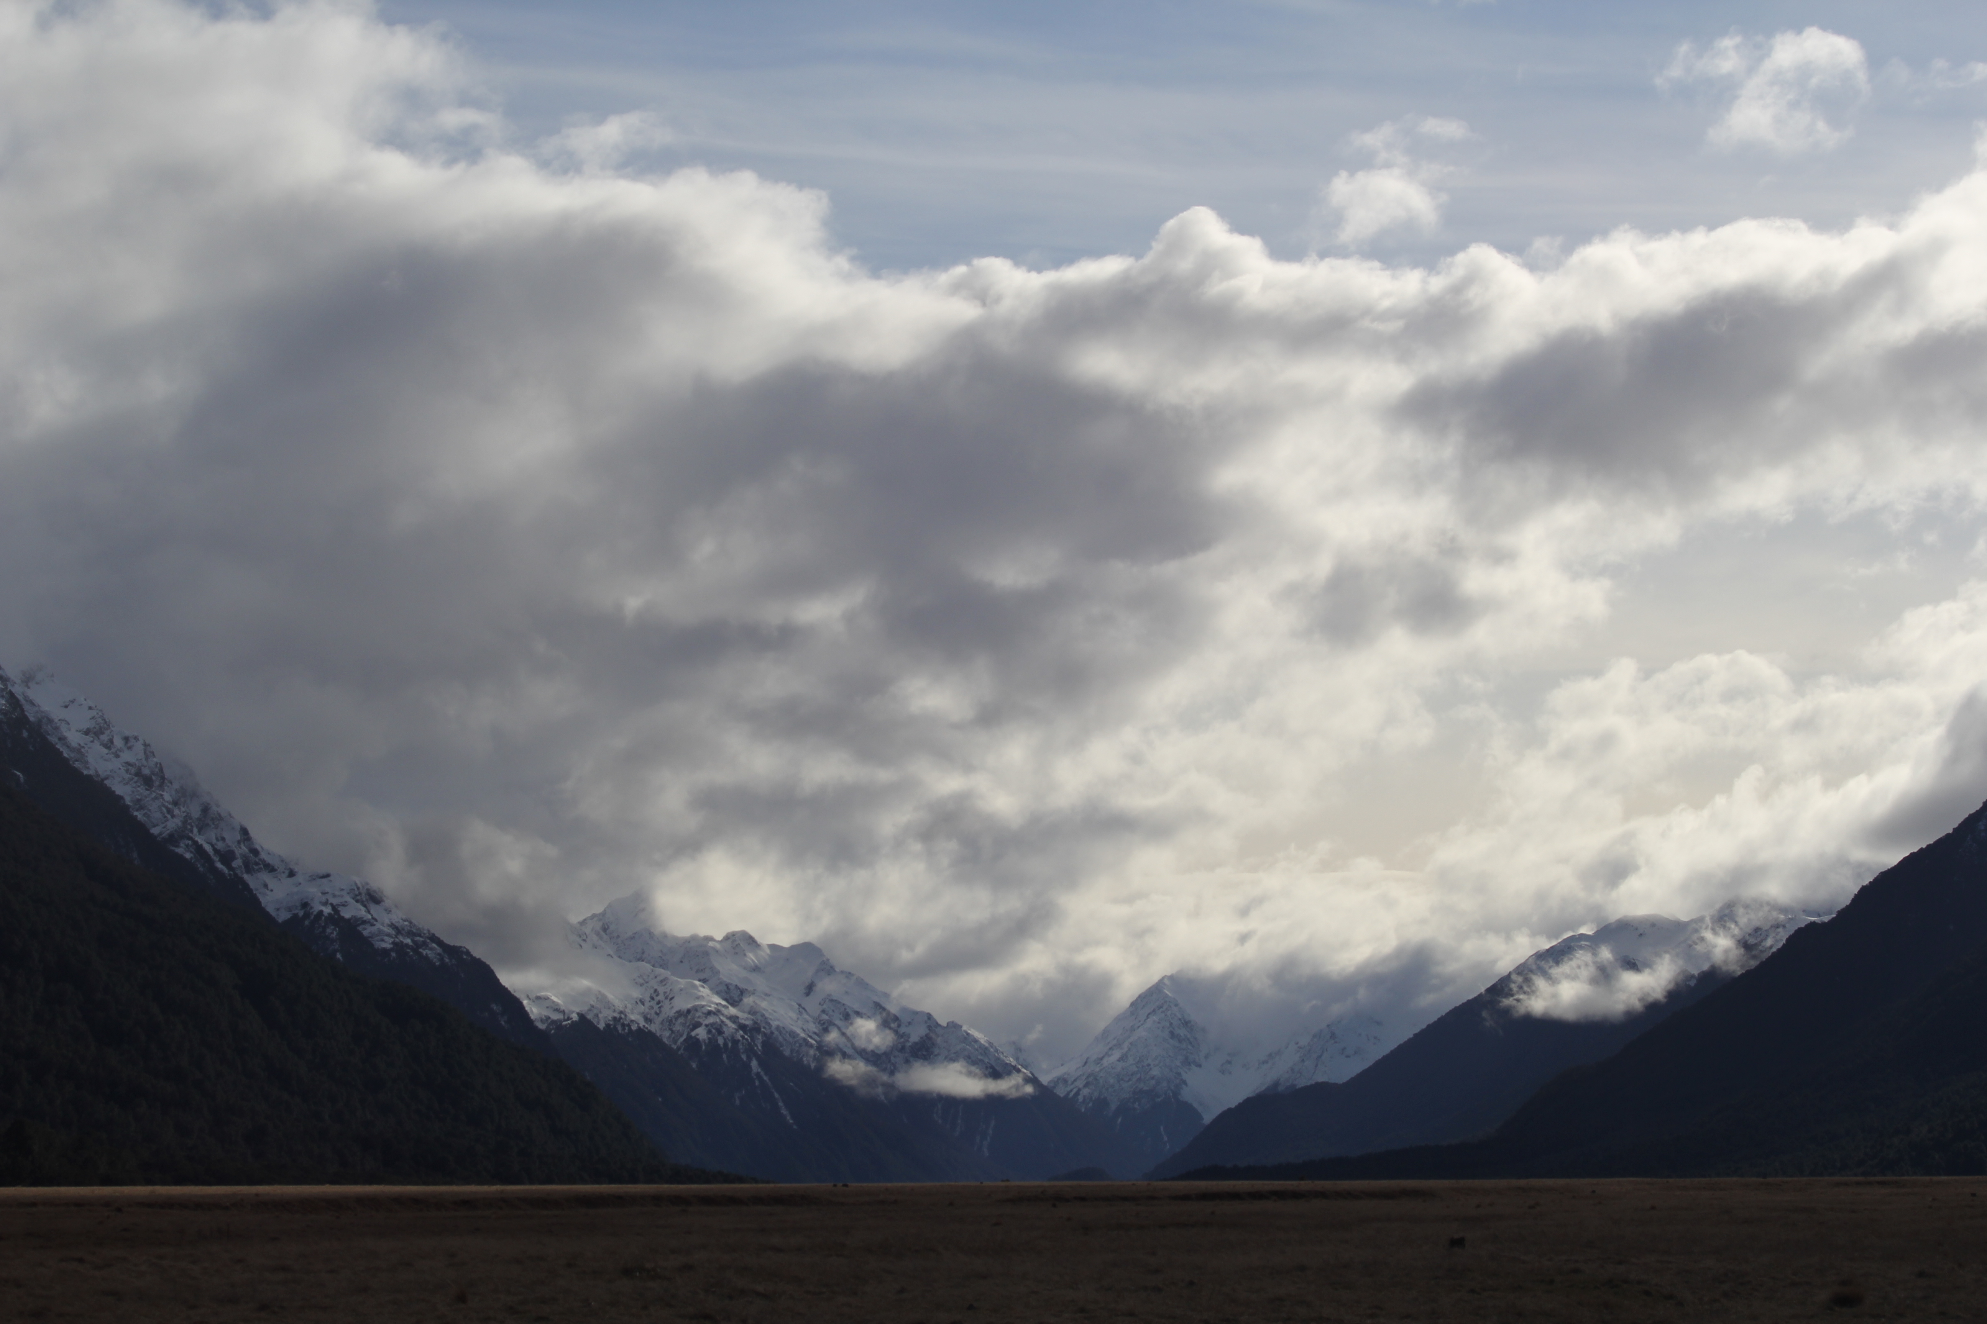


Assignments
Tuesday 03 FEB Level 0 … Ideas
Tuesday 10 FEB Bio Sketch
Tuesday 17 FEB Level 1 … Outline … 2 weeks later
Thursday 19 FEB Milky Way Neighborhood
Tuesday 03 MAR Level 2 … 1st Draft … 2 weeks later
Tuesday 24 MAR Level 3 … 2nd Draft … 3 weeks later
Tue/Thu 14/16 APR Presentations … 3 weeks later
Thursday 23 APR Level 4 … submit … 1 week later

Slide 3
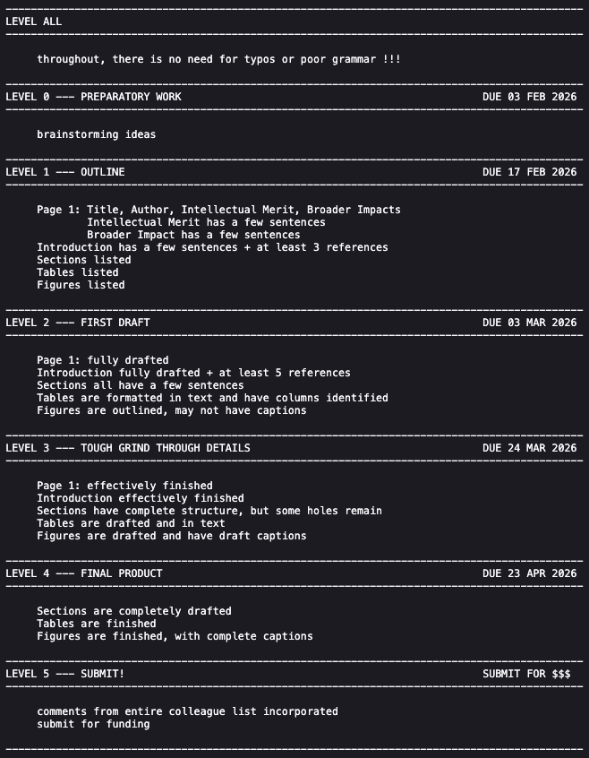
Notes:
Aldebaran at 20 pc, Hyades at 47 pc

Slide 4
Milky Way Disk: Clusters II
image: Rogelio Bernal Andreo
Notes:
Aldebaran at 20 pc, Hyades at 47 pc

Slide 5
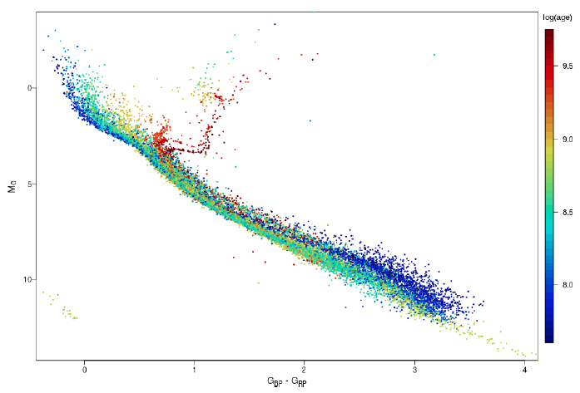
Pleiades + Hyades
32 open clusters in Gaia
Hyades
~ 8.90
Pleiades
~ 8.04
A0
M0
M3
M5
GC/Babusiaux+ (2018)

Slide 6
Open Clusters
HOW MANY
1610: Galileo in Sidereus Nuncius
“the galaxy is nothing else but a mass of innumerable stars planted together in clusters”
1771: Messier had 26 open clusters
2020: ~ 2000 known in Milky Way … and 2000 more?
LABORATORIES
SAME DIFFERENT
age masses
metallicity evolutionary states
proper motions/RVs
distance/extinction
ATTRIBUTES
form via Giant Molecular Clouds … > 100,000 M… ~1000 in spiral
typical cluster output ~few hundred M
~ 10% efficiency rate of material conversion to stars
disrupted by GMCs, other clusters, themselves … old open clusters rare
Notes:
range of molecular cloud masses and cluster output … giants are enormous

Slide 7
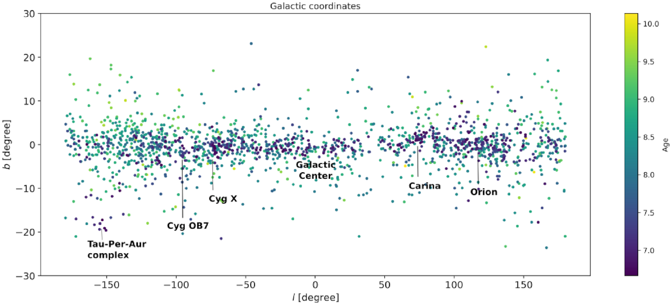
Open Clusters
RESOURCES
1. WEBDA = Mermilliod et al. (last update SEP 2013)
https://webda.physics.muni.cz
2. DAML02 / OPENCLUST = Dias et al.
https://heasarc.gsfc.nasa.gov/W3Browse/all/openclust.html (last update SEP 2024)
JUN 2021 Gaia DR2 update … 1743 open clusters
https://academic.oup.com/mnras/article/504/1/356/6209133

Slide 8
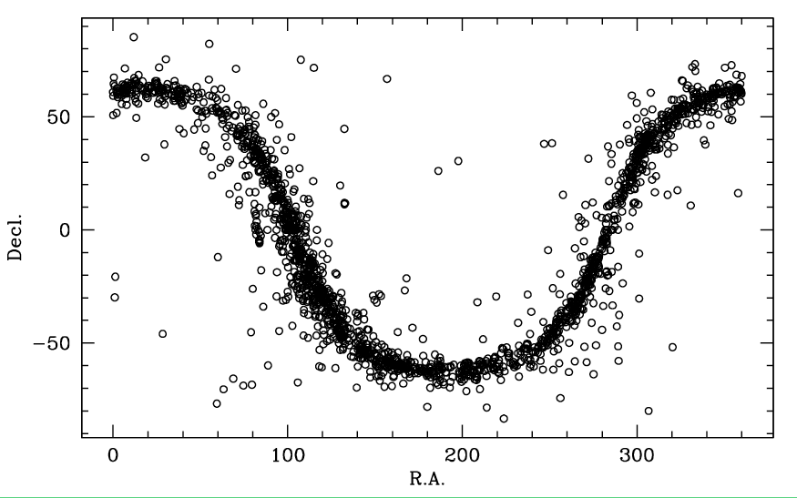
Open Clusters in MW Disk
gap
near
Altair
GC
Notes:
circle is Galactic Center at RA 17^{h} 45^{m} 40^{s} DEC −29° 00′ 28
no particular reason for gap near Altair … as far as I know

Slide 9
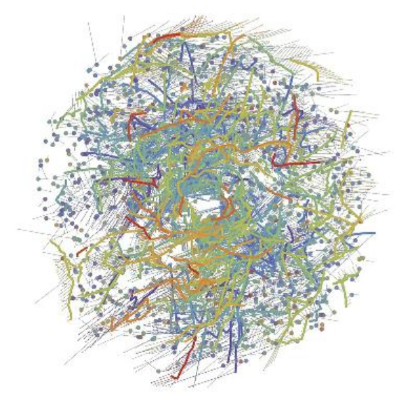
Gaia Clusters + Moving Groups
dots stellar clusters
lines comoving groups
dashed 5 Myr trajectories
(gap is artefact)
purple oldest … 1 Gyr
red youngest … < 100 Myr
1312 clusters/associations/groups
328 strings
1 kpc
Kounkel & Covey (2019)
Notes:
This diagram shows a face-on view of stellar ‘families’ – clusters (dots) and co-moving groups (thick lines) of stars – within about 3000 light-years from the Sun, which is located at the center of the image. The diagram is based on data from the second data release of ESA’s Gaia mission. Each family is identified with a different color and comprises a population of stars that formed at the same time. Purple hues represent the oldest stellar populations, which formed around 1 billion years ago; blue and green hues represent intermediate ages, with stars that formed hundreds of millions of years ago; orange and red hues show the youngest stellar populations, which formed less than a hundred million years ago. Thin lines show the predicted velocities of each group of stars over the next 5 million years, based on Gaia’s measurements. The lack of structures at the center is an artefact of the method used to trace individual populations, not due to a physical bubble. Image credit: M. Kounkel & K. Covey (2019)

Slide 10
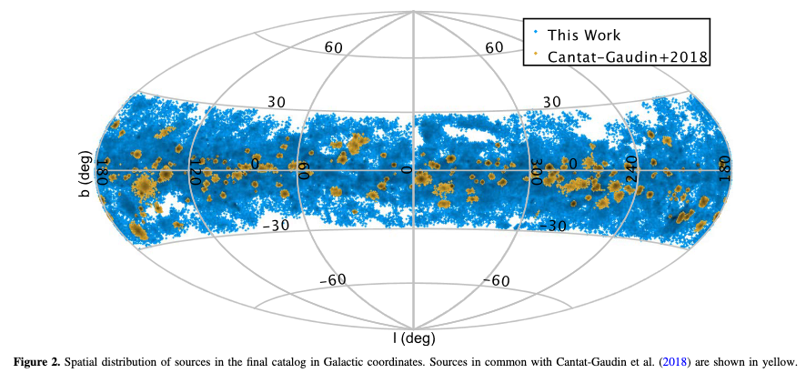
Open Clusters in MW Disk
Kounkel & Covey (2019)

Slide 11
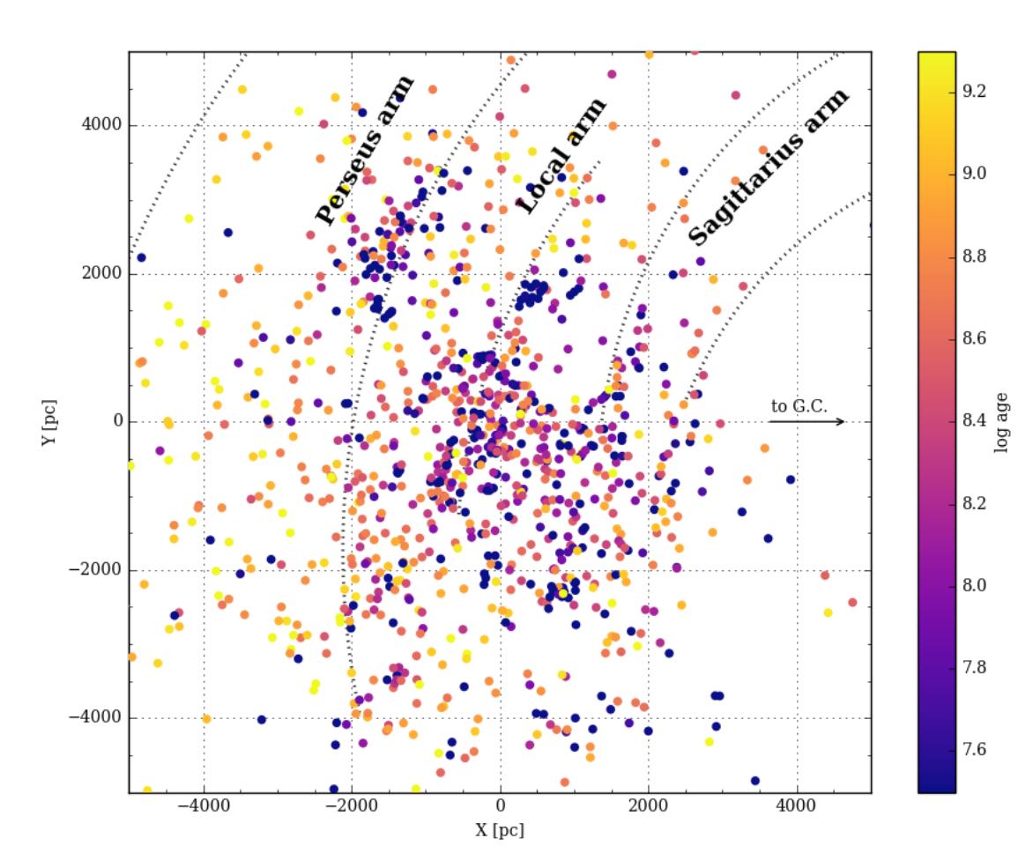
Open Clusters in MW Disk
from Gaia DR2
1229 open clusters … 60 new
Cantat-Gaudin (2018)
Notes:
They do a “fit” to see if there is spiral structure, but it’s not very convincing.

Slide 12
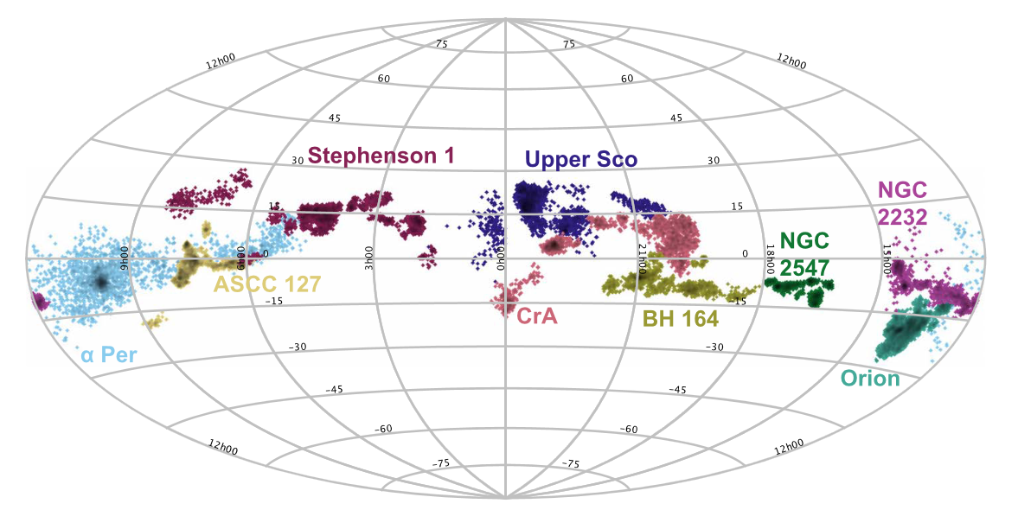
Open Clusters in MW Disk
130 pc
11 Myr
170 pc
50-70 Myr
400 pc
2 Myr
Kounkel & Covey (2019)

Slide 13
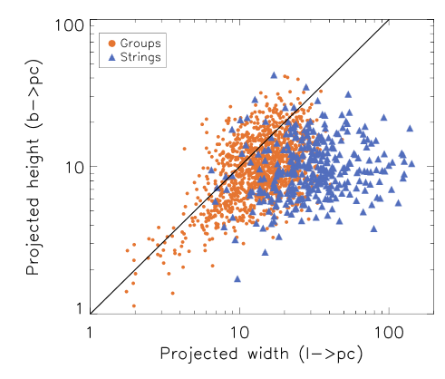
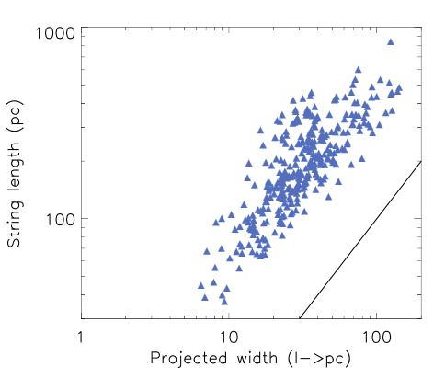
Open Clusters in MW Disk
clusters round-ish
strings are strings
typical string
30 pc wide … 200 pc long
most lack central cluster
… primordial
Kounkel & Covey (2019)
Notes:
Figure 9. Apparent sizes of the groups and the strings shown as a function of their relation of various dimensions. Projected width and length are measured from the
standard deviation in l and b converted to the physical units at the typical distance to the structure. The length is traced along the spine of the string end-to-end in the
XYZ plane. The black line shows the line of equity.

Slide 14
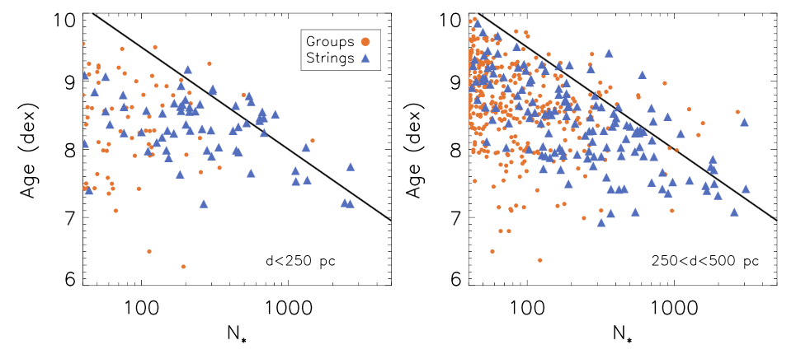
Open Clusters in MW Disk
strings have more stars than groups
have similar ages … but none very young or very old
black line is group size evolution with slope ~ -1.5
Kounkel & Covey (2019)
Notes:
Figure 11. Number of stars in individual groups and strings in various distance slices. The black line shows an approximate evolution of the group size is the power
law with the slope of ∼−1.5

Slide 15
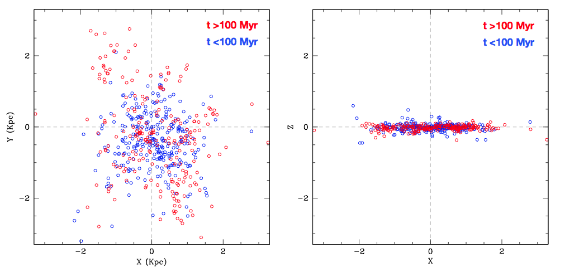
Open Clusters in MW Disk
clusters detected locally
inhomogeneous … star formation bursts / spiral arms
most confined to Galactic disk
Notes:
note that MW extends much further than can be mapped in right plot!

Slide 16
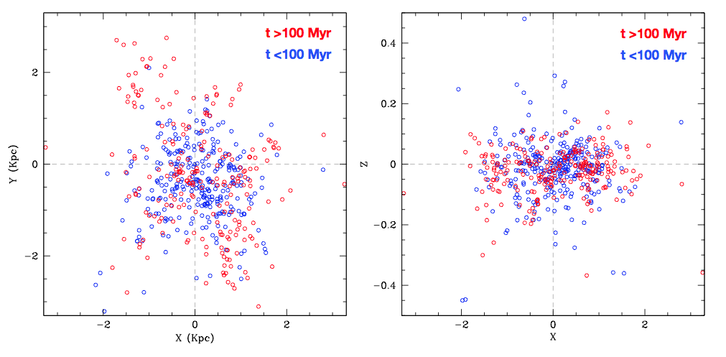
Open Clusters in MW Disk
clusters detected locally
inhomogeneous … star formation bursts / spiral arms
most confined to Galactic disk
concentrated within ~ 100 pc … disk thickness
What is the ratio of MW disk length vs. width?
Notes:
note that MW extends much further than can be mapped in right plot!

Slide 17
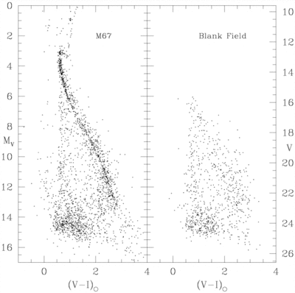
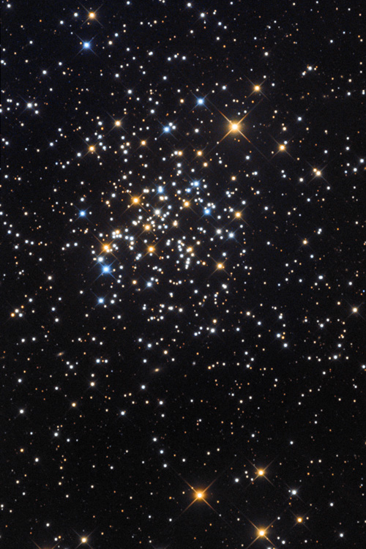
Members 1: Field Decontamination
M67
age 3-5 Gyr
Richer+ (1998)
Notes:
control field a few arcmin away, paper doesn’t actually have subtracted HRD

Slide 18
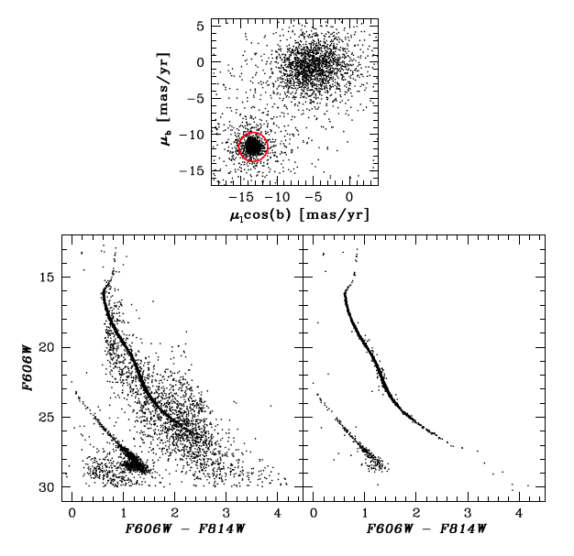
Members 2: Proper Motions
globular cluster
NGC 6397
126 orbits
with HST/ACS
Kalarai & Richer (2010)

Slide 19
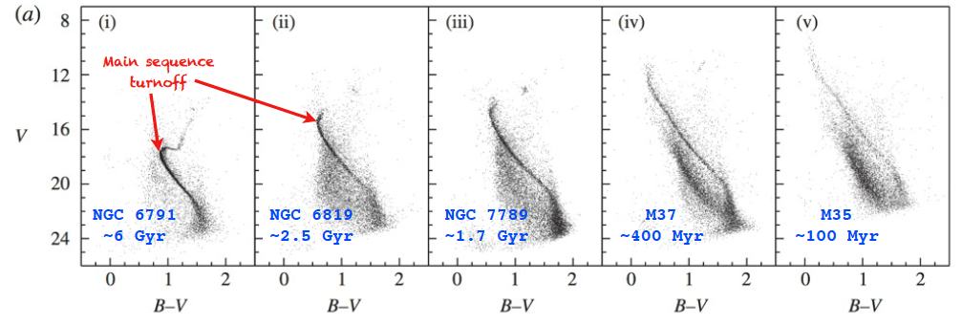
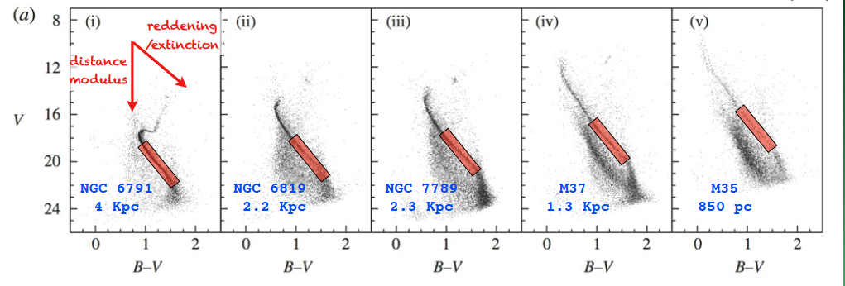
Ages via Main Sequence Turnoffs
cluster stars at same distance … main sequence over background stars
turnoff age relies on models … metallicity is confounding factor
distance by main sequence matching
color shift (tilt) due to reddening … more = clockwise
Kalarai & Richer (2010)

Slide 20
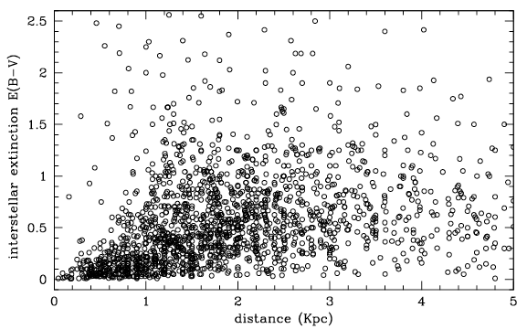
Clusters Yield Extinction
independent measures of distance and extinction
far from uniform … patchy

Slide 21
Members 3: Parallaxes + Motions
32 open clusters in Gaia
M0
M3
M5
GC/Babusiaux+ (2018)

Slide 22
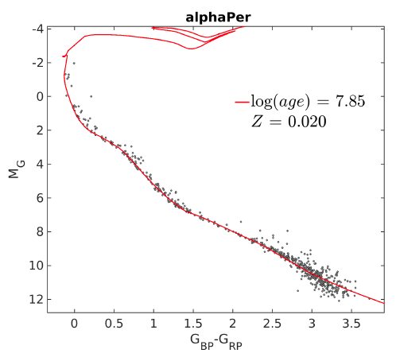
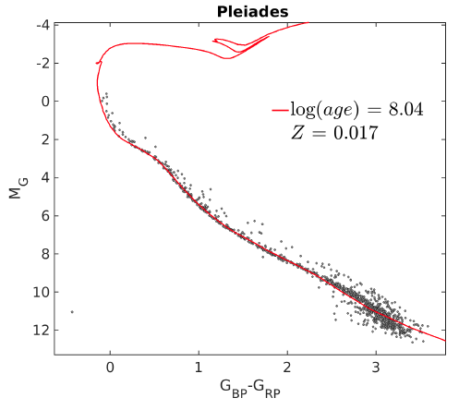
alpha Per + Pleiades in Gaia
young ~100 Myr
turnoffs near B stars … no red giants
no white dwarfs
GC/Babusiaux+ (2018)

Slide 23
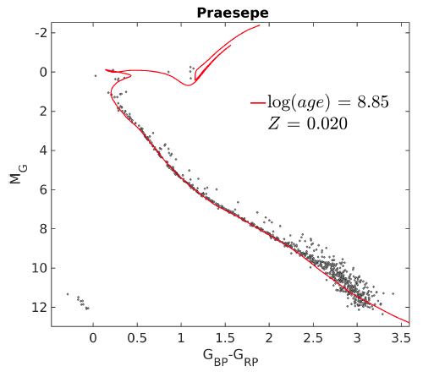
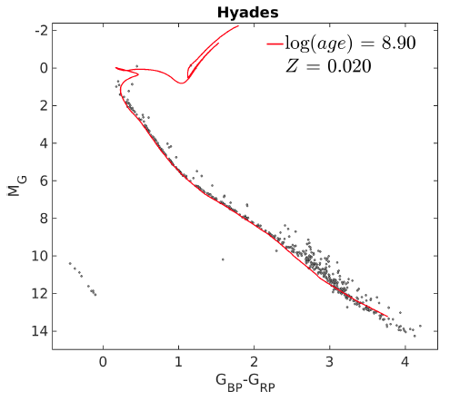
Praesepe + Hyades in Gaia
same age ~1 Gyr + same metallicity
B and A stars gone
Hyades have 4 red giants + 9 white dwarfs
GC/Babusiaux+ (2018)
Notes:
Hyades giants under red lines?

Slide 24
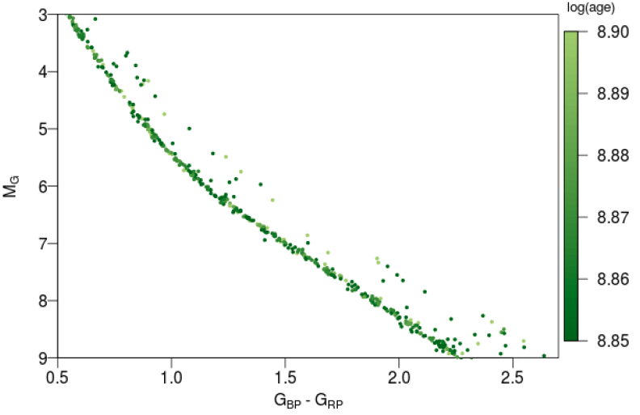
Praesepe + Hyades in Gaia
ignored
M dwarfs
GC/Babusiaux+ (2018)
Notes:
HRD for the Hyades and Praesepe clusters, showing the detailed agreement between the main sequences of the two clusters, the narrowness of the combined main sequence, and a scattering of double stars up to 0.75 mag above the main sequence.

Slide 25
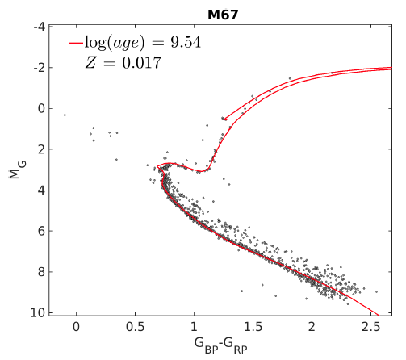
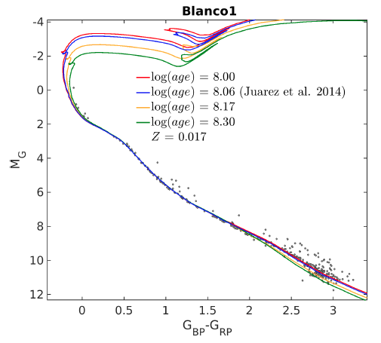
M67 + Blanco 1 in Gaia
M67: 3-5 Gyr
many red giants + blue stragglers … why no white dwarfs?
900 pc
Blanco1: unsolvable … poorly-defined turnoff, no giants
GC/Babusiaux+ (2018)
Notes:
can’t see white dwarfs

Slide 26
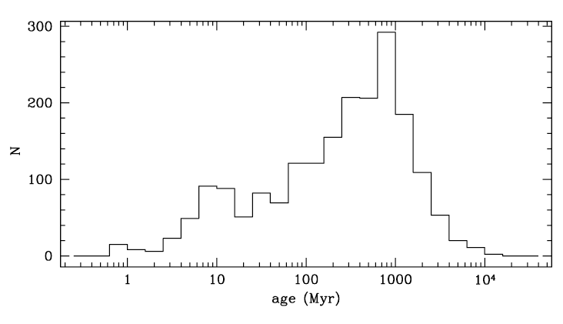
Cluster Ages
log ages
many clusters younger than 1 Gyr
few older than 1 Gyr

Slide 27
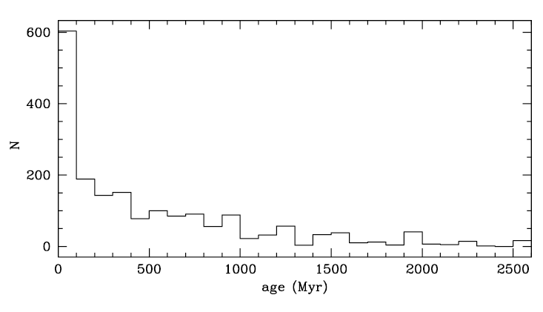
Cluster Ages
90% < 500 Myr
linear ages
many clusters younger than 1 Gyr
few older than 1 Gyr
careful: OB stars obvious in young clusters, not old

Slide 28
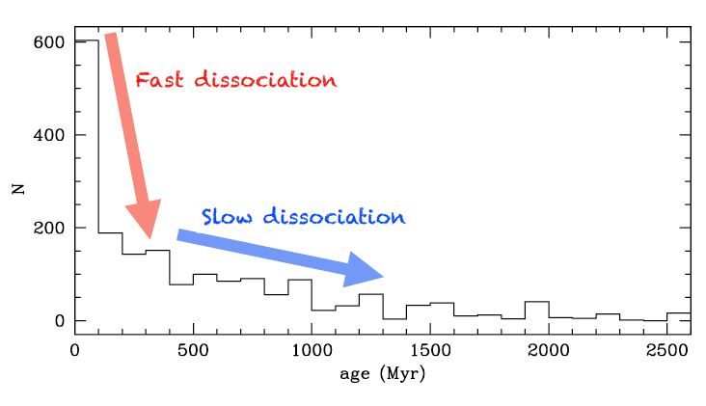
Cluster Dispersal
MASS LOSS
dying stars ~ 30% mass lost
winds, SNe
STELLAR EVAPORATION
mass segregation
star-star scattering
tidal stripping
linear ages
Why do clusters disperse?

Slide 29
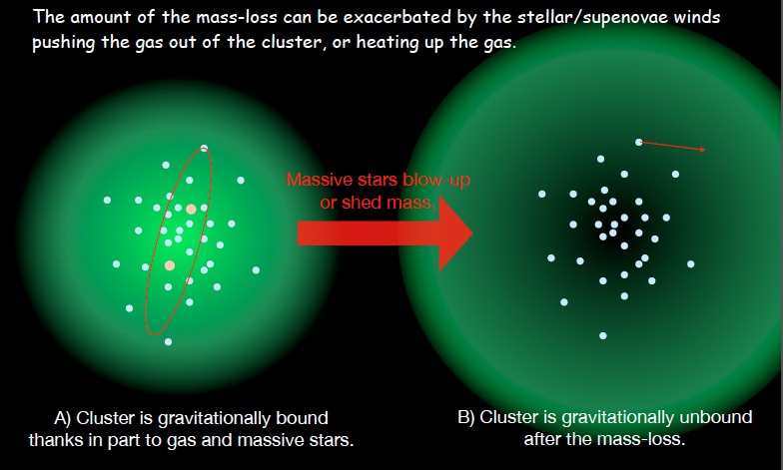
Cluster Dispersal

Slide 30
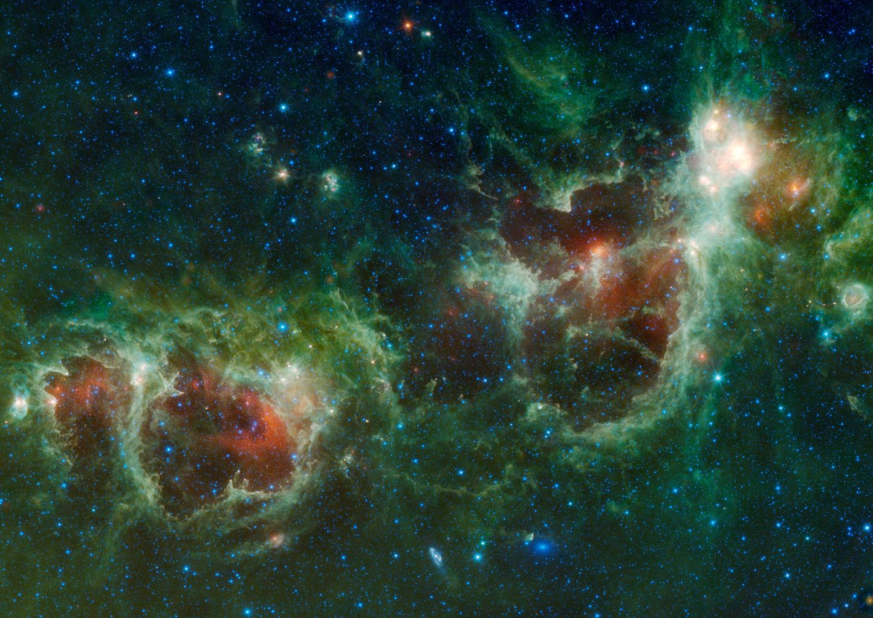
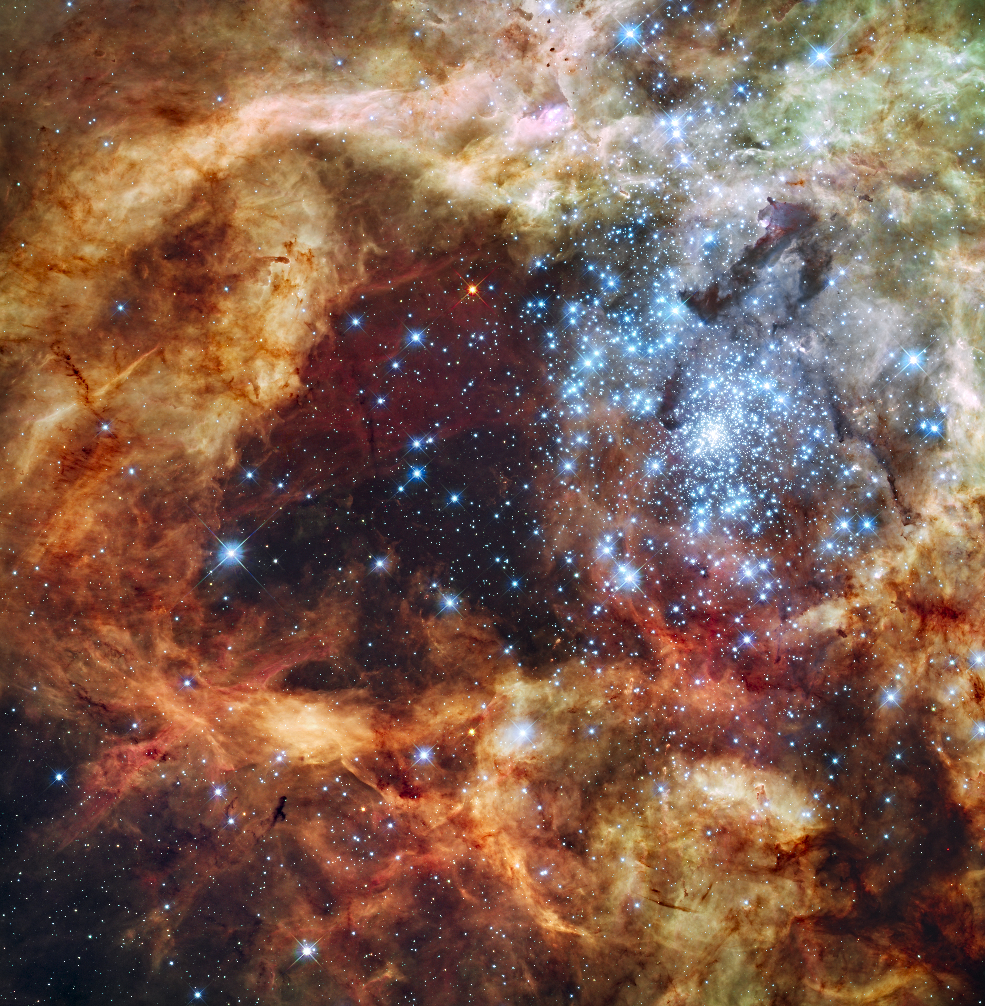
Cluster Dispersal
Tarantula
Nebula
IC 1848
Heart and Soul Nebula

Slide 31
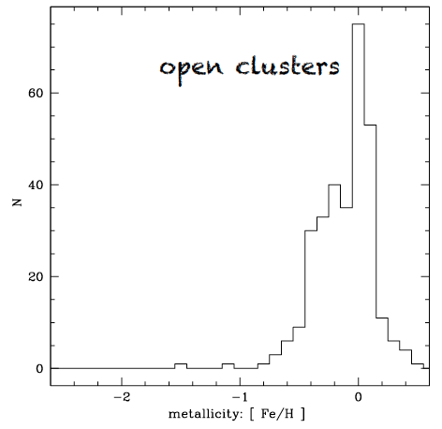
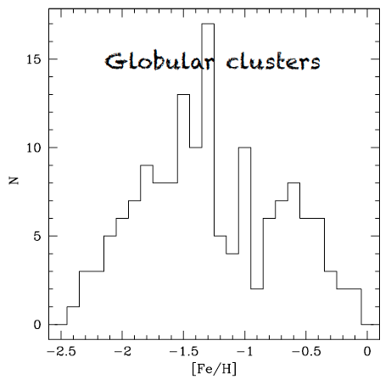
Cluster Metallicities
What do you conclude?
open clusters MUCH more metal rich than (most) globulars

Slide 32
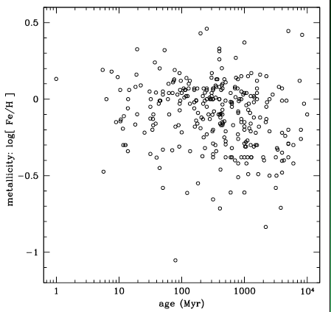
Open Cluster Metallicities
What do you conclude?
no clear correlation between metallicity and age

Slide 33
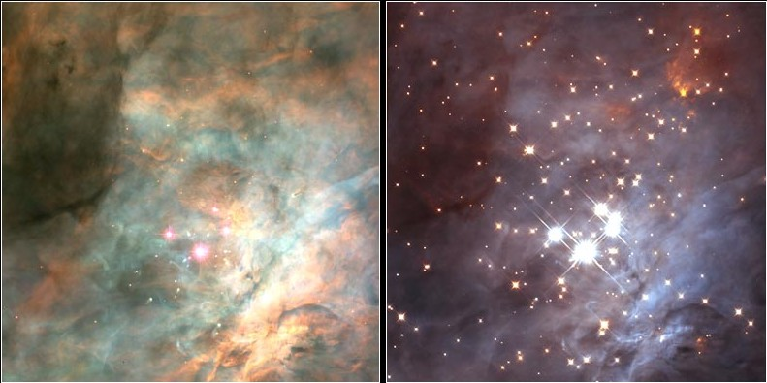
Hidden Clusters
Orion in optical (HST/WFPC2) and infrared (HST/NICMOS)
https://commons.wikimedia.org/w/index.php?curid=1191304

Slide 34
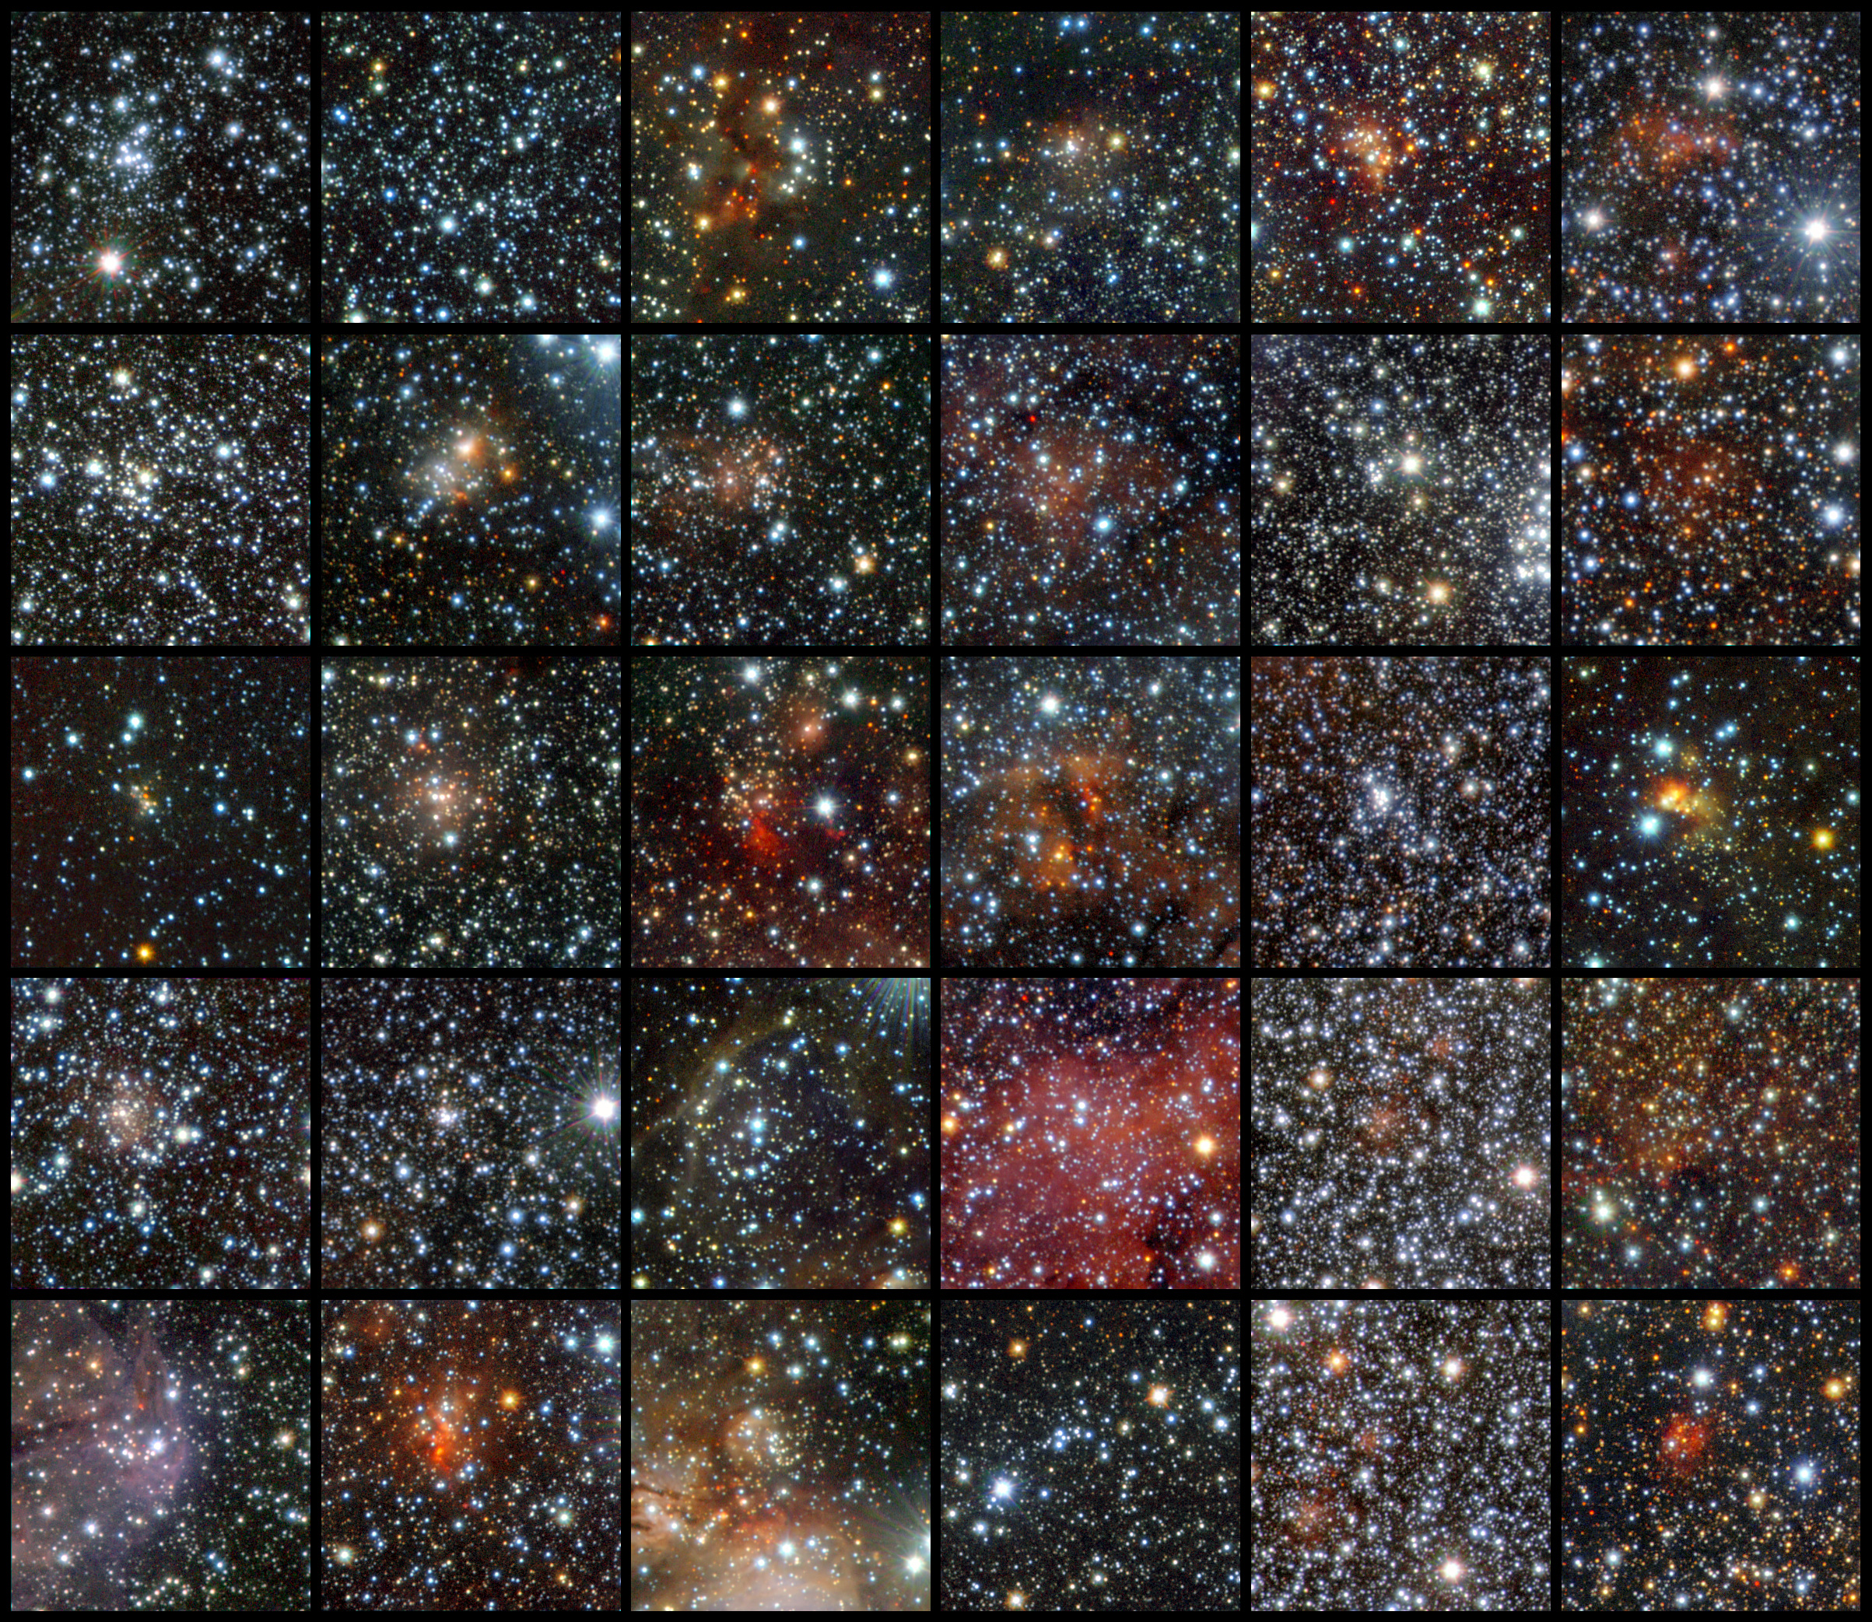
30 of 96 VISTA Clusters Revealed
VISTA = 4.1m at Paranal in yzJHK_{s}
ESO/J. Borissova
Notes:
Using data from the VISTA infrared survey telescope at ESO’s Paranal Observatory, an international team of astronomers has discovered 96 new open clusters hidden by the dust in the Milky Way. Thirty of these clusters are shown in this mosaic. These tiny and faint objects were invisible to previous surveys, but they could not escape the sensitive infrared detectors of the world’s largest survey telescope, which can peer through the dust. This is the first time so many faint and small clusters have been found at once. The images are made using infrared light in the following bands: J (shown in blue), H (shown in green), and Ks (shown in red).

