Slide 1
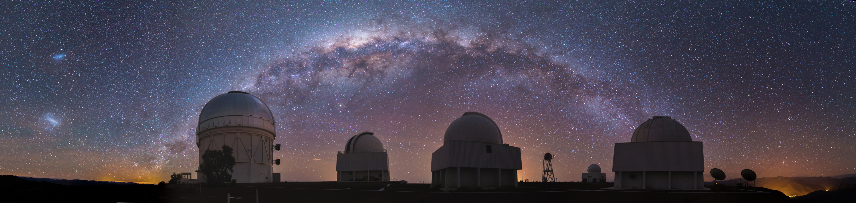
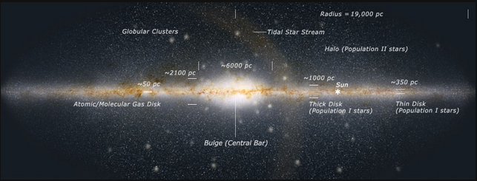
Milky Way Disk

Slide 2
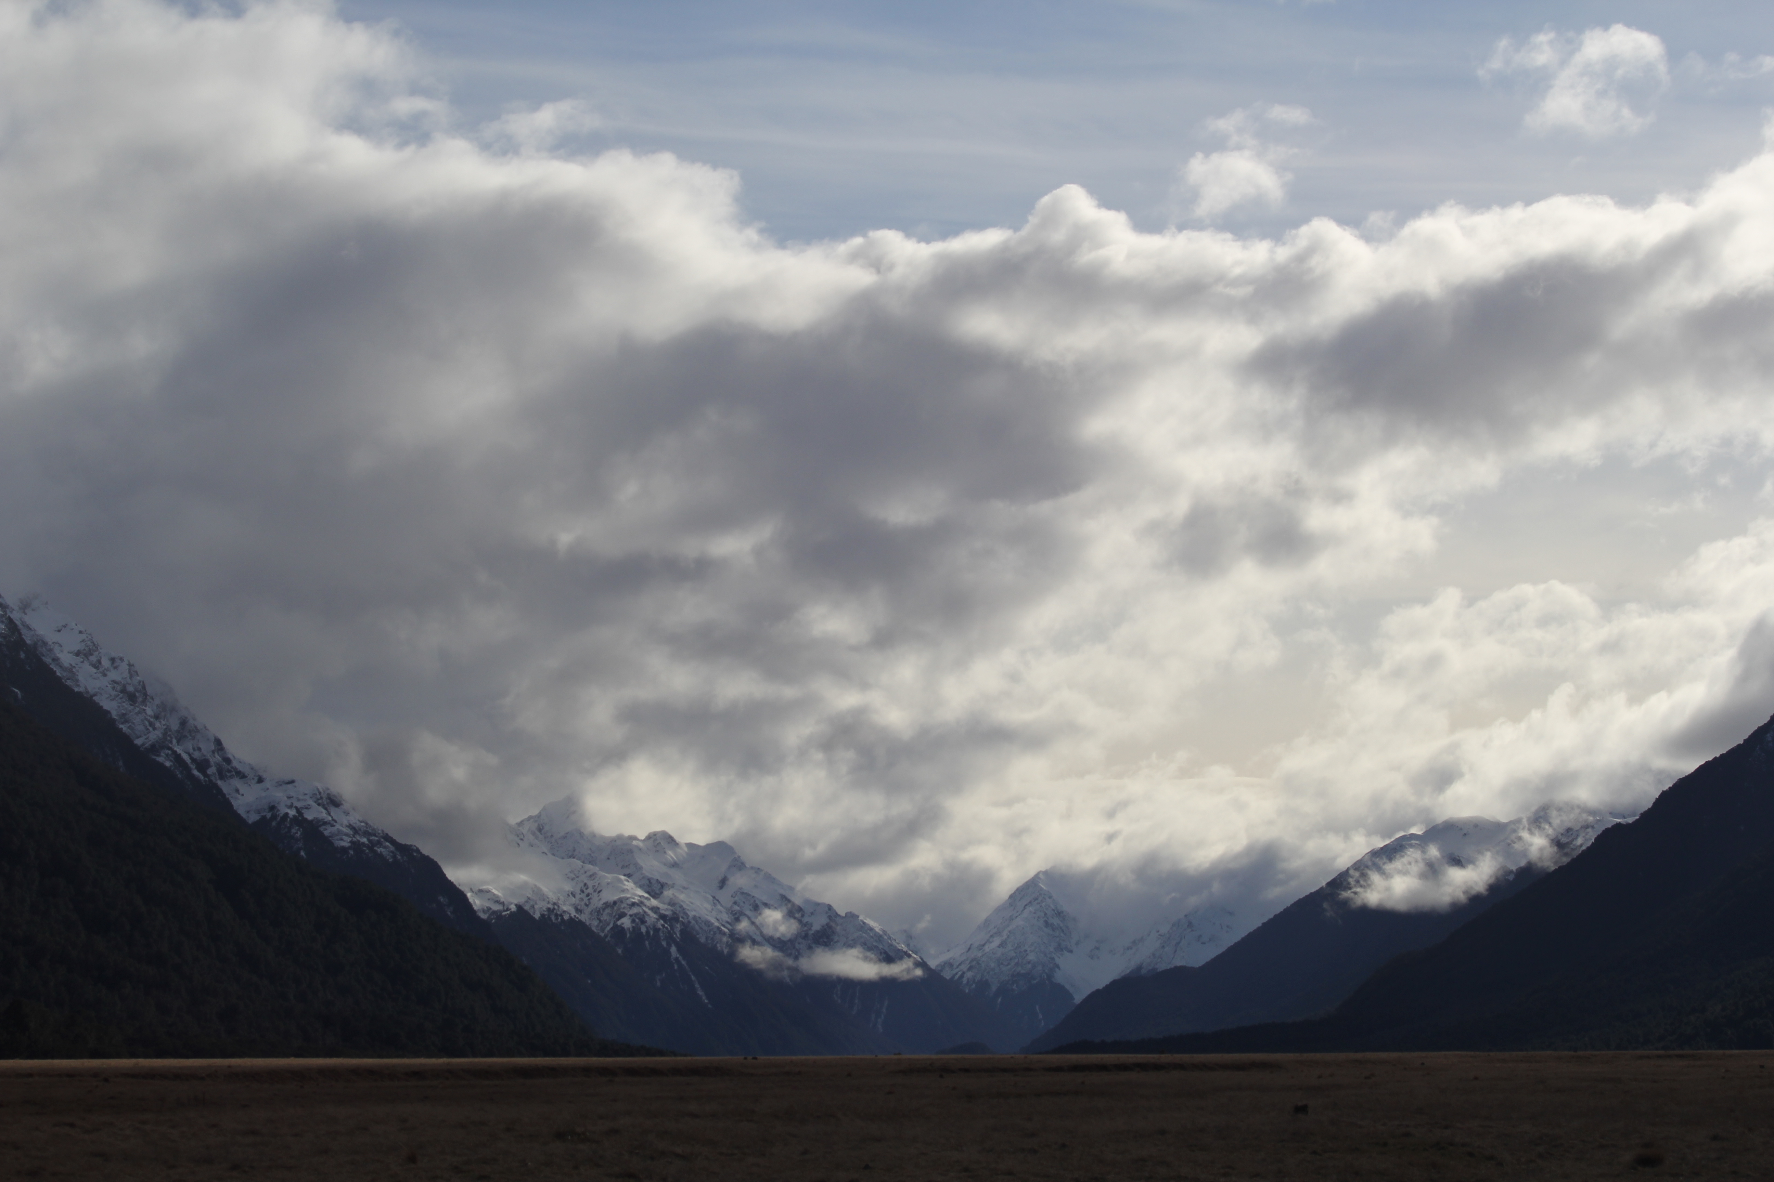


Assignments
Tuesday 03 FEB Level 0 … Ideas
Tuesday 10 FEB Bio Sketch
Tuesday 17 FEB Level 1 … Outline … 2 weeks later
Thursday 19 FEB Milky Way Neighborhood
Tuesday 10 MAR Level 2 … 1st Draft … 3 weeks later
Tuesday 31 MAR Level 3 … 2nd Draft … 3 weeks later
Tue/Thu 14/16 APR Presentations … 2 weeks later
Thursday 23 APR Level 4 … submit … 1 week later

Slide 3
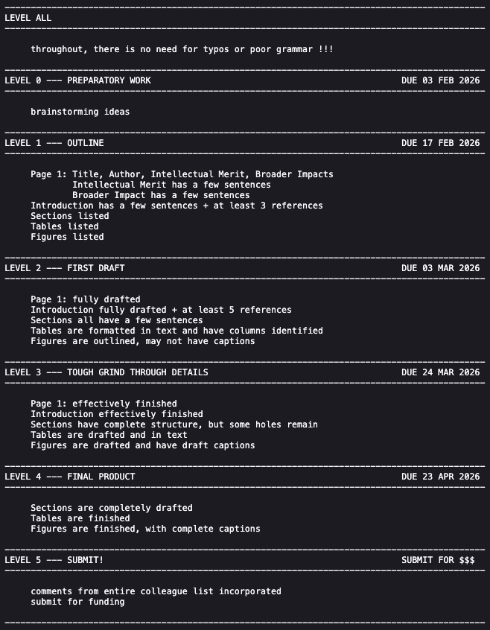

Slide 4
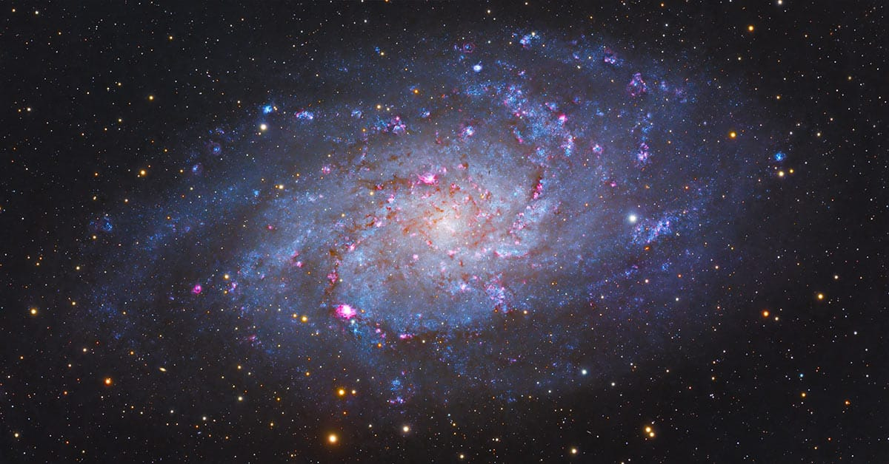
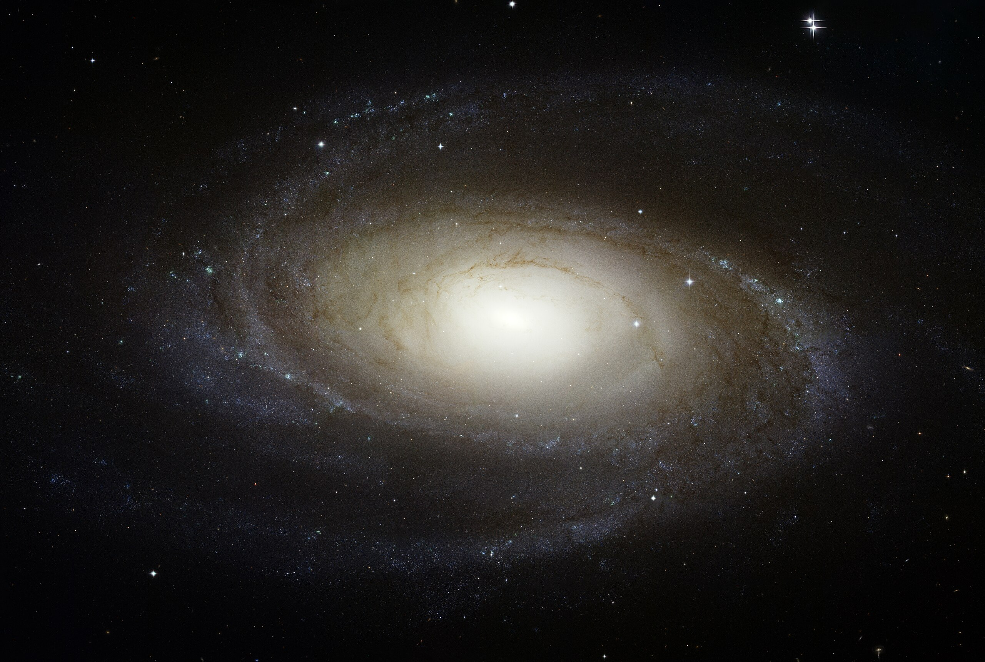
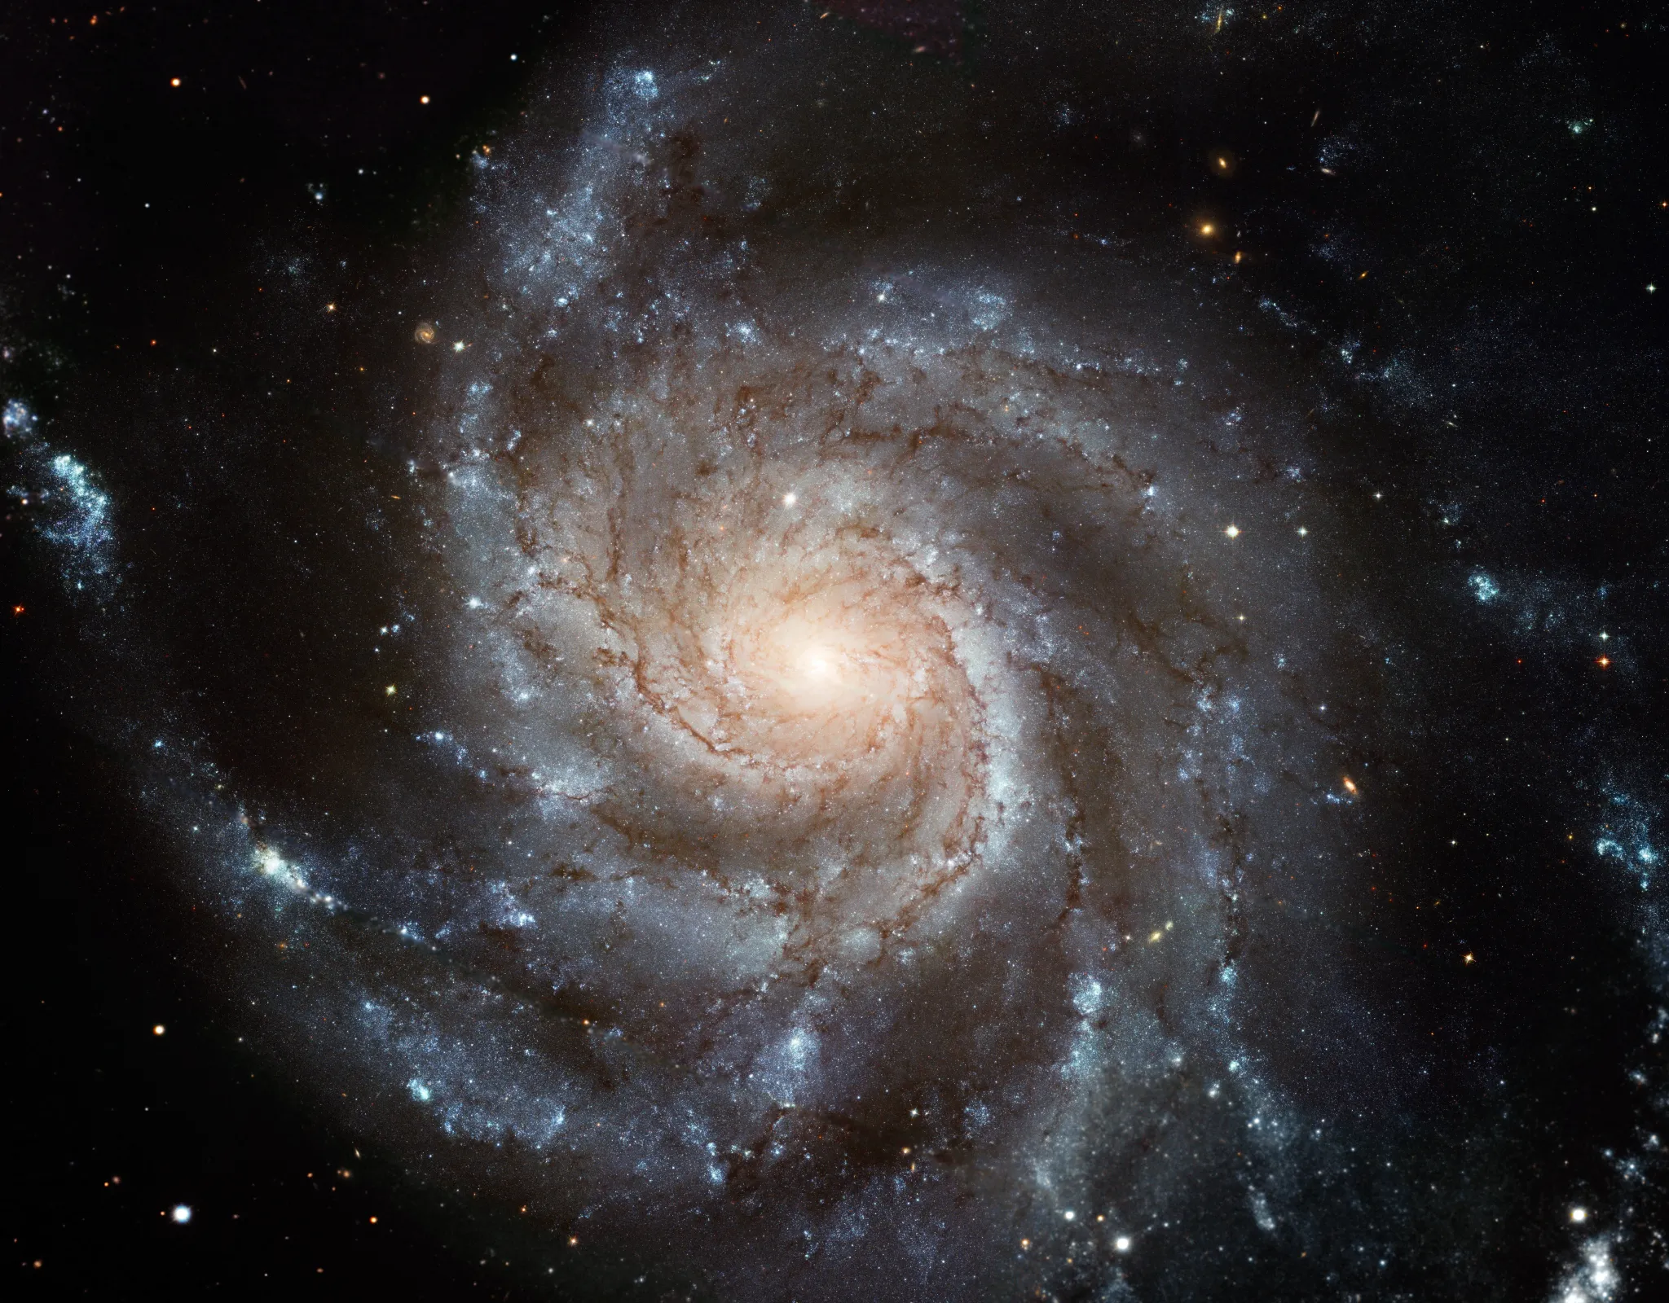
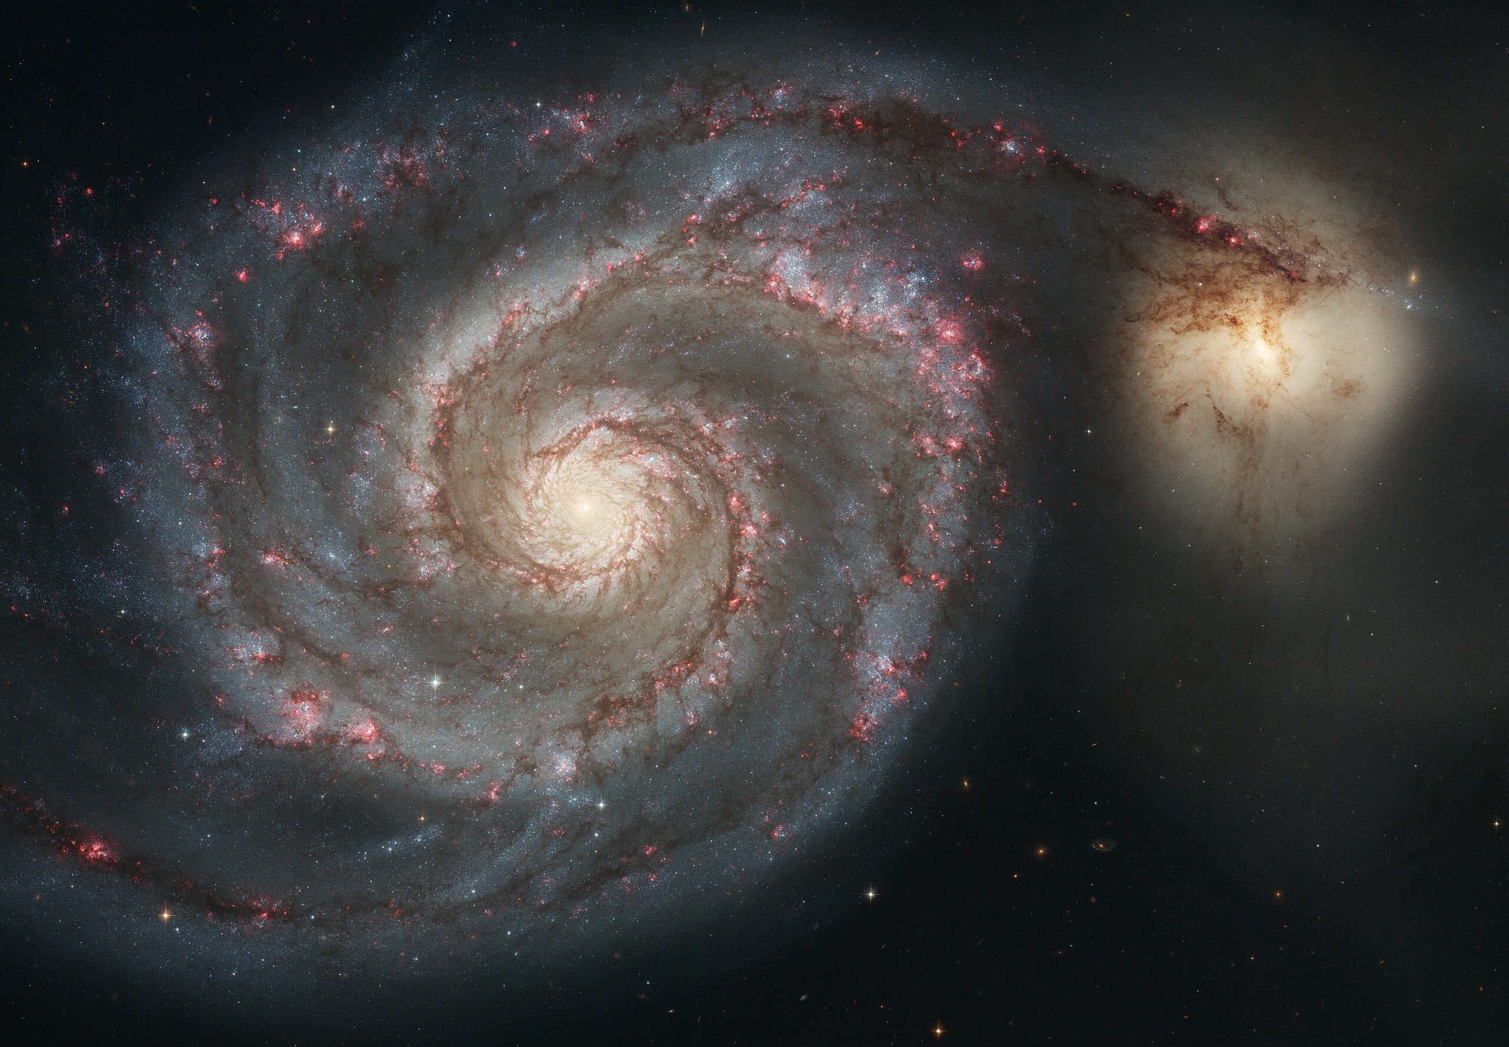
Milky Way Neighborhood
Team Triangulum (M33)
Team Bode’s (M81)
Team Pinwheel (M101)
Team Whirlpool (M51)

Slide 5
Milky Way Neighborhood (2024)
 | RA | DEC | Size (kpc) | Dist (kpc) | Bits / # Globulars / References
Milky Way | --- | --- | 40 | 0 | warp, bar, 2-4 arms, LMC, SMC, Sgr dSph, ~150 globulars
Andromeda M31 | 00:43 | +41:16 | 50 | 730 | warp, bar, 2? arm / ring, M32, M110, ~460 globulars
Triangulum M33 | 01:33 | +30:39 | 19 | 912 | AGN, flocculent, 54 globulars
Bode’s M81 | 09:55 | +69:03 | 27 | 3675 | AGN low-luminosity, thick disk only?, N globulars
Pinwheel M101 | 14:03 | +54:20 | 59 | 6500 | Nearly face-on, circular, > 10^12 stars, 150 globulars
Whirlpool M51 | 13:30 | +47:13 | 38 | 7800 | M52 companion, bridge starburst

Slide 6
Milky Way Neighborhood (2026)
 | RA | DEC | Size (kpc) | Dist (kpc) | Bits / # Globulars / References
Milky Way Todd | --- | --- | 60 20 in | 0 | warp, bar, 2-4 arms, LMC, SMC, Sgr dSph, 50+ small galaxies, ~150 globulars, Earth, Ryland Grace + Rocky, 40 Eri ABC (wd+K+M) = home of Rocky, Vulcan, tau Ceti (G)
Andromeda M31 Roger + Ben | 00:43 | +41:16 | 67 22 in | 780 22 ft | SB(rs)b --- bulge, bar, 2ish spiral arms, massive dust ring circle around outer edge, 500+ globulars, oldest stars 12 Gyr, headed for MW crash in 6 Gyr
Triangulum M33 Megan + Ella | 01:33 | +30:39 | 18x16 3 in | 840 23 ft | SA(s)cd --- flocculent spiral (loose arms/mess), late-type, Triangulum tango with MW + And, small but bulge > MW, 100+ star clusters, 1 cluster with 200 O/B stars
Bode’s M81 Madeline + Akshat | 09:55 | +69:03 | 29 10 in | 3700 103 ft | SA(s)ab --- 2 tight arms grand design spiral, Large bulge, 7x10^6 central SMBH, 74+ globulars, 2 big irregular galaxies, ~150 globulars, 2000-3000 open clusters
Pinwheel M101 Karina + AJ | 14:03 | +54:20 | 77 26 in | 6644 185 ft | SAB(rs)cd --- 2000-3000 open clusters, six 3-13 kpc companions caused a lot of star formation, NON-rotating Pinwheel
Whirlpool M51 Madison + Mahir | 13:30 | +47:13 | 30 10 in | 7500 208 ft | SAbc --- grand design, Seyfert 2 AGN, interacting with NGC 5195 (18 kpc, passing behind) with bridge 8 kpc … boosted star formation
Notes:
1 inch = 3 kpc

Slide 7
Milky Way Neighborhood (2026)
 | RA | DEC | Size (kpc) | Dist (kpc) | Relative Size
Milky Way Todd | --- | --- | 60 20 in | 0 | 1.0
Andromeda M31 Roger + Ben | 00:43 | +41:16 | 67 22 in | 780 22 ft | 1.1
Triangulum M33 Megan + Ella | 01:33 | +30:39 | 18x16 3 in | 840 23 ft | 0.4
Bode’s M81 Madeline + Akshat | 09:55 | +69:03 | 29 10 in | 3700 103 ft | 0.5
Pinwheel M101 Karina + AJ | 14:03 | +54:20 | 77 26 in | 6644 185 ft | 1.2
Whirlpool M51 Madison + Mahir | 13:30 | +47:13 | 30 10 in | 7500 208 ft | 0.5
Notes:
1 inch = 3 kpc

Slide 8
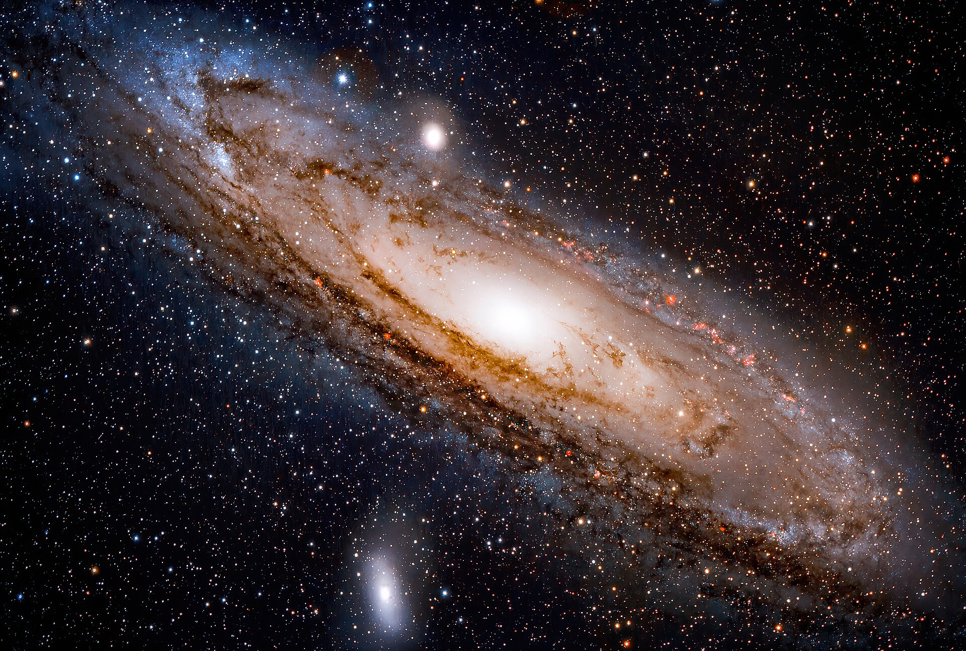
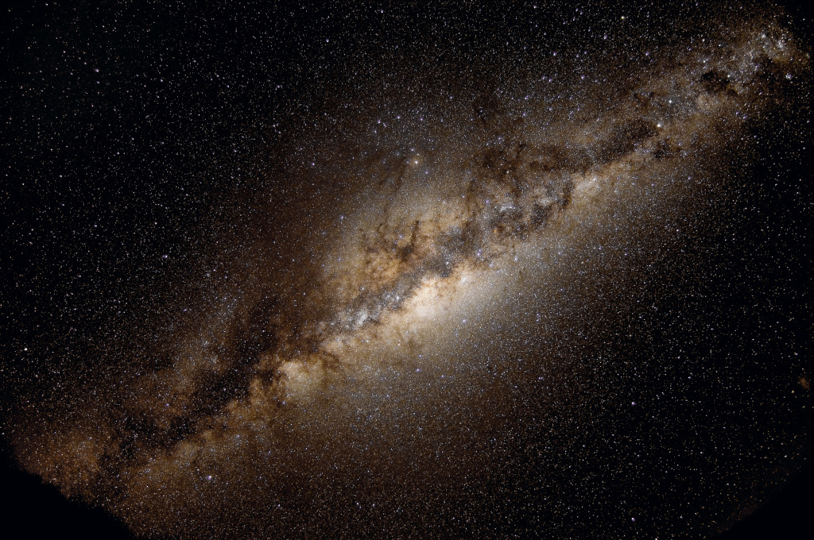
Milky Way Neighborhood
Triangulum (M33)
Bode’s (M81)
Whirlpool (M51)
Milky Way
Andromeda (M31)
Pinwheel (M101)

Slide 9
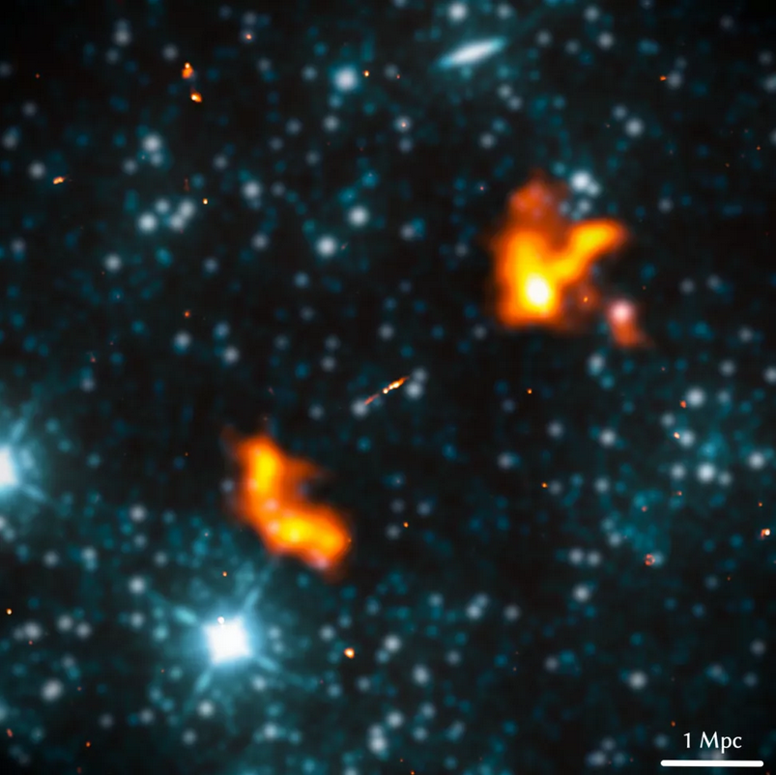
Largest Galaxy (?)
“Alcyoneus”
Alcyoneus was the son of Ouranos, the Greek primordial god
of the sky. He was also one of the greatest of the Gigantes
(Giants), and a challenger to Heracles during the Gigantomachy
— the battle between the Giants and the Olympian gods for
supremacy over the Cosmos.
giant radio galaxy
host at z = 0.25
elliptical … 2.4 x 10¹¹ M_{sun}
SMBH … 4 x 10⁸ M_{sun}
projected length 4.99 Mpc
M. Oei+ (2022)
joint radio (orange) infrared WISE (blue) image
Notes:
host galaxy appears to be ”normal” for giant radio galaxies (which are hardly normal galaxies)
Al – key – o -- nus

Slide 10
Milky Way Today
What defines the edge of a galaxy?
How do you know the depth of galaxies?
What is the best way to get a distance in the MW Neighborhood?
Why is H_{o} a bad idea here?

Slide 11
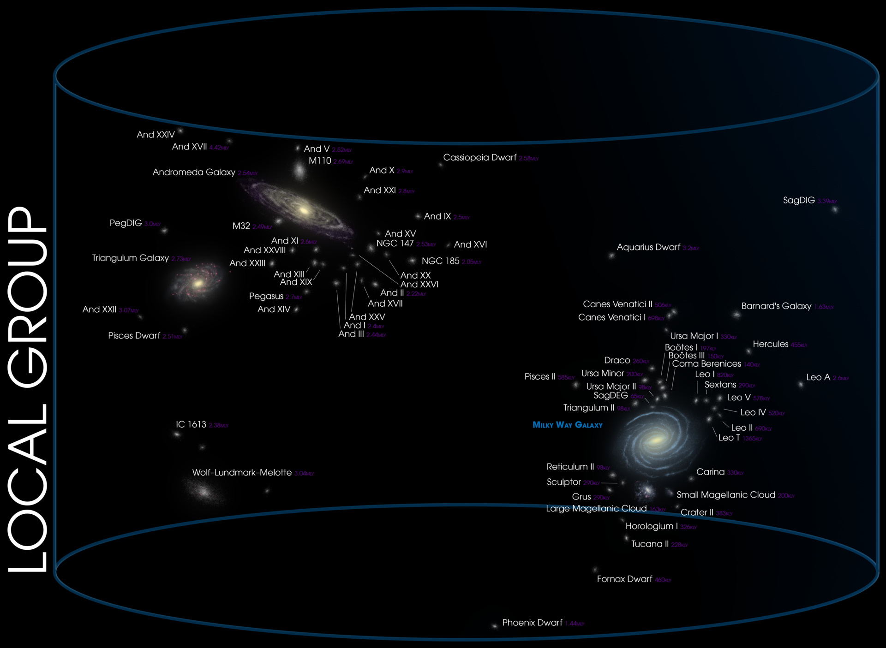
Local Group

Slide 12
Milky Way Disk

Slide 13
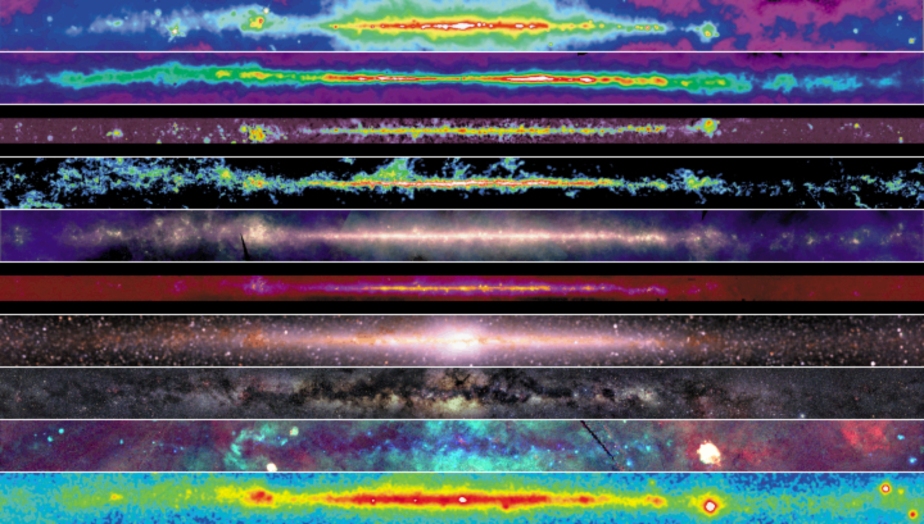
Milky Way Disk
R
R
R
R
I
I
I
V
X
G
Notes:
10 views of the MW disk

Slide 14
Milky Way Disk
RADIO (408 MHz) from high-energy e⁻ moving through interstellar mag field at ~c
shock waves from SN accelerate e⁻
RADIO (1.4 GHz = 21cm) from atomic H tracing warm ISM
ideal tracer of the MW disk, warp?
RADIO (115 GHz) from molecular H₂ inferred from CO tracing cold ISM
clumpy tracers of spiral arms = giant molecular clouds (GMCs)
Notes:
H2 is tough to detect directly at interstellar conditions
The characterization of giant molecular clouds (GMCs) – the sites of nearly all star formation activity in the local Universe – is an important step towards understanding how stars are born. Molecular hydrogen (H₂) is the most abundant molecule in the interstellar medium (ISM), but its rotational emission lines are not excitable at the temperatures found in most GMCs. However, the second most abundant molecule is carbon monoxide (CO), which has rotational transitions that are easily excitable within typical GMCs, making CO a good tracer of molecular gas. Additionally, the lower levels of CO emit at a frequency that can be observed from the ground. Therefore, CO has become the favored tracer for studying molecular gas in GMCs.

Slide 15
Milky Way Disk
long-IR (12/60/100 microns from IRAS) thermal emission from dust
dust is heated by starlight … star formation regions
What temps
sampled?
mid-IR (6.8-10.8 microns from WISE) from molecules like PAHs in gas clouds
embedded red giants, planetary nebulae, and massive stars
What temps
sampled?
near-IR (1.2-3.5 microns from COBE) from K giants in the disk seen through dust
clear evidence of bulge
What temps
sampled?

Slide 16
Milky Way Disk
OPTICAL (0.4-0.6 microns) primarily stars ≤1 kpc because dust blocks emission
dark patches map emission in H₂ and IR maps
… it really does match the H₂ (remember: CO) map

Slide 17
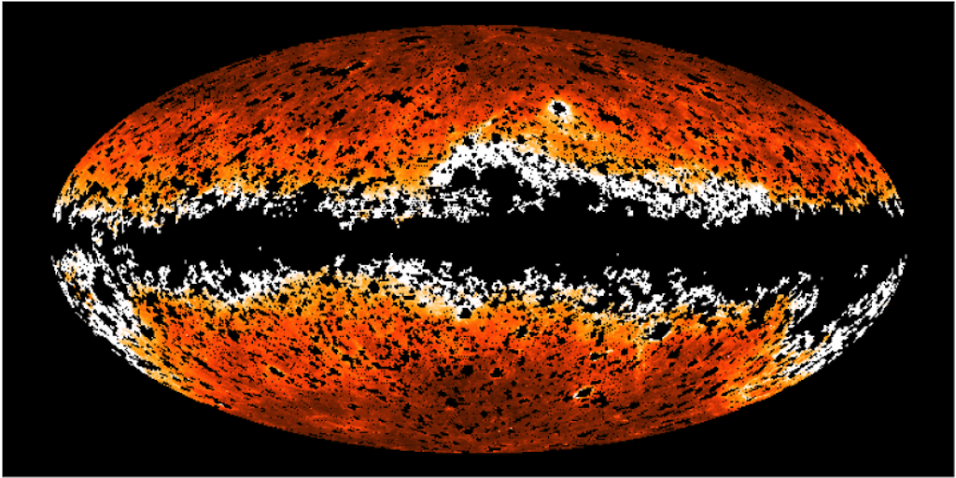
Milky Way Disk
UV (1344-1786 Å from GALEX) shows that the MW disk is “missing”
H atoms and dust block UV photons
X-RAY (0.25/0.75/1.5 keV from ROSAT) hot shocked gas
dark patches are cold clouds
Crab Pulsar
Vela Pulsar Geminga Pulsar
GAMMA (energy > 300 MeV from Compton) cosmic rays hitting H nuclei in clouds
pulsars, galactic center
What are
the dots?
Notes:
Geminga 250 pc in Gemini
Vela 300 pc in Vela --- spins 11X/sec, brightest persistent source of gamma rays
Crab 2200 pc in Taurus
Closest pulsar is at 85 pc PSRJ0108-1431
gamma rays (energies > 1 GeV shown) produced by energetic particles accelerated in shock waves of supernovae remnants colliding with gas atoms

Slide 18
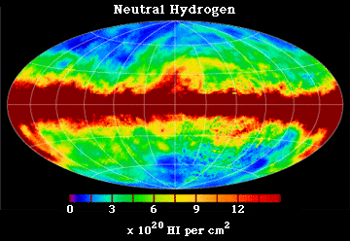
Milky Way: Radio 21cm
Dickey & Lockman (1990)

Slide 19
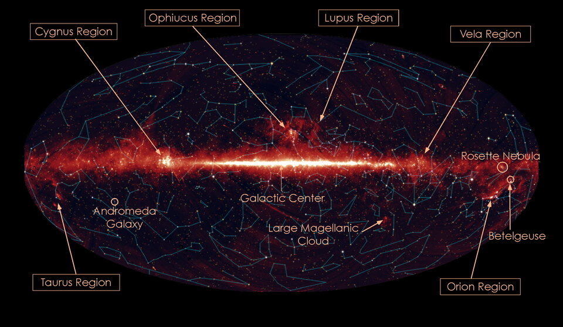
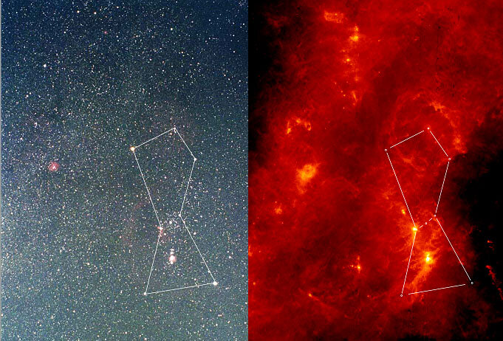
Milky Way: IR 9 microns
AKARI Mission (2007)

Slide 20
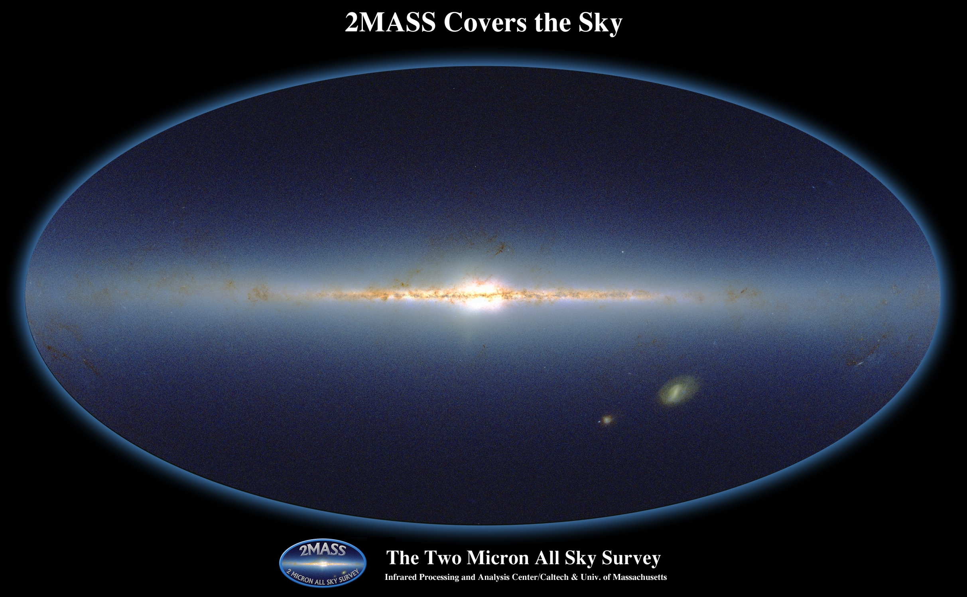
Milky Way: Infrared 2MASS
dwarf
Sagittarius
galaxy
~ 0.1 billion point sources (of ~ 0.5 billion total)

Slide 21
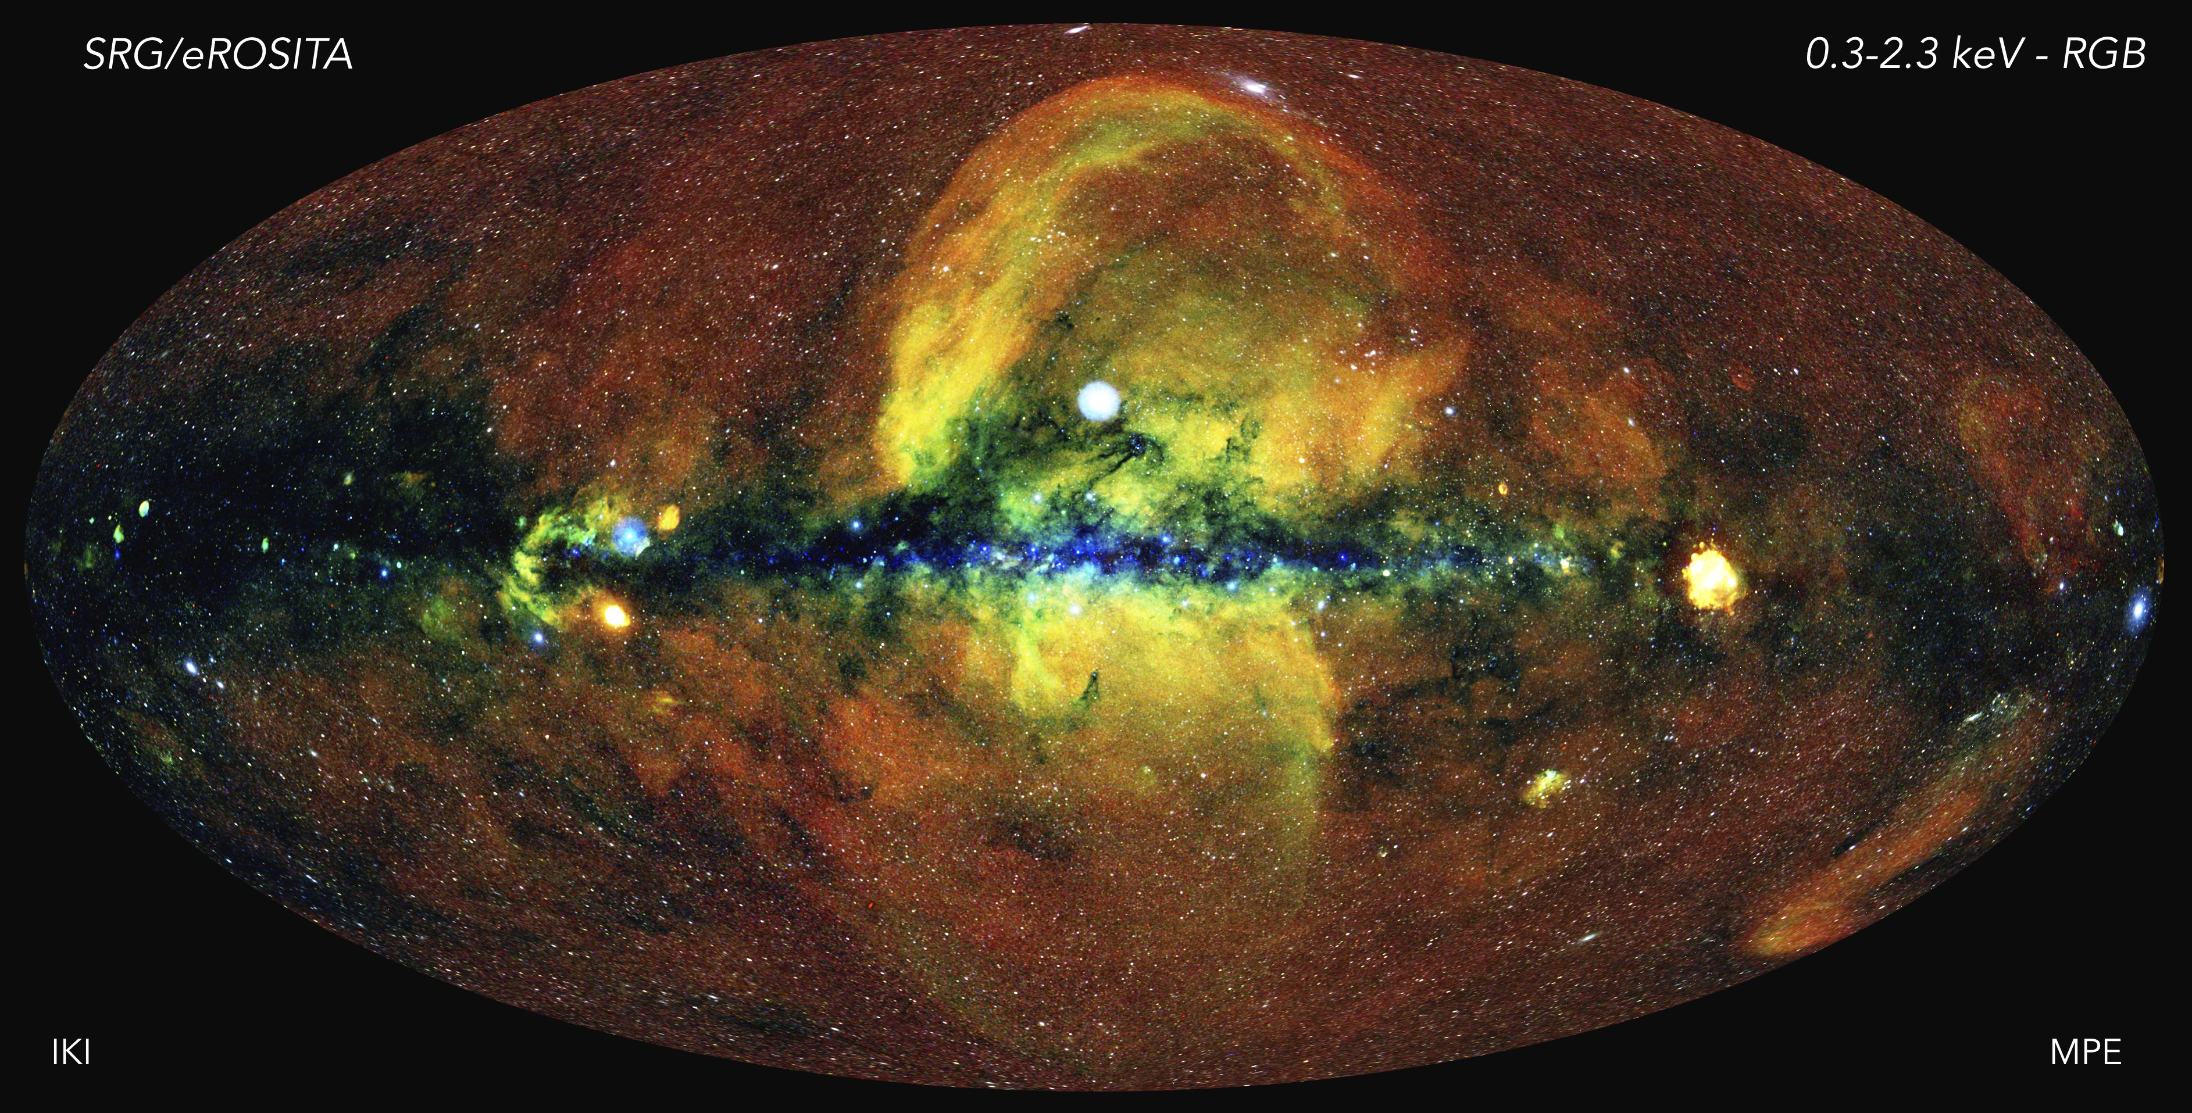
Milky Way: X-ray
Germany/Russia
OCT 2019 to FEB 2022
red (0.3-0.6 keV) … diffuse, Local Bubble hot gas around Solar System
green (0.6-1.0 keV) … SN fountains of hot gas
blue (1.0-2.3 keV) … high energies poke through
white dots ... ~ uniform distribution of AGN
Notes:
Data collection stopped 26 FEB 2022 … 2 days after Russia invaded Ukraine.
The energetic universe as seen with the eROSITA X-ray telescope. The first eROSITA all-sky survey was conducted over a period of six months by letting the telescope rotate continuously, thus providing a uniform exposure of about 150-200 seconds over most of the sky, with the ecliptic poles being visited more deeply. As eROSITA scans the sky, the energy of the collected photons is measured with an accuracy ranging from 2% - 6%. To generate this image, in which the whole sky is projected onto an ellipse (so-called Aitoff projection) with the centre of the Milky Way in the middle and the body of the Galaxy running horizontally, photons have been colour-coded according to their energy (red for energies 0.3-0.6 keV, green for 0.6-1 keV, blue for 1-2.3 keV). The original image, with a resolution of about 10”, and a corresponding dynamic range of more than one billion, is then smoothed (with a 10’ FWHM Gaussian) in order to generate the above picture. The red diffuse glow away from the galactic plane is the emission of the hot gas in the vicinity of the solar system (the Local Bubble). Along the plane itself, dust and gas absorb the lowest energy X-ray photons, so that only high-energy emitting sources can be seen, and their colour appears blue in the image. The hotter gas close to the galactic centre, shown in green and yellow, carries imprinted the history of the most energetic processes in the life of the Milky Way, such as supernova explosions, driving fountains of gas out of the plane, and, possibly, past outburst from the now dormant supermassive black hole in the centre of the galaxy. Piercing through this turbulent, hot diffuse medium, are hundreds of thousands of X-ray sources, which appear mostly white in the image, and uniformly distributed over the sky. Among them, distant active galactic nuclei (including a few emitting at a time when the Universe was less than one tenth of its current age) are visible as point sources, while clusters of galaxies reveal themselves as extended X-ray nebulosities. In total, about one million X-ray sources have been detected in the eROSITA all-sky image, a treasure trove that will keep the teams busy for the coming years. Credit: Jeremy Sanders, Hermann Brunner and the eSASS team (MPE); Eugene Churazov, Marat Gilfanov (on behalf of IKI)

Slide 22
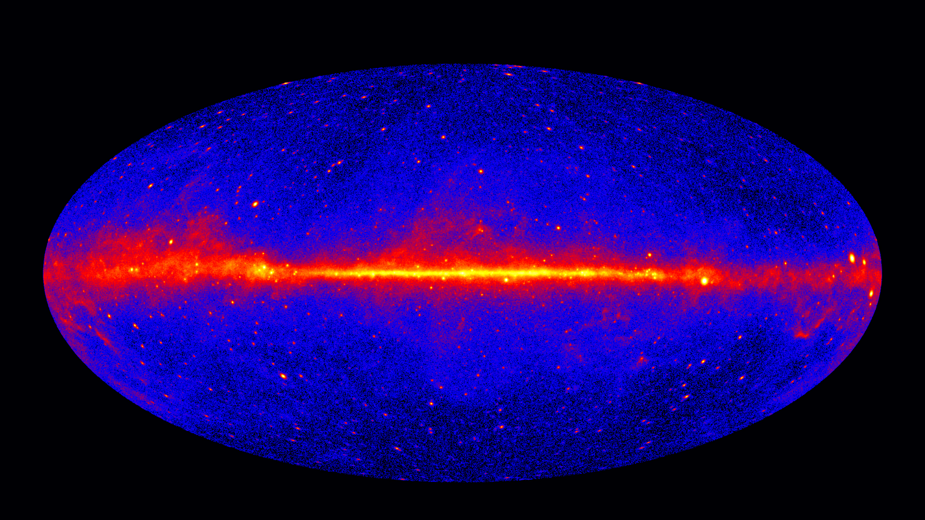
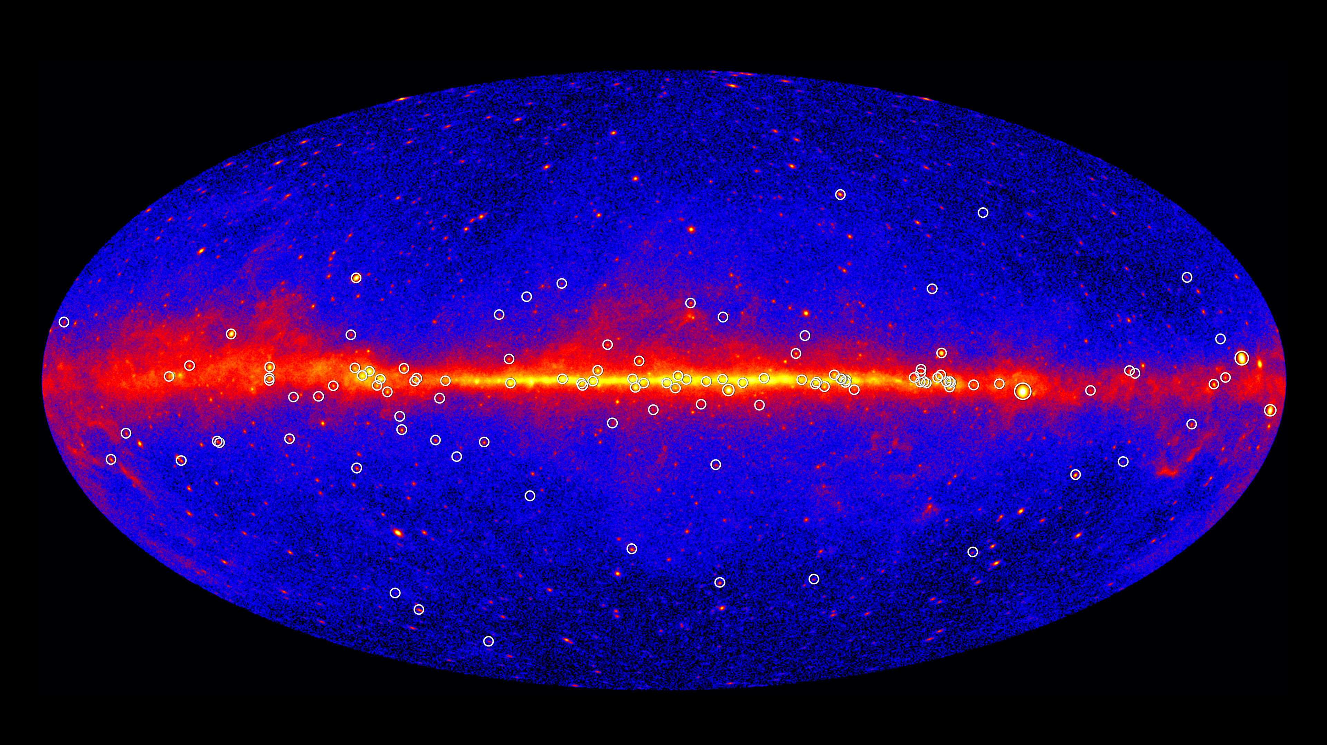
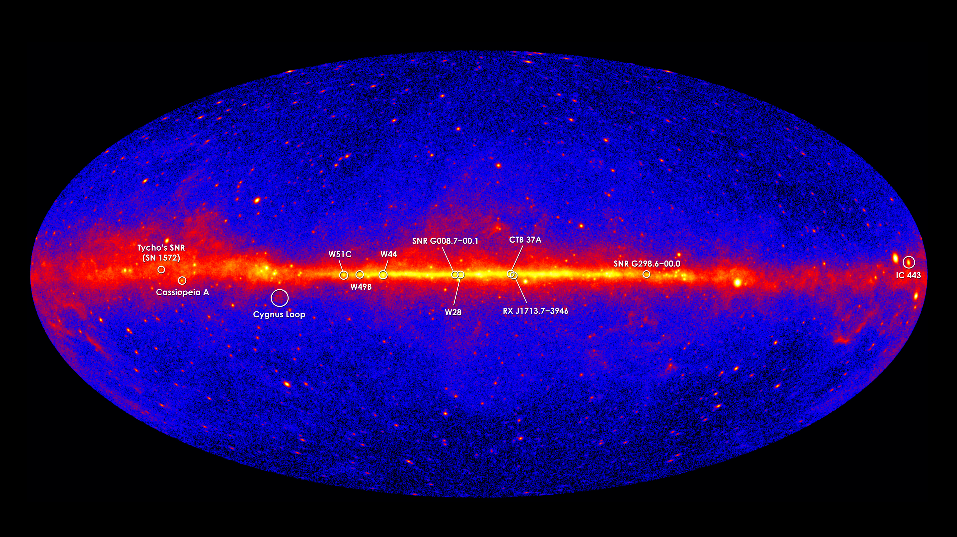
Milky Way: Gamma
Crab
Vela. Geminga
SN remnants
pulsars
Fermi 5-year map
https://ishivvers.github.io/maps/pulsars.html
https://ishivvers.github.io/maps/sne.html
Notes:
gamma rays (energies > 1 GeV shown) produced by energetic particles accelerated in shock waves of supernovae remnants collide with gas atoms
Vela pulsar (spins 11X/sec) is brightest persistent source of gamma rays

Slide 23
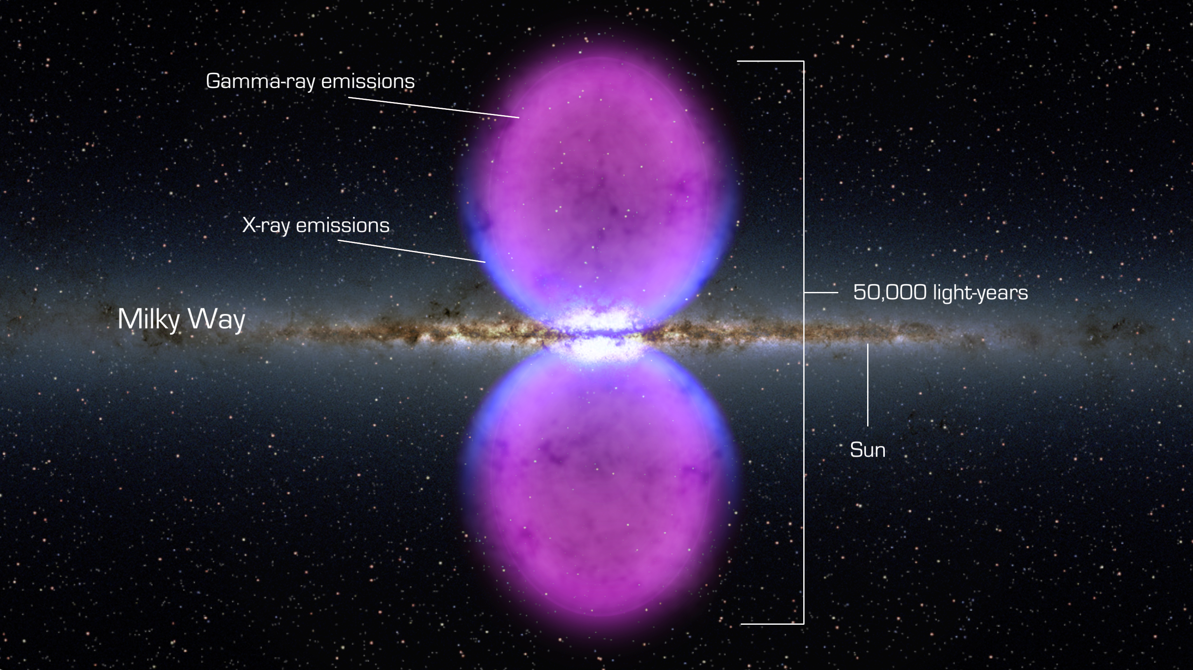
Milky Way Disk: Gamma
Fermi Bubbles
Notes:
Fermi bubbles movie worth watching, but website does not seem to be fixed …

Slide 24
Milky Way Disk
R
R
R
R
I
I
I
V
X
G

