Slide 1
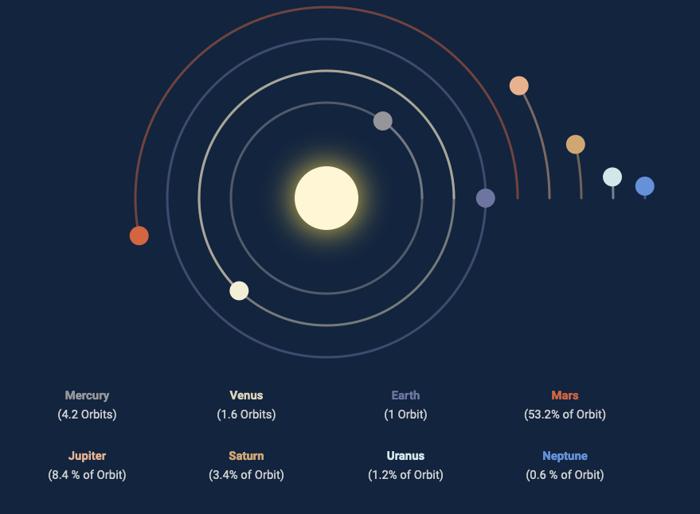

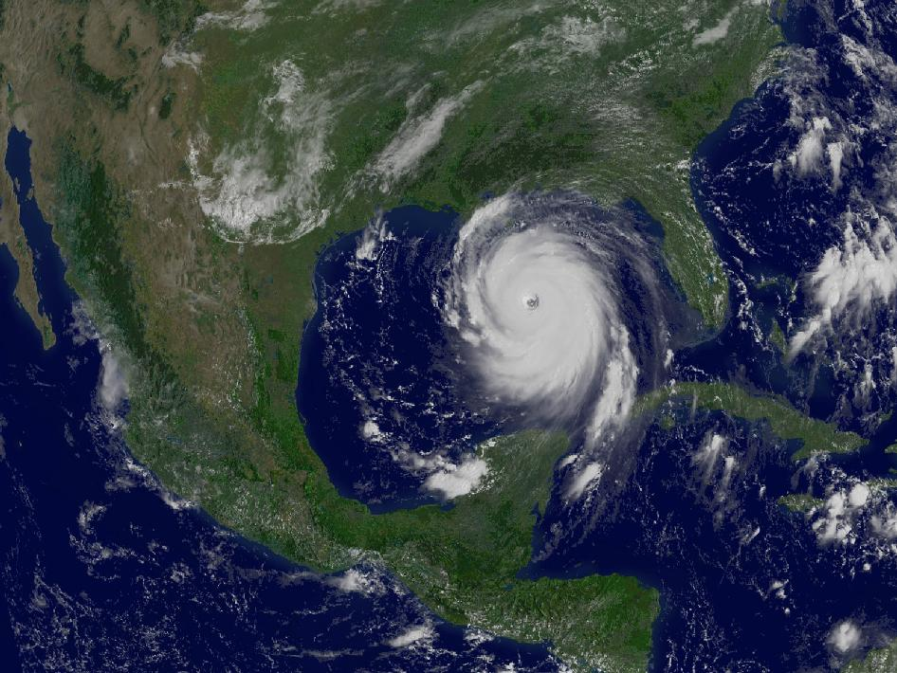
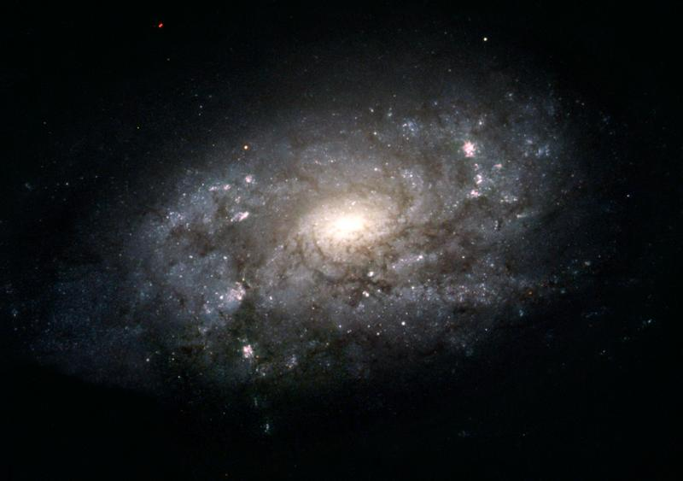
Milky Way Rotation Curve
space-facts.com
Charlotte Leaper
NGC 3949
NASA
NASA (HST)

Slide 2
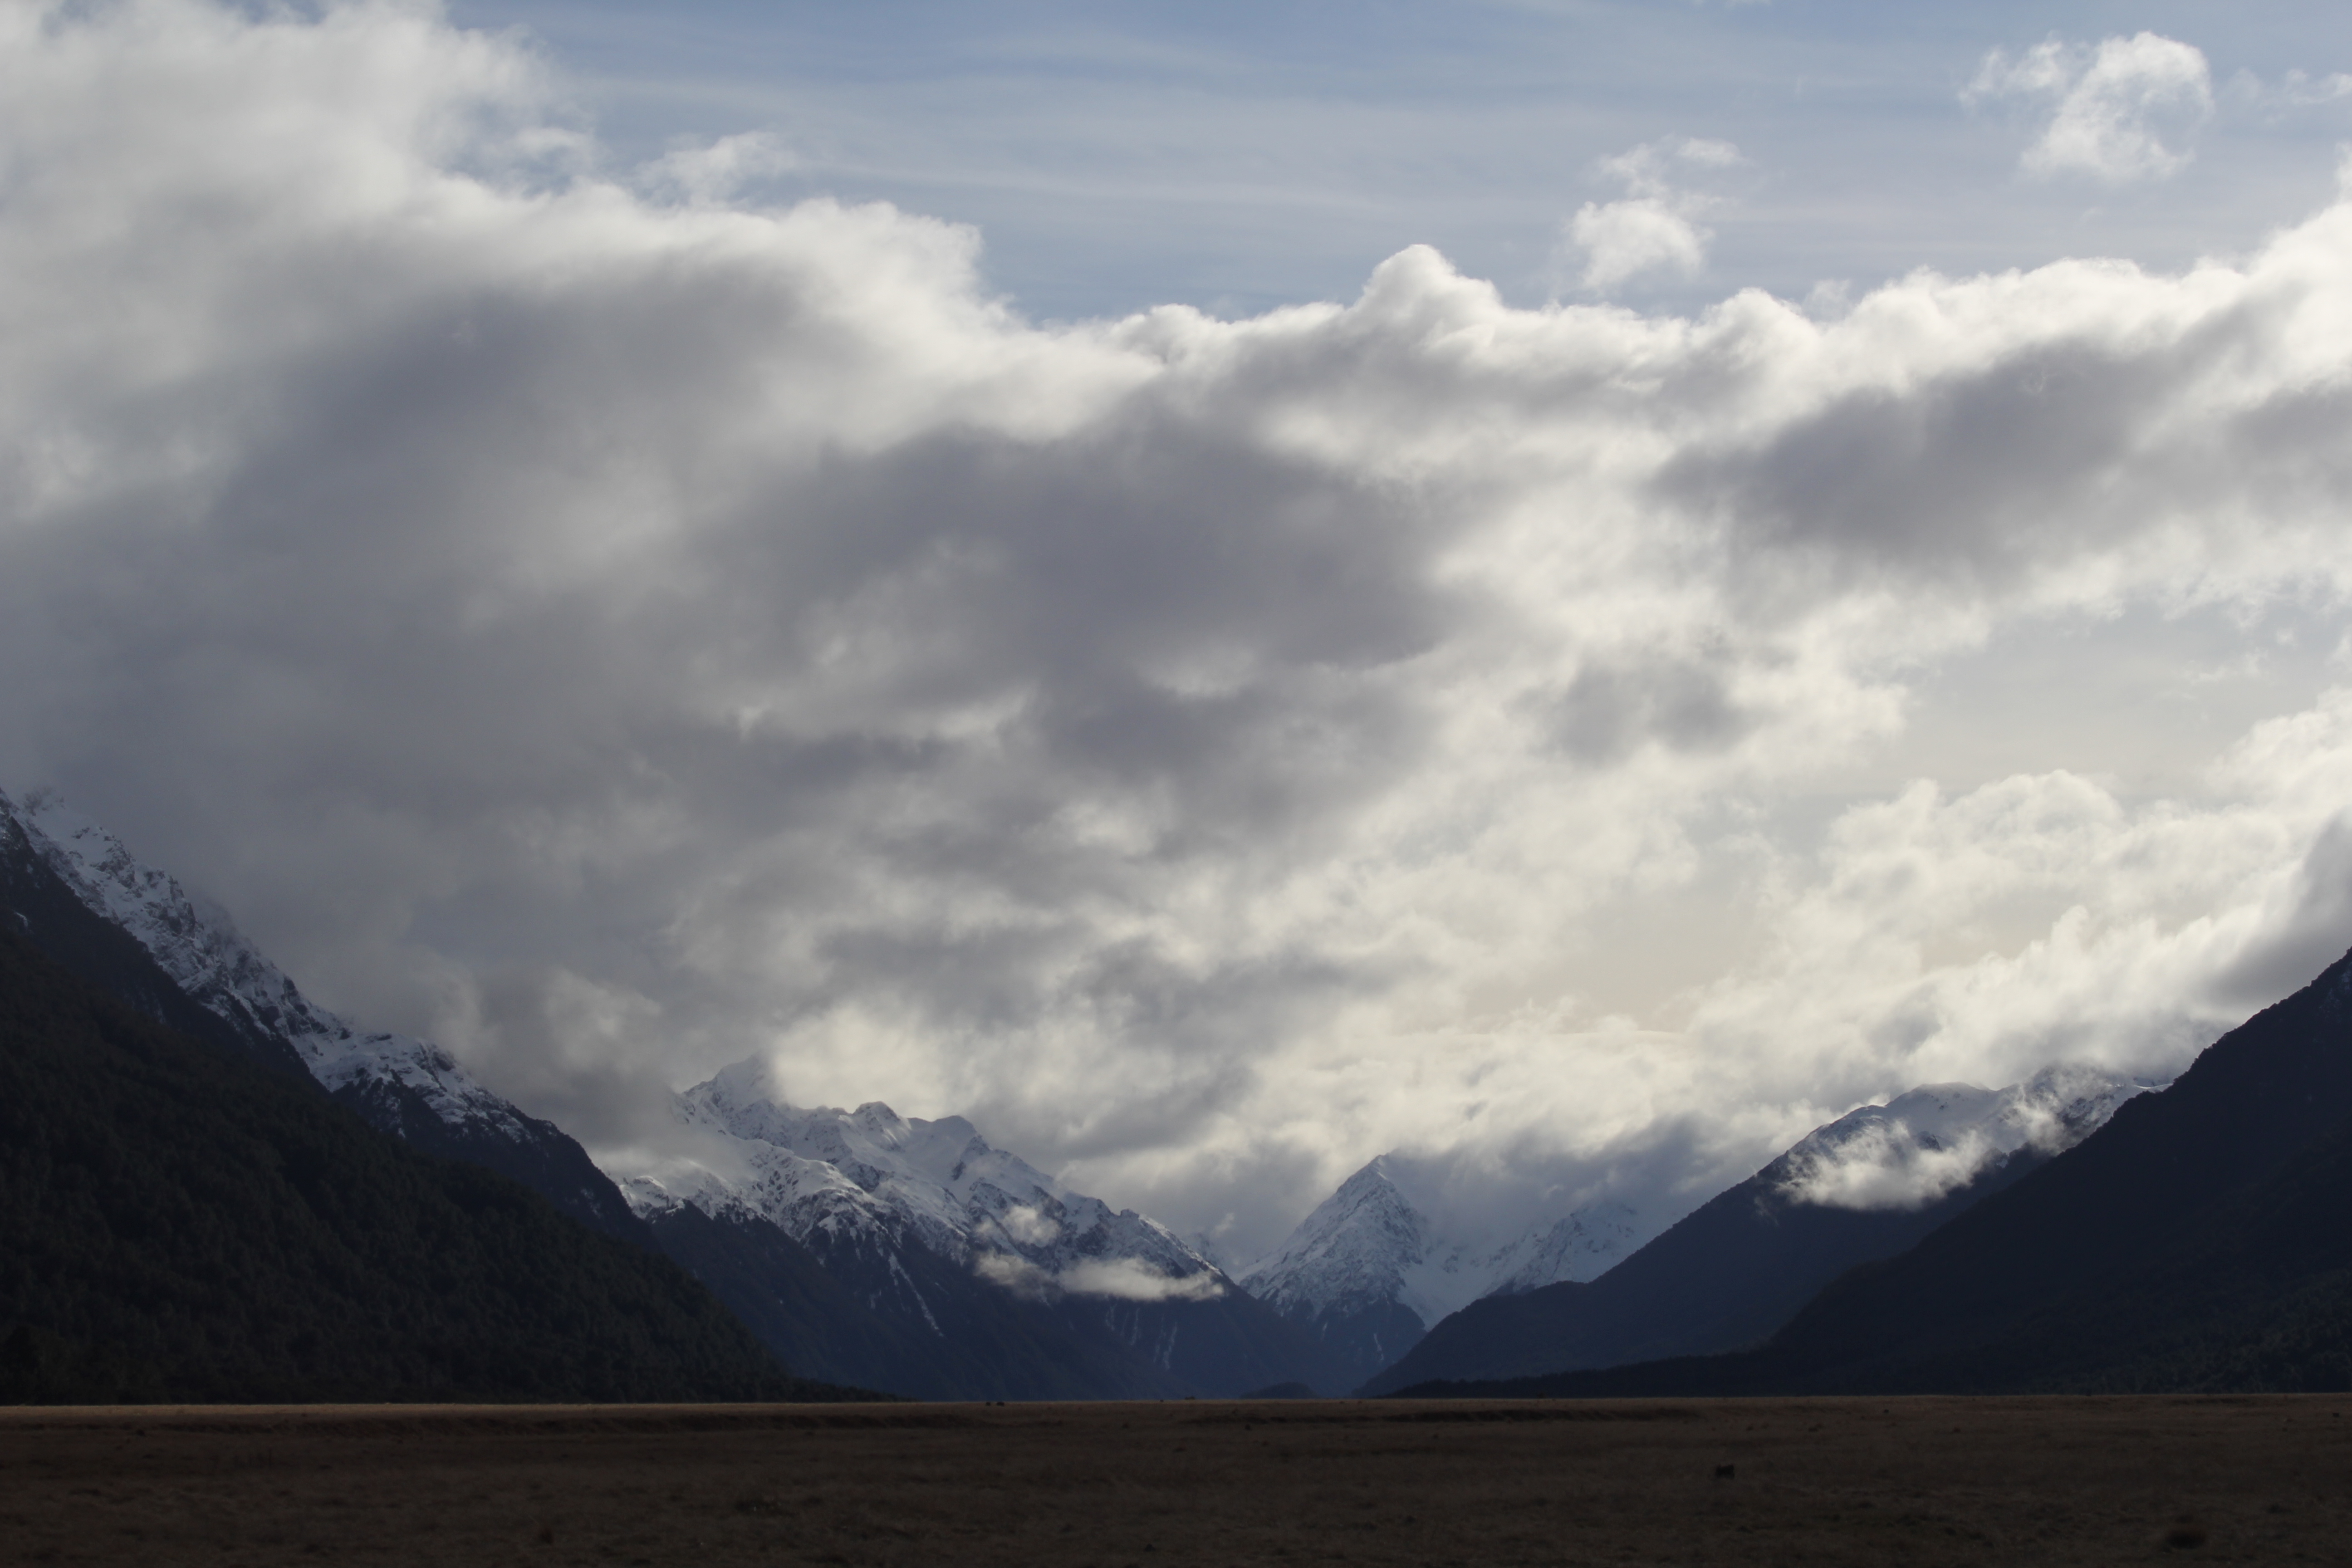


Assignments
Tuesday 03 FEB Level 0 … Ideas
Tuesday 10 FEB Bio Sketch
Tuesday 17 FEB Level 1 … Outline … 2 weeks later
Thursday 19 FEB Milky Way Neighborhood
Tuesday 10 MAR Level 2 … 1st Draft … 3 weeks later
Tuesday 31 MAR Level 3 … 2nd Draft … 3 weeks later
Tue/Thu 14/16 APR Presentations … 2 weeks later
Thursday 23 APR Level 4 … submit … 1 week later

Slide 3
Milky Way Neighborhood (2026)
 | RA | DEC | Size (kpc) | Dist (kpc) | Bits / # Globulars / References
Milky Way Todd | --- | --- | 60 20 in | 0 | warp, bar, 2-4 arms, LMC, SMC, Sgr dSph, 50+ small galaxies, ~150 globulars, Earth, Ryland Grace + Rocky, 40 Eri ABC (wd+K+M) = home of Rocky, Vulcan, tau Ceti (G)
Andromeda M31 Roger + Ben | 00:43 | +41:16 | 67 22 in | 780 22 ft | SB(rs)b --- bulge, bar, 2ish spiral arms, massive dust ring circle around outer edge, 500+ globulars, oldest stars 12 Gyr, headed for MW crash in 6 Gyr
Triangulum M33 Megan + Ella | 01:33 | +30:39 | 18x16 3 in | 840 23 ft | SA(s)cd --- flocculent spiral (loose arms/mess), late-type, Triangulum tango with MW + And, small but bulge > MW, 100+ star clusters, 1 cluster with 200 O/B stars
Bode’s M81 Madeline + Akshat | 09:55 | +69:03 | 29 10 in | 3700 103 ft | SA(s)ab --- 2 tight arms grand design spiral, Large bulge, 7x10^6 central SMBH, 74+ globulars, 2 big irregular galaxies, ~150 globulars, 2000-3000 open clusters
Pinwheel M101 Karina + AJ | 14:03 | +54:20 | 77 26 in | 6644 185 ft | SAB(rs)cd --- 2000-3000 open clusters, six 3-13 kpc companions caused a lot of star formation, NON-rotating Pinwheel
Whirlpool M51 Madison + Mahir | 13:30 | +47:13 | 30 10 in | 7500 208 ft | SAbc --- grand design, Seyfert 2 AGN, interacting with NGC 5195 (18 kpc, passing behind) with bridge 8 kpc … boosted star formation
Notes:
1 inch = 3 kpc

Slide 4
Milky Way Disk Formation
Four Phases 1. early star formation in ENORMOUS contracting cloud
globular clusters as substantial blobs
halo stars old
halo stars have random motion
2. collapse of gas to disk … shape
3. star formation in disk … young stars now
4. absorbing other galaxies/GCs … star streams
HALO FIRST … DISK LAST
In which phase does disk heating occur?
Notes:
ANSWER: all phases

Slide 5
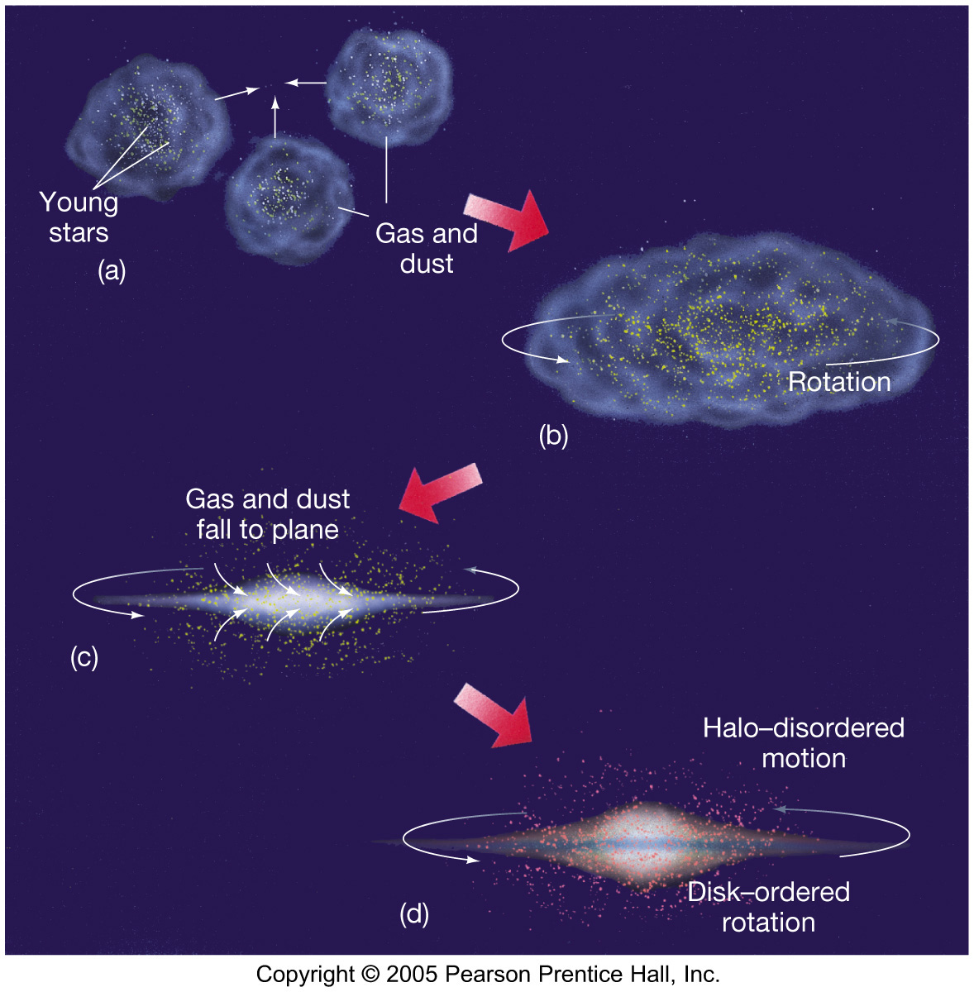
Formation

Slide 6
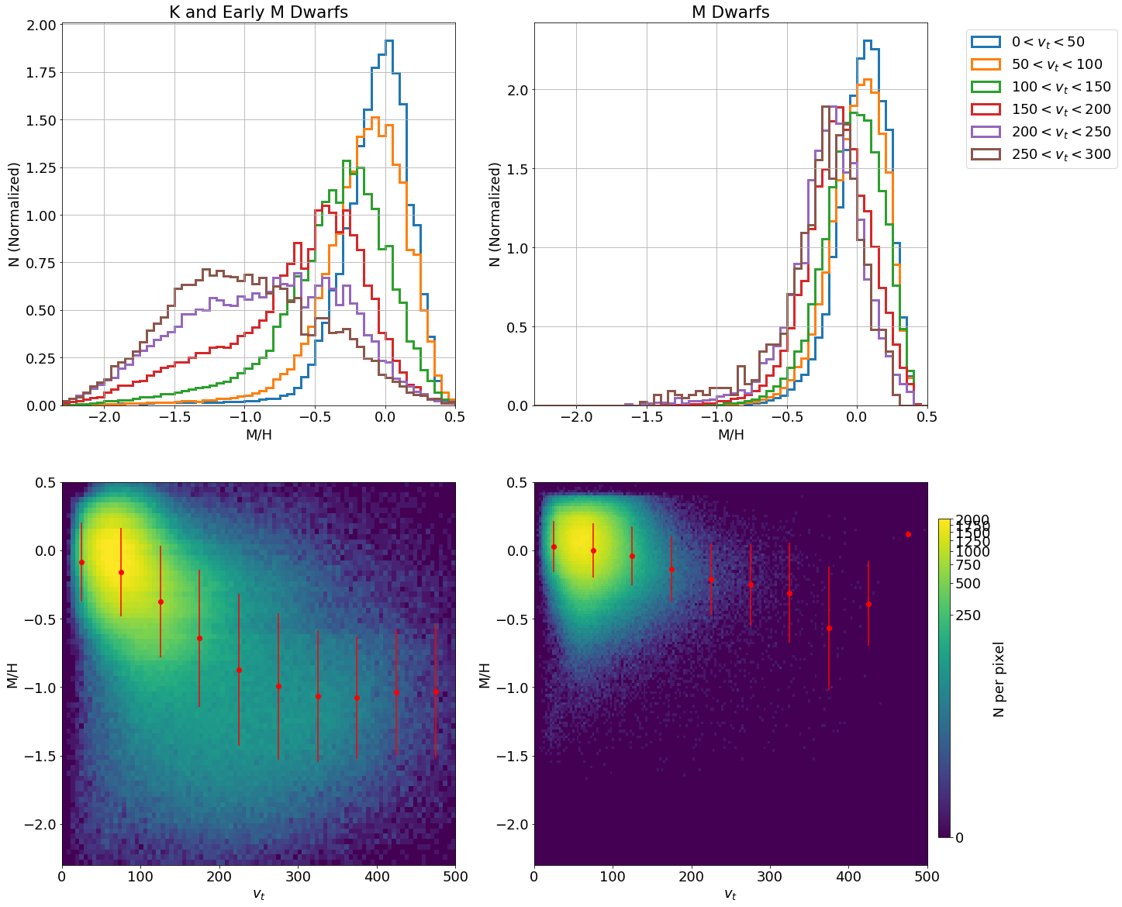
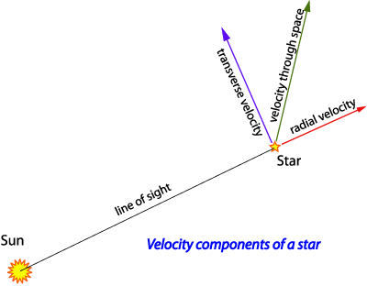
Galactic Motions: On-Sky
David Darling
Medan et al. 2021
What does this plot show?
What would it look like for OB stars?
Notes:
Medan uses 1.7 million stars from GDR2

Slide 7
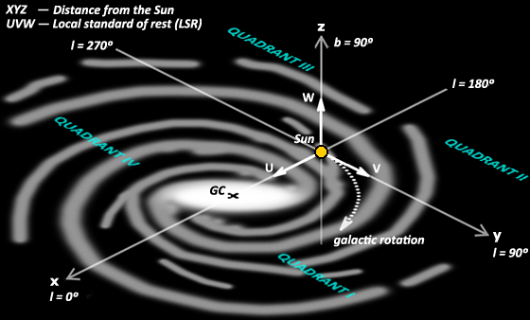
Galactic Motions: UVW
Bruce MacEvoy

Slide 8
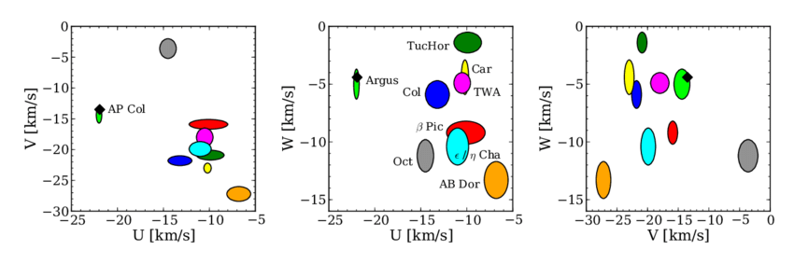
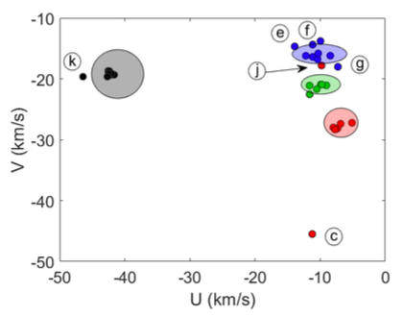
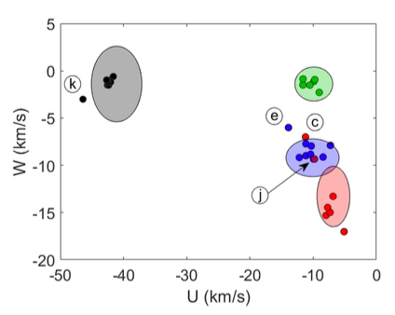
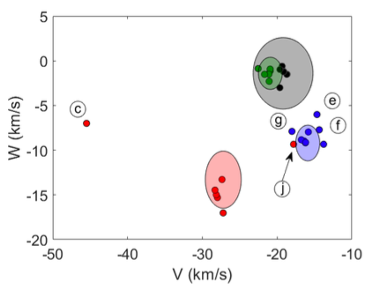
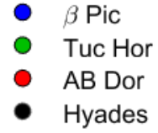
Galactic Motions: UVW
Bruce MacEvoy
Riedel et al. 2011
Hubbard-James
et al. 2022
Why don’t some cluster members land in ovals?

Slide 9
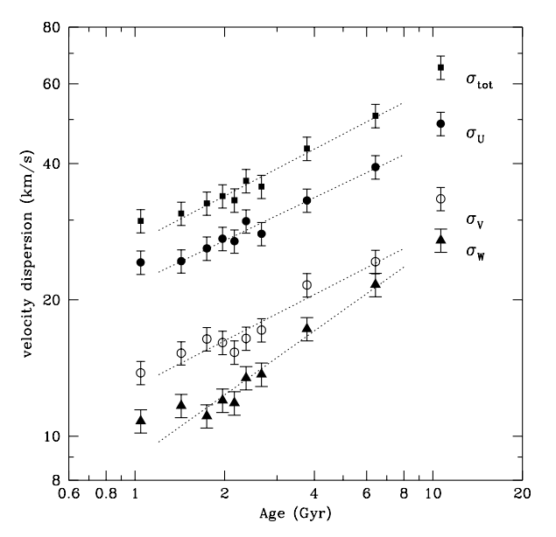
Galactic Motions: Velocity Dispersion
~ 14000 F/G dwarfs
Hipparcos/Tycho astrometry
~ 63000 RV measurements
ages from isochrone fits
Nordstrom et al. 2004
What is this process called?
ANSWER: “thin disk heating” … by GMCs and spiral arms
Notes:
bubble data not fit --- unrelaxed young structures and thick disk stars

Slide 10
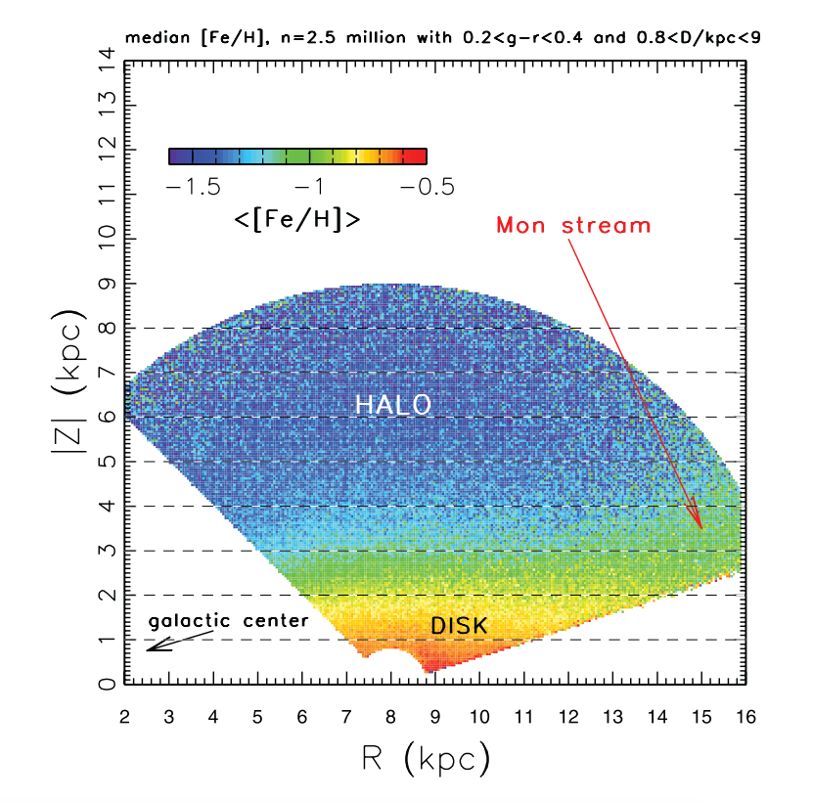
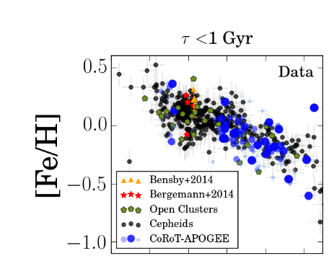
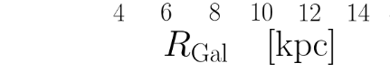
Metallicities
Ivezic et al. 2008
Anders et al. 2017
How does metallicity change vertically?
How does metallicity change horizontally?

Slide 11
Milky Way Rotation Curve
space-facts.com
Charlotte Leaper
NGC 3949
NASA
NASA (HST)
Notes:
EXERCISE --- students go to the board in groups to map rotation curves before revealing plots
Solar System ---NO, space velocity decreases as you go out
Carousel --- NO, space velocity increases as you go out
Hurricane Katrina --- SORT OF, but very fast near center
NGC 3949 --- YES, similar to Milky Way

Slide 12
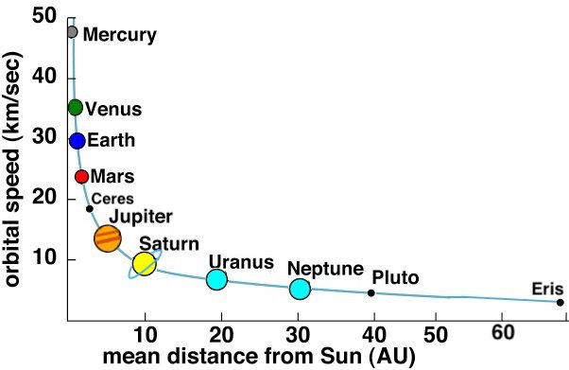
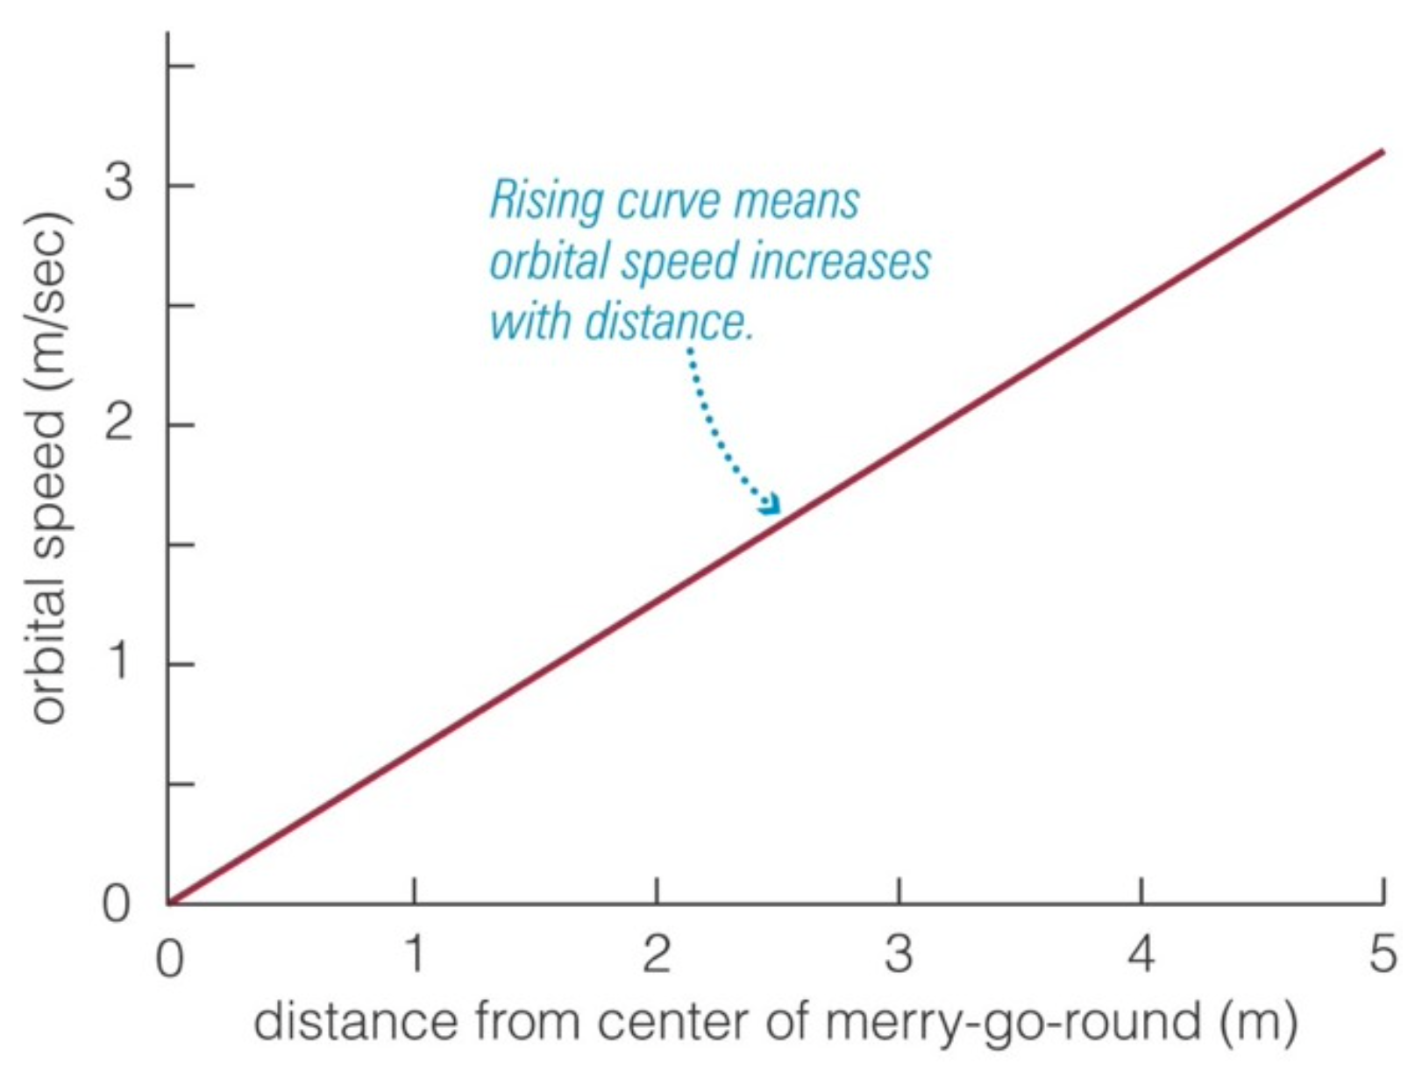
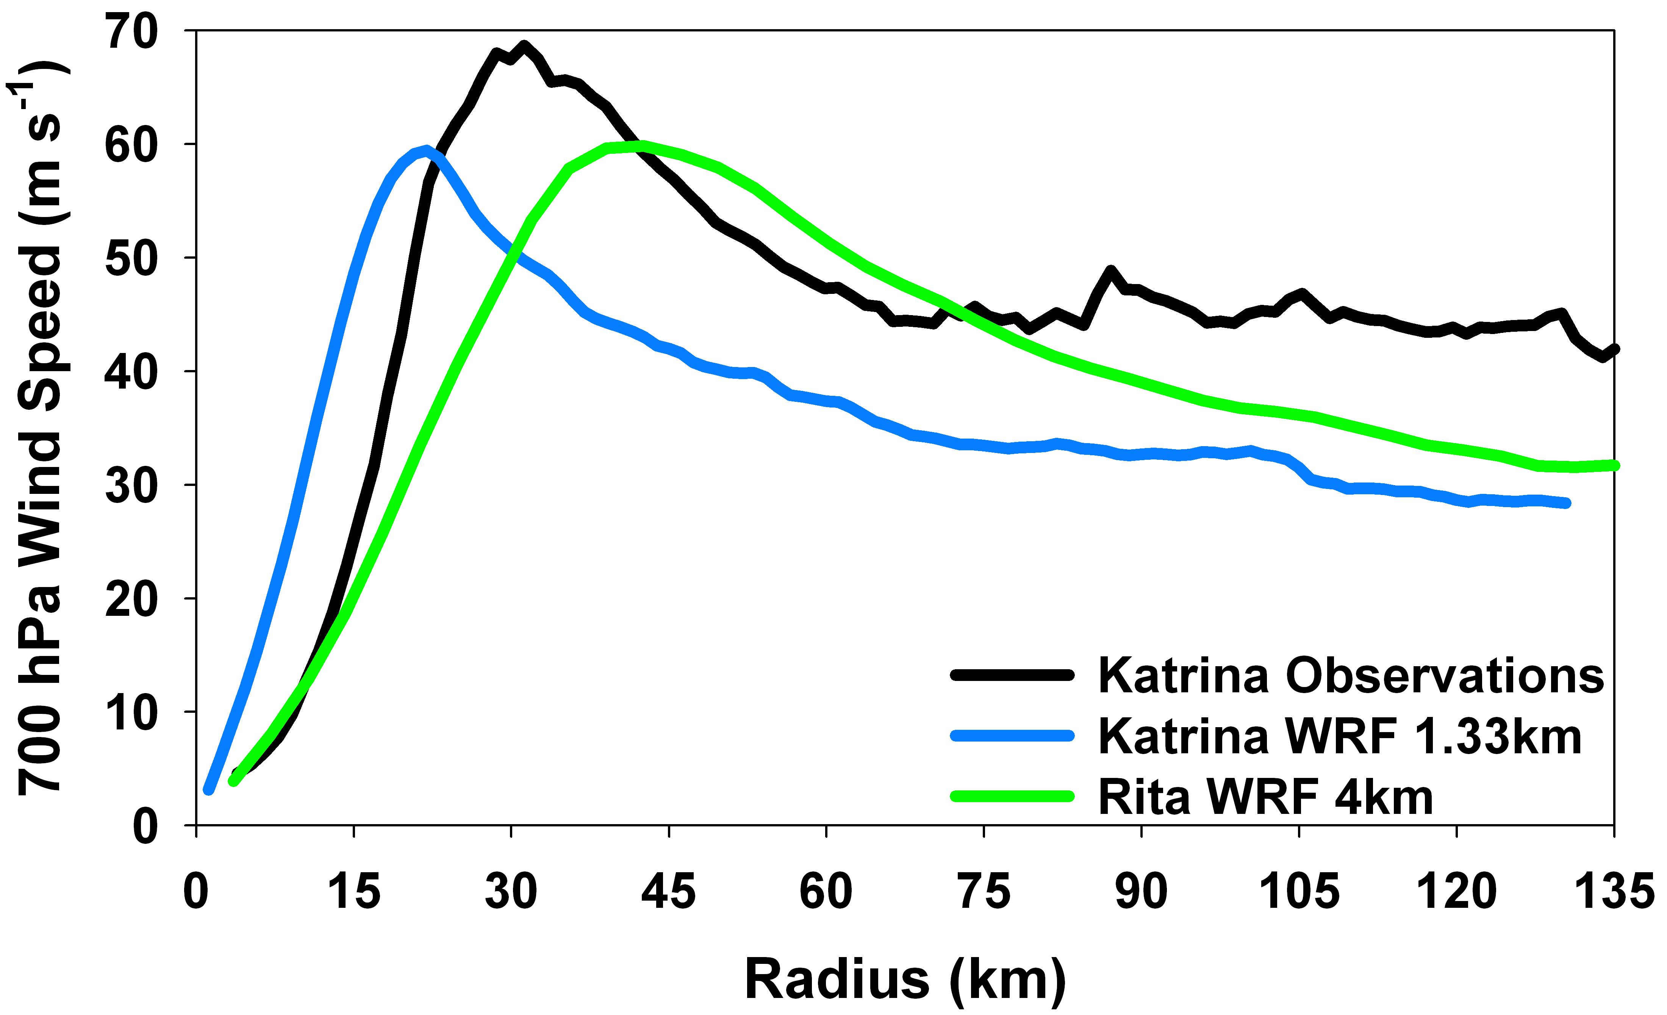
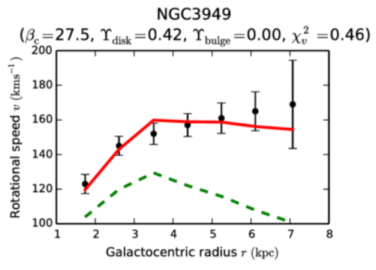
Milky Way Rotation Curve
space-facts.com
Pearson Education
www.atmos.albany.edu
Chan & Hui 2018
Notes:
Solar System ---NO, space velocity decreases as you go out
Carousel --- NO, space velocity increases as you go out
Hurricane Katrina --- SORT OF, but very fast near center
NGC 3949 --- YES, flat moving out …NGC3949 similar to Milky Way

Slide 13
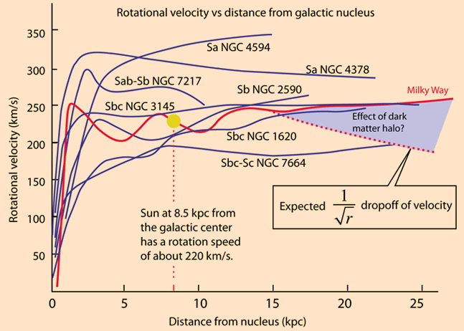
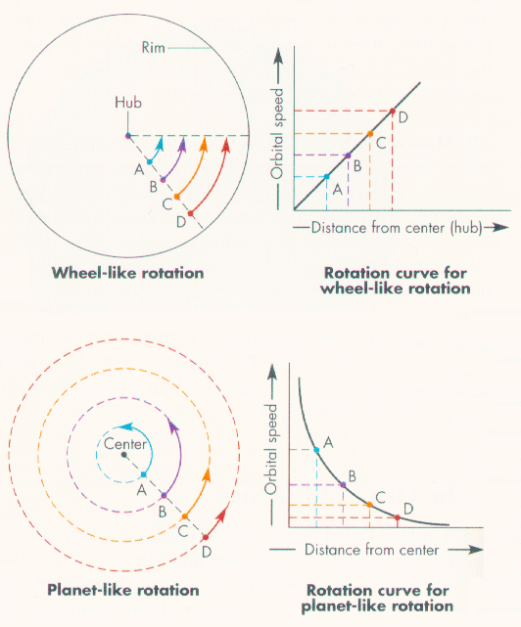
Rotation Curves
Notes:
spirals

Slide 14
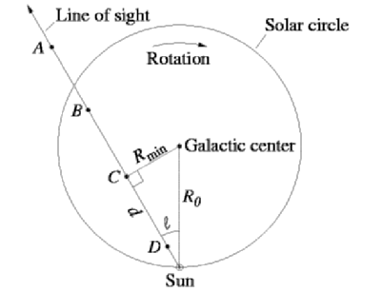
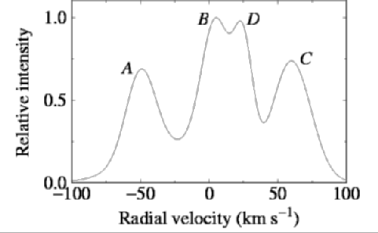
MW Rotation Curve
Tangent Point Method
visible … starlight absorbed
radio … use HI clouds
don’t know distance to cloud
V_{rad} greatest at tangent point = C
R_{min} = R sin l
V_{rad} = V_{C} − V sin l
V_{rad} = (Ω_{R} − Ω) Rsin l
you can map V_{rad} as a function of l which translates to R ... but only for R < R

Slide 15
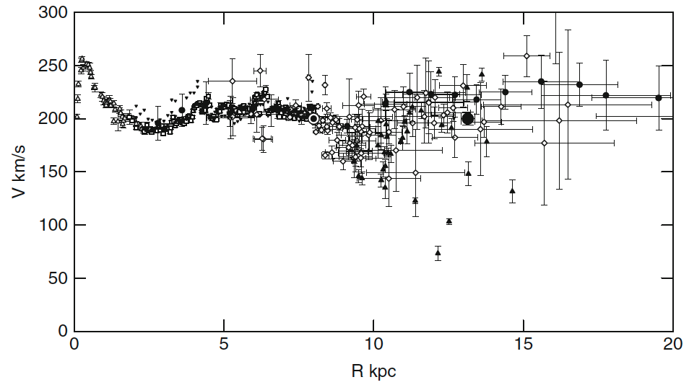
Rotation Curve
inner curve
tangent points
outer curve
distance estimates
Sofue+ (2009)
Notes:
Fig. 1. Observed circular velocities representing the rotation curve of the Galaxy. Open triangles: HI tangent velocity method (Burton & Gordon 1978); rectangles: CO tangent (Clemens 1989); reverse triangles: HI tangent (Fich et al. 1989); diamonds: CO and HII regions (Fich et al. 1989; Blitz et al. 1982); filled triangles: Demers and Battinelli (2007); circles: HI thickness (Honma and Sofue 1997a, b); big circle at 13.1 kpc: VERA-parallax, proper motion, and velocity (Honma et al. 2007). All data have been converted to (R0, V0) = (8.0, 200.0 km/s).

Slide 16
Rotation Curve
HI open/reverse triangles, circles
CO rectangles
CO+HII diamonds
C stars filled triangles
S269 star formation region’s parallax/proper motion = big dot
189 ± 9 microarcsec = 5.3 kpc … same as Sun’s velocity … flat rotation curve
Sofue+ (2009)
Notes:
Fig. 1. Observed circular velocities representing the rotation curve of the Galaxy. Open triangles: HI tangent velocity method (Burton & Gordon 1978); rectangles: CO tangent (Clemens 1989); reverse triangles: HI tangent (Fich et al. 1989); diamonds: CO and HII regions (Fich et al. 1989; Blitz et al. 1982); filled triangles: Demers and Battinelli (2007); circles: HI thickness (Honma and Sofue 1997a, b); big circle at 13.1 kpc: VERA-parallax, proper motion, and velocity (Honma et al. 2007). All data have been converted to (R0, V0) = (8.0, 200.0 km/s).

Slide 17
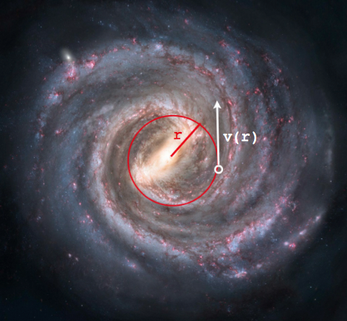
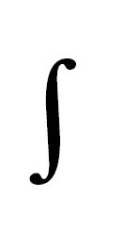
Rotation Velocities
orbital motion
F_{c} = F_{g}
mv²/r = GMm/r²
v(r) = (GM/r)^{1/2}
where M is the mass inside radius r:
M(r) = ρ(r) πr² dr
BUT, what *IS* is the mass inside radius r?
M(r) = M_{blackhole} + M _{bulge}(r) + M_{disk}(r) + M_{halo}(r)
… so …
v(r) = ( G[M_{blackhole} + M _{bulge}(r) + M_{disk}(r) + M_{halo}(r)] / r )^{1/2}
Notes:
Fc = centripetal force
had a 2 in the Mr equation, not sure why

Slide 18
Rotation Curve
bulge
disk
halo
Sofue+ (2009)
Notes:
Fig. 1. Observed circular velocities representing the rotation curve of the Galaxy. Open triangles: HI tangent velocity method (Burton & Gordon 1978); rectangles: CO tangent (Clemens 1989); reverse triangles: HI tangent (Fich et al. 1989); diamonds: CO and HII regions (Fich et al. 1989; Blitz et al. 1982); filled triangles: Demers and Battinelli (2007); circles: HI thickness (Honma and Sofue 1997a, b); big circle at 13.1 kpc: VERA-parallax, proper motion, and velocity (Honma et al. 2007). All data have been converted to (R0, V0) = (8.0, 200.0 km/s).

Slide 19
Rotation Curve (Sofue+ 2009)
bulge
de Vaucouleurs (1958) surface mass profile: Σ(r) ~ e^{(−r/Rscale)1/4}
R_{scale} = 0.5 kpc
mass distribution spherical (really ok down to ~0.5 kpc)
M/L ratio constant ≈ 7 M/L
M_{bulge} = 2 X 10¹⁰ M
disk
Freeman (1970) surface mass profile: Σ(r) ~ e^{(−r/Rscale)} + Δ
R_{scale} = 3.5 kpc
Δ is density perturbation due to arms or rings
M_{disk} = 7 X 10¹⁰ M
halo
Kent (1986) spherical mass profile: ρ(r) ~ ρ_{central} / [1 + (r/R_{scale})²]
R_{scale} = 5.5 kpc
forces flat rotation curve at large radius as ρ(r) goes to zero
… BUT many combinations of ρ_{central} and R_{scale} work as well as mass profiles
M_{disk} ~ 10¹¹ M within 20 kpc
Notes:
Total masses of individual components integrated in a sphere of radius R. Dotted line: bulge; thick solid line: disk; dash: halo; and long dashed line: their sum.

Slide 20
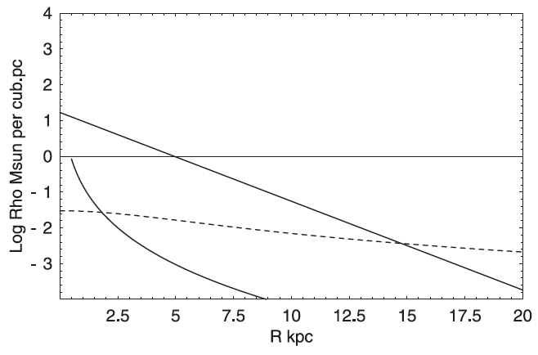
Rotation Curve: volume density
disk
(ignore this)
halo
bulge
Sofue+ (2009)

Slide 21
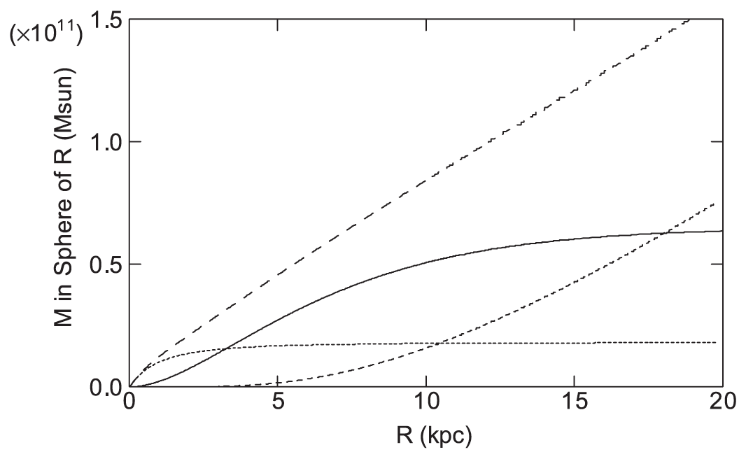
Rotation Curve: total mass
total
disk
halo
bulge
Sofue+ (2009)
Notes:
Total masses of individual components integrated in a sphere of radius R. Dotted line: bulge; thick solid line: disk; dash: halo; and long dashed line: their sum.

Slide 22
Total Mass … Stars
10¹¹ M
median stellar mass ~ 0.3 M
3 X 10¹¹ stars
“300 billion stars”
How does all this mass affect observed VELOCITIES?

Slide 23
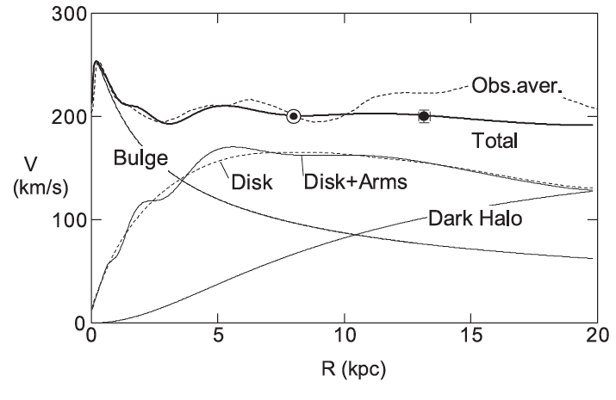
Rotation Curve
Sofue+ (2009)

Slide 24
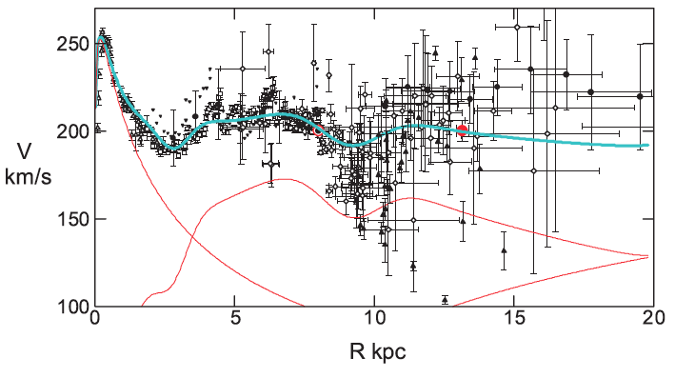
Rotation Curve
3 kpc dip
9 kpc dip
sum
bulge disk
halo
Sofue+ (2009)
Why no contribution from M_{blackhole} included?
Notes:
note cutoff at 100 km/s instead of 0 km/s

Slide 25
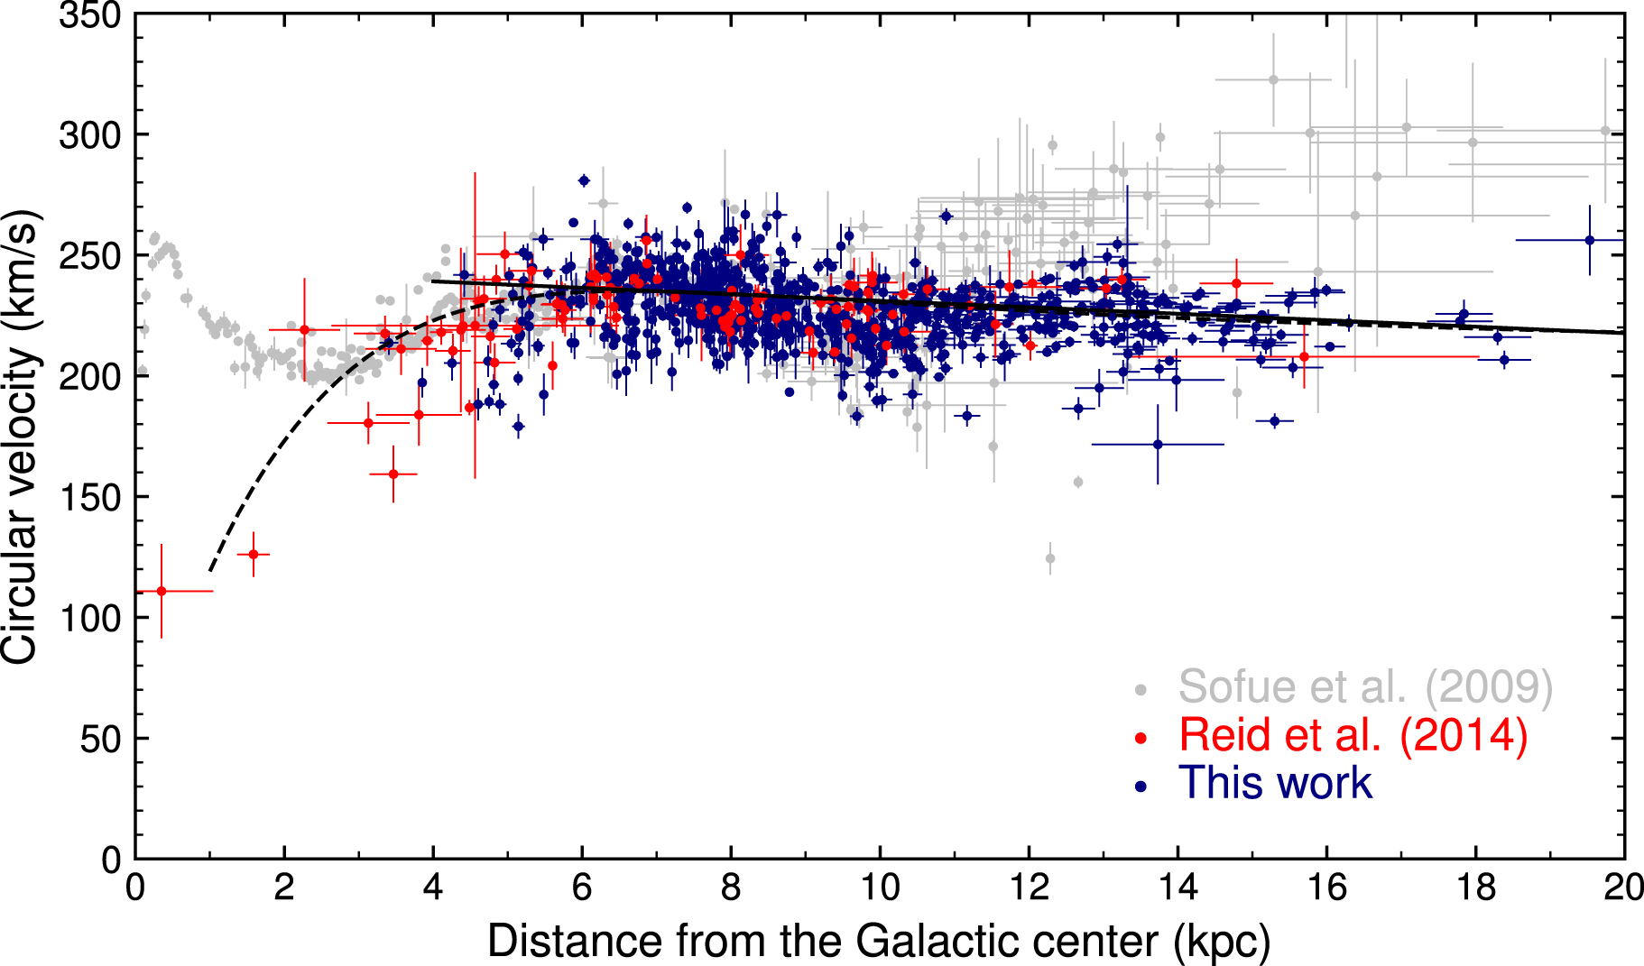
Rotation Curve
3 kpc dip
9 kpc dip
sum
bulge disk
halo
773 Cepheids
distances from infrared P-L relations (WISE and Spitzer)
Gaia proper motions and radial velocities
Mroz+ (2019)
Notes:
mid-infrared P-L relations key … you can see the Cepheids far away
Rotation curve of the Milky Way for Cepheids assuming R₀ = 8.09 kpc and Θ₀ = 233.6 km s⁻¹ (model 2). Red data points represent high-mass star-forming regions (Reid et al. 2014). Gray data points are taken from Sofue et al. (2009) and are rescaled to new (R₀, Θ₀) using formula . Solid and dashed lines show the best-fitting models (linear and universal, respectively).

Slide 27
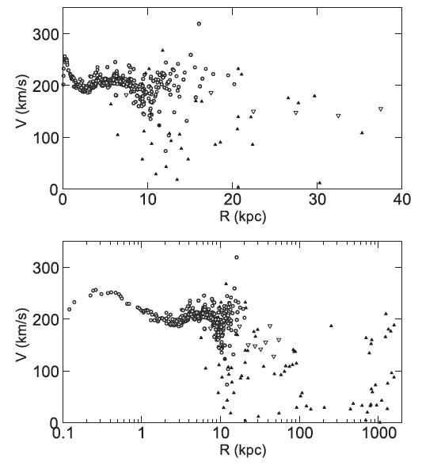
Grand Rotation Curve
Galactic Center to 1 Mpc
MW-And ~ 0.8 Mpc
circles = disk objects
triangles = non-disk
globulars+satellites
Sofue 2012

Slide 28
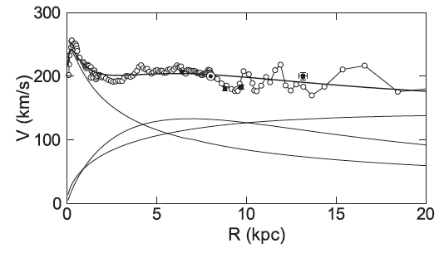
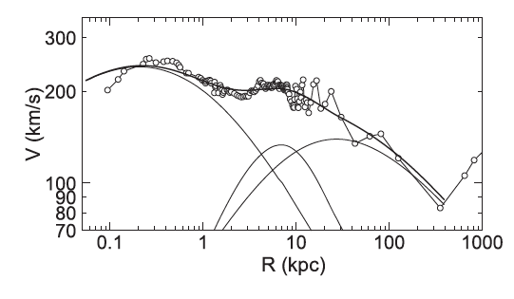
Grand Rotation Curve
Galactic Center to 1 Mpc
MW-And ~ 0.8 Mpc
within 385 kpc = halfway to And
bulge 1.7 X 10¹⁰ M ~ 2%
disk 3.4 X 10¹⁰ M ~ 4%
halo 6.5 X 10¹¹ M ~ 94%
TOTAL 7.03 (± 1.01) X 10¹¹ M
implies
halo/(bulge+disk) = 14:1
≈ dark matter/baryons
bulge
halo
disk
bulge
halo
disk
Sofue 2012
Notes:
squares in top panel are VERA results
error on TOTAL mass is truly ABSURD

