Slide 1
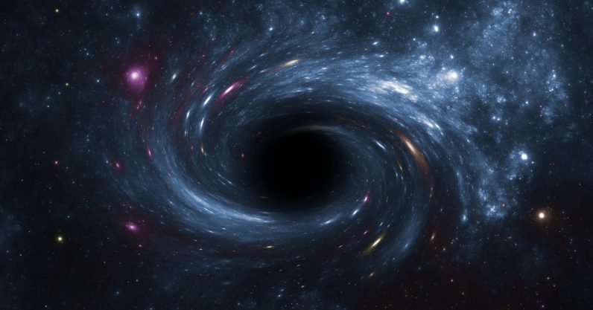
Galactic Center

Slide 2
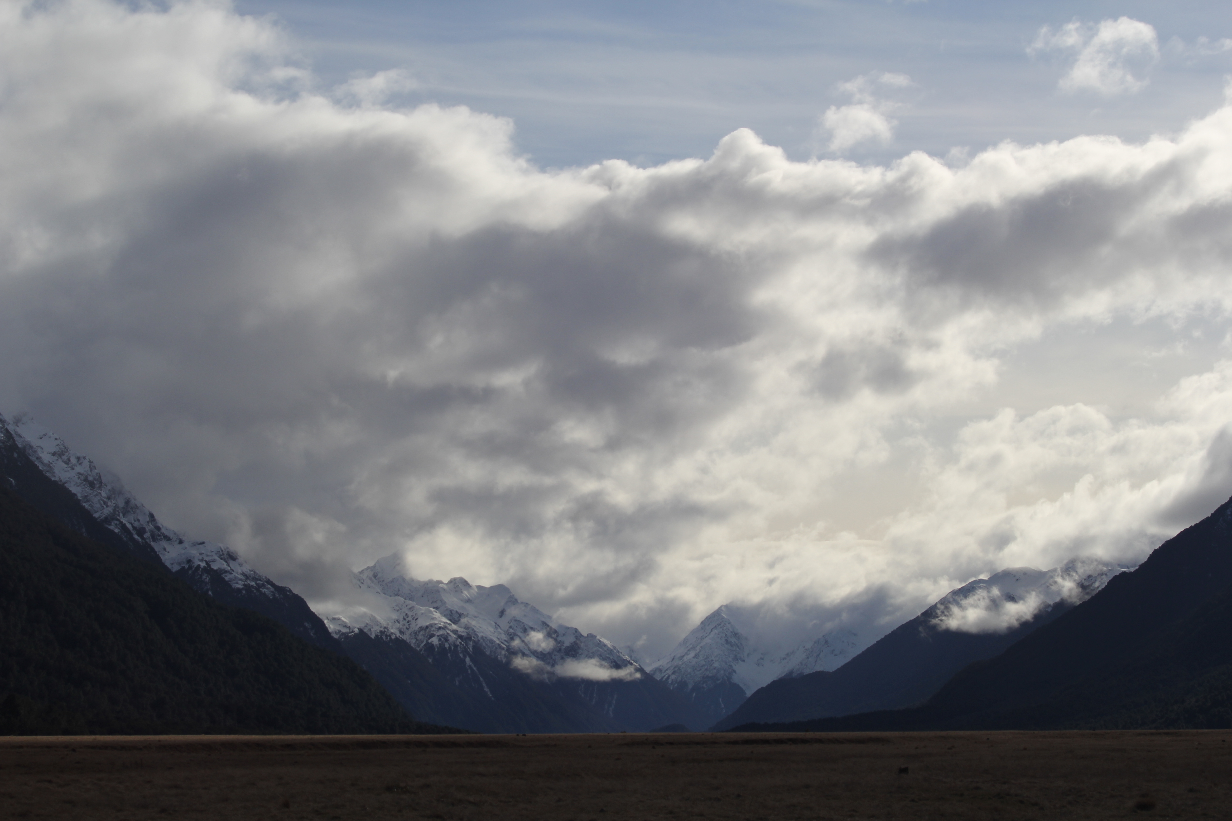


Assignments
Tuesday 03 FEB Level 0 … Ideas
Tuesday 10 FEB Bio Sketch
Tuesday 17 FEB Level 1 … Outline … 2 weeks later
Thursday 19 FEB Milky Way Neighborhood
Tuesday 10 MAR Level 2 … 1st Draft … 3 weeks later
Tuesday 31 MAR Budgets + Narrative
Tuesday 07 APR Level 3 … 2nd Draft … 4 weeks later
Tue/Thu 14/16 APR Presentations … 1 week later
Thursday 23 APR Level 4 … submit … 1 week later

Slide 3
Page 1
Title/Name/Intellectual Merit/Broader Impact
IM (Abstract) and BI should be balanced … or lean to IM
I.M. “Goal of this work is to answer the scientific question … ?”
“Here I propose …”
say Gaia
say ground-based telescope(s) to be used
results … “deliverables”
B.I. Astro impact … relatively easy
science + grad/undergrad student skills
Public impact … harder, what will YOU, specifically, do?
#visits + #students reached

Slide 4

Proposal Pieces
GOAL: Fund yourself as a $75K/year postdoc for 3 years
1. Project Description 8.0 pages text + 2.0 pages Tab/Fig
2. References 0.5 page
3. Biographical Sketch 2.0 pages (SciENcv)
4. Budget 1.0 page (spreadsheet)
5. Budget Justification 1.0 page
6. Facilities 0.5 page
7. Student Mentoring Plan 0.5 page
8. Data Management Plan 0.5 page
Total Challenge ~ 16 pages

Slide 5
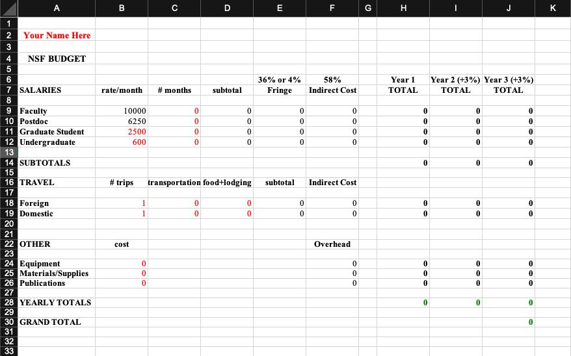
Budget

Slide 6

Budget Justification

Slide 7
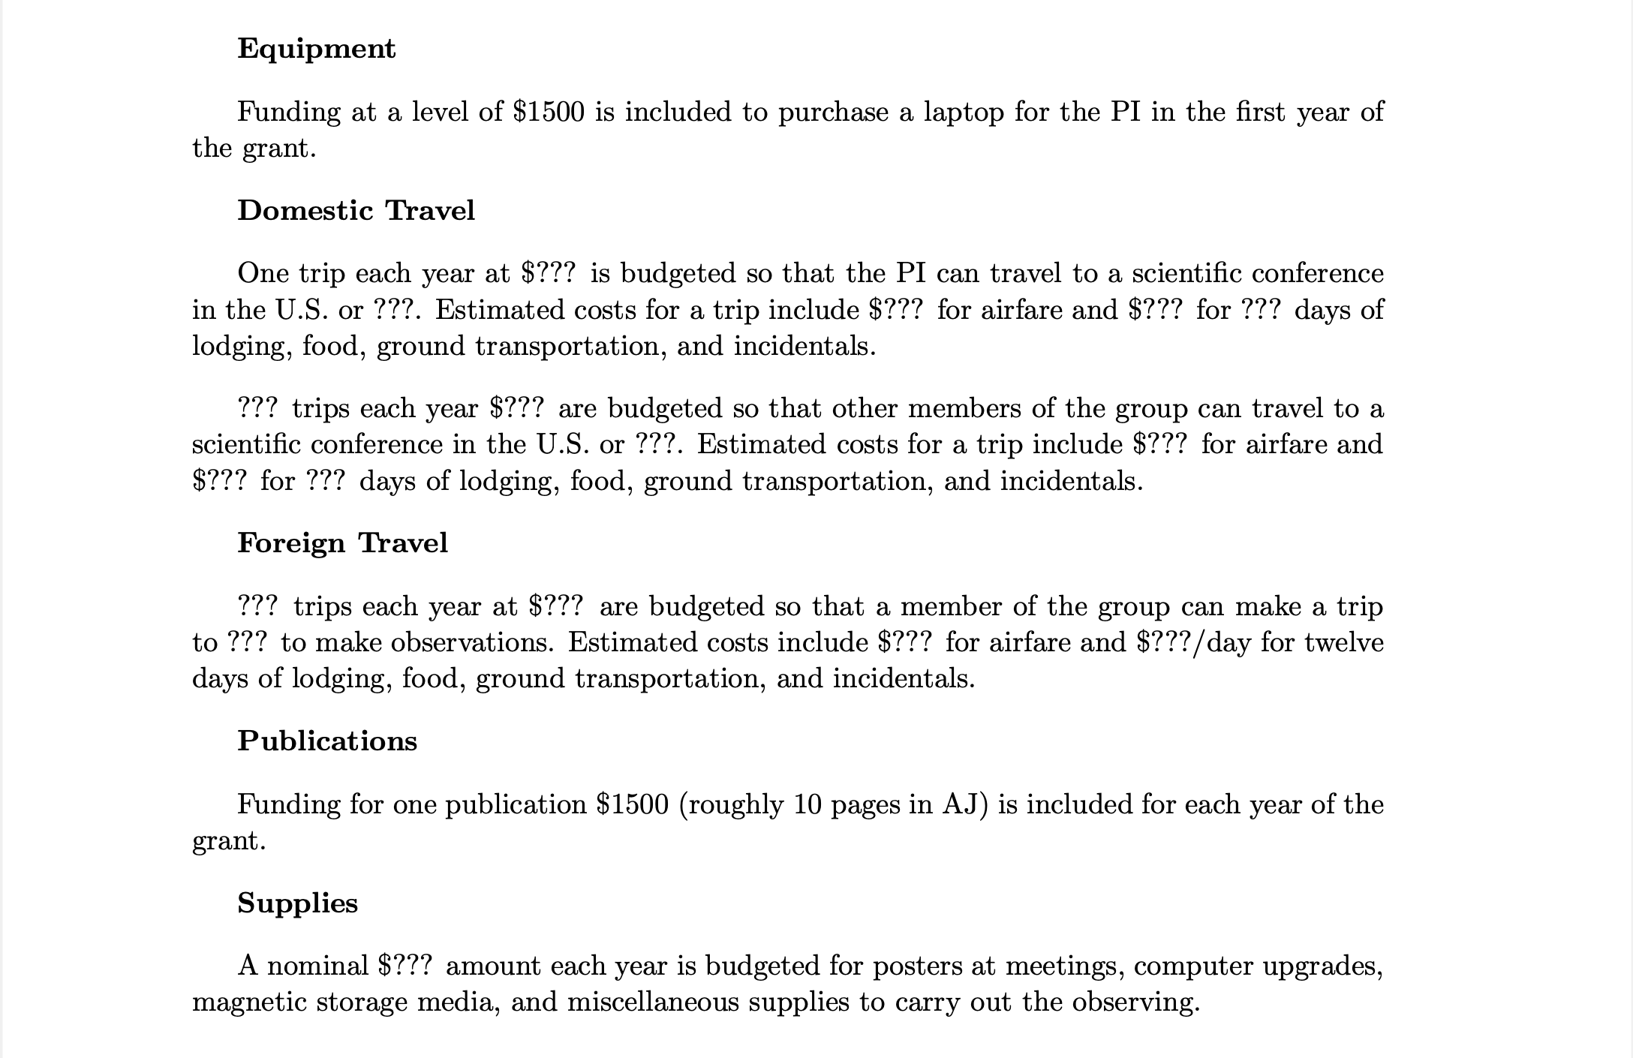
Budget Justification

Slide 8
Galactic Center

Slide 9
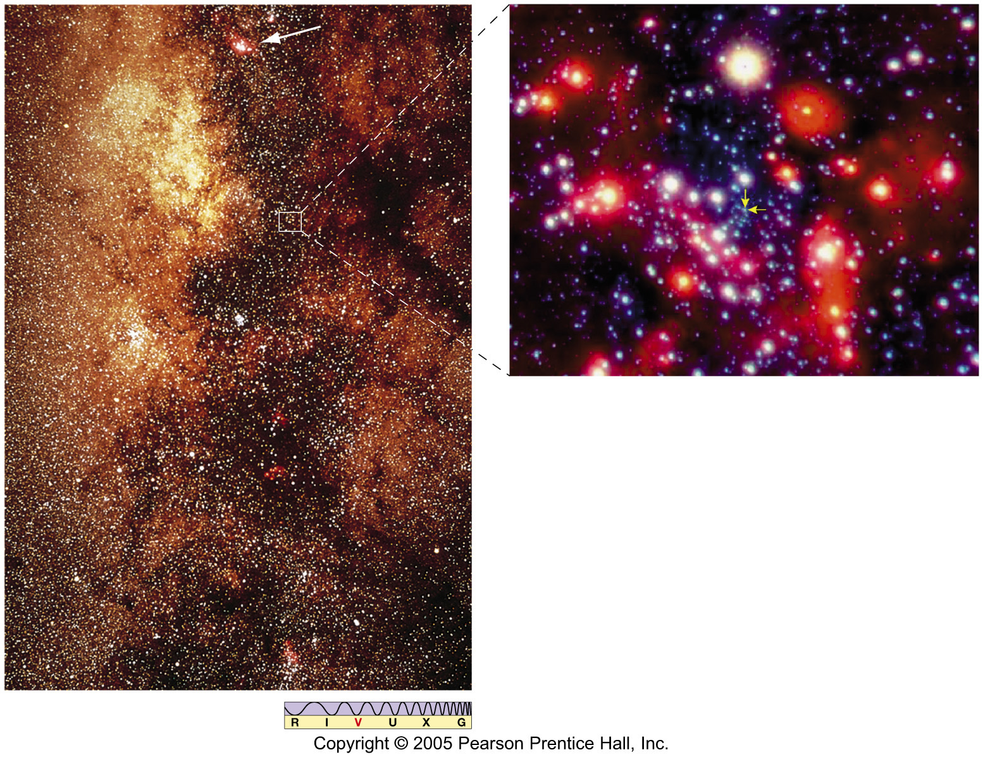
Milky Way Center
~8.4 kpc away
center of globular clusters
center of gas distribution
location of Sgr A*
Notes:
right picture is from Chandra

Slide 10
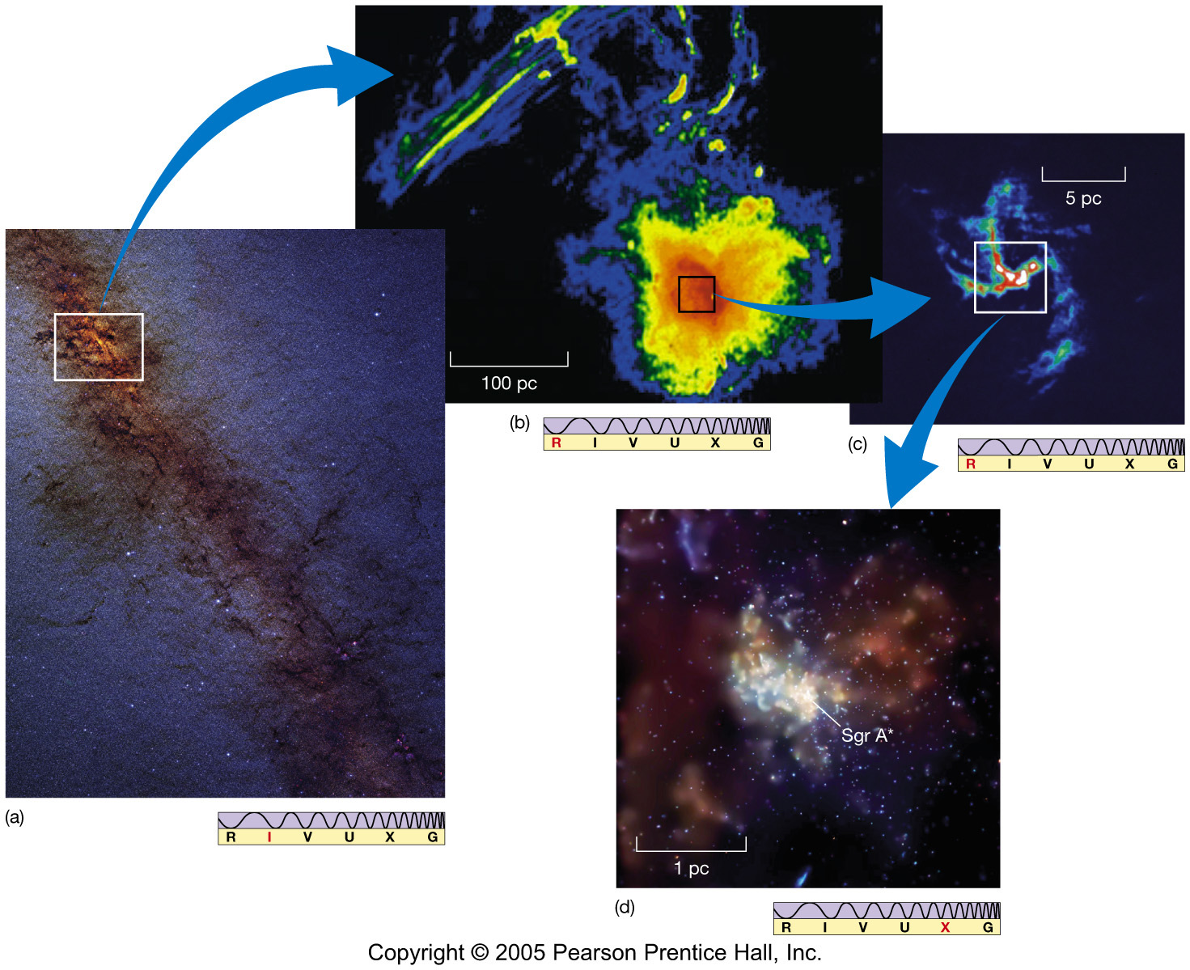
Milky Way Center

Slide 11
Milky Way Center
Contents 50,000 stars/cubic parsec … 500,000 X local!
molecular gas ring, diameter 400 parsecs
Ground Zero bright radio source … Sgr A*
1931: radio source near MW Center by Jansky
1974: Sgr A* discovered by Balick and Brown

Slide 12
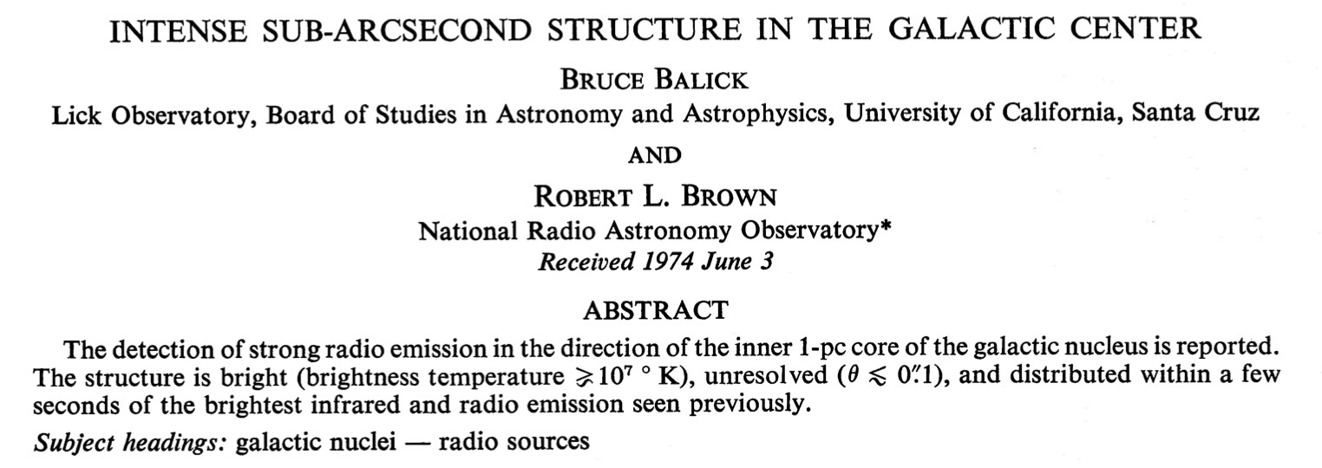
MW Center Structure
ApJ 1974
previously infrared background and 5 sources within 20 arcsec
radio structure at 2⎯20 arcsec
found bright radio source with size < 0.1 arcsec
The high brightness temperature, small angular diameter,
and intimate association with strong IR and nearby radio continuum sources
makes the sub-arcsecond structure unique in the Galaxy.
The unusual nature of the sub-arcsecond structure and its positional coincidence with
the inner 1-pc core of the galactic nucleus strongly suggests that this structure is physically
associated with the galactic center (in fact, defines the galactic center).
The available information shows that there exist some intriguing morphological similarities
between this structure and the more energetic nuclei of other galaxies in terms of
their size and brightness.
Notes:
6 page paper … 2 authors

Slide 13
Milky Way Center
Contents 50,000 stars/cubic parsec … 500,000 X local!
molecular gas ring, diameter 400 parsecs
Ground Zero bright radio source … Sgr A*
1931: radio source near MW Center by Jansky
1974: Sgr A* discovered by Balick and Brown
X-rays, gamma rays … energetic
hot gas at 10000 K … heating
extended filaments … magnetic fields
flickering … small
fast moving gas+stars … MASSIVE
Specs L_{xrays} = 2 X 10³³ erg/s … implies 10⁻¹⁰ Eddington
10⁵ times dimmer than standard accretion models
very little accretion = material flows AROUND black hole
Massive Stars + Baby Arms + Ring + high mass, small source
Notes:
The Eddington limit is the maximum luminosity a body (such as a star) can achieve when there is balance between the force of radiation acting outward and the gravitational force acting inward. The state of balance is called hydrostatic equilibrium.

Slide 14
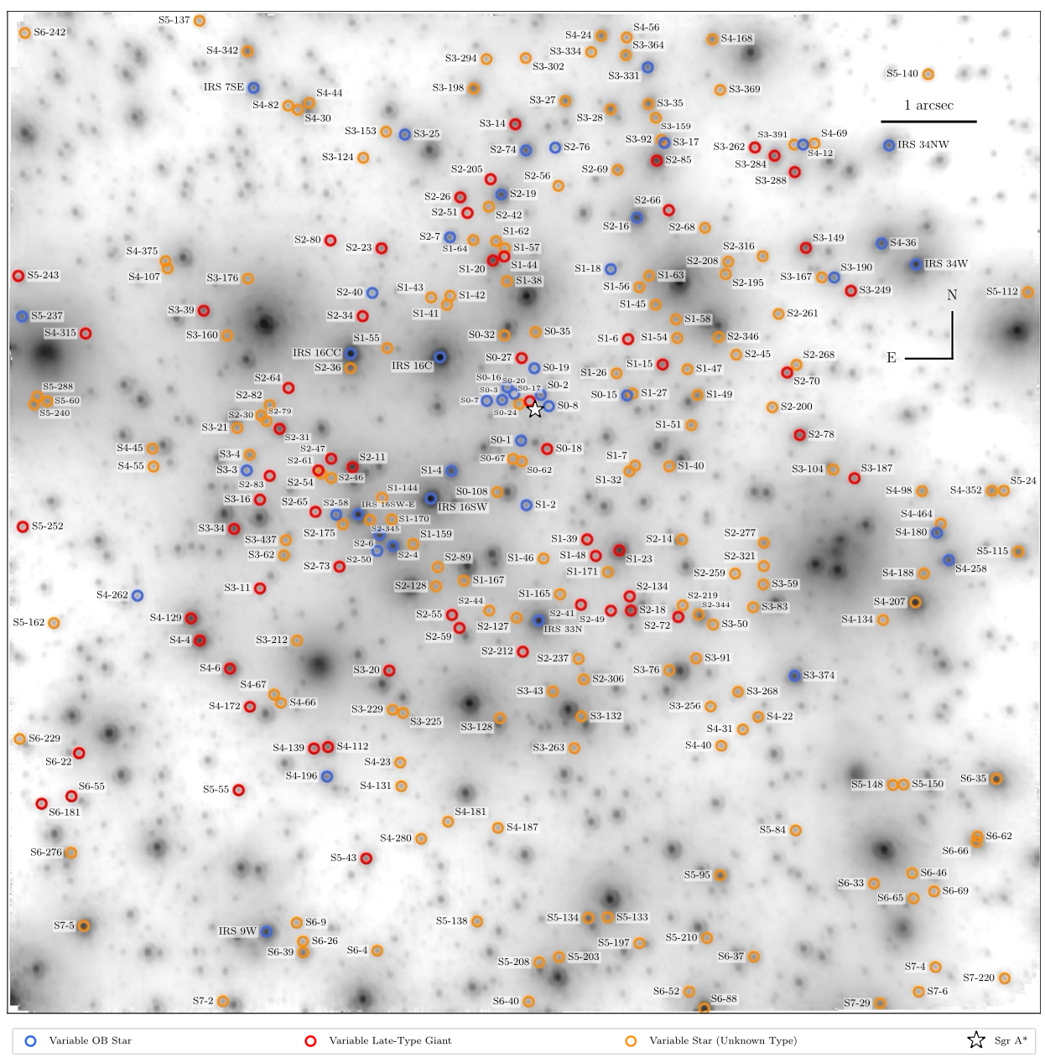
Galactic Center: Stars
563 variable stars with
infrared AO in central 0.4 pc
11.5 yr using Keck NIRC2
star Sgr A*
blue OB stars
red giants
orange unknown type
What kind of variable do you want?
How do you measure depth here?
Gautam+ (2019)
Notes:
no Cepheids … can’t really measure depth
complication … proper motions carry stars behind obscuring gas/dust

Slide 15
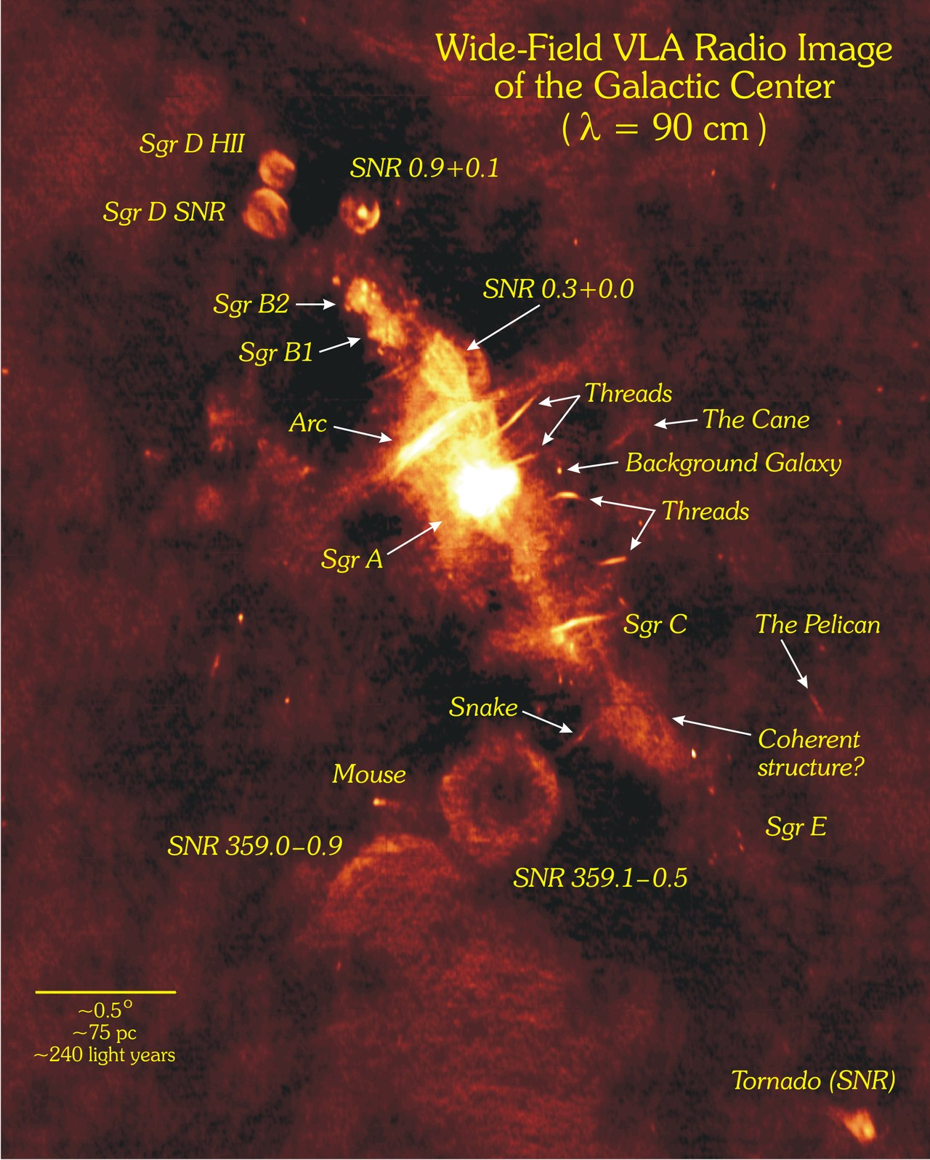
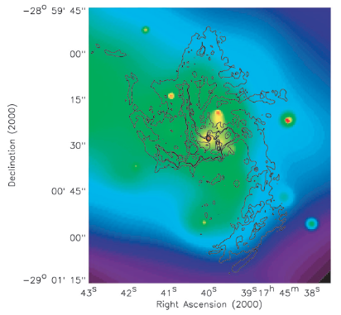
Galactic Center: Baby Arms
~ 1 pc
CHANDRA xray source at Sgr A*
radio source at Sgr A*
Baganoff+ (2003)
Notes:
RIGHT: disk not seen in xrays (colors), but arms are evident in VLA 6cm contours on top

Slide 16
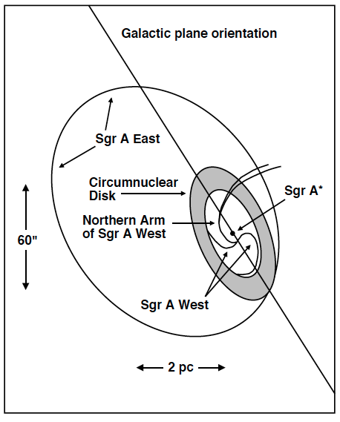
Galactic Center: Baby Arms
East
SN remnant
~ 1 pc
CHANDRA xray source at Sgr A*
radio source at Sgr A*
mini spiral arms evident at 6 cm
and converge on Sgr A*
West
spiral
Baganoff+ (2003)
Notes:
LEFT: Schematic diagram of the principal constituents of the Sgr A radio complex. (1) outer ellipse depicts the location of the radio shell of Sgr A East, which is a filled-center structure in X-rays (2) black hole Sgr A* center of cavity surrounded by circumnuclear disk (3) ionized gas features of Sgr A West and central cluster of luminous, hot stars also lie in this cavity
RIGHT: disk not seen in xrays (colors), but arms are evident in VLA 6cm contours on top

Slide 17
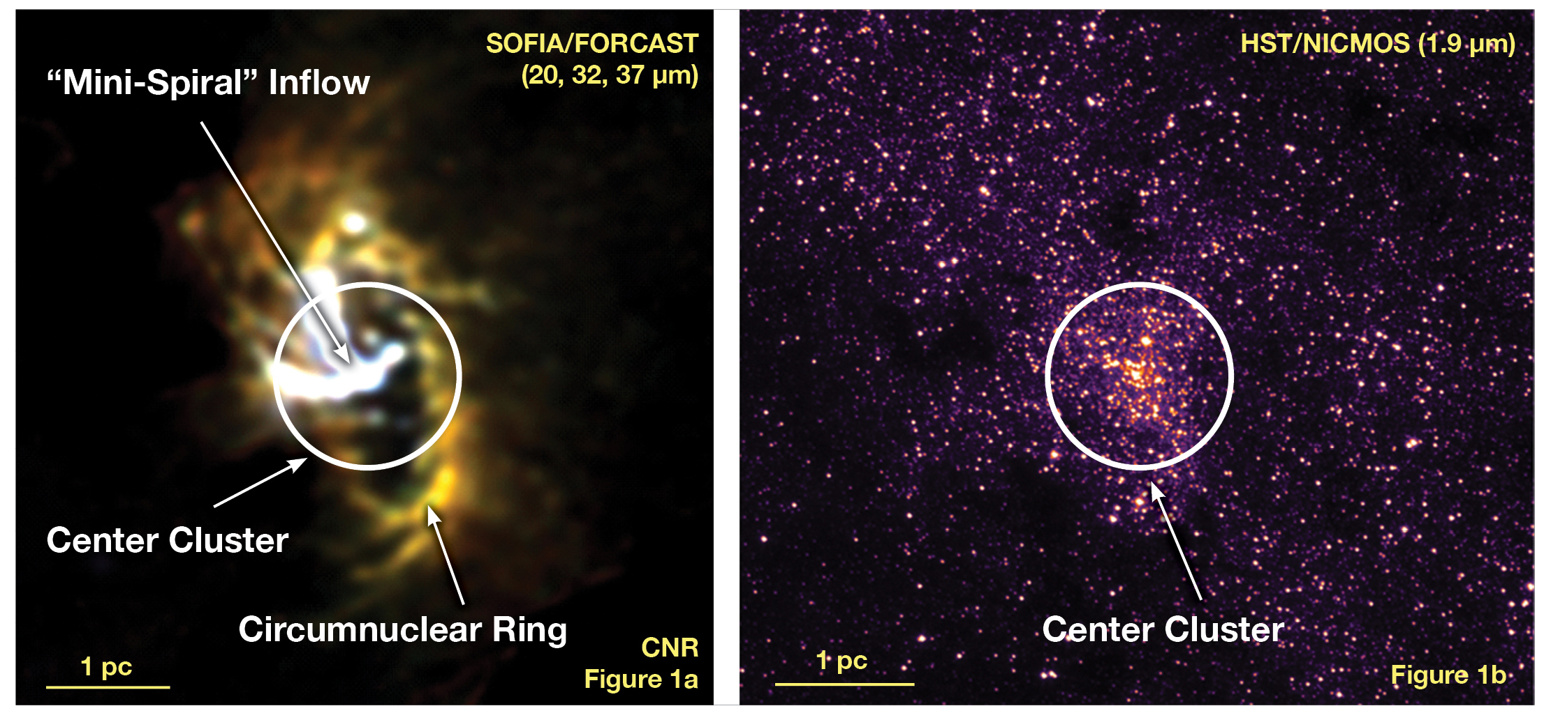
Galactic Center: Ring and Stars
spiral inflow from
Circumnuclear Ring material
patchiness in star counts from
Circumnuclear Ring material
Notes:
Figure 1a: SOFIA/FORCAST mid-infrared image of the Milky Way Galaxy's nucleus showing the Circumnuclear Ring (CNR) of gas and dust clouds orbiting a central supermassive black hole. The bright Y-shaped feature is believed to be material falling from the ring toward the black hole that is located where the arms of the "Y" intersect. Figure 1b: HST/NICMOS near-infrared image showing the same field of view with the same scale and orientation as Figure 1a. At this wavelength, opaque dust in the plane of the Milky Way hides features that are seen in the SOFIA image. In contrast, the stars in the HST image emit mostly visible and near-infrared light and so are not seen in the SOFIA mid-infrared image. Extra opacity due to especially dense concentrations of dust in the CNR produces patches of apparently lower star density in the near-infrared image.

Slide 18
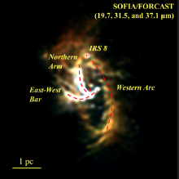
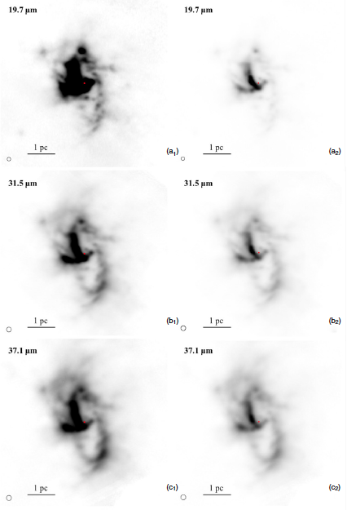
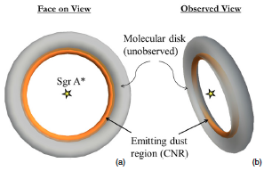
Galactic Center: Ring
stretched stretched
for ring for arms
emitting dust seen
molecular ring unseen
Lau+ (2013)

Slide 19
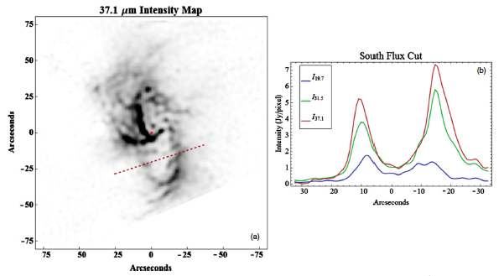
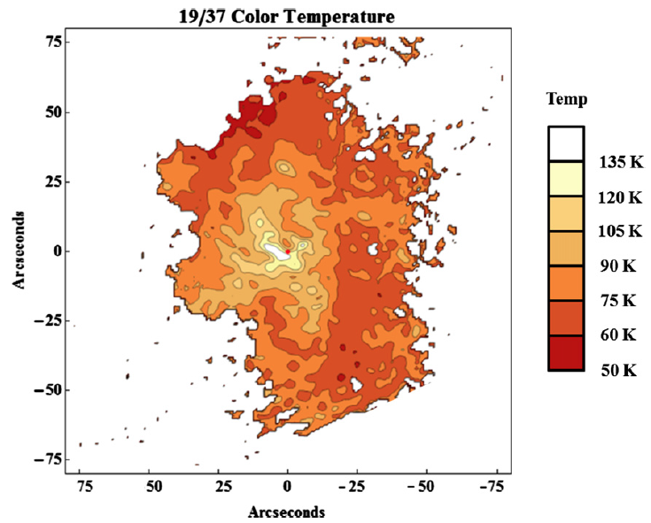
Galactic Center: Ring
shifts in lines with wavelength indicate temperature differences
observed dust is heated centrally
Lau+ (2013)

Slide 20
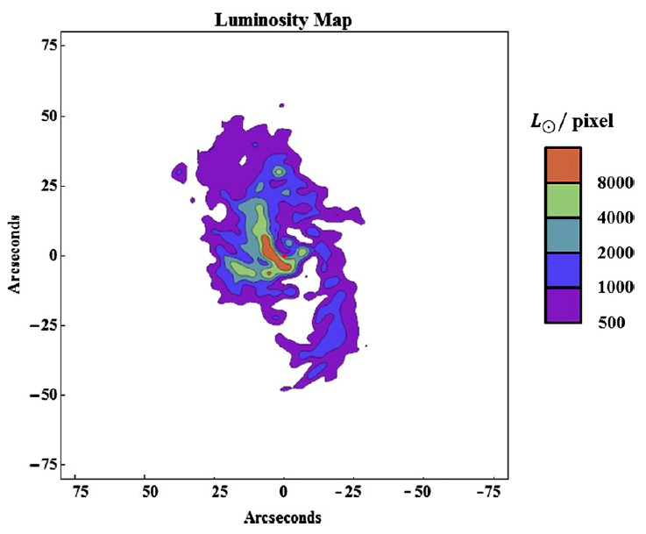
Galactic Center: Stellar Flux
Lau+ (2013)
total CNR luminosity ~2.5 X 10⁶ L
central OB + WR stars have luminosity ~2 X 10⁷ L
dust in ring absorbs all UV/opt photons … ring inner wall ~ 0.35 pc

Slide 21
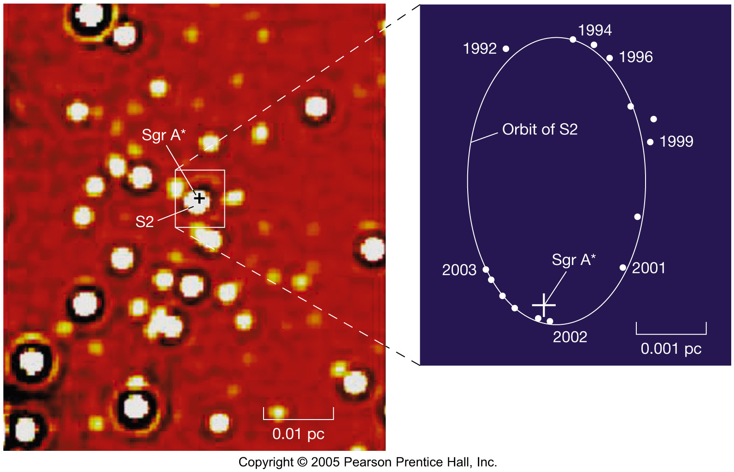
Milky Way Center

Slide 22
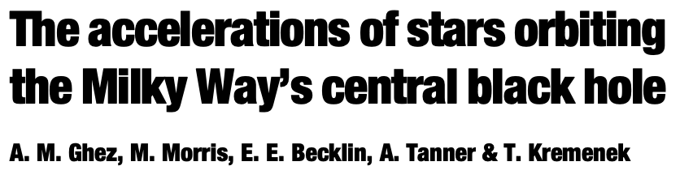
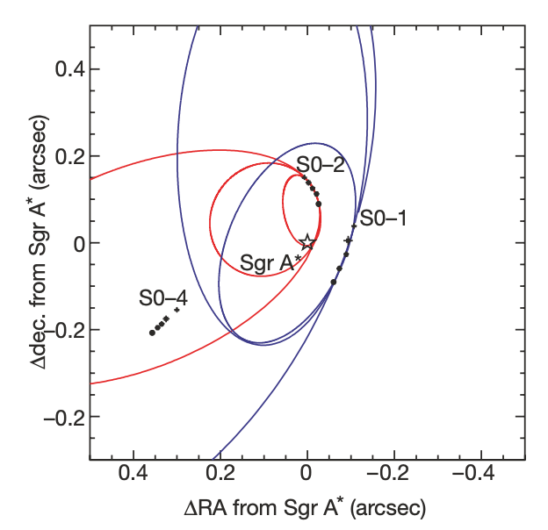
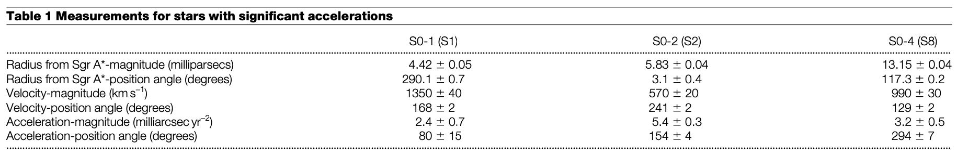
Galactic Center: 2000
Nature 2000
astrometry 1995-1999
3 stars within 0.005 pc
accelerations, not orbits
M_{BH} ~ 3 X 10⁶ M⦿
Notes:
orbits highly uncertain
this was by no means the first estimate of the mass of the central black hole

Slide 23
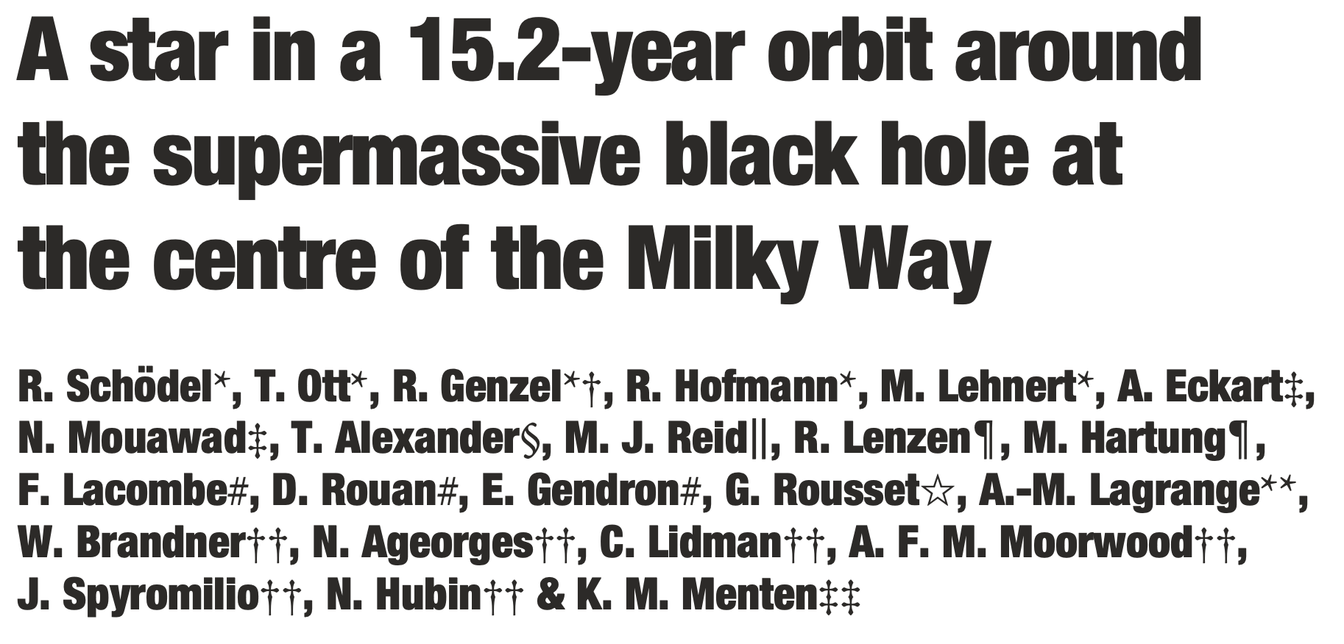
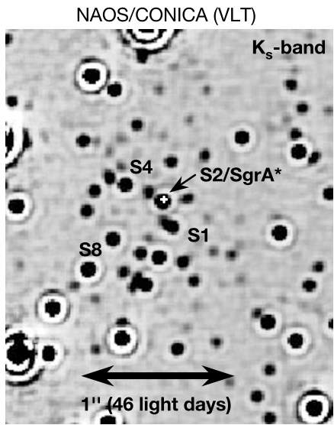
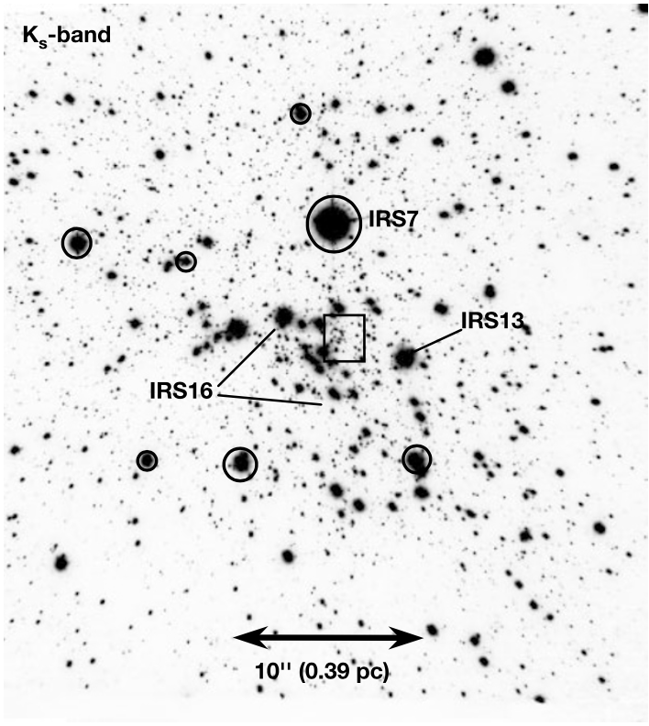
Galactic Center: 2002
Nature 2002

Slide 24
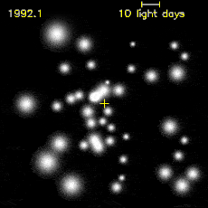
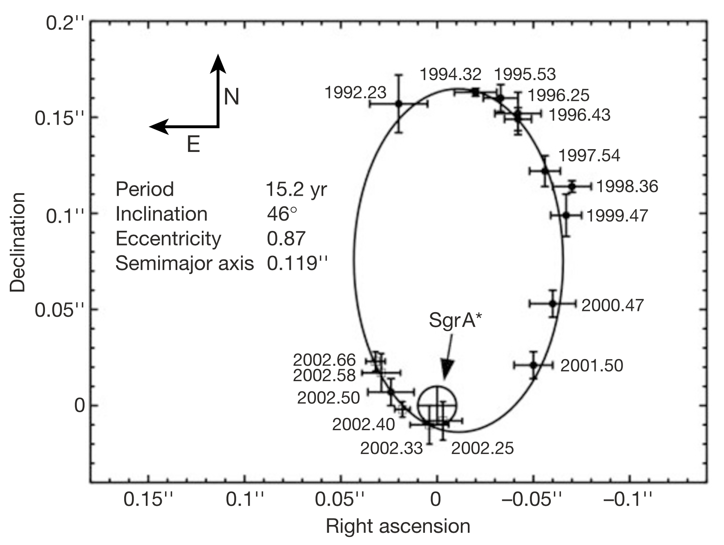
Galactic Center: 2002
astrometry 1992-2002
SO-2 orbital P = 15.2 yr
pericenter 17 light hours
M_{BH} = 3.7 (1.5) X 10⁶ M⦿

Slide 25
MW Central BH Mass
What is the mass of the central black hole?
use Kepler’s Third Law
M_{BH} + M_{star} = a³ / P²

Slide 26
MW Central BH Mass
What is the mass of the central black hole?
use Kepler’s Third Law
M_{BH} + M_{star} = a³ / P²
M_{BH} >>>>> M_{star}
M_{BH} = a³ / P²
a = 0.1 arcsec … P = 15 yr
but, 0.1 arcsec at 8 kpc = 800 AU
M_{BH} = 800³ / 15²
M_{BH} = 2 X 10⁶ M⦿

Slide 27
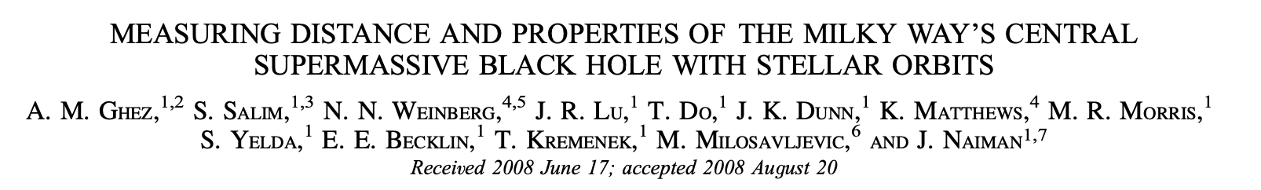
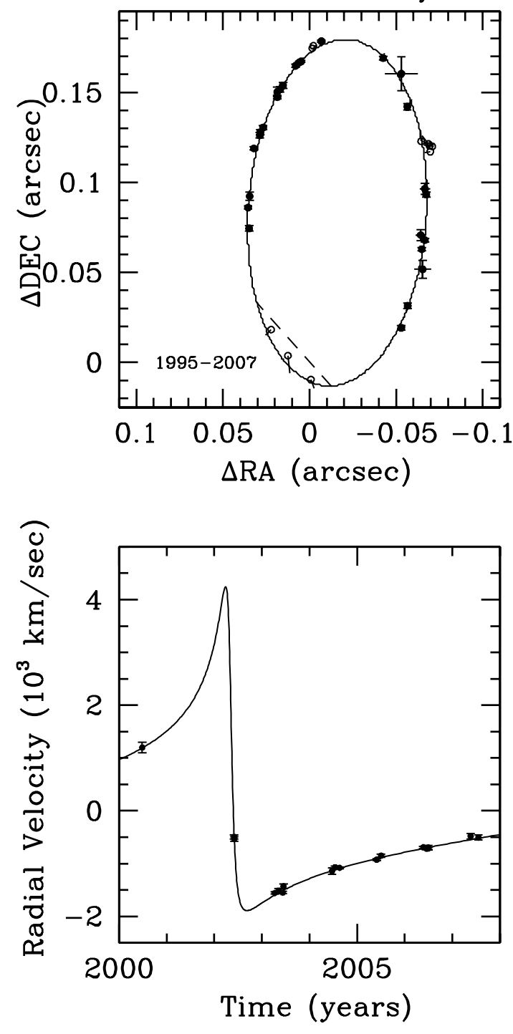
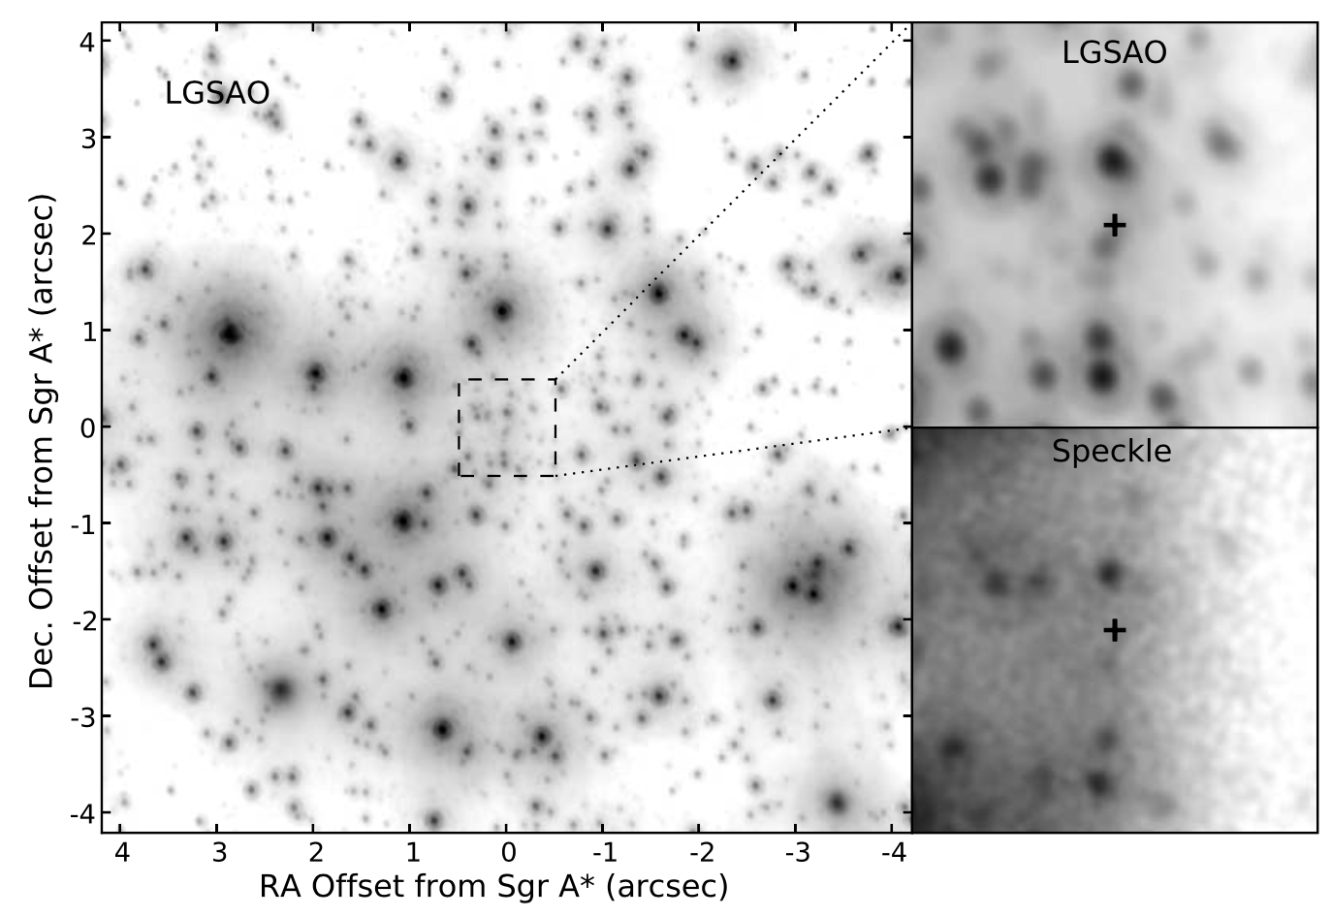
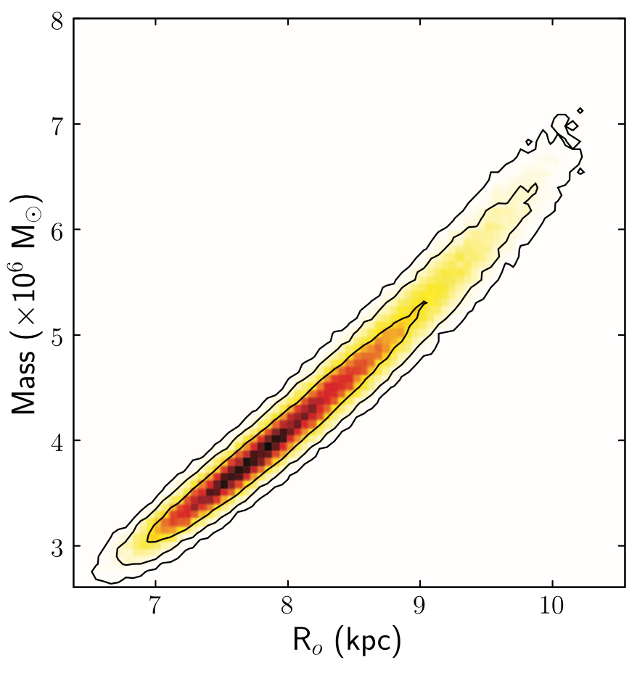
Galactic Center: 2008
ApJ 2008
astrometry + RV 1992-2007
3D orbit of SO-2
R₀ = 8.4 (0.4) kpc
M_{BH} = 4.5 (0.4) X 10⁶ M⦿
Notes:
LGSAO has 10X better precision than speckle

Slide 28
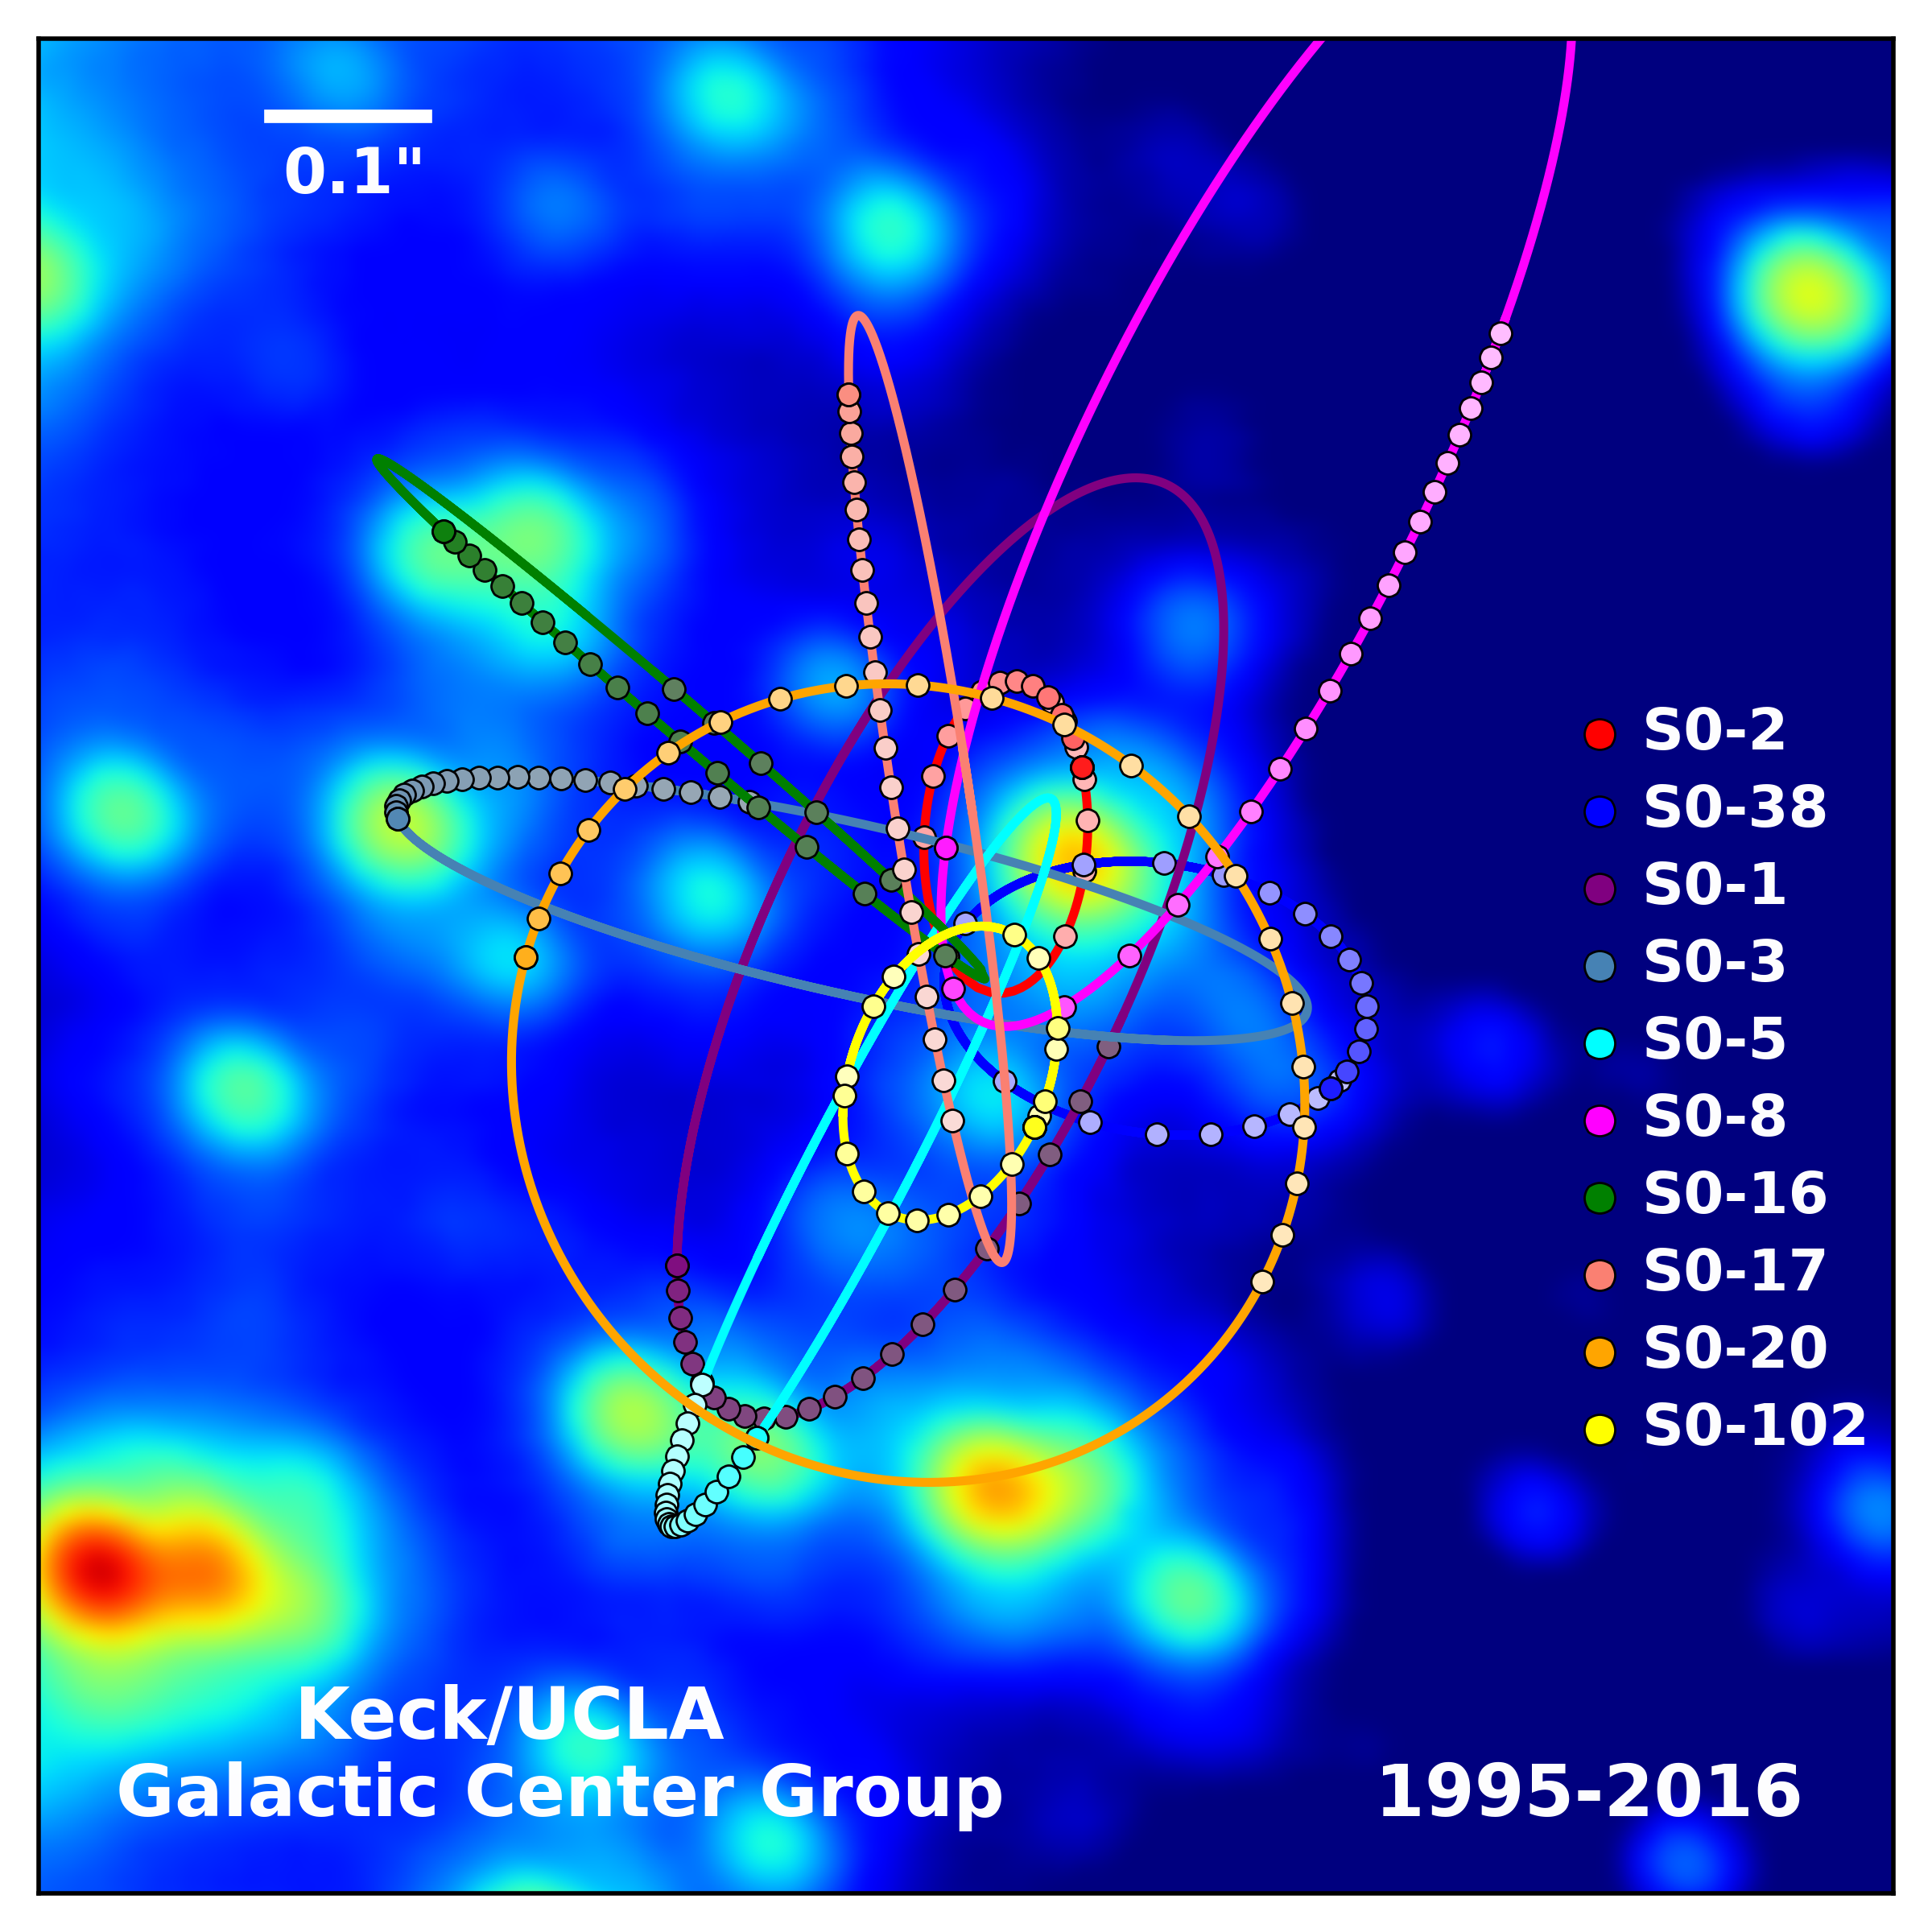
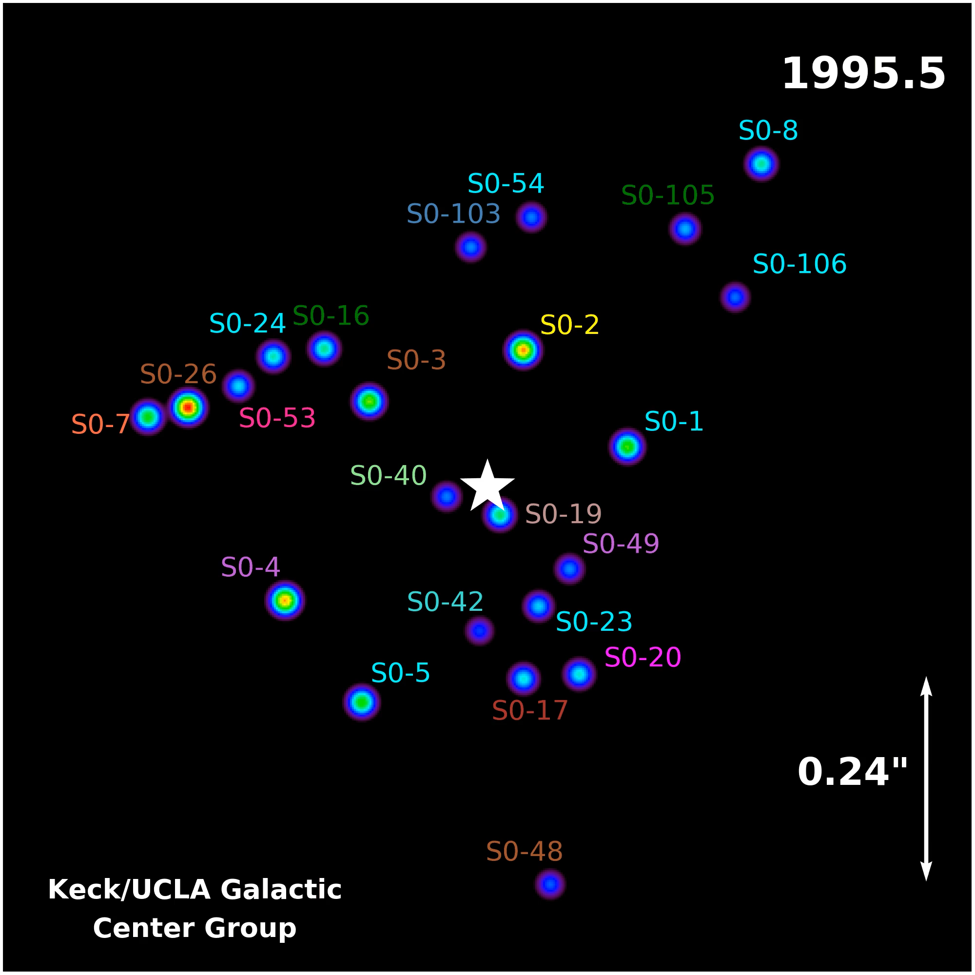
Galactic Center: 2020

Slide 29
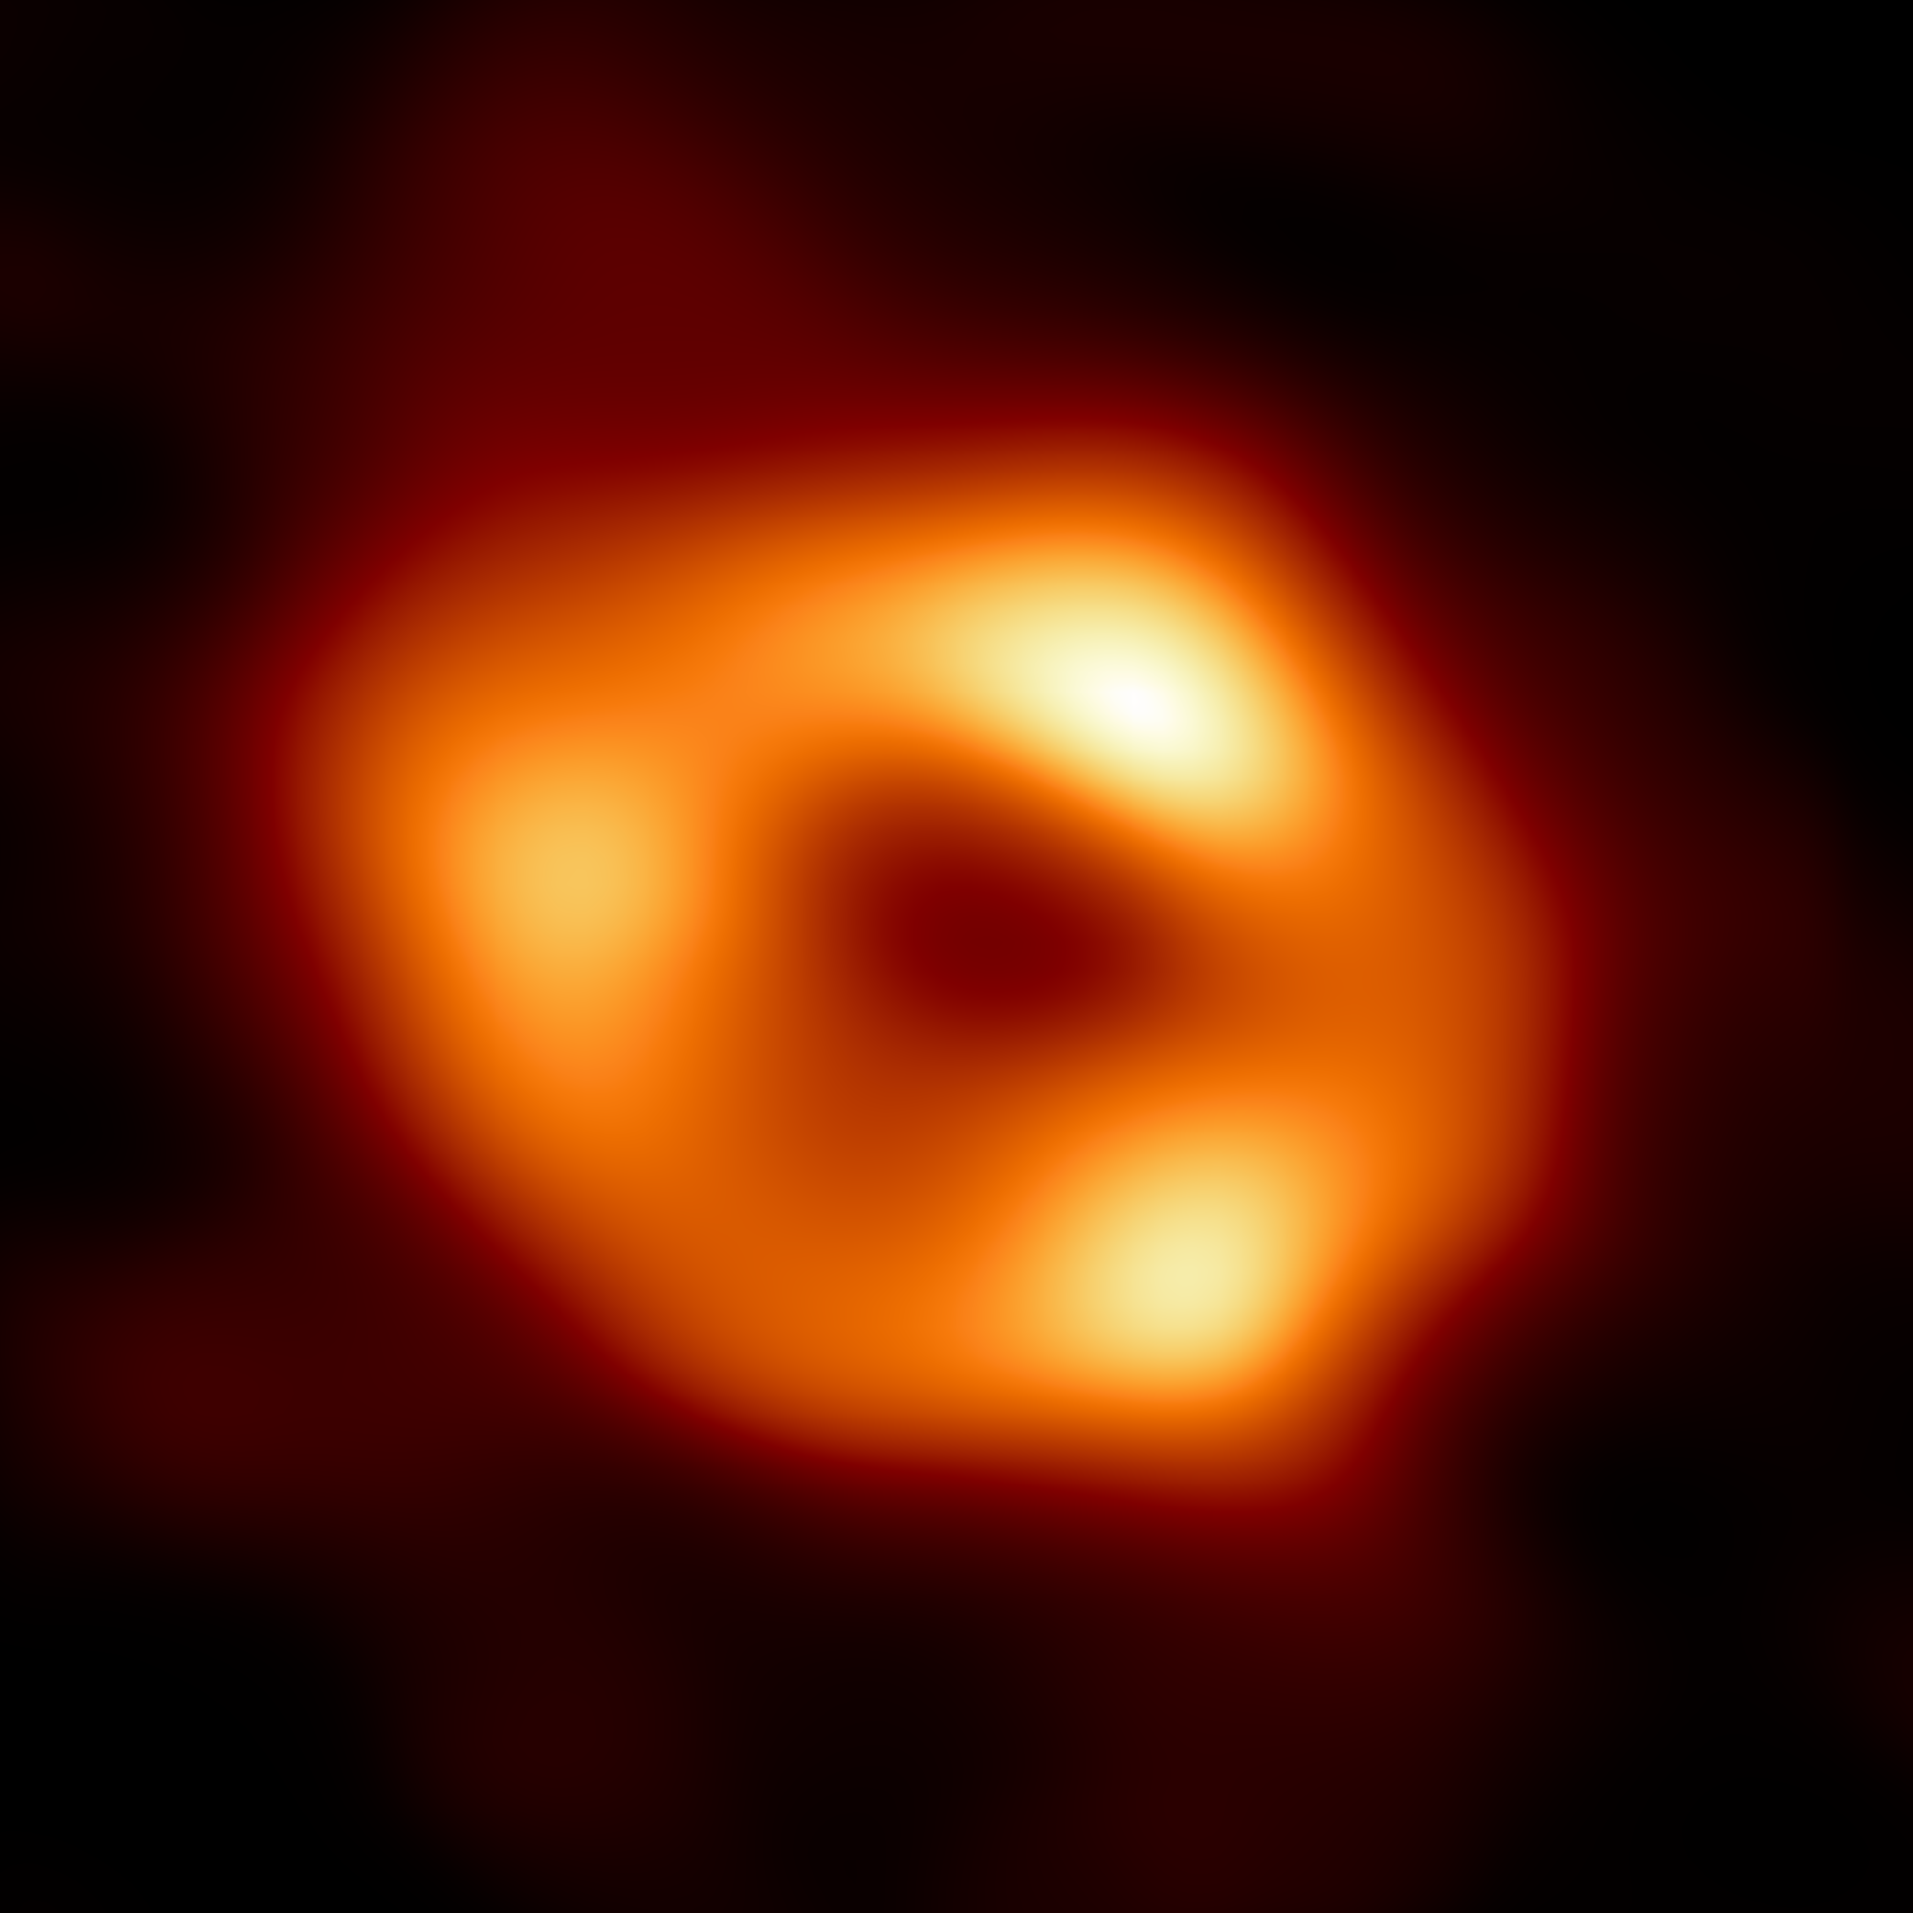
Galactic Center: 2022
Event Horizon Telescope … 8 radio telescopes across Earth .. at 1.3 mm
tough to image … glowing gas that takes < 30 minutes to orbit
ring diameter = 52 (2) microarcseconds … a “donut on the Moon”
M_{BH} = 4 X 10⁶ M⦿

Slide 30
Milky Way Center: VERY Close
We report the detection of continuous positional and polarization changes of the compact source SgrA* in high states (“flares”) of its variable near-infrared emission with the near-infrared GRAVITY-Very Large Telescope Interferometer (VLTI) beam-combining instrument. In three prominent bright flares, the position centroids exhibit clockwise looped motion on the sky, on scales of typically 150 μas over a few tens of minutes, corresponding to about 30% the speed of light. At the same time, the flares exhibit continuous rotation of the polarization angle, with about the same 45(±15) min period as that of the centroid motions. Modelling with relativistic ray tracing shows that these findings are all consistent with a near face-on, circular orbit of a compact polarized “hot spot” of infrared synchrotron emission at approximately six to ten times the gravitational radius of a black hole of 4 million solar masses. This corresponds to the region just outside the innermost, stable, prograde circular orbit (ISCO) of a Schwarzschild–Kerr black hole, or near the retrograde ISCO of a highly spun-up Kerr hole. The polarization signature is consistent with orbital motion in a strong poloidal magnetic field.
GRAVITY Collaboration (2018)

Slide 31
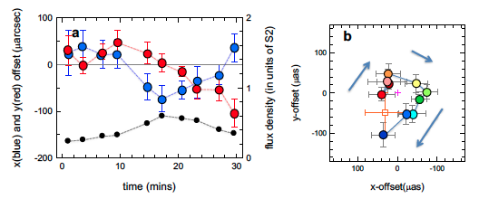
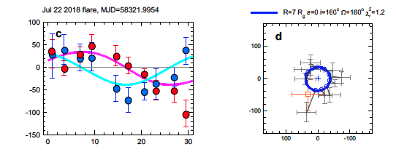
Milky Way Center: VERY Close
NS
hot spot motion
orbit includes
light bending
lensing
time dilation
6-10 times
BH horizon
30% c !!!
EW
flux
GRAVITY Collaboration
(2018)
Notes:
(a): Time evolution of the east-west (east positive, blue) and north-south (red) position offset of the July 22 flare (MJD=58321.9954) centroids from their medians, as well as the flux density evolution (right y-axis, black) in units of the flux of S2 (14.0 mag). Error bars are 1sigma. For this purpose the total intensity was computed from the sum of the two polarization directions. (b): Projected orbit of the flare centroid on the sky (colour ranging from brown to dark blue as a qualitative marker of time through the 30-minute observation, relative to their medians (small black cross) and after removal of the S2 motion and differential refraction between S2 and SgrA*). The orange square and 1sigma uncertainty is the long-term astrometric position of the mass centre of the S2 orbit (approximately the orbital centroid, although shifts between apparent and true centroids can
be introduced by lensing, relativistic beaming, and azimuthal shearing of an initially compact ‘hot spot’). (c) and (d): Comparison
of the data of the bottom two panels with a realization of a simple hot spot model in the Schwarzschild metric, including light bending, lensing, time dilation and other effects of GR and/or special relativity (SR), computed from the NERO relativistic ray tracing code (Bauböck et al. in prep.). Similar results were obtained with the GYOTO code (Vincent et al. 2011b; Grould et al. 2016). The purple and cyan continuous curves in (c) show the same orbit in x(t) and y(t), compared to the data in blue and red. The continuous blue curve in (d) denotes a hot spot on a circular orbit with R = 1.17 ⇥ R(ISCO, a = 0, M = 4.14 ⇥ 106M(), seen at inclination 160' (clockwise on the sky, as for the data in (d)) and with the line of nodes at⌦ = 160' (%r
2 = 1.2). Open blue circles and grey bars connect the data points to their locations on the best fit orbit.

Slide 32
What is causing this?
SUPERMASSIVE BLACK HOLE
3.6 to 4.3 million M
“stuff” to < 0.8 AU
Schwarzchild radius = 0.08 AU

Slide 33
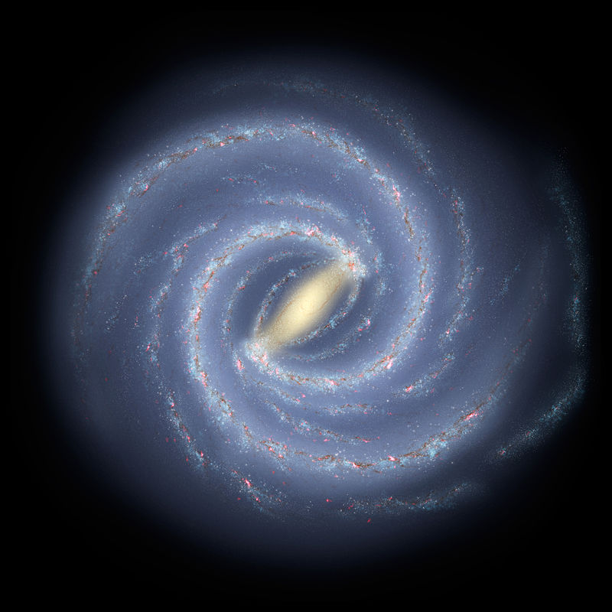
Milky Way Today
THIS
IS
AN
ARTIST’S
CONCEPTION!
.

Slide 34
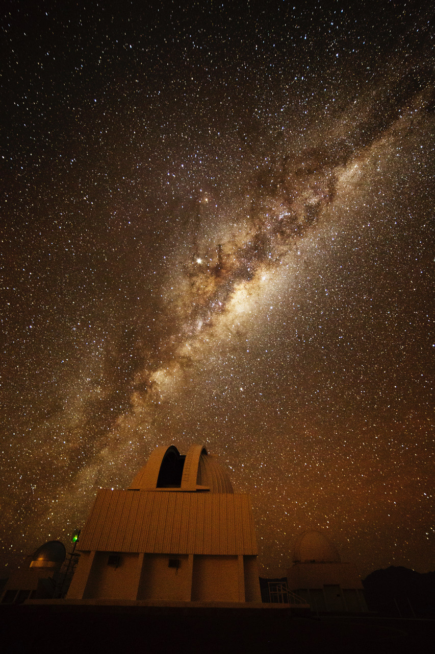
THIS
IS
THE
REAL
THING!
photo: Travis Rector

