Slide 1
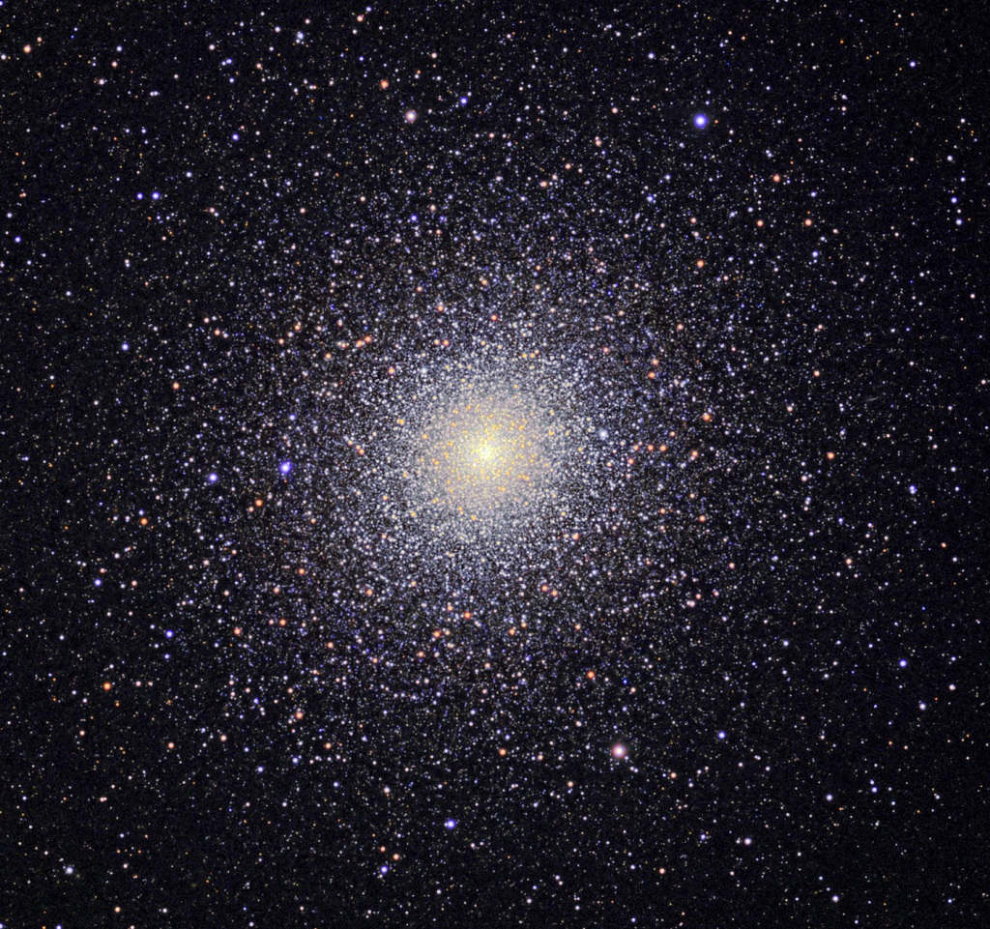
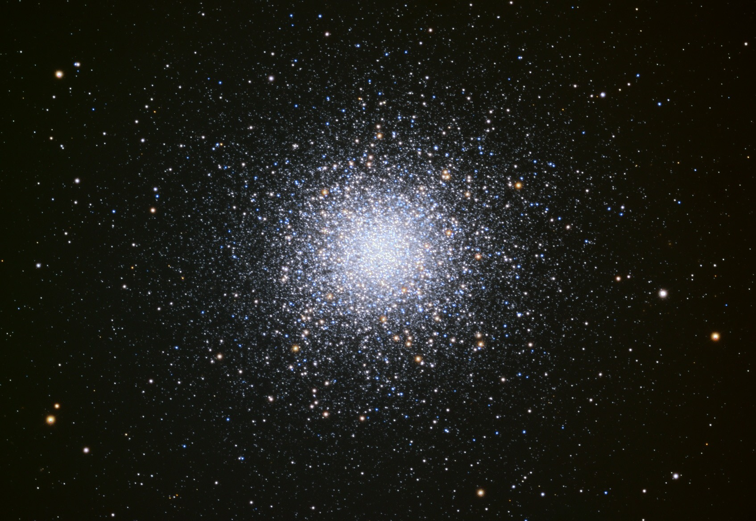
MW Globular Clusters
M13 in Hercules 47 Tuc in Tucana
(north) (south)
Notes:
THIS SEEMS LIKE A SHORT LECTURE, BUT WE ONLY MADE IT TO SLIDE 20

Slide 2
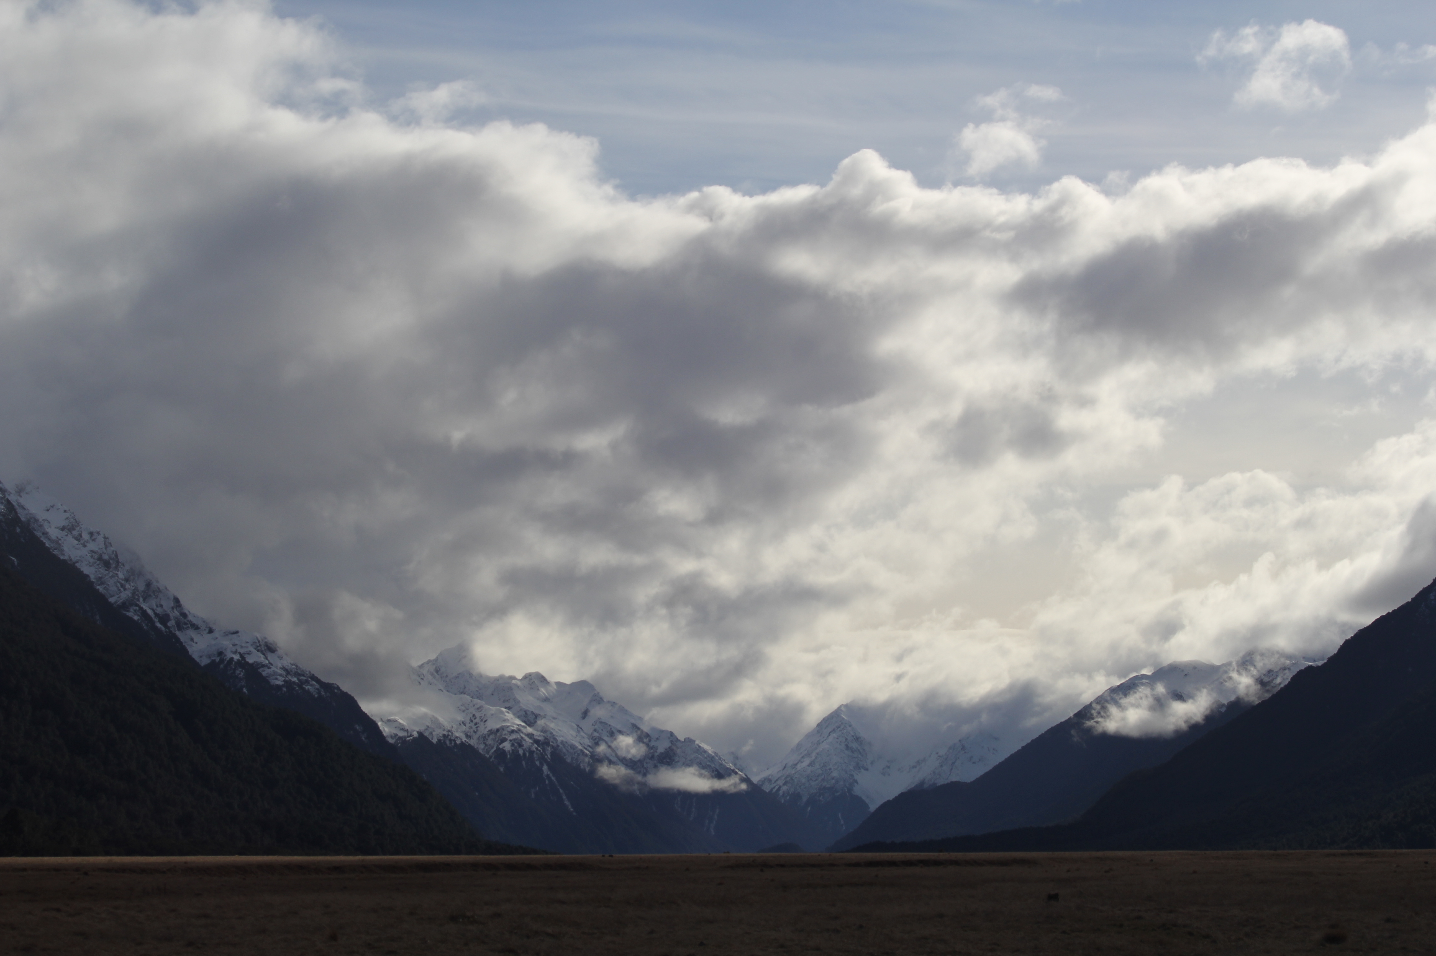
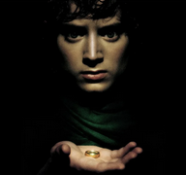

Assignments
Tuesday 03 FEB Level 0 … Ideas
Tuesday 10 FEB Bio Sketch
Tuesday 17 FEB Level 1 … Outline … 2 weeks later
Thursday 19 FEB Milky Way Neighborhood
Tuesday 10 MAR Level 2 … 1st Draft … 3 weeks later
Tuesday 31 MAR Budgets + Narrative
Tuesday 07 APR Level 3 … 2nd Draft … 4 weeks later
Tue/Thu 14/16 APR Presentations … 1 week later
Thursday 23 APR Level 4 … submit … 1 week later

Slide 3

Proposal Pieces
GOAL: Fund yourself as a $75K/year postdoc for 3 years
1. Project Description 8.0 pages text + 2.0 pages Tab/Fig
2. References 0.5 page
3. Biographical Sketch 2.0 pages (SciENcv)
4. Budget 1.0 page (spreadsheet)
5. Budget Justification 1.0 page
6. Facilities 0.5 page
7. Student Mentoring Plan 0.5 page
8. Data Management Plan 0.5 page
Total Challenge ~ 16 pages

Slide 4
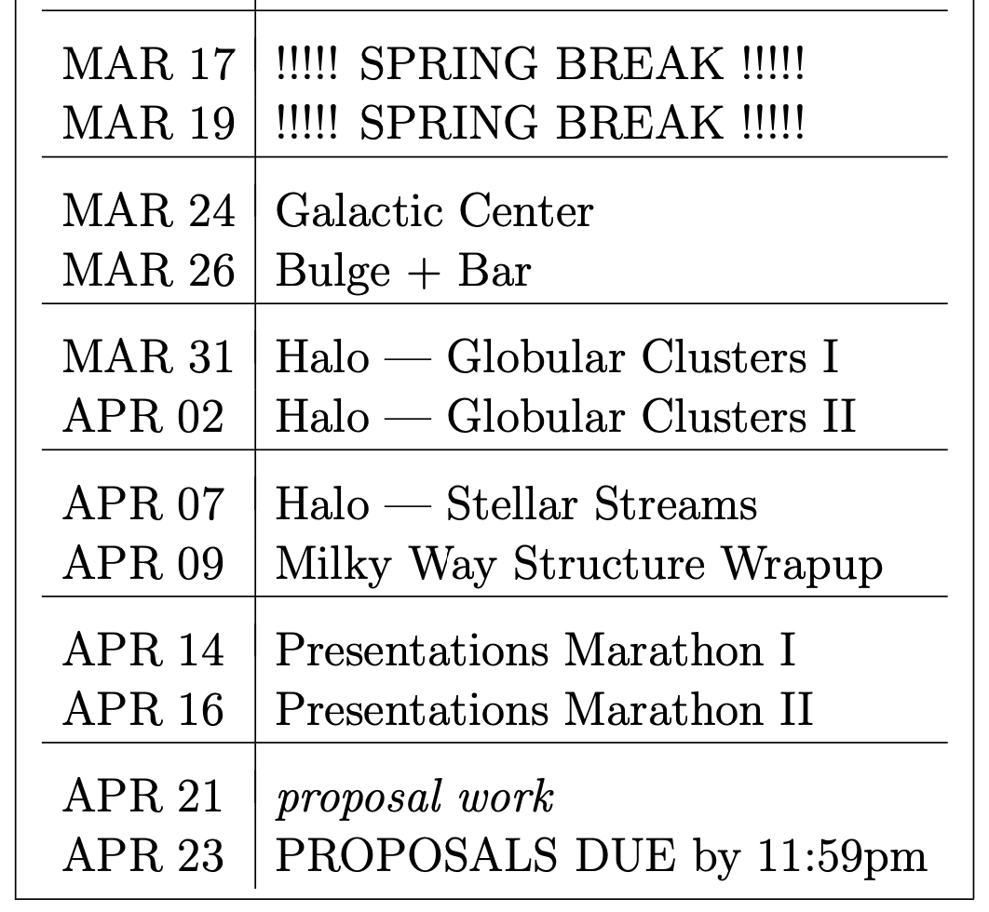
Proposal Future Bits
Tuesday 31 MAR
Budget and Justification
Tuesday 07 APR
Facilities/Mentoring/Data
Tue/Thu 14/16 APR
Presentations
Thursday 23 APR
Final Proposal = 8 pieces

Slide 5

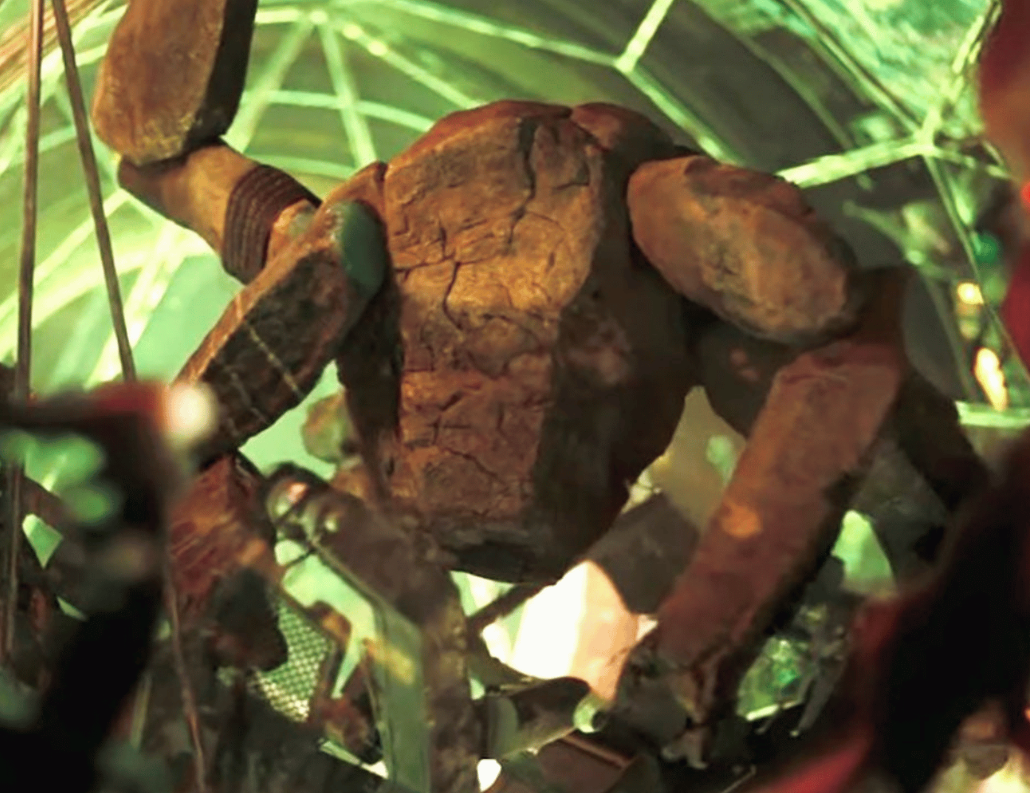
Assignments
Tuesday 03 FEB Level 0 … Ideas
Tuesday 10 FEB Bio Sketch
Tuesday 17 FEB Level 1 … Outline … 2 weeks later
Thursday 19 FEB Milky Way Neighborhood
Tuesday 10 MAR Level 2 … 1st Draft … 3 weeks later
Tuesday 31 MAR Budgets + Narrative
Tuesday 07 APR Level 3 … 2nd Draft
Facilities/Mentoring/Data
Tue/Thu 14/16 APR Presentations
Thursday 23 APR Level 4 … submit … 6 weeks later

Slide 6
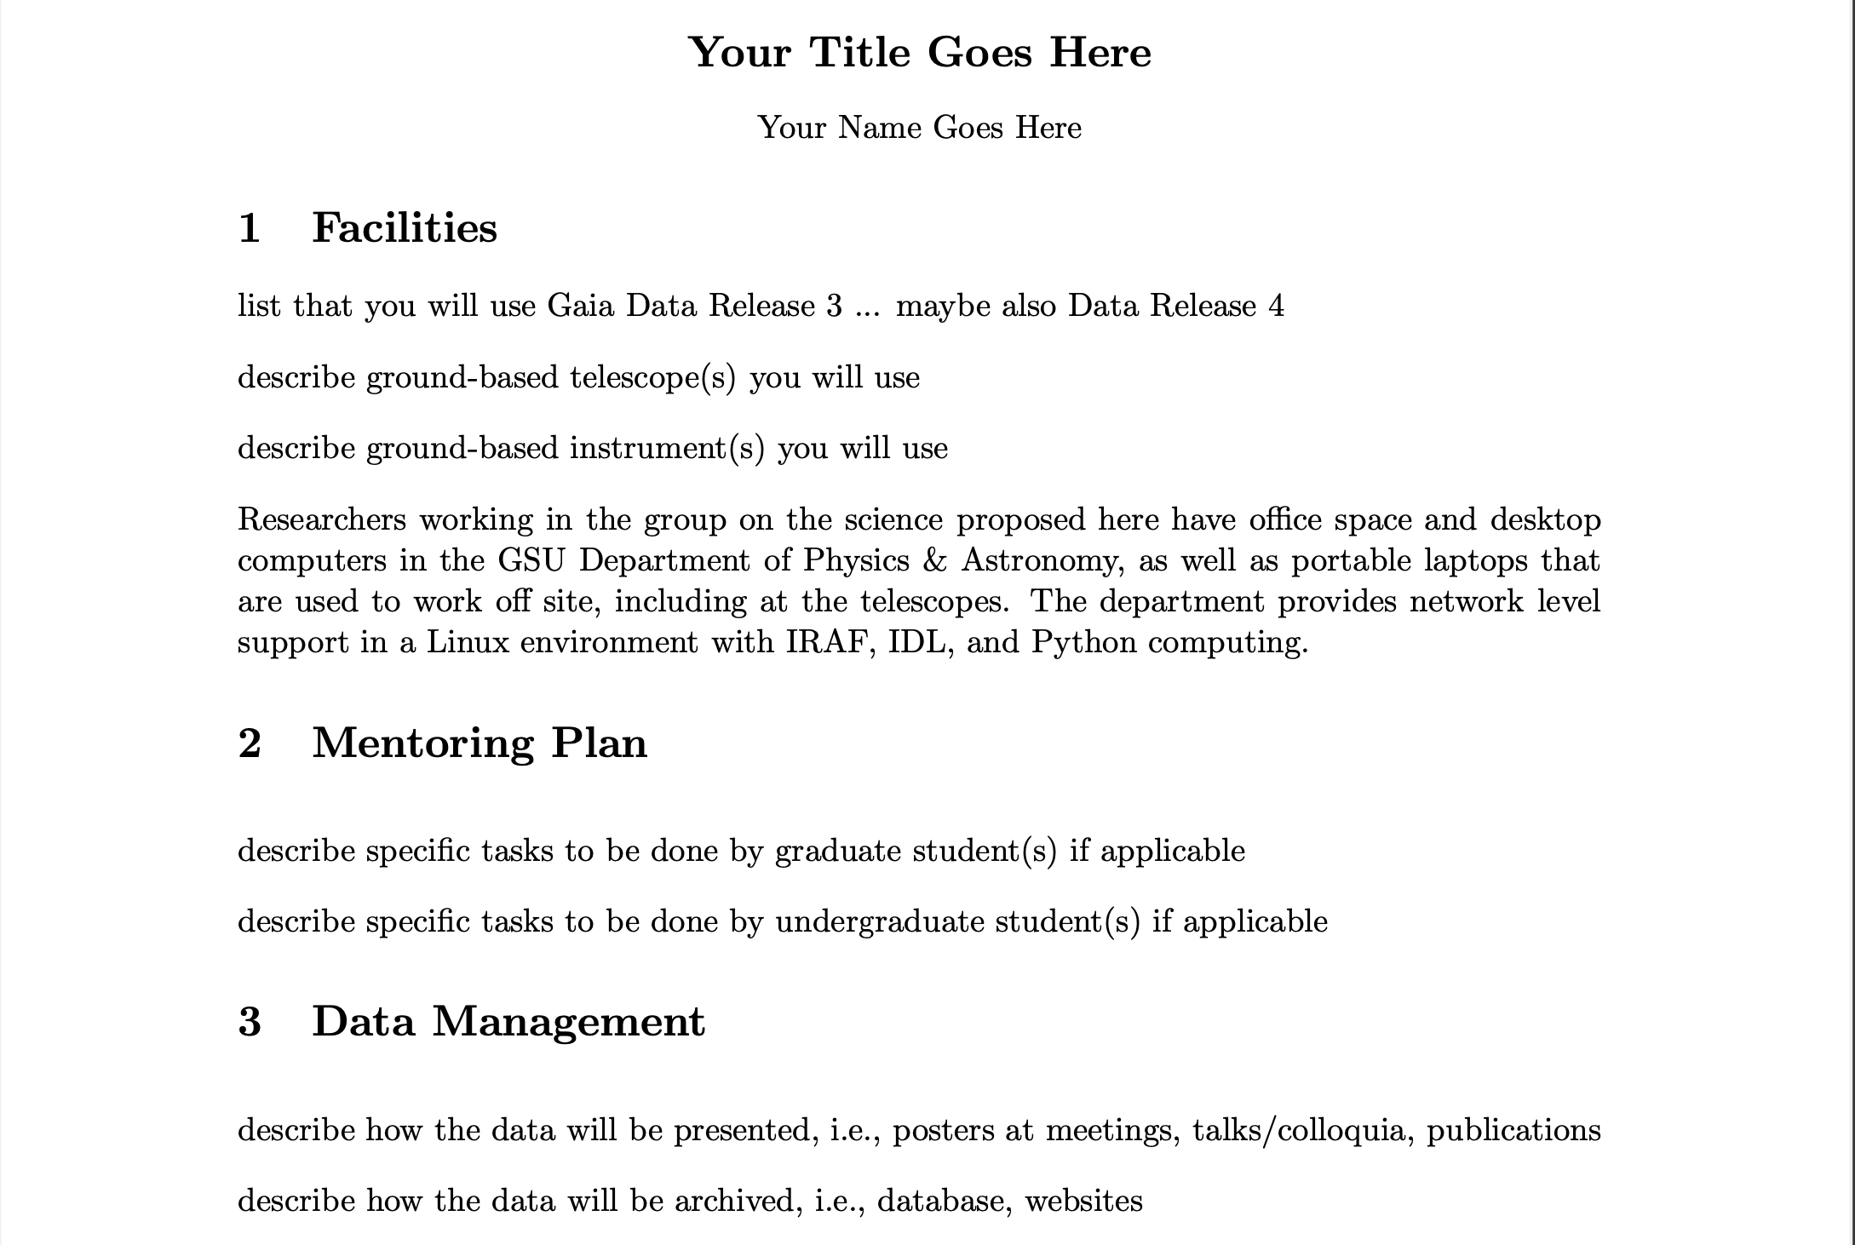
Facilities/Mentoring/Data

Slide 7
MW Globular Clusters
M13 in Hercules 47 Tuc in Tucana
(north) (south)
Notes:
Virialized means KE = -1/2 PE … GC is bound … as many stars moving in as out … GC is not rotating

Slide 8
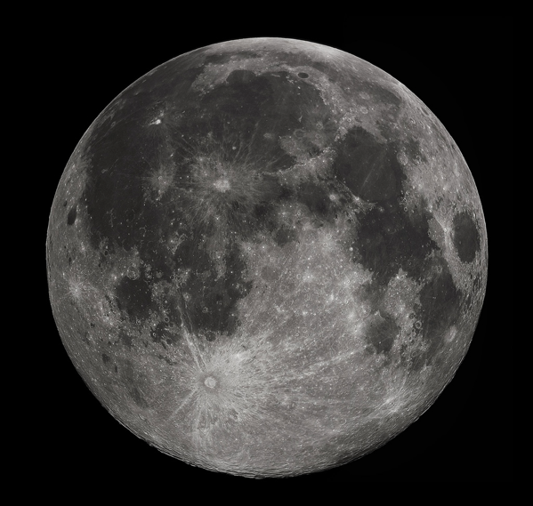
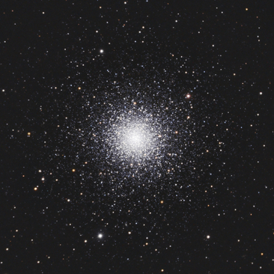
MW Globular Clusters
M3 at ~10 kpc
15’

Slide 9
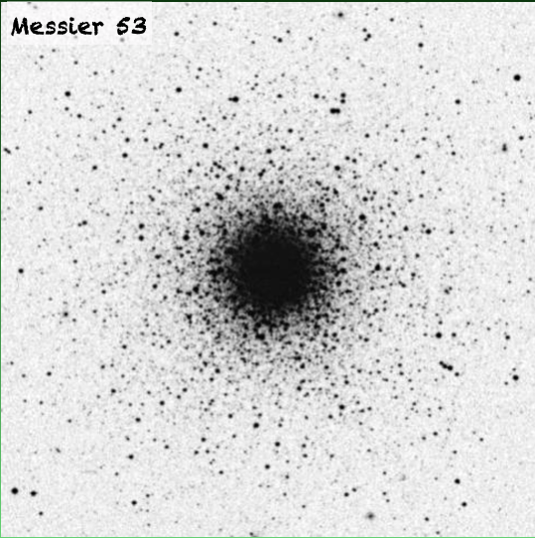
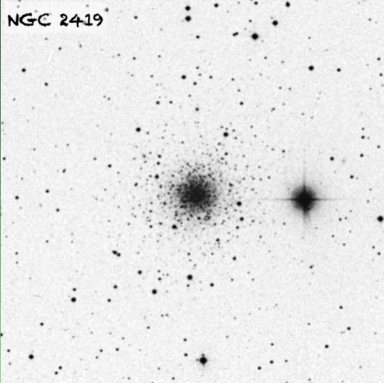
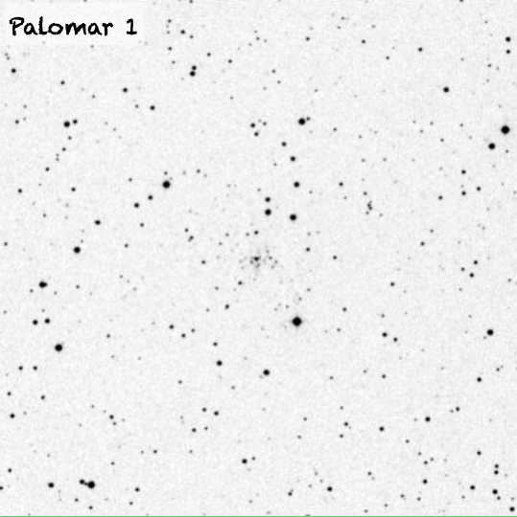
MW Globular Clusters
15’
29 globulars in Messier Catalog
+ various sources with NGC and IC names (Dreyer 1888 … 1908)
+ ~dozen more from Palomar Sky Survey
+ other efforts
= 168 total GCs now known around MW
… maybe a dozen more behind disk/bulge
Notes:
NGC = New General Catalogue … Dreyer in 1888 with updates IC = Index Catalogues by Dreyer in 1895 and 1908

Slide 10
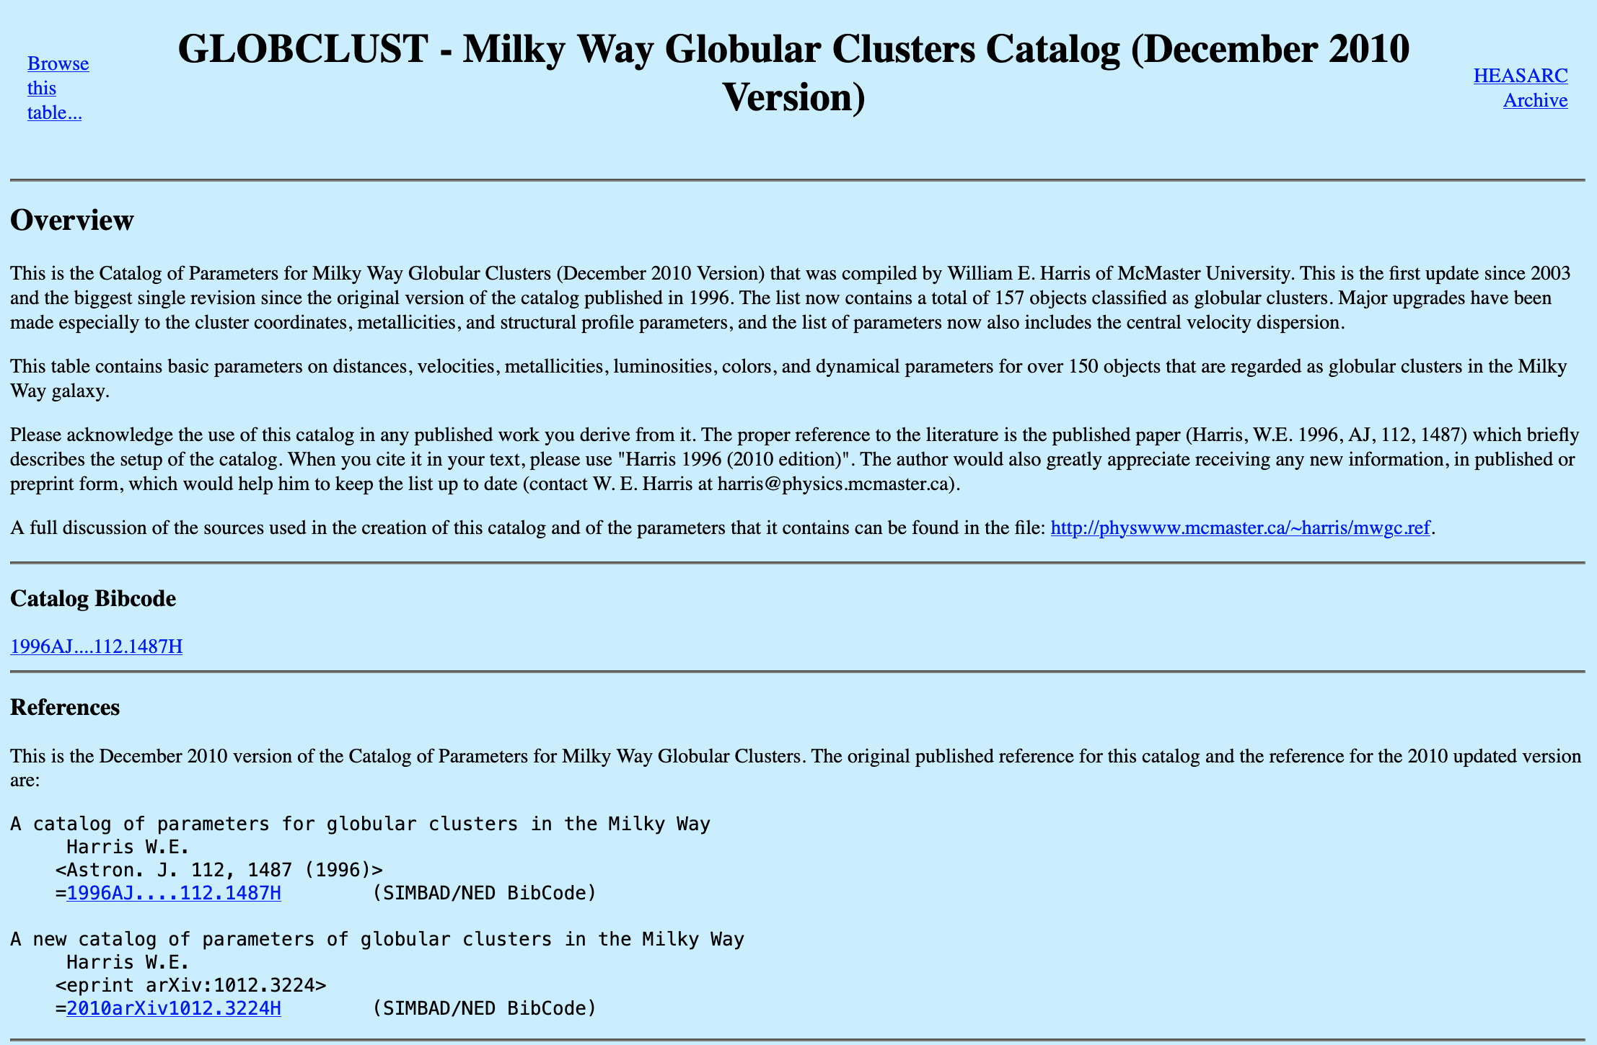
MW Globular Clusters
https://heasarc.gsfc.nasa.gov/w3browse/all/globclust.html

Slide 11
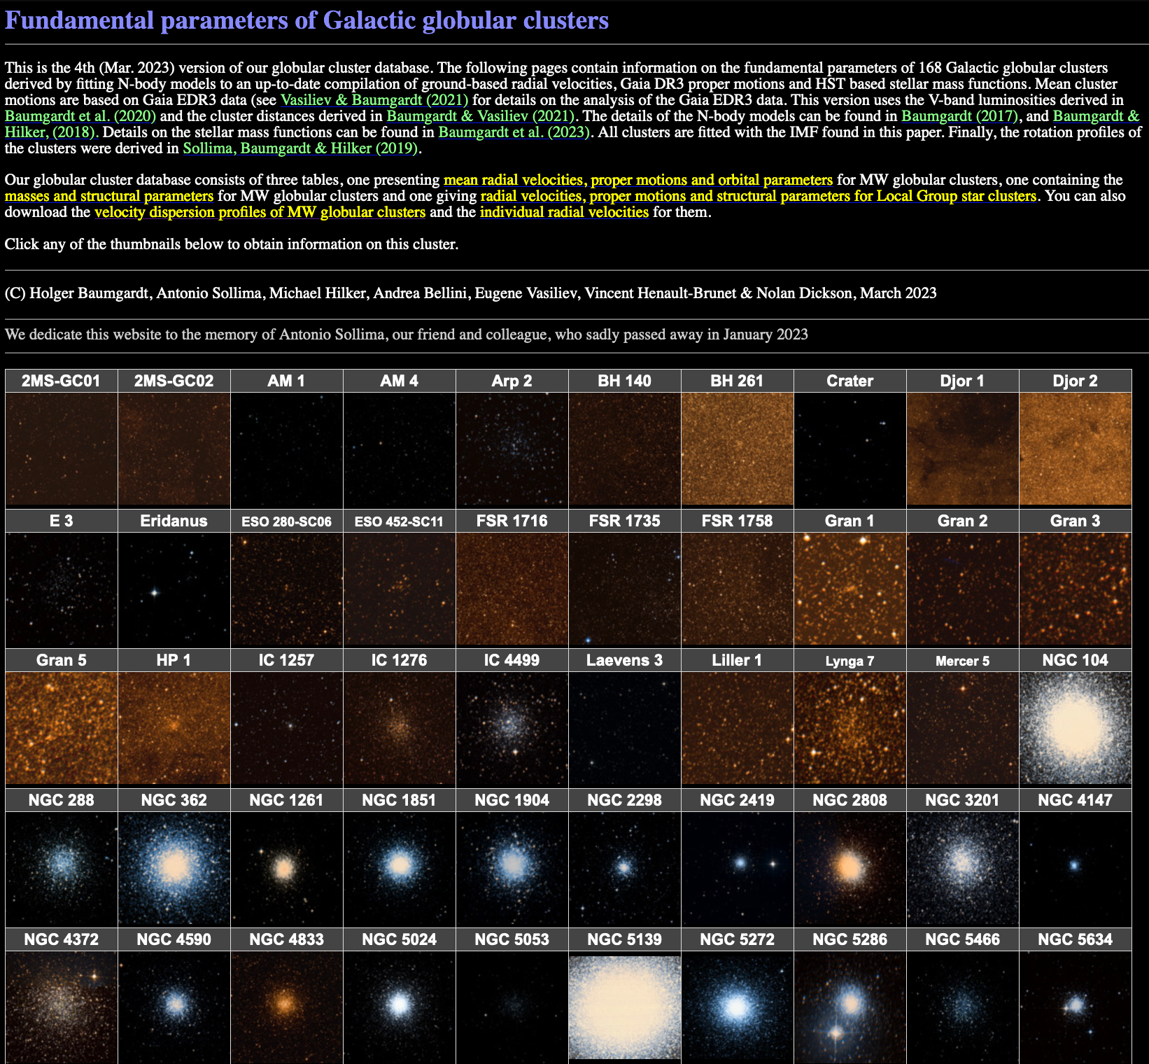
MW Globular Clusters
Baumgardt Catalog as of March 2023 has 168 MW globulars
https://people.smp.uq.edu.au/HolgerBaumgardt/globular/
Notes:
NGC 104 = 47 Tuc
NGC 5139 = omega Cen

Slide 12
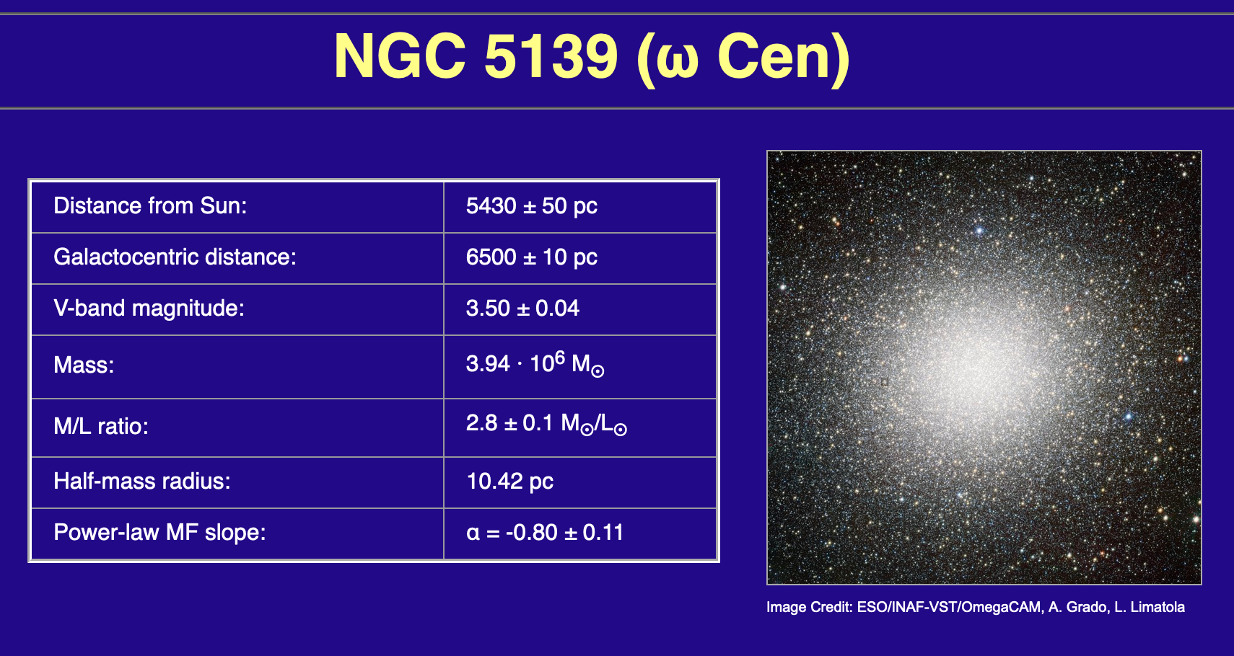
MW Globular Clusters
Baumgardt Catalog as of March 2023 has 168 MW globulars
https://people.smp.uq.edu.au/HolgerBaumgardt/globular/
Notes:
omega Cen is the brightest GC … next is 47 Tuc at V = 4.1 … M13 at V = 5.8

Slide 13
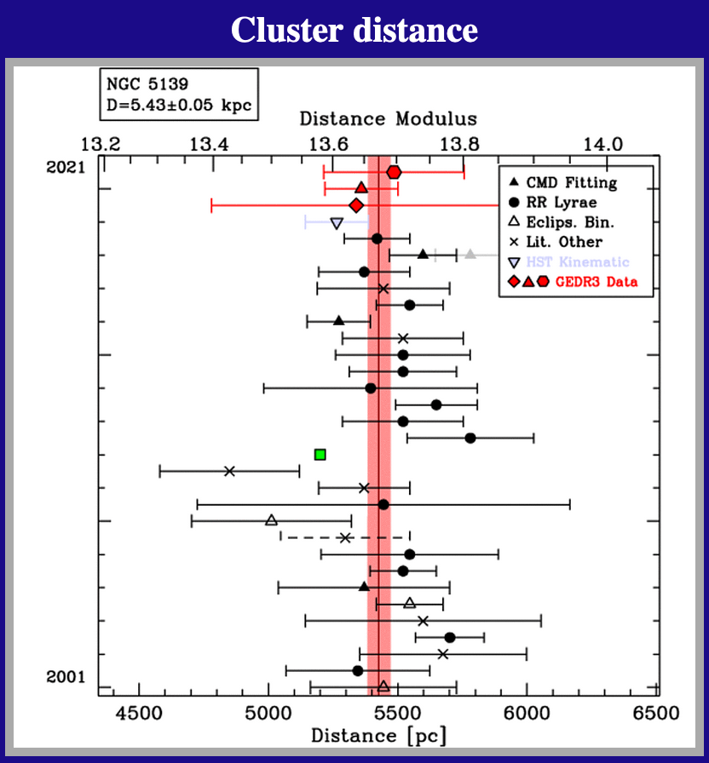
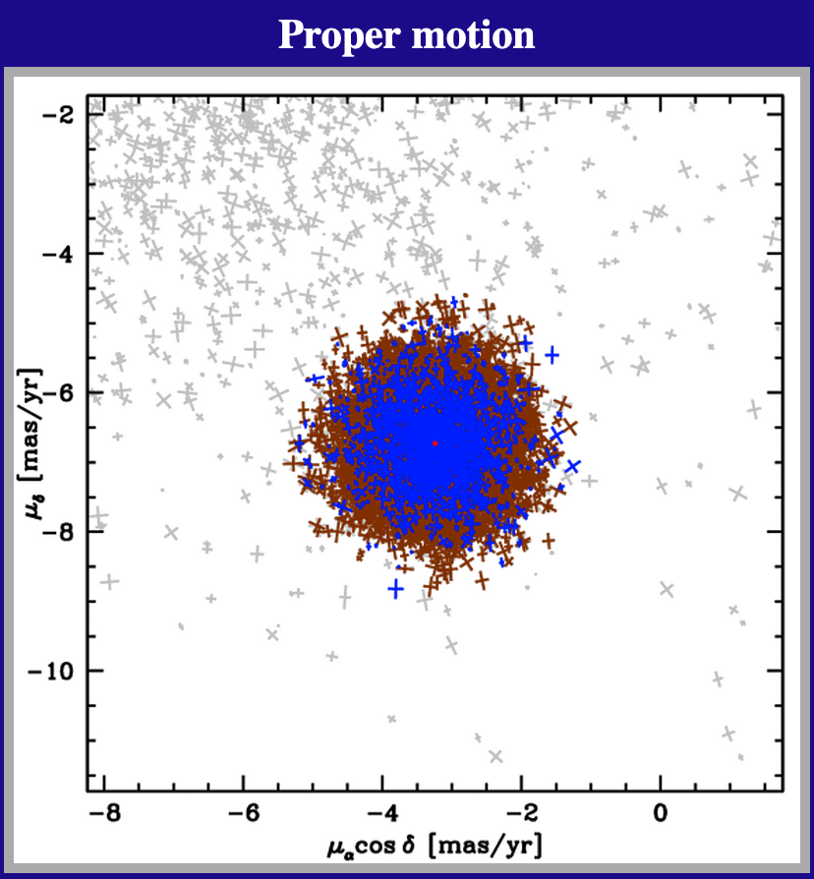
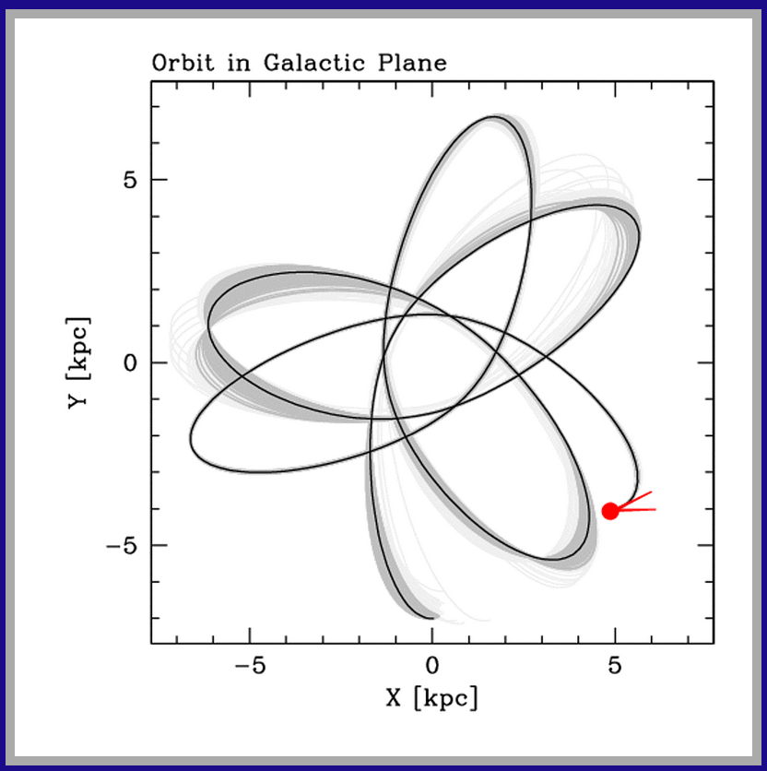
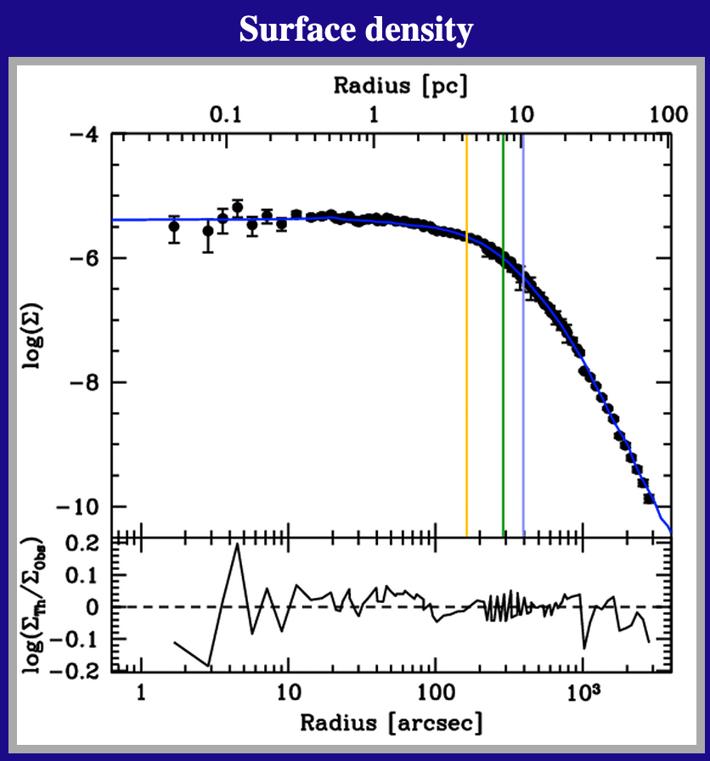
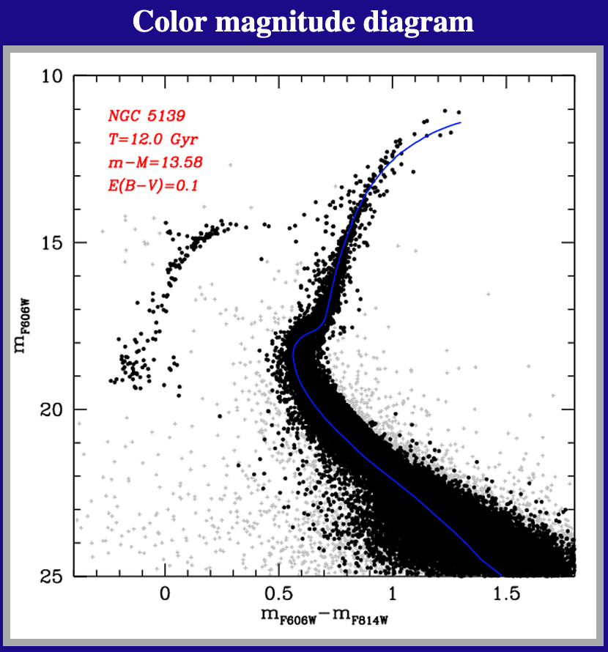
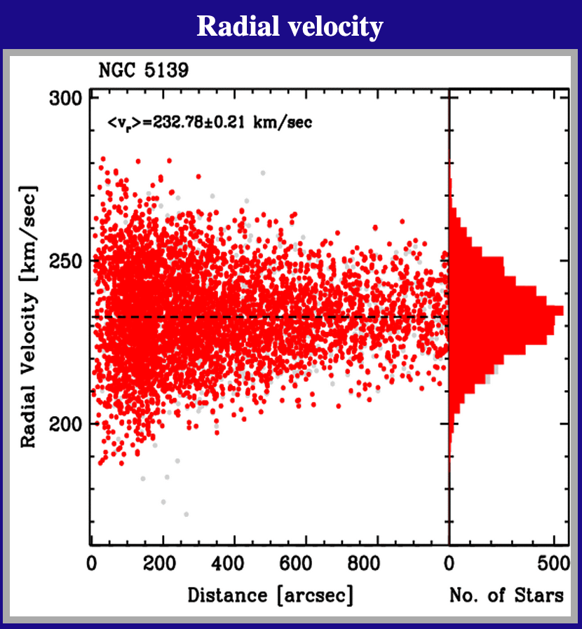
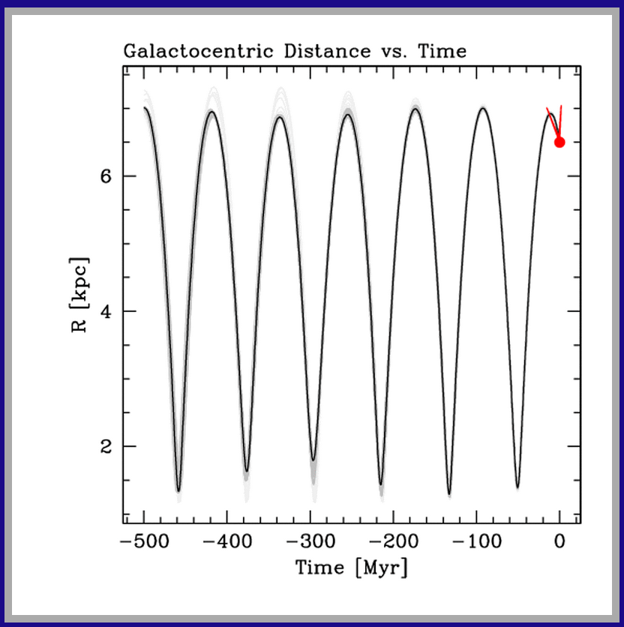
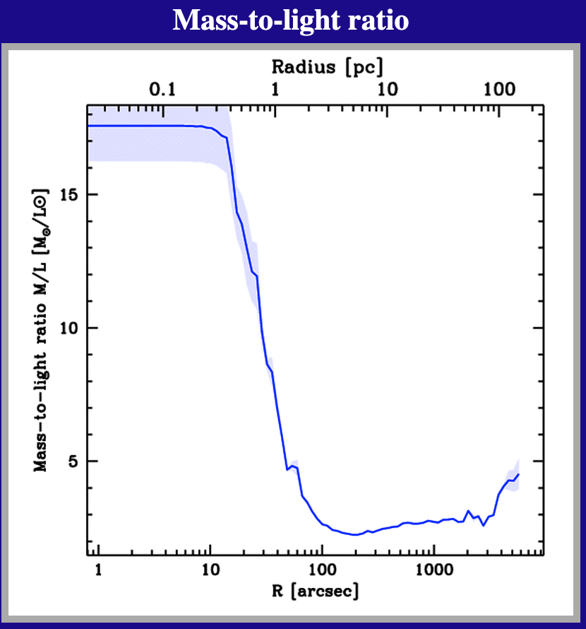
MW Globular Clusters
Baumgardt Catalog as of March 2023 has 168 MW globulars
https://people.smp.uq.edu.au/HolgerBaumgardt/globular/
Notes:
THESE PLOTS TOO SMALL … GO INTERACTIVE VIA WEBSITE
This is only 8 of 17 (!) plots available on the website.
Huge M/L drop due to compact remnants in close? … other GCs have rises by factors of a few

Slide 14
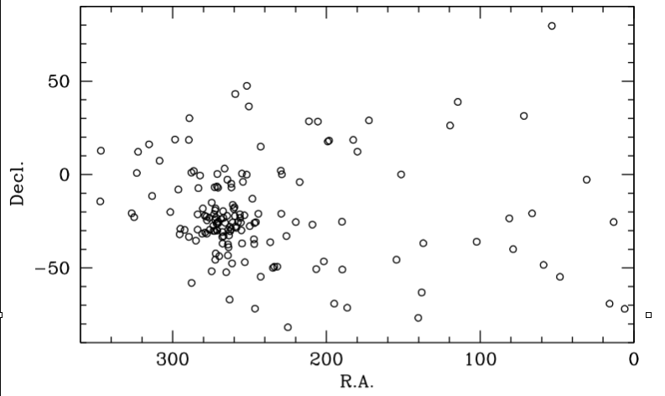
GCs: Location
concentrated near Galactic center, in Sagittarius
“GCs surround GC”

Slide 15
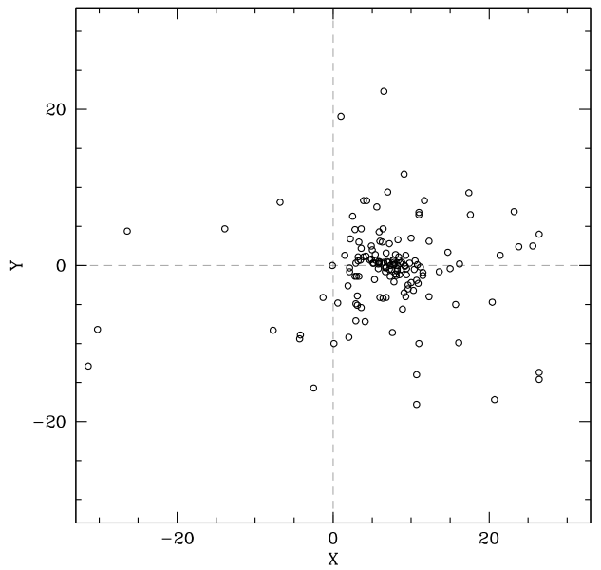
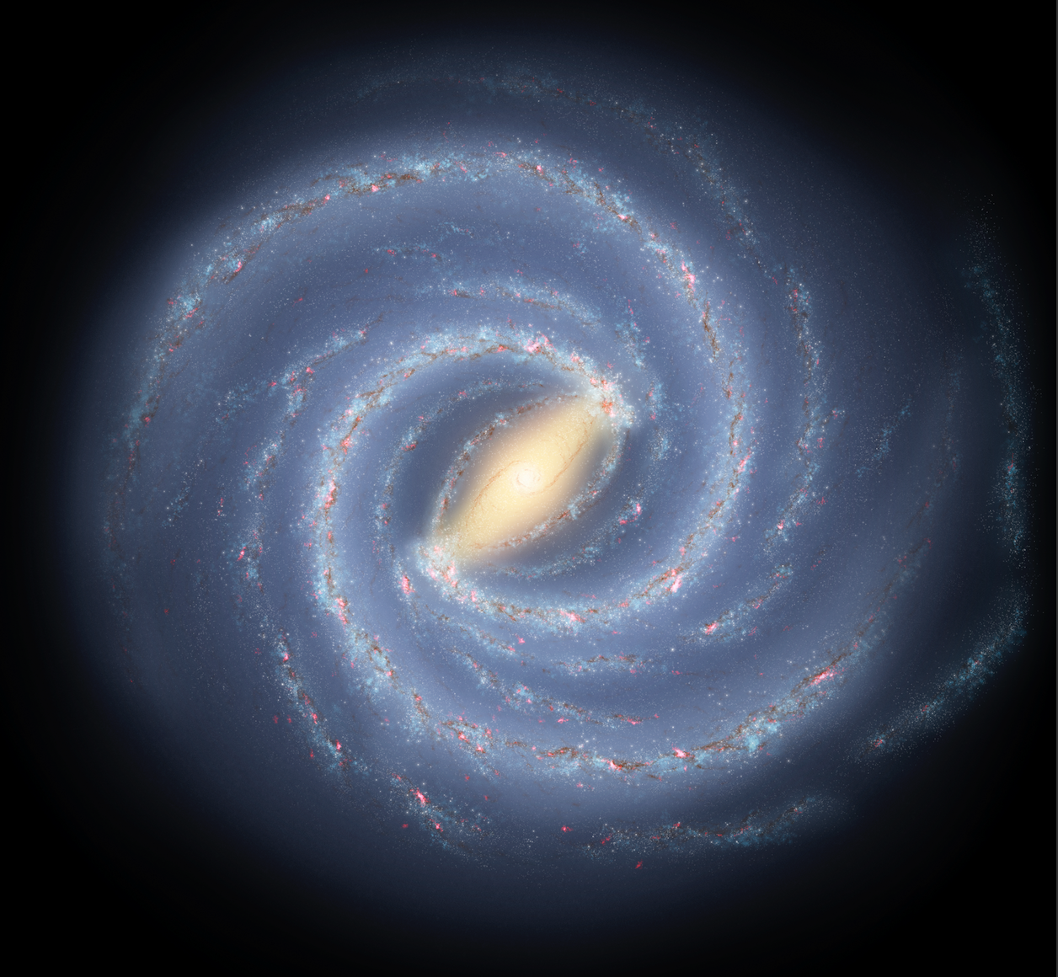
GCs: Location
adding physical distances indicates center ~8 kpc away
… thank you Shapleys

Slide 16
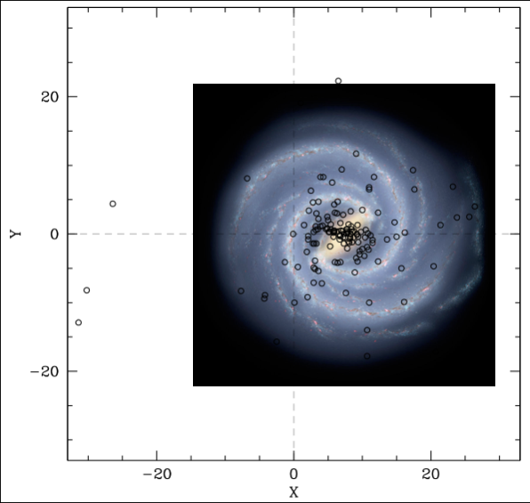
GCs: Location
adding physical distances indicates center ~8 kpc away
… thank you Shapleys

Slide 17
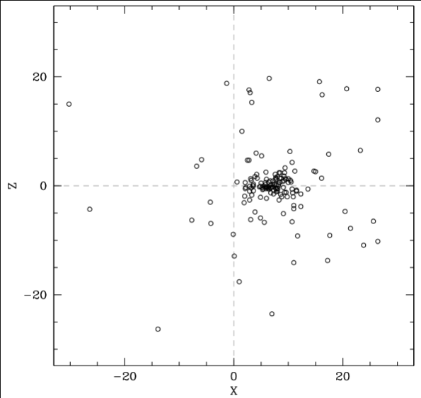
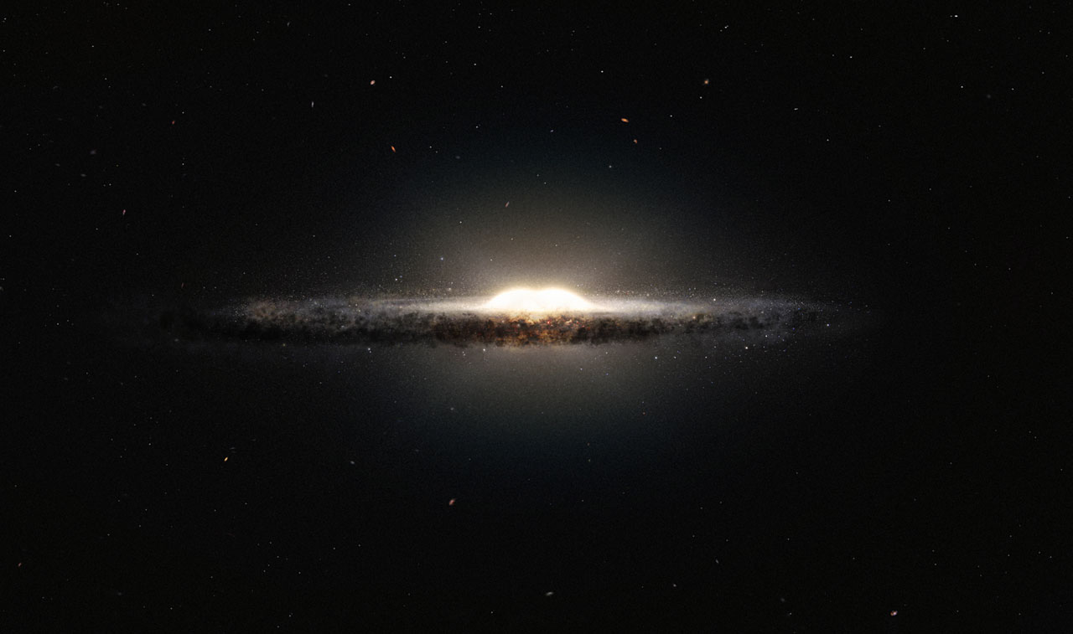
GCs: Location
most globulars within 4 kpc of GC … spherical distribution
“a super-globular made up of mini globulars”

Slide 18
GCs: Location
most globulars within 4 kpc of GC … spherical distribution
“a super-globular made up of mini globulars”

Slide 19
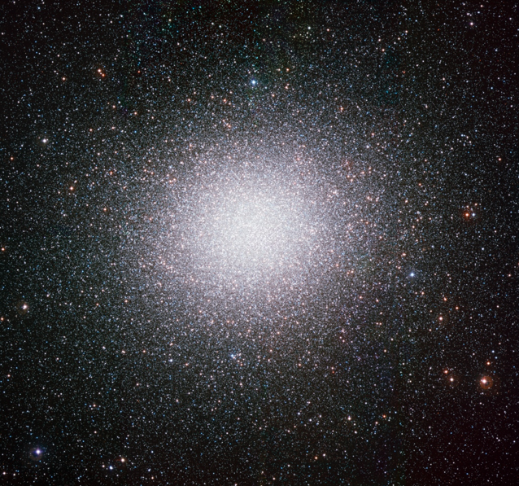
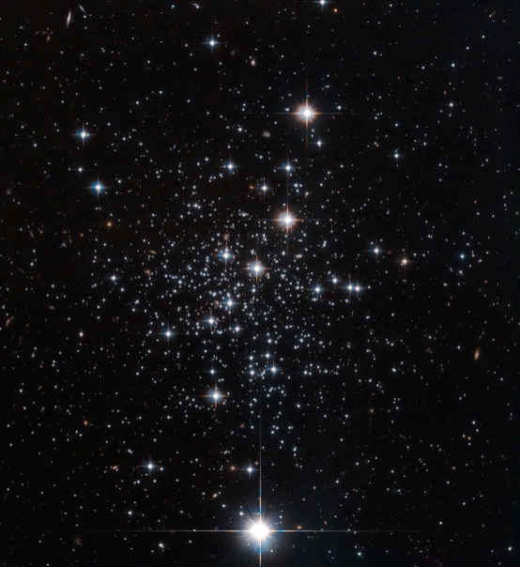
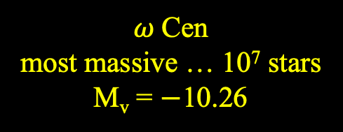

GCs: Sizes/Shapes
$ω$Cen
most massive … 10⁷ stars
M_{v} = $−$10.26
Palomar 12
one of smallest … few 1000 stars
M_{v} = $−4.47$

Slide 20
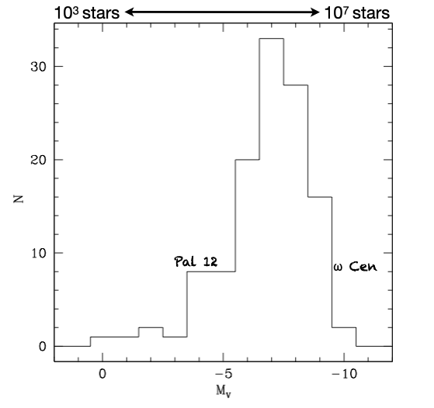
GCs: Sizes/Shapes
GC luminosity function
most have 10⁵ – 10⁷ stars
smaller cluster deficit real

Slide 21
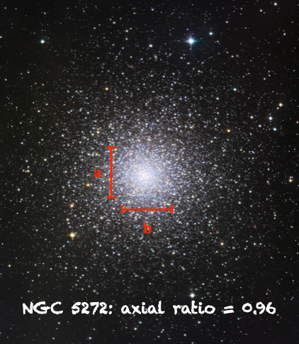
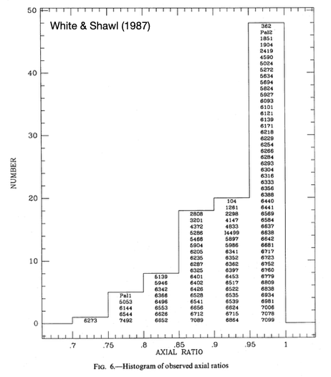
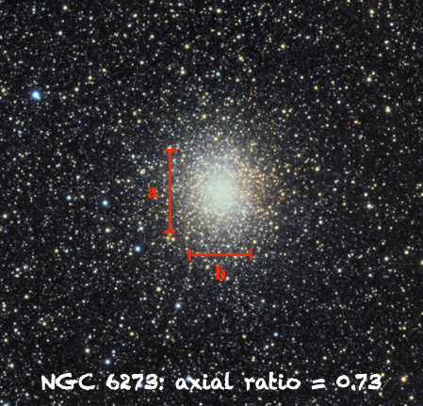
GCs: Sizes/Shapes
axial ratios [b/a] typically ~1
NGC 6273 most elliptical … possible systemic rotation

Slide 22
GCs: Sizes/Shapes
M3 is ~15’ across, about 10 kpc away,
and contains about 500,000 stars.
How many stars?
1. measure GC total luminosity
2. assume a mass function
3. use a mass-luminosity relation
4. get estimate of total # stars
How large is M3 in parsecs?
What is the stellar density, assuming
uniformly filled (obviously not true)?
What is the stellar density within
the half-mass radius of 1 arcmin?
M3 at ~10 kpc
15’

Slide 23
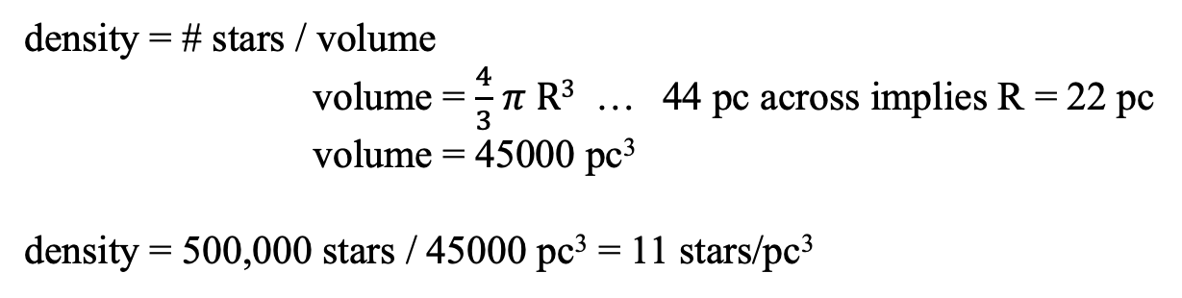
M3 Globular Fun
M3 is ~15’ across, about 10 kpc away, and contains about 500,000 stars.
How large is M3 in parsecs?
15 arcmin = 900 arcsec
1 arcsec at 1 parsec = 1 AU
900 arcsec at 1 parsec = 900 AU
900 arcsec at 10 kpc = 900 AU x 10⁴ = 9 x 10⁶ AU
convert 1 pc / 206265 AU = 44 pc across
What is the stellar density, assuming uniformly filled (obviously not true)?
density = # stars / volume
volume = $\frac{4}{3}$ $π R3$ … 44 pc across implies R = 22 pc
volume = 45000 pc³
density = 500,000 stars / 45000 pc³ = 11 stars/pc³
What is the stellar density within the half-mass radius of 1 arcmin?
density = 250,000 stars / ($\frac{ 4}{3}$ $π (\frac{44}{15})3$ pc³) ~ 2000 stars/pc³ in R = 3 pc sphere!

Slide 24
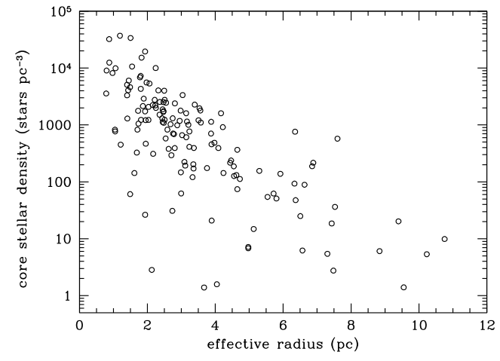
GCs: Sizes/Shapes
M3
SN
larger clusters tend to have lower central densities … more diffuse
compare: solar neighborhood 373 stars within 10 pc … density is ~0.1 stars/pc³
Notes:
red circle is M3

Slide 25
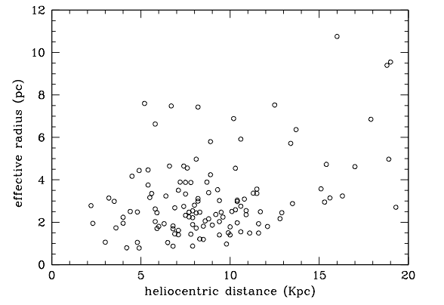
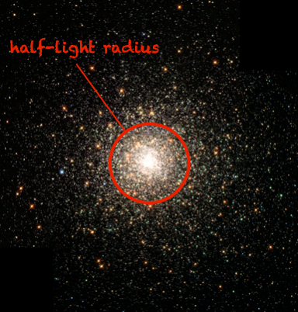
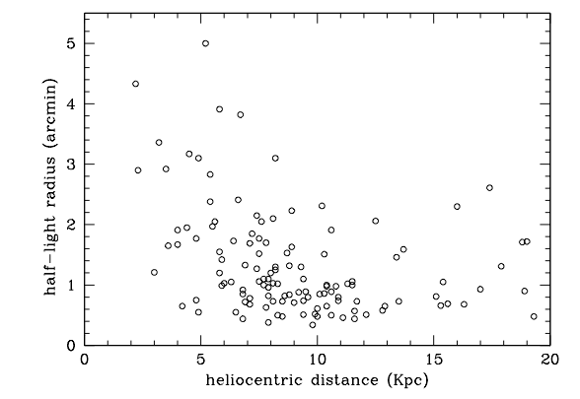

GCs: Sizes/Shapes
half-light radius often used to characterize GCs
nearby GCs have larger radii (duh), but ~all have R_{hl} > 20 arcsec
from R_{hl} and distance …derive effective radii R_{e}
most GCs have R_{e} ~ 1$−$5 pc

Slide 26
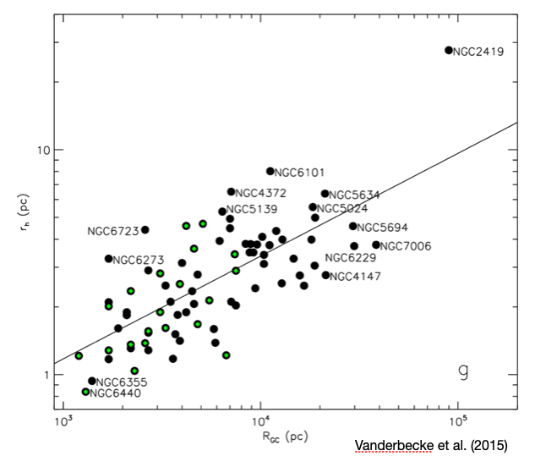
GCs: Sizes/Shapes
GC size related to distance from Galactic center
small/dense clusters survive larger tidal forces … or have been stripped

Slide 27
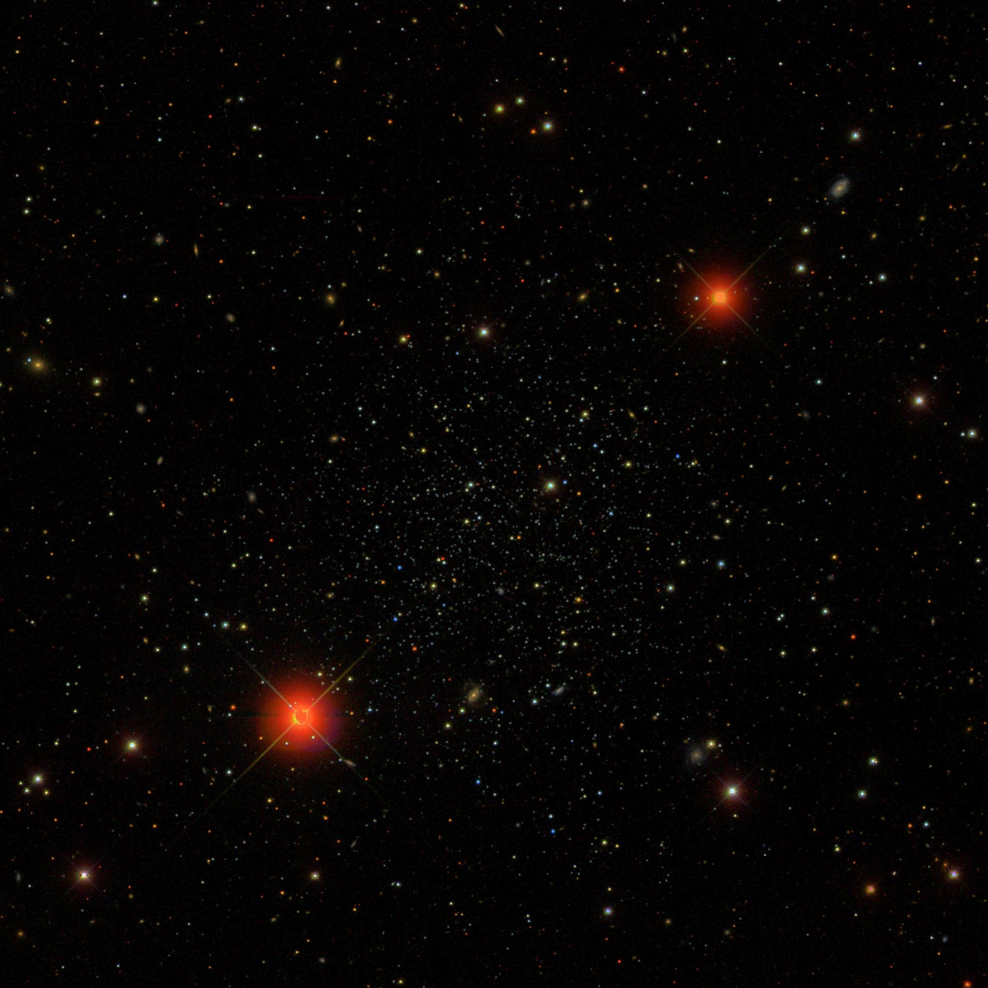
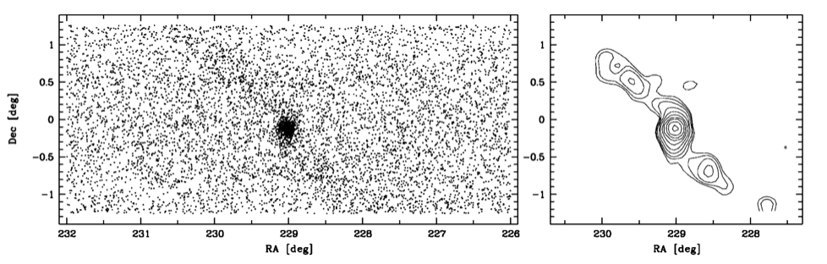
GCs: Sizes/Shapes
Palomar 5
SDSS commissioning data
tidal tails stretching 2.6º on sky
heavy mass loss … ~1/3 of cluster stars
can use to determine orbit around MW
stars become members of halo or bulge
Odenkirchen+ (2001)
Notes:
Palomar 5 has effective radius of ~35 pc (?)

