Slide 1
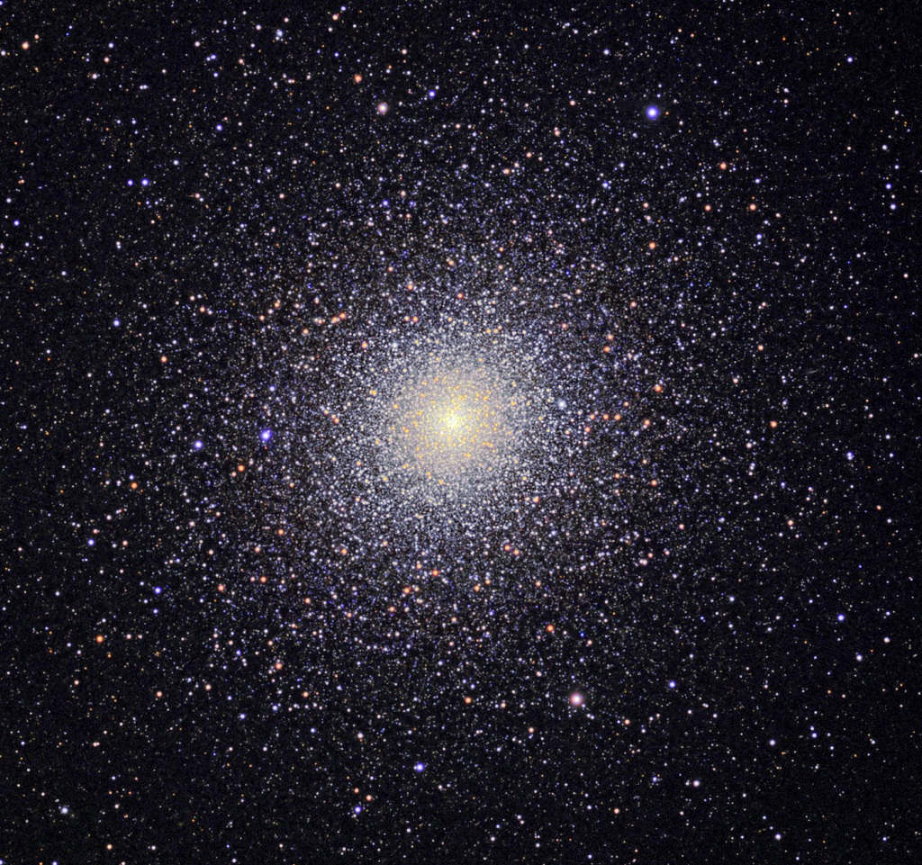
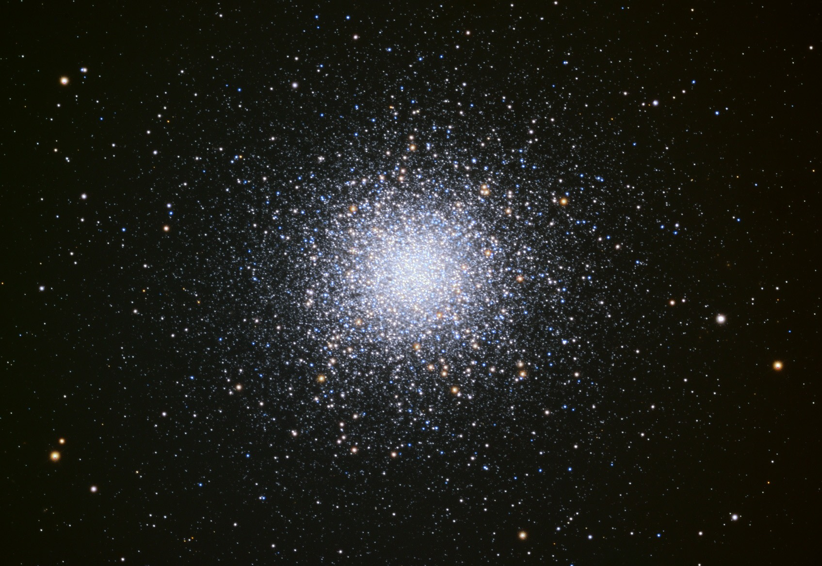
MW Globular Clusters
M13 in Hercules 47 Tuc in Tucana
(north) (south)
Notes:
This would be short without continuation from last globular cluster lecture.

Slide 2
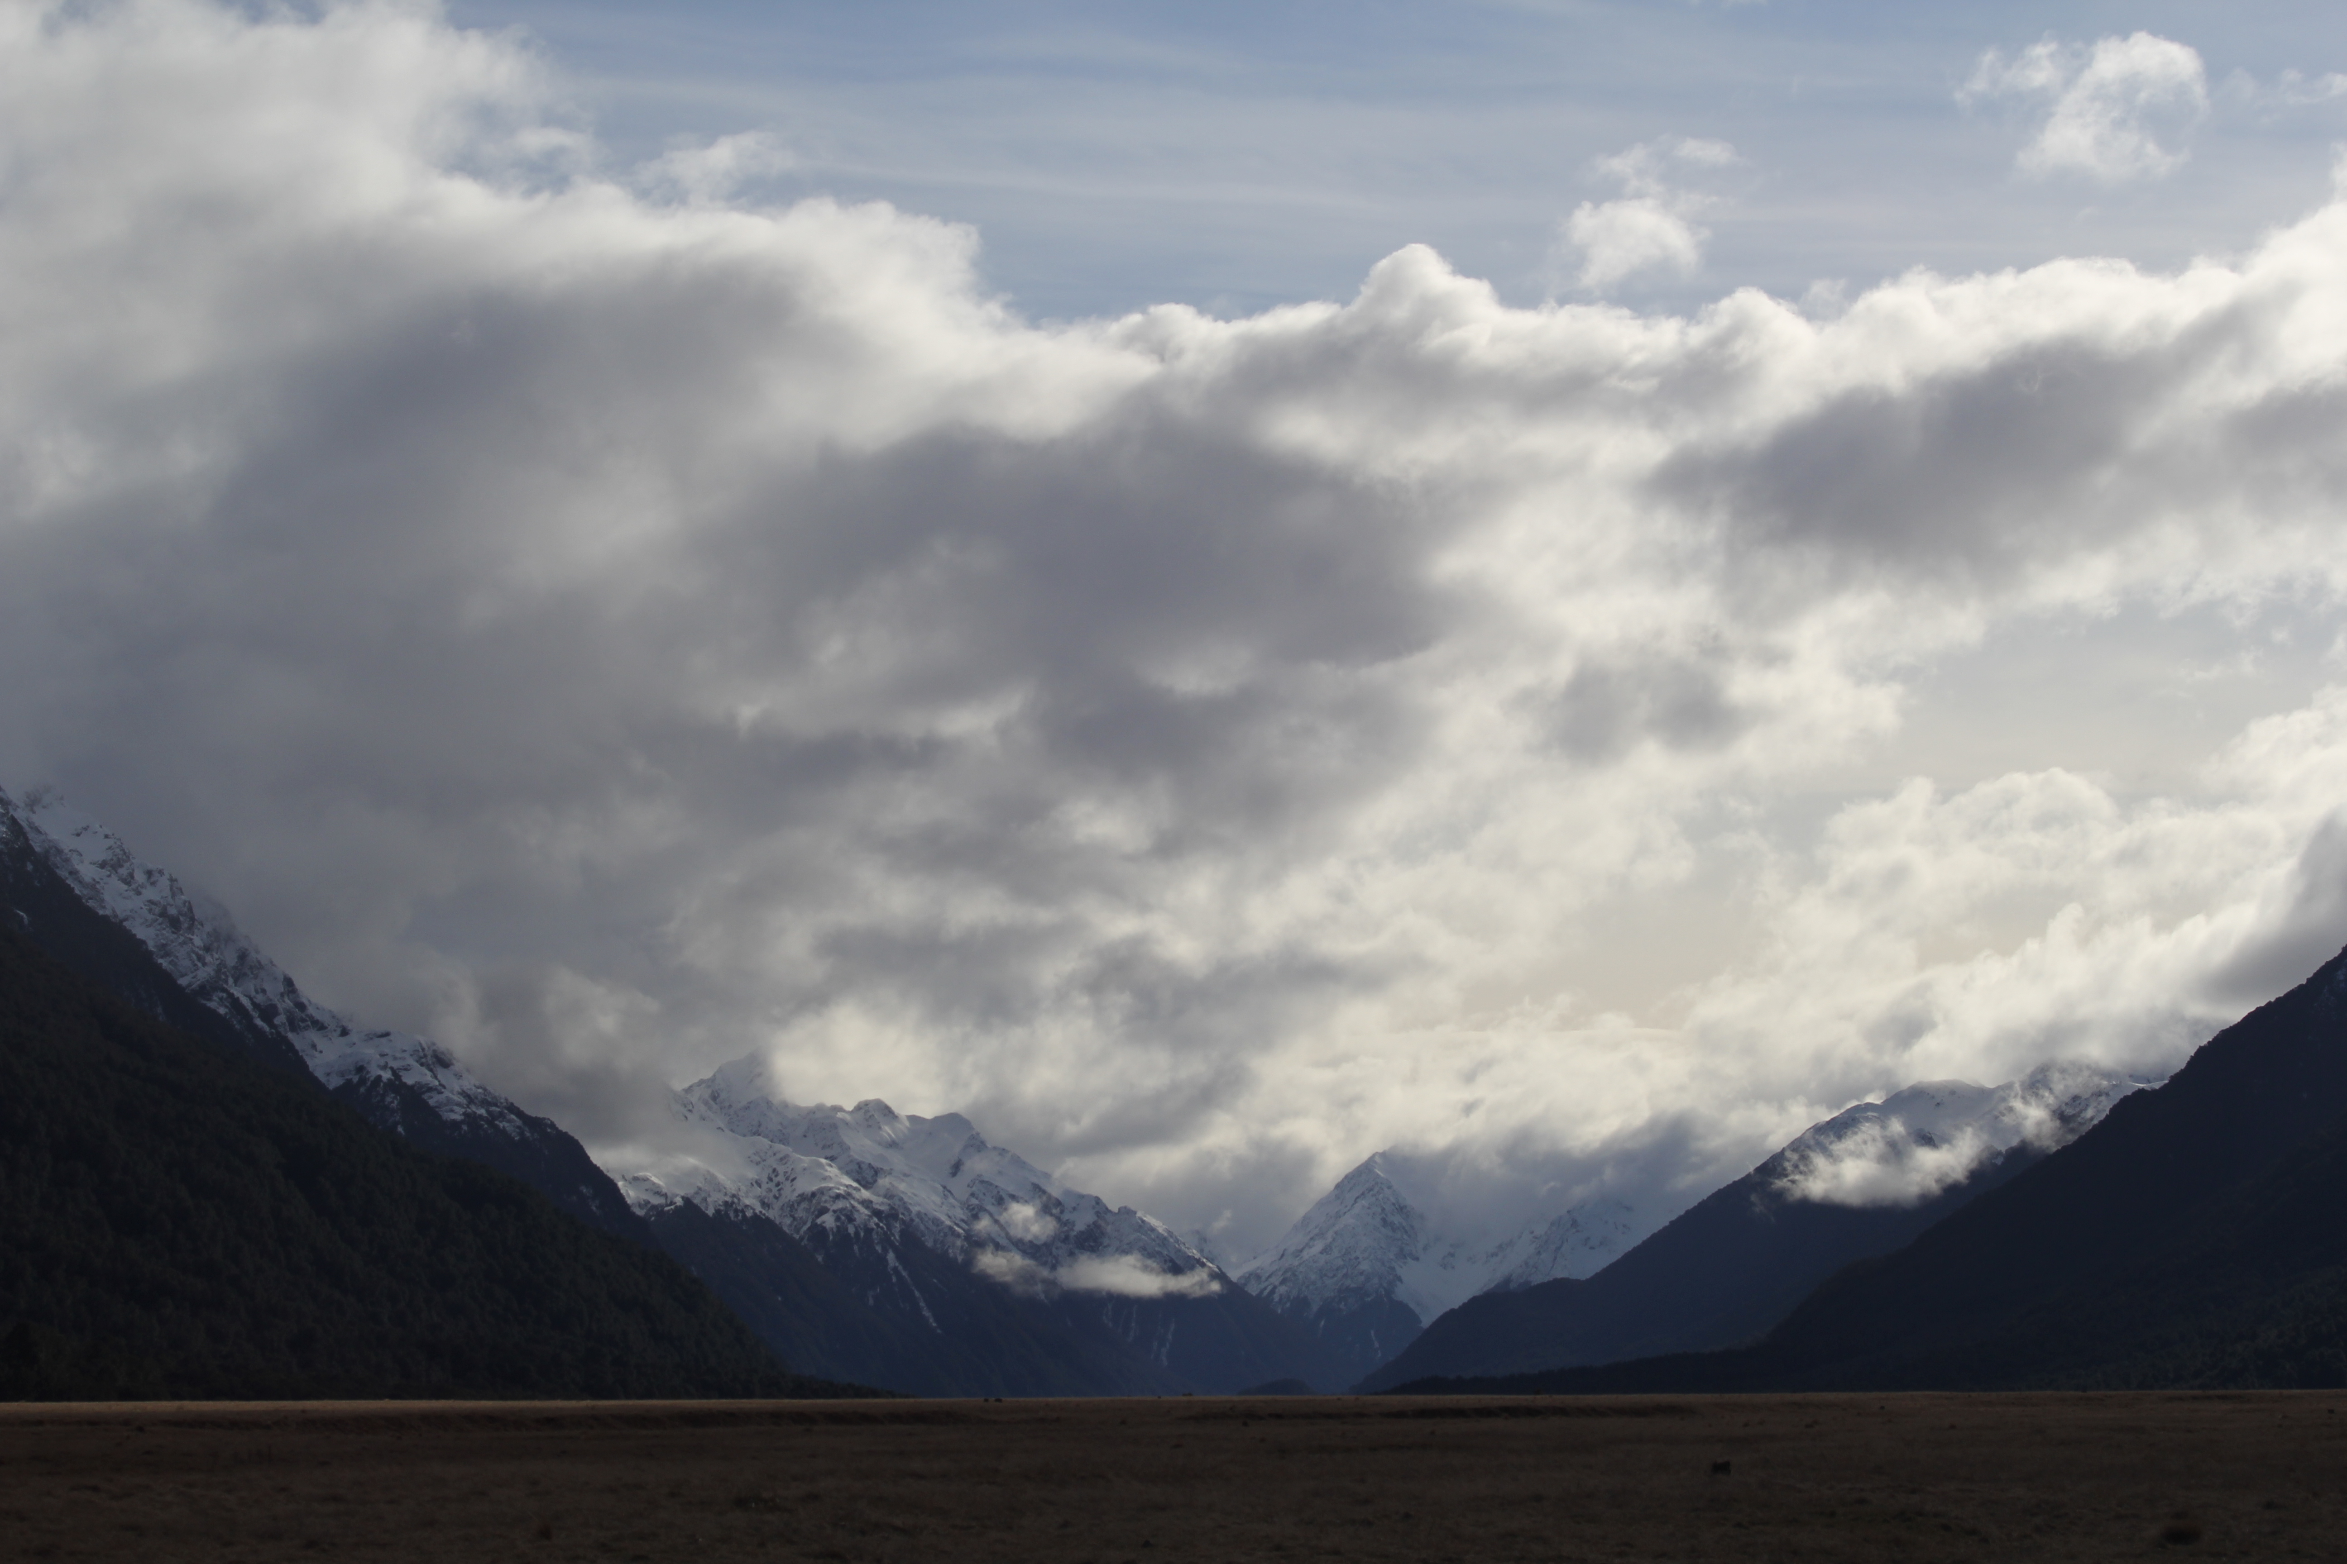

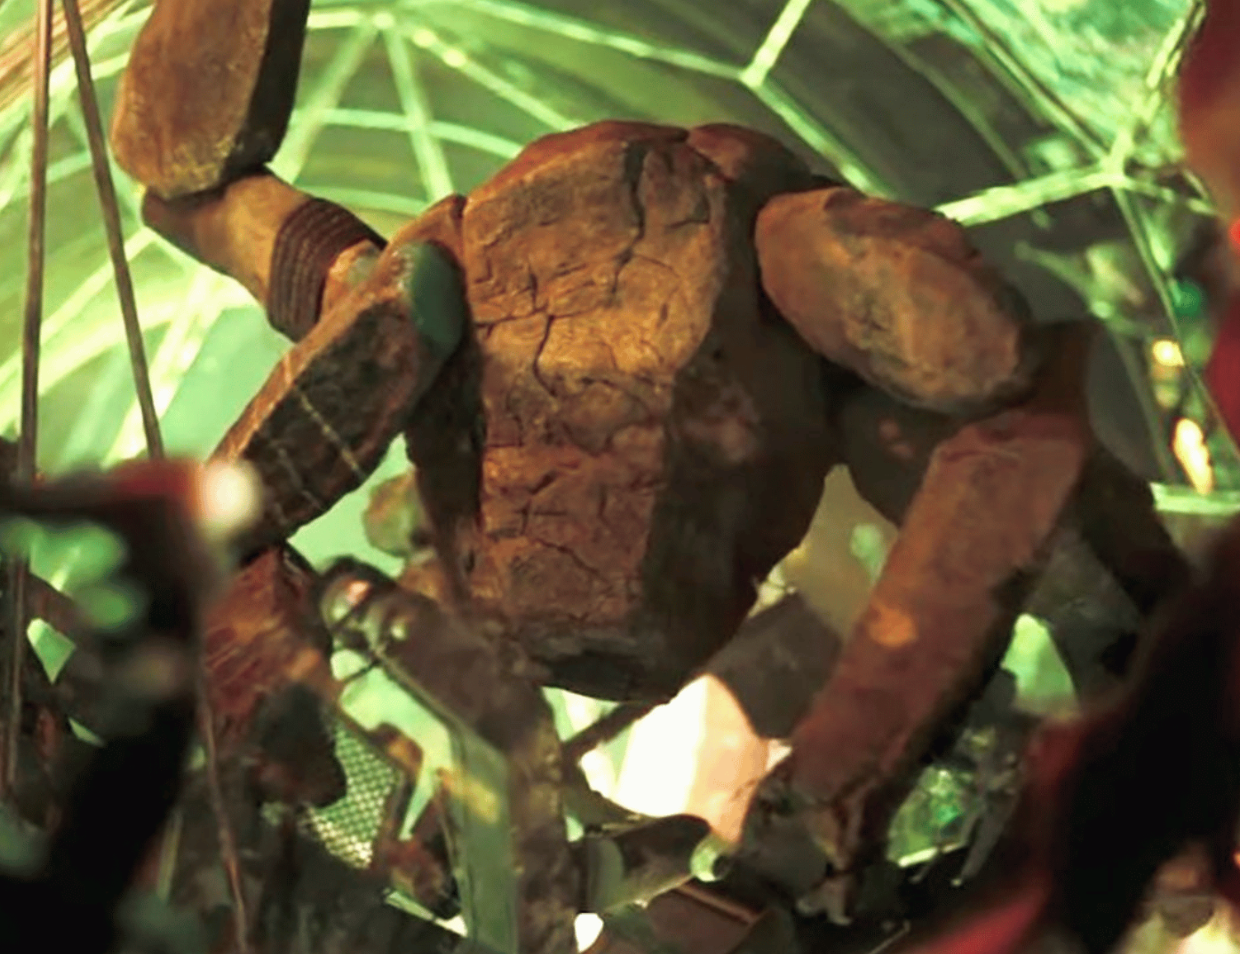
Assignments
Tuesday 03 FEB Level 0 … Ideas
Tuesday 10 FEB Bio Sketch
Tuesday 17 FEB Level 1 … Outline … 2 weeks later
Thursday 19 FEB Milky Way Neighborhood
Tuesday 10 MAR Level 2 … 1st Draft … 3 weeks later
Tuesday 31 MAR Budgets + Narrative
Tuesday 07 APR Level 3 … 2nd Draft
Facilities/Mentoring/Data
Tue/Thu 14/16 APR Presentations
Thursday 23 APR Level 4 … submit … 6 weeks later

Slide 3
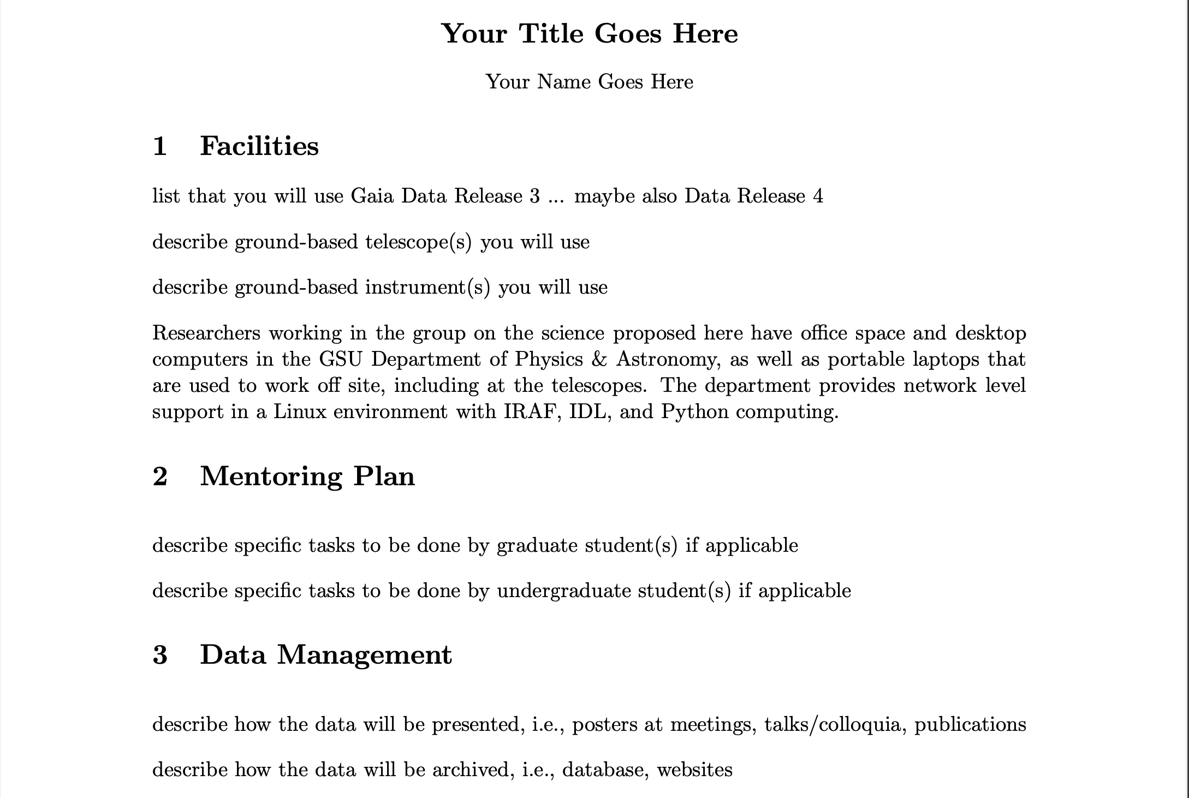
Facilities/Mentoring/Data

Slide 4
MW Globular Clusters
M13 in Hercules 47 Tuc in Tucana
(north) (south)

Slide 5
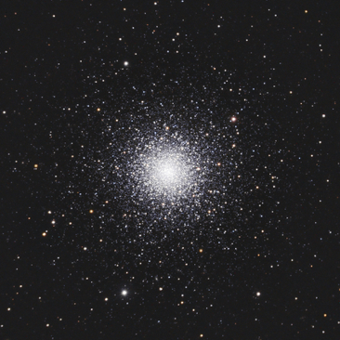
GCs: Sizes/Shapes
M3 is ~15’ across, about 10 kpc away,
and contains about 500,000 stars.
How many stars?
1. measure GC total luminosity
2. assume a mass function
3. use a mass-luminosity relation
4. get estimate of total # stars
How large is M3 in parsecs?
What is the stellar density, assuming
uniformly filled (obviously not true)?
What is the stellar density within
the half-mass radius of 1 arcmin?
M3 at ~10 kpc
15’

Slide 6
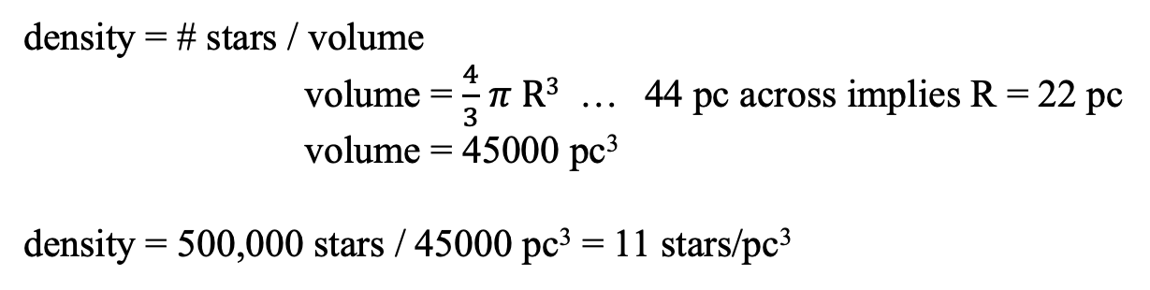
M3 Globular Fun
M3 is ~15’ across, about 10 kpc away, and contains about 500,000 stars.
How large is M3 in parsecs?
15 arcmin = 900 arcsec
1 arcsec at 1 parsec = 1 AU
900 arcsec at 1 parsec = 900 AU
900 arcsec at 10 kpc = 900 AU x 10⁴ = 9 x 10⁶ AU
convert 1 pc / 206265 AU = 44 pc across
What is the stellar density, assuming uniformly filled (obviously not true)?
density = # stars / volume
volume = $\frac{4}{3}$ $π R3$ … 44 pc across implies R = 22 pc
volume = 45000 pc³
density = 500,000 stars / 45000 pc³ = 11 stars/pc³
What is the stellar density within the half-mass radius of 1 arcmin?
density = 250,000 stars / ($\frac{ 4}{3}$ $π (\frac{44}{15})3$ pc³) ~ 2000 stars/pc³ in R = 3 pc sphere!

Slide 7
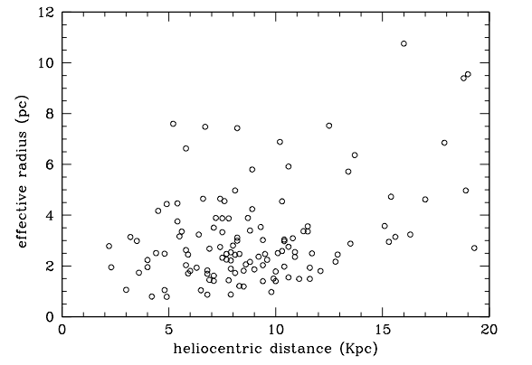
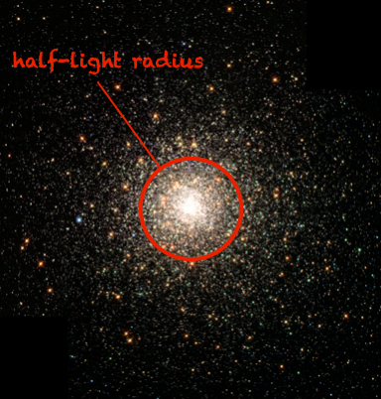
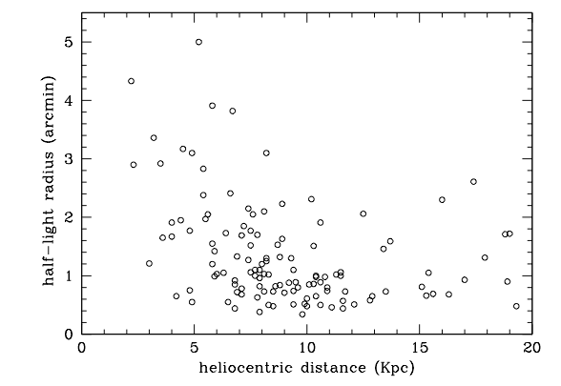
GCs: Sizes/Shapes
half-light radius often used to characterize GCs
nearby GCs have larger radii (duh), but ~all have R_{hl} > 20 arcsec
from R_{hl} and distance …derive effective radii R_{e}

Slide 8
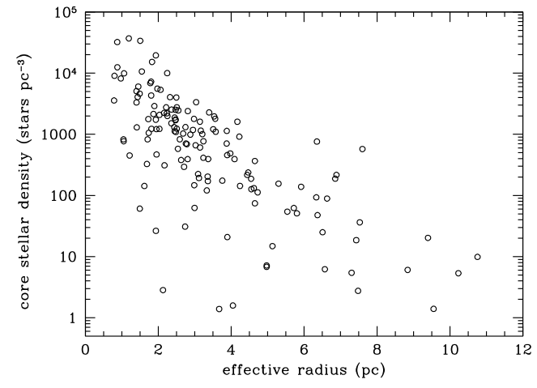
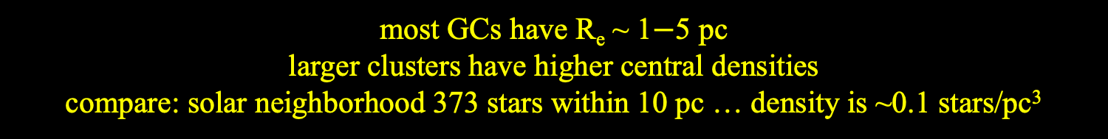
GCs: Sizes/Shapes
M3
SN
most GCs have R_{e} ~ 1$−$5 pc
larger clusters have higher central densities
compare: solar neighborhood 373 stars within 10 pc … density is ~0.1 stars/pc³
Notes:
red circle is M3

Slide 9
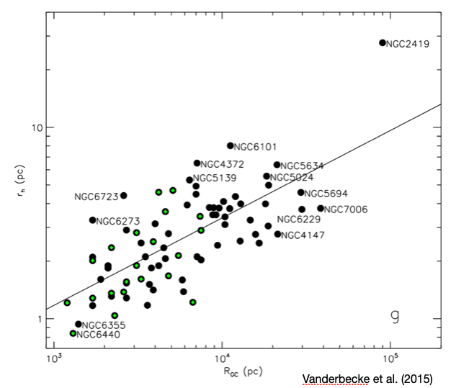
GCs: Sizes/Shapes
GC size related to distance from Galactic center
small/dense clusters survive larger tidal forces … or have been stripped

Slide 10
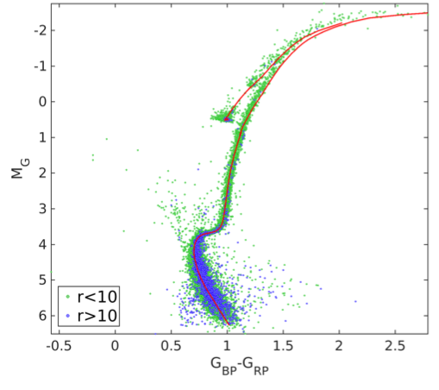
GC HR Diagrams
47 Tuc
green < 10 arcmin = 3X half-light radius
blue > 10 arcmin
Babusiaux+ (2018)

Slide 11
GC HR Diagrams
asymptotic giant branch
6
horizontal branch
5
4
red giant branch
blue
stragglers
7
3
subgiant branch
main seq turnoff
2
1
main sequence
Babusiaux+ (2018)

Slide 12
GC HR Diagrams
AGB
MSTO: used to determine age
SGB: narrow … stars of same
mass evolving off simultaneously
= all stars have same age
RGB H shell only
HB He → C core
H → He shell
AGB He → C shell
H → He shell
BS mass exchange
HB
RGB
BS
MSTO
SGB
Babusiaux+ (2018)

Slide 13
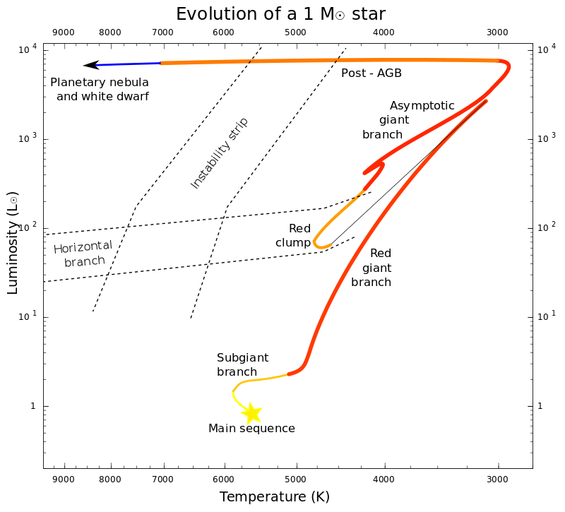


Sun *DOES* go AGB
~ 200 R$⊙$
helium flash
He → C shell
H → He shell
~ 150 R$⊙$
He → C core
H shell only
Notes:
Sun *DOES* go AGB

Slide 14
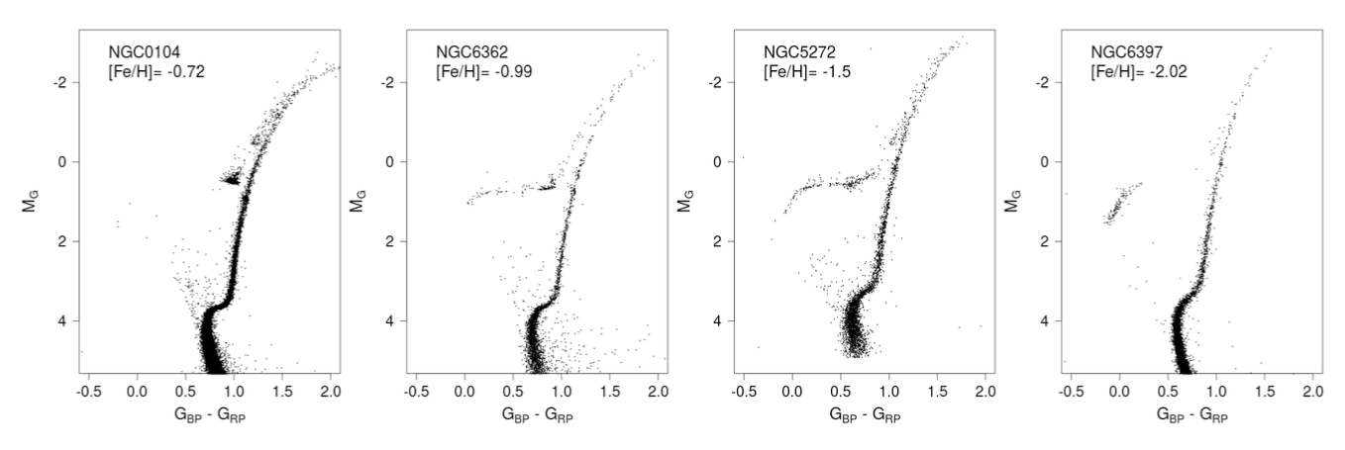
GC HR Diagrams
47 Tuc
M 3
Which cluster is furthest?
M 3 at 10.4 kpc … faint stars missing
Which cluster is closest?
NGC 6397 at 2.4 kpc … tighter main seq
How do the MSTOs compare?
higher metallicity … redder
How do the RGBs compare?
higher metallicity … redder
How do the HBs compare?
lower metallicity … stretches blueward
Babusiaux+ (2018)
Notes:
NGC 104 = 47 Tuc … 4.5 kpc
NGC 6362 … 7.6 kpc
NGC 5272 = M3 … 10.4 kpc
NGC 6397 … 2.4 kpc

Slide 15
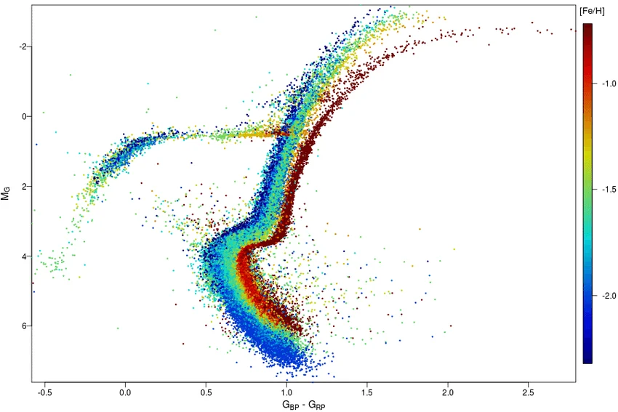
GCs: Metallicities
14 GCs
Babusiaux+ (2018)

Slide 16

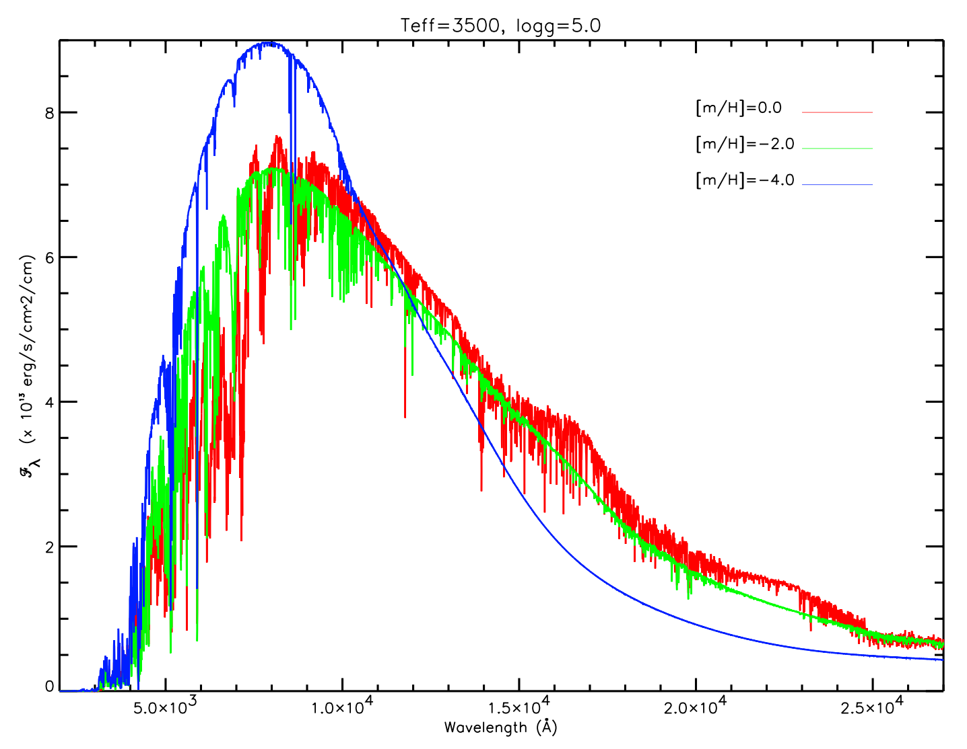
1,865 × 2,560
GC Colors
Why are high metallicity stars RED
and low metallicity stars BLUE?
star
star
Jao+
(2008)
Line blanketing: many metals (particularly Fe)
in stellar atmospheres of stars absorb
blue light, so the star looks redder.
Opacity: more metals absorb energy from the
stellar interior, making red giants “swell up”
more, causing cooler (redder) temperatures.
Metal poor stars are blue … Metal rich stars are red
WHY?
Notes:
NGC 104 = 47 Tuc … 4.5 kpc
NGC 6362 … 7.6 kpc
NGC 5272 = M3 … 10.4 kpc
NGC 6397 … 2.4 kpc

Slide 17
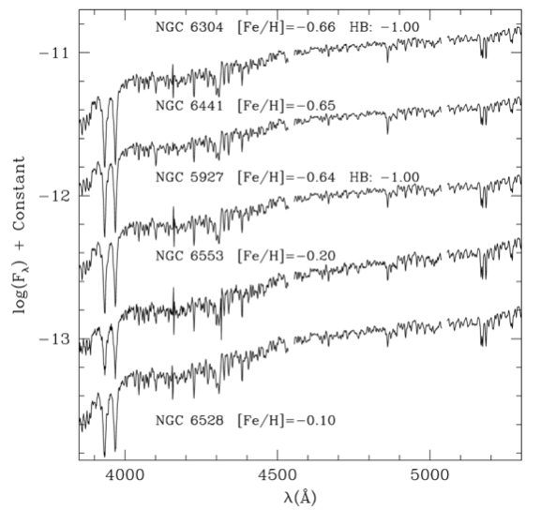
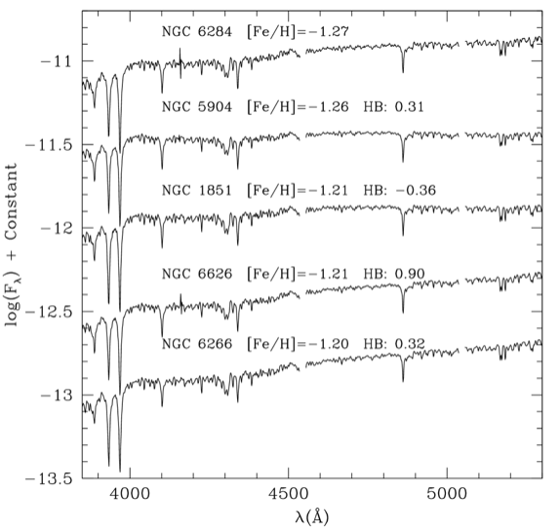
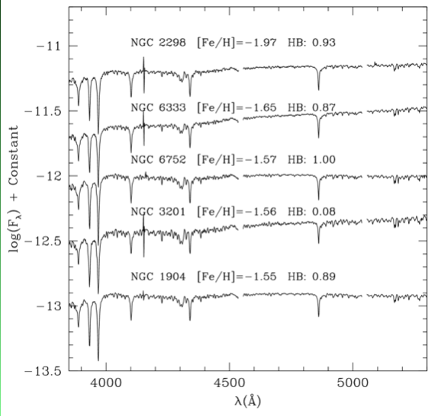
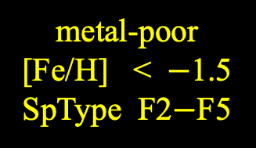
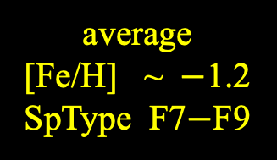
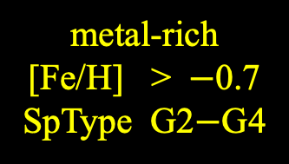
GCs: Metallicities
chemical composition estimated using spectra of cores
metal-rich
[Fe/H] > $−$0.7
SpType G2$−$G4
average
[Fe/H] ~ $−$1.2
SpType F7$−$F9
metal-poor
[Fe/H] < $−$1.5
SpType F2$−$F5
Schiavon+ (2005)

Slide 18
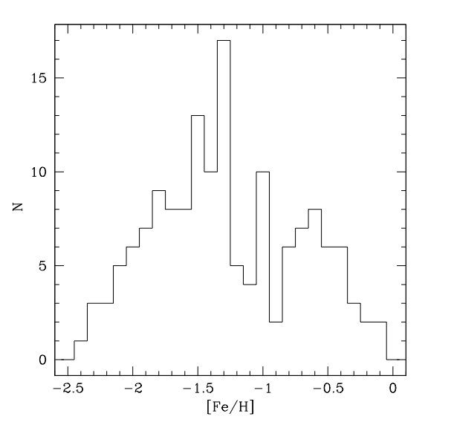
GCs: Metallicities
solar
neighborhood
VERY metal-poor compared to SN and MW disk … likely much older

Slide 19
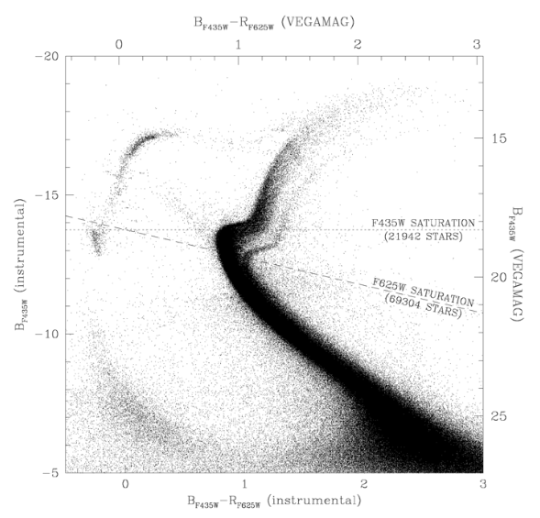
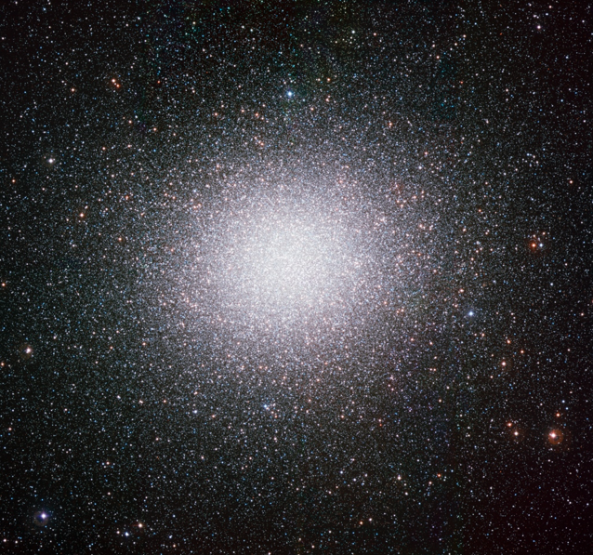
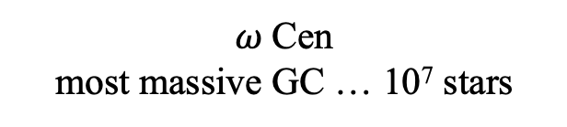
GC HR Diagrams
most GCs are “single population” clusters … stars have = ages, metallicities, but …
$ω$Cen
most massive GC … 10⁷ stars
multiple MS, SGB, RGB, …
What might cause this?
dwarf galaxy core?
merged GCs?
Anderson+ (2010)

Slide 20
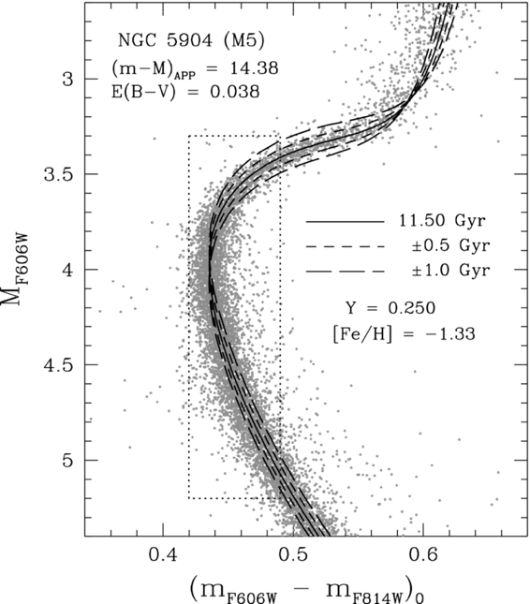
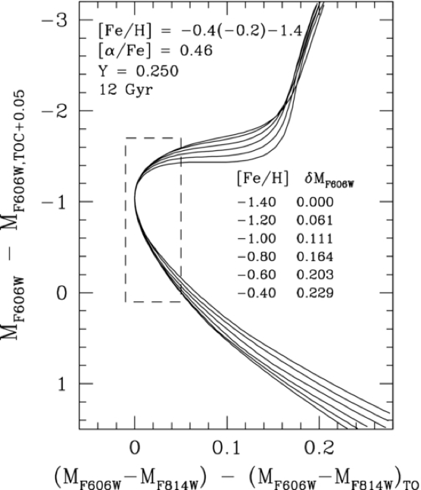
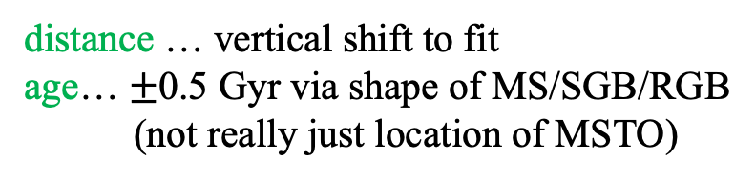
GC Ages
distance … vertical shift to fit
age… $±$0.5 Gyr via shape of MS/SGB/RGB
(not really just location of MSTO)
adjustments by changing
metallicity
Van den Berg+ (2013)

Slide 21
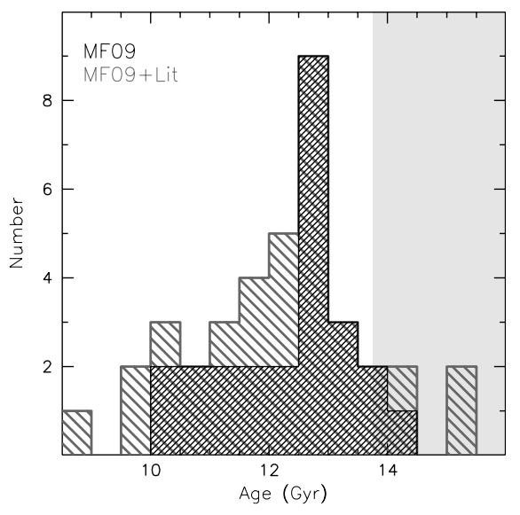
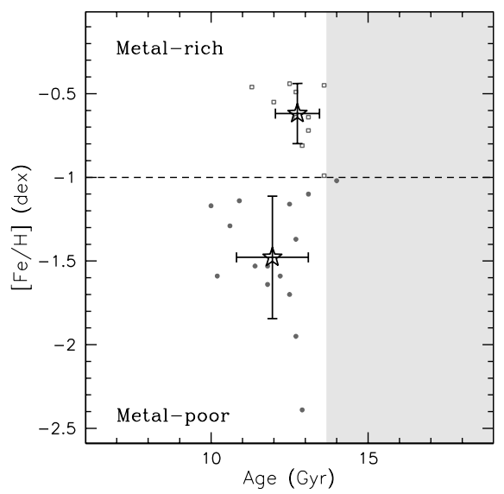
GC Ages
ages from isochrone fits
a few ages > 13.7 Gyr
GCs are oldest MW components
more metal rich are older
say what?
another factor at play …
Roediger+ (2014)
Notes:
Left: Adopted age distribution for the S05 GGC sample based on either MF09 alone (black), or MF09 plus additional sources of age information in the literature (for those clusters not studied by MF09; dark gray). The shaded region corresponds to ages in excess of that of the universe (Komatsu et al. 2011).

Slide 22
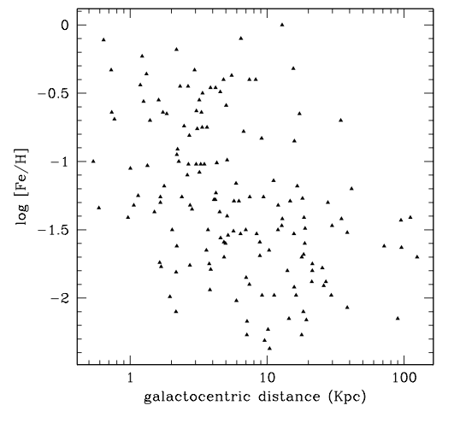
GC Ages
slight correlation:
higher metallicity when closer to Galactic Center
Why might that be?
GCs near GC had (slightly) enriched metal content from early star formation (?)
BUT!!! GCs are moving in/out of Galactic potential
GC metallicity depends more on environment than age
location, location, location
bottom line: GCs are not older than the Universe …
Roediger+ (2014)

Slide 23
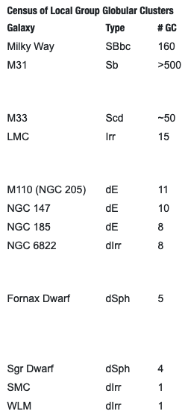
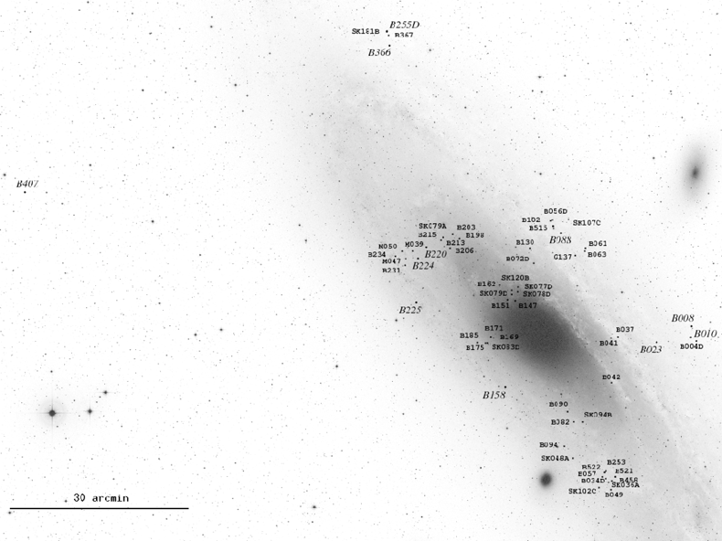
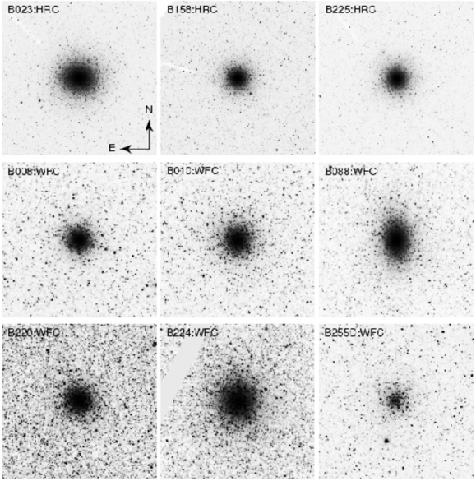
Andromeda Globular Clusters
Andromeda
Triangulum
And+
HST images
all Local Group galaxies
with GCs as of 2018
https://skyandtelescope.org/sky-and-telescope-magazine/extragalactic-globular-clusters/
Sibila+ (2009)
Notes:
We don’t really know why Andromeda has 3X the globulars as the MW.
M33 = Triangulum
M110 = larger And satellite
M32 = brighter And satellite … no GCs listed

