Slide 1
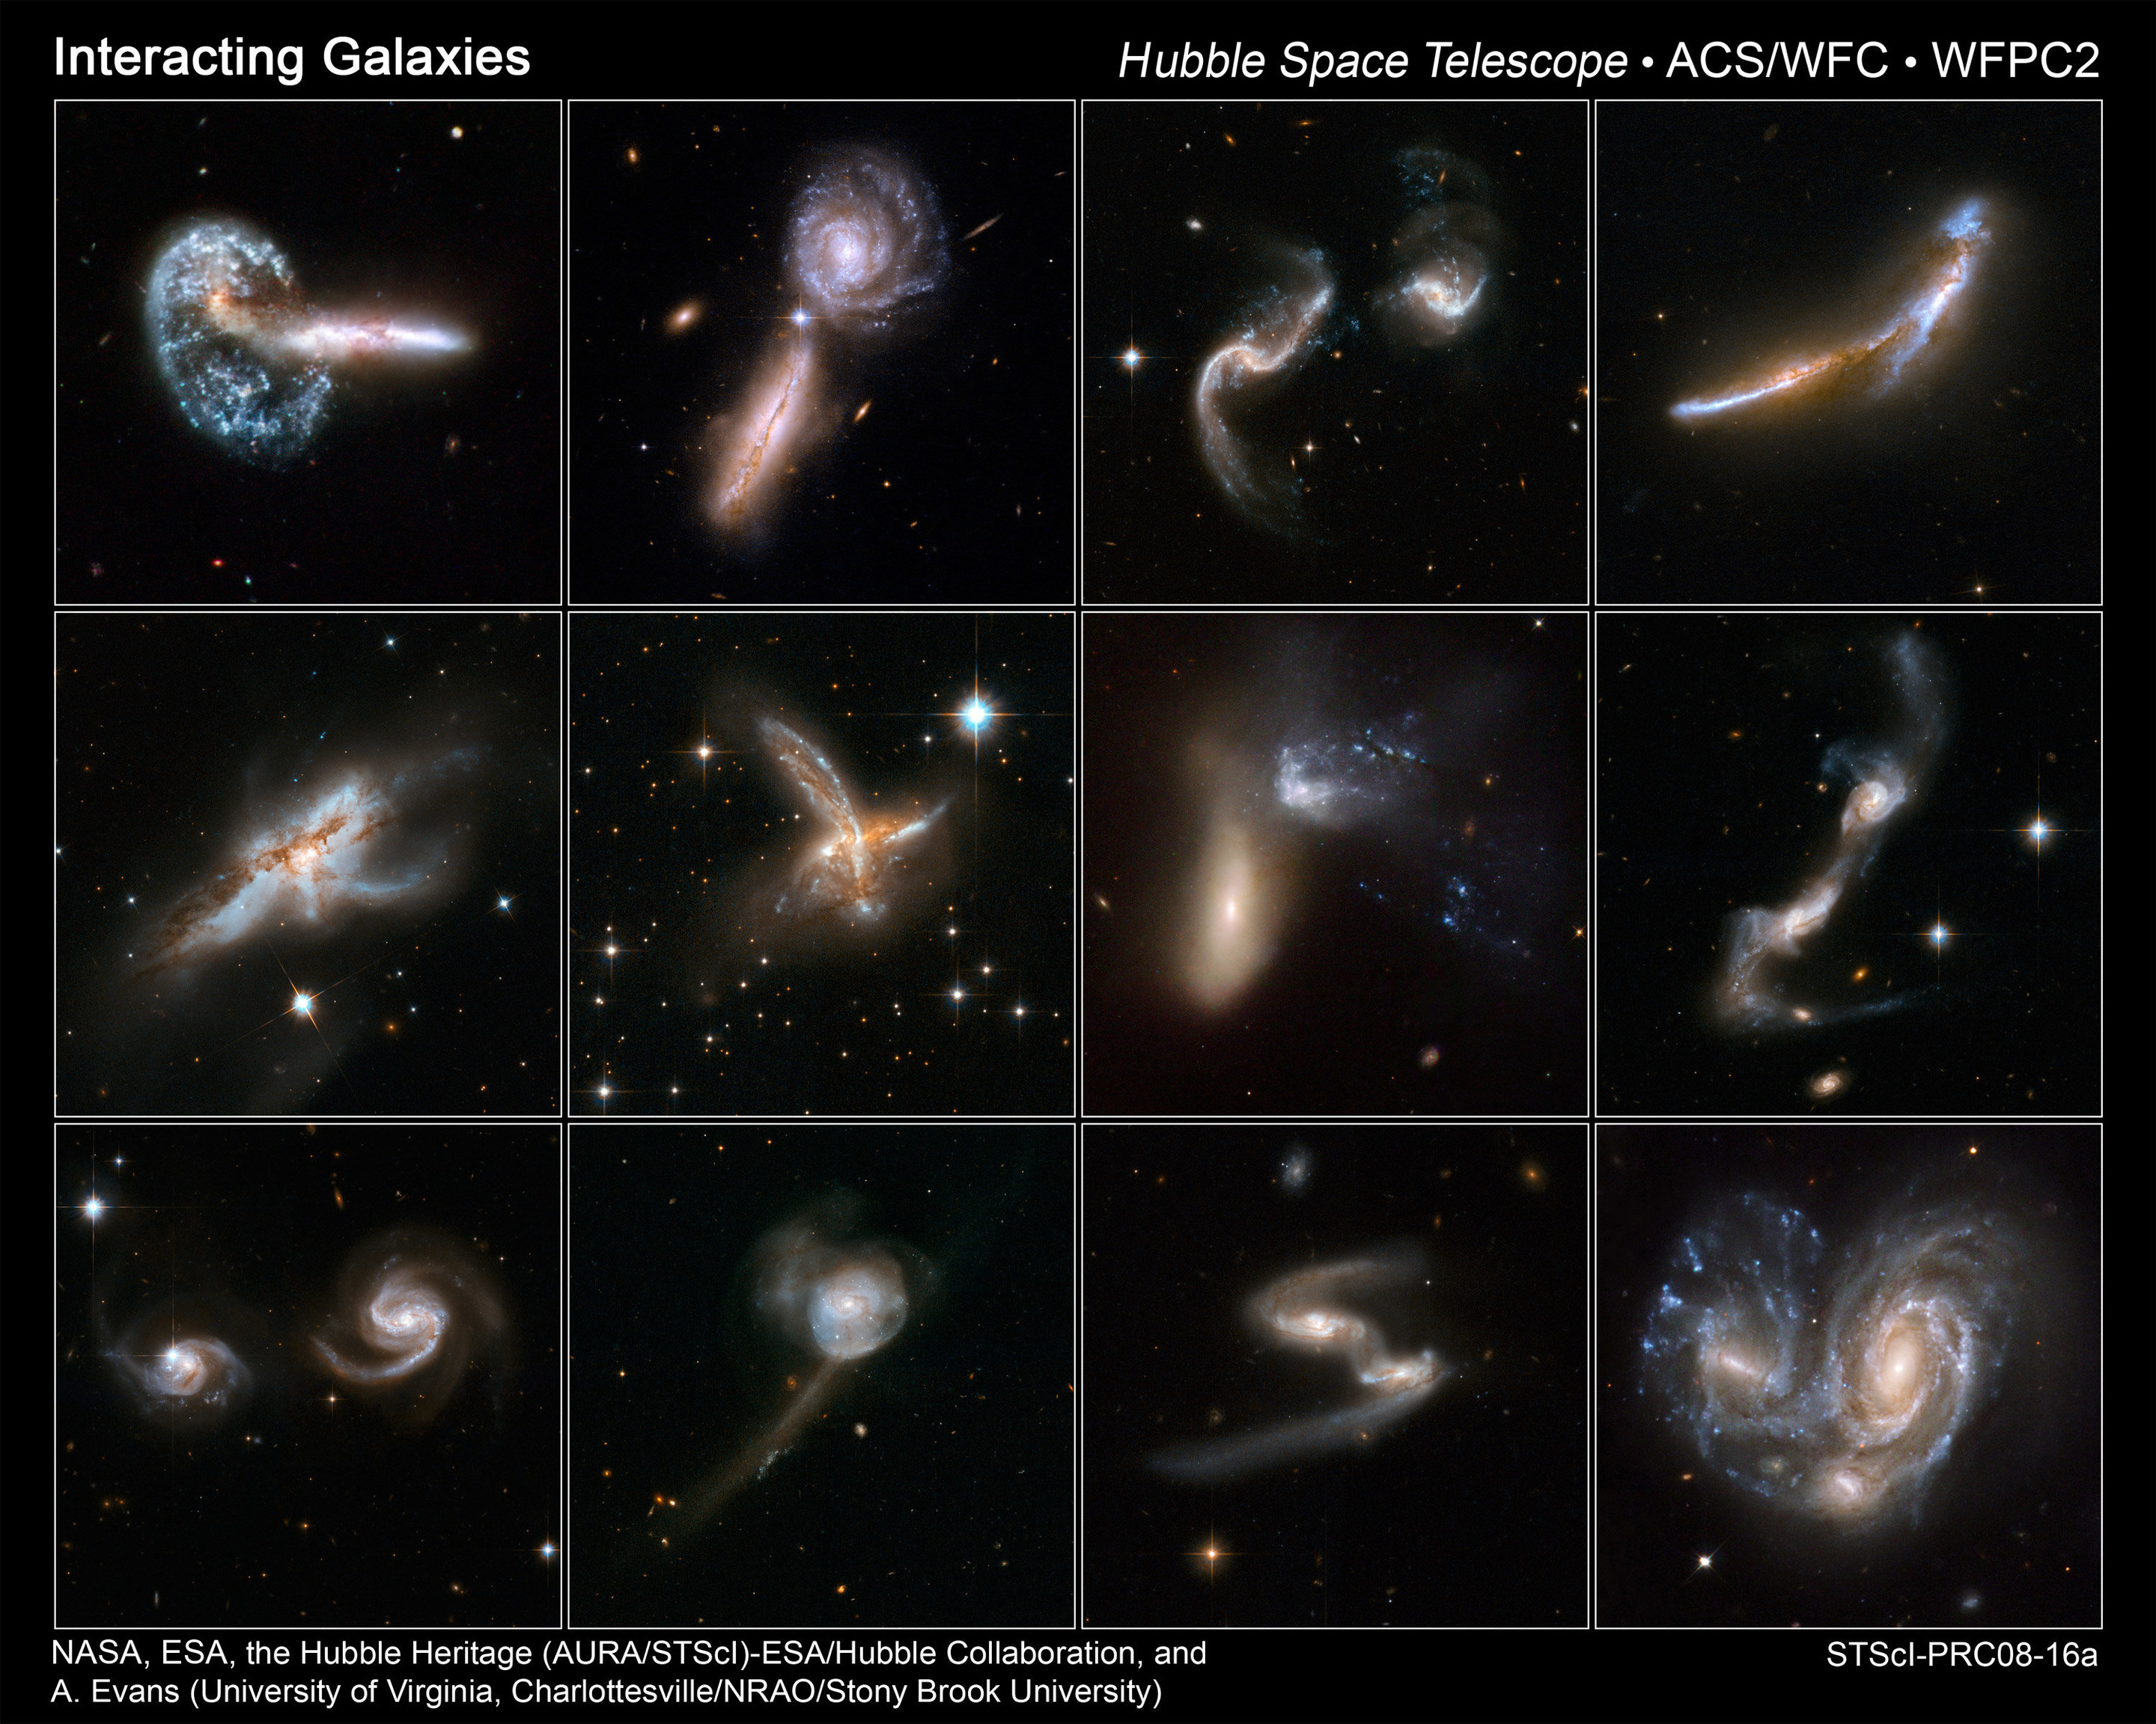
MW Tidal Streams
Notes:
This would be ~60 min without finishing globular cluster lecture to start.

Slide 2
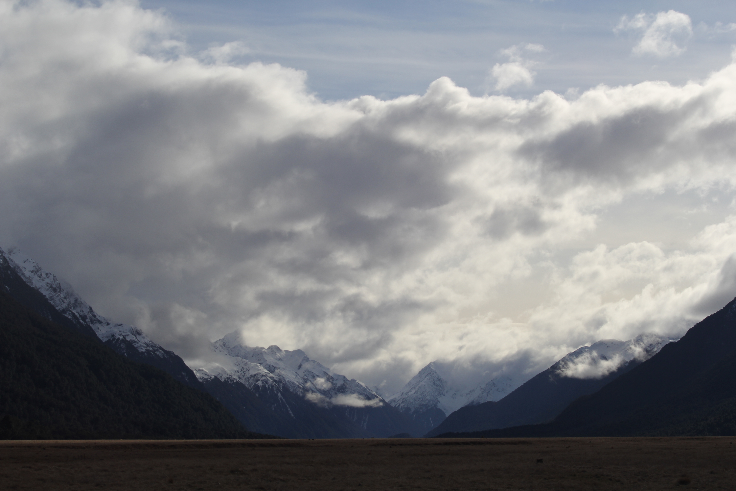

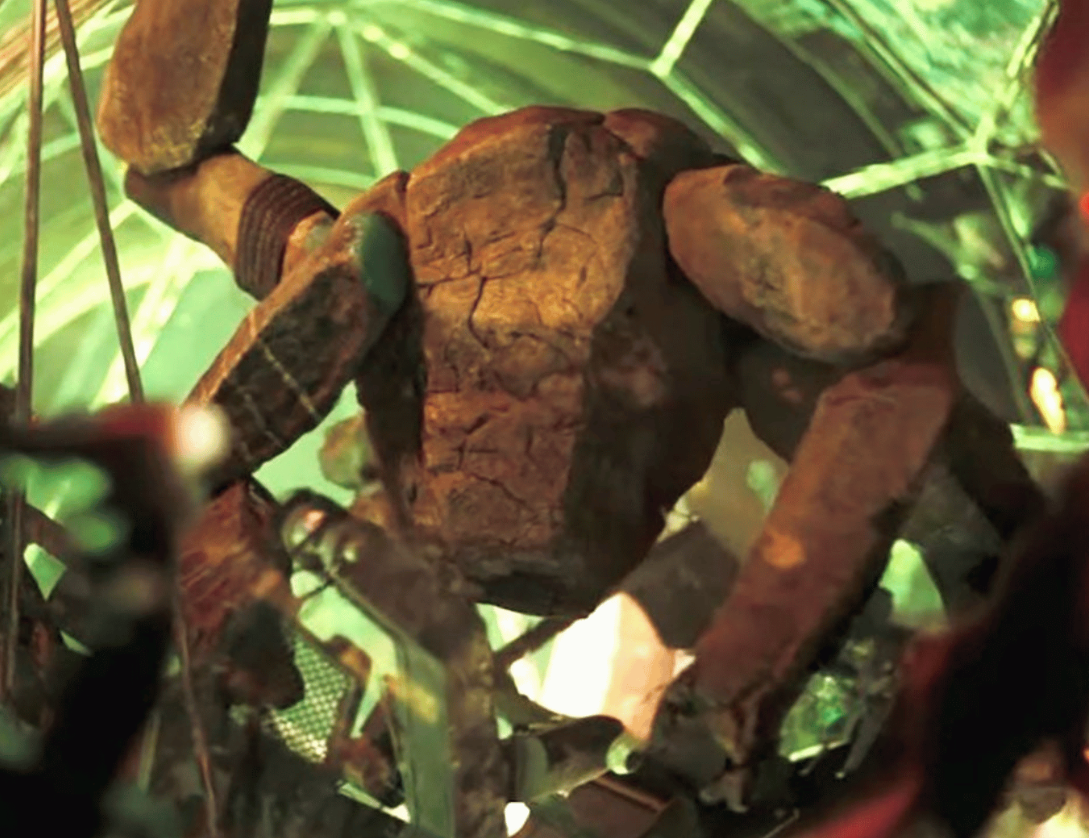
Assignments
Tuesday 03 FEB Level 0 … Ideas
Tuesday 10 FEB Bio Sketch
Tuesday 17 FEB Level 1 … Outline … 2 weeks later
Thursday 19 FEB Milky Way Neighborhood
Tuesday 10 MAR Level 2 … 1st Draft … 3 weeks later
Tuesday 31 MAR Budgets + Narrative
Tuesday 07 APR Facilities/Mentoring/Data
Tue/Thu 14/16 APR Presentations
Thursday 23 APR Level 4 … submit … 6 weeks later

Slide 3
MW Tidal Streams

Slide 4
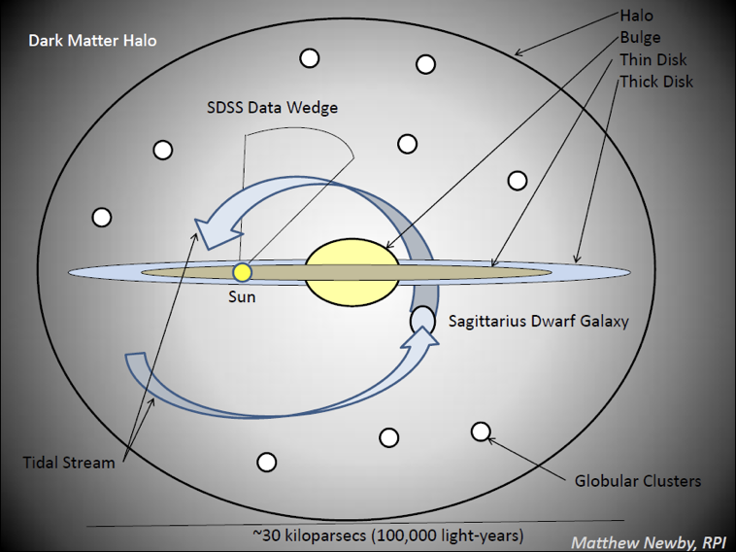
MW Tidal Streams
Satellite Galaxies and Globular Clusters produce Stellar Streams
Notes:
SG and GC are different types of stellar systems … SS are just tidal productions from them

Slide 5
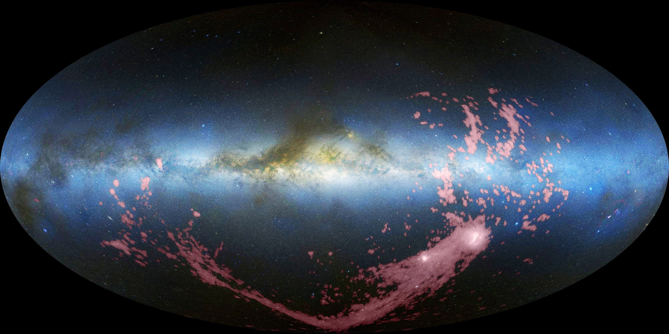
MW Tidal Streams
Magellanic Stream
What is a tidal stream?

Slide 6
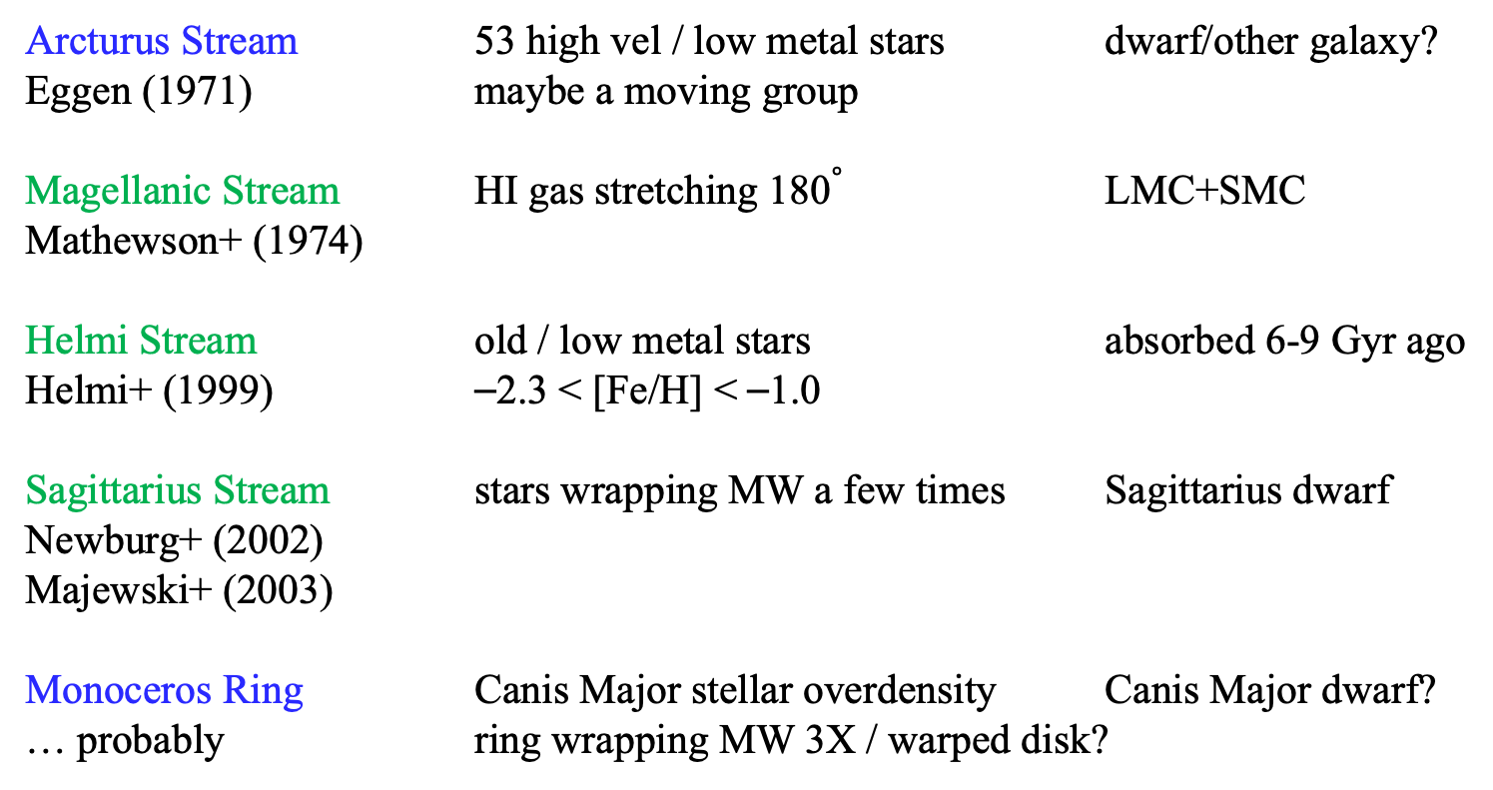
MW Tidal Streams: The Big 3+
Arcturus Stream 53 high vel / low metal stars dwarf/other galaxy?
Eggen (1971) maybe a moving group
Magellanic Stream HI gas stretching 180$∘$ LMC+SMC
Mathewson+ (1974)
Helmi Stream old / low metal stars absorbed 6-9 Gyr ago
Helmi+ (1999) ⎯2.3 < [Fe/H] < ⎯1.0
Sagittarius Stream stars wrapping MW a few times Sagittarius dwarf
Newburg+ (2002)
Majewski+ (2003)
Monoceros Ring Canis Major stellar overdensity Canis Major dwarf?
… probably ring wrapping MW 3X / warped disk?
This is a complicated business …
Notes:
Arcturus Stream includes Arcturus … low metals not confirmed, really a mixture … maybe result of merger or just a moving group

Slide 7
Magellanic Stream (1974)
long ribbon of gas ~halfway around MW
discovered in radio in 1970s … LMC and SMC at head of stream
most gas from SMC ~2 Gyr ago … second region recently from LMC
determined via gas absorption lines of O and S using background quasars
…..O/S levels match SMC

Slide 8
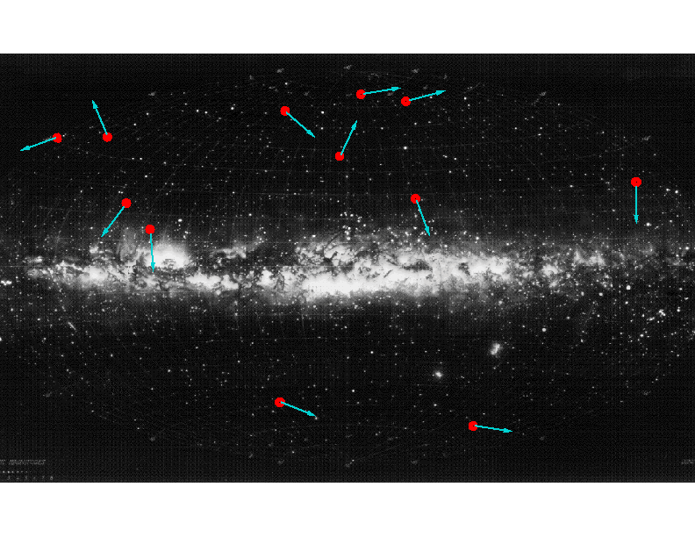
Helmi Stream (1999)
used Hipparcos data
all over sky
mapped space motions
movie: https://www.astro.rug.nl/~ahelmi/research/debris_streams.html

Slide 9
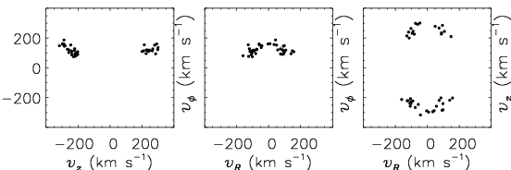
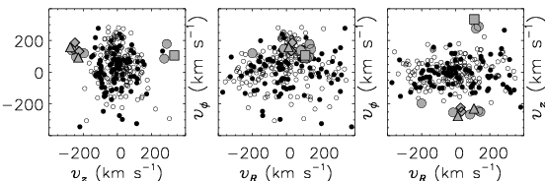
Helmi Stream (1999)
SIMULATIONS
OBSERVATIONS
Helmi+ (1999)

Slide 10
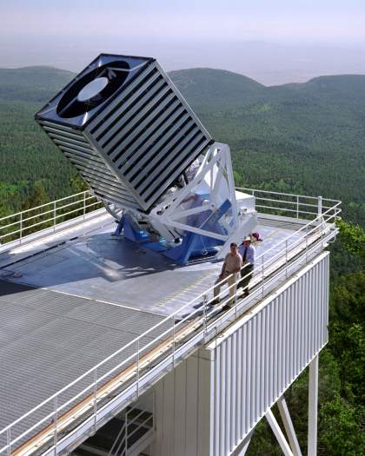
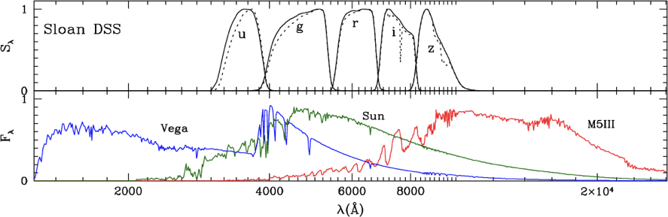
SDSS
dedicated 2.5m at APO ... started in 2000 and still going
photometric survey of ~1 billion objects … 35% of sky
… ended 2009
now > 4 million spectra (ongoing)
primary goal = galaxy+quasar redshifts
created new filters ugriz … 95% complete to mags 22.0, 22.2, 22.2, 21.3, and 20.5
Notes:
Vega shows Balmer jump … caused by electrons being completely ionized directly from the second energy level of H, creating a continuum of absorption at shorter wavelengths

Slide 11
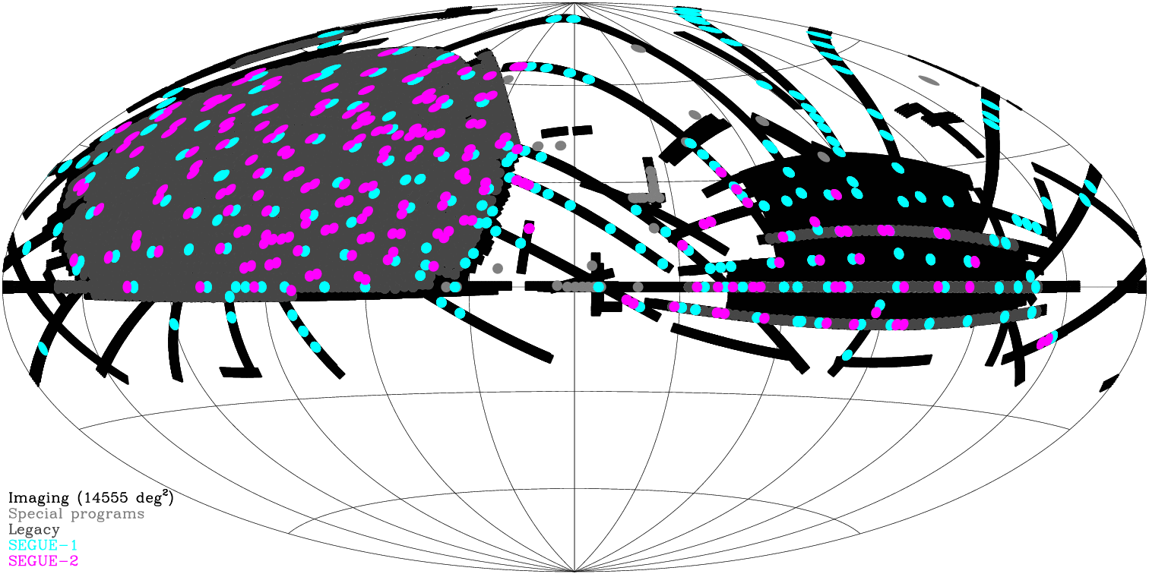
SDSS
16h 12h 08h 04h 00h
observed primarily toward the north and south Galactic poles
Notes:
SEGUE1 and 2 got spectroscopy via plates/fibers on ~350,000 stars to study stars in the disk, halo, and streams (not bulge).
Yellow dots are NGP and SGP.

Slide 12
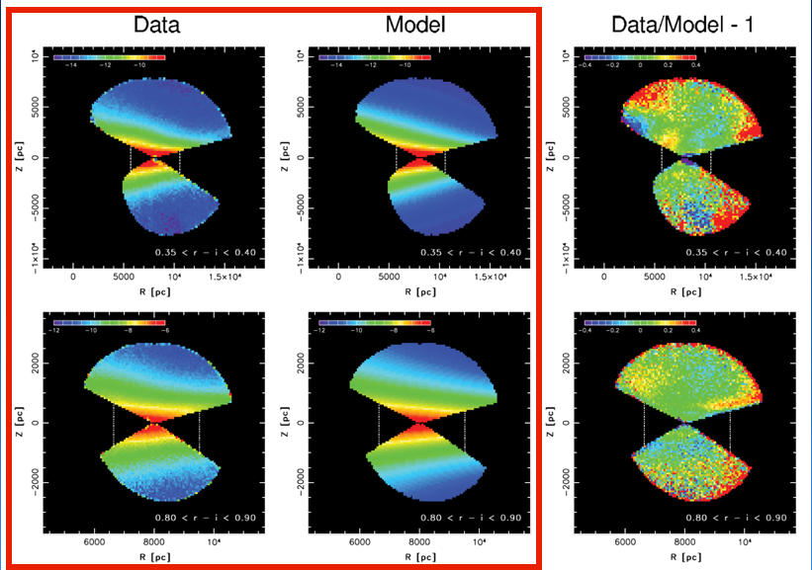
SDSS
model includes thin disk + thick disk + best oblong halo
Notes:
top/bottom … different colored stars
note different distance scales on x axes … vertical lines cover 5 kpc (top) and 3 kpc (bottom)

Slide 13
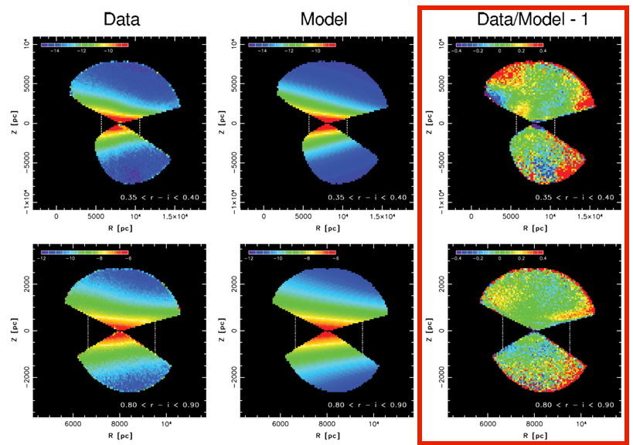
SDSS
oblong halo subtraction reveals residual substructures

Slide 14
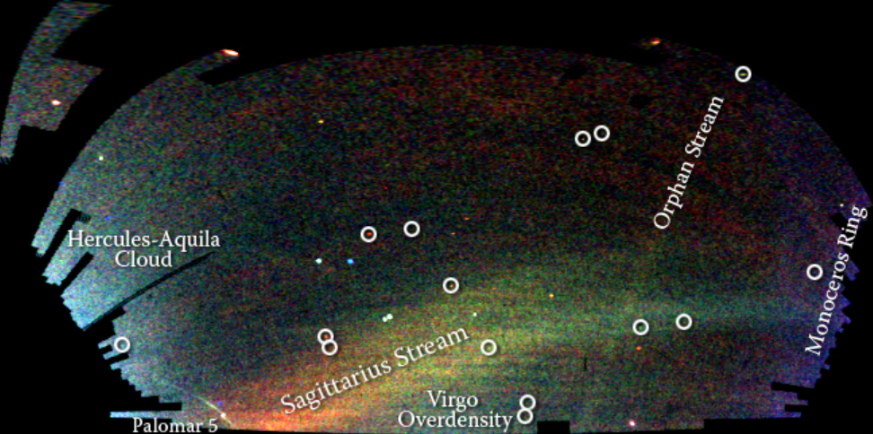
SDSS Tidal Streams (2002/2003)
SDSS “Field of Streams”
halo stars … color indicates distance, intensity indicates #stars
Sagittarius … from dwarf galaxy
Orphan … from Ursa Major dwarf galaxy (maybe)
Monoceros Ring … encircles MW disk
Palomar 5 … shown in GC discussion
+ new MW companions in circles (2 GCs + dwarf galaxies)
Notes:
Hercules and Virgo have overdensities

Slide 15
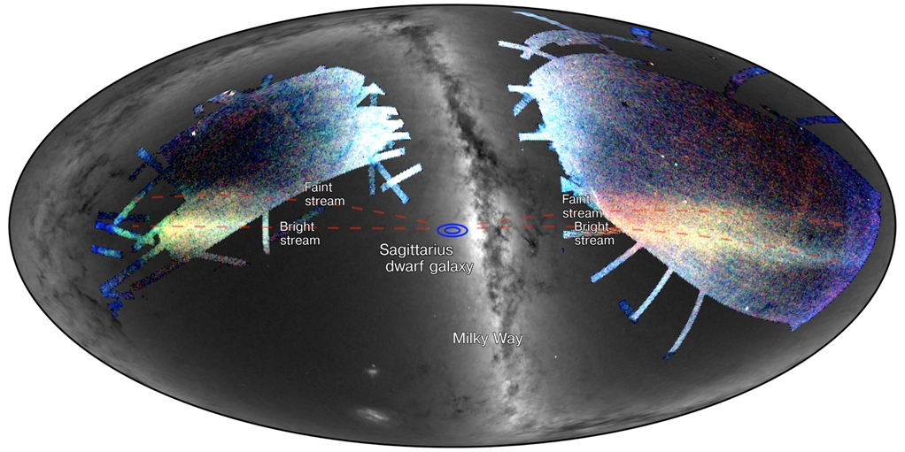
SDSS Tidal Streams
Sagittarius dwarf spheroidal galaxy discovered by Ibata+ 1994
streams projected on the sky
2 densest streams point to Sag dwarf galaxy
Bright stream + Faint stream

Slide 16
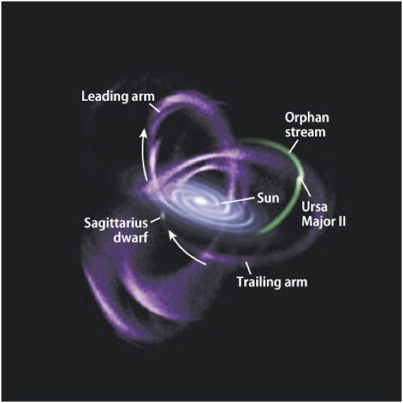
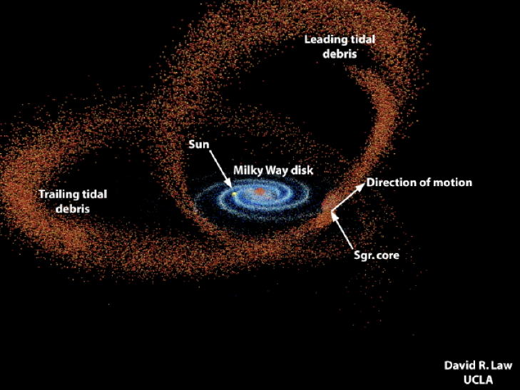
MW Tidal Streams
movie: https://www.youtube.com/watch?v=WW-ps2zg89s
Notes:
Movie is a simulation of the Sagittarius stream in the presence of the Milky Way and Large Magellanic Cloud. The stars in Sagittarius are shown in red/yellow histogram, dark matter is shown in blue. Past orbit of the Sagittarius dwarf is shown as a dotted blue line. The LMC is shown as a green circle and its past orbit is shown as a dashed green line. The yellow star and yellow nearly circular curve shows the solar orbit in this potential. The Milky Way center is shown as a red plus sign and its past orbit it shown as a red line.

Slide 17
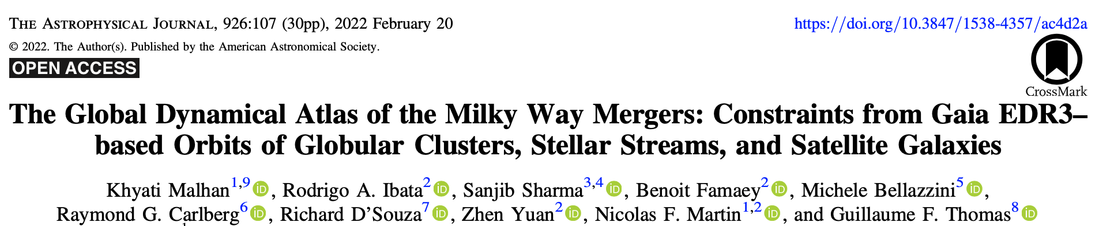
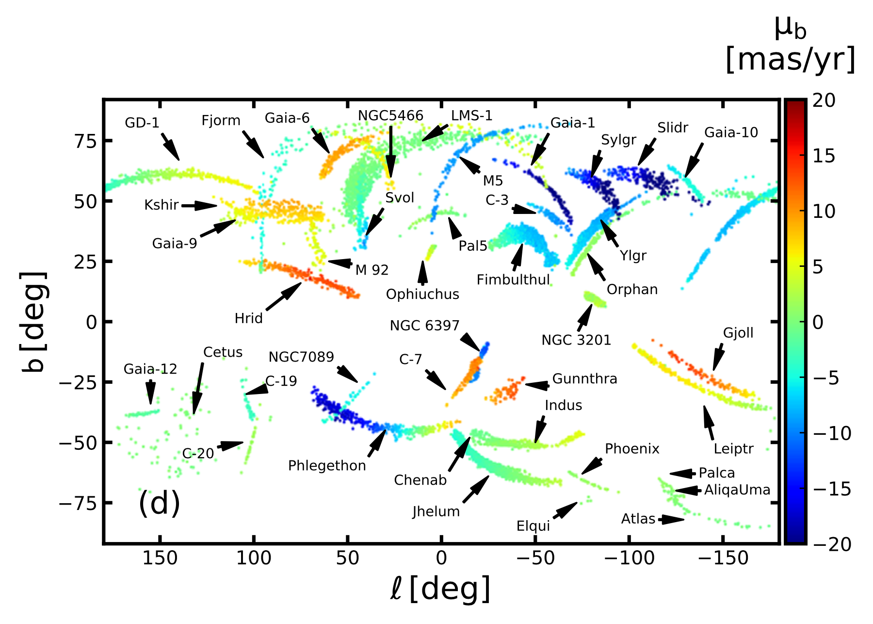
MW Tidal Streams 2022
MW mergers by connecting
170 globular clusters
46 satellite galaxies
41 stellar streams …
dynamically evolved GC+SG
= 257 halo objects!
Gaia EDR3 + radvel data
match angular momenta along
orbits in 3D space
6 groups: (1) Sagittarius, (2) Cetus, (3) Gaia-Enceladus/Sausage, (4) LMS-1/Wukong,
(5) Arjuna/Sequoia/I’itoi, (6) Pontus (new)
connects streams to objects … maps construction of Milky Way
Notes:
each group includes an ensemble of GCs, SGs, and Streams
only Elqui connected to Sagittarius dwarf galaxy … WTF

Slide 18
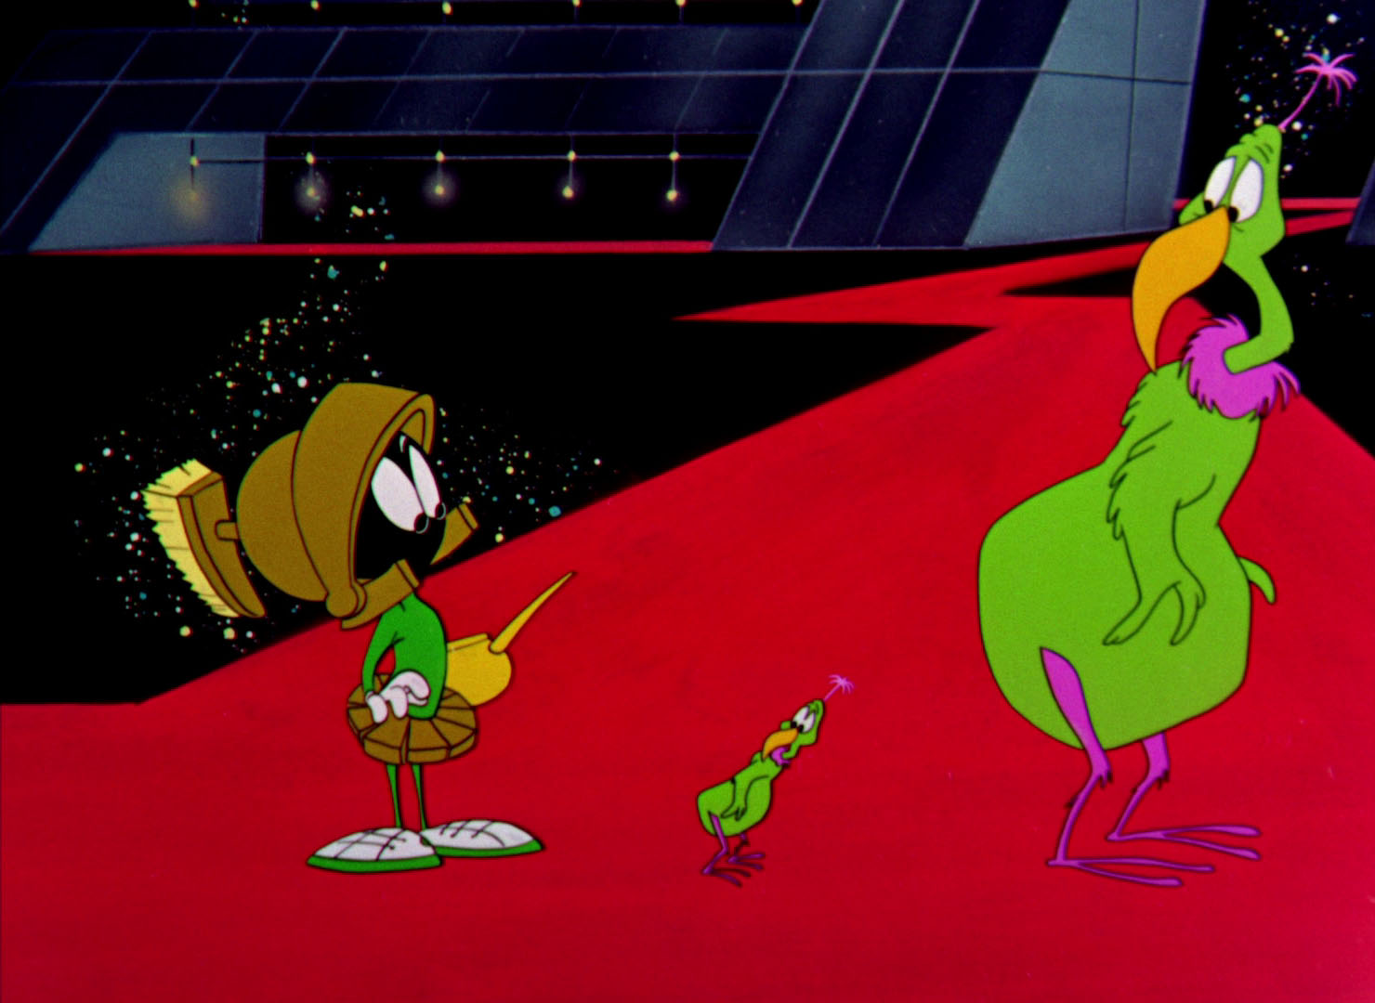
Putting it All Together
building something big (MW) …
… out of something small (dwarf galaxies …)
tidal streams are current evidence

Slide 19
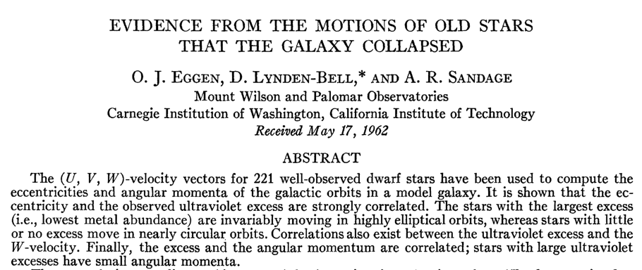
MW Construction
What are the implications?
MW eating smaller galaxies … bottom-up formation
Galactic halo continues to grow … gets homogenized
BUT!!! early model of MW construction in 1962 … still called “ELS model”
turns out to be wrong, but reasoning useful
Key Point: stellar metallicity holds clues to MW formation

Slide 20
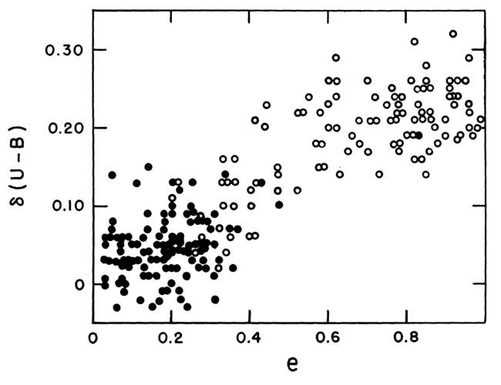
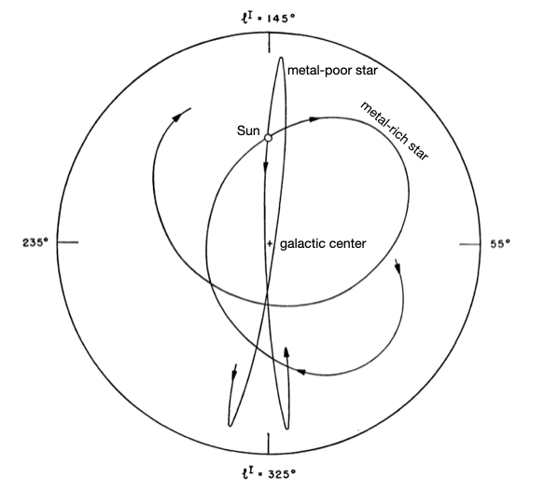
MW Construction
stars with large UV excess
(= low metallicity, open points)
→ Galactic orbits with
high eccentricity
→ low metallicity stars
far from MW
1. MW collapses as it forms
2. stars start on circular orbits
3. gas collapses to center/disk
4. mass inside orbit increases
5. orbits become eccentric
older/low metallicity stars
in outer halo
Eggen+ (1962)

Slide 21
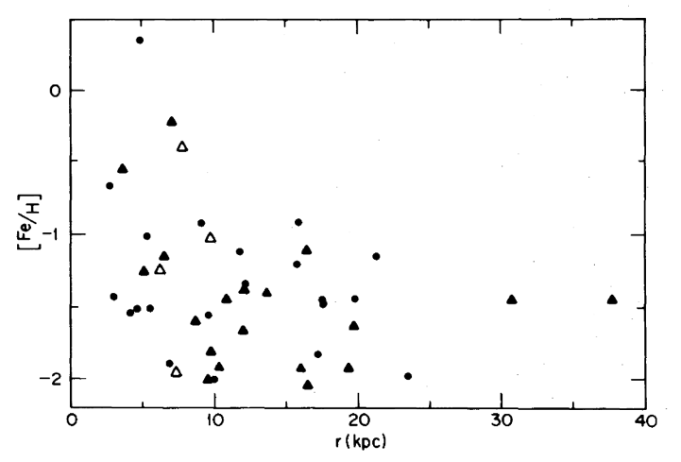
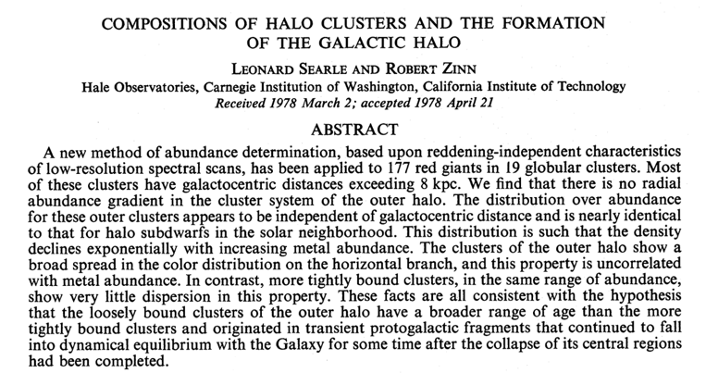
MW Construction
need a careful study of metallicities at various distances from MW
Searle and Zinn (1978) metallicities of red giants in globulars
showed ELS did not work
no radial abundance gradient
instead … “fragmented accretion” to create MW
Notes:
Solid triangles = new Searle and Zinn measurements … open triangles = literature … circles from Kukarkin (1974)

Slide 22
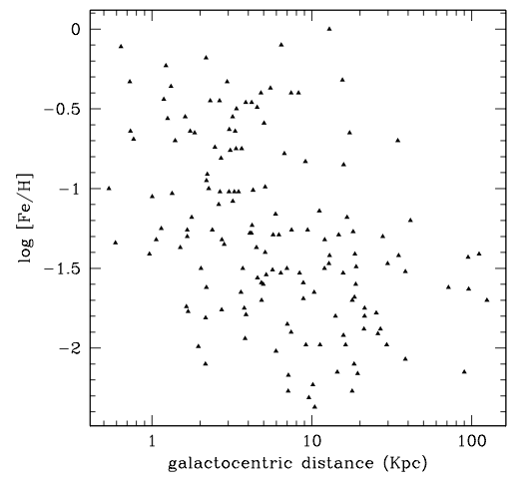
MW Construction
need a careful study of metallicities at various distances from MW
recall slight trend in [Fe/H] for GCs with distance from GC
It’s complicated …
Notes:
Solid triangles = new Searle and Zinn measurements … open triangles = literature … circles fomr Kukarkin (1974)

Slide 23
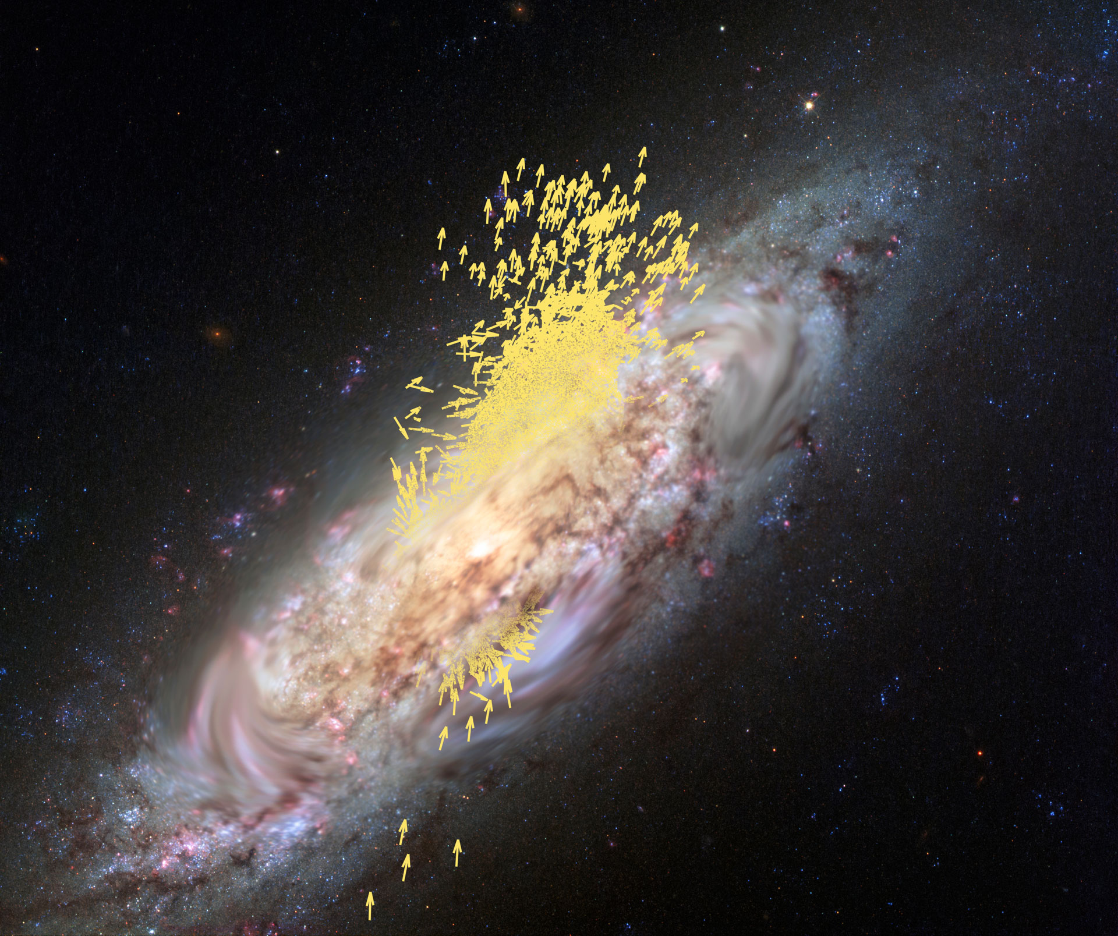
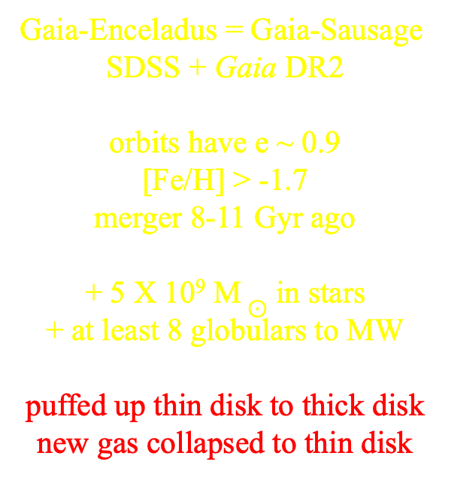
MW Construction
Gaia-Enceladus = Gaia-Sausage
SDSS + Gaia DR2
orbits have e ~ 0.9
[Fe/H] > -1.7
merger 8-11 Gyr ago
+ 5 X 10⁹ M $⊙$ in stars
+ at least 8 globulars to MW
puffed up thin disk to thick disk
new gas collapsed to thin disk
Helmi+ (2018)
Deason+ (2018)
Myeong+ (2018)
Belokurov+ (2018)
Notes:
Enceladus was offspring of Gaia (but so were a lot of folks … dumb name)
more mass added in gas and dark matter

Slide 24
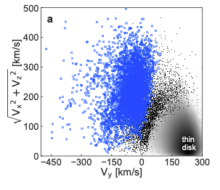
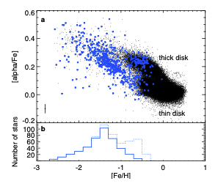
MW Construction
Gaia-Enceladus
velocity distribution
slightly retrograde revolution in MW
[Fe/H] / alpha elements
G-E vs. thick disk
G-E has range of abundances
… SMC-sized galaxy merged
Helmi+ (2018)

Slide 25
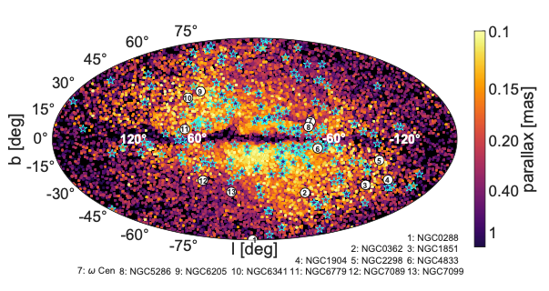
MW Construction
Gaia-Enceladus
Gaia-Enceladus
not kidding on the parallaxes used … errors less than 20%
starred symbols are RR Lyraes
Helmi+ (2018)

Slide 26
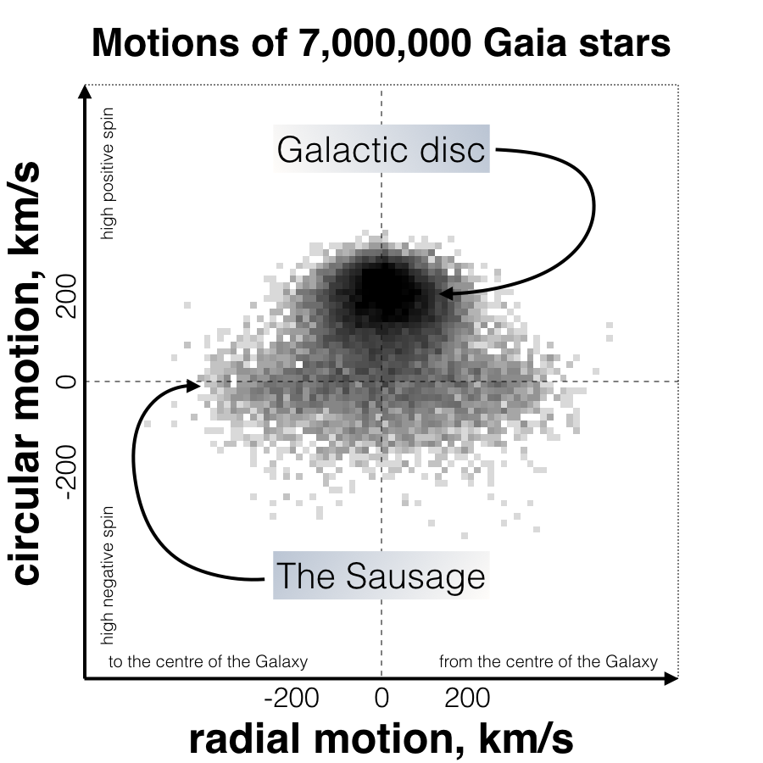
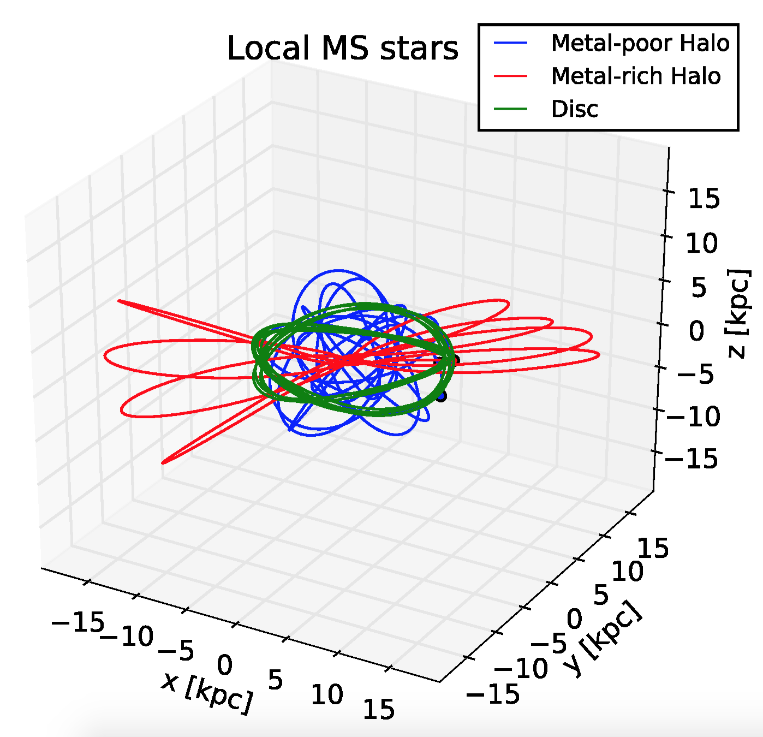
MW Construction
Gaia-Enceladus = Gaia-Sausage
https://www.youtube.com/watch?v=9fTGPkp-CJg&t=1s
Deason+ (2018)
Myeong+ (2018)
Belokurov+ (2018)

Slide 27
MW Construction

Slide 28
Todd’s Top 10 Tips for Talks
Match the time of your talk to the time allocated.
Watch the “um”s and other useless sounds/words.
Use the fewest words possible per slide.
4. Be sure that all Figure details are legible from the back of the room.
5. Be careful with red and green in deference to our color-challenged friends.
6. If you must have an equation, describe each variable clearly.
7. Use pauses to great effect.
8. Use gestures appropriately, but not frantically.
9. Move, and use lack of movement to great effect.
10. Enjoy your topic … or don’t bother!
Notes:
28

Slide 30
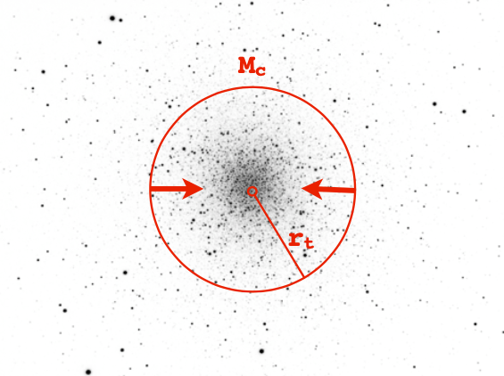
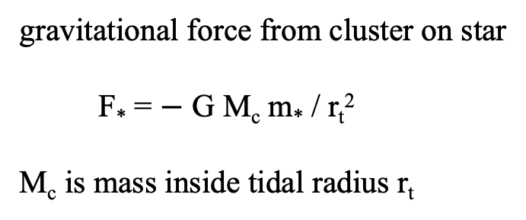
Tidal Forces
gravitational force from cluster on star
F* = $−$ G M_{c} m* / r_{t}²
M_{c} is mass inside tidal radius r_{t}
*
cluster at distance R_{G} from MW with mass M_{G}
… for r_{t} << R_{MW} the tidal force is differential
F_{tidal} = 2 G r_{t} M_{G} m* / R_{G}³
Notes:
This was for review.

