Slide 1
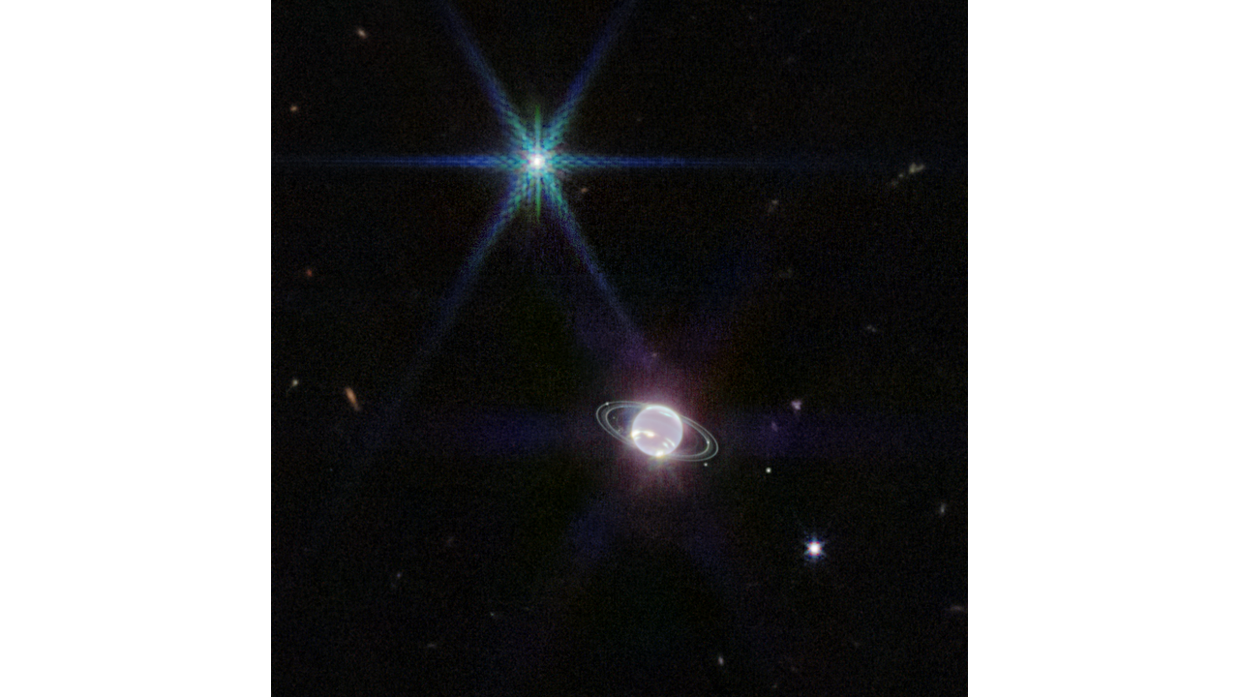
Where is this?
Notes:
Neptune has 14 known satellites, and seven of them are visible in this image.Triton, the bright spot of light in the upper left of this image, far outshines Neptune because the planet’s atmosphere is darkened by methane absorption at infrared wavelengths. Triton reflects an average of 70 percent of the sunlight that hits it.
This terrain looks like lumpy sediment on top of patterned ground. The lumpy sediment is likely just loosely consolidated because it is covered with spidery channels. This landform is uniquely Martian, formed in the spring as seasonal dry ice turns directly into gas that erodes channels in the surface.

Slide 2
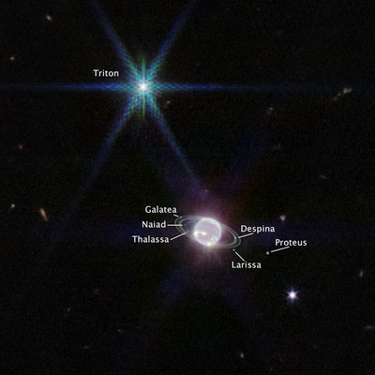
Where is this?
Notes:
Neptune has 14 known satellites, and seven of them are visible in this image.Triton, the bright spot of light in the upper left of this image, far outshines Neptune because the planet’s atmosphere is darkened by methane absorption at infrared wavelengths. Triton reflects an average of 70 percent of the sunlight that hits it.
This terrain looks like lumpy sediment on top of patterned ground. The lumpy sediment is likely just loosely consolidated because it is covered with spidery channels. This landform is uniquely Martian, formed in the spring as seasonal dry ice turns directly into gas that erodes channels in the surface.

Slide 3
Spaceship Name!
TODAY, 08 SEP
5 SSE! Points
SSE Ephemeris
Trojan Horse
Hail Mary
Skeld
Ocean Gate
Astraois
Lagrange Point

Slide 4
Spaceship Name!
TODAY, 08 SEP
5 SSE! Points
SSE Ephemeris … 1
Trojan Horse … 4
Hail Mary … 5
Skeld … 2
Ocean Gate … 4
Astraois … 4
Lagrange Point … 1

Slide 5
SSE Spaceship 2024
SSE!
Odysseus
The Best Astro Transport (The BAT Mobile)
The Cosmic Orbit Haven
The NRY
Research Expedition for Cosmic ObservatioNs Ship (RECONS)
Rimor (Latin for explorer)
Master Astronomers Rising Though Adversity (MARTA)

Slide 6
Solar System Explorers: 10 SEP
Describe something you have already learned in this course that you did not know previously.
1.
2.
3.
4.
5.
6.
7.
8.
9.
10.
11.
12.
13.
14.
15.
16.
17.
18.
19.
20.

Slide 7
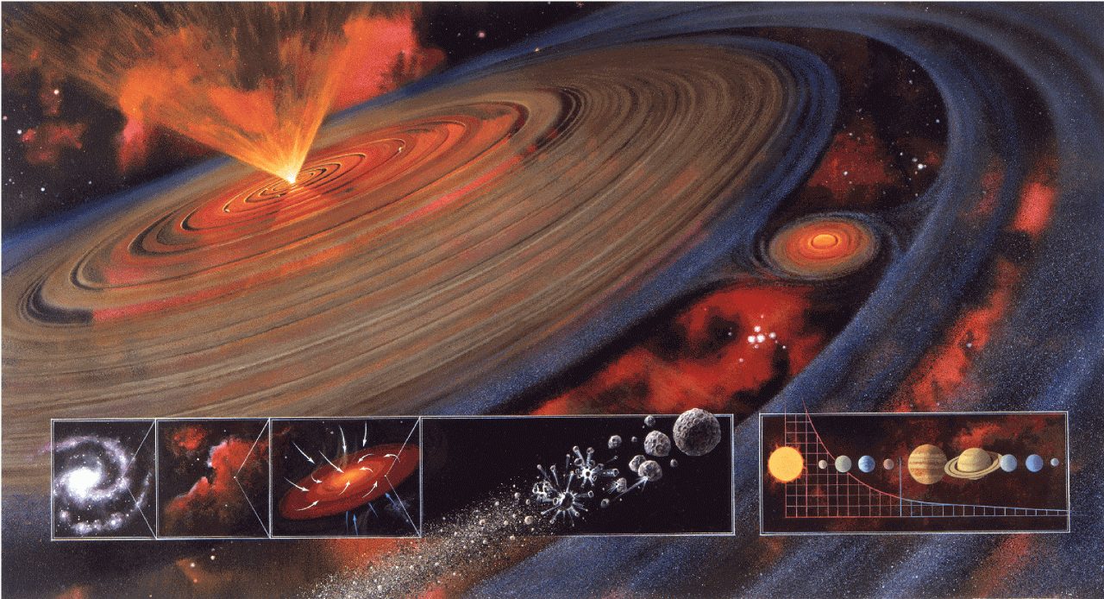
Solar System Formation II

Slide 8
Condensation to a Solar System
I. molecular cloud core before t = 0
II. freefall collapse t = 0.1 to 1 Myr
III. protostar / disk evolution t ~ 1 to 10+ Myr
IV. baby star / clearing / planet building t ~ 100 Myr
V. evolution of Solar System t > 100 Myr

Slide 9
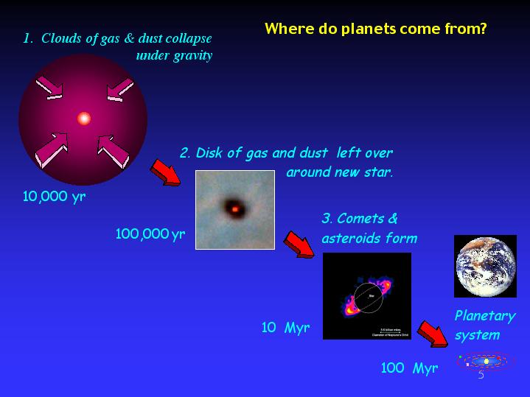
Solar System Construction

Slide 10
I. Molecular Cloud Core
T ~ 10-30 K
primarily H₂ and He, traced by CO, CN, OH, HCN, H₂O, etc.
Jeans mass is minimum mass for collapse (PE in vs. KE out):
M_{J} ~ (k/G μ m)^{3/2} T^{3/2} / ρ^{1/2}
assumes thermal pressure only (no turbulence, rotation, mag fields)
k = Boltzmann constant μ = mean particle weight
T = temp m = mass of H
G = grav constant ρ = density
key attributes: temperature and density
shock mechanism needed to start the process …
hot star outflows, supernovae, spiral density waves
SSE! hands up!
Notes:
cloud will collapse if the potential energy holding it together exceeds kinetic (thermal) energy trying to make it expand
for typical molecular cloud conditions, Jeans mass is 100 Mo and Jeans radius is 1 pc

Slide 11
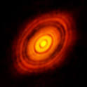
II. Freefall Collapse
0.1 to 1 Myr
timescale for collapse, t_{ff} ~ ρ^{-1/2} (inside-out)
angular momentum problem results in disk formation
fragmentation may occur if cloud rotating
… multiple star system
contraction by ~1000X likely

Slide 12
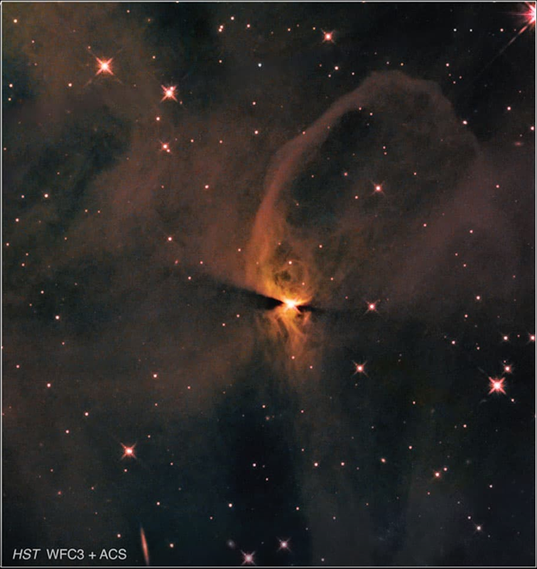
III. Protostar / Disk Evolution
1 to 1000 Myr (mass-dependent)
vertical collapse of disk
protostar stage when infrared radiation trapped
magnetic braking of protostar when gas becomes ionized
viscous torques move material in and out
chemical evolution
Sun reflects initial composition of disk
but … disk chemistry depends on distance from Sun
Notes:
stellar birthday considered various ways --- opacity = 1 … deuterium fuses … H fuses

Slide 13
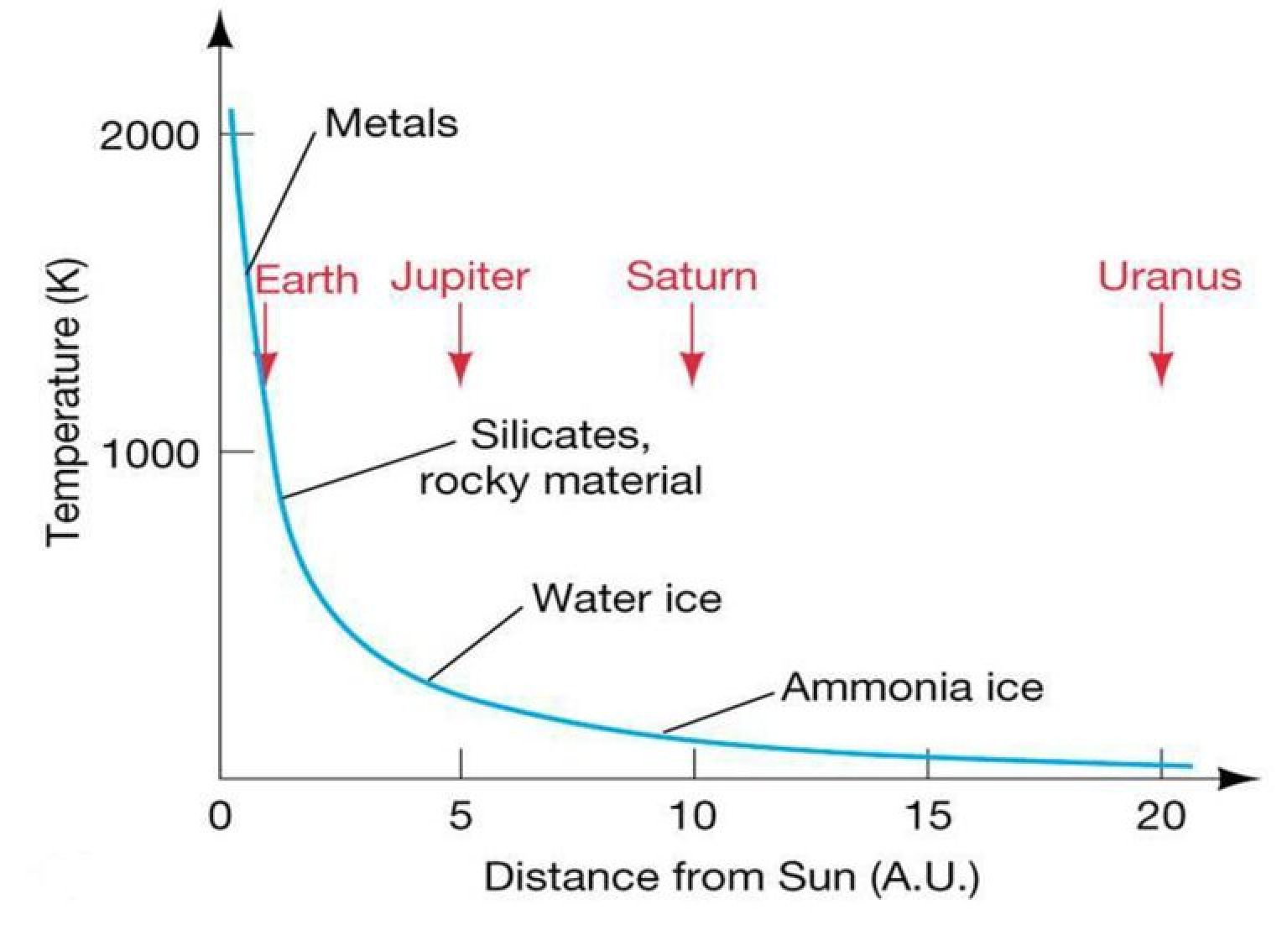
Differentiation in Solar Nebula
Notes:
uncompressed (zero pressure) density decreases from Mercury through Earth

Slide 14
Disk Condensation Chemistry
*** assumes chemical equilibrium, low pressures of solar nebula ***
2000K pretty much everything vaporized
1400K Fe and Ni form an alloy
1300K magnesium silicates (Mg/Si/O)
1200K feldspars (Ca/Na/K/Al/Si/O)
700K 1 AU carbon form transition CO → CH₄ (beware Pluto … solneb not eq)
500K iron oxide (FeO), olivines/pyroxenes (Mg/Fe/Si/O)
[ 373K 2 AU H₂O liquid ]
300K nitrogen form transition N₂ → NH₃ (beware Triton … solneb not eq)
[ 273K H₂O ice ]
180K 3 AU pure H₂O ice (hydrated silicates at warmer temps)
120K 4 AU ammonia clathrate (NH₃ . H₂O)
[ 77K N₂ liquid ]
70K methane clathrate (CH₄ . 6H₂O)
40K CH₄ and Ar ices
25K CO and N₂ ices
*** disequilibrium chemistry is norm beyond several AU ***
Notes:
Mercury has Fe core; Venus has Fe-Ni; Earth has Fe-Ni; Mars has Fe-Ni or Fe-FeS
Pluto has N2 ice with traces of CO and CH4

Slide 15
Ices/Liquids in the Solar System
phase transitions at one atmosphere pressure while cooling
373K H₂O liquid
273K H₂O ice
240K NH₃ liquid
195K NH₃ ice
194K CO₂ ice (sublimates)
111K CH₄ liquid
90K CH₄ ice
77K N₂ liquid
63K N₂ ice
331K Earth (hot)
268K Mars (hot)
186K Mars (cold)
185K Earth (cold)
124K Jupiter
95K Saturn
72K Enceladus
59K Uranus, Neptune
45Kv Pluto
38Kv Triton
Notes:
wat ... amm … car … met … nit

Slide 16
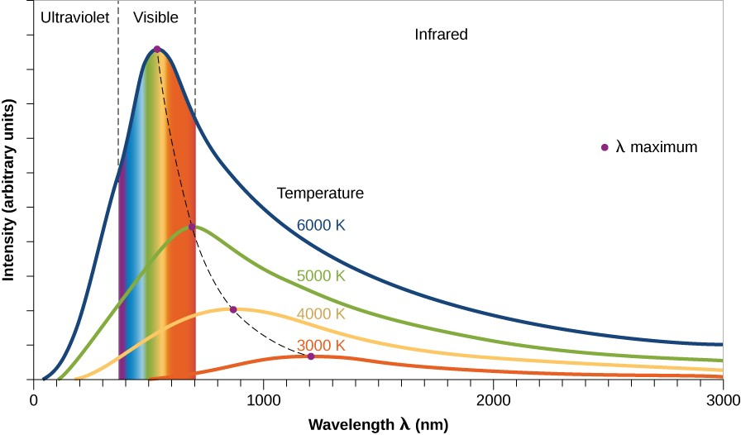
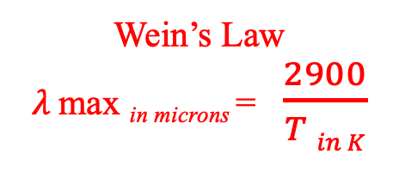
III. Protostar / Disk Evolution
SSE! hands up!
BLACKBODIES yield TEMPERATURES, imply WAVELENGTHS

Slide 17
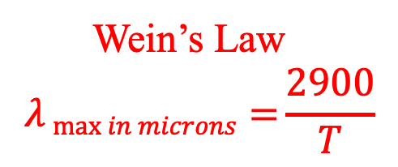
IRAS (1983): The Turning Point
IRAS excesses at 12, 25, and 60 microns over stellar photosphere
Aumann (1985) gives nice statistics of IRAS catalog:
756 sources corresponding to stars
504 dwarfs or subgiants
267 have 12 and 25 micron fluxes
36 have 12, 25, and 60 micron fluxes
12 are “Vega-like” with significant 60 micron fluxes
14% of A-type stars (N = 6)
3% of F-type stars (N = 4)
< 1% of G/K-type stars (N = 2)
detecting protostellar disks or debris disks?
Notes:
IRAS also had 100 micron band
those percentages must be out of the 504 dwarfs or subgiants because the numbers are about 42 A stars, 132 F stars, > 200 G/K stars, ## M stars
protoplanetary disk = massive, hot … debris disk = low mass, cold

Slide 18
Disks
protostellar disks
“high” mass ... “hot”
debris disks
low mass … cold
Notes:
protoplanetary disk = massive, hot … debris disk = low mass, cold

Slide 19
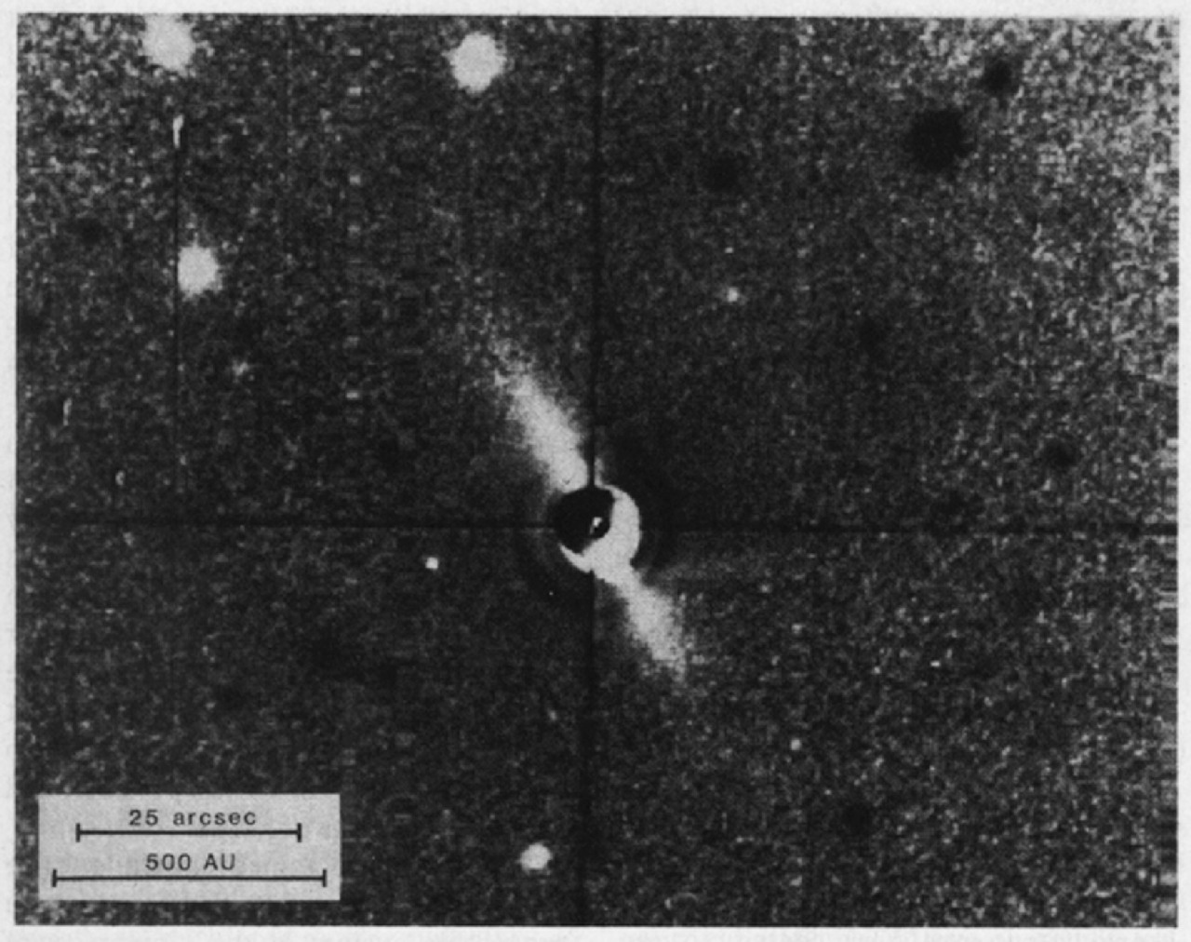
beta Pictoris Disk
A5V star, 19.3 pc, 20 (?) Myr old
brightest infrared excess of any main sequence star detected by IRAS
circumstellar debris disk first imaged by Smith & Terrile (1984)
disk almost edge on, extends beyond 2000 AU (!) at optical wavelengths
temperature/color profile indicates large blackbodies not present
two (or more) disks, clear within 80 AU (inner void from 10 micron flux)
… ice sublimates in inner disk leaving grains, or planet clearing?
beta Pic has (at least) double disk
…
cleared in 20 (?) Myr
Notes:
emission intensity transition at 100 AU … models indicate albedo ~0.35 for grains in outer disk

Slide 20
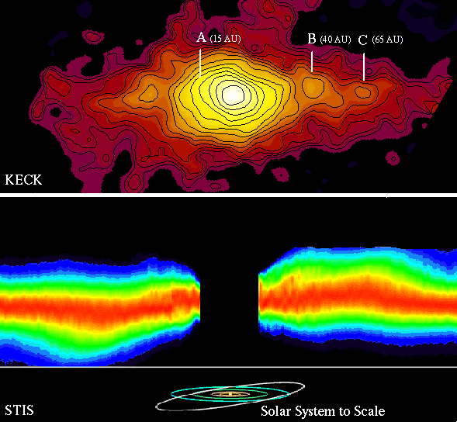
beta Pictoris Disk
MIRLIN map:
15 AU ring tilted
40 AU ring opp. tilt
65 AU ring asymmetric
STIS image:
warp in disk is real
(exaggerated here)

Slide 21
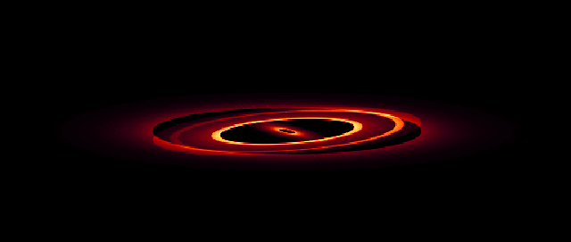

beta Pictoris Disk Model
model must match:
brightness
inclination
extent
colors (temps)
80 deg
89 deg

Slide 22
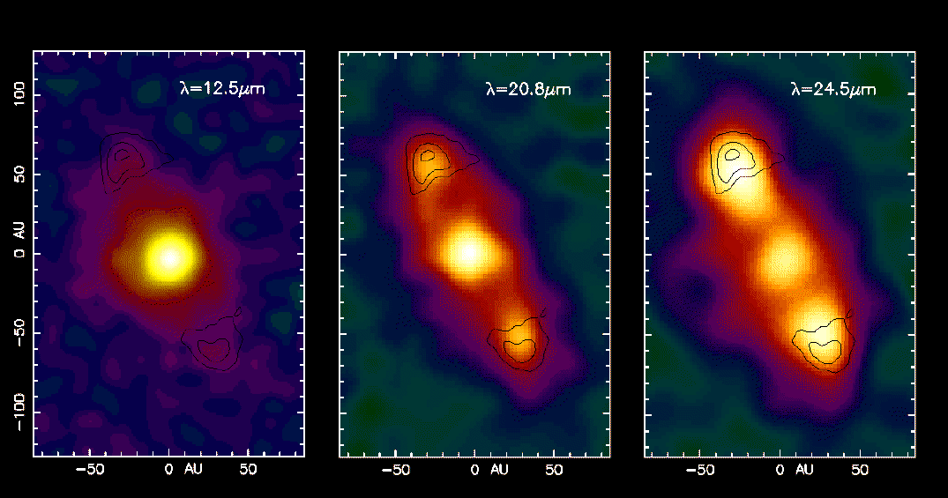
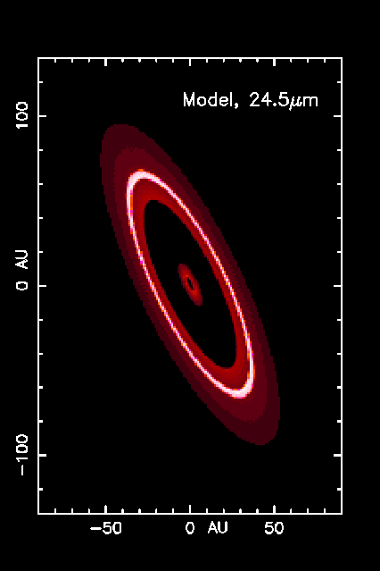
HR 4796A Disk
A0 star, 67 pc, 10 (?) Myr old discovered by Koerner et al. (1998)
outer ring structure from different temp samples
stellar photosphere fades (but still there)
dust brightens … disk stretches
central star has excess flux … hot dust in close, cleared to Kuiper Belt
10 (?) Myr double disk … transition between protostellar + debris disks

Slide 23
The IRAS Fab Four
Name SpType L distance age i r_{in} r_{out} T_{dust} M_{dust}
(suns) (pc) (deg) (AU) (AU) (K) (Moons)
Vega | A0V | 60 | 7.8 | 200 Myr | 85 | 80 | 120 | 80 | 0.2
Fomalhaut | A3V | 13 | 7.7 | 200 Myr | < 30 | 100 | 140 | 40 | 1.4
beta Pic | A5V | 9 | 19.3 | 20 Myr | 89 | 20 | 2000+ | 85 | 3.0
eps Eri | K2V | 0.3 | 3.2 | 500 Myr | 70 | 50 | 80 | 35 | 0.1
The Fab Fifth
HR 4796A | A0 | 18 | 67 | 10 Myr | 72 | 55 | 80 | 65: | ?

Slide 24
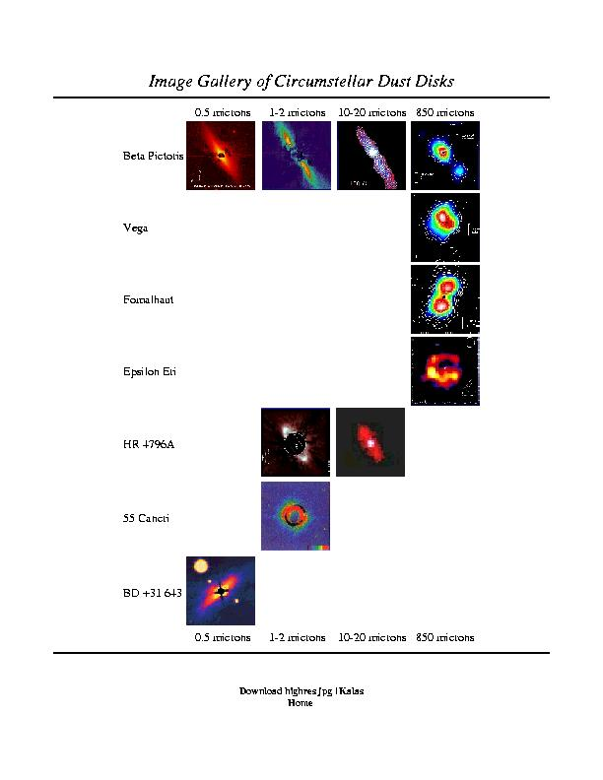
Disk Photo Gallery
multi-wavelength study crucial
optical: stellar photosphere
near-IR: warm dust
far-IR: cool dust
sub-mm: very cold dust
radio: high resolution
molecular contents
flows

Slide 25
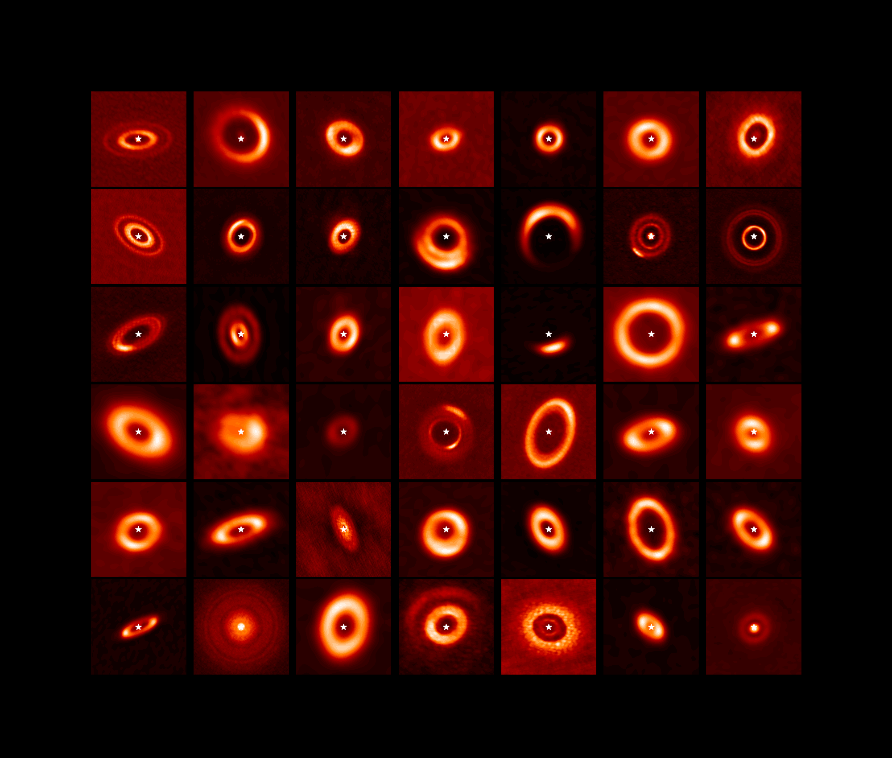
ALMA Disks
N. van der Marel

Slide 26
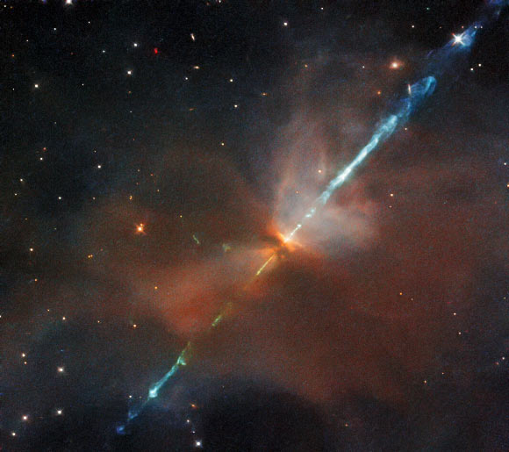
IV. Baby Star / Planet Building
THE STAR
core temp reaches 10⁶ K, deuterium fuses … 10⁷ K, H fuses
T Tauri phase … bipolar outflow, gas cleared
HH (Herbig-Haro) objects … blobs, gas jettisoned
HST image of HH 24
in Orion
Notes:
T Tauri stars have conical jets
HH objects are bright blobs of nebulosity where jets collide with ISM, typically found near the youngest T Tauri stars

Slide 27
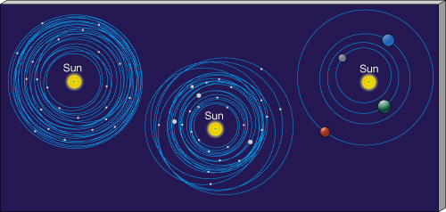
IV. Baby Star / Planet Building
THE PLANETS
buildup of terrestrial planets ~100 Myr
slow accumulation of small bodies
not much mass involved
buildup of giant planets ~10 Myr (need to have gas around)
all SS Jovians have roughly the same heavy element mass…
5, 15, 300, 300 X solar heavy/H+He ratios in J/S/U/N
H+He total mass varies wildly!
fraction of total mass: 90% J, 75% S, 10% U, 10% N
PAPER TOPIC: Why two kinds of giant planets?
Notes:
98% of Sun’s mass is H+He
Jup mass 2x10^27 ~ 20X Nep
Nep mass 1x10^26

Slide 28
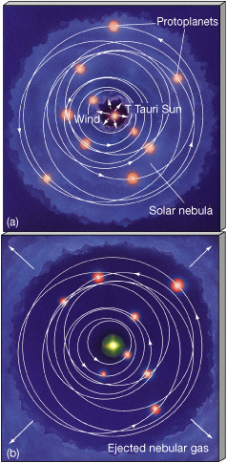
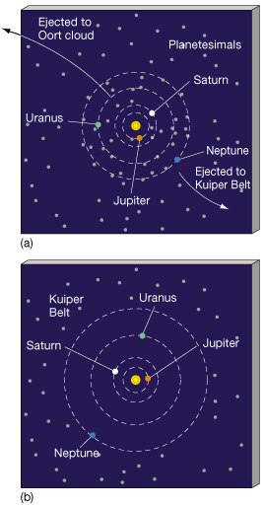
Clearing of Debris
GAS
“DUST”

Slide 29
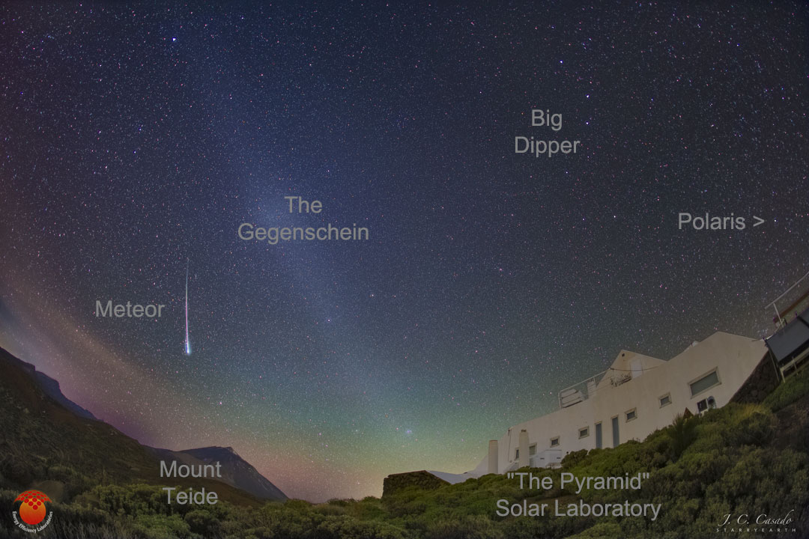
Dust Remains
Notes:
Gegenschein is dust in opposition to the Sun’s position

Slide 30
The Nice Model
problem: Jupiter, Saturn, Uranus, Neptune
NOT in circular, coplanar orbits
 | a (AU) | e | i (deg)
Jupiter | 5.20 | 0.048 | 1.30
Saturn | 9.54 | 0.056 | 2.49
Uranus | 19.19 | 0.046 | 0.77
Neptune | 30.07 | 0.009 | 1.77
solution: wandering giant planets (Tsiganis et al. 2005)
interactions with disk of planetesimals

Slide 31
The Nice Model
details: start with 4 Jovians with e and i ~ 0.001
Jupiter 5.45 AU
Saturn < 8.65 AU
Ice Giant 1 11-13 AU
Ice Giant 2 13.5-17 AU
add 1000-5000 bodies with total mass 30-50 Earths
located beyond Jovians, extends to ~35 AU
EVOLVE!
http://lucy.swri.edu/2018/04/24/Nice-Model.html
Jupiter moves in … Saturn drifts out
Jup:Sat resonance 1:2 strongest ... kaboom!
Ice Giants migrate out wildly
Ura/Nep swap in 50% of simulations
Notes:
those 3000 bodies each have masses ¼ Mercury or 6XPluto

Slide 32
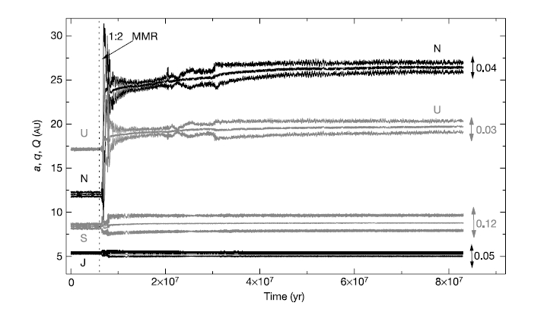
The Nice Model
10 Myr
Tsiganis et al. 2005
Notes:
this is one simulation … note short period of time
a is semimajor axis, q is perihelion, Q is aphelion
e noted on right, maximum during last 2 Myr shown

Slide 33
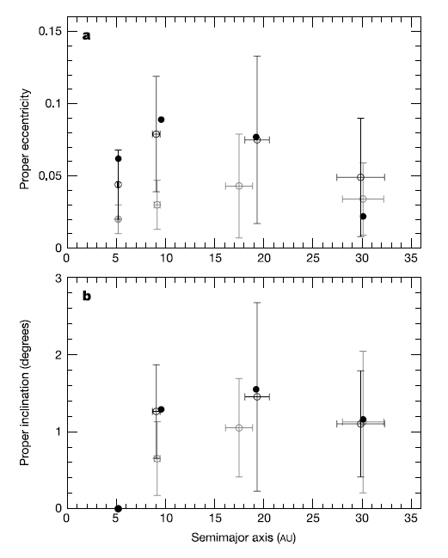
migration stops when
disk nearly depleted
→ present day
solid: today
gray: 0 Sat-IG encounters
black: ≥ 1 Sat-IG encounter
more disk mass?
more stability
Jup-Sat too far apart
final e too small
Tsiganis et al. 2005
Notes:
final Jup-Sat separation depends on initial mass of disk
IG = Ice Giant

Slide 34
The Nice Model
“Our model
statistically reproduces all aspects of the orbits of the giant planets.
[a, e, i for Jup/Sat/Ura/Nep]
It is consistent with the existence of regular satellites,
with the observed distributions of Jupiter’s Trojans,
perhaps with the existence of Neptune’s Trojans, and
does not contradict the distribution of main-belt asteroids.”
Tsiganis et al. 2005

Slide 35

V. Evolution of Solar System
SSE! hands up!
Name any characteristic of the SS that is different today than how the SS looked at age 10 Myr.

Slide 36
V. Evolution of Solar System
Nice Model
happens in the first ~10 million years
continuous bombardment (craters, regolith, oceans?)
giant impacts (Moon origin, Venus retrograde?, Uranus tilt?)
tidal locking of moons (many)
resonances that cause evolution (Io-Eur-Gany, Kirk gaps, Plutinos)
captures (asteroids, Triton)
changing atmospheres (Venus, Earth, Mars, Titan, Pluto)
ring systems/toroids (Io)
icecaps (Mercury, Earth, Moon, Mars)
erosion (Earth, Mars, Titan)
vulcanism (Venus, Earth, Mars, Io, Enceladus, Triton)
life

Slide 37
…………………………
Notes:
37

Slide 38
HR 4796A Disk Details
A0 star, 67 pc, ~10 Myr old
circumstellar disk discovered by Koerner et al. (1998)
… disk inclined by 72 deg
emission intensity increases (!) with radius, implying inner hole 40-70 AU
… clearance out to Kuiper Belt?
ring width is < 17 AU from NICMOS observations
… corresponding to thin Kuiper Belt, or shepherding planets?
dust beyond clearing could be due to smashing comets
8.8/10.3/12.5 micron flux excess implies inner disk with T ~ 160 K at ~10 AU
… similar temp to zodiacal dust in our Solar System
bottom line: HR 4796A has double disk in a transition state at 10 Myr
… between massive protostellar disks and more tenuous debris disks

