Slide 1
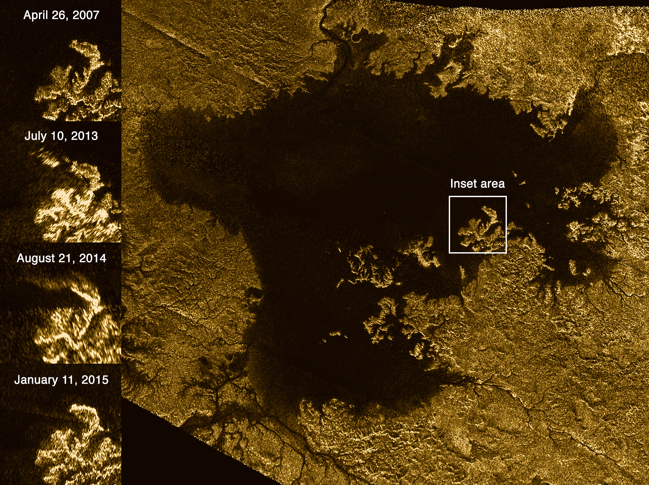
Where is this?
Notes:
TITAN BY CASSINI: These images from the Radar instrument aboard NASA's Cassini spacecraft show the evolution of a transient feature in the large hydrocarbon sea named Ligeia Mare on Saturn's moon Titan.
Analysis by Cassini scientists indicates that the bright features, informally known as the "magic island," are a phenomenon that changes over time. They conclude that the brightening is due to either waves, solids at or beneath the surface or bubbles, with waves thought to be the most likely explanation. They think tides, sea level and seafloor changes are unlikely to be responsible for the brightening.
The images in the column at left show the same region of Ligeia Mare as seen by Cassini's radar during flybys in (from top to bottom) 2007, 2013, 2014 and 2015.
The bottom image was acquired by Cassini on Jan. 11, 2015, and adds another snapshot in time as Cassini continues to monitor the ephemeral feature (previously highlighted in PIA18430). The feature is apparent in the images from 2013 and 2014, but it is not present in other images of the region.
Cassini has observed similar transient features elsewhere in Ligeia Mare, and also in Kraken Mare (see PIA19047). These features are the first instances of active processes in Titan's lakes and seas to be confirmed by multiple detections. Their changing nature demonstrates that Titan's seas are not stagnant, but rather, dynamic environments.
The Cassini radar team plans to re-observe this particular region of Ligeia Mare one more time during Cassini's final close flyby of Titan in April 2017. The results may further illuminate the phenomenon responsible for the appearance of the transient features.
The large image panel shows Ligeia Mare in its entirety. Ligeia is Titan's second-largest liquid hydrocarbon sea, and has a total area of about 50,000 square miles (130,000 square kilometers), making it 50 percent larger than Lake Superior on Earth. This panel is a mosaic of five synthetic aperture radar images acquired by Cassini between 2007 and 2014. It shows a region approximately 330 by 305 miles (530 by 490 kilometers) in area.
An earlier version of the mosaic was released as PIA17031; the new version includes new data to fill in some gaps in coverage and to improve the quality of coverage in some of the previously imaged areas.
The images have been colorized and processed for aesthetic appeal.

Slide 2
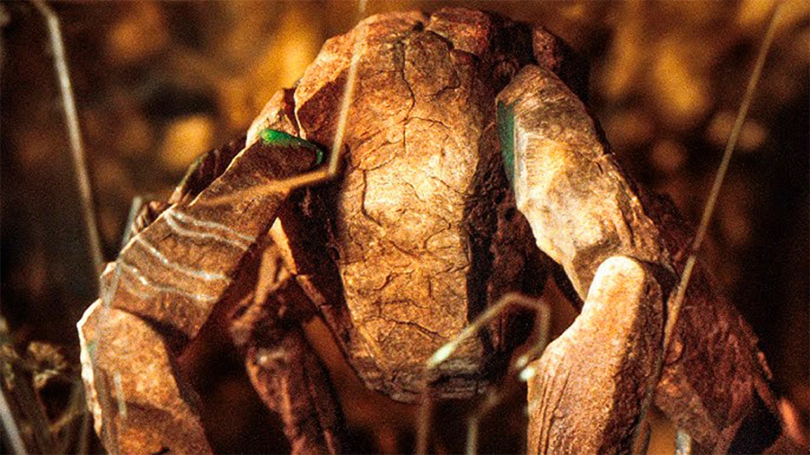
Spaceship Name!
SSE Ephemeris … 1
Trojan Horse … 4
Hail Mary … 5
Skeld … 2
Ocean Gate … 4
Astraois … 4
Lagrange Point … 1

Slide 3
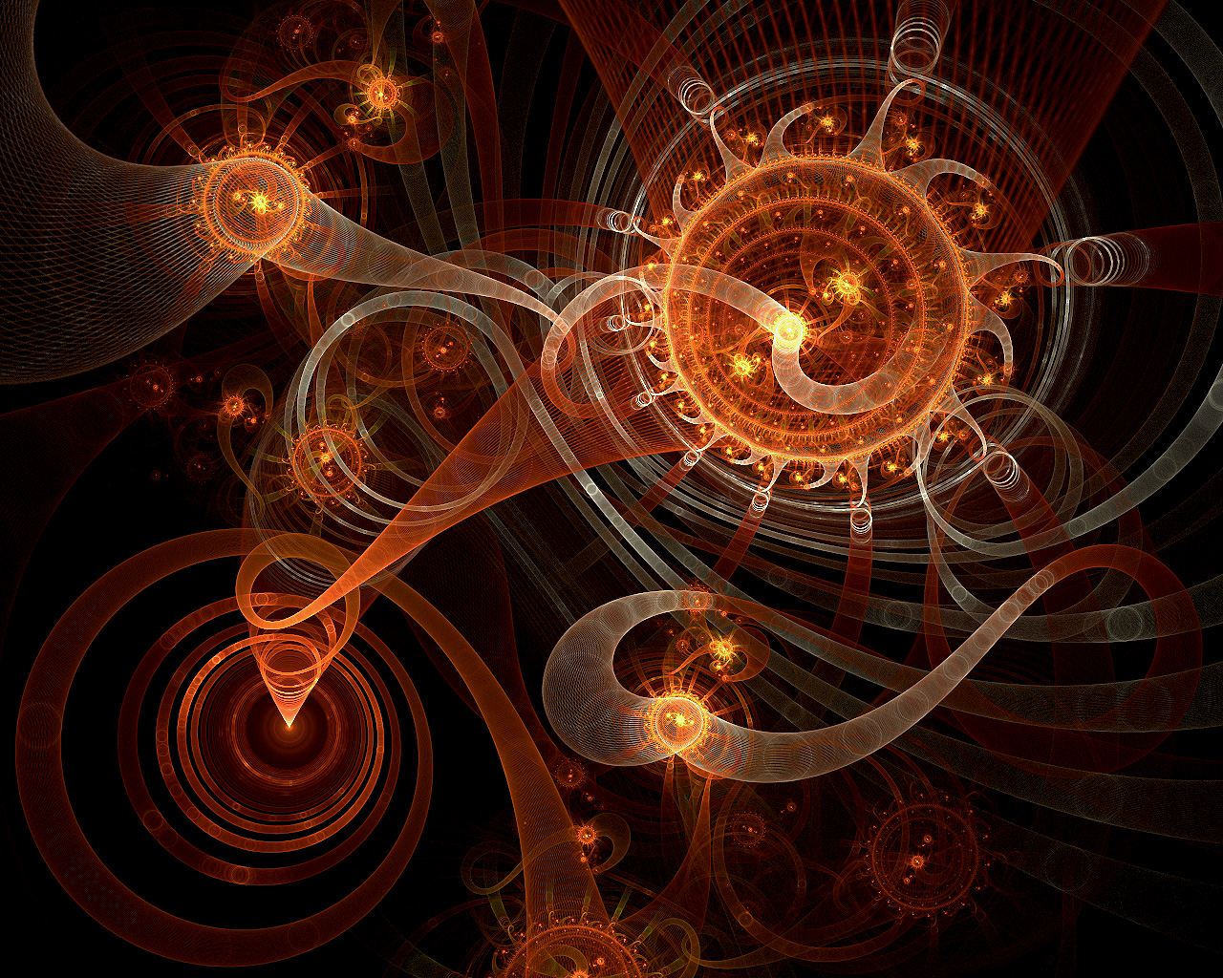
Dynamics I

Slide 4
Basic Newton
G m_{Earth} m₂
F _{gravity on Earth} = — _______________
r²
 | m₂ (kg) | r (m) | F_{gravity}
Sun | 1.99e30 | 1.50e11 | 3.52e22 | Winner! | 178 X Moon
Venus | 4.87e24 | 4.14e10 | 1.13e18
Moon | 7.35e22 | 3.84e08 | 1.98e20
Jupiter | 1.90e27 | 6.29e11 | 1.91e18
What about the Moon?
m_{Earth} = 5.97e24 kg
Earth-Moon has F_{Earth} ~ 1.98e20, Sun-Moon has F_{Sun} ~ 4.34e20
Notes:
1/r for gravitational ENERGY rather than FORCE

Slide 5
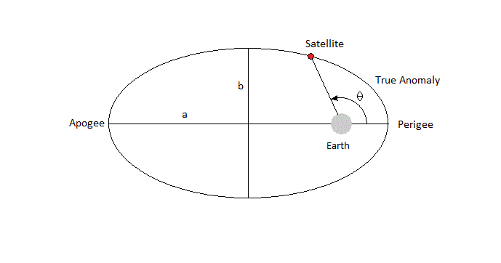
Dynamics: Kepler I
Kepler I: planetary orbits are ellipses with the Sun at a focus
a (1 − e²)
r_{Earth-Sun} = ______________
1 + e cos θ
e = eccentricity = (1 − b²_{minor}/a²_{major})^{1/2}
θ = true anomaly = angle between perihelion and current position
SSE! hands up!
What is a?
What is b?

Slide 6
Dynamics: Kepler I
Kepler I: planetary orbits are ellipses with the Sun at a focus
a (1 − e²)
r_{Earth-Sun} = ______________
1 + e cos θ
e = eccentricity = (1 − b²_{minor}/a²_{major})^{1/2}
θ = true anomaly = angle between perihelion and current position
Newton I : both bodies move along elliptical paths, with one focus of each ellipse located at the center of mass
m₁r₁ + m₂r₂
r_{CM} = _________________
M
M = m₁ + m₂
Application: discovery of extrasolar planets

Slide 7
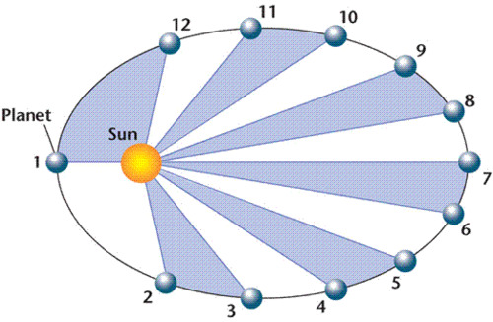
Dynamics: Kepler II
Kepler II: a line between a planet and the Sun sweeps out equal areas in equal times
dA/dt = constant
Newton II : a line connecting two bodies (or connecting one body to the center of mass position) sweeps out equal areas in equal times
dL/dt = 0
(conservation of angular momentum)
Application: spectroscopic binary orbits; prediction of planet locations

Slide 8
Dynamics: Kepler III
Kepler III: planetary orbital periods and distances from the Sun are directly (and simply) related as long as you assume SS units
P² (yr) = a³ (AU)
Newton III: it also works outside of the Solar System
4π²a³ a³
P² = __________________ or M_{total} = _______
G (m₁ + m₂) P²
solar masses, AU, yrs
Application: stellar and planetary masses
need fractional mass, f, for individual masses
dirty little secrets of exoplanet masses …
Notes:
dirty secrets: RV --- inclination unknown, so minimum masses + must guess mass of primary star
transit --- must guess radius of star

Slide 9
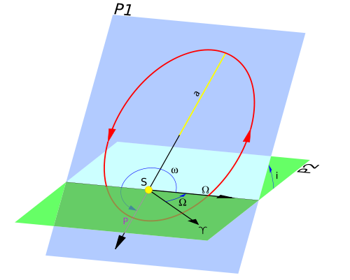
Orbital Elements
a semimajor axis size
e eccentricity shape
i inclination (0 degrees = face-on) tilt angle
P orbital period time
SSE!
SSE!
SSE!
Notes:
inclination ~0deg for planets in SS; however, edge on systems are 90deg in eclipsing binaries and transiting planets
longitude of periastron is little omega with a bar over it

Slide 10
Orbital Elements
a semimajor axis size
e eccentricity shape
i inclination (0 degrees = face-on) tilt angle
P orbital period time
T epoch of periastron a date
ω argument of periastron tωist angle
Ω longitude of ascending node spin angle
Notes:
inclination ~0deg for planets in SS; however, edge on systems are 90deg in eclipsing binaries and transiting planets
longitude of periastron is little omega with a bar over it

Slide 11
Tωist ω: Argument of Periastron

Slide 12
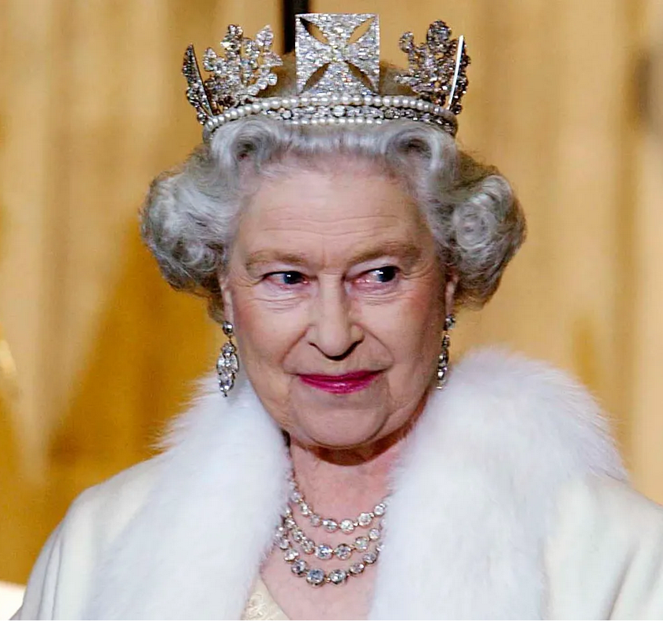
Spin Ω: Longitude of Ascending Node

Slide 13
Orbital Elements
a semimajor axis size
e eccentricity shape
i inclination (0 degrees = face-on) tilt angle
P orbital period time
T epoch of periastron a date
ω argument of periastron tωist angle
Ω longitude of ascending node spin angle
equinox equinox of date sets direction of equinox
f fractional mass a number
Two observations will not yield an orbit. Why?
Each point has (X position, Y position, time). There are 7 classical unknowns, so you need a third point to give you 9 pieces of data to solve equations.
Notes:
inclination ~0deg for planets in SS; however, edge on systems are 90deg in eclipsing binaries and transiting planets
longitude of periastron is little omega with a bar over it

Slide 14
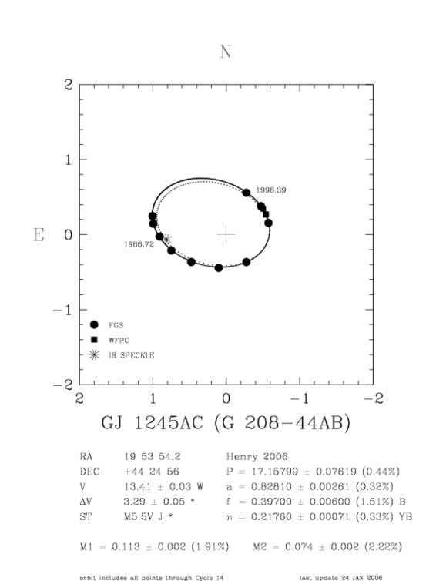
GJ 1245 AC
Stars: Very Low Mass
Notes:
you can use astrometry from various sources

Slide 15
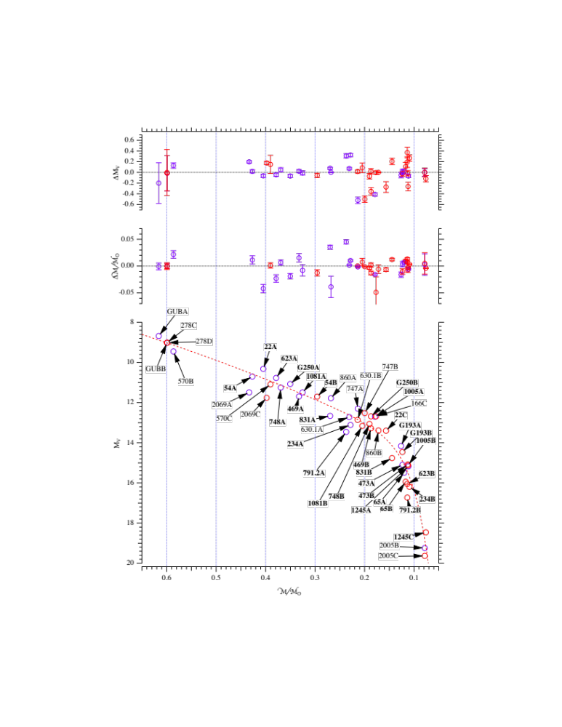
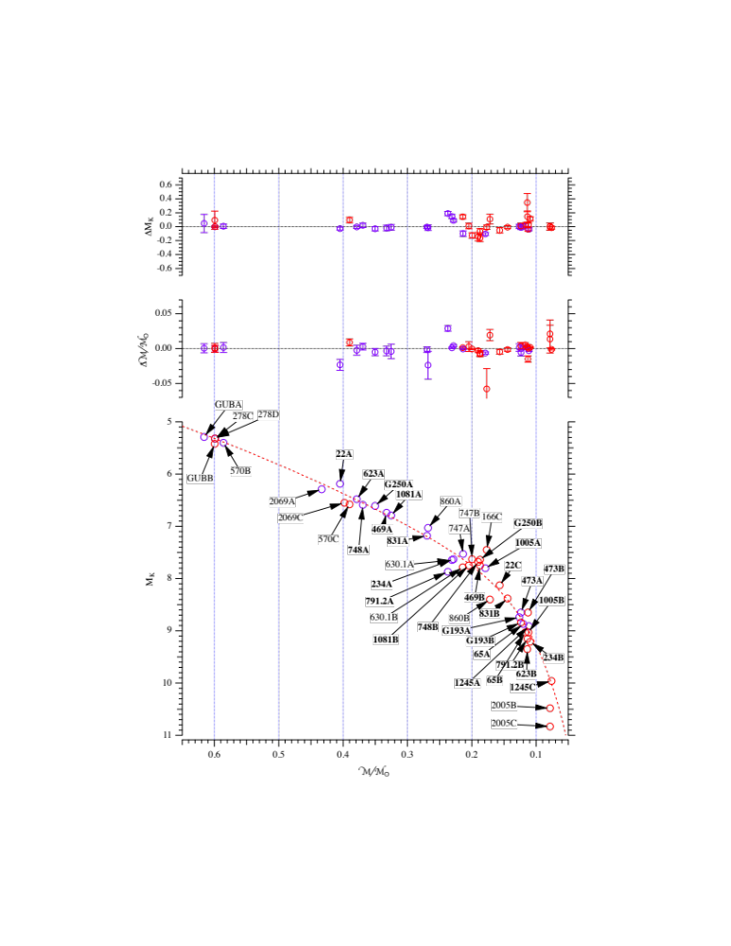
M Dwarf Masses
scatter = 0.023 M ~ 7%
scatter = 0.014 M ~ 4%
M_{V}
M_{K}
Benedict, Henry, Franz et al. 2016

Slide 16
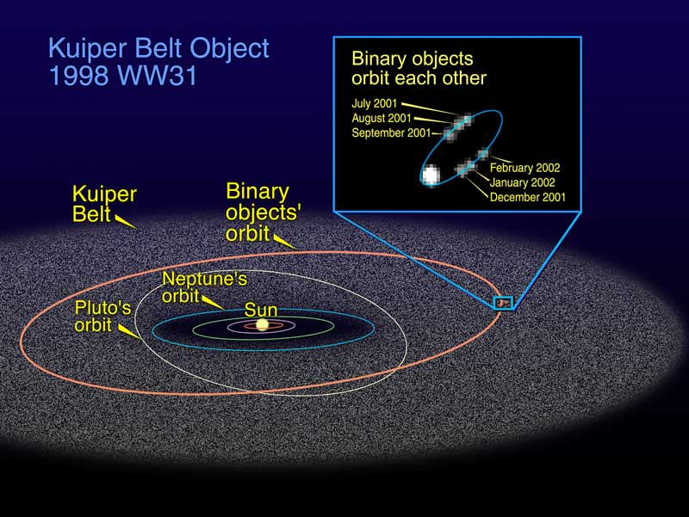
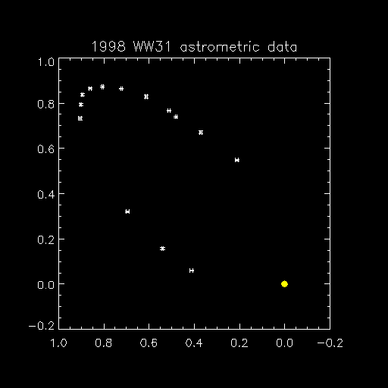
Far Out Orbits in Solar System
located 44.7 AU
P_{sun} ~ 300 yrs
HST WFPC2 images
V = 23.1
P_{orb} 587.3 ± 0.2 days
a 22620 ± 40 km
m_{tot} 0.02% Pluto
at least 116 multiple TNOs known
www2.lowell.edu/users/grundy/tnbs/status.html
Notes:
WW31 was the first binary TNO discovered, other than Pluto
had 77 multiples known as of 2015 class … 108 as of 2020 class … 116 as of 2022 class … no change for 2024

Slide 17
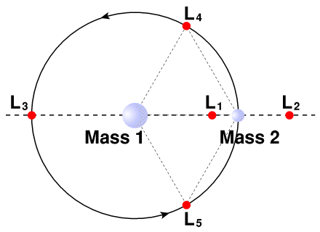
Counter-Intuitive Dynamics
Lagrange Points: where objects feel no net force in rotating frame; gravitational force of two masses cancels centrifugal force because of rotation
5 points per two body system
Greek/Trojan asteroids at Jup/Ven?/Ear/Mar/Ura?/Nep
small moons at Sat/Tethys (Telesto+Calypso) and Sat/Dione (Helene+Polydeuces)
Earth orbiting spacecraft
WMAP
Gaia
Euclid
JWST
Roman
SSE! hands up!
Name a spacecraft
out at L2.
SOHO
Notes:
Planetary Sciences
17
L1 L2 L3 unstable … L4 L5 stable

Slide 18
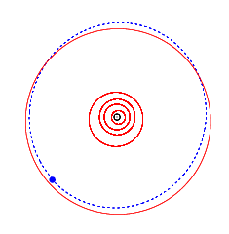
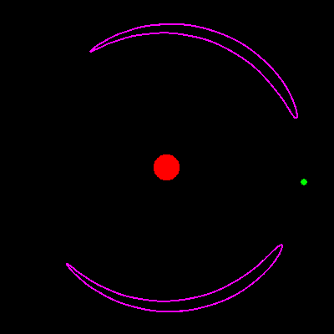
Counter-Intuitive Dynamics
Tadpole orbits: librating positions around L4 and L5
note corotating frame!
Greek/Trojan asteroids at Jupiter, etc.
Notes:
Animation is for Trojan Hektor.
If the body is in front of the planet (relative to the planet's orbital motion) and a little further from the Sun, it will orbit the Sun slightly slower than the planet.
As it is slower, the planet will slowly catch up. (It takes many "years" for the planet to get close to the body.)
As the planet catches up with the body, the gravitational effect of the planet will tend to pull back on the body, this causes the body to lose energy and begin to fall slightly towards the sun.
The slight fall towards the sun causes the body to move to a closer orbit to the Sun and so speed up. It appears paradoxical, but it the fact that the gravitational drag of the planet on the body actually causes it to speed up.
The body speeds up and so begins to move away from the planet.
When the body is makes an angle of more than 60 degrees from the planet, the gravitational pull of the planet now has the opposite effect. It combines with the pull of the sun to cause the body to accelerate, and (apparently paradoxically) this acceleration causes the body to move to a more distant orbit, and slow down.
There are two things key to understanding this. First, remember that the diagrams are drawn with a fixed planet. I.e. the "camera" is rotating at the same rate as the planet takes to orbit the sun, so the planet appears fixed. If you don't rotate the camera, you would see that the body actually has a nearly elliptical orbit, relative to the Sun. Second, you need to grasp the idea that, in orbit, drag doesn't slow you down. Drag causes you to fall towards the sun and speed up.

Slide 19
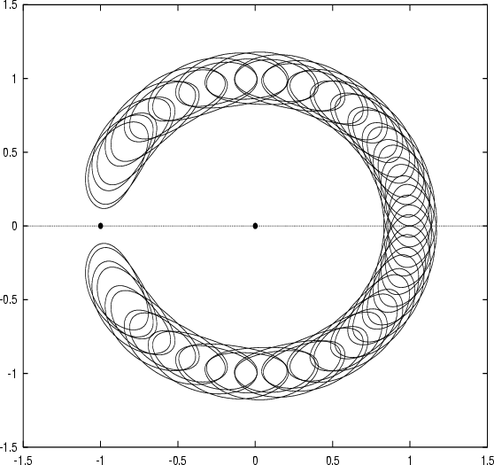
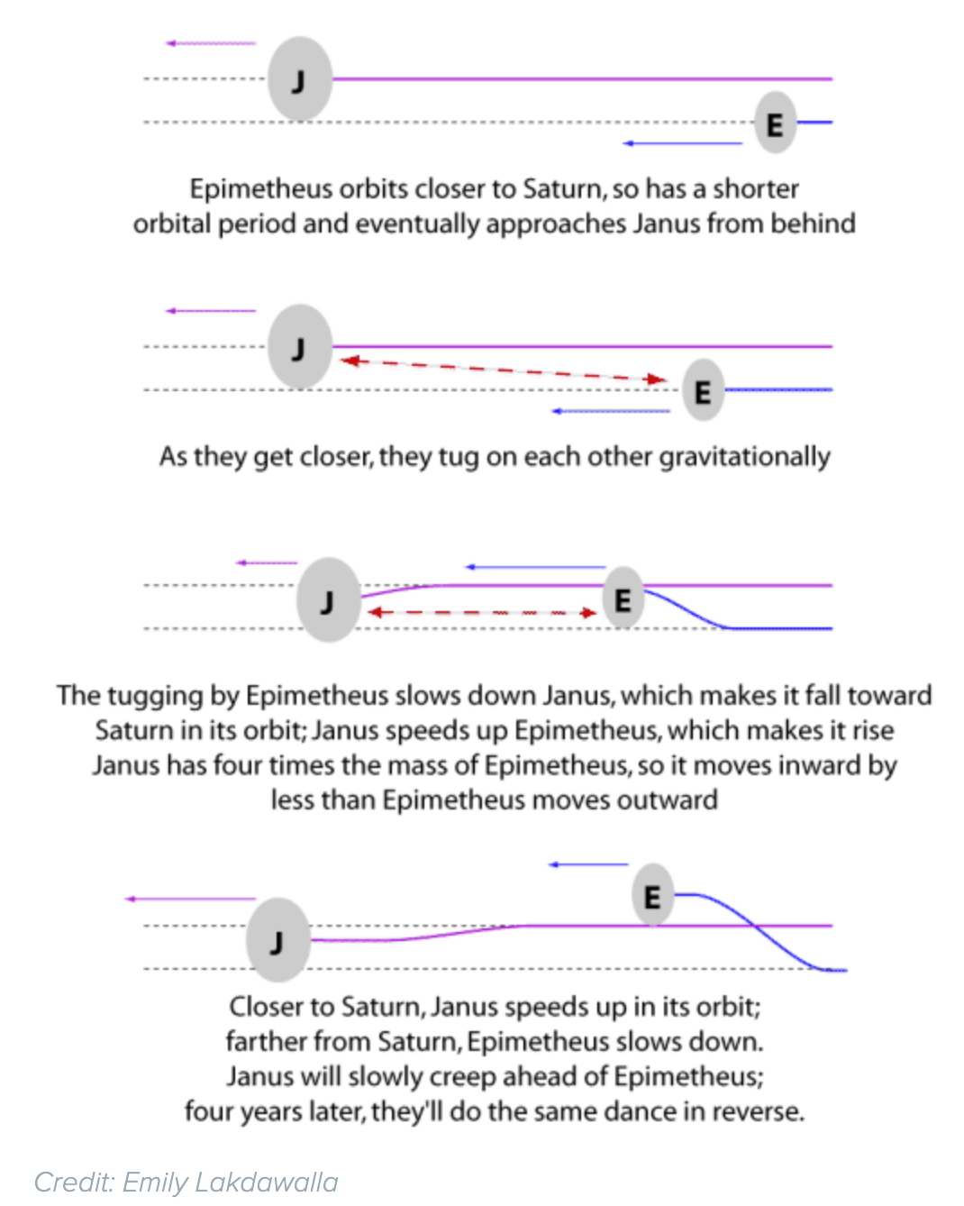
Counter-Intuitive Dynamics
Horseshoe orbits: orbit swapping due to particles passing in orbits, or in resonance with larger bodies (note corotating frame!)
Janus and Epimetheus (Saturn) swap orbits every 4 years
Cruithne and 2002 AA29 around Earth
Notes:
Cruithne is 5km in size, closest approach 0.1 AU, mag 15 at closest approach

Slide 20
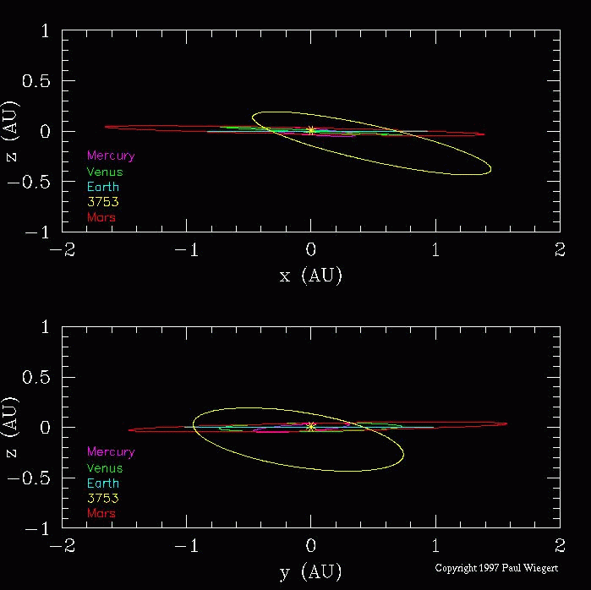
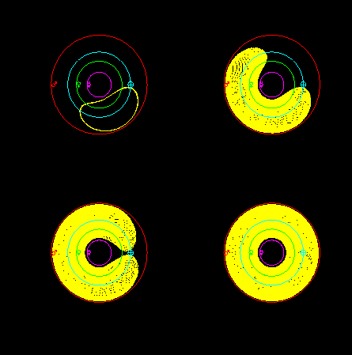
Counter-Intuitive Dynamics
Horseshoe orbits: Cruithne --- each loop takes 364.02 days … ~1 yr
www.astro.uwo.ca/~wiegert/3753/3753.html
Notes:
upper left of four figures is one year … lower right is overlapped horseshow after 385 years
Cruithne (KROOee-nyuh, only 2 syllables) were the first Celtic group to reach the British Isles

Slide 21
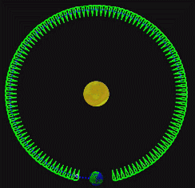
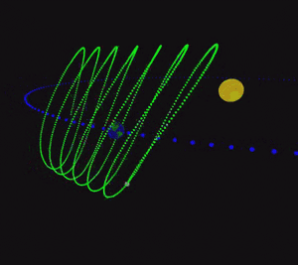
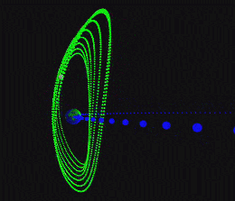
Counter-Intuitive Dynamics
Horseshoe orbits: 2002 AA29 --- each vertical loop takes 1 yr
www.astro.uwo.ca/~wiegert/AA29/AA29.html
7 asteroids co-orbital with Earth known as of 2024
Notes:
7 co-orbital asteroids --- https://en.wikipedia.org/wiki/Co-orbital_configuration#Earth_co-orbital_asteroids

Slide 22
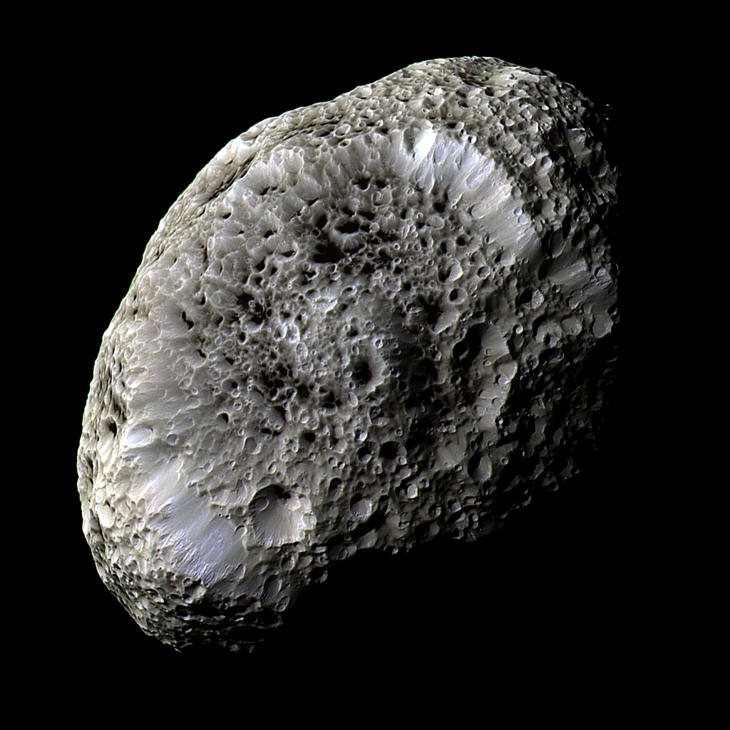
Counter-Intuitive Dynamics
Chaotic motion: trajectories that begin arbitrarily close together will diverge exponentially with time (note that 4.6 Gyr is often not “sufficient time”)
Mars’ axis tilt
Hyperion rotation in Saturn-Titan tug-of-war
Resonances: orbital periods with ratios A : B (both integers)
Io : Europa : Ganymede (1:2:4)
Neptune : Plutinos (3:2)
Asteroids : Jupiter (lots) --- pumped up e leads to Kirkwood gaps
Saturn ring particles : Saturn moons (Mimas, Atlas, …)
Notes:
Io:Europa:Ganymede really 1.000 : 2.008 : 4.044
NOT QUITE RESONANT: Consider the orbits of Earth and Venus, which arrive at almost the same configuration after 8 Earth orbits and 13 Venus orbits. The actual ratio is 0.61518624, which is only 0.032% away from exactly 8:13. The mismatch after 8 years is only 1.5° of Venus' orbital movement. Still, this is enough that Venus and Earth find themselves in the opposite relative orientation to the original every 120 such cycles, which is 960 years. Therefore, on timescales of thousands of years or more (still tiny by astronomical standards), their relative position is effectively random.

Slide 23
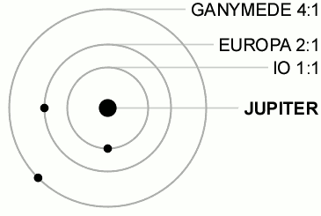
1 : 2 : 4

Slide 24
Solar System Explorers: 10 SEP
Describe something you have already learned in this course that you did not know previously.
1. Solid N2 in our SS.
2. Moon orbits the Sun!
3. Pluto has dynamically packed moon system.
4. Pluto has very high e and i for its orbit.
5. Kirkwood Gaps are a thing in the Main Belt.
6. Pluto has geologic activity.
7. Uranus and Neptune have little H+He.
8. Uranus and Neptune have non-symmetric mag fields.
9. Uranus and Neptune may have flipped according to Nice Model.
10. Jupiter has monster magnetotail.
11. Ganymede has its own mag field.
12. Globular clusters have appropriate Jeans masses.
13. There is more to ice than H2O.
14. Jup/Ura/Nep have rings!!!
15. Ura/Nep blue because of CH4 absorption.
16. Trojans and Greeks exist.
17. Only Titan and Earth have liquids on the surface.
18. No liquid CO2 in the SS.
19. Mars’ seasons by orbit not obliquity.
20. Asteroids fuse together.

Slide 25
Solar System Explorers: 17 SEP
Describe a dynamical situation in the Solar System involving 2 or more bodies that is unusual, in the sense that it is not a simple orbit.
1.
2.
3.
4.
5.
6.
7.
8.
9.
10.
11.
12.
13.
14.
15.
16.
17.
18.
19.
20.

Slide 26
…………………………
Notes:
26

