Slide 1
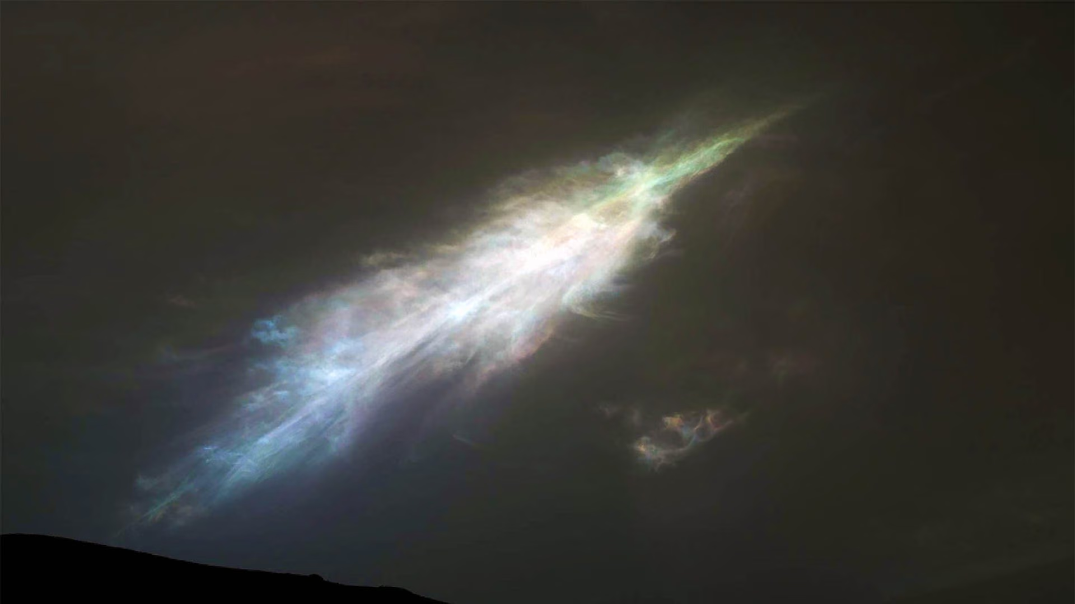
Where is this?
Notes:
Mars noctilucent clouds … CO2 ice … 2023.0127 … slightly color enhanced, but not too much

Slide 2
SSE!
Which terrestrial world’s atmosphere has the largest scale height?
…
Titan
In which wavelength regime should you observe atmospheres
to detect molecular rotation transitions?
…
radio
Name one of the cloud decks expected in the gas giants’ atmospheres.
…
ammonia
ammonium hydrosulfide
water

Slide 3
Solar System Explorers: 01 OCT
How does the Sun affect objects in the Solar System?
1.
2.
3.
4.
5.
6.
7.
8.
9.
10.
11.
12.
13.
14.
15.
16.
17.
18.
19.
20.

Slide 4
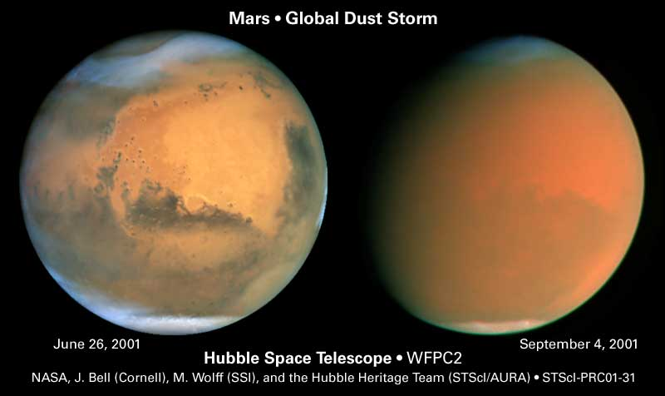
Weather

Slide 5
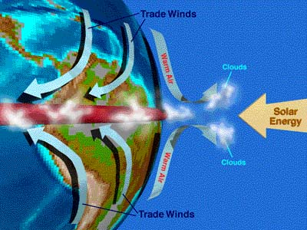
Weather
IN GENERAL …
solar heating leads to
Hadley cells --- subsolar point heated, poles not
hot air rises, move towards low pressure poles, air cools and sinks
thermal tidal winds --- hot day side, cold night side
substantial atmospheres ΔT/T < 1%, tenuous can be large (Mars 20%)
condensation flows --- sublimation/condensation of gas
Mars (CO₂), Triton and Pluto (N₂ + CH₄)
Notes:
slow-rotating Venus has 1 Hadley cell … Earth has 3/hemisphere … Jovians have many

Slide 6
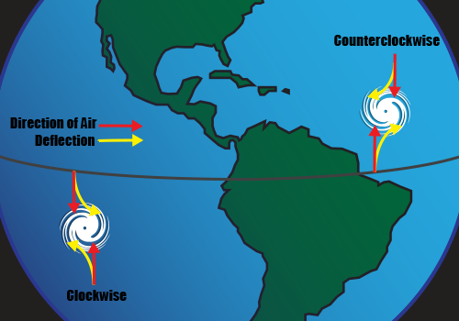
Weather: Earth
EARTH
Hadley cell circulation --- air bubbles change latitude
Coriolis effect breaks uniform flow into three regions/hemisphere
wet air rises near equator, cools, drops water … rainforests
dry air descends in mid-latitude …deserts
near equator, Coriolis effect weak and temp gradient minimal N ←→ S
solar heating + Earth rotation produce steady winds W ← E
trade winds carry heated water westward (extra warm water in W. Pacific)
if trade winds weaken, less water moved west …buildup sloshes back
temp of E. Pacific water rises … El Nino!
occurs in southern hemisphere summer (i.e. Saturnalia/Christmas)
Notes:
Air at equator moving fast, as it drifts north, it “outruns” the air there, so moves ahead.

Slide 7
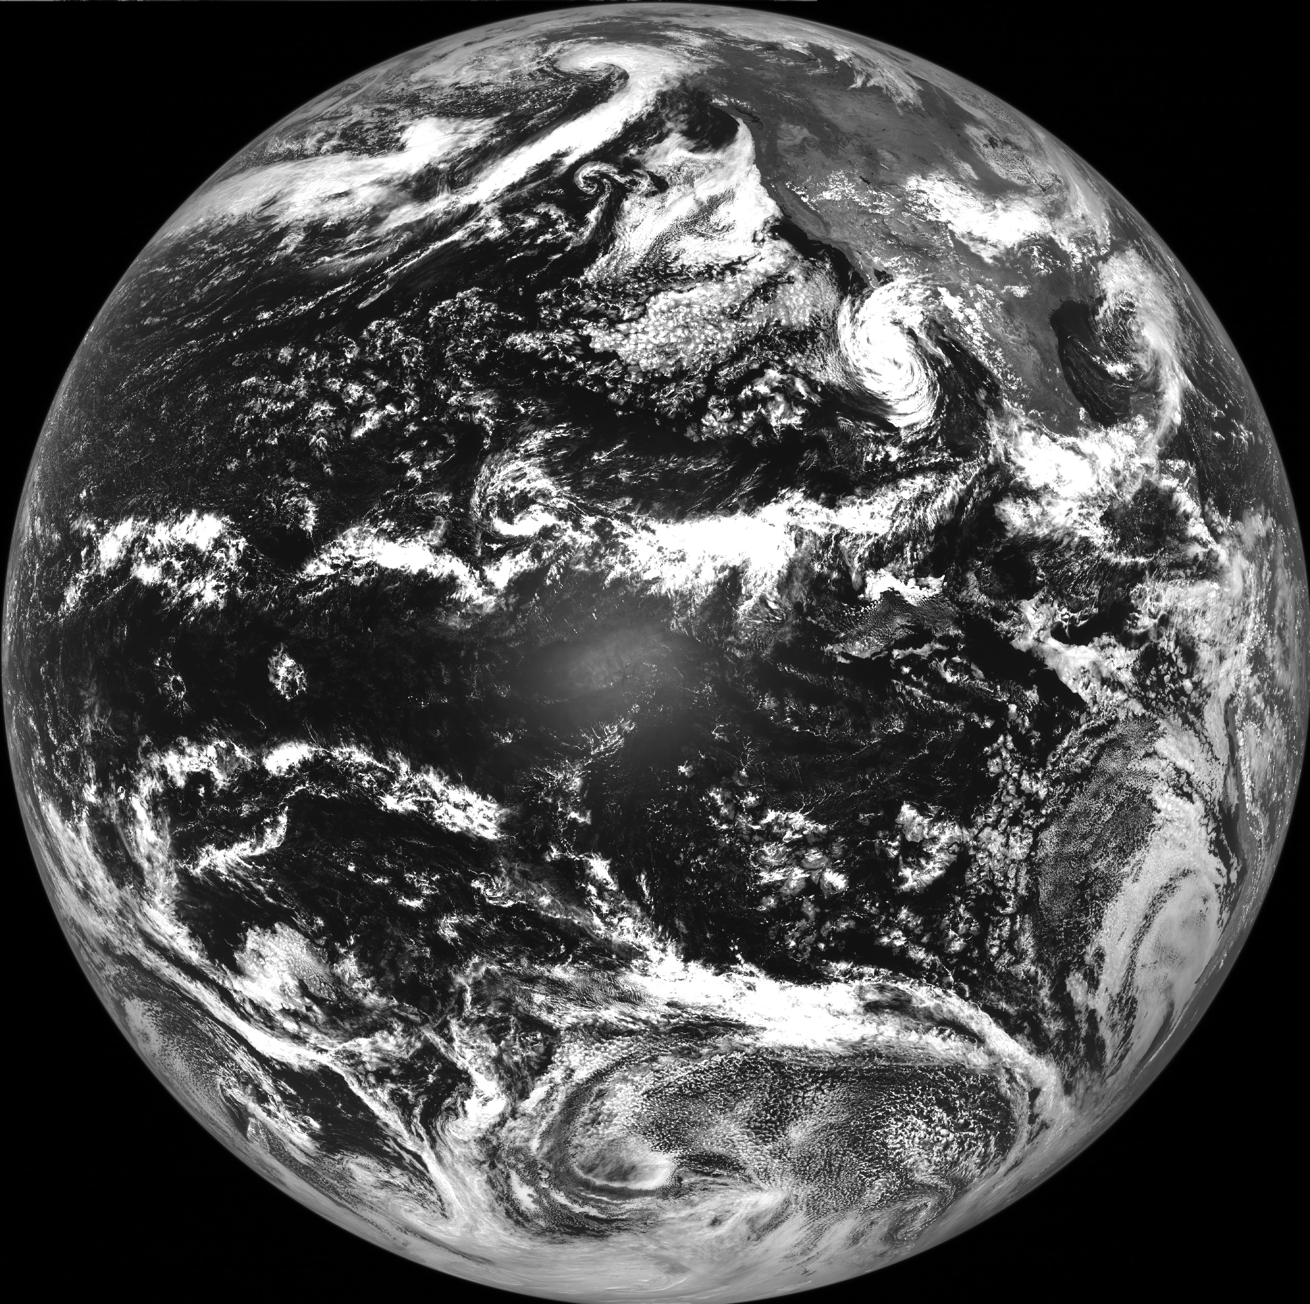
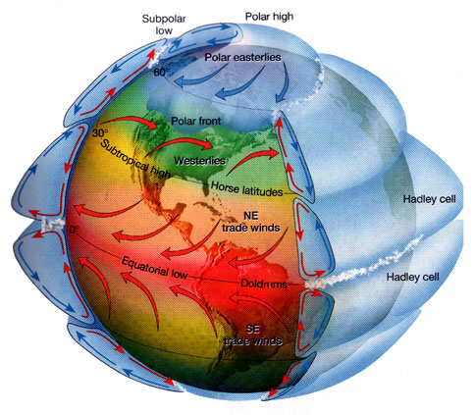
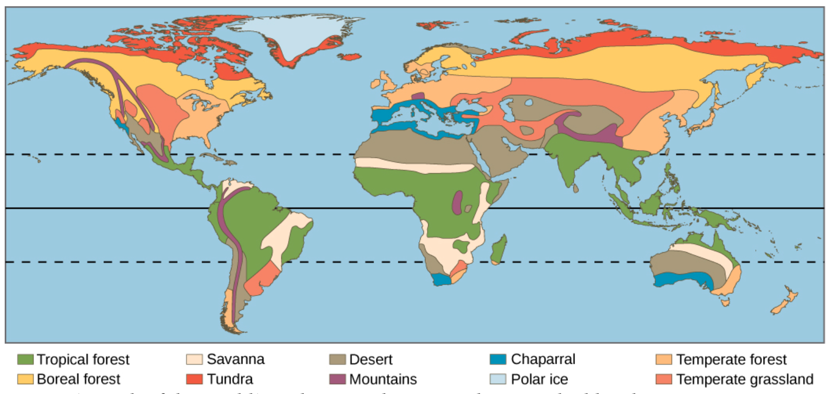
Hadley Cells
deserts
rainforests
deserts
Notes:
hurricanes DO NOT spin as the Hadley cell winds … smaller perturbations that peel off

Slide 8
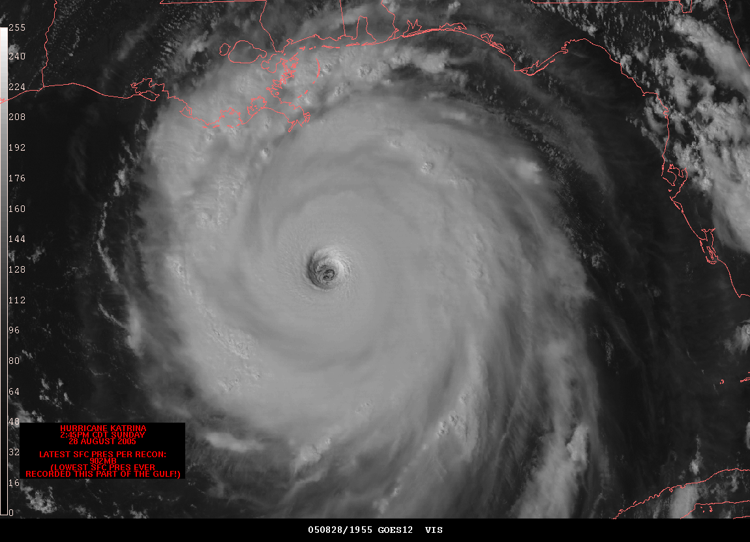

Slide 9
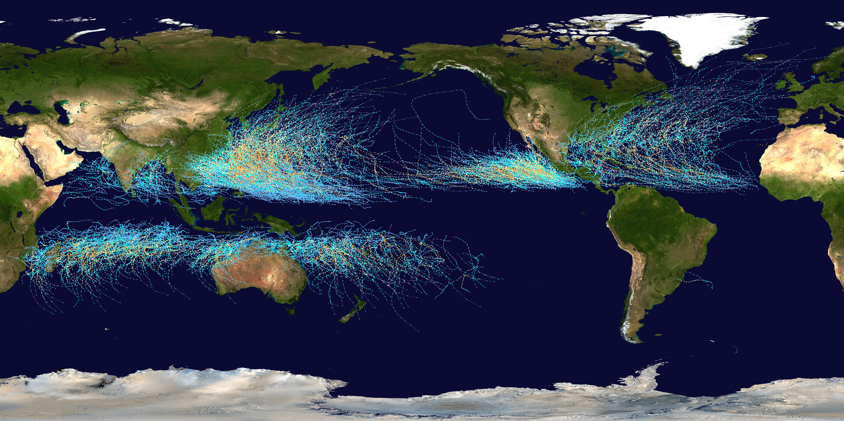
Storm Tracks 1985-2005
typhoons hurricanes
cyclones
SSE ?
Notes:
why no hurricanes in South America?
Tropical storms hitting South America have distinct disadvantages compared with the North American situation. The energy to drive tropical systems is derived from warm ocean waters. For tropical storms to form, the ocean temperature needs to exceed 79.7 Fahrenheit, which is common in the North Atlantic and Caribbean oceans between June and November. Reaching these temperatures is rare in the South Atlantic Ocean, even during their summer. Hurricanes do not form within 5 degrees of the equator and that includes a large geographic region of South America. The small Coriolis forces there inhibit circulation development.
Also … lack of weather disturbances favorable for development in the South Atlantic Ocean.

Slide 10
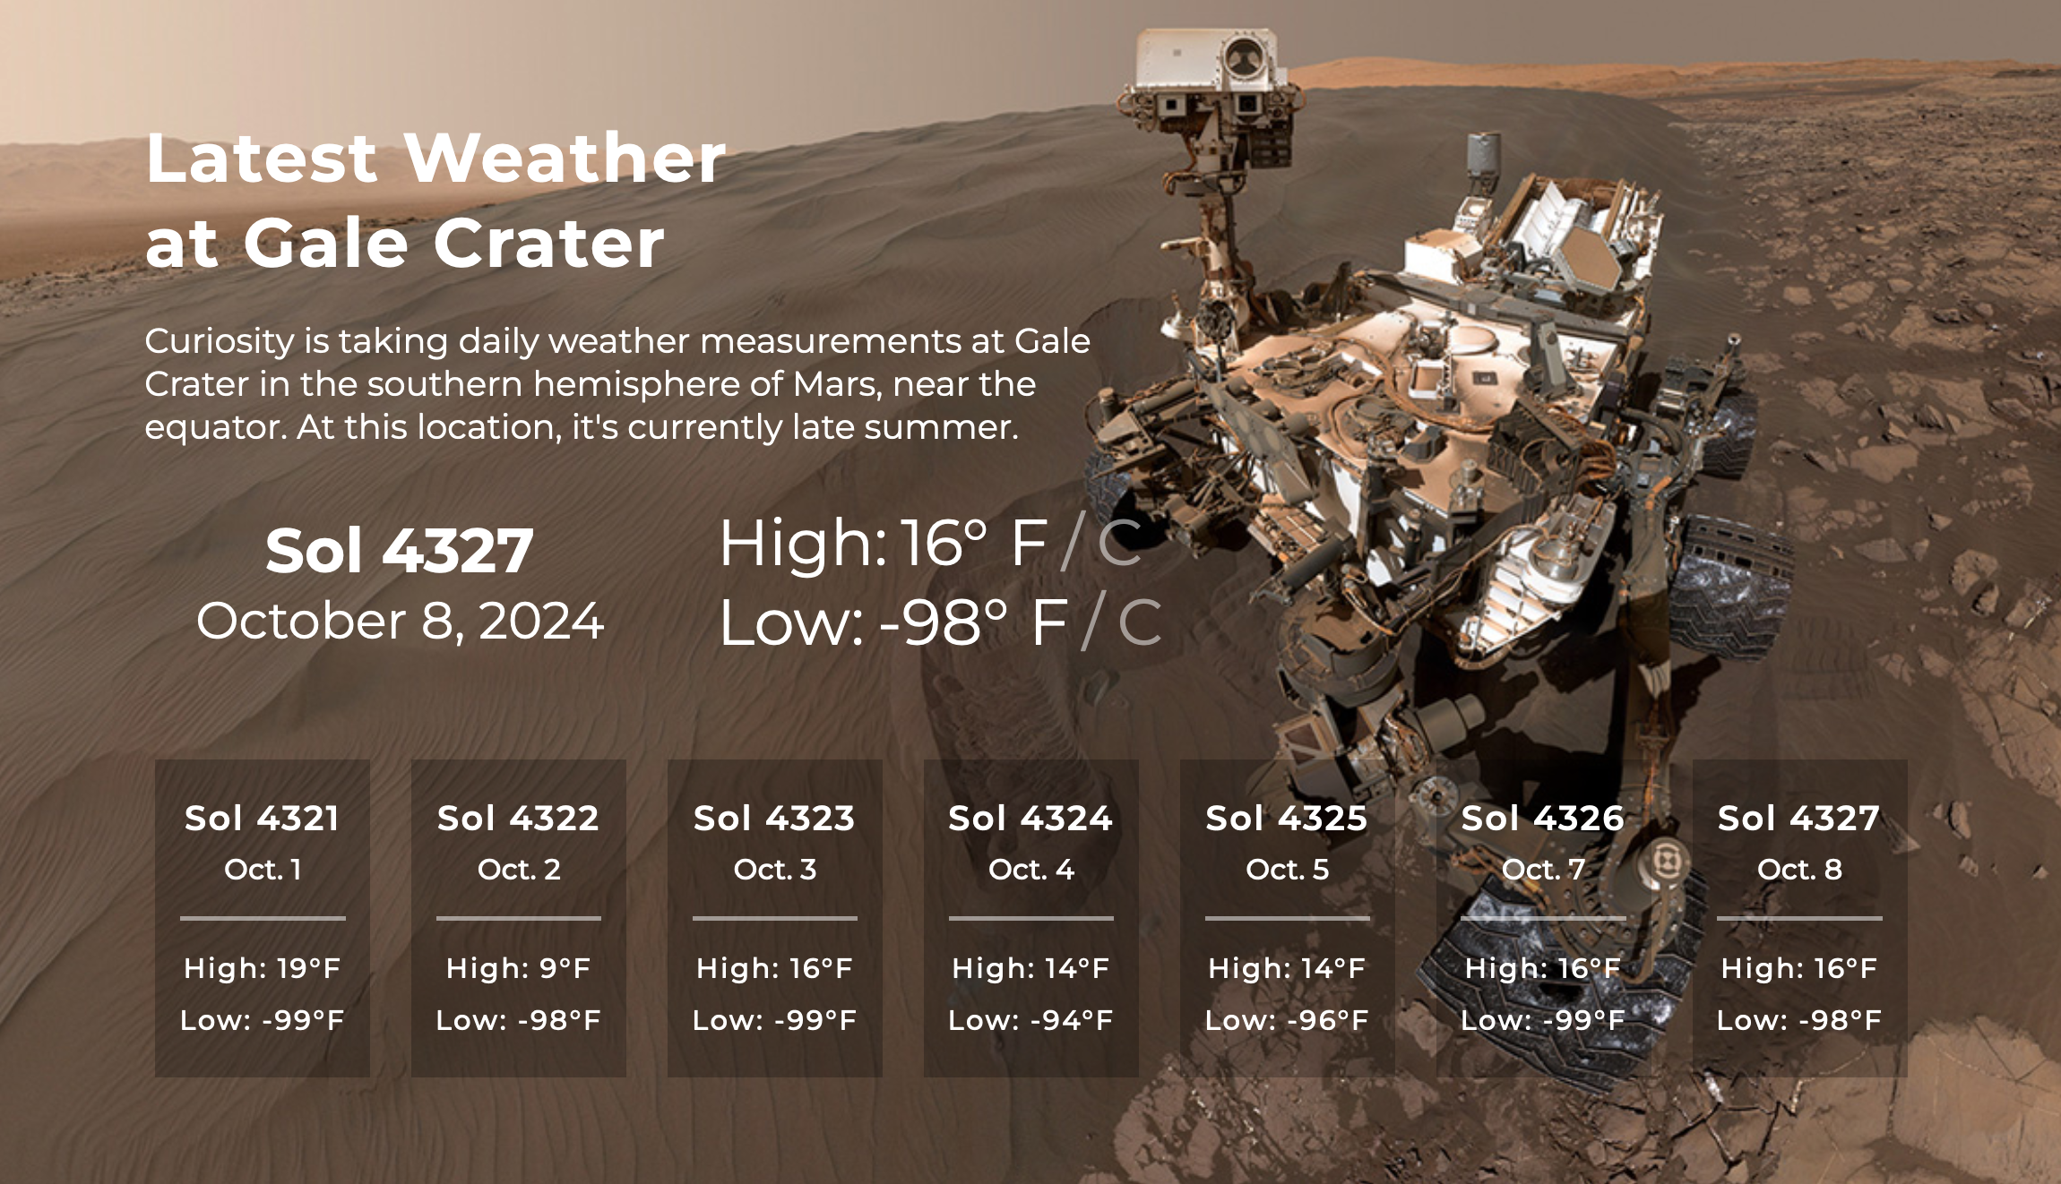
Weather: Mars
highest temp measured = 43F = 279K
Notes:
Perseverance is nuclear powered … all ok
Curiosity is nuclear powered … all ok
Opportunity was solar powered … last response 10 JUN 2018, after 5111 sols
Spirit was solar powered … last response 22 MAR 2010, after 2208 sols

Slide 11
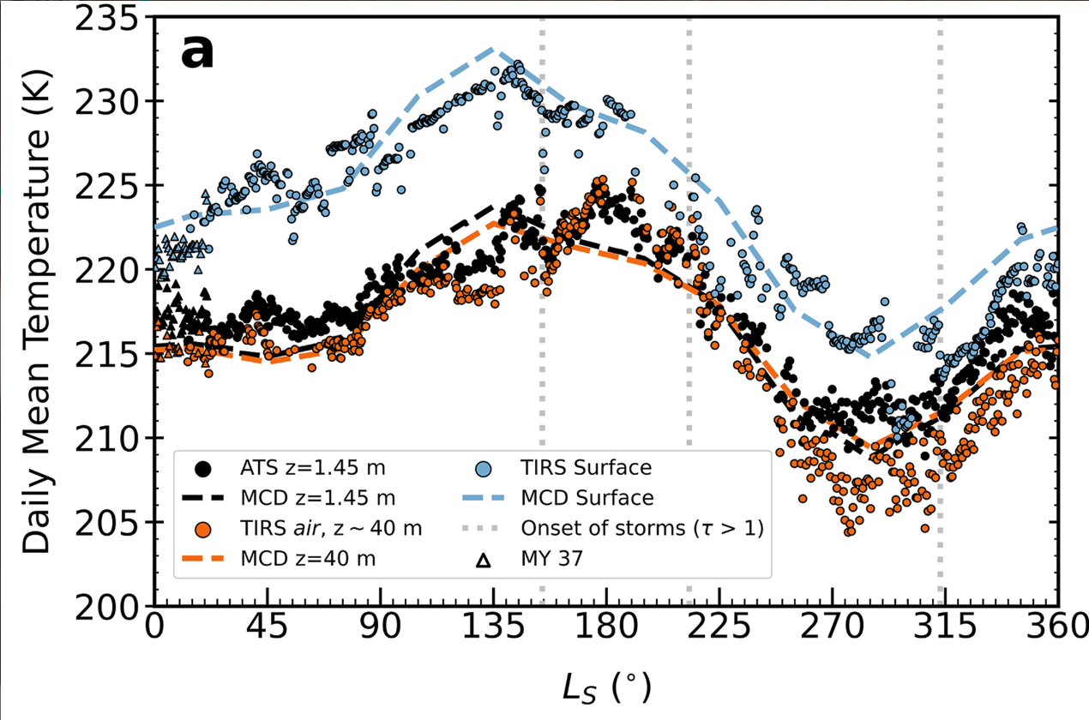
Weather: Mars
Perseverance location at Jezero Crater … 30 deg N
Munguira+ 2024
Notes:
T drops quickly from surface to 1.45m
T at surface affected by storms
Ls is degrees around orbit for 1 Martian year
Perseverance is nuclear powered … all ok … ~30 deg N

Slide 12
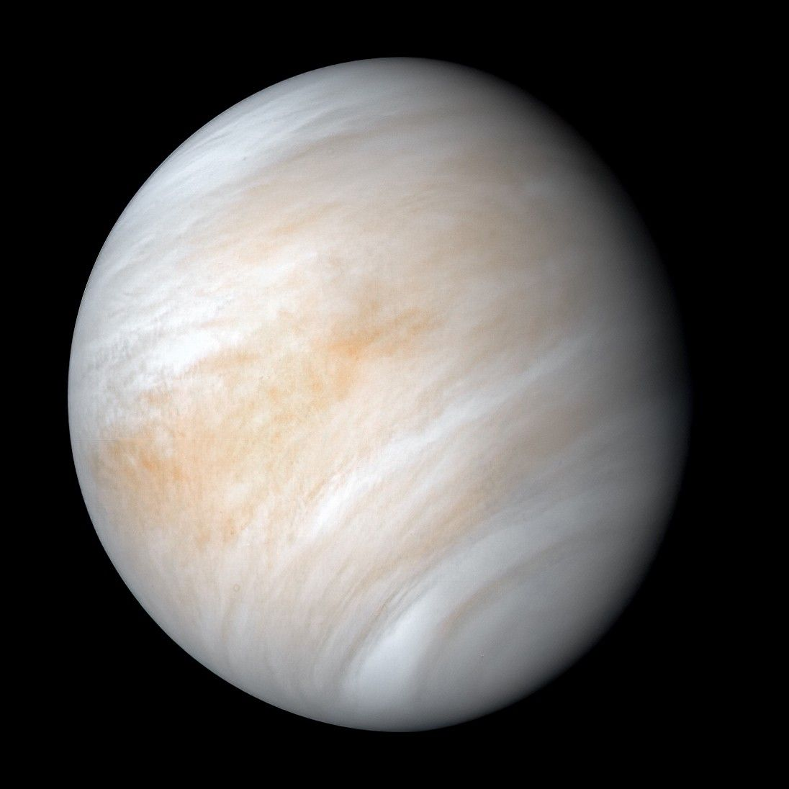
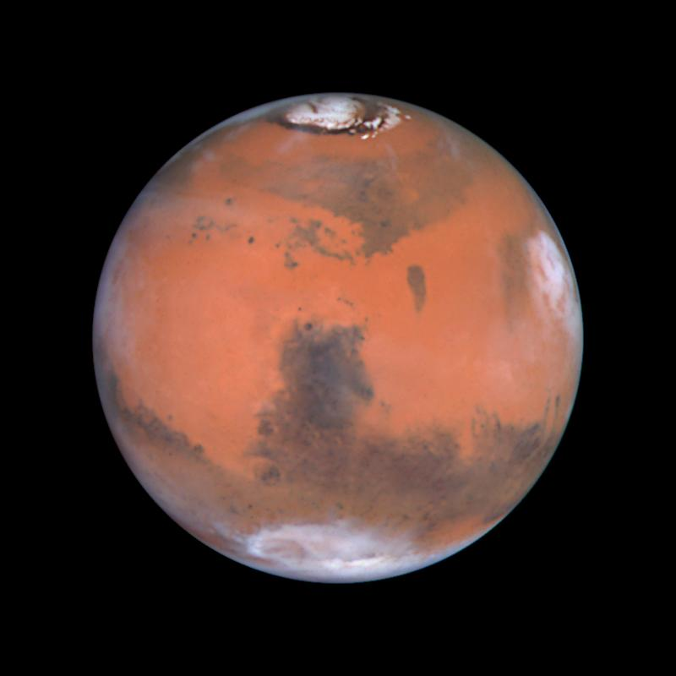
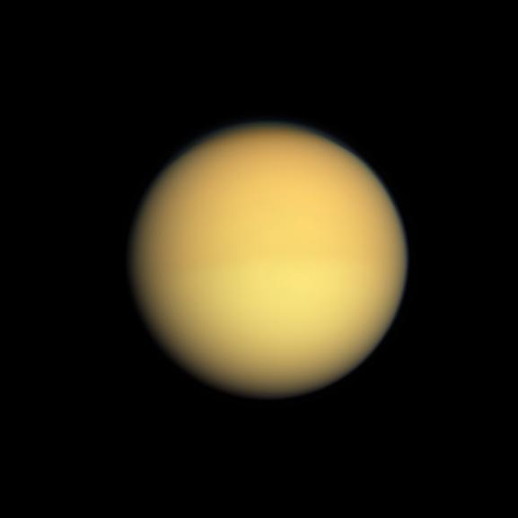
Weather: Terrestrials
VENUS
surface (0 km) winds ~non-existent in isothermal lower atm
tropospheric winds (60 km) same direction as planet rotates
circle Venus in 4 days … ~200 mi/hr
superrotating winds … rotates once every 240 days
MARS
condensation flows of CO₂ from one pole to another
strong thermal tide (day/night) winds … dune production
~100 mi/hr winds … dust devils
build to runaway dust storms
extreme topography leads to eddies
TITAN
constantly hazy
CH₄ clouds and rain
enough wind to create dunes
Notes:
dunes on Venus, Earth, Mars, Titan

Slide 13
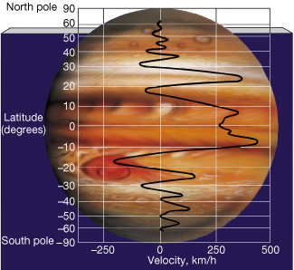
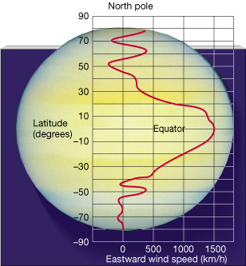
Weather: Jovians
JUPITER
multiple jet streams, at equator … 220 mi/hr
~ symmetric around equator … convective cells ~ Hadley from the inside
zones = white ~ cold (high opacity) = high altitude NH₃ ice
belts = dark ~ warm (low opacity) = low altitude
GRS at 380 mi/hr
SATURN
multiple jet streams, at equator 900 mi/hr
~ symmetric around equator … convective cells ~ Hadley from the inside
N pole hexagonal vortex … S pole hurricane with eyewall
URANUS
three jet streams, up to 560 mi/hr
NEPTUNE
three jet streams, up to 1500 mi/hr
we see thin upper layers (<1% R) of atmospheres …
Notes:
windy layers of Uranus and Neptune occupy the outermost 0.15 and 0.2 percent of their masses, respectively, suggesting that shallow processes drive those winds, such as swirling caused by moisture condensing and evaporating in the atmosphere

Slide 14
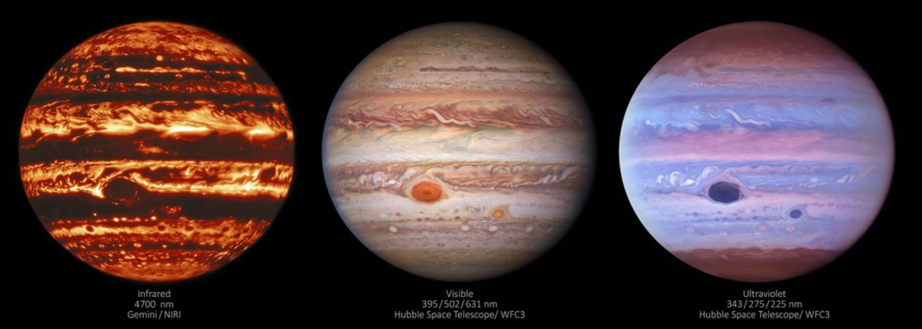
Weather: Jupiter’s Great Red Spot
What do we know?
long-lived … Schwabe in 1831 (Galileo 1610? Cassini 1665?)
large, but shrinking … 30,000 miles in late 1800s → 10,000 miles today
rotates clockwise in ~5 Earth days
highest place on planet … upwelling, rotating hurricane … cold at 115K
at least 500 km deep (Juno) … but not as deep as 3000 km streams
Why is it RED?
1. upwelling material
2. organic chemistry compounds … NH₃ + C₂H₂ blasted by UV … “sunburned”
3. sulfur / phosphorous compounds … tholins to make it really red
SSE!
Notes:
Cassini spacecraft found inconsistent belt/zone temperatures
https://science.nasa.gov/science-news/science-at-nasa/2014/28nov_sunburn/
C2H2 = acetlyene

Slide 15
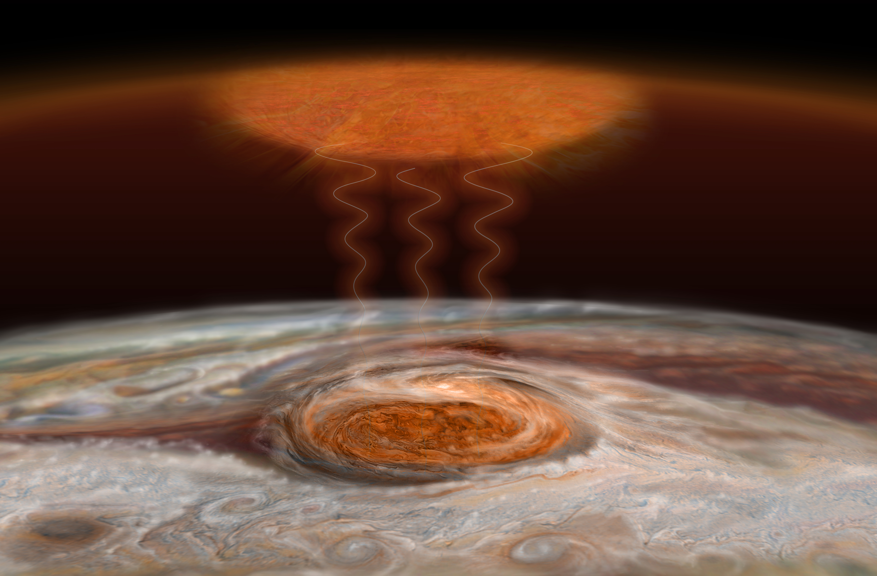
Great Red Spot: Cold + Hot
1600 K
new theory:
gravity and acoustic waves “crashing” in upper atm
O’Donoghue et al. 2016
115 K
125 K
Notes:
The storm in the Great Red Spot produces two kinds of turbulent energy waves that collide and heat the upper atmosphere. Gravity waves are much like how a guitar string moves when plucked, while acoustic waves are compressions of the air (sound waves). Heating in the upper atmosphere 500 miles (800 kilometers) above the Great Red Spot is thought to be caused by a combination of these two wave types “crashing,” like ocean waves on a beach.

Slide 16
Photochemistry: General
photodissociation and photoionization lead to chemical reactions in upper atm
outer electron shells blasted by photons with λ < 1000 Å
inner electron shells blasted by photons with λ < 100 Å
rates determined by J(z) = ∫ σ F e ^{-τν(z)/cosθ} dν
where σ is the photon absorption cross section at frequency ν
F is the solar flux density in photons cm⁻¹ s ⁻¹ Hz ^{–1} outside atm
generally
# surviving photons decreases from upper atm,
# molecules decreases from lower atm,
so, product concentration highest somewhere in the middle

Slide 17
Photochemistry: Earth
EARTH: oxygen chemistry
atomic oxygen production O₂ + ph → O + O λ < 1750 Å
ozone production
O₂ + O + X → O₃ + X 3-body reaction dominates
ozone destruction
O₃ + ph → O₂ + O λ < 3100 Å
O₃ + O → O₂ + O₂
O₃ + H → OH + O₂ not terribly important
O₃ + NO → NO₂ + O₂ NO₂ back to NO quickly … chain reaction
O₃ + Cl → ClO + O₂ ClO back to Cl quickly … chain reaction
The last one is the bad one…
At 30 km, where maximium O₃ is found, T ~ 260K …
Cl destruction rate is 1000 times NO destruction rate
SSE! Why less N₂ chemistry?
Notes:
N2 has strong triple bond
O2 has weaker double bond

Slide 18
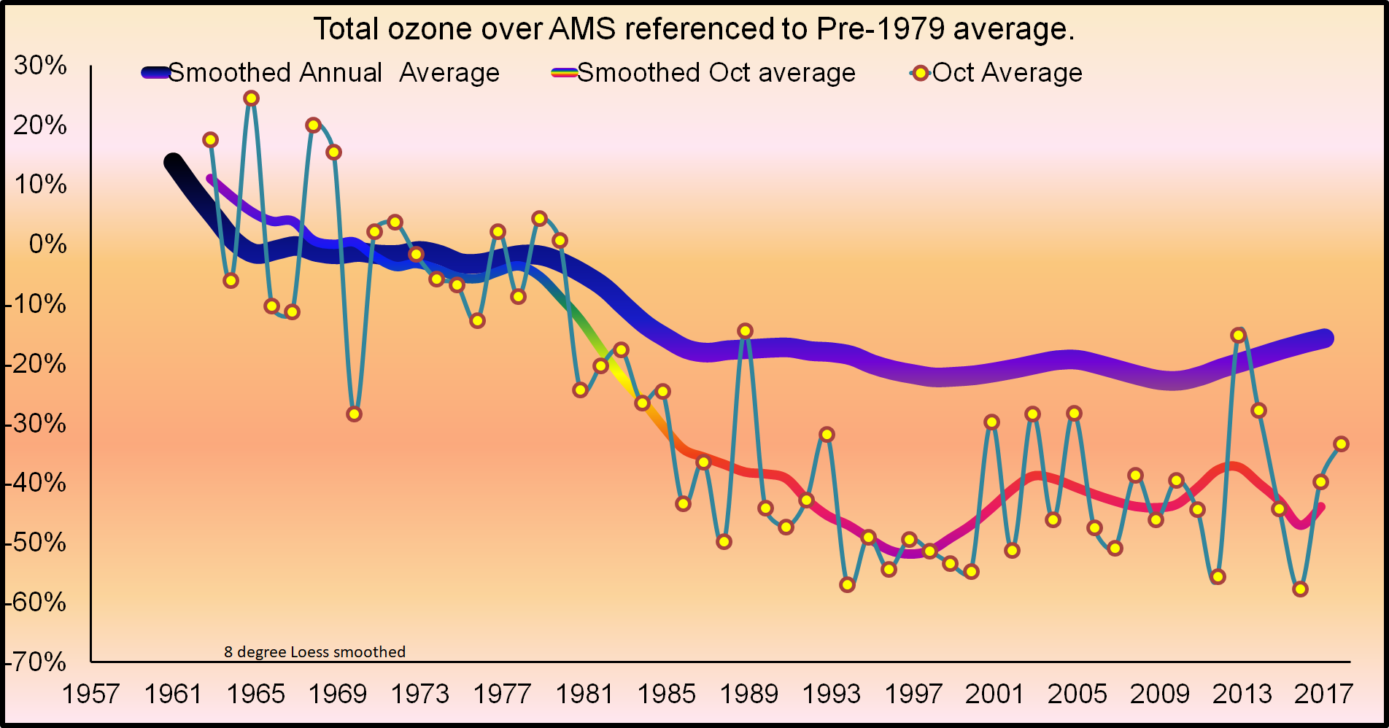
Ozone Stabilization
Amundsen Scott South Pole Station
Montreal
Protocol
https://www.esrl.noaa.gov/gmd/dv/spo_oz/ozdob.html
Notes:
Changes in Total Column Dobson Ozone measurements made at the Amundsen Scott South Pole Station (AMS) during 15-31 October. The y-axis shows ozone change (percent) from the pre-ozone hole reference level of 300 DU (averaged over 1962-1978). The dots are column ozone averages for the 15-31 October period measured from 1962 to 2017. The thin line is the Loess-smoother fit to the data. The record-long average thickness of the ozone layer over the South Pole is 260 DU (245 DU after 1979). If the ozone layer was compressed to a layer of pure ozone at the sea level, the thickness would be 2.6 (2.45) millimeters thick -- about 2 and half stacked dimes. If the entire atmosphere were to be also compressed, it would be about 8 kilometers (5 miles) thick.

Slide 19
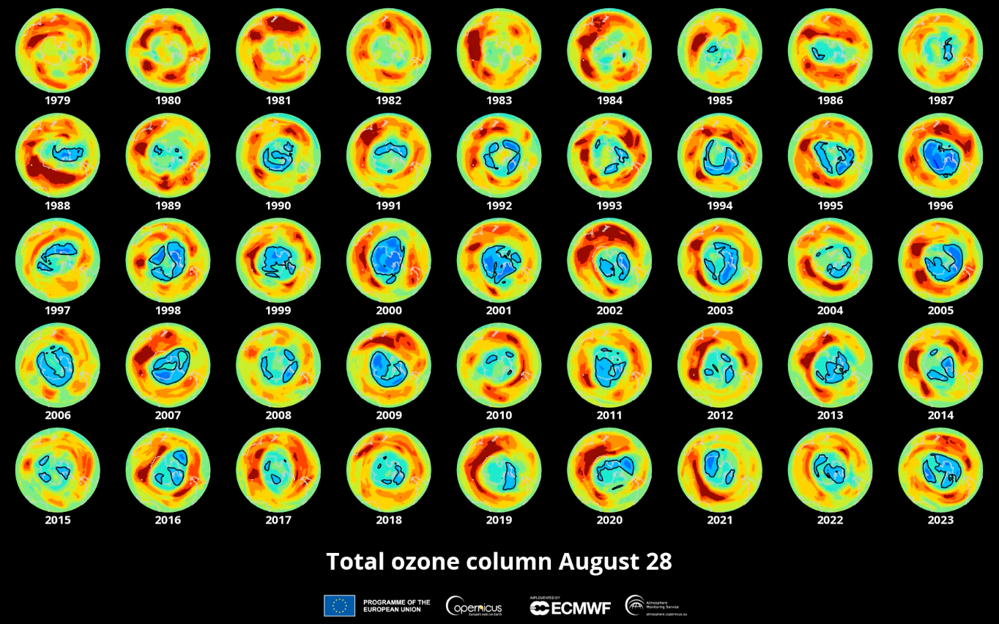
Ozone Depletion over 44 Years
https://atmosphere.copernicus.eu/cams-data-show-one-largest-antarctic-ozone-holes-record-august
Notes:
measured in Dobson units

Slide 20
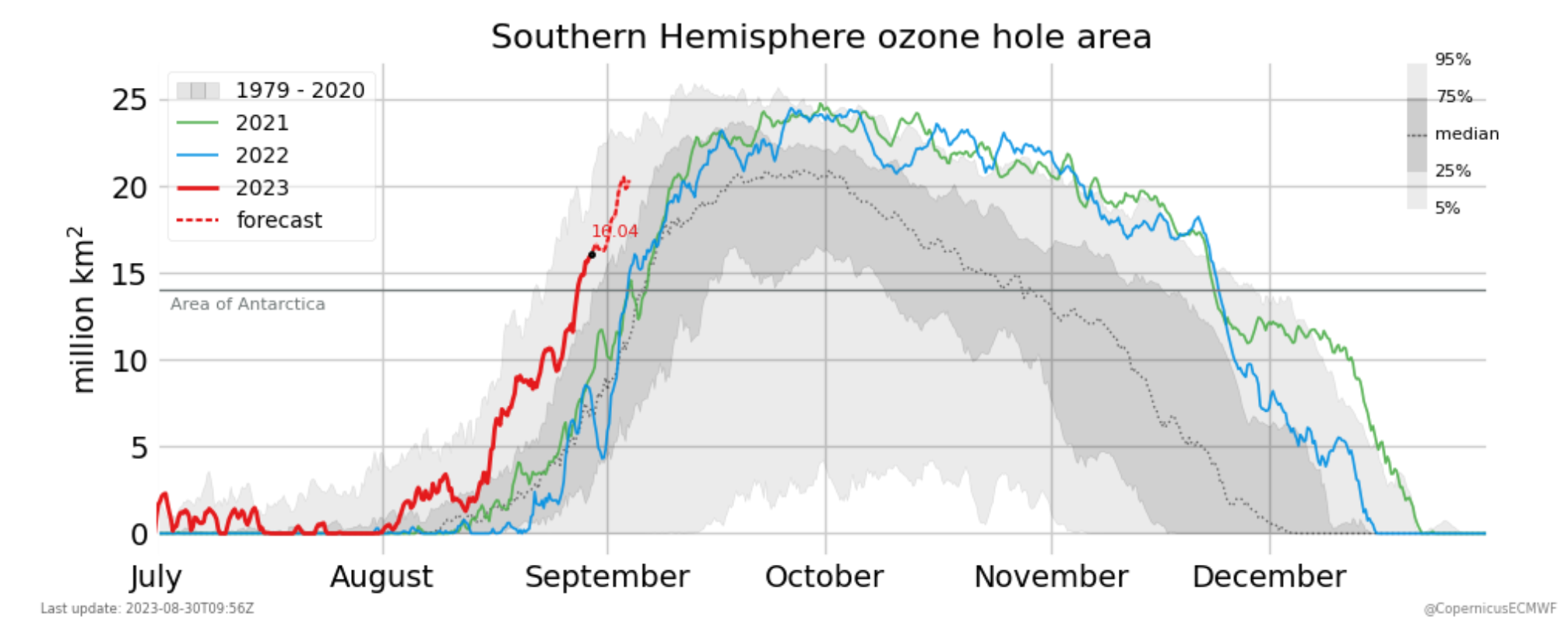
Ozone Depletion over 44 Years
https://atmosphere.copernicus.eu/cams-data-show-one-largest-antarctic-ozone-holes-record-august
Notes:
measured in Dobson units

Slide 21
Photochemistry: Terrestrials
VENUS and MARS: carbon dioxide chemistry
carbon dioxide destruction
CO₂ + ph → CO + O λ < 1690 Å
VENUS: sulfuric acid chemistry
sulfuric acid production
SO₂ + O → SO₃ O from reaction above
SO₃ + H₂O → H₂SO₄ sulfuric acid
TITAN: nitrogen and methane chemistry

Slide 22
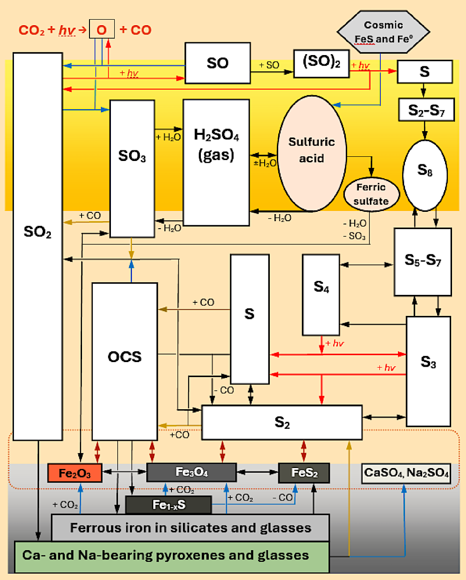
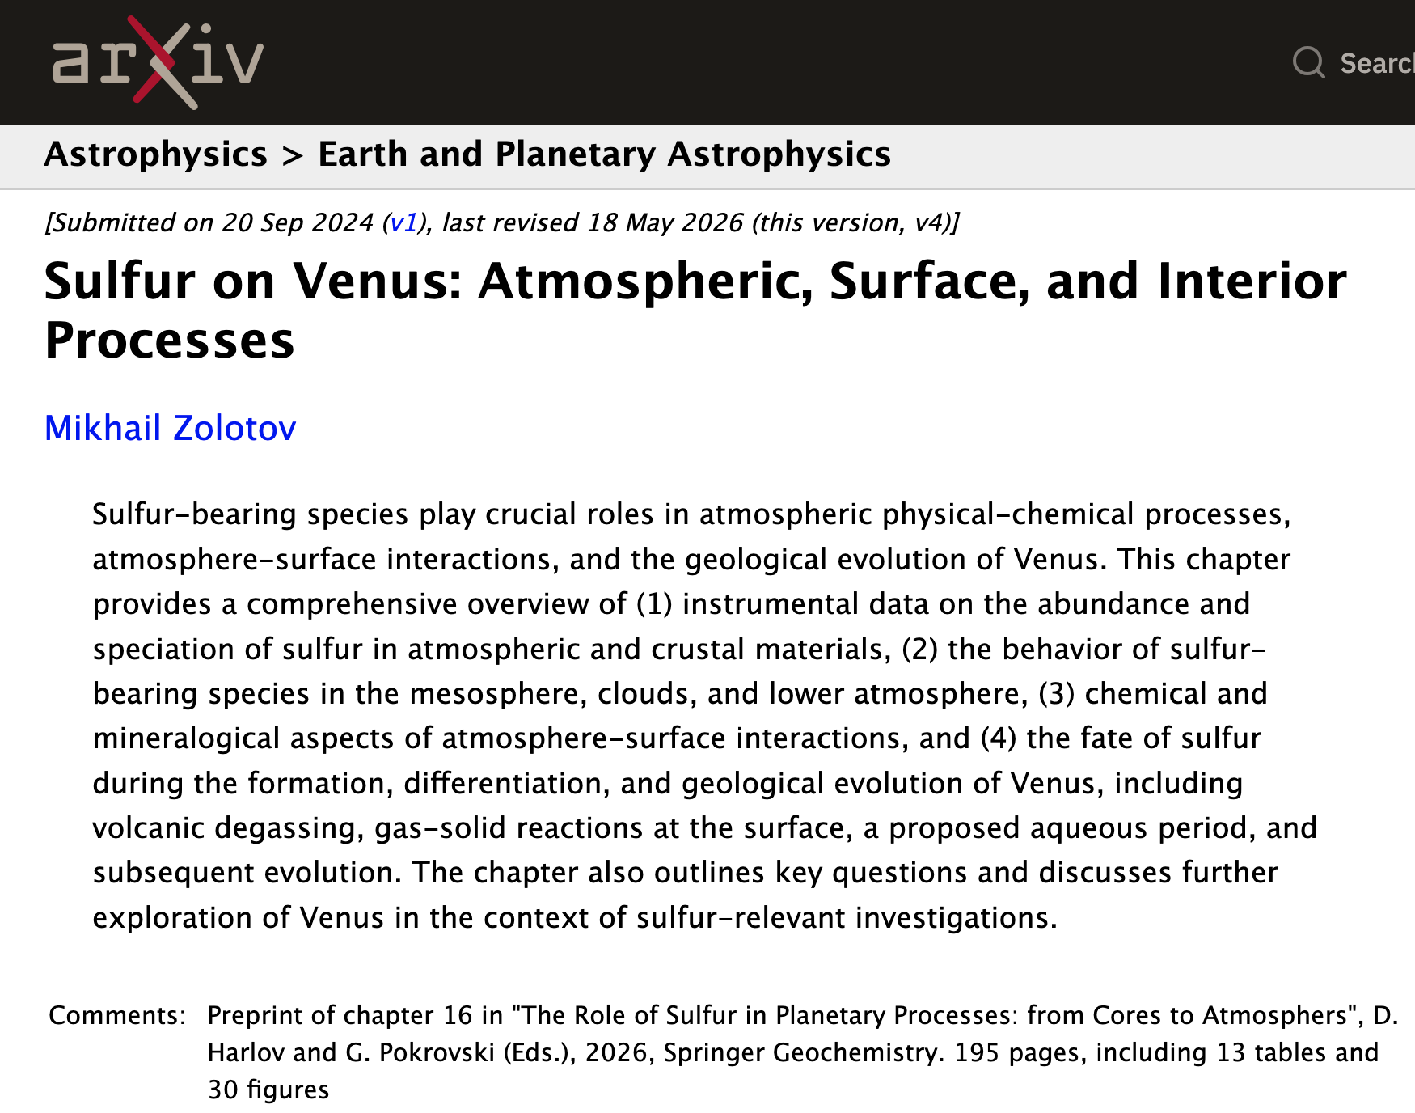
Photochemistry: Terrestrials
Notes:
Looks like a PhD thesis.

Slide 23
Photochemistry: Terrestrials
VENUS and MARS: carbon dioxide chemistry
carbon dioxide destruction
CO₂ + ph → CO + O λ < 1690 Å
VENUS: sulfuric acid chemistry
sulfuric acid production
SO₂ + O → SO₃ O from reaction above
SO₃ + H₂O → H₂SO₄ sulfuric acid
TITAN: nitrogen and methane chemistry
N₂ battered by charged particles … not solar UV
CH₄ photodissociated by solar UV λ < 1600 Å
thick smog layer of ….
hydrocarbons: C₂H₂ acetylene | C₂H₄ ethylene | C₂H₆ ethane | C₃H₈ propane +
nitriles: HCN hydrogen cyanide | C₂N₂ cyanogen | HC₃N cyano acetylene +
tholins: … and little orange beings?
SSE! What? … 3 categories

Slide 24
Photochemistry: Jovians
relevant molecular species are
C = 6 CH₄ Uranus and Neptune, primarily
N = 7 NH₃ Jupiter and Saturn, primarily
O = 8 H₂O
P = 15 PH₃
S = 16 H₂S
methane chemistry
CH₄ + ph → C₂H₂, C₂H₄, C₂H₆ … λ < 1600 Å
ammonia chemistry
NH₃ + ph → NH₂ λ < 2300 Å
NH₂ + NH₂ → N₂H₄ hydrazine haze
other reactions → N₂, HCN
phosphine chemistry
PH₃ + ph → … P₄ (red … GRS?) 1600 Å < λ < 2300 Å
hydrogen sulfide chemistry
H₂S + ph → … S₈, NH₄xSy, HxSy λ < 3170 Å
sulfur (yellow), ammonium polysulfide (orange), hydrogen polysulfide (brown)
SSE! What is element #14?
Notes:
hydrazine is rocket fuel

Slide 25
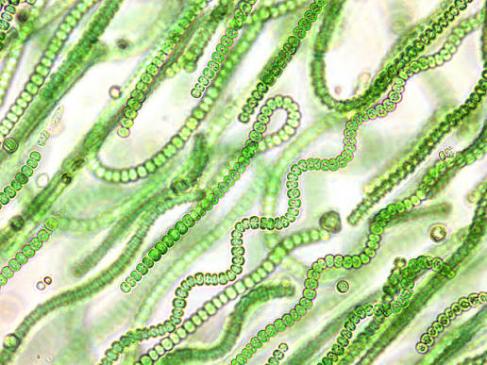
Atmospheric Origin & Evolution
if the terrestrial atmospheres were primordial and all H and He lost, fractions =
63% CO₂
22% Ne
10% N₂
4% COS
trace Ar, Kr, Xe
but, all noble gases on Earth are down by 10⁶⁻¹⁰, so atm is not primordial!
secondary atm(s) generated by volcanic outgassing
asteroid/comet accretion
atm/crust interactions
biogenic processes
long-term changes Sun has increased L by 30% since 4.6 Gyr ago
planetary albedo changes
planetary obliquity/orbital eccentricity changes
Notes:
Ne 10 … Ar 18 ... Kr 36 … Xe 54
noble gases too heavy to escape via thermal processes, and should be much more prevalent if atm from solar nebula … so, atm must be secondary
COS = carbonyl sulfide

Slide 26
Earth’s 4 Atmospheres
1 = primordial H₂ He lost
H₂O NH₃ CH₄ UV splits → H gone
…bombardment? … H₂O added
2 = volcanic H₂O NH₃ CH₄ UV splits → H gone
N₂ N₂O nitrogen supply
(O highly reactive, so it disappears, leaving N₂)
CO₂ SO₂ into rocks/oceans
… Earth cools … H₂O condenses
3 = biogenic O₂ cyanobacteria invent photosyn.
O₃ chemically generated
4 = anthropogenic CO₂ CH₄ CFCs …

Slide 27
…………………………
Notes:
27

