Slide 1
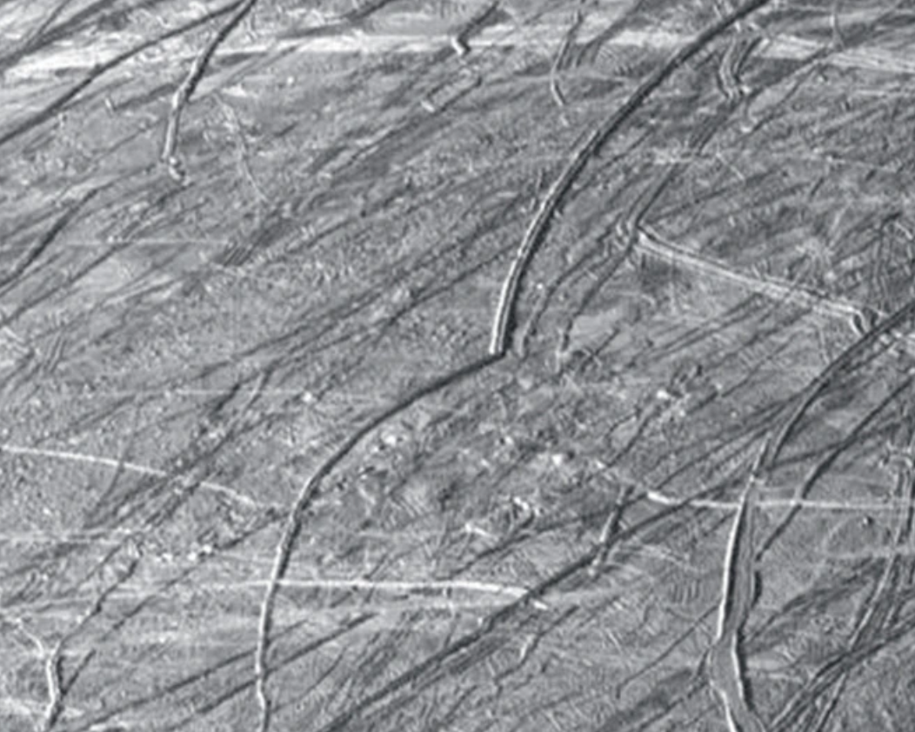
Planetary Surfaces I
Where is this?
SSE!

Slide 2
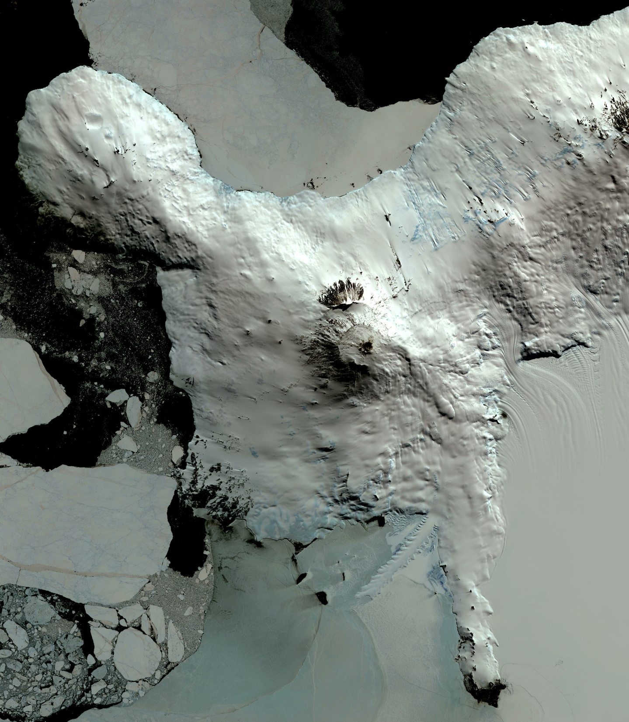
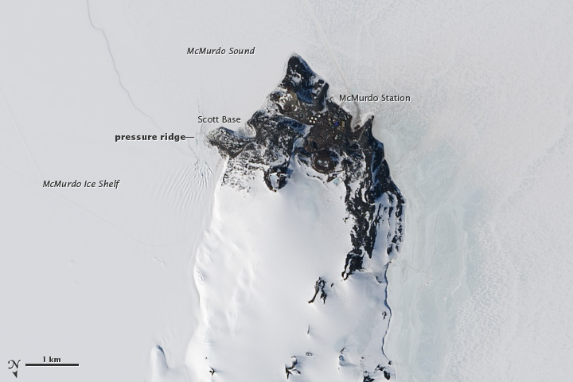
Where is this?
Mount Erebus
Mount Erebus
to
McMurdo Station
36 km
McMurdo Station
Notes:
EARTH BY TERRA: Mount Erebus, the world's southernmost historically active volcano, overlooks the McMurdo research station on Ross Island (which is roughly opposite the Antarctica Peninsula). The 3794-m-high Erebus is the largest of three major volcanoes forming the crudely triangular Ross Island. An elliptical 500 x 600 m wide, 110-m-deep crater truncates the summit and contains an active lava lake within a 250-m-wide, 100-m-deep inner crater. The glacier-covered volcano was erupting when first sighted by Captain James Ross in 1841. Continuous lava-lake activity with minor explosions, punctuated by occasional larger strombolian explosions that eject bombs onto the crater rim, has been documented since 1972, but has probably been occurring for much of the volcano's recent history. The image was acquired December 31, 2013, covers an area of 63 x 73 km, and is located at 77.5 degrees south, 167.1 degrees east.
With its 14 spectral bands from the visible to the thermal infrared wavelength region and its high spatial resolution of 15 to 90 meters (about 50 to 300 feet), ASTER images Earth to map and monitor the changing surface of our planet. ASTER is one of five Earth-observing instruments launched Dec. 18, 1999, on Terra. The instrument was built by Japan's Ministry of Economy, Trade and Industry. A joint U.S./Japan science team is responsible for validation and calibration of the instrument and data products.

Slide 3
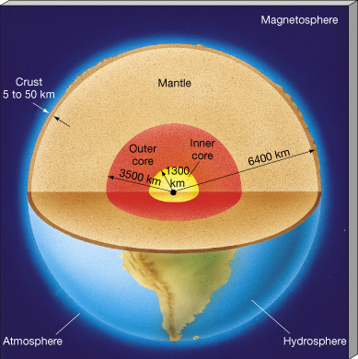
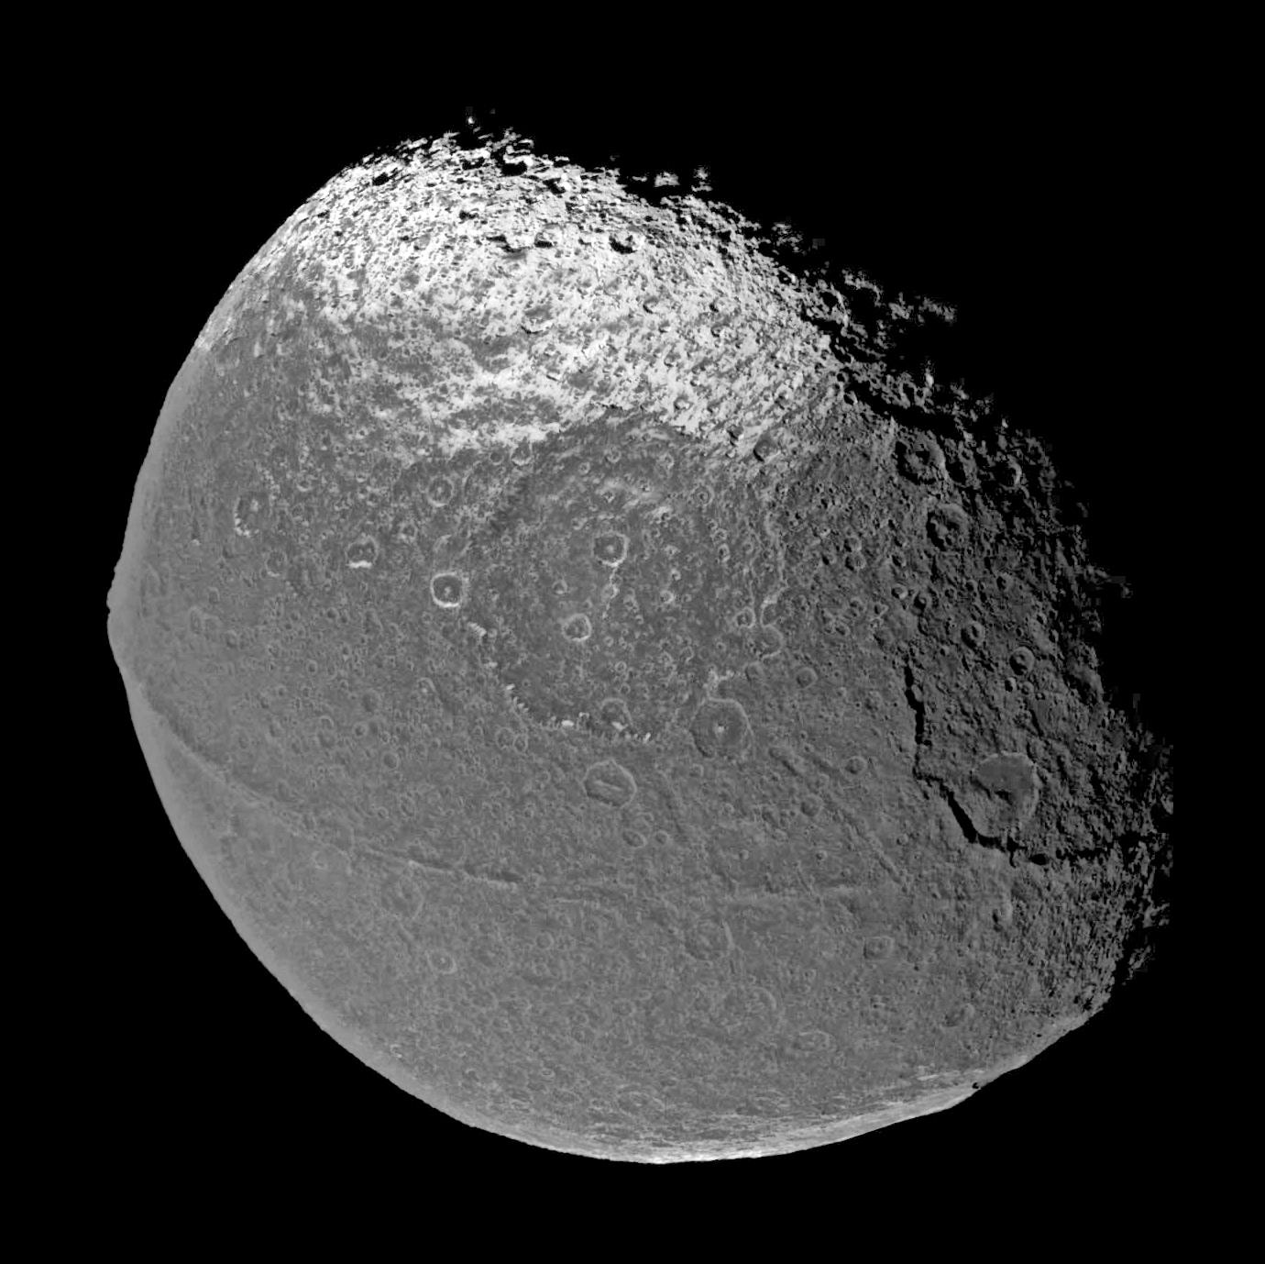
Planetary Surfaces
Why look at the surface?
1. formation history (composition)
2. past geologic activity
3. current geologic activity
Observables
1. albedo: high, low, differentiated, variable
2. terrain: faults, ridges, cliffs, cracks
3. volcanoes: tectonics, activity
4. cratering: environment
Where are we talking about? … the CRUST
Earth crust: 5 to 50 km thick
Moon crust: 60 km (Earth side) to 150 km (far side)
Mars crust: 10 to 75 km thick (Fe2O3 accounts for 18% surface mass!)
SSE! Where is this?
Notes:
Iapetus
Fe2O3 is hematite … rust is Fe2O3xH2O = hydrated hematite

Slide 4
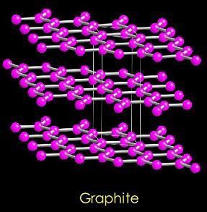
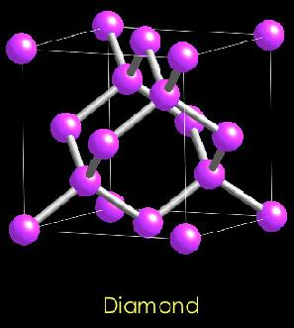
Minerals
minerals natural compounds with specific chemical composition
ORDERED + specific architecture of atoms

Slide 5
Minerals
minerals natural compounds with specific chemical composition ORDERED + specific architecture of atoms
held together by
ionic bond --- electrostatic attraction between opposite charges, Na⁺Cl¯
covalent bond --- shared electrons, diamond
Van der Waals --- occurs in minerals that have polar molecules, H2O
most common minerals on terrestrial planets … silicates = having silicon + oxygen
quartz SiO2
olivine (Fe,Mg)2SiO4
pyroxene (Fe,Mg)2Si2O6 10% of Earth rocks
feldspar (K,Na)AlSi3O8 , CaAl2Si2O8 60% of Earth rocks
next most common minerals … oxides = (usually) Fe + oxygen
magnetite Fe3O4
hematite Fe2O3
limonite HFeO2
outer Solar System … ices … four favorites …
H2O, NH3, CH4 , CO2 … mixed versions = clathrates … comets have all
Notes:
Van der Waals force = weak electrical attraction between molecules and atoms in a solid
NaCl is sodium chloride = halite = salt
% given are for SURFACE rocks (light stuff floats)

Slide 6

Rocks
rocks assemblages of different minerals
MESSY classified by composition and method of origin
four major categories …
primitive, igneous, metamorphic, sedimentary
1. primitive --- formed directly out of the solar nebula
asteroids, meteorites, comets
2. igneous --- result from melted rocks (cooled magma)
most common rock type on Earth!
underground formation = intrusive or plutonic (Stone Mountain)
slow cooling, large grains, e.g. granite (70% Si), peridotite
above ground formation = extrusive or volcanic
fast cooling, small grains, e.g. basalt (50% Si), pumice, obsidian
observable:
if small, localized, thick deposit, light … likely granite (high Si)
if large, spread out, thin deposit, dark … likely basalt (lower Si)
if very runny … Ol Doinyo Lengai (little Si … natrocarbonatite)
SSE! What are they?
Notes:
Stone Mountain is a pluton, a type of igneous intrusion. Primarily composed of quartz monzonite, the dome of Stone Mountain was formed during the formation of the Blue Ridge Mountains around 300–350 million years ago (during the Carboniferous period)
IT IS NOT "the largest exposed piece of granite in the world” … El Capitan 910 meters high … Stone Mountain 251 meters high

Slide 7
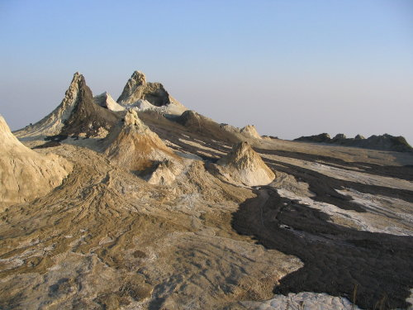
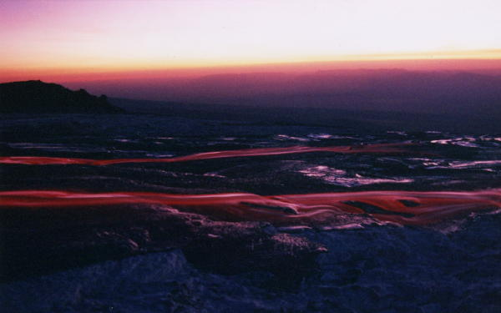
Ol Doinyo Lengai
Tanzania
fluid 800K, H₂O viscosity
natrocarbonatite lava
sodium carbonate
potassium carbonate
(basaltic lava hotter 1370K)
Notes:
Ol Doinyo Lengai in Tanzania; only volcano erupting natrocarbonatite
looks like flowing black oil/brown foam in day

Slide 8
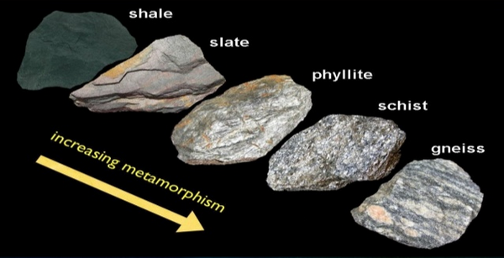
Rocks, continued
3. metamorphic --- altered by temperature and/or pressure and/or chemistry
squeezed/folded mountains, subducted rocks, igneous intrusion
marble = metamorphosed limestone (or other carbonate)
quartzite = metamorphosed quartz
gneiss = metamorphosed granite
schist = metamorphosed shale, granite
slate = metamorphosed shale
4. sedimentary --- made by movement of wind/water … deposition … coagulation
sorting typically done by size and weight during transport
conglomerates = large grains
sandstone = medium grains 20% of Earth sedimentary rocks
shale = fine grains 70% of Earth sedimentary rocks
limestone = bio (or not) 10% of Earth sedimentary rocks
non-biological: CaSiO₃ (soil) + 2CO₂ + H₂O → CaCO₃ + CO₂ + H₂O + SiO₂
biological: CaCO₃ incorporated into marine animal shells (CO₂ from atm)
Notes:
Many granite countertops are actally gneiss.
Pure limestone is made up of two component minerals: calcium carbonate and calcium-magnesium carbonate. The chemical formula for calcium carbonate is CaCO₃. The chemical formula for calcium-magnesium carbonate is CaMg(CO₃)₂.
had note “largest C reservoir on Earth” at the bottom of the slide … biological carbonate?

Slide 9
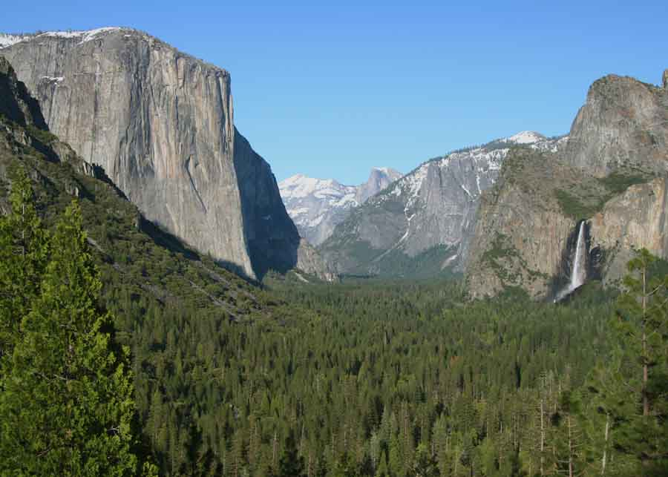
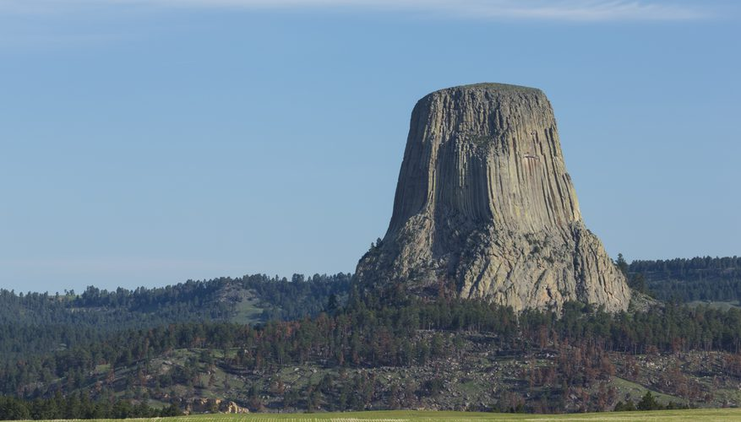
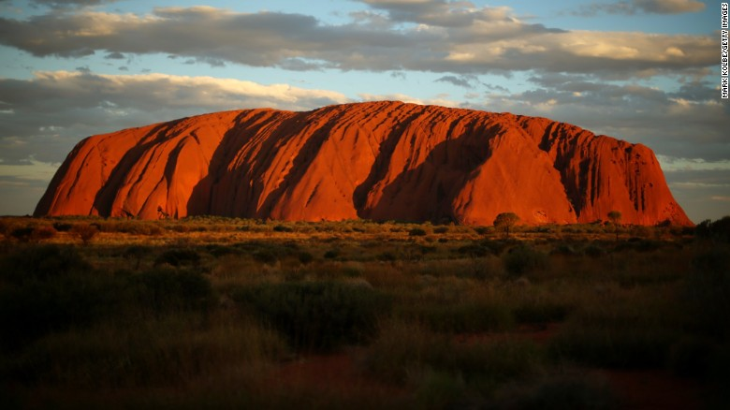
Monoliths
Yosemite
igneous plutonic granite
Devils Tower
igneous phonolite (low silica content)
Uluru
sedimentary sandstone
Notes:
Yosemite --- igneous plutonic granite
Devils Tower --- igneous phonolite porphyry (mixed grain size) with conspicuous crystals of white feldspar
Uluru --- sedimentary sandstone

Slide 10
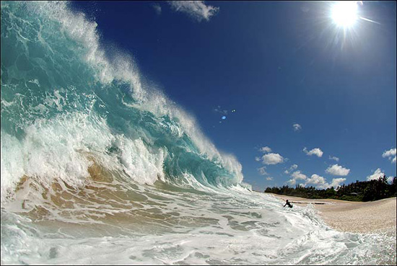
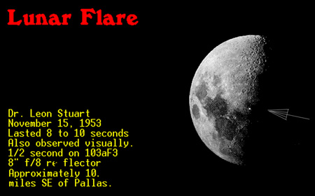
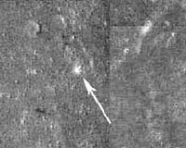
Surfaces via Morphology
Morphology --- features caused by two large categories of processes
endogenic --- caused by/at/within the body
gravity (and rotation)
tectonics
volcanism
wind
liquids
chemical reactions
exogenic --- caused by external forces
impact cratering
solar wind sputtering
cosmic ray sputtering
life
2 km crater
30X Hiroshima
Notes:
magnetic fields assist in both sputtering processes

Slide 11
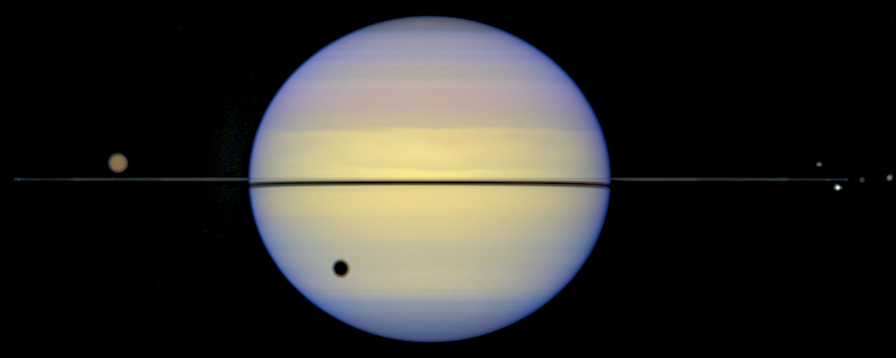
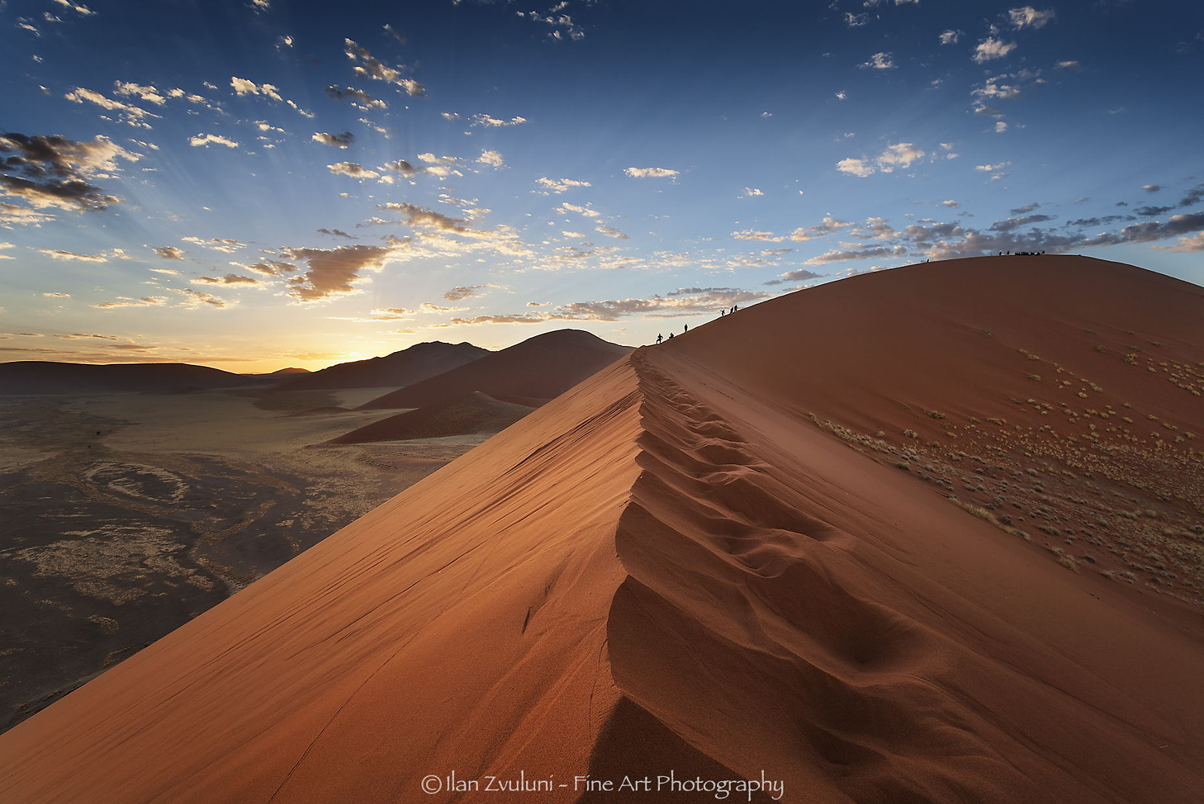
Surfaces via Gravity
gravity
lowest energy configuration for matter is spherical
large bodies have polar flattening due to rotation
small bodies can maintain non-spherical shape
downhill slides lead to rounding … angle of repose … depends on
type of material
size of grains
shape of grains
shaking/quaking
liquid content
temperature
not always predictable … landslides, avalanches, glaciers, lava flows
Notes:
angle of repose depends mainly on FRICTION … picture is Namibia

Slide 12
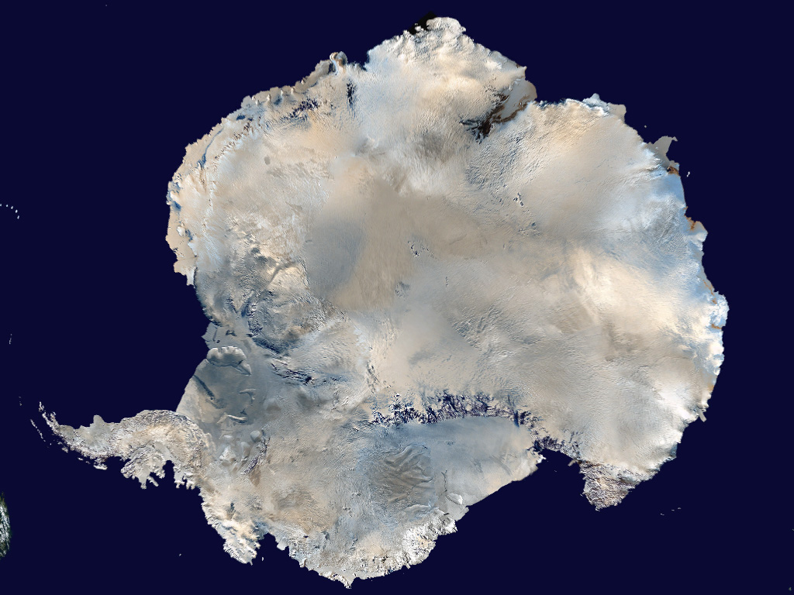
Surfaces via Tectonics
tectonics any crustal deformation caused by surface motion
shrinkage from Gyr ago … Mercury
added lava weight … mare on Moon, coronae on Venus
added ice weight … Antarctica, polar caps on Mars
orogenesis … mountain building
folding --- bent/flipped over layers
faulting --- snapping/breaking
tensional stress … vertical motion → normal faults
compressional stress … vertical motion → reverse faults
plates grinding horizontally → strike-slip faults
tectonic features … Mercury, (Venus), Earth, Moon, (Mars), Europa, Titan?
folds/faults plate boundaries
grabens long block of crust that has been dropped
horsts long block of crust that has been uplifted
scarps steep cliffs
rilles linear or curved fault line/lava tube collapses
plate tectonics now seen on Earth (maybe Mercury)
Notes:
Venus and Mars in () because tectonic movement due (only?) to pushes from below

Slide 13
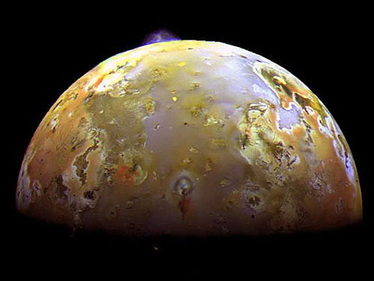
Surfaces via Volcanism
volcanism when magma breaks through the surface
magma heated to liquid by
accretion
differentiation of heavy and light material
tidal interaction
radioactivity
explosive eruptions when gases bubble out faster than oozing can occur
Earth gases: H₂O (70-90%), CO₂, SO₂
Io: SSE!
Enceladus: SSE!
Triton: N₂ geysers heated by magma that has not (yet) been seen
Pluto: H₂O, N₂, NH₃, CH₄ ?
volcanic features … Venus, Earth, Mars, Io, Enceladus, Triton, Titan?, Pluto?
lava plains lunar maria
shield volcano gentle slope, low viscosity lava Oly Mons, Mauna Loa
cinder cones sharp slope set by angle of repose, pyroclastic
composite cones some lava, some pyroclasts Vesuvius, Etna, St. Helens
craters small … pressure support fails
calderas large … collapse of entire magma chamber
SO₂
H₂O

Slide 14
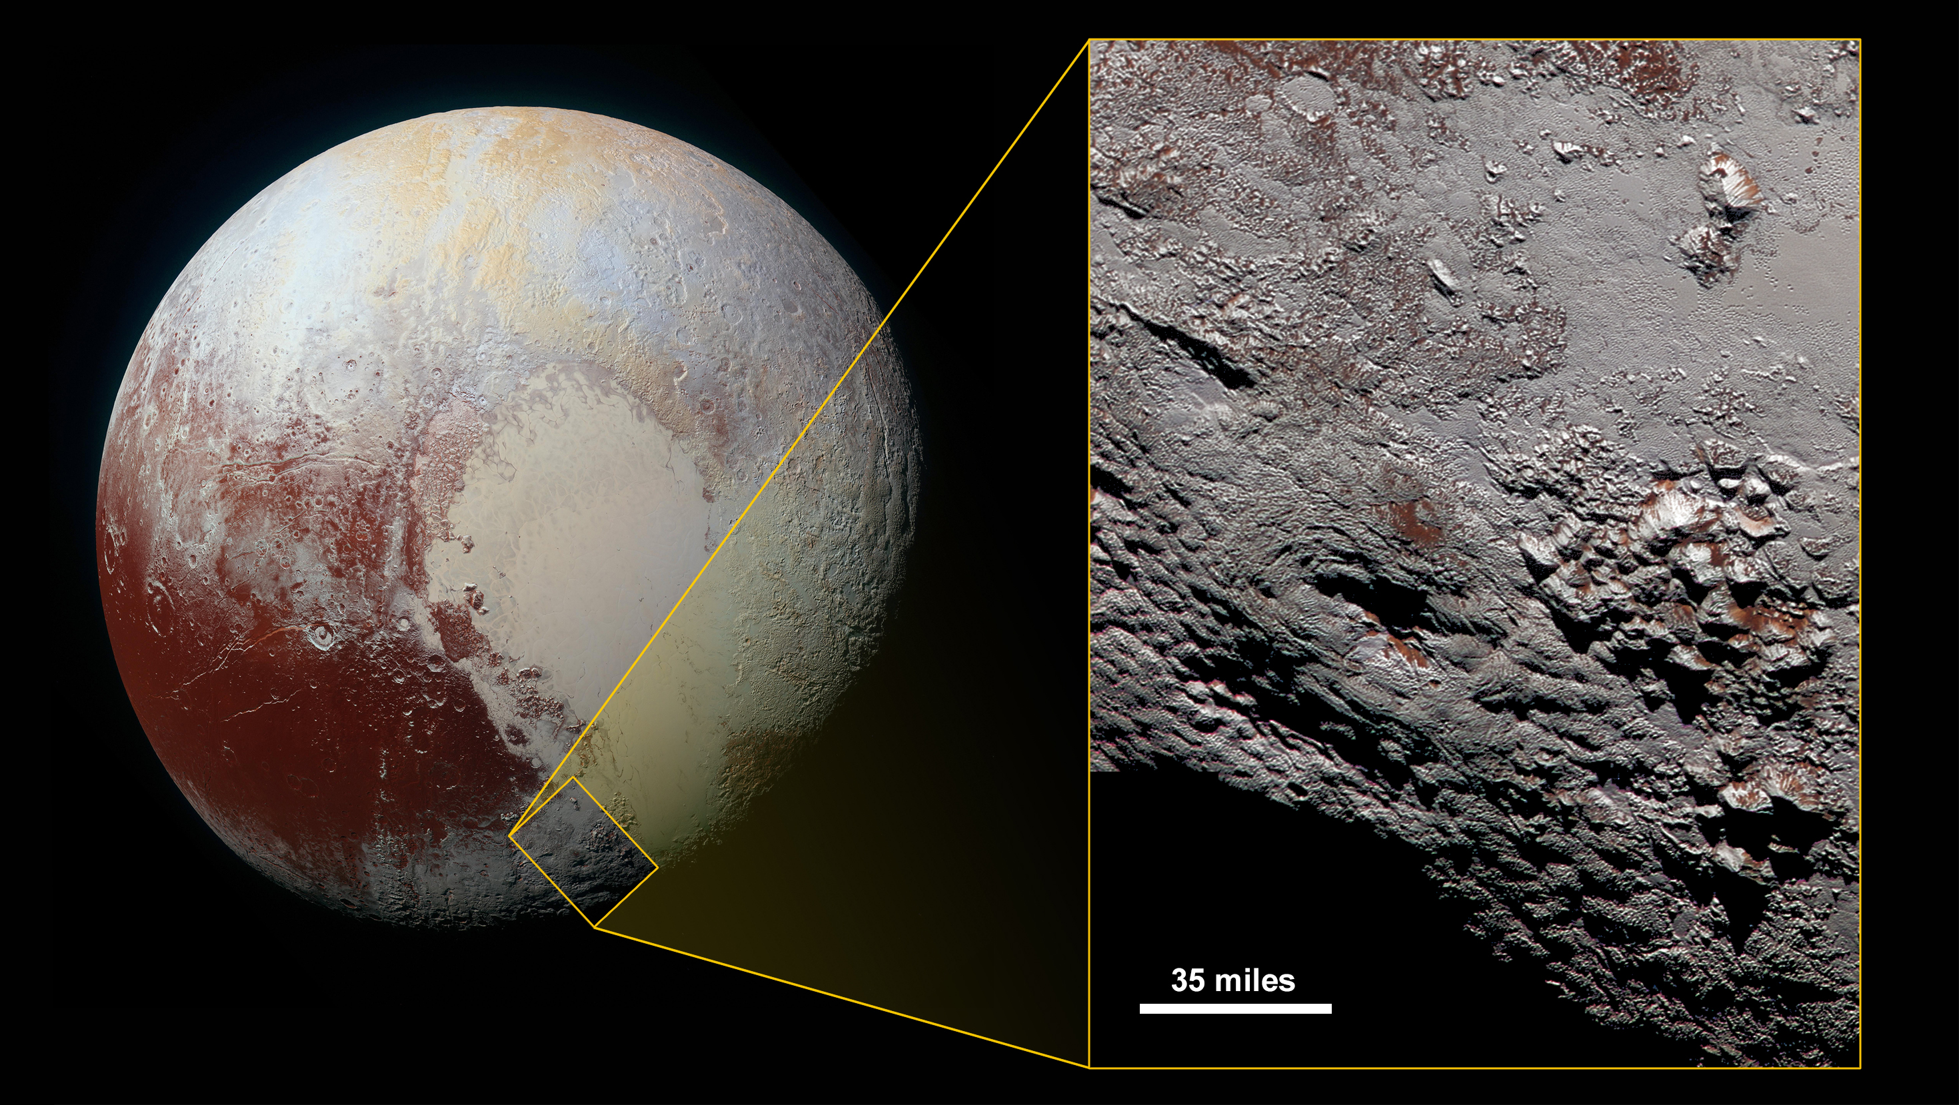
Plutonian Volcano?
Notes:
Wright Mons in Color. This composite image of a possible ice volcano on Pluto includes pictures taken by the New Horizons spacecraft’s Long Range Reconnaissance Imager (LORRI) on July 14, 2015, from a range of about 30,000 miles (48,000 kilometers), showing features as small as 1,500 feet (450 meters) across. Sprinkled across the LORRI mosaic is enhanced color data from the Ralph/Multispectral Visible Imaging Camera (MVIC), from a range of 21,000 miles (34,000 kilometers) and at a resolution of about 2,100 feet (650 meters) per pixel. The entire scene is 140 miles (230 kilometers) across.

Slide 15
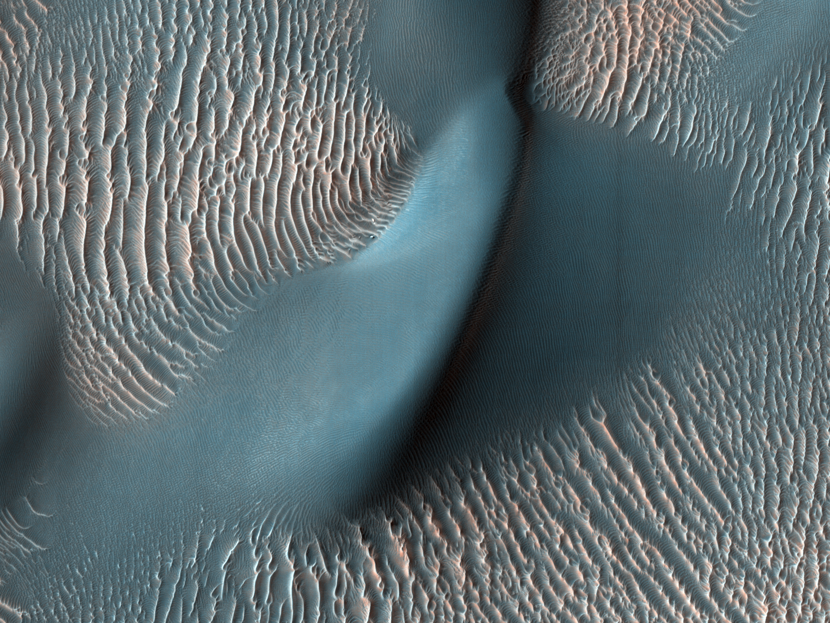
Surfaces via Wind, Liquids, Chem.
1. convection (wind) to lift and transport particles
Earth, Mars yes!
Venus, Titan probably
2. liquid drives rates
Earth: H₂O 97.5% oceans, 1.7% glaciers, 0.7% groundwater
Mars: H₂O until ~ 3 Gyr ago
Titan: CH₄/C₂H₆ Huygens probe shows fluvial features
3. transport of material by ice
Earth, Mars yes!
Europa: H₂O frozen crust affected from below rather than atmosphere
Pluto ???
4. chemical reactions with components in atmosphere
Venus SSE!
Earth H₂O weathering/hydration, CO₂ to carbonates
Mars O₂ to Fe₂O₃
Titan CH₄ weathering
H₂SO₄
Notes:
Martian dunes
H2SO4 = sulfuric acid

Slide 16
Solar System Explorers: 01 OCT
How does the Sun affect objects in the Solar System?
1. Heats up the entire Solar System.
2. Creates O3 on Earth.
3. Makes clouds in atmospheres.
4. Gravity wins and holds SS objects in orbits.
5. Solar wind strips atmospheres.
6. Heats asteroids and pushes them around.
7. Sun’s magnetosphere protects SS from cosmic rays.
8. Corpuscular drag makes small dust grains spiral inward.
9. Poynting-Robertson drag makes Saturn ring particles rain.
10. Photosynthesis rocks.
11. Sputtering makes tenuous atmospheres.
12. Aurorae caused by solar storms.
13. Sunsets and sunrises cause winds on Earth … and all over!
14. Creates chemical cycles linking surface to atmosphere … make it rain!
15. CMEs smash electronics and wimpy humans.
16. Sunburn on the Great Red Spot.
17. Tides!!!
18. Orbit expansion because Sun loses mass.
19.
20.

Slide 17
Solar System Explorers: 08 OCT?
Give any feature seen in the spectrum of a Solar System object (not the Sun) that
makes that object’s emitted spectrum NOT a blackbody. Give the atomic/molecular
species and wavelength affected, e.g., CO₂ as an absorber on Earth at 15 microns.
1.
2.
3.
4.
5.
6.
7.
8.
9.
10.
11.
12.
13.
14.
15.
16.
17.
18.
19.
20.

Slide 18
Solar System Explorers: 08 OCT?
Describe something unique about any surface found in the Solar System (e.g. Earth has liquid H₂O on its surface.)
1.
2.
3.
4.
5.
6.
7.
8.
9.
10.
11.
12.
13.
14.
15.
16.
17.
18.
19.
20.

Slide 19
…………………………
Notes:
19

