Slide 1
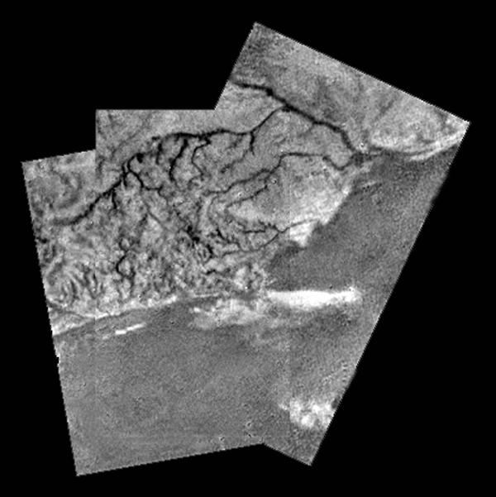
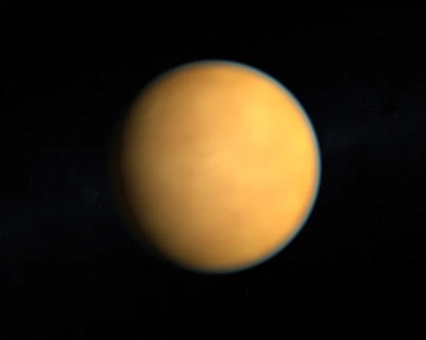
Planetary Surfaces III
Where
is
this?
Notes:
2 h 30 min in atm, then ~30 min on ground
500X brighter than full Moon on surface … about 10 min after sunset on Earth

Slide 2
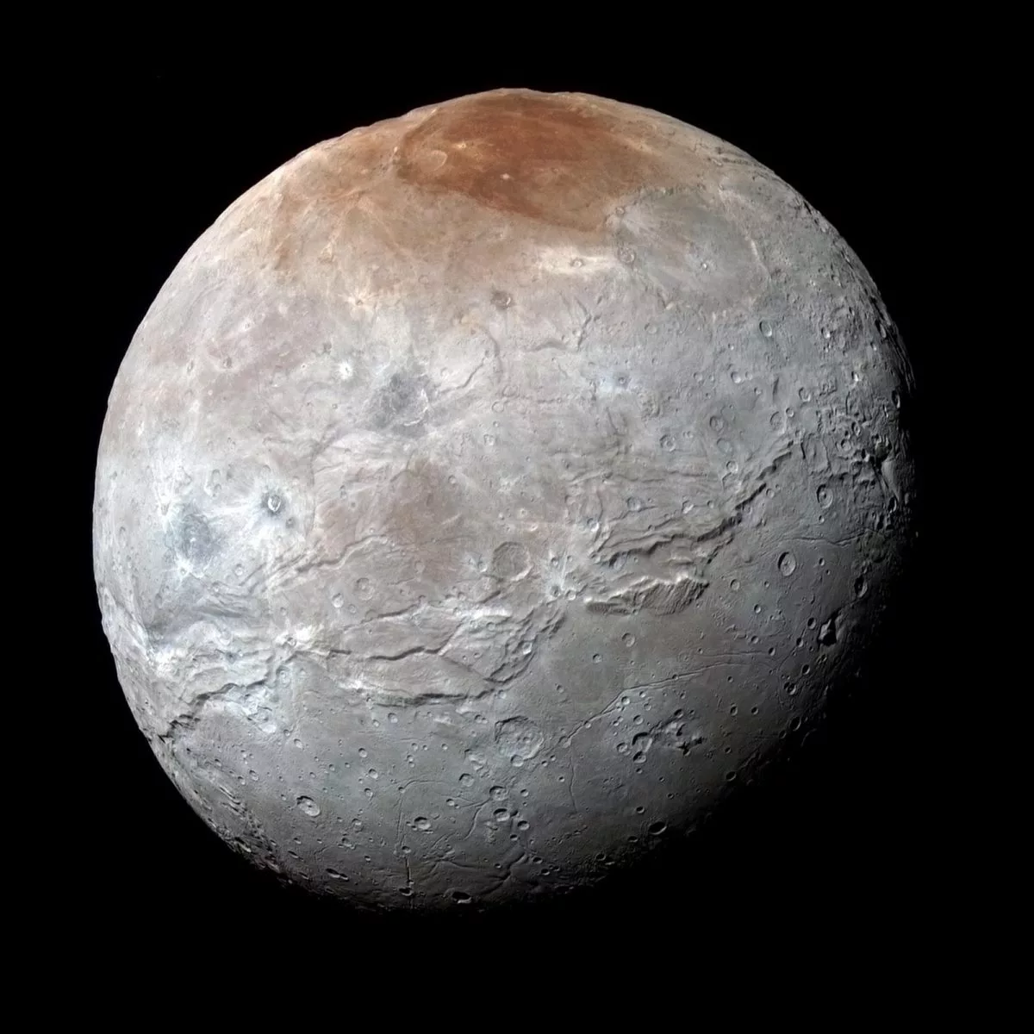
Planetary Surfaces III
Where
is
this?
Notes:
seasonal “atmospheric surges” in Charon’s very thin atmosphere, ultraviolet radiation and methane form the distinctive red marking
molecules originate from Pluto and freeze on Charon’s surface at the moon’s North Pole
methane sublimates off Charon when warmest and chemistry turns it and ethane red at the pole

Slide 3
Research Paper Level 2
due Thursday, 29 OCT
paper starting to take shape (worth 10 points)
hand in printed copy
ultimate goal is 10 pages of text + 5 pages of Figures and Tables
10 points:
1. Abstract full draft
2. Introduction 8+ sentences, major references included
3. Motivation YOU
4/5. Sections all have bullets
6/7. Discussion 8+ sentences
8. Tables 2+ formatted with columns identified
9. Figures 2+ outlined/sketched, captions given
10. References 10ish

Slide 4
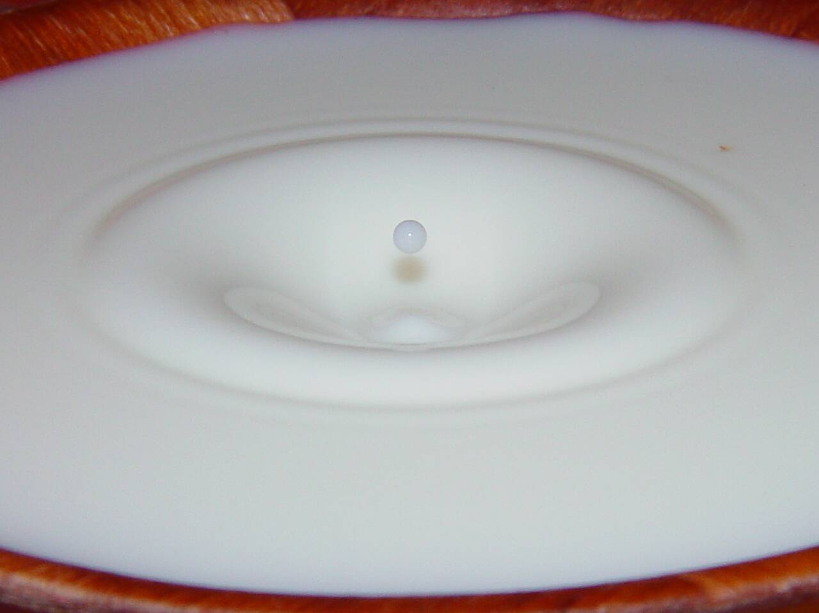
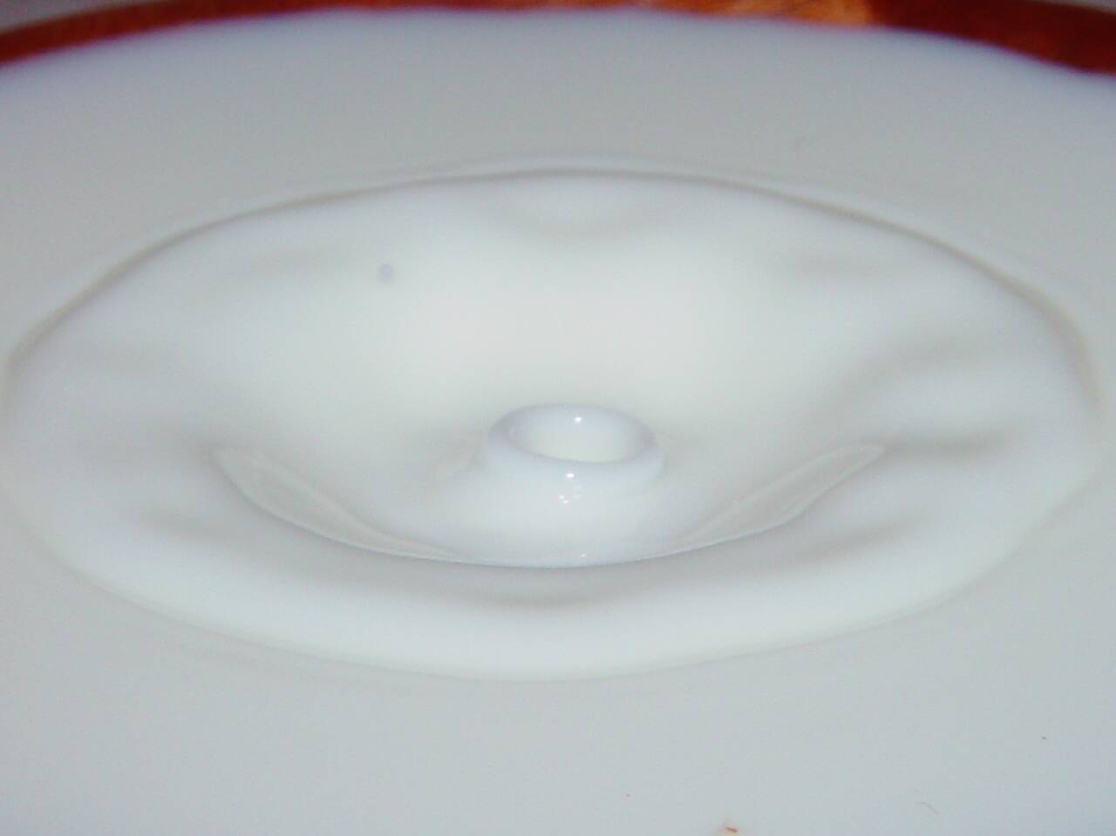
Surfaces via Cratering
cratering *SMACK*
five types
1. microcrater sub-cm micrometeorites, dust airless bodies
2. simple few km small impactors diameter:depth ~ 5:1
3. complex few 100 km large impactors central peak
4. basin 1000+ km giant impactors concentric rings
5. palimpsest mutated old craters (ice flows) / melted impact
Notes:
central peaks are formed by rock rebounding, being pushed back up by the strength of the underlying rock after the initial impact event … happens within minutes of the impact itself, even in craters 10s-km across
world’s gravity and composition determine transition sizes for different types

Slide 5
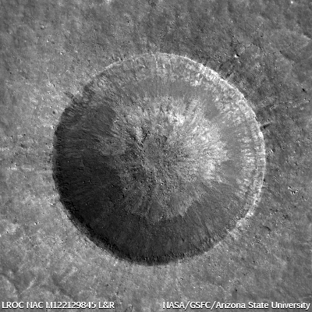
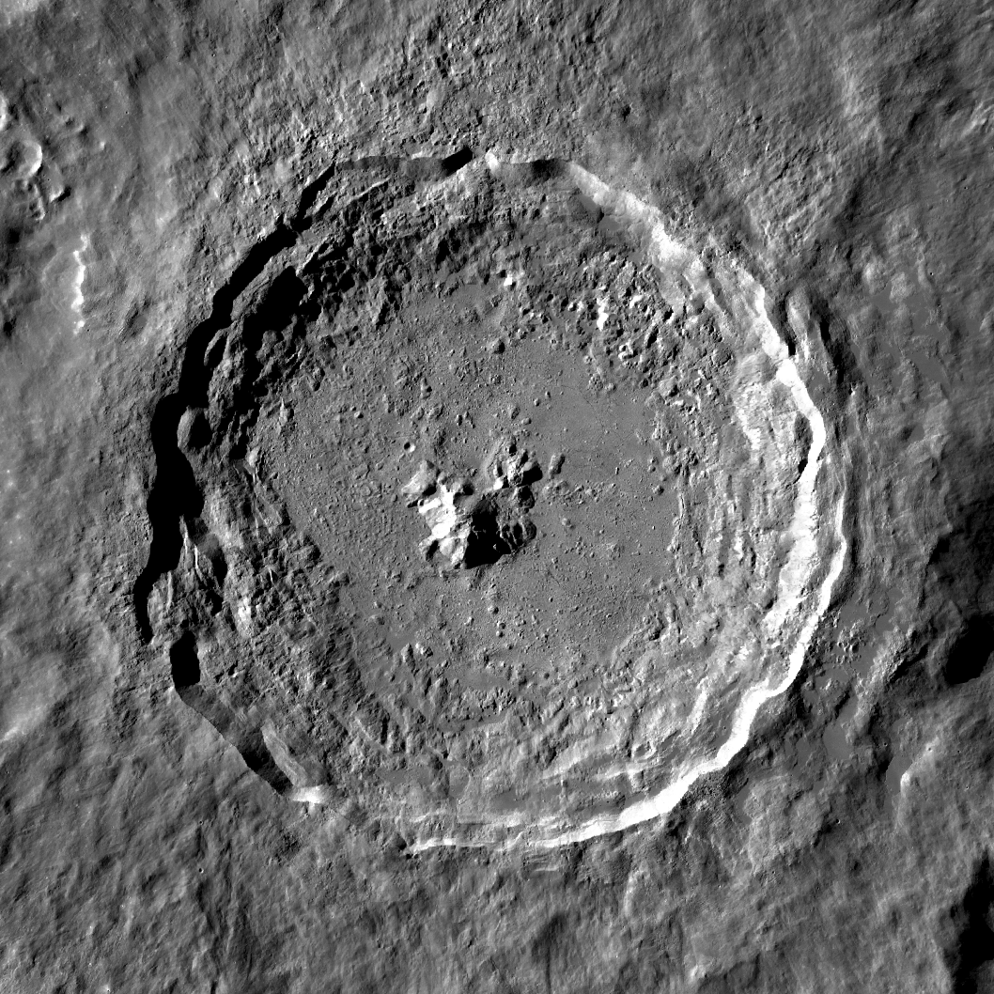
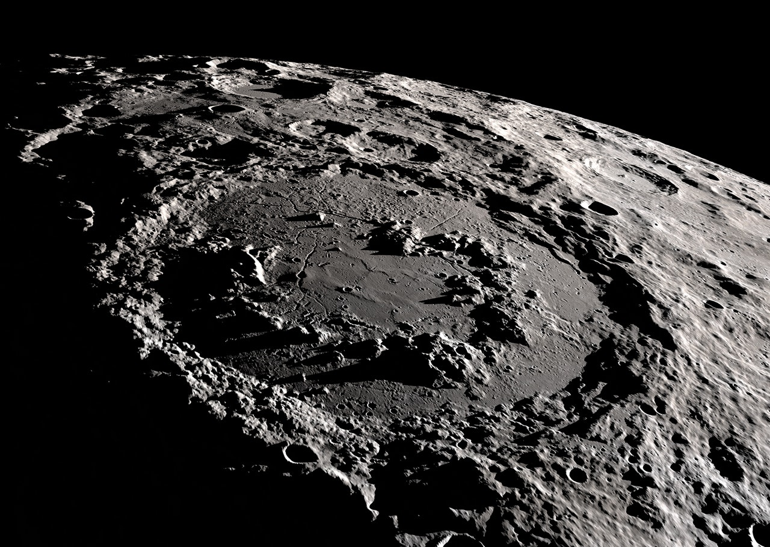
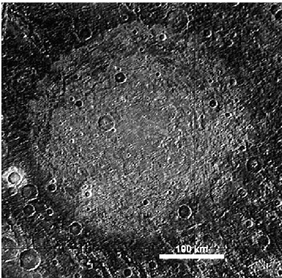
Surfaces via Cratering
simple = Linne
Moon
complex = Tycho
Moon
basin = Schrodinger
Moon
palimpsest = Memphis
Facula on Ganymede
Notes:
palimpsest = a manuscript or piece of writing material on which the original writing has been effaced to make room for later writing but of which traces remain … something reused or altered but still bearing visible traces of its earlier form.

Slide 6
Cratering Features
1. primary crater initial impact hole
2. ejecta blanket debris field to ~ 1 crater diameter beyond rim
rocky or sploshy
3. secondary craters rocks ejected from primary impact site
4. rays linear, formed by powdered/resolidified magma
5. breccia high T/P minerals found lining the crater walls
6. regolith produced by micrometeorites
7. focused features “weird terrain” on Mercury (not on icy worlds)

Slide 7
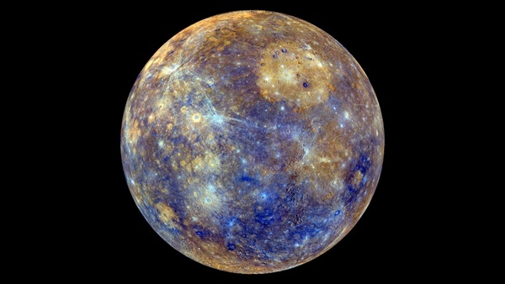
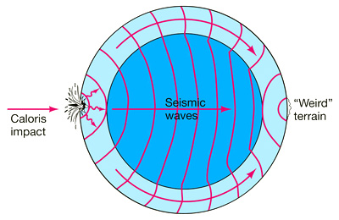
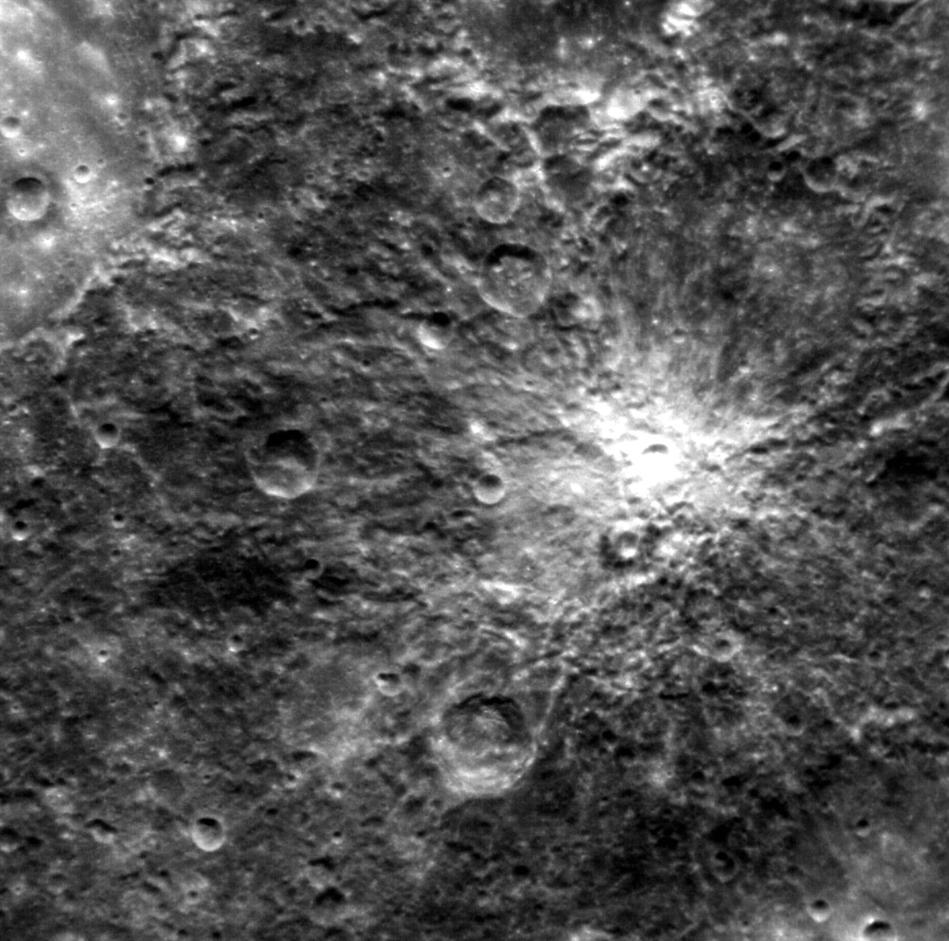
Mercury
Caloris
Basin
Notes:
weird terrain on Mercury … rugged terrain that is hilly and lineated

Slide 8
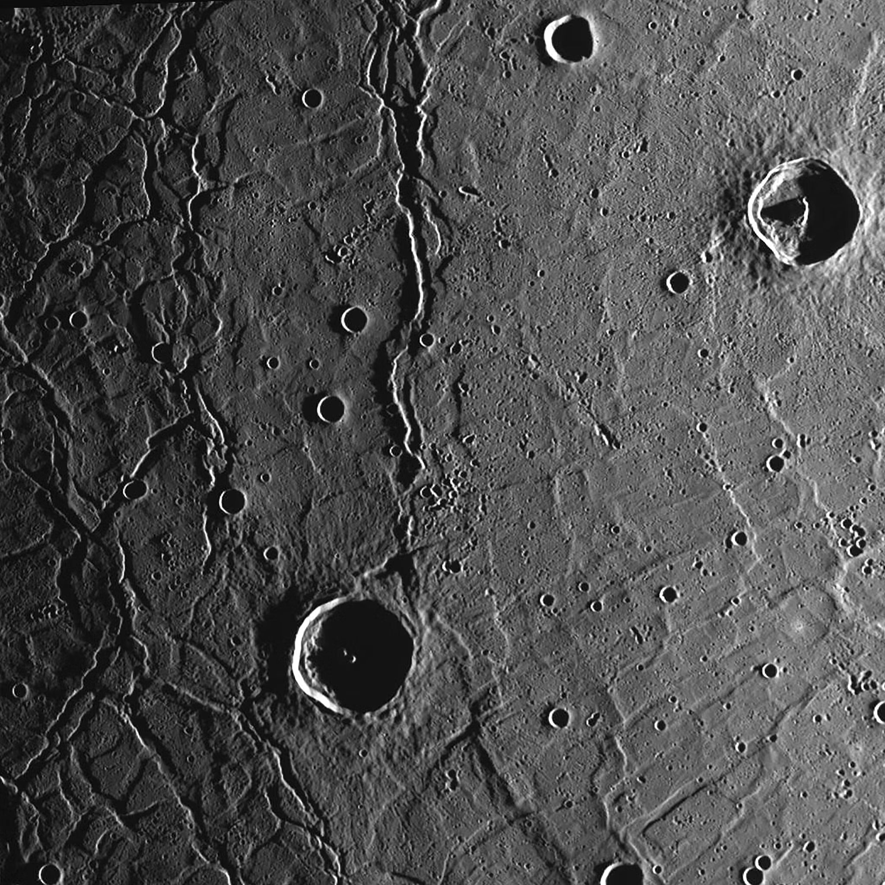
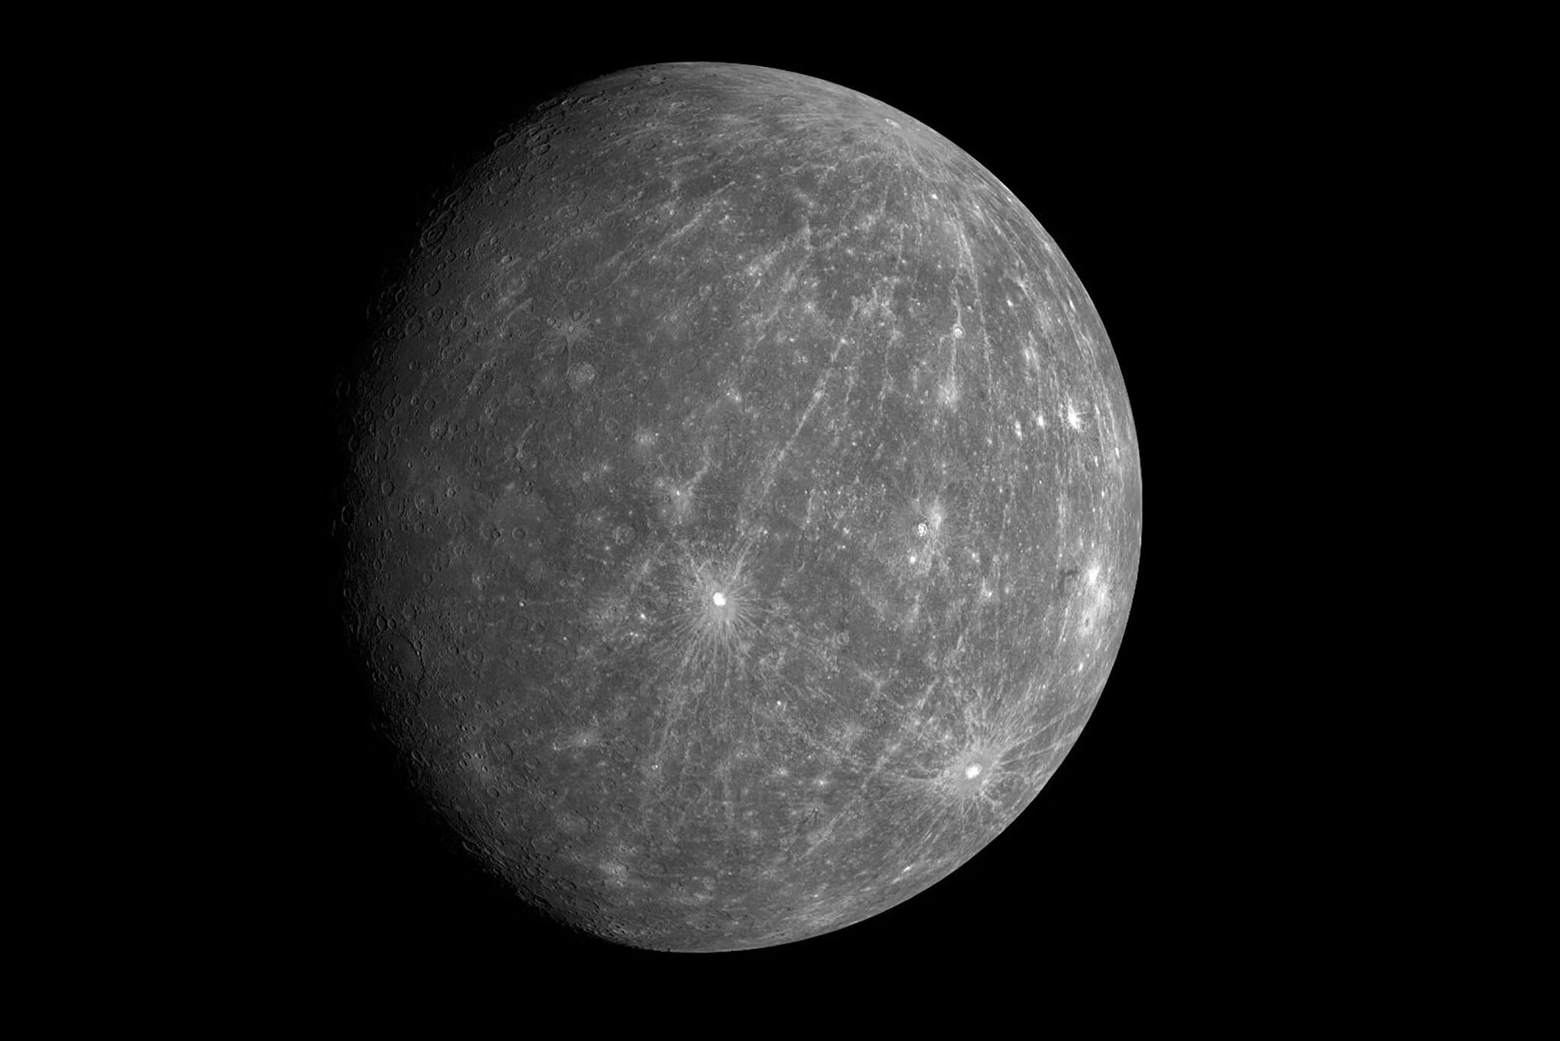
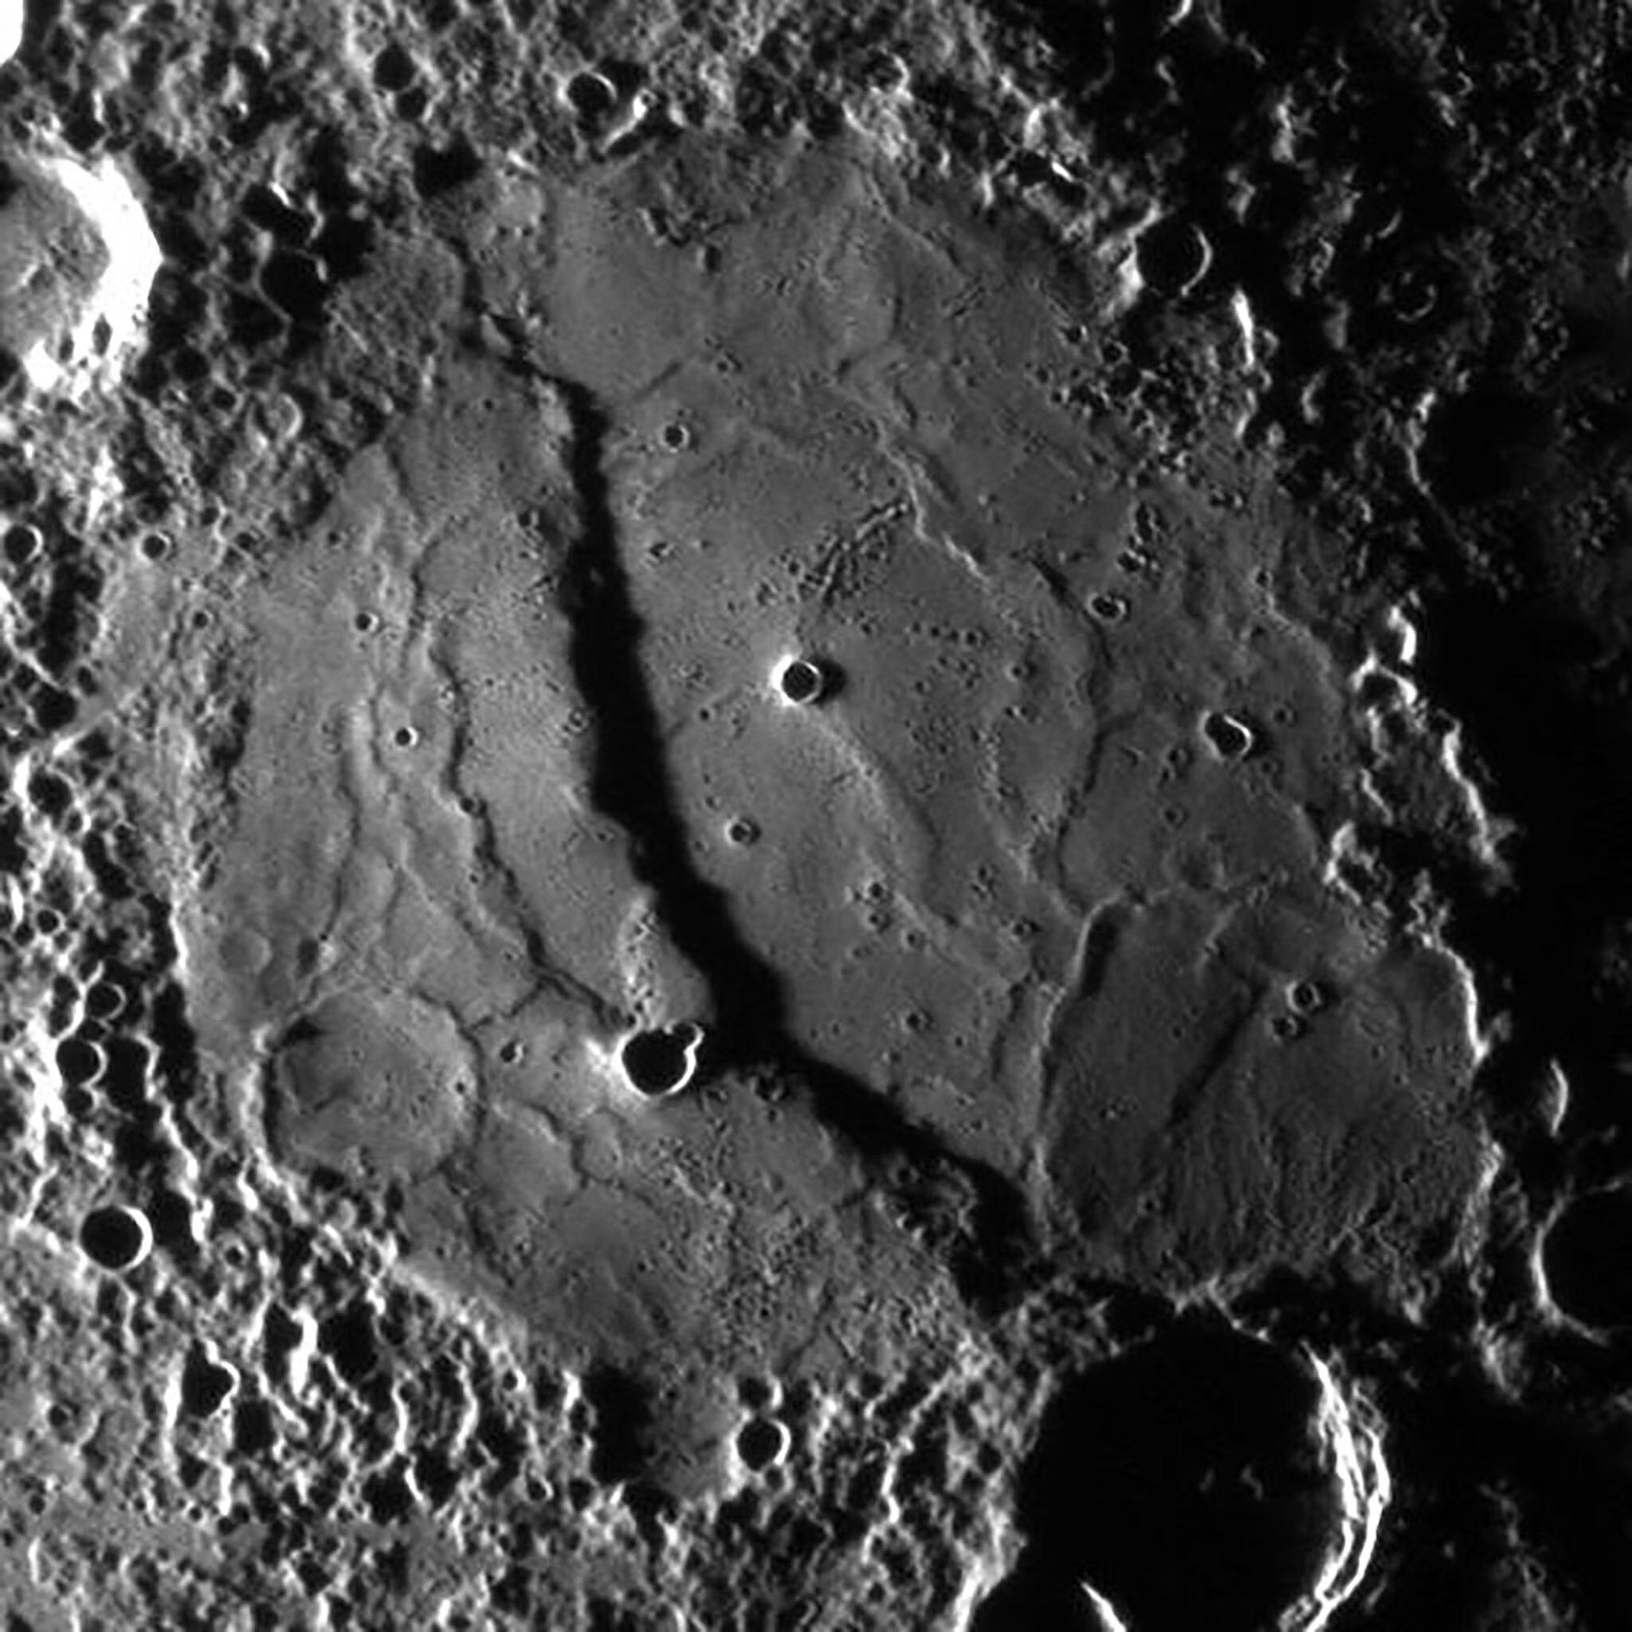
Mercury
shrunk
by ~1%
Notes:
SEP 2026: When Mercury formed about 4.5 billion years ago in the raucous collisions of the early solar system, it was a much hotter planet. Over many millennia, however, its metallic core has cooled and contracted, causing the planet’s surface to warp and wrinkle.
Previous estimates suggested that Mercury had shrunk by just a few miles since its formation. Now, scientists say it is shrinking up to 30 percent faster than expected. It might have even shrunk by as much as 14.5 miles, which is nearly one percent of its current radius of 1,516 miles.
Many bodies, like the moon and Mars, are shrinking but Mercury can shrink more because of its large metal core.

Slide 9
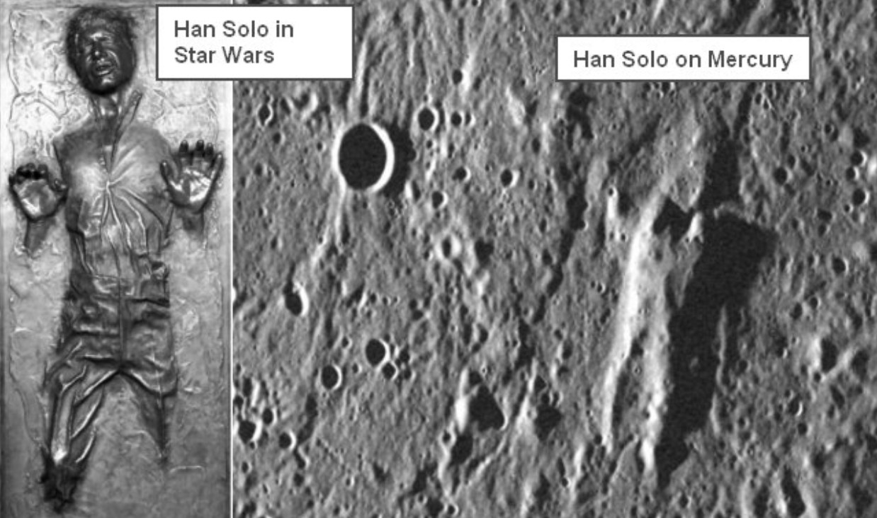
Mercury
Notes:
weird terrain on Mercury … rugged terrain that is hilly and lineated

Slide 10
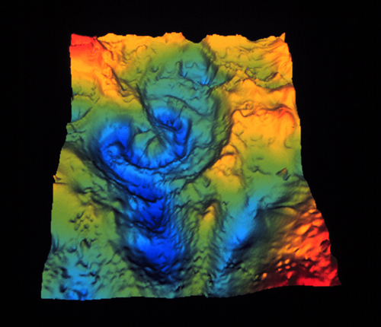
Chicxulub
66 million years ago…
crater on Yucatan Peninsula … 80/130/195 km in diameter for various rings
Notes:
add another picture of buried crater walls ???

Slide 11
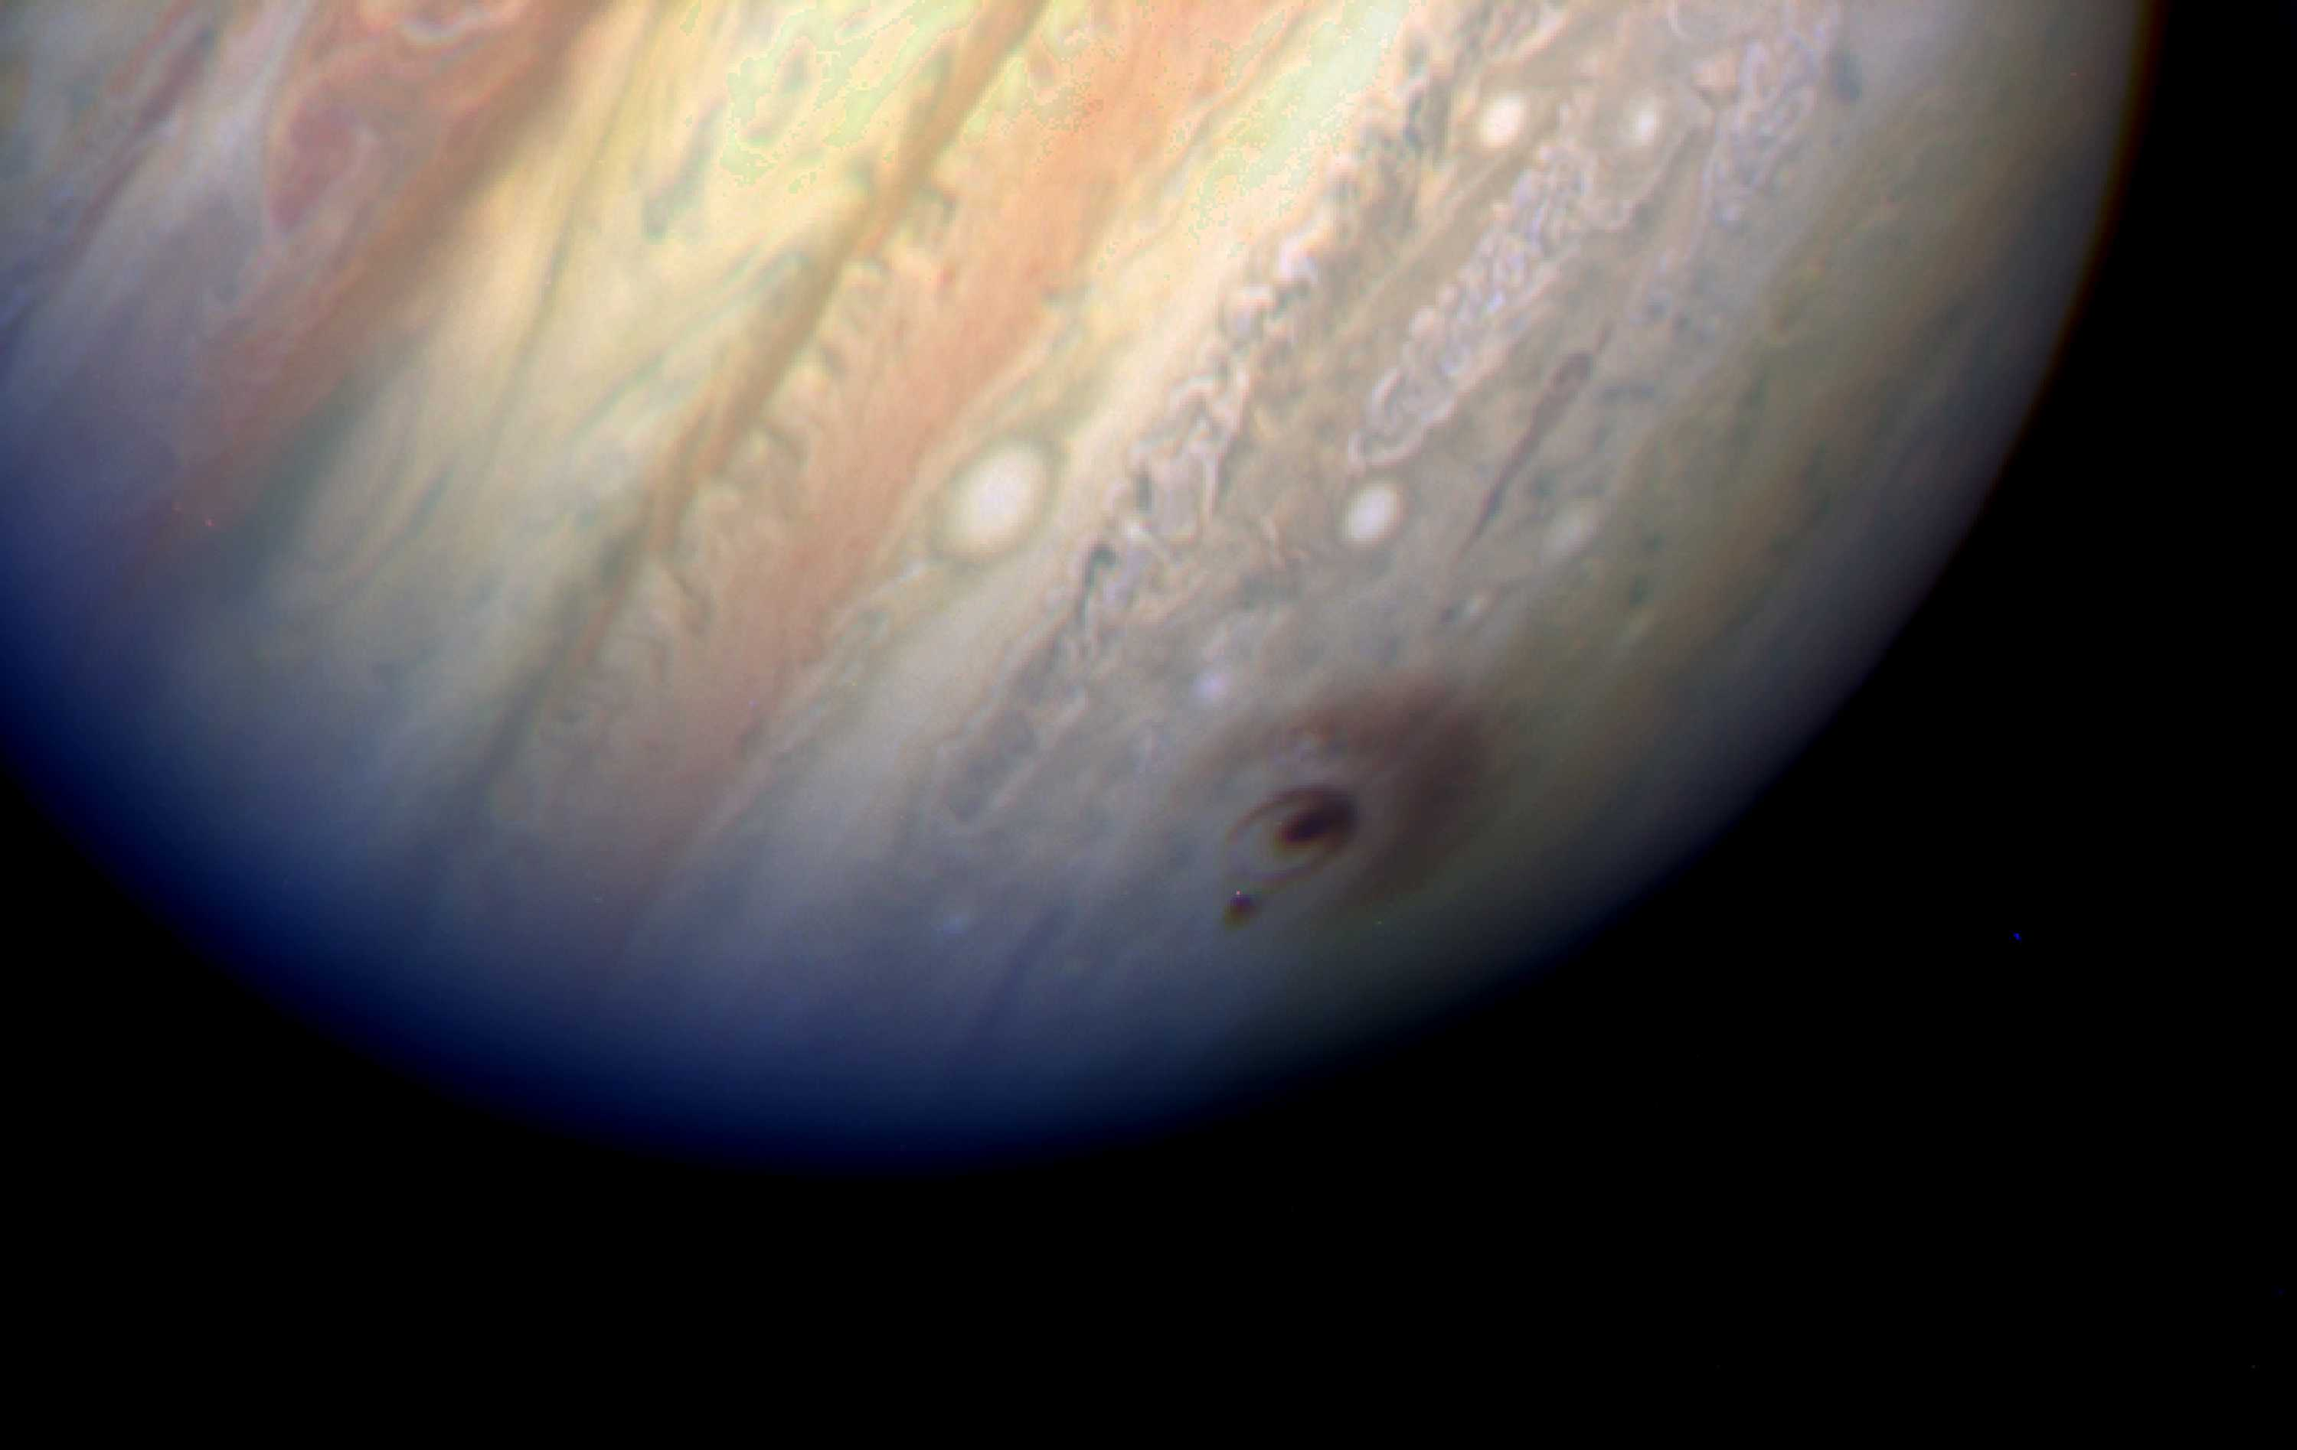
Chicxulub
65 million years ago…
crater on Yucatan Peninsula … 80/130/195 km in diameter for various rings
Cretaceous-Tertiary boundary (a.k.a. KT boundary)
10-100X normal iridium in sediments worldwide
confirmed by gravity anomaly measurements
impactor was 10 km in size
100 X energy of SL9 single impact … 10⁹ H bombs
scenario includes double shock wave (into Earth, back into impactor)
double fireball of (1) vaporized rock, then (2) CO₂ released from limestone
so many ways to die …
1. within a few thousand km, ignited plants and animals
2. HNO₃ (nitric acid) and H₂SO₄ (sulfuric acid) formed and rained down
3. tsunami spreads to wipe out coastal areas
4. dust in atmosphere doesn’t help …
… roughly 50% of species die

Slide 12
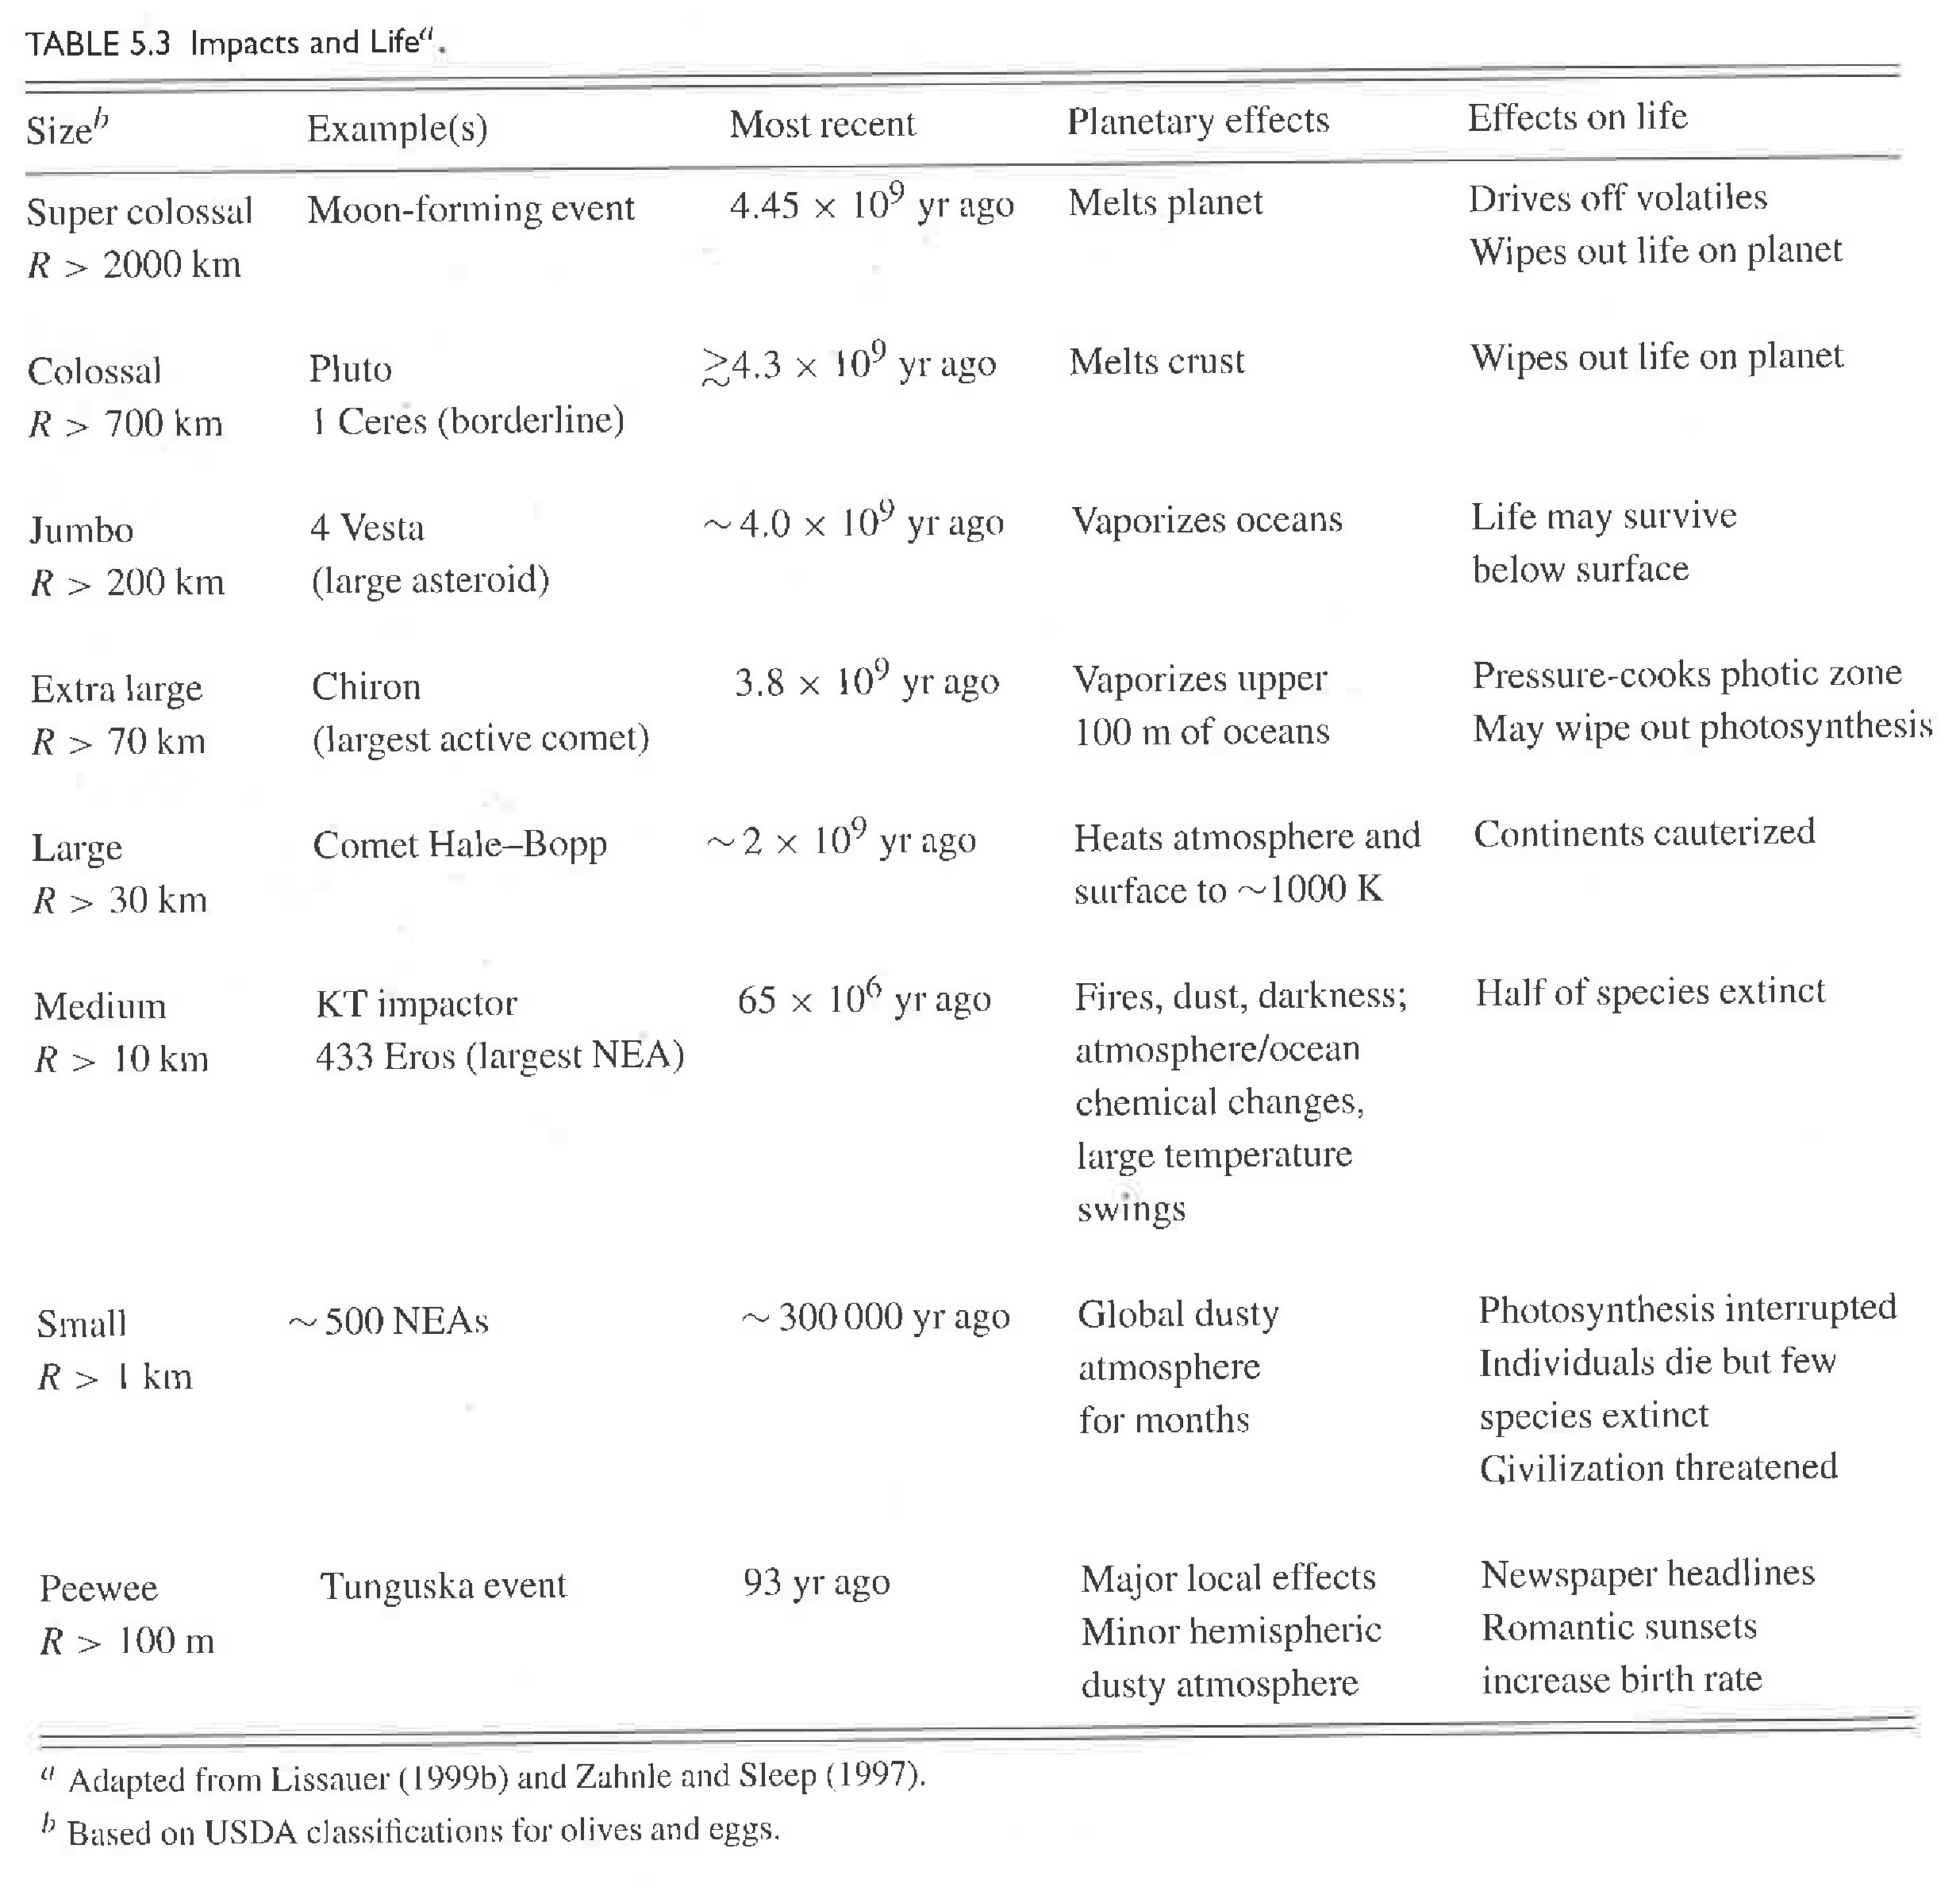
Cratering Impacts
Notes:
olives and eggs!
romantic sunsets … increase birth rate

Slide 13
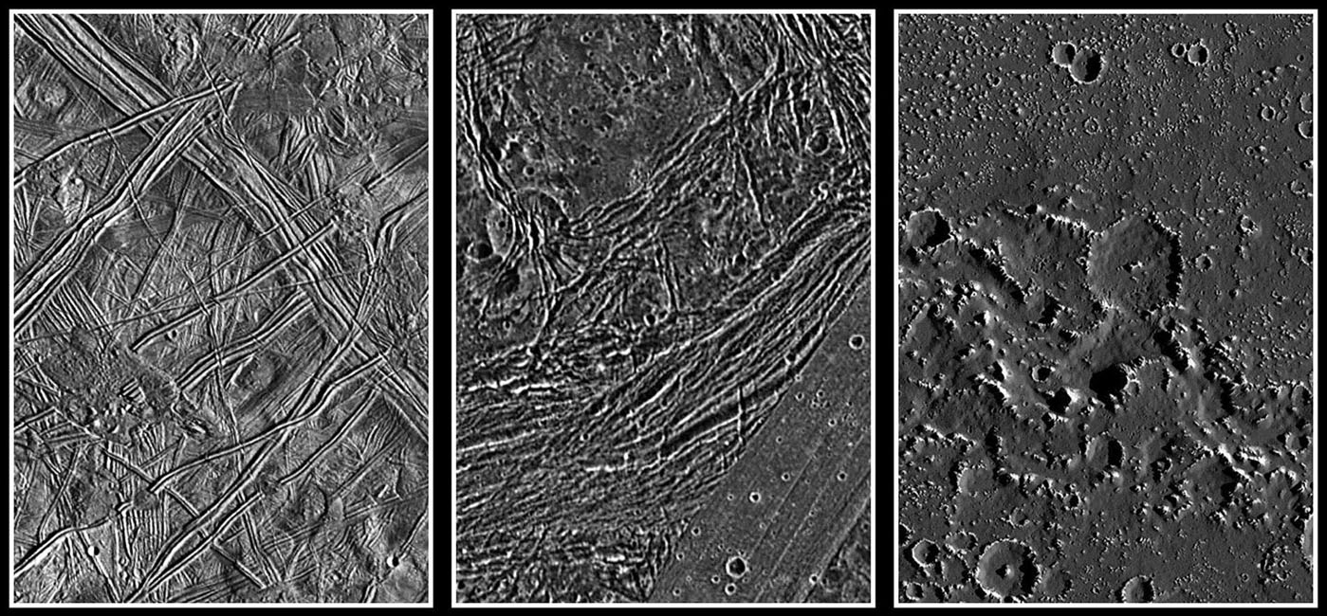
SSE! SSE! SSE!
−
10 km

Slide 14
Europa Ganymede Callisto
−
10 km

Slide 15
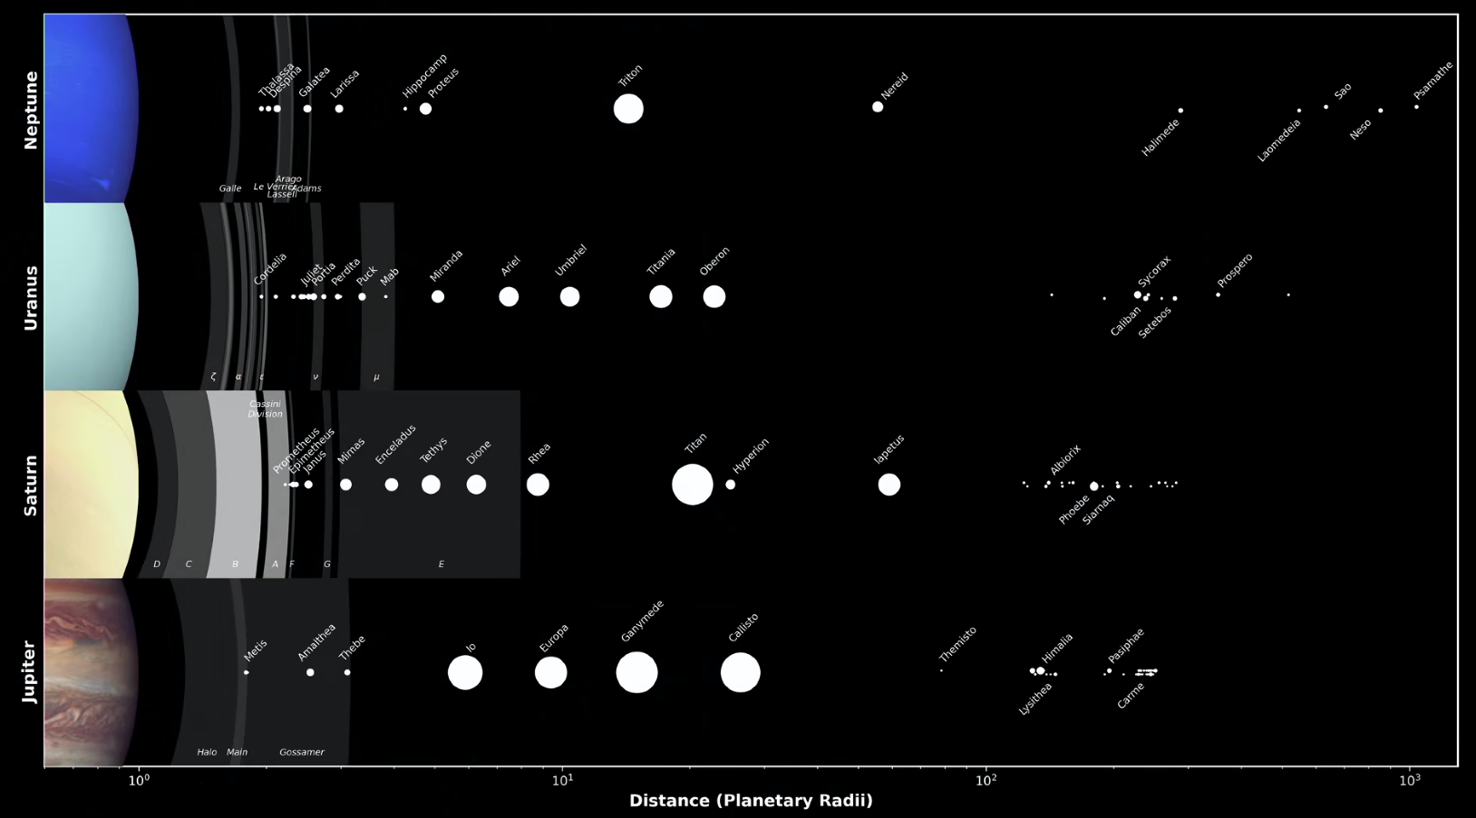
Jovian Moon Systems

Slide 16
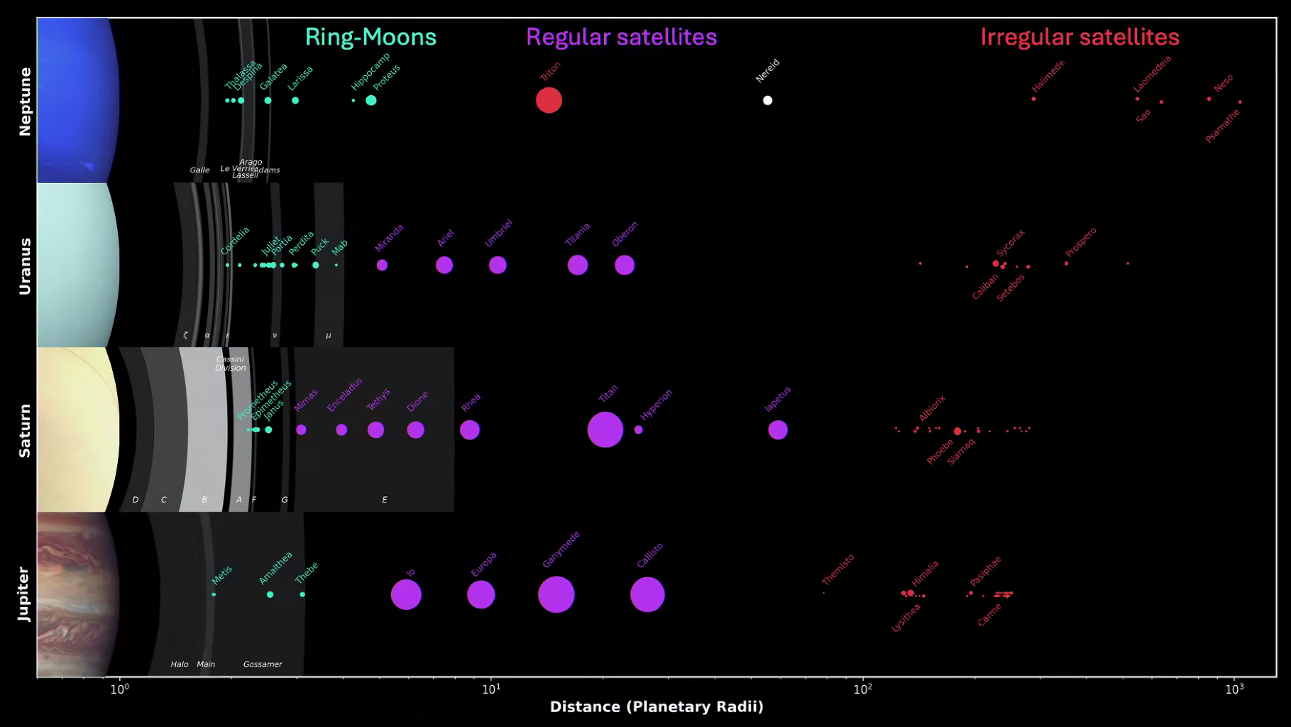
Jovian Moon Systems

Slide 17
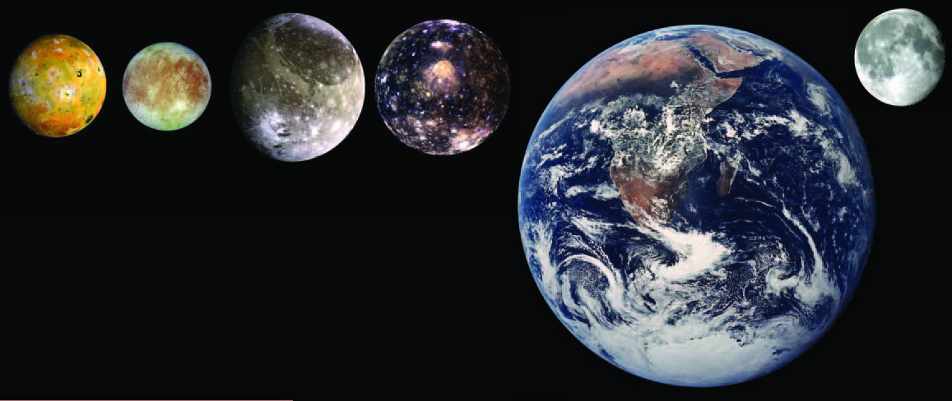
Galileans
3.53 g/cm³ 3.02 g/cm³ 1.94 g/cm³ 1.85 g/cm³ 5.52 g/cm³ 3.34 g/cm³
rocky
active
volcanoes
calderas
rocky
H2O ice
floes
ridges
lenticulae
cycloids
dirty ice
craters
palimpsests
grooves
light/dark
areas
icy-est
craters
palimpsests
Notes:
lenticulae = “freckles” from convective upwelling of warm ice, like lava lamps

Slide 18
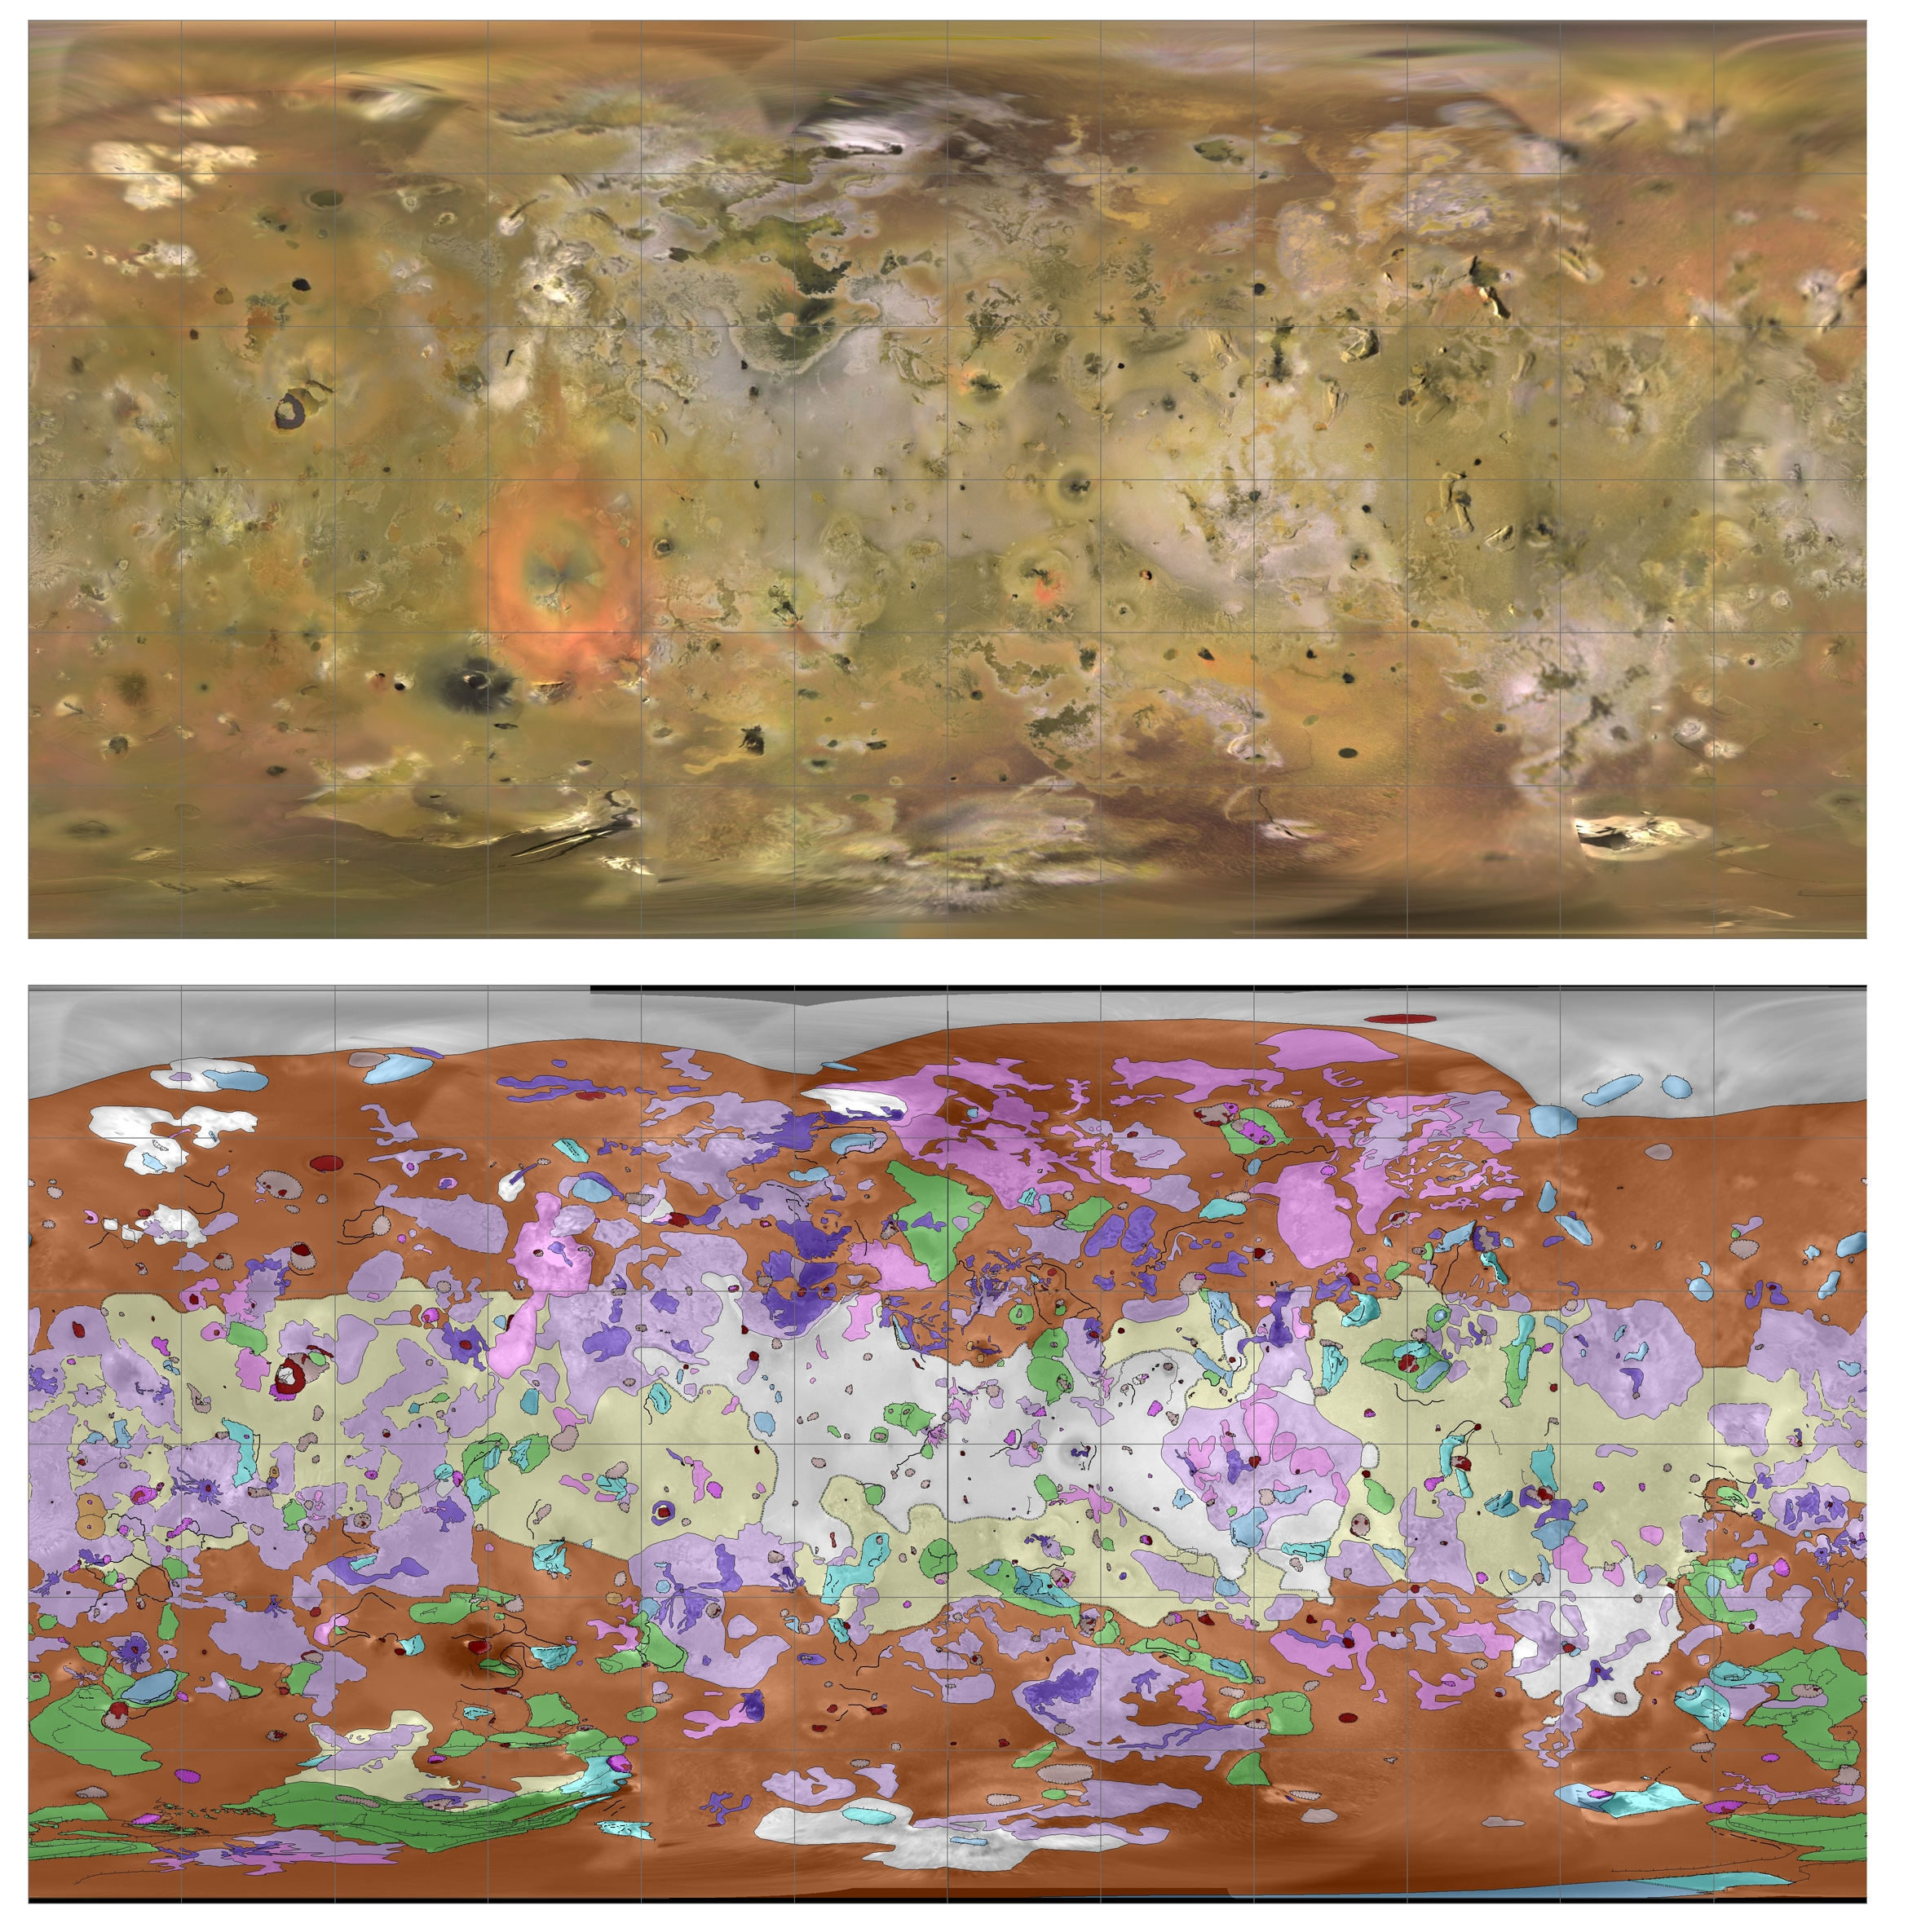
Io Map
density is 3.53 g/cm³ ≈ Moon at 3.34 g/cm³ … rock
zero craters found … surface less than a few Myr old
surface covered with SO2 frost
Notes:
light areas are sulfur compounds … dark areas are pyroxene and olivine
red ring from Pele (?) via polymeralization of S2 … fades over months, so must be recent

Slide 19
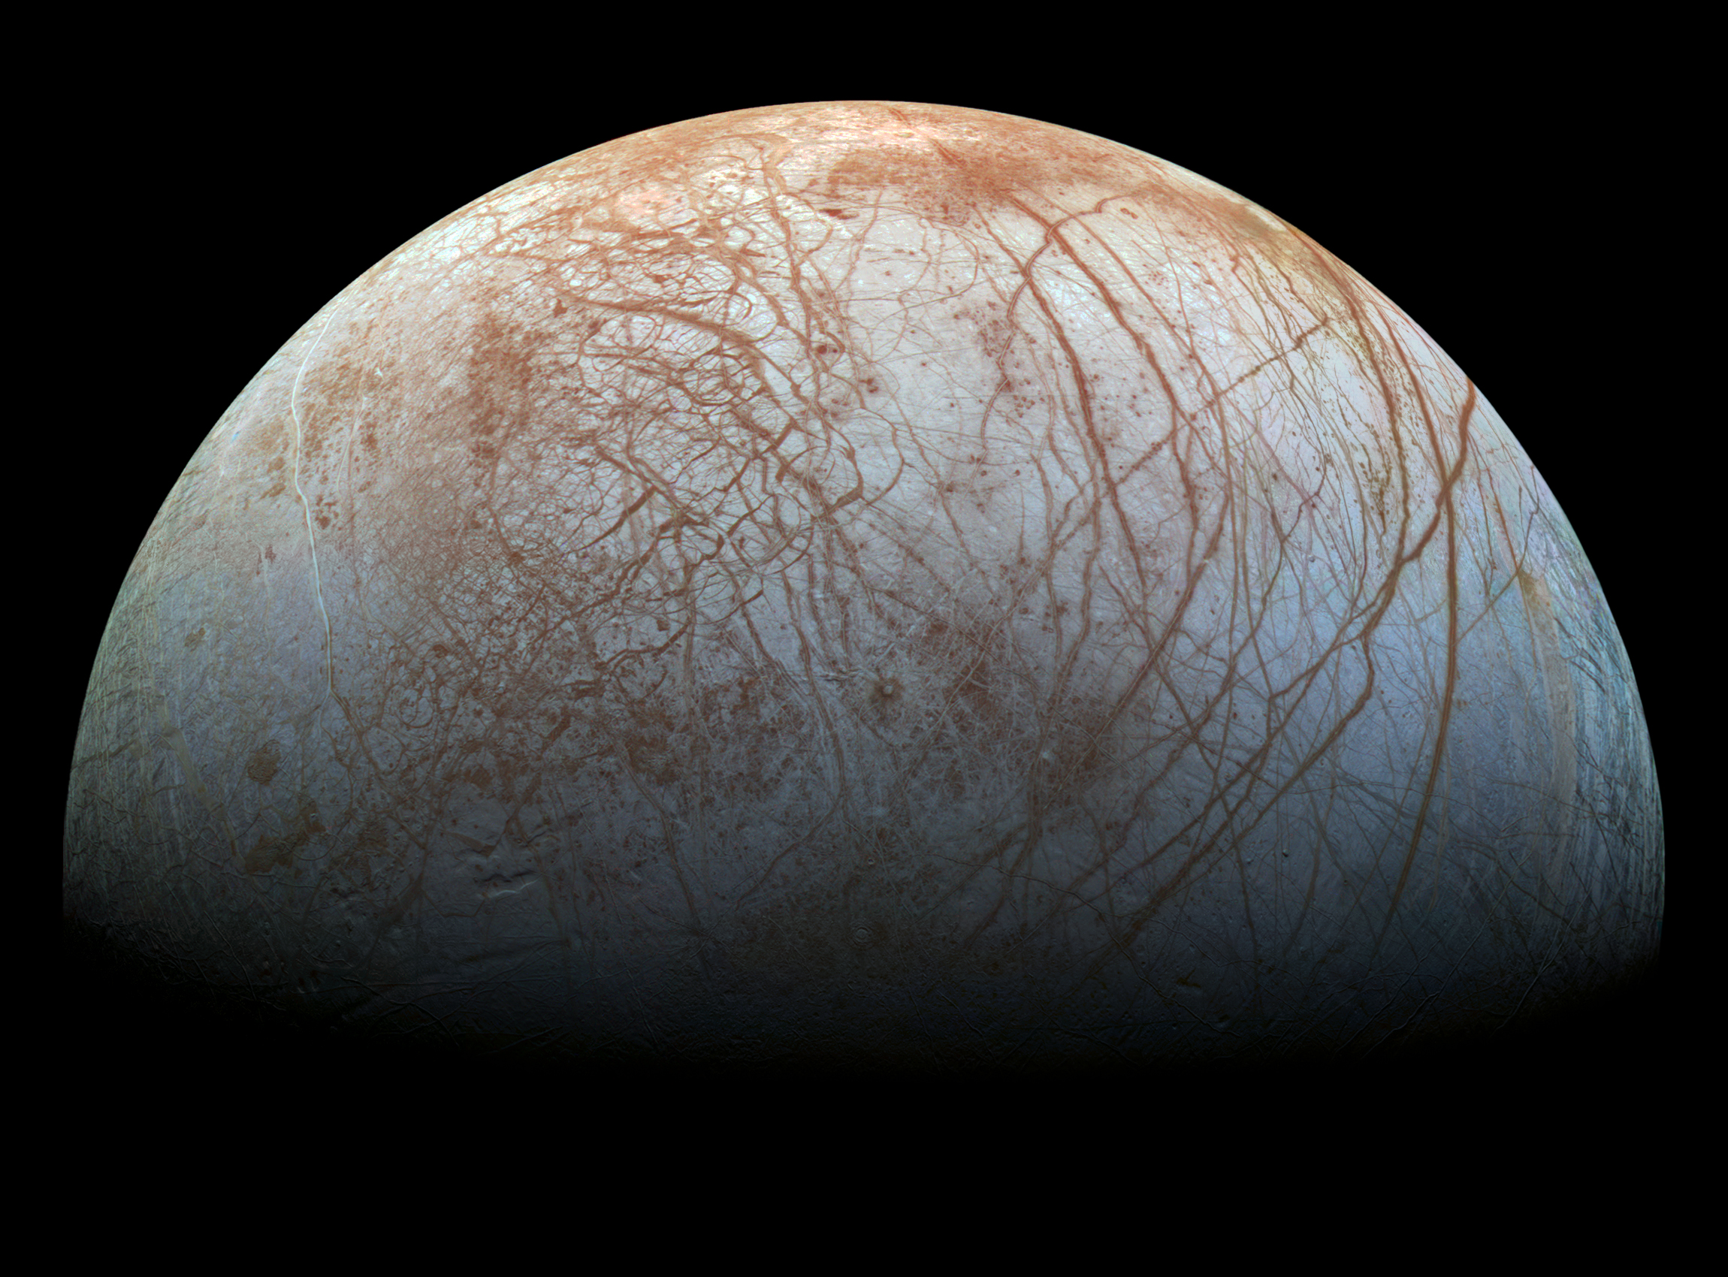
Europa
density is 3.02 g/cm³ < Moon at 3.34 g/cm³ … rock + some ice
very few craters … young surface
subsurface ocean
Notes:
The only way to get such an induced magnetic field is if there's some substance that is globally connected, and conductive — and only salty water fits the bill. Phillips noted you wouldn't get the same readings with isolated pools of water, like what's found under ice sheets on Earth. Slushy water-ice mixtures don't work, either. "Maybe graphite could get you that, but that would be ridiculous."
POSSIBLE PLUMES SEEN!

Slide 20
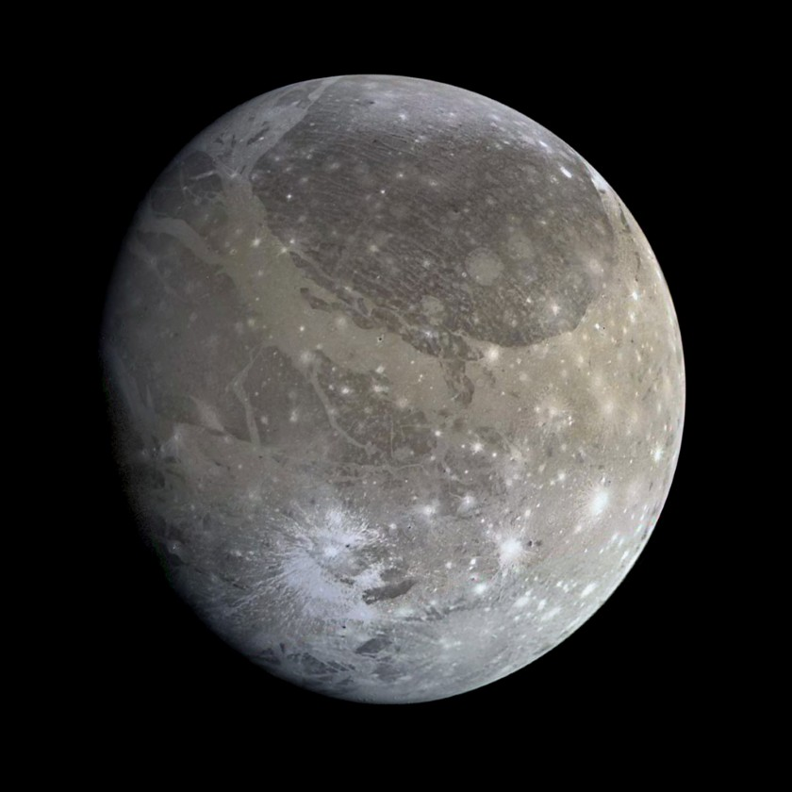
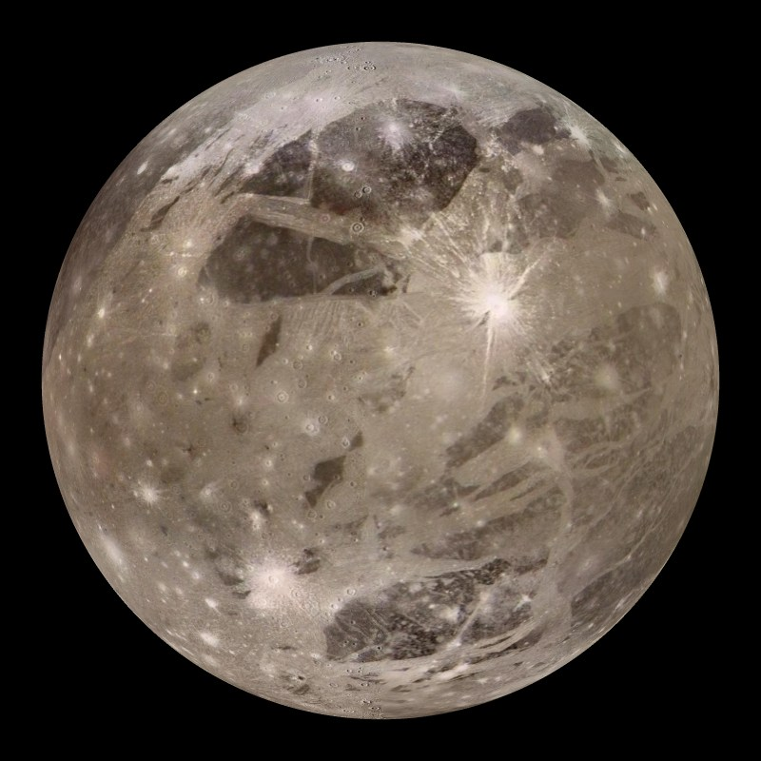
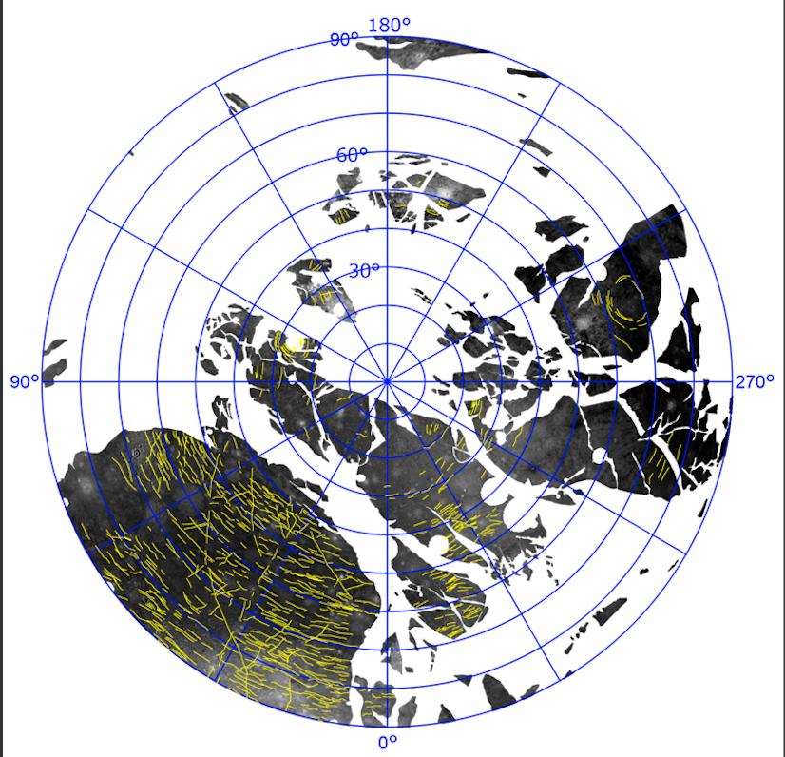
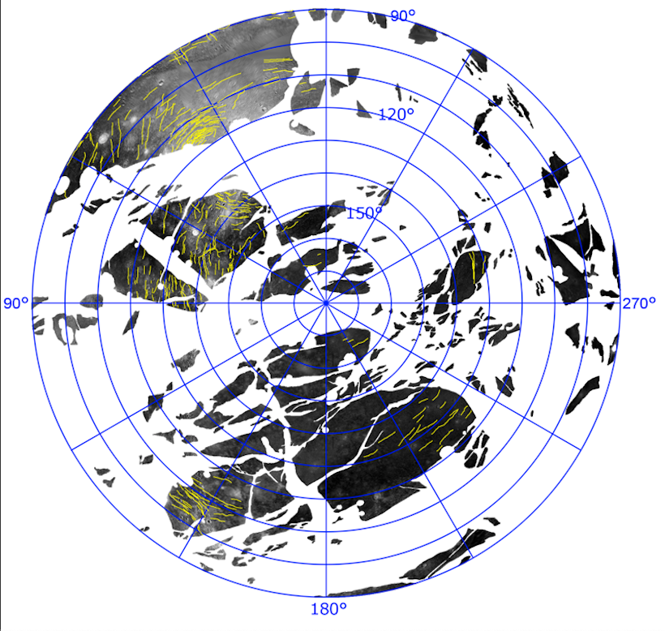
Ganymede
density is 1.94 g/cm³ << Moon at 3.34 g/cm³ … rock + ice
subsurface ocean likely
palimpsests and very large impacts
Notes:
inserts: single large impact that sent rings around Ganymede?
1. The Galileo probe measured Ganymede's magnetic field in 2002, providing some data supporting the theory that the moon has an ocean.
2. Scientists used Hubble to monitor Ganymede's auroras, ribbons of light at the poles created by the moon's magnetic field. The moon's auroras are also affected by Jupiter's magnetic field because of the moon's proximity to the huge planet. When Jupiter's magnetic field changes, so does Ganymede's. Researchers were able to watch the two auroras "rock" back and forth with Hubble. Ganymede's aurora didn't rock as much as expected, so by monitoring that motion, the researchers concluded that a subsurface ocean was likely responsible for dampening the change in Ganymede's aurora created by Jupiter.

Slide 21
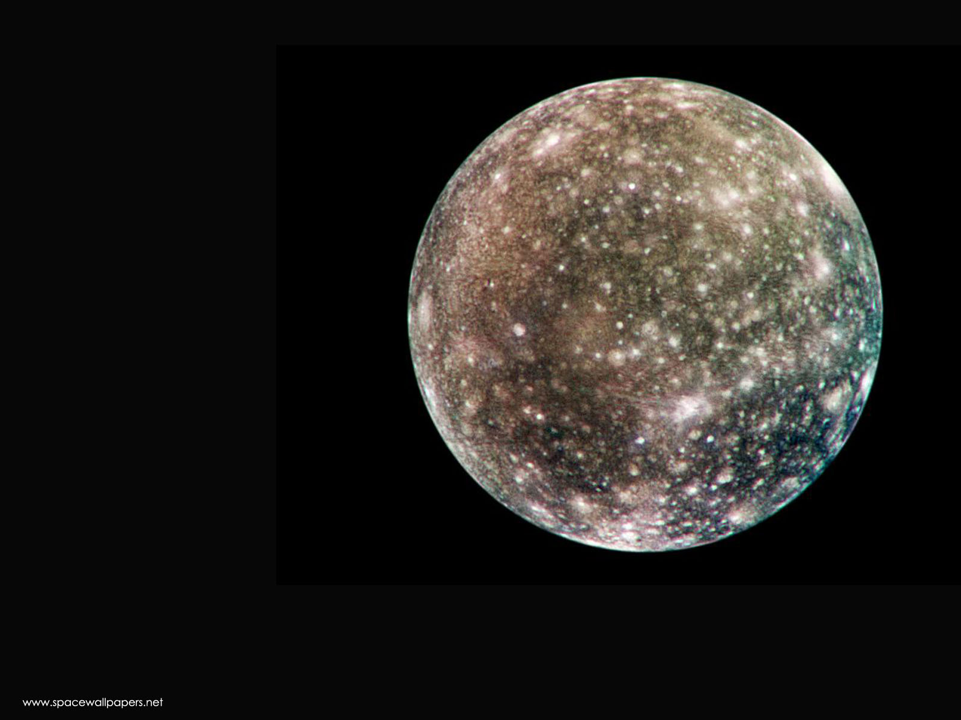
Callisto
density is 1.85 g/cm³ << Moon at 3.34 g/cm³ … rock + ice
pockmarked with craters (most heavily cratered in SS) … old(est)
subsurface ocean likely
Notes:
Signs that Callisto's magnetic field, like Europa's, is variable, which can be explained by the presence of varying electrical currents associated with Jupiter that flow near Callisto's surface. Their next challenge was to discover the source of the currents.
"Because Callisto's atmosphere is extremely tenuous and lacking in charged particles, it would not be sufficient to generate Callisto's magnetic field; nor would Callisto's icy crust be a good conductor, but there very well could be a layer of melted ice underneath," Kivelson said. "If this liquid were salty like Earth's oceans, it could carry sufficient electrical currents to produce the magnetic field."
Lending further credence to the premise of a subsurface ocean on Callisto, Galileo data showed that electrical currents were flowing in opposite directions at different times. "This is a key signature consistent with the idea of a salty ocean," Khurana added, "because it shows that Callisto's response, like Europa's, is synchronized with the effects of Jupiter's rotation."

Slide 22
Titan
Notes:
2 h 30 min in atm, then ~30 min on ground
500X brighter than full Moon on surface … about 10 min after sunset on Earth

Slide 23
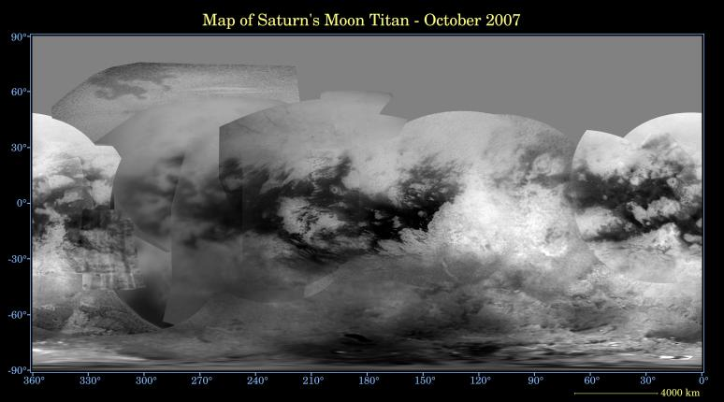
Titan Map from Cassini 2007
density is 1.88 g/cm³ … rock + ice
few craters … surface less than 1 Gyr old
liquid CH4/C2H6 lakes near poles cover ~1% of surface and change size
imaged at 9380 A

Slide 24
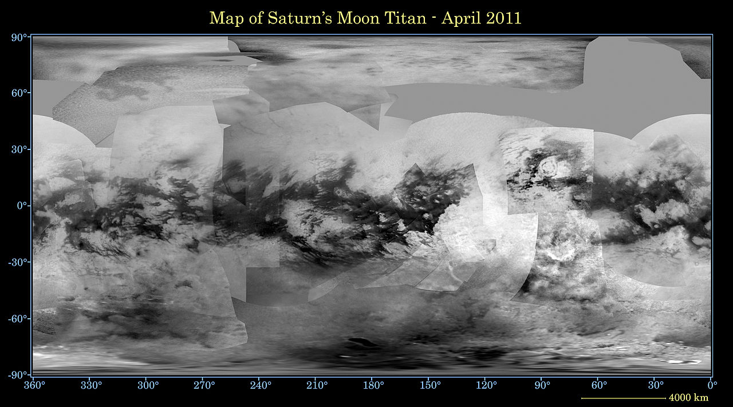
Titan Map from Cassini 2011
density is 1.88 g/cm³ … rock + ice
few craters … surface less than 1 Gyr old
liquid CH4/C2H6 lakes near poles cover ~1% of surface and change size
imaged at 9380 A

Slide 25
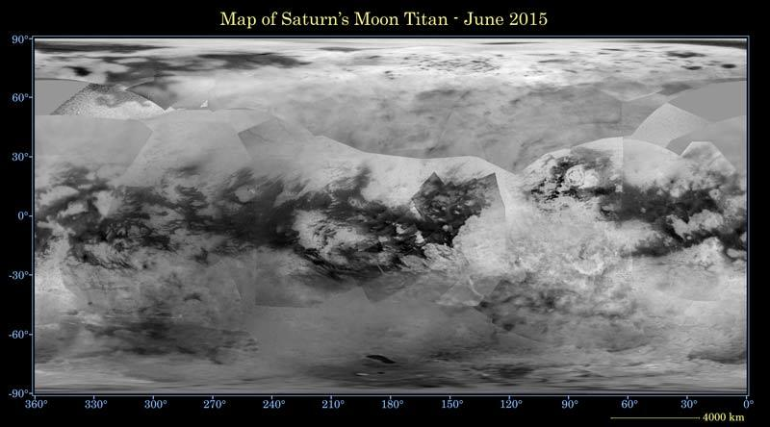
Titan Map from Cassini 2015
density is 1.88 g/cm³ … rock + ice
few craters … surface less than 1 Gyr old
liquid CH4/C2H6 lakes near poles cover ~1% of surface and change size
imaged at 9380 A

Slide 26
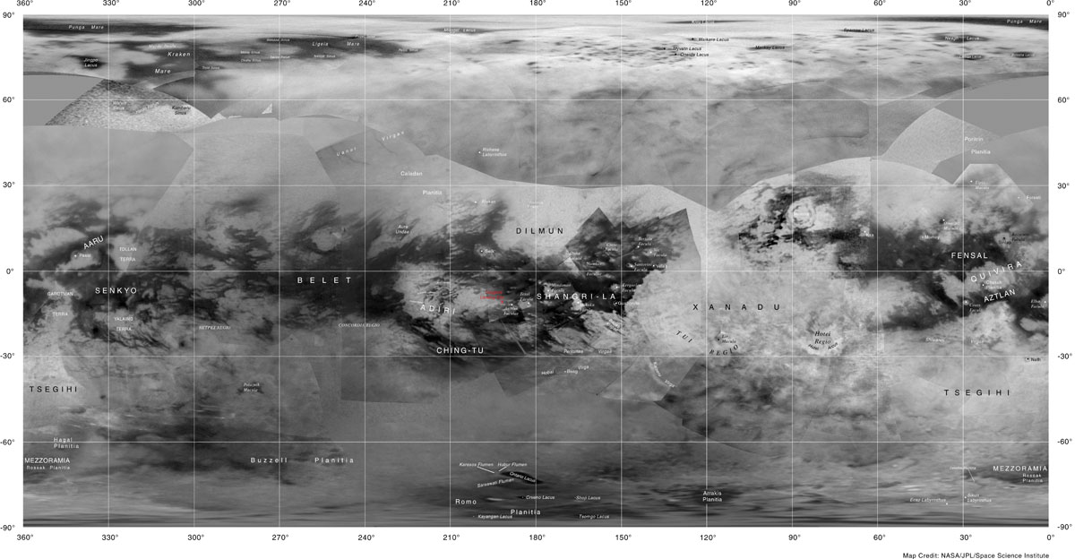
Titan Map from Cassini 2015
density is 1.88 g/cm³ … rock + ice
few craters … surface less than 1 Gyr old
liquid CH4/C2H6 lakes near poles cover ~1% of surface and change
imaged at 9380 A
Notes:
Shangri-La = beautiful imaginary place, from novel Lost Horizon by James Hilton
Xanadu = idyllic place inspired by the summer residence of Kublai Kahn (grandson of Genghis Khan)
Kraken Mare

Slide 27
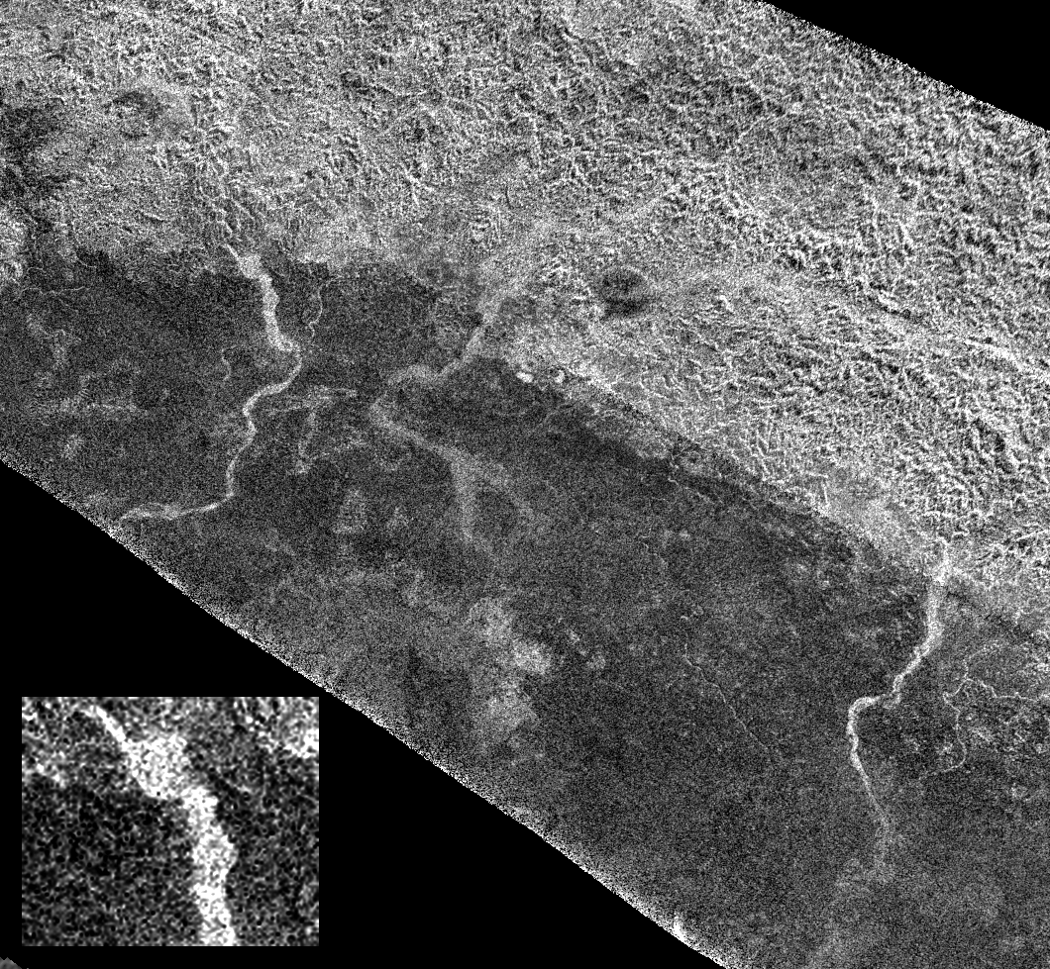
Titan: Xanadu
Xanadu
rough surface
bright in radar
5 km wide
Notes:
active riverbeds with CH4, or dry arroyos? unknown
resolution ~ 1 km

Slide 28
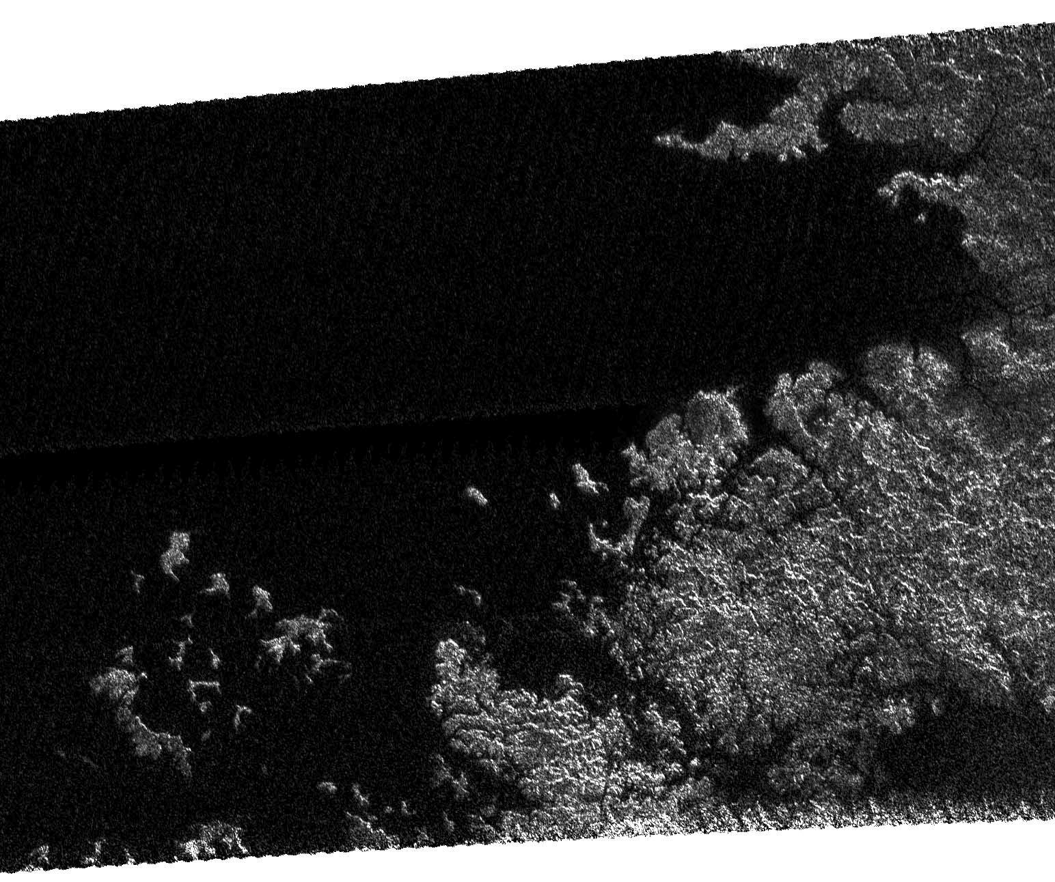
Titan: 70deg N
Titan: 70deg N
Xanadu
(M)ethane Sea?

Slide 29
Titan Close Up
https://www.youtube.com/watch?v=svmGxFaGILY

Slide 30
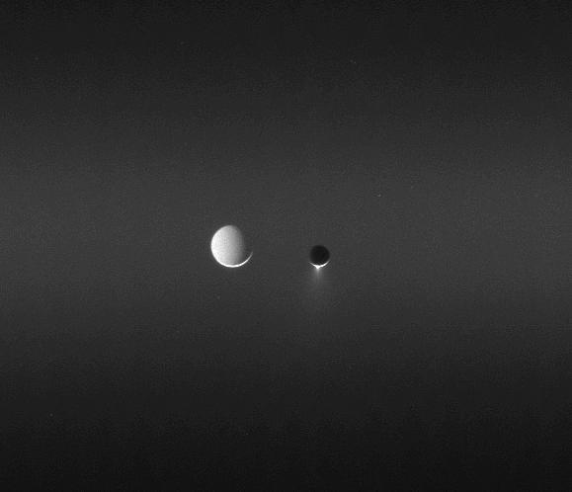
Tethys and Enceladus
Tethys and Enceladus
Notes:
Tethys much more distant … note that it’s lit up by Sun/Saturn

Slide 31
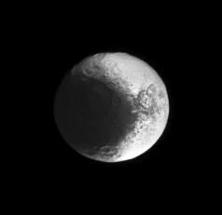
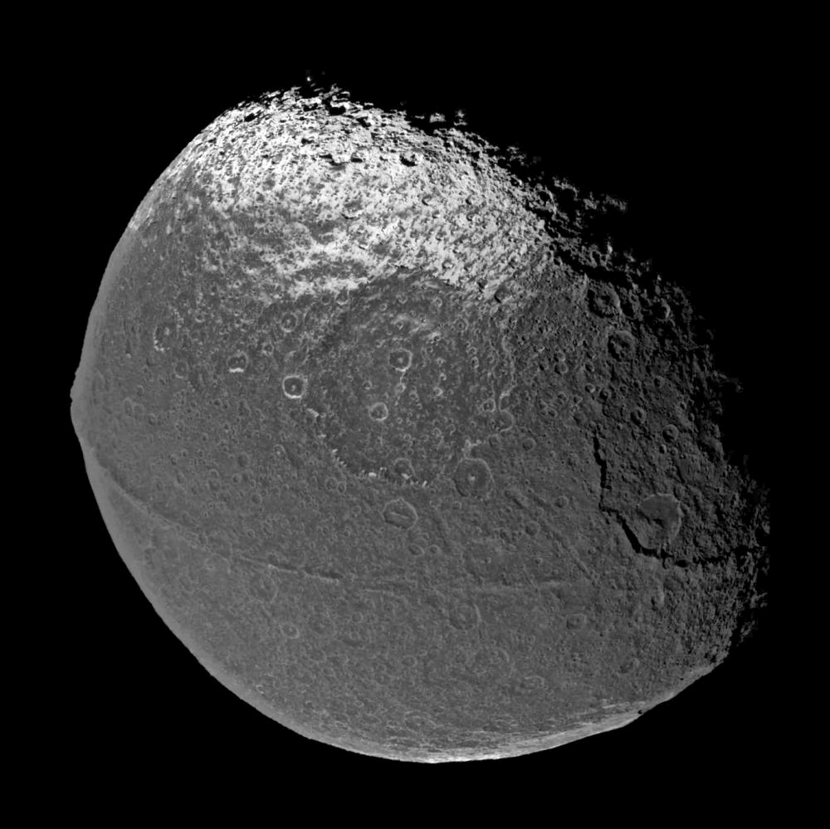
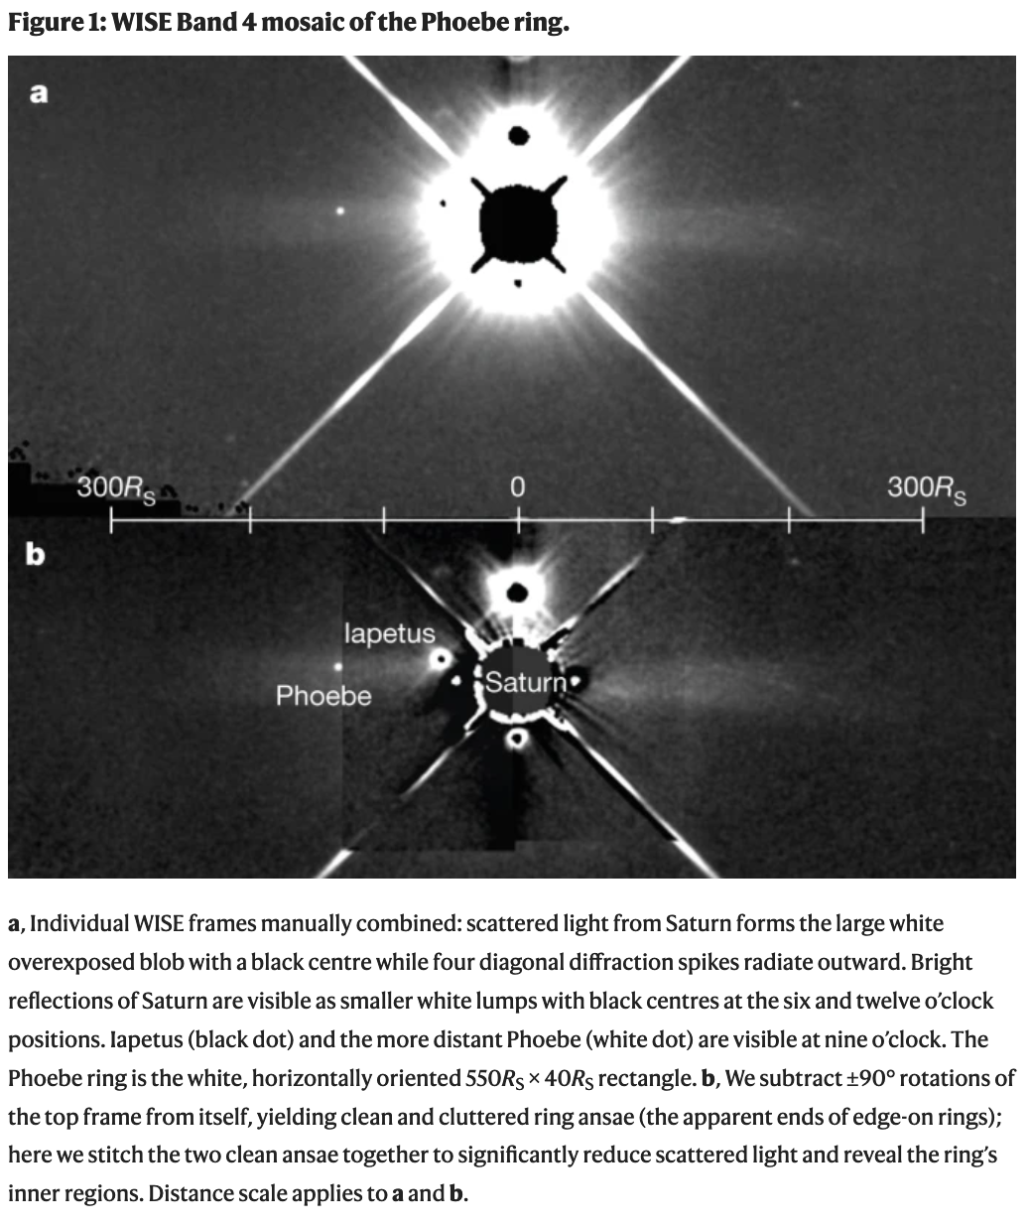
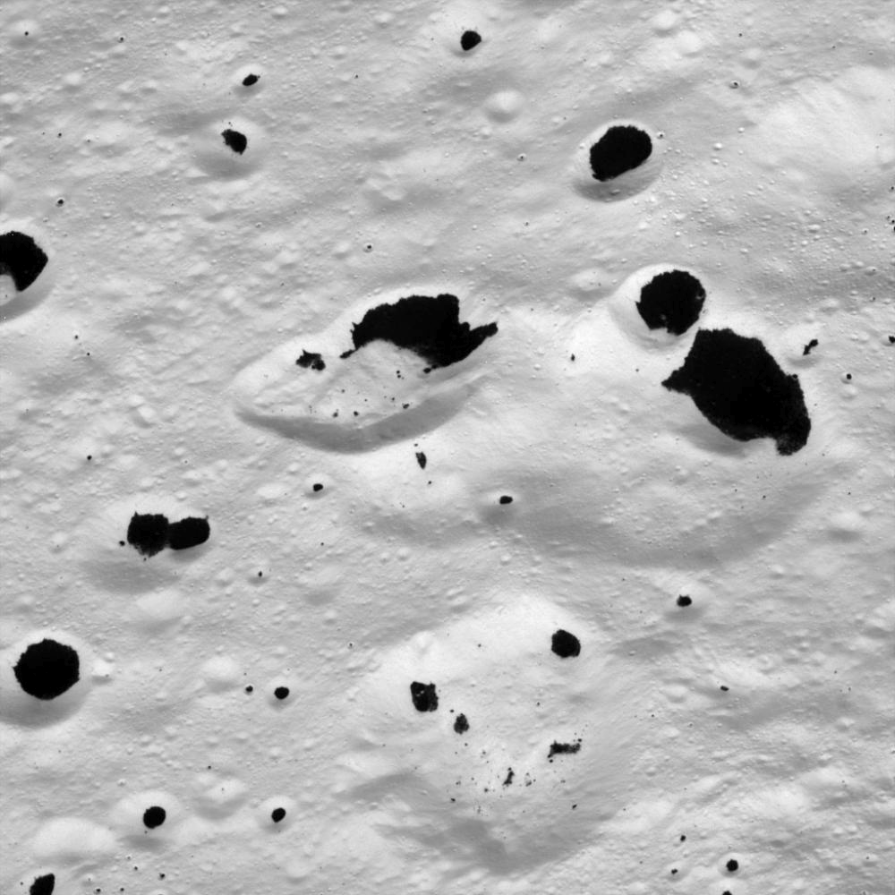
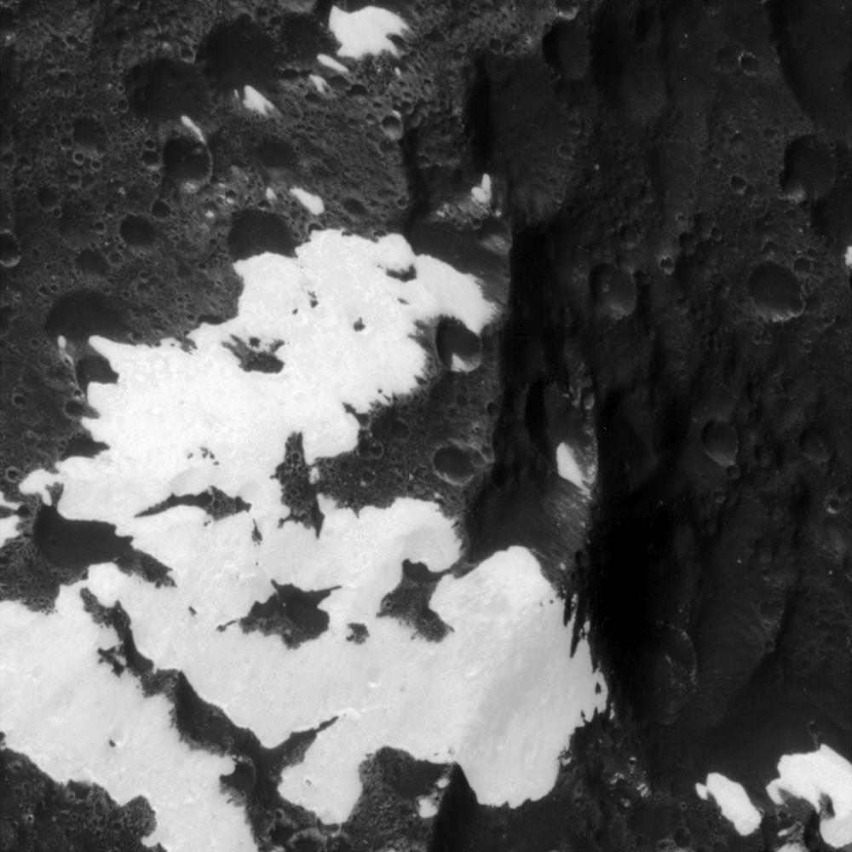
Iapetus
albedo ~ 0.60 albedo ~ 0.04
Notes:
dark region is leading hemisphere … organics including HCN-polymers … origin from Phoebe, which orbits retrograde --- debris ring has been seen!
ridge is 20 km wide

Slide 32
Jovian Moon Systems

Slide 33
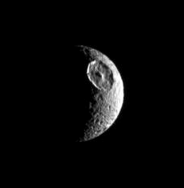
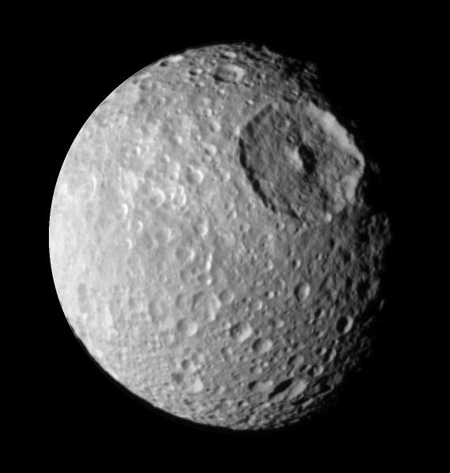
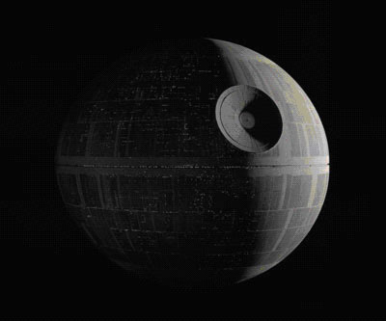
Mimas

Slide 34
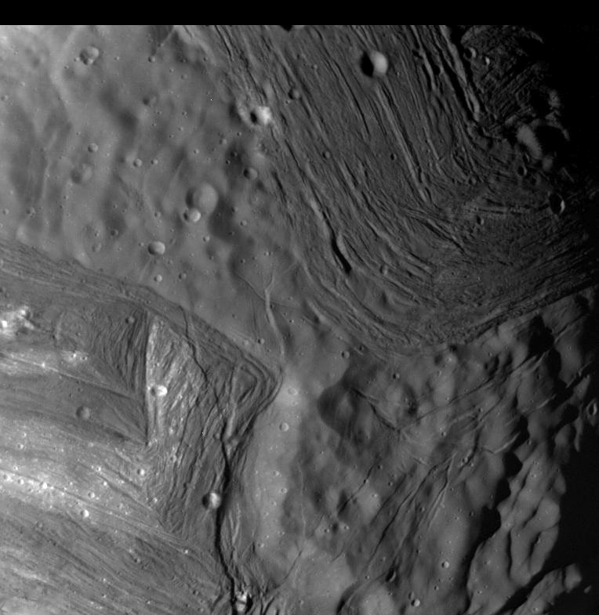
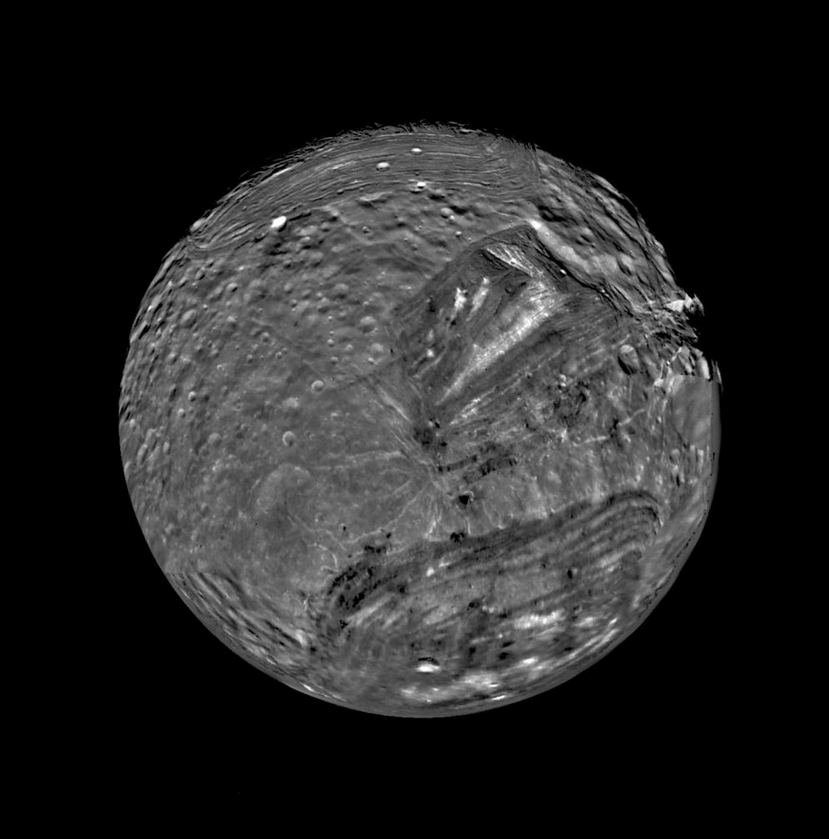
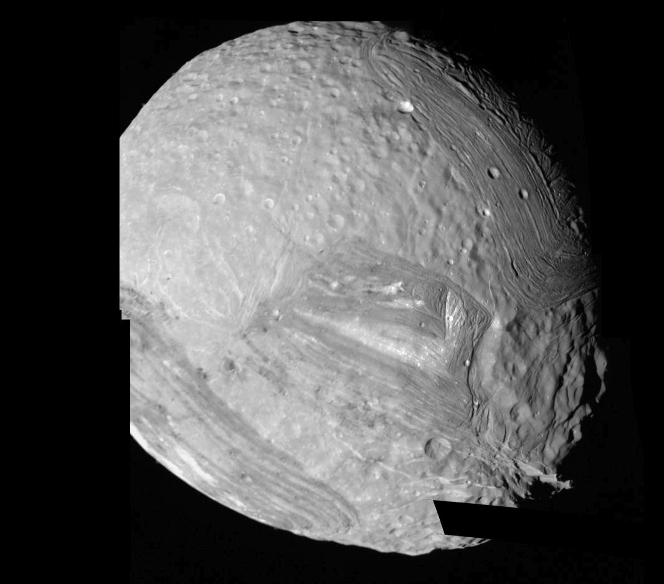
Miranda
5 km
high
D =
470 km
> 1%
… 127 km
on Earth!
Notes:
Uranian moon

Slide 35
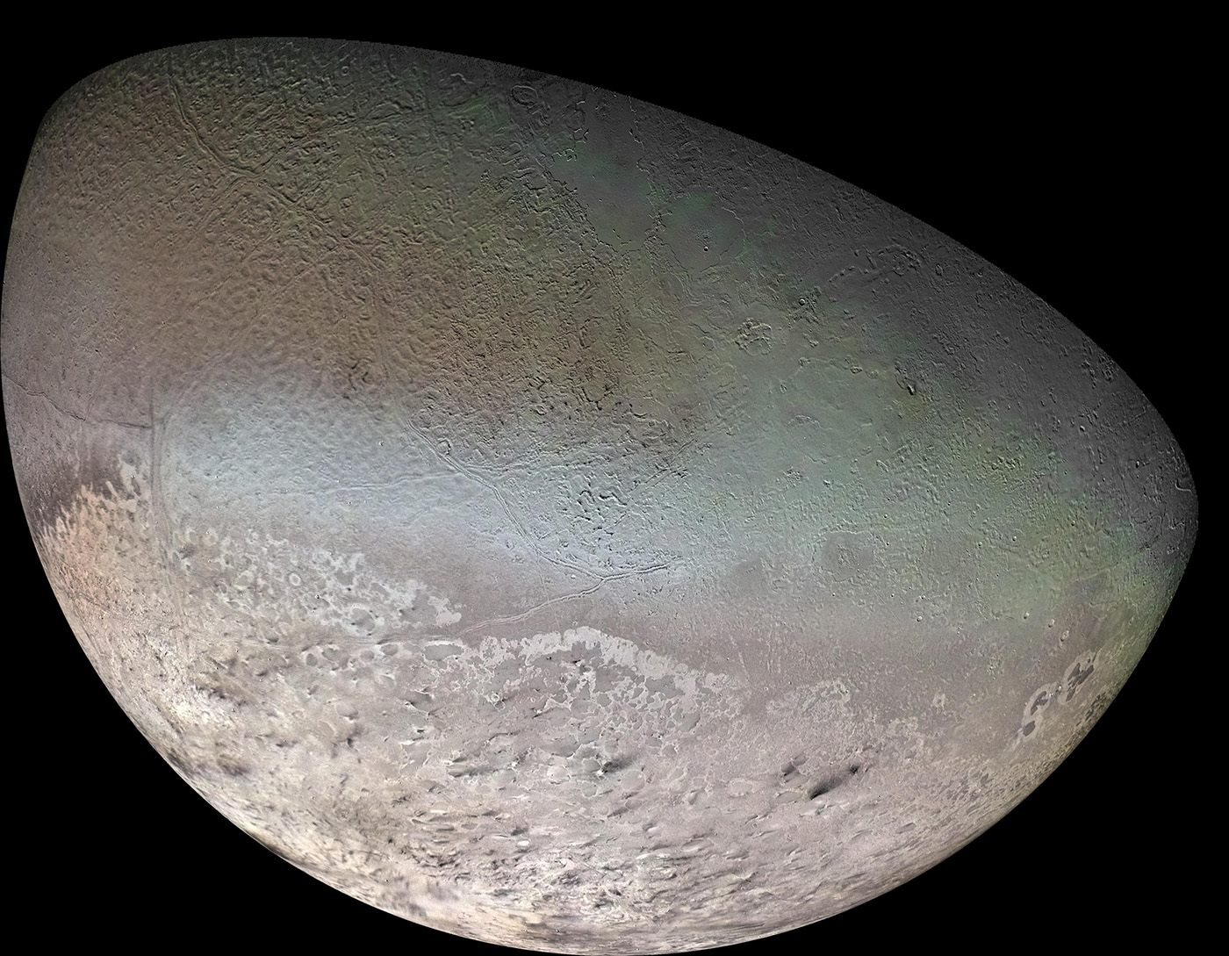
Triton
2.05 g/cm³
N₂/CH₄ ice
cantaloupe
terrain
(repeated
fracturing)
N₂ geyser
plumes

Slide 36
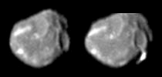

But Wait, There’s More …
We’ve talked about a bit We’ve barely mentioned
Venus Mercury
Earth Moon
Mars Io
Titan Europa (more later)
Ganymede
Callisto
Enceladus (more later)
Iapetus
Mimas
Miranda
Triton
Pluto
In a longer course, we’d also talk about
Amalthea reddest object in Solar System + some green
emits more heat than it receives from Sun
Hyperion The Sponge … with density 0.5 g/cm³
Notes:
Amalthea: red from Io’s sulfur … green unknown … heat from electric currents in core or tidal stresses?

Slide 37
Solar System Explorers: 08 OCT
Give any feature seen in the spectrum of a Solar System object (not the Sun) that
makes that object’s emitted spectrum NOT a blackbody. Give the atomic/molecular
species and wavelength affected, e.g., CO₂ as an absorber on Earth at 15 microns.
1. Venus 7.3 microns SO2
2. Titan 2-300 microns HCN
3. Jupiter 9-10 microns PH3
4. Earth 9.6 microns O3
5. Jupiter 7.7 microns CH4
6. Mars 15 microns CO2
7. Io 4-7 microns SO2
8.
9.
10.
11.
12.
13.
14.
15.
16.
17.
18.
19.
20.

Slide 38
Solar System Explorers: 08 OCT
Describe something unique about any surface found in the Solar System (e.g. Earth has liquid H₂O on its surface.)
1. Earth … life
2. Venus … bismuth/lead frost
3. Venus … pancake domes
4. Mars … red because of hematite on surface
5. Iapetus … walnut ridge
6. Pluto … heart of N2/CH4/CO ice
7. Iapetus … multi-hemisphere bi-albedo
8. Io … no craters
9. Callisto ... oldest surface
10. Miranda … shattered
11. Chiron … donated tholins from Pluto
12. Mercury … table salt on surface
13. Enceladus … tiger stripes
14.
15.
16.
17.
18.
19.
20.

Slide 39
Solar System Explorers 15 OCT
Name a location in the Solar System where surface processing is/was occurring.
Each process can be used only once. Describe how that surface is or was
reprocessed, e.g. Earth’s land mass coastlines change because of liquid H₂O.
1.
2.
3.
4.
5.
6.
7.
8.
9.
10.
11.
12.
13.
14.
15.
16.
17.
18.
19.
20.

Slide 40
…………………………
Notes:
40

Slide 41
Bye Bye Atlanta?
empirical formula for crater size (5.26b):
D = 1.8 ρ_{m}^{+0.11} ρ_{p} ^{–0.33} g_{p} ^{–0.22} (2R) ^{+0.13} E ^{0.22} (sinθ) ^{+0.33}
ρ_{m} density of impactor
ρ_{p} density of planet
g_{p} gravity of planet
R radius of impactor
E kinetic energy of impact
θ angle from horizontal (assume 45 deg impact)
2 point SSE bonus: what size meteorite needed to turn Atlanta → crater?
assume Atlanta 30 km circular target
(due Thursday)
Notes:
they do this in lab, so it’s sort of a repeat … answer turns out to be about 1km with factors of 2 related to incoming velocity

